Slide 1
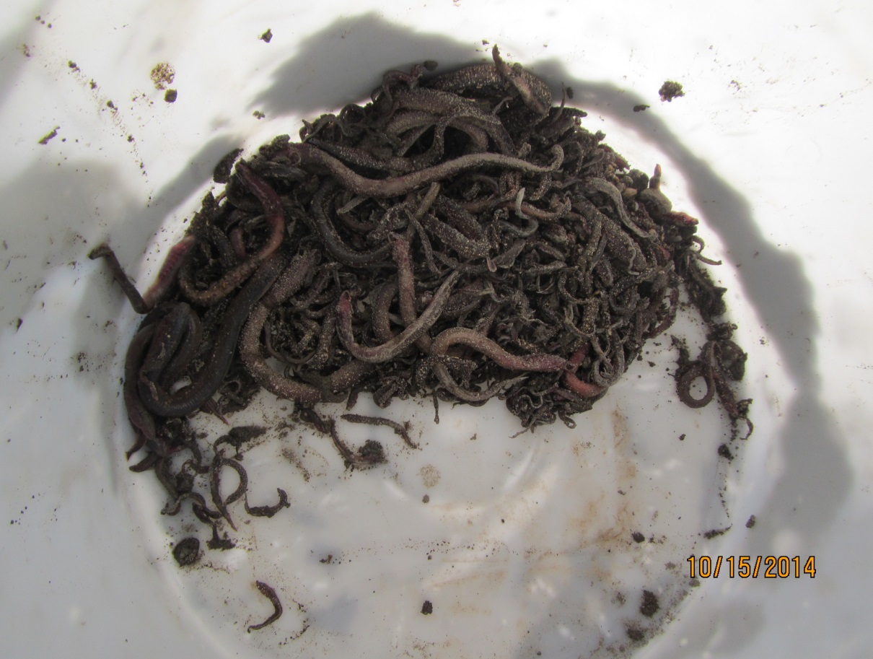
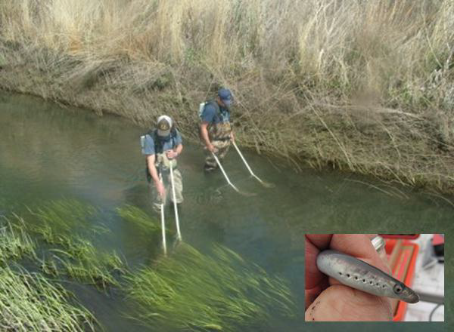
Larval/Juvenile Lamprey Entrainment in Irrigation Diversions (Yakima Subbasin)
CTUIR & BOR
Yakama Nation Fisheries: Pacific Lamprey Recovery Project
Tyler Beals, Ralph Lampman, Patrick Luke, Dave’y Lumley, Ed Johnson and Frank Spillar
Notes:
I would also like to note ….CTUIR and BOR

Slide 2
Overview
Background
What we know & don’t know
2. Summary of Previous Findings(~2013)
3. New Findings in 2014
4. Recommendations (Short-Term &
Long-Term)

Slide 3
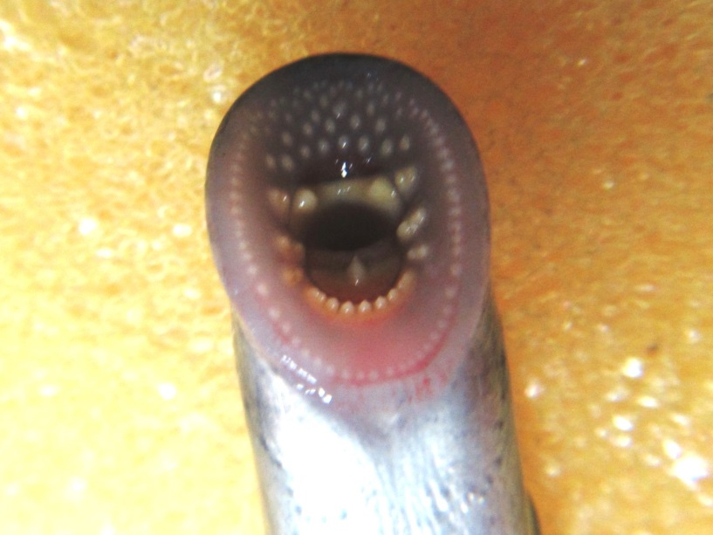
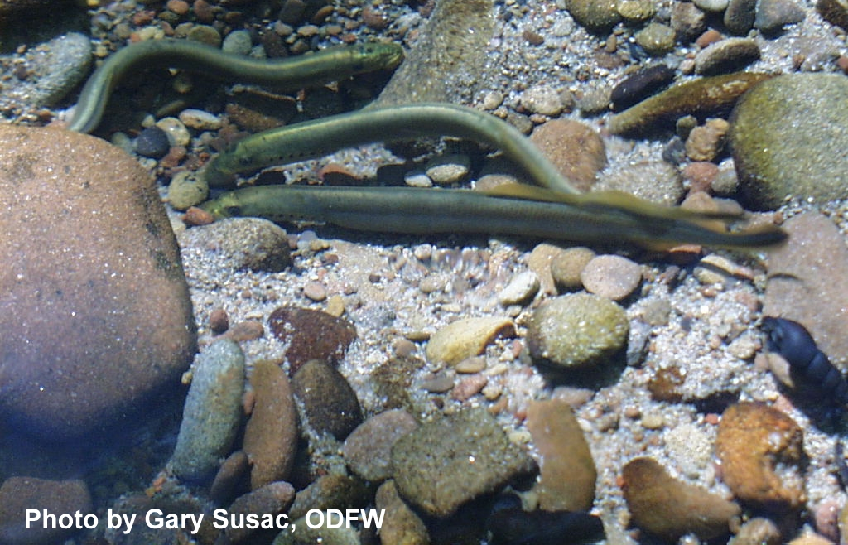
“2” Lamprey Species
Pacific Lamprey
Western River Lamprey
Western Brook Lamprey

Slide 4
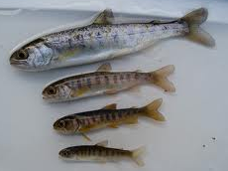
Coho Salmon
Lamprey

Slide 5
3/32” or 2.4 mm
Notes:
In a hatchery setting we looked at

Slide 6
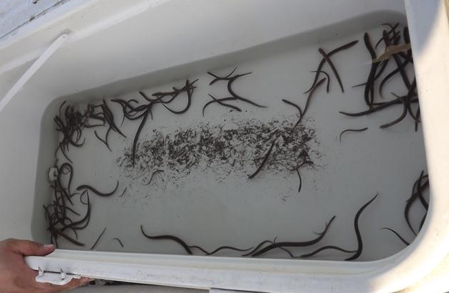
Hundreds of thousands of juvenile and larval lamprey are found each year in dewatered diversions
large
small
Notes:
In the Columbia River Basin, …… so this is not just a Yakima Subbasin problem. For example in the Wenatchee River at Dryden Diversion, where only Pacific Lamprey reside, we have estimated the number of entrained lamprey to be greater than 5,000.

Slide 7
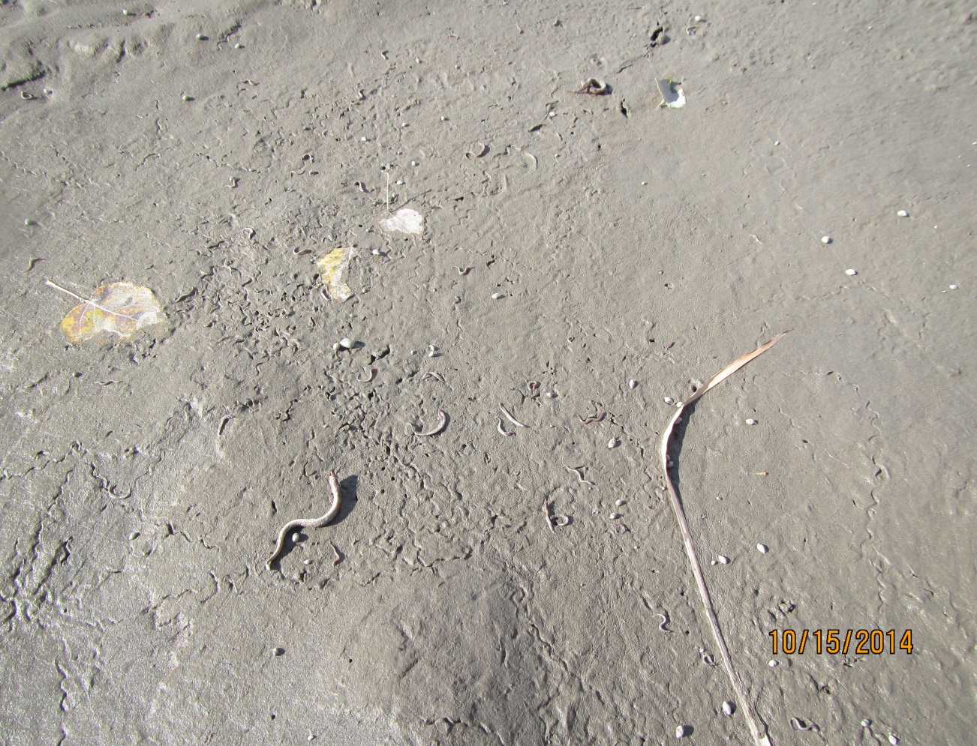
Irrigation Diversions provide refuge and ideal habitat for juvenile/larval lamprey
Notes:
Fine sediment collects in these irrigation diversions which provide…..in this photo we see about 50 dead lamprey on top of the sediment

Slide 8
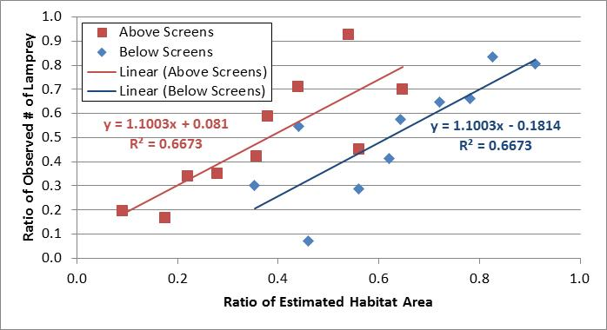
2013 Match-Pair Analysis
More sediment = more lamprey
Control the fine sediment, control larval entrainment?
Notes:
In 2013 we looked at the relationship between the area of larval habitat (shown on the x axis) and the # of lamprey (shown on the Y axis). Click* …. The take home message here is that the more sediment an area has, we expect to see more lamprey. Control the fine sediment, we may be able to control larval entrainment.

Slide 9
2014 Observed # of Lamprey
63.6%
36.4%
Total = 3,427
4,514
2178
864
Downstream
Notes:
Lets take a look at our 2014 information; We surveyed 15 irrigation diversions;

Slide 10
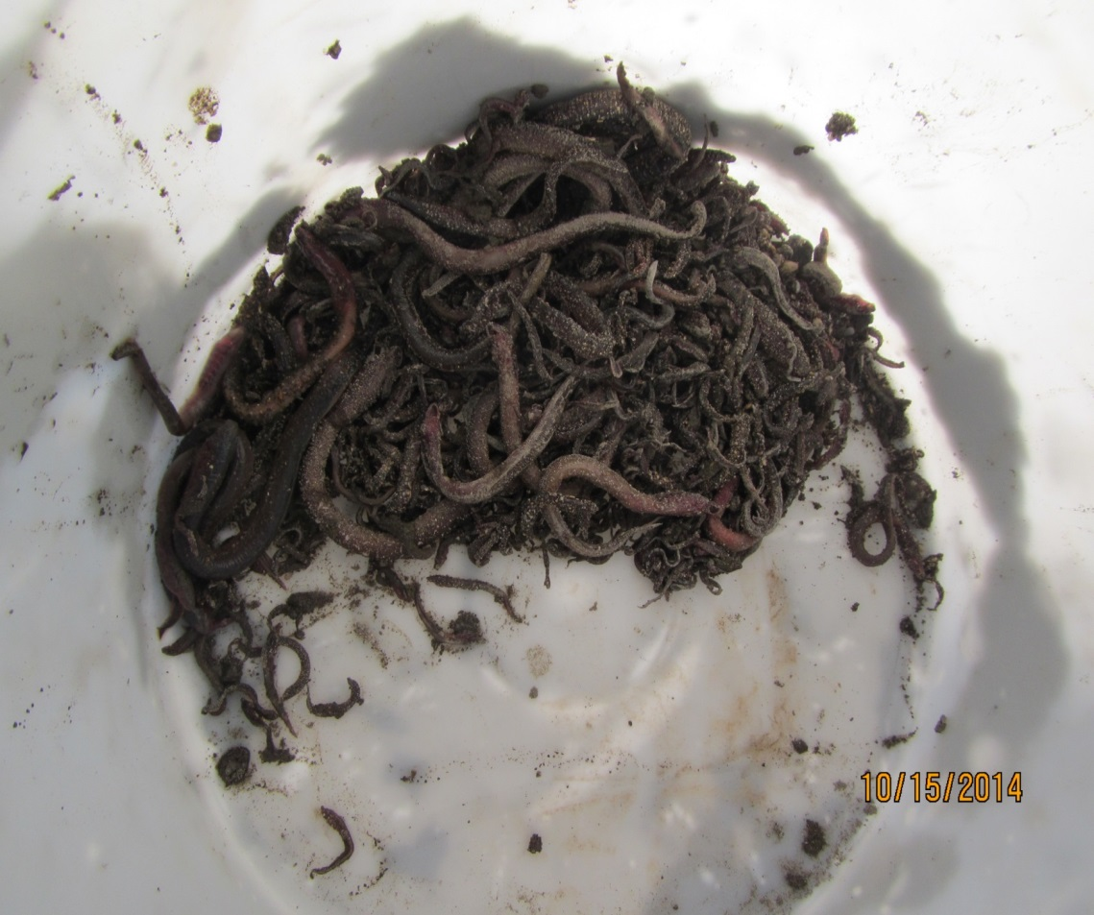
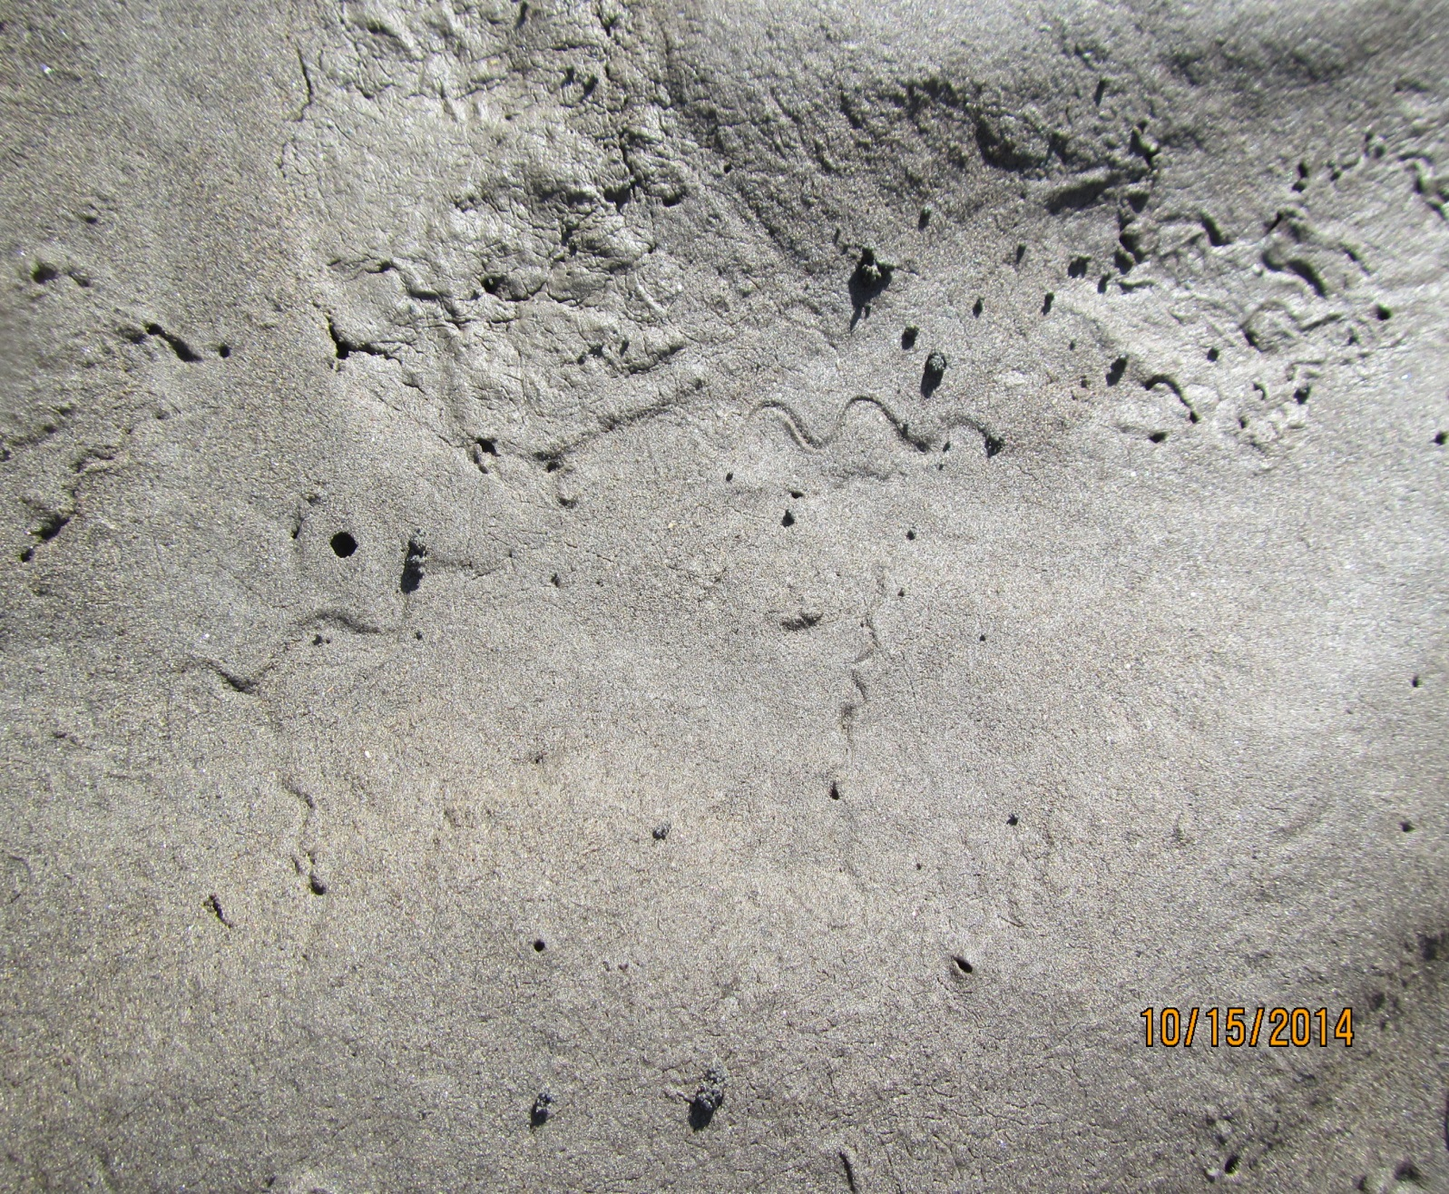
Desiccated Lamprey
1087 total desiccated lamprey (mostly < 50 mm)
24.1 % of the total # of observed lamprey
Underestimate of total number
Snake-like trail markings on sediment

Slide 11
2014 Observed Larval Habitat
Total = 14,183 m²
(32,102 m² in 2013)
49.6%
50.4%
7024 m²
7159 m²
Downstream
Notes:
Additionally, there is quite a large area of larval habitat at these diversions – Start with 2014; then 32,102 (covered more diversions, focused on the canal area); average is 50/50 but there is a wide variety to where the habitat collects between diversions.– small amount (14,000 = 2.8 football fields; ~ 3). Type 3 habitat (17.9 % of the total area observed at visited diversions)

Slide 12
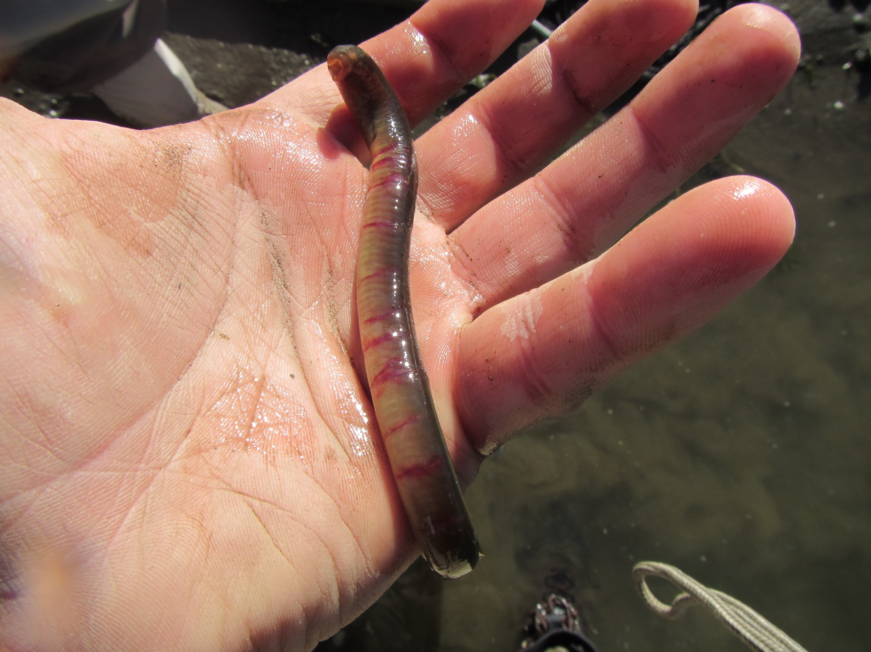
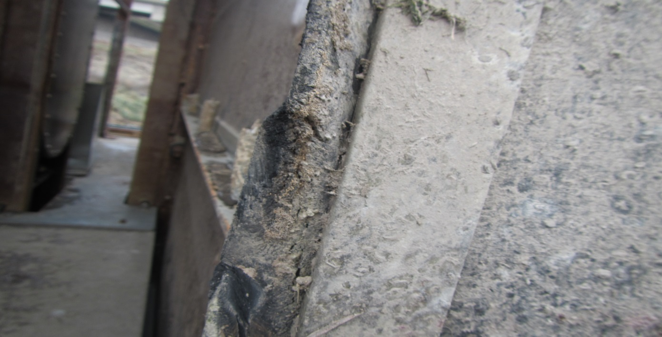
Size Class Distribution
Vertical metal
Bar (~6mm gap)
Torn rubber
Seal (5-14mm gap)
Notes:
Larger fish – shouldn’t be passing through looked at Sunnyside….even the smallest hole that they can pass through they will

Slide 13
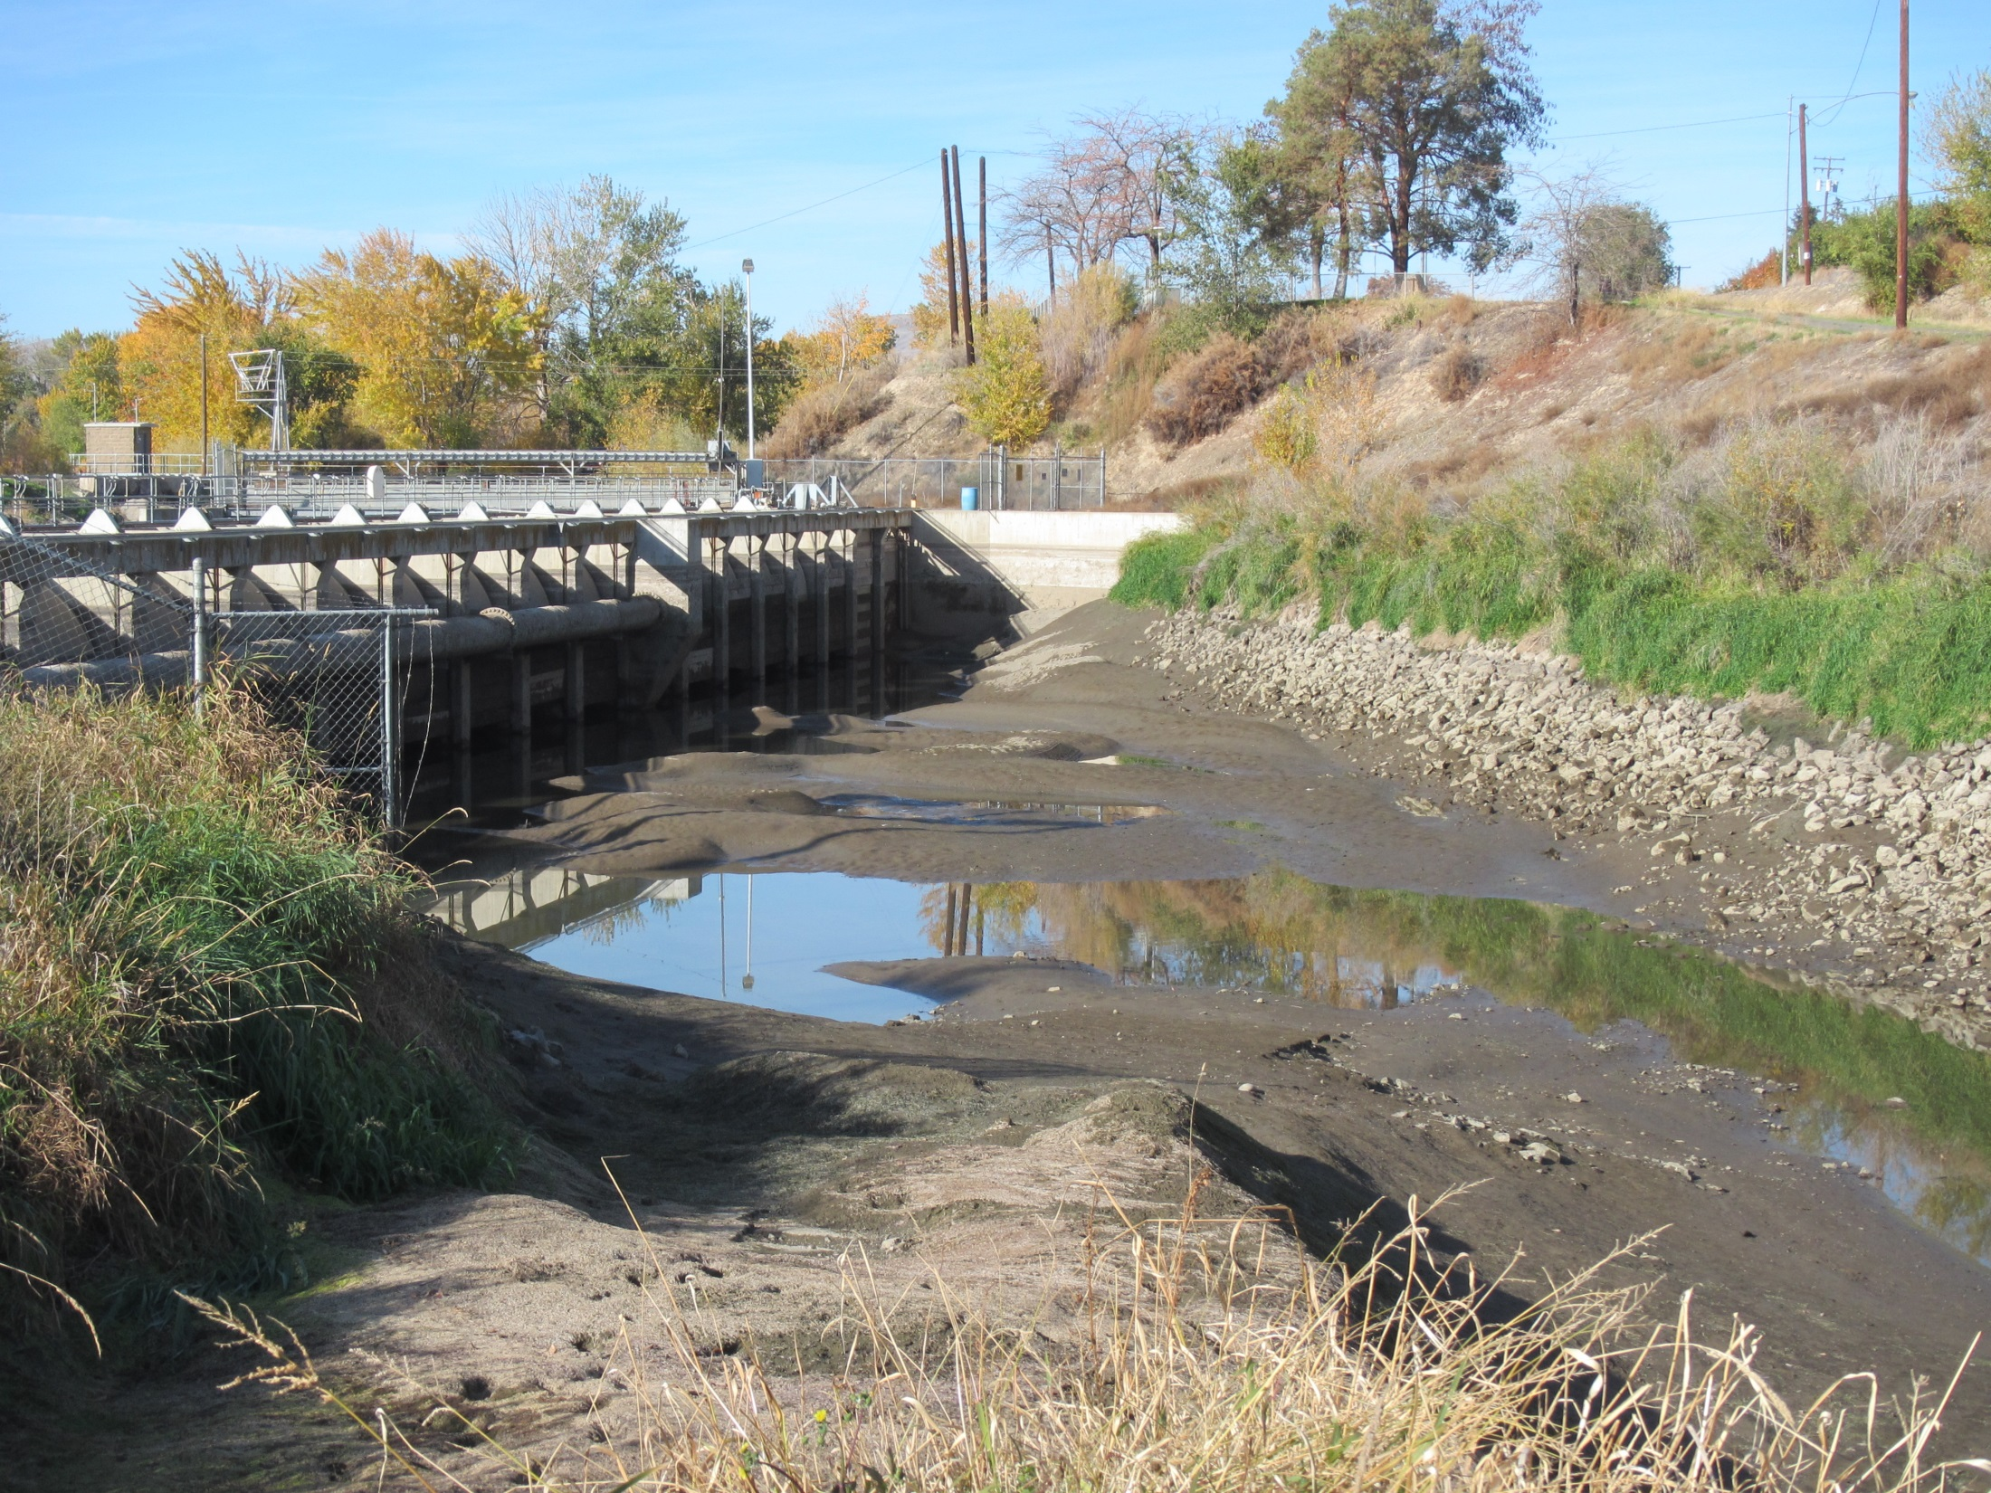
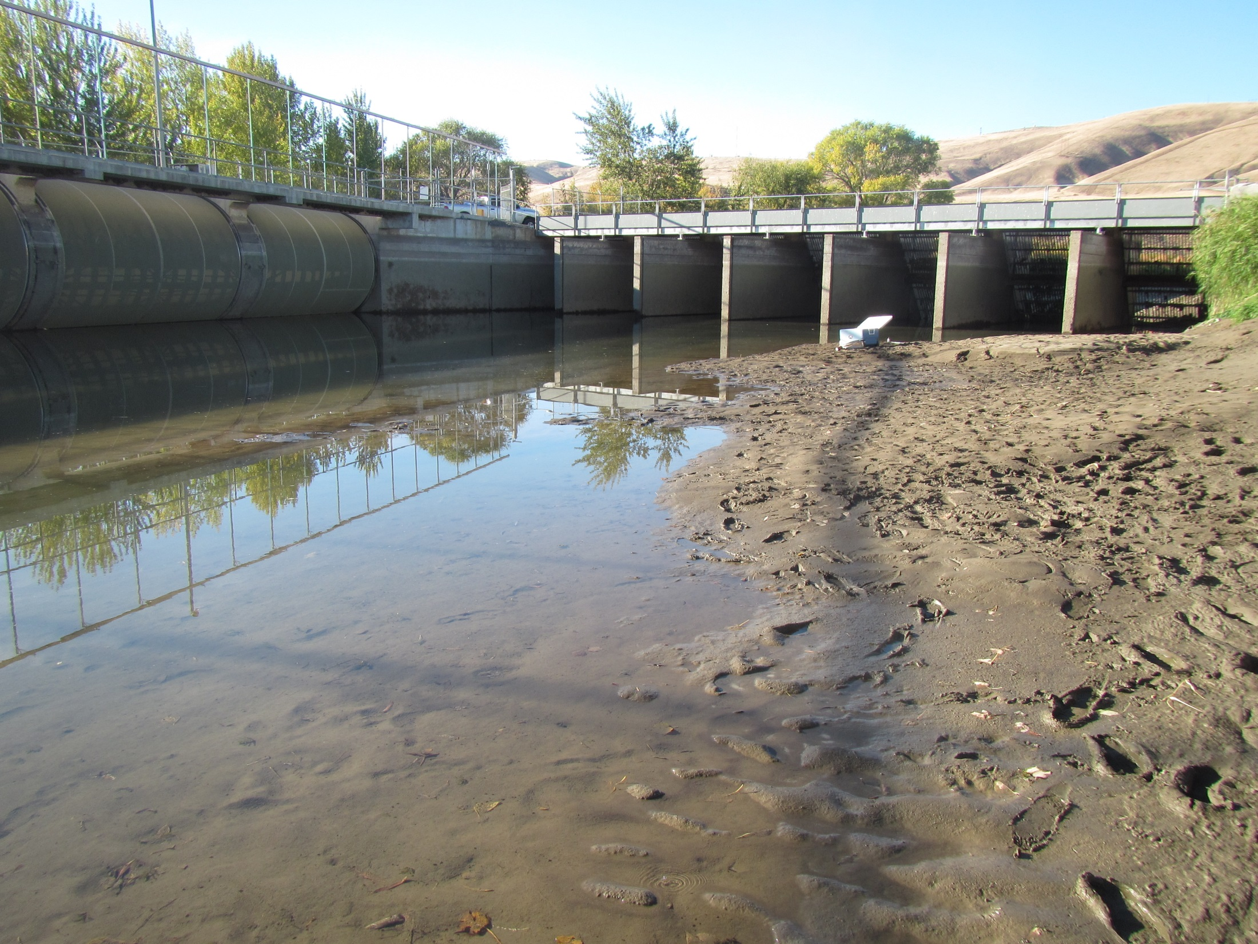
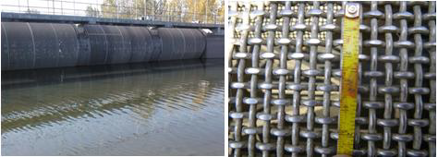
Larvae # Estimations
Wapato and Sunnyside diversions
Large Scale Irrigation Diversions
1300 and 2000 cfs, respectively
1/8” wire mesh screen
Close proximity to each other
.
Entrain thousands of larval lamprey each year
91.4% of all observed lamprey in 2014
Contrasting sediment/larval distribution
3/32”-1/8” (2.38-3.18mm)
Wire Cloth/ Rotary Drum 1/8” Wire Mesh
Notes:
We find thousands of larval lamprey in Wapato and Sunnyside Diversions. Our goal was to better estimate the number of lamprey entrained here …. Mention the total % of lamprey observed came from Wapato/Sunnyside diversions ; and larvae distribution; contrasting sediment/lamprey distribution; ~ 5 rkm apart (Sunnyside/Wapato);

Slide 14
Larvae # Estimations
Single Day Estimation
Wapato and Sunnyside Diversions
Wet vs. Dry Larval Habitat
Exclude # of dry/desiccated lamprey
Finding by chance
Divided wetted habitat in sections
Estimated # of lamprey per section
Mark-Recapture Study
Wapato Diversion
Chapman Mark-Recapture Method
VIE Tagging
Notes:
The first objective was to calculate a single day estimation

Slide 15
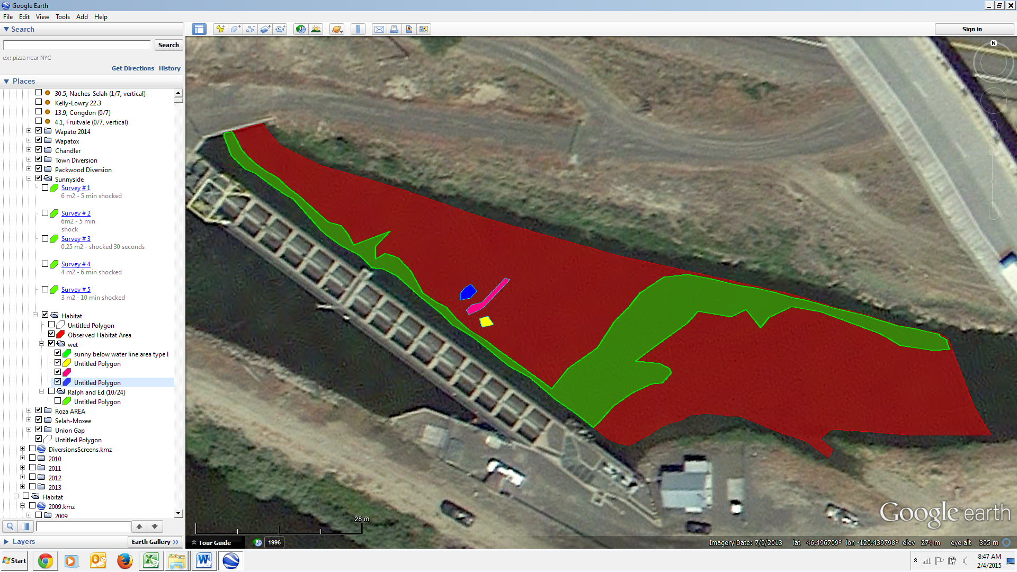
Sunnyside Diversion
4
3
Flow
2
1
5

Slide 16
Results from # Estimations
Single Day Estimation
Sunnyside – 5,249
Wapato – 3,259
Mark-Recapture Study
19-45 % observed during a single pass survey
45 % (conservative)
Sunnyside – 11,664
Wapato – 7,423
18, 907 entrained larval/Juvenile Lamprey
Notes:
Based on a single pass assessment, the estimated number of lampreys entrained within these areas of interest in Sunnyside Diversion (Yakima River; river km 171.0) and Wapato Diversion (Yakima River; river km 175.5) were estimated to be 3259 and 5249, respectively. Visual implant elastomer (VIE) tags were inserted into larval/juvenile lampreys captured within a high density area above the fish screens at Wapato Diversion. The resulting mark recapture study concluded that potentially only between 19 and 45 percent of the lamprey present in a given area were observed during a single pass survey. If we assume that during our single pass estimate we observed only 45% of the lamprey present (the highest percentage based on our mark recapture study), our estimated totals for Wapato and Sunnyside diversions within the area of interest would increase dramatically to18,907 lampreys (7,423 and 11,664, respectively). In addition to this estimate, over 1,000 desiccated larvae were found in these two diversions; however, this number is likely an underestimate based on the difficulty in finding desiccated larvae from predation and rapid decomposition of larval bodies.

Slide 17
% PA Entrainment
Diversions downstream Roza Dam
Identified 1201 larval lamprey
Average PA % = 7 %
Wapato
~ 519 PA lamprey
Sunnyside
~ 816 PA lamprey
Notes:
More of a problem when restore the numbers – as the numbers increase (7% now likely to increase over time)

Slide 18
Instream Monitoring of Larval Movement, Behavior and Entrainment
Monitor Instream Movements through repeat surveys
Find lamprey after diversion dewatering
Tagging
VIE Tags (> 15 mm)
PIT Tags (> 70 mm)
Fin clip markings (> 50 mm)

Slide 19
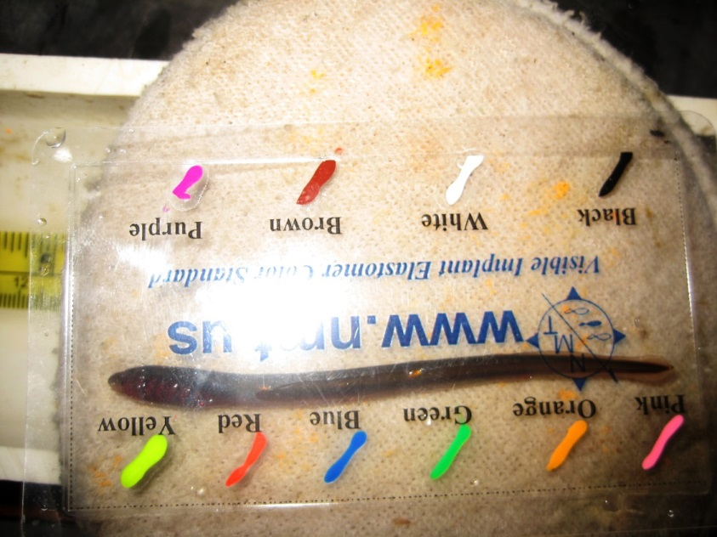
Lamprey > 50 mm
Middle
Posterior
Lamprey < 50 mm

Slide 20
Tagging Methods – PIT (>70 mm)
8 mm Pico PIT tags
3mm microsurgical blades (full cut)
10-15 mm
Slightly below half way point, aiming for upper part of cavity
Heart + Liver
other organs
*Method by CTUIR

Slide 21
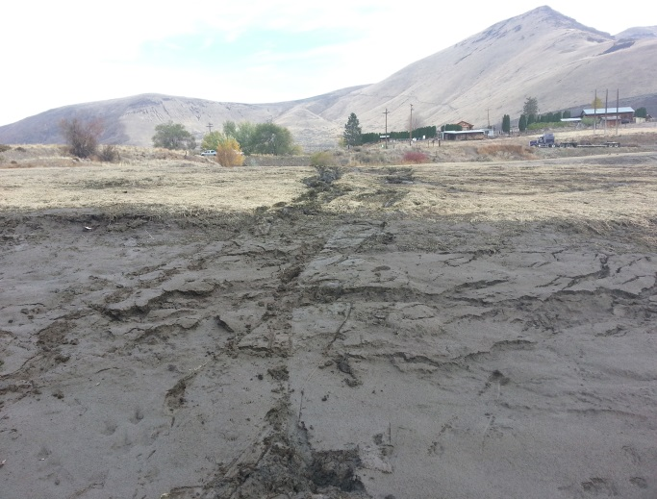
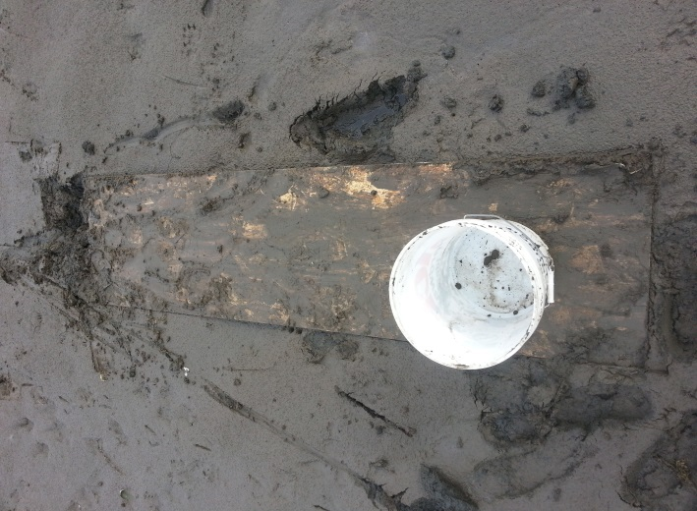
Roza Reservoir
34,251 m² Type I
10/29/2014
12,231 m² Type I
(- 64.3%)
Notes:
Large amount of habitat gets dewatered, boards (don’t recomment), deepwater electroshocking to better understand

Slide 22
Chandler Diversion Outmigration
2014
8 captured at Chandler Bypass.
35 additional large larvae - Dryden Diversion
Only 12.5% of the macrophthalmia and 2.9% of the larval lamprey were detected.
2015
31 Macrophthalmia
1 PA Larvae
Possible Impacts:
Predation, screens designed for salmonids or other unknown factors
Notes:
As a result, although all juvenile pit tagged fish migrating back to the river through the bypass channel are supposed to be detected at the pit tag arrays.

Slide 23
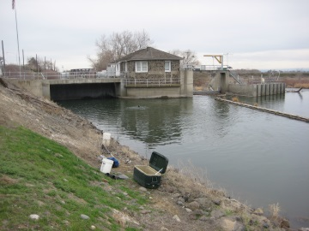
Long-term Fixes
Headgate Orientation to Control Sediment
Canal Channel Configuration
Headgate opening not from bottom
Vibrating or Electrifying the fish screens
Headgate opening not from bottom
Headgate orientation parallel to the main channel flow
Canal channel configuration
Perpendicular to Flow
-> More Sediment
Parallel to Flow
-> Less Sediment
Notes:
Vibration of screens, Electrifying the drum screens with a 3 burst per sec
Might deter the larger larvae from interacting with the fish screens but the smaller larvae (which are force to go with the flow), may still become entrained.
Headgates currently open from the bottom (most likely where fine sediment has accumulated during the fall and winter months).
When the headgate opens from the bottom, any larvae that are residing in this fine sediment will likely become entrained. Opening the headgate from a position other than the bottom (i.e. several feet up) may reduce the initial entrainment of larval lamprey. Future studies to determine fine sediment accumulation at the headgate of major diversions (i.e. Sunnyside and Wapato) need to be studied.
Again, if you control the sediment, we may be able to reduce the number of lamprey that pass through the fish screens and ultimately the number of lamprey that enter the diversion all together. The fine sediment provides an important foundation to the river ecosystem, and if we can reduce the sediment that enters the diversions, we will allow for more available habitat for the lamprey saved from the irrigation diversions.

Slide 24
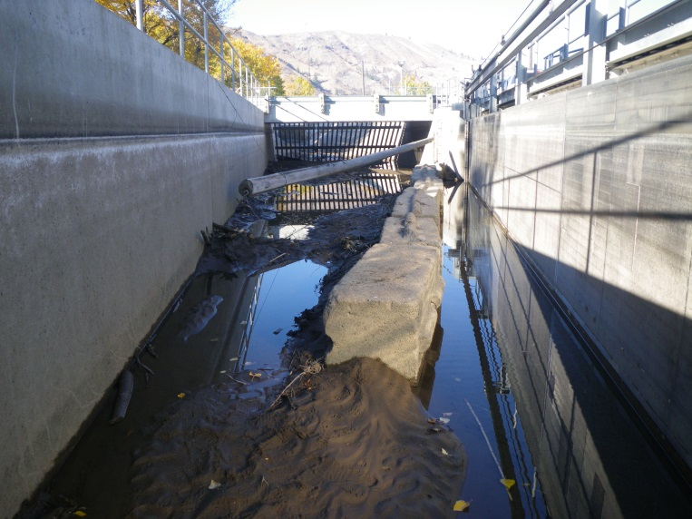
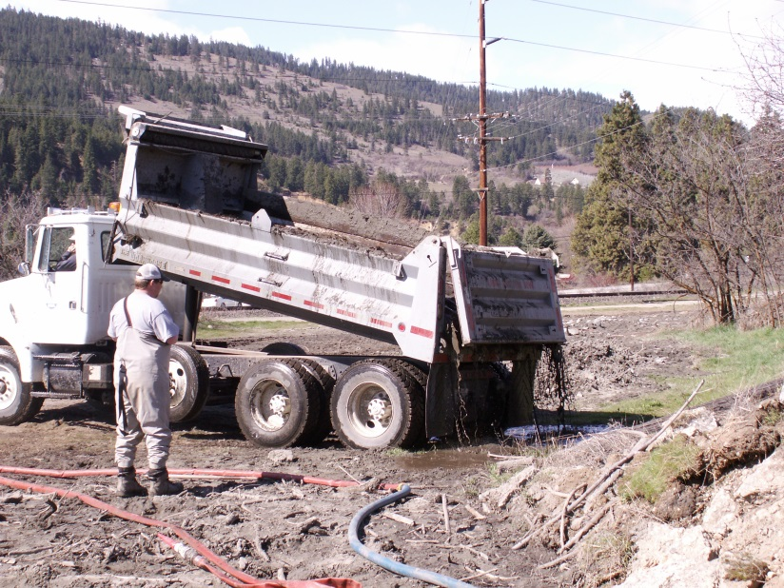
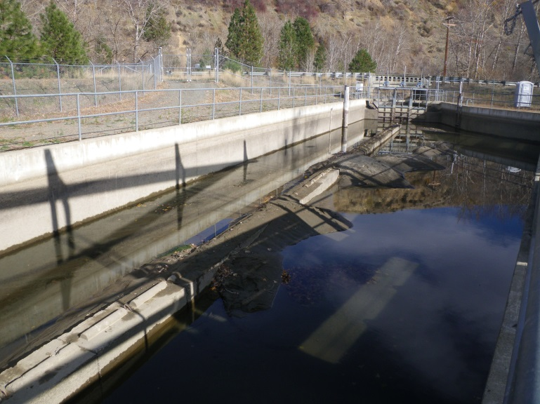
Short-Term Fixes
Reduce dewatering rates
Ecology blocks to alter the orientation of sediment deposition to occur upstream of the fish screens
Using plastic-lined dump trucks to haul sediment and larvae to irrigation ponds that connect to the Yakima River.
Blowing out all fine sediment through bypass before or while dewatering
Outlet
Above Screens (Naches-Selah)
Below Screens (Town)
aaa
aaa
Notes:
Ecology blocks,

Slide 25
Other Solutions??
Notes:
Still need to do maintenance work every year, but can do it in the spring instead of fall when sediment less of an issue

