Slide 1
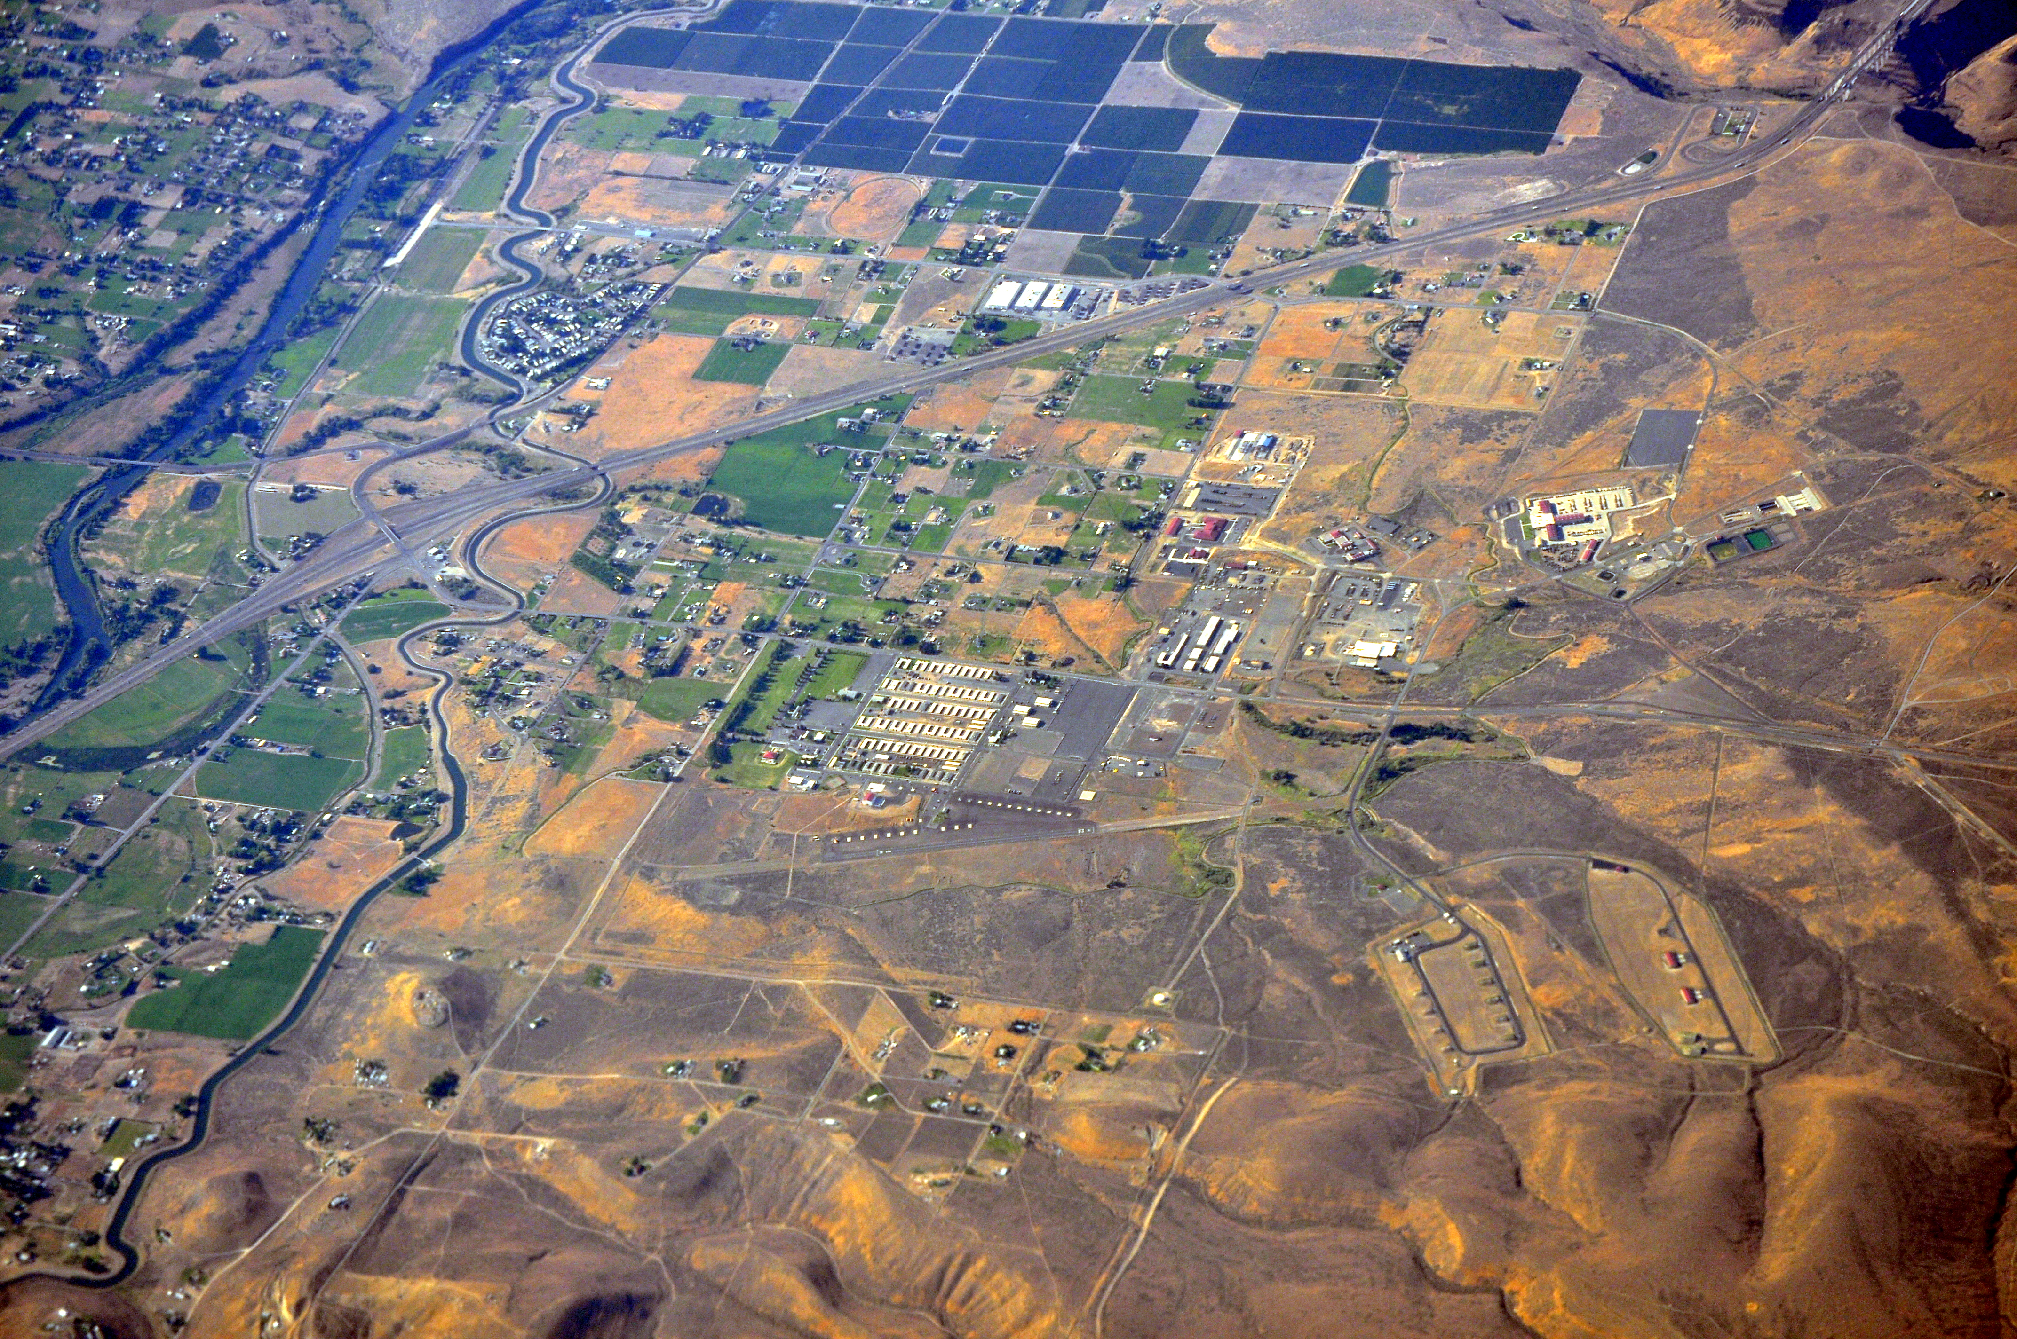
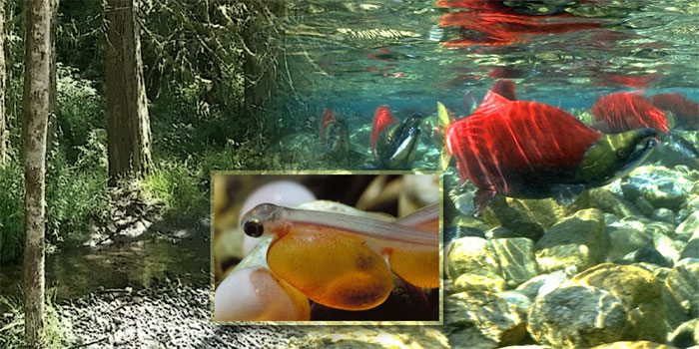

Climate Change in the Yakima Basin:
Implications for Aquatic Habitat and
Water Management
Yakima Basin Science & Management Conference 2015
Ingrid M. Tohver – Climate Impacts Group, University of Washington

Slide 2
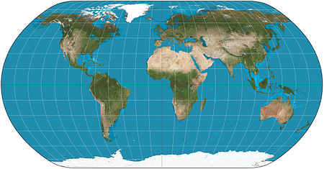
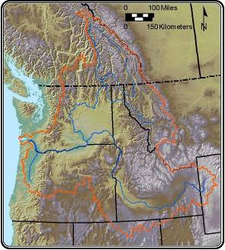

The Climate Impacts Group
An interdisciplinary team based at UW studying climate impacts in the Pacific Northwest since 1995
Areas of study: | Water resources Salmon Forests Coasts Agriculture
UW Climate Impacts Group
Objectives | Increase regional resilience to climate variability and change Produce science accessible to (and useful for!) the decision making community
Notes:
The Climate Impacts Group is an interdisciplinary team of researchers and staff based at the University of Washington in Seattle.
The CIG conducts research on the impacts of climate variability and climate change on the PNW environment and its communities.
Our research is focused on four areas: (see list)
The purpose of this research is to… (see bullets)

Slide 3
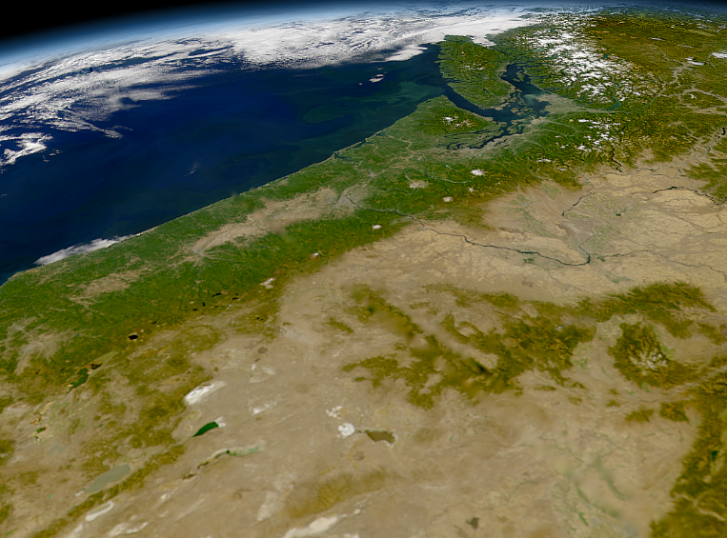
Observed Changes in PNW Climate

Slide 4

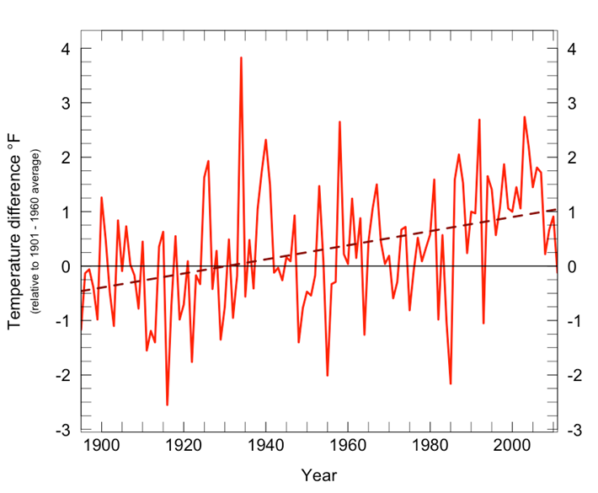
Average annual PNW temperature
has increased +1.3°F (1885-2011 )
Warming observed in all seasons except spring (1980-2011)
Rate of warming has increased since 1970
Short-term periods of cooling (seasonal or annual) are normal
(Figure source: Climate Impacts Group; see also Kunkel et al. 2013, Mote et al. 2013; Abatzaglou 2014)
Notes:
From Abatzoglou:
Warmest year regionally: 1934
Warmest 10-yr period: 1998-2007
Linear trend, 1901-2012: ~0.1°F to 0.13°F per decade
Accelerated rate of warming in more recent decades: ~0.2°C (~0.36°F) per decade for 1970-2012 and 1980-2012
Warming trends found in all seasons except spring 1980-2012 (re: cool springs 2008-2011)
Seasonal trends are statically significant in less than half of the periods considered.

Slide 5

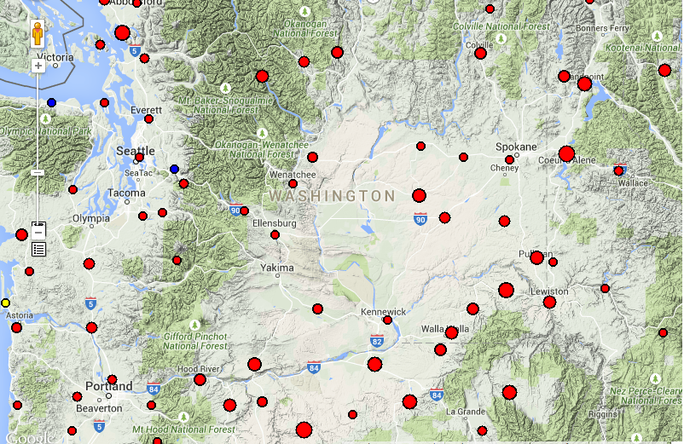
Mean Temperature Trend Analysis 1895-2014
Ellensburg: +0.8°F
Sunnyside: +1.4°F
http://www.climate.washington.edu/trendanalysis/

Slide 6
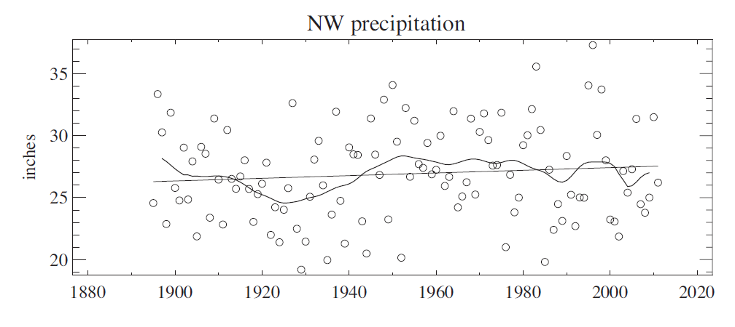
No clear trend in observed
average annual precipitation
Slightly higher variability (+16%) since 1970
No statistically significant trends
Figure 2.4 in Dalton et al. 2013
Notes:
From Chapter 2 in Dalton et al 2013 (Island Press report) - Figure 2.3 Annual mean precipitation in the Northwest (Washington, Oregon, and Idaho) calculated from US Historical Climate Network data Version 2 (USHCN V2) using the Climate at a Glance utility from the National Climatic Data Center, for period of record 1895–2011. The smooth curve is computed using locally weighted regression.

Slide 7
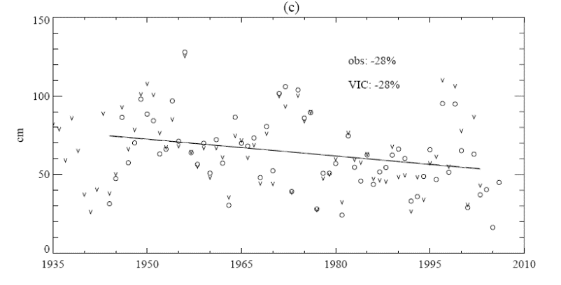
Decline in Long-term Spring Snowpack
Spring snowpack varies year-to-year, but declined ~25% from
mid-20th century through 2006
Changes in regionally averaged April 1 SWE for the
WA and OR Cascades, 1944-2006
Mote et al. 2008
Notes:
From Mote, P.W., A.F. Hamlet, and E.P. Salathé. 2008. Has spring snowpack declined in the Washington Cascades?. Hydrology and Earth System Sciences 12: 193-206.
Fig. 5. Cumulative SWE as a function of elevation, for the Washington Cascades. Regionally averaged 1 April SWE for observations (o) computed for the 1944–2006 snow courses using area-weighting and infilling of missing values with best-correlated time series, and VIC
(v). The VIC values have been scaled to the mean observed SWE. Linear fits for observed (solid) and VIC (dashed) overlap.

Slide 8
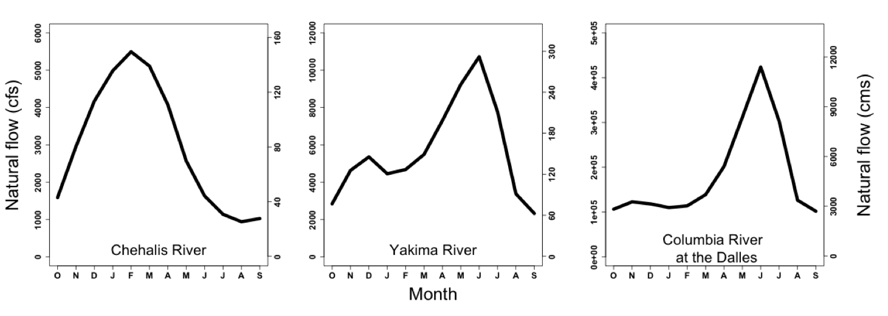
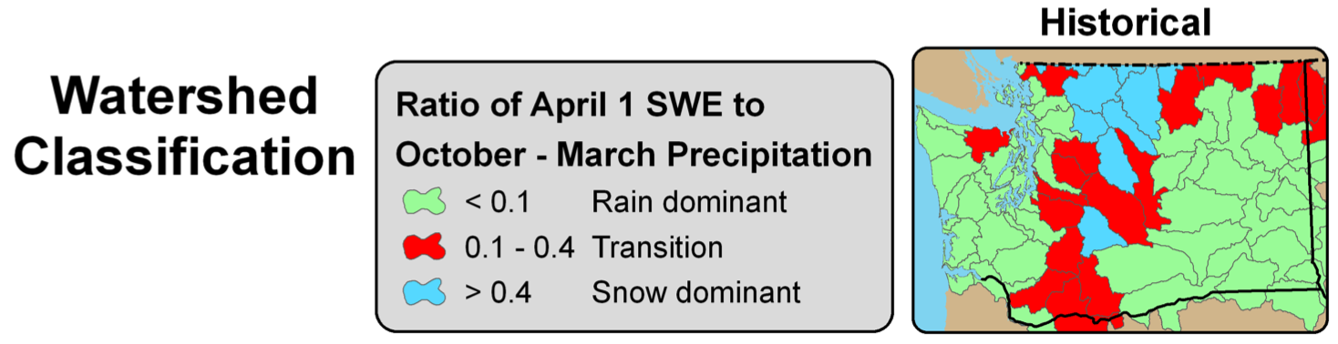
Snow-Influenced Hydrology
rain-dominant
“transient” – double peaked
snowmelt-dominant

Slide 9
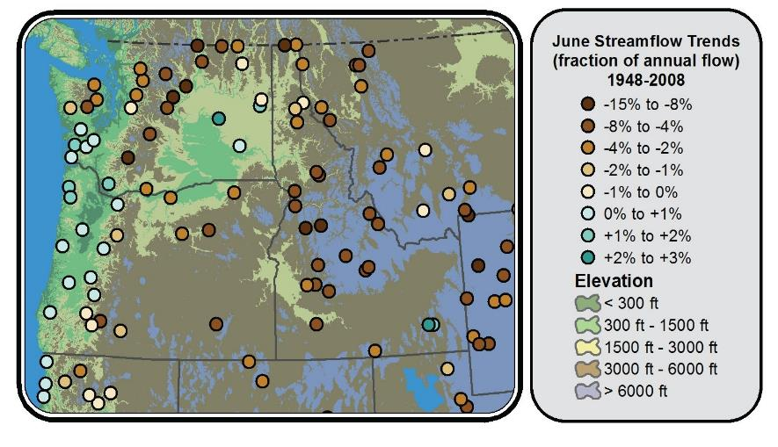

Earlier Peak Streamflow in
Snowmelt-Influenced Basins
National Climate Assessment 2014, Figure 21.1
Notes:
Figure 21.1: Reduced June flows in many Northwest snow-fed rivers is a signature of warming in basins that have a significant snowmelt contribution. The fraction of annual flow occurring in June increased slightly in rain-dominated coastal basins and decreased in mixed rain-snow basins and snowmelt-dominated basins over the period 1948 to 2008.¹ The high flow period is in June for most Northwest river basins; decreases in summer flows can make it more difficult to meet a variety of competing human and natural demands for water. (Figure source: adapted from Fritze et al. 2011²).

Slide 10
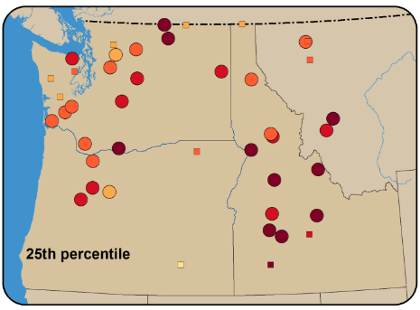
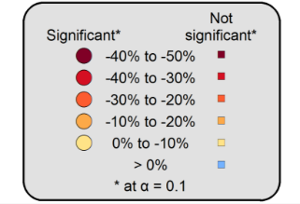
Decrease in Summer Low Flows
1948-2006
Figure from Raymondi et al. 2014; adapted from Luce and Holdren 2009
Notes:
Figure 3.4 Adapted from a study by Luce and Holden (2009), these maps depict the changes in 25th percentile annual flow (top), and mean annual flow (bottom) at streamflow gauges across the Northwest for 1948–2006. Circles represent statistically significant trends (at a=0.1), whereas squares represent locations where trends were not statistically significant

Slide 11
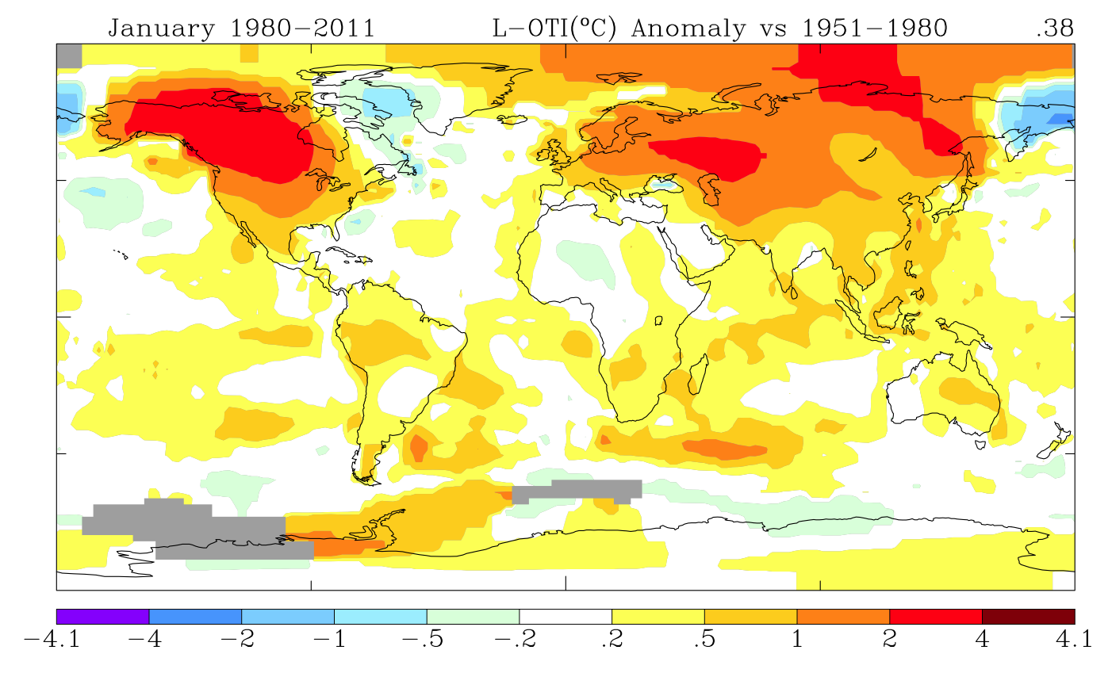
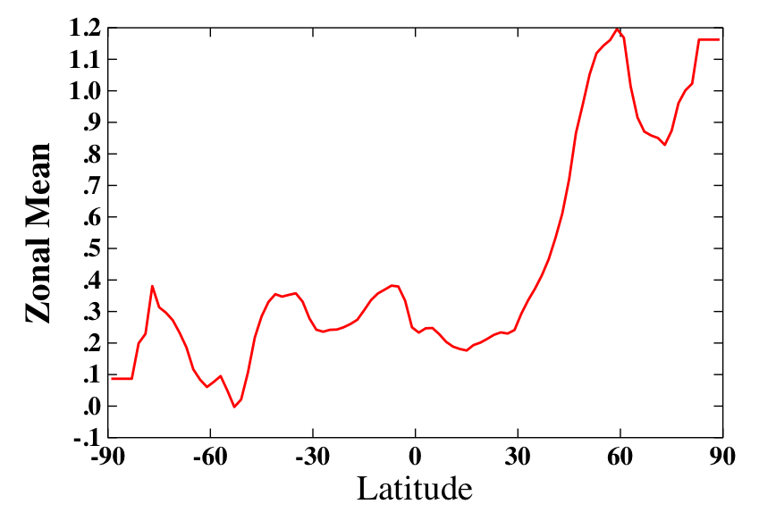
Observed Global Temperatures
Data source: NASA Goddard Institute for Space Studies
Notes:
Northern hemisphere undergone most warming in past 3 decades.
More land mass, and land = better absorber of heat.
Arctic in warmest zones.
Causes of consistent warming trend: more sun energy, natural climate variations, volcanoes, rising GHGs (only one plausible to have caused observed long-term warming)

Slide 12
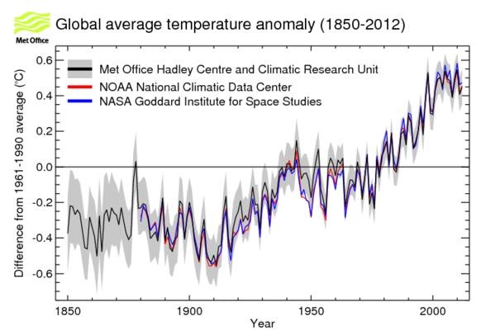
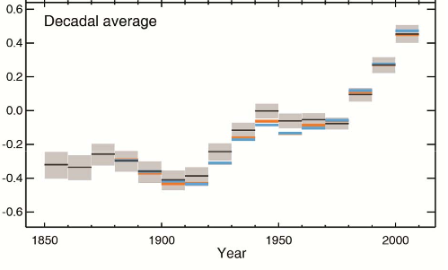
Observed Global Temperatures Anomalies
Figure sources: Met Office and IPCC 2013

Slide 13
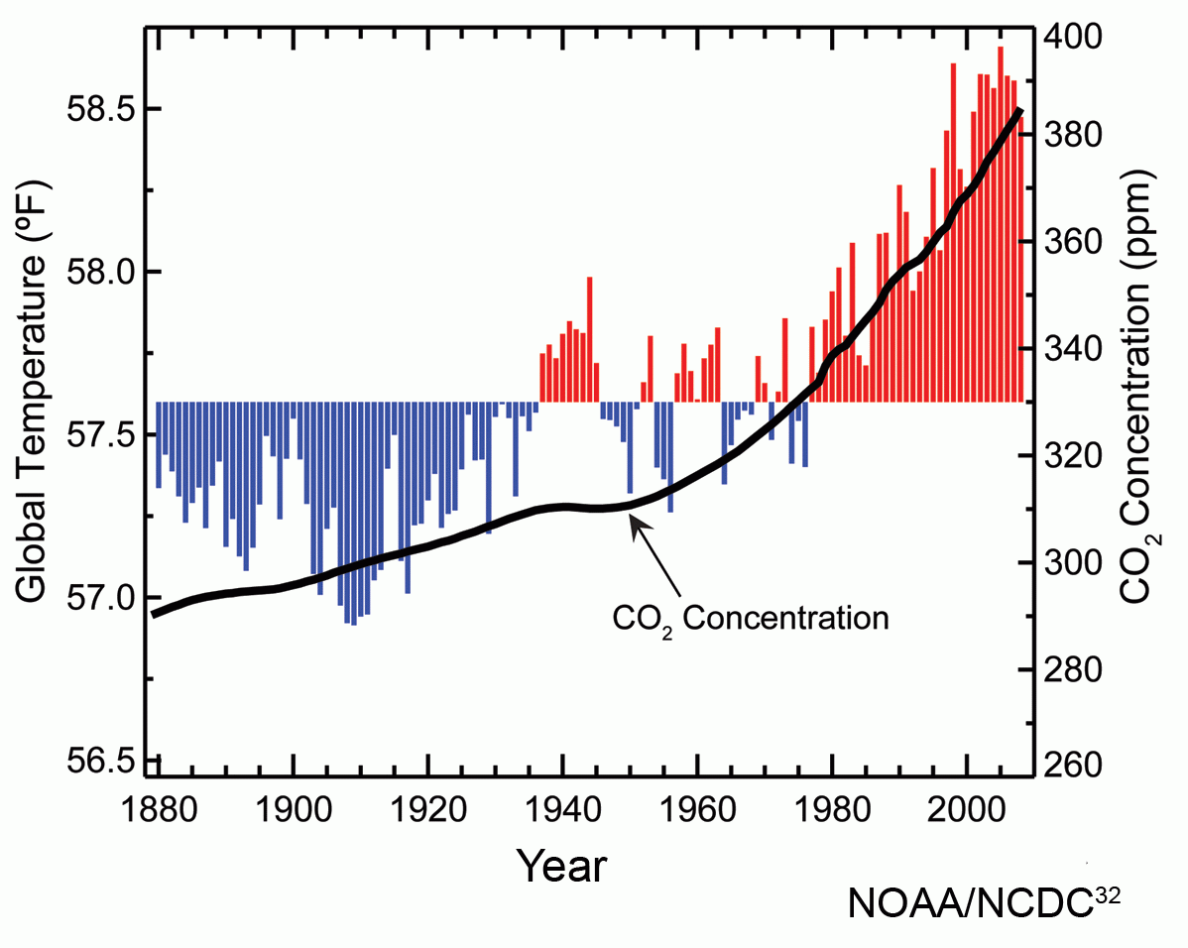

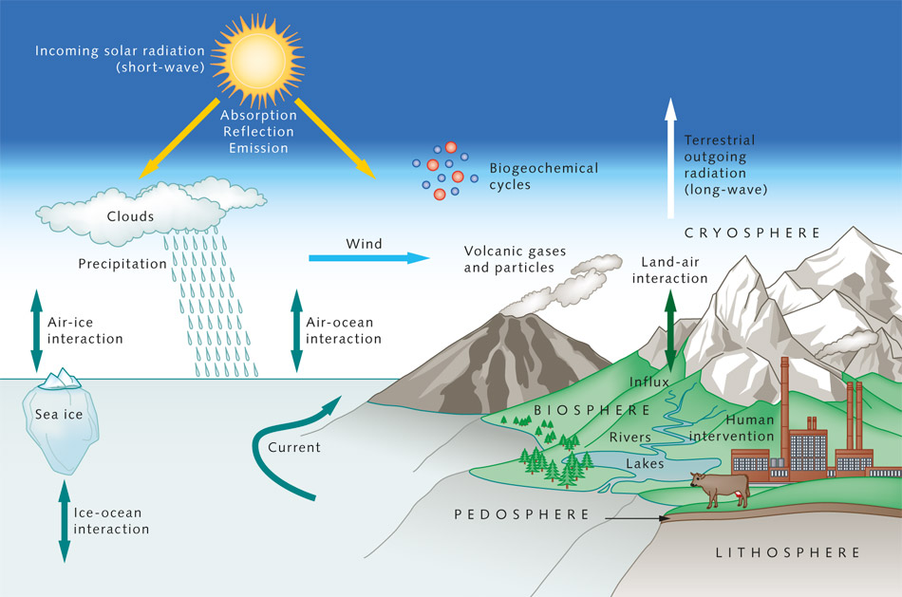
Global Climate System and Models
Major determinants of climate:
Solar radiation*
Atmospheric GHGs*
Natural climate variations
Volcanoes
Image source: Met Office
Climate models represent the interactions of the atmosphere and oceans as numbers
Notes:
Greenhouse gases play a critical role in determining global temperature. Without these gases, the Earth’s average temperature would be somewhere on the order of 0°F -- a temperature so low that the Earth would be frozen and could not sustain life -- rather than the comfortable average of 59°F today (http://www.ucsusa.org/global_warming/science/global-warming-faq.html).
How does this happen?
When incoming solar radiation (shortwave) passes through the Earth’s atmosphere, much of this radiation is absorbed by the Earth’s surface. A portion of that energy is re-radiated back towards the atmosphere but at different wavelengths (longwave); rather than being visible light, the re-radiated energy is infrared. Various trace “greenhouse” gases (less than 1% by volume) in the atmosphere absorb much of the infrared radiation from the Earth’s surface and release that energy as heat back towards the Earth’s surface; the remainder escapes into space. These gases include water vapor, carbon dioxide, methane

Slide 14
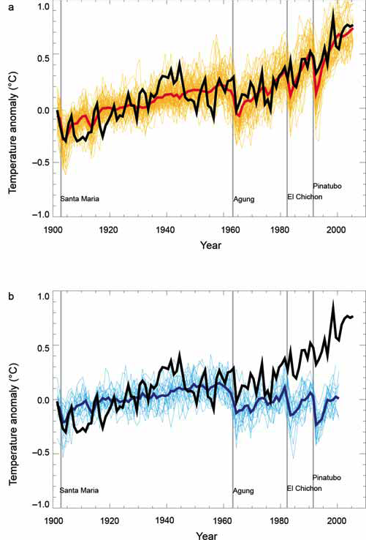
Climate Model Responses to Inputs
Only natural forcings
Anthropogenic and natural forcings
Models cannot track observed temperature changes without the input of human-generated greenhouse gases
Source: Hegerl et al. 2007
Notes:
Black lines are observed global mean surface temperature anomalies relative to 1901 – 1950
Colorful areas are global climate model simulations, solid lines are the multi-model means
Natural forcings plot of 19 simulations using five models
Anthropogenic plot includes 58 simulations using 14 models

Slide 15
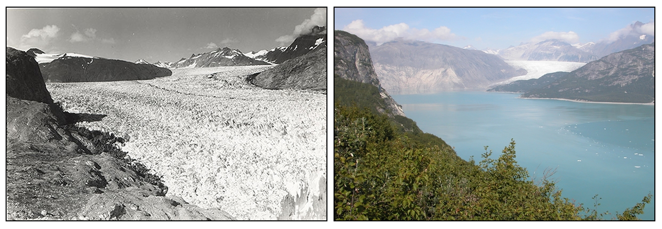
The Future Ain’t What it Used to Be
- Yogi Berra
Muir Glacier in Alaska
Aug 13, 1941
Aug 31, 2004
Image Credit: National Snow and Ice Data Center
Notes:
On the left is a photograph of Muir Glacier taken on August 13, 1941, by glaciologist William O. Field; on the right, a photograph taken from the same vantage on August 31, 2004, by geologist Bruce F. Molnia of the United States Geological Survey (USGS).
According to Molnia, between 1941 and 2004 the glacier retreated more than twelve kilometers (seven miles) and thinned by more than 800 meters (875 yards).
Ocean water has filled the valley, replacing the ice of Muir Glacier; the end of the glacier has retreated out of the field of view. The glacier’s absence reveals scars where glacier ice once scraped high up against the hillside. In 2004, trees and shrubs grow thickly in the foreground, where in 1941 there was only bare rock.

Slide 16
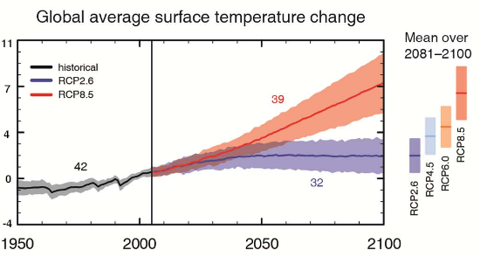
Projected 21st Century Global Warming
°F
Image source: IPCC 2103
Notes:
The IPPC 2007 report generated several global climate models to simulate physical dynamics of ocean, atmosphere, land and ice to determine future temperature
trajectories using the CO2 emissions scenarios as inputs to the models.
This figure is based on 21 global climate models and 3 emission scenarios. Again, CIG uses A1B and B1 scenarios in our analyses of regional impacts.
We wanted to encompass a high and low scenario out to the mid 21st century and as you can see the two highest scenarios are neck and neck by mid-century.
Changes in global temperature are relative to the average climate of 1980-1999
If emissions were held at year 2000 levels (yellow line), the range of additional warming through the 2090s would be about 1.1 degrees F (0.5-1.6 F)
The 3.2 to 7.2 F range is considered the IPCC’s “best estimate” rage of 21st century warming.
But as you recall from the CO2 emissions slide, we are on an emissions trajectory above the highest scenario depicted here.
The amount of warming in the future is highly dependent on the current and near-future greenhouse gas concentrations.
Temperature projections for the 21st century are presented as a range, rather than a single number, to reflect the widening range of possibilities for future greenhouse gas emissions, which will vary based on assumptions about:
population growth,
economic and technological development, and
global climate sensitivity to these changes.
The CIG used these global projections and downscaled them to reflect regional projections of temperature and precipitation,
taking into consideration local effects of the mountainous terrain, the ocean and atmosphere. -->
The B1 emissions scenario represents a slower increase in greenhouse gas emissions with stabilization of CO2 concentrations by 2100 (the concentration of carbon dioxide will be 550ppm in 2100). The A1B emissions scenario has higher greenhouse gas emissions than the B1 scenario: the concentration of carbon dioxide will be 720ppm in 2100.
The A1B and B1 scenarios have the same population projections (population peaking mid-century then declining). The main difference in the scenarios is energy use. The A1B scenario story line has a balance between fossil fuels and other energy sources, while the B1 story line assumes the use of more clean and resource-efficient technologies
Note that the different temperature projections (the red, green, and blue lines) stay fairly close together through the mid-21st century and then diverge more noticeably after the 2050s. This reflects the fact that temperature changes in the coming decade are being largely driven by the concentration of greenhouse gases already in the atmosphere. Additionally, emissions in the next few decades are more certain because of current population statistics (we know how many of us there are and how long we typically live) and the life-span of existing coal-burning power plants and cars, for example.

Slide 17
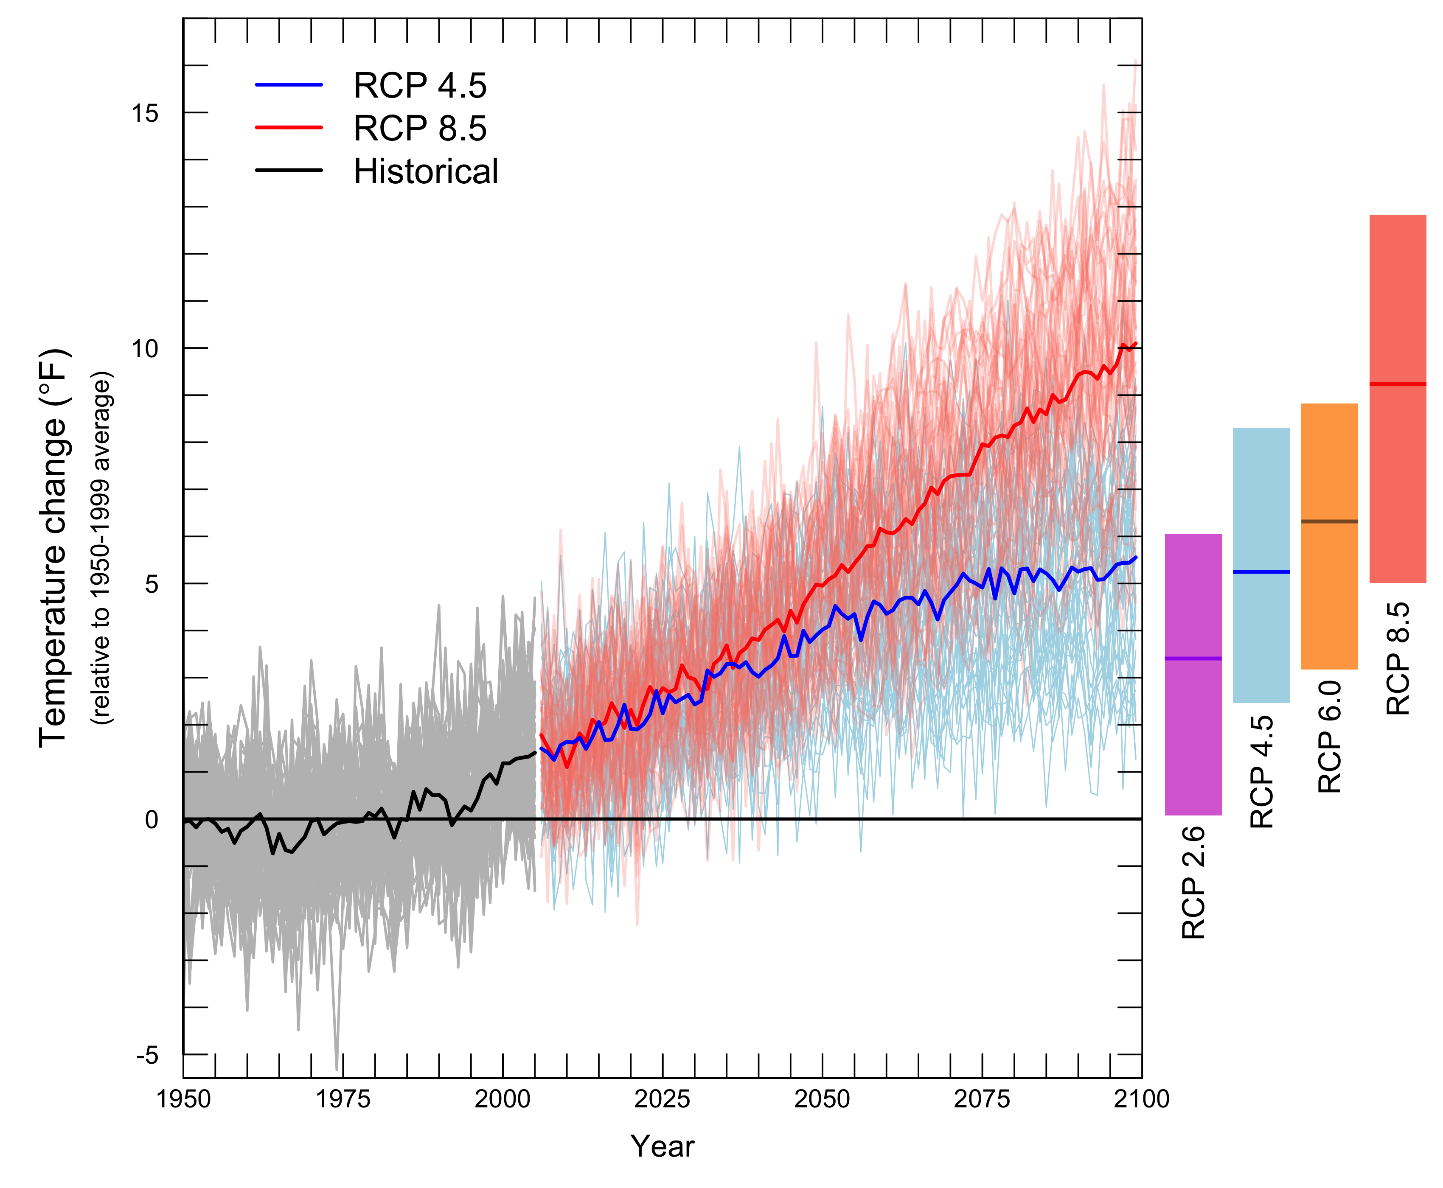
Projected Increases in PNW Temperature
Data source: Abatzoglou (2014)
Notes:
Observed (1950–2011) regional mean temperature and simulated (1950–2100) regional
mean temperature for selected CMIP5 global models for the RCP4.5 and RCP8.5 scenarios.

Slide 18
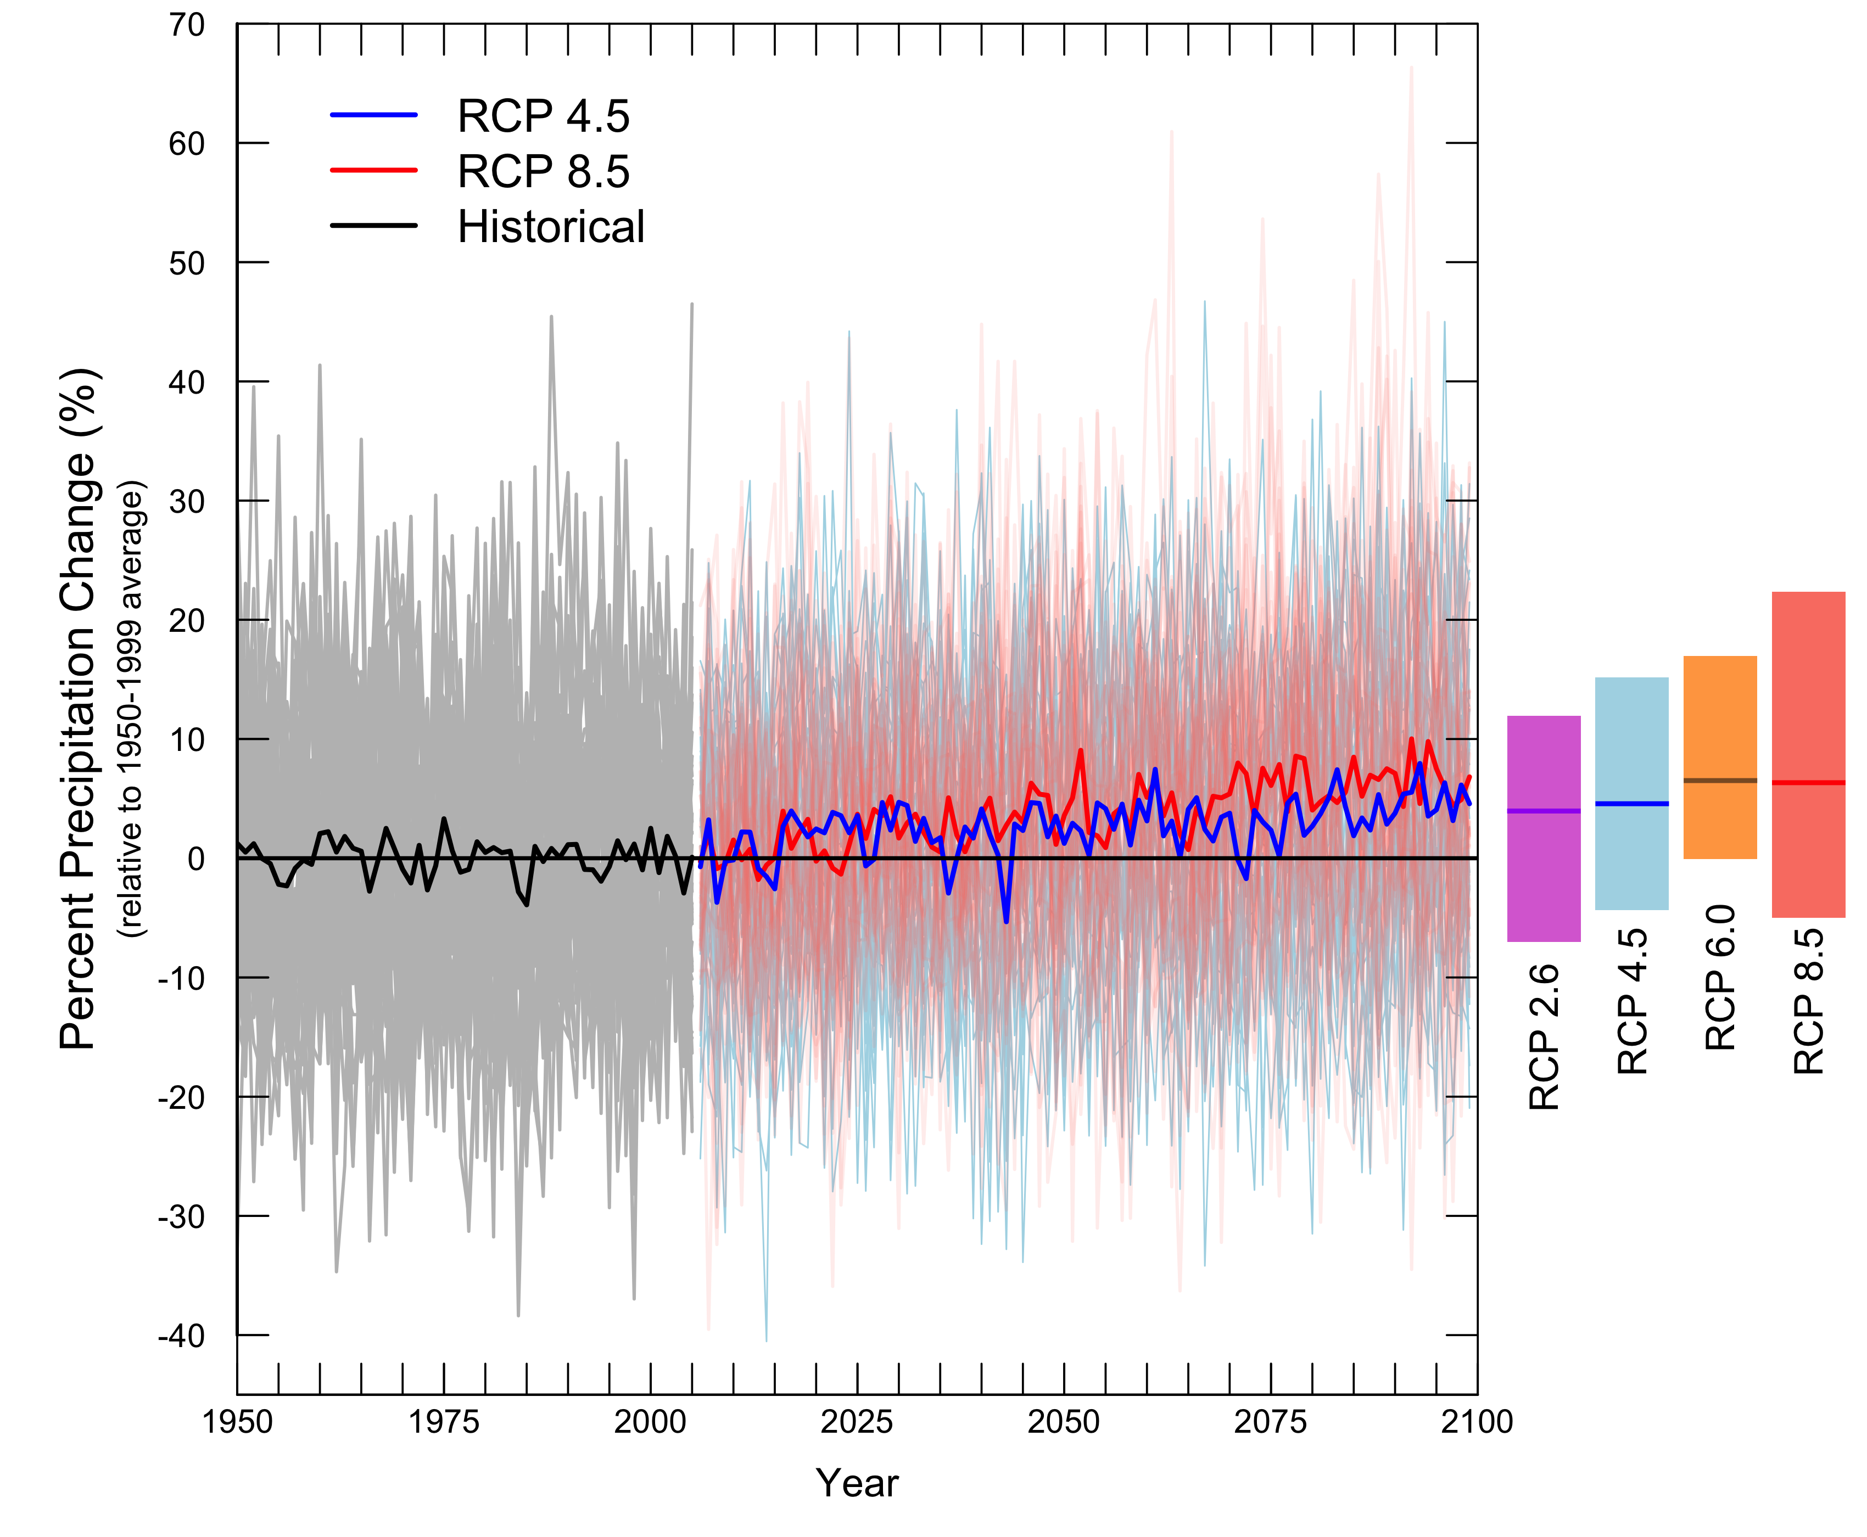
Projected Changes in PNW Annual Precipitation
Small changes in annual precipitation (-5% to +10 %)
Data source: Abatzoglou (2014)
Notes:
18
Changes in annual mean and seasonal precipitation (2041-2070 divided by 1950-1999) averaged across the NW, calculated from CMIP3-SRES and CMIP5-RCP simulations. Each dot represents one model, and the light and dark shaded boxes indicate respectively the 1-sigma departure from the mean and the 95% confidence interval on the estimation of the mean. Means are indicated by thick horizontal lines in the boxes.

Slide 19
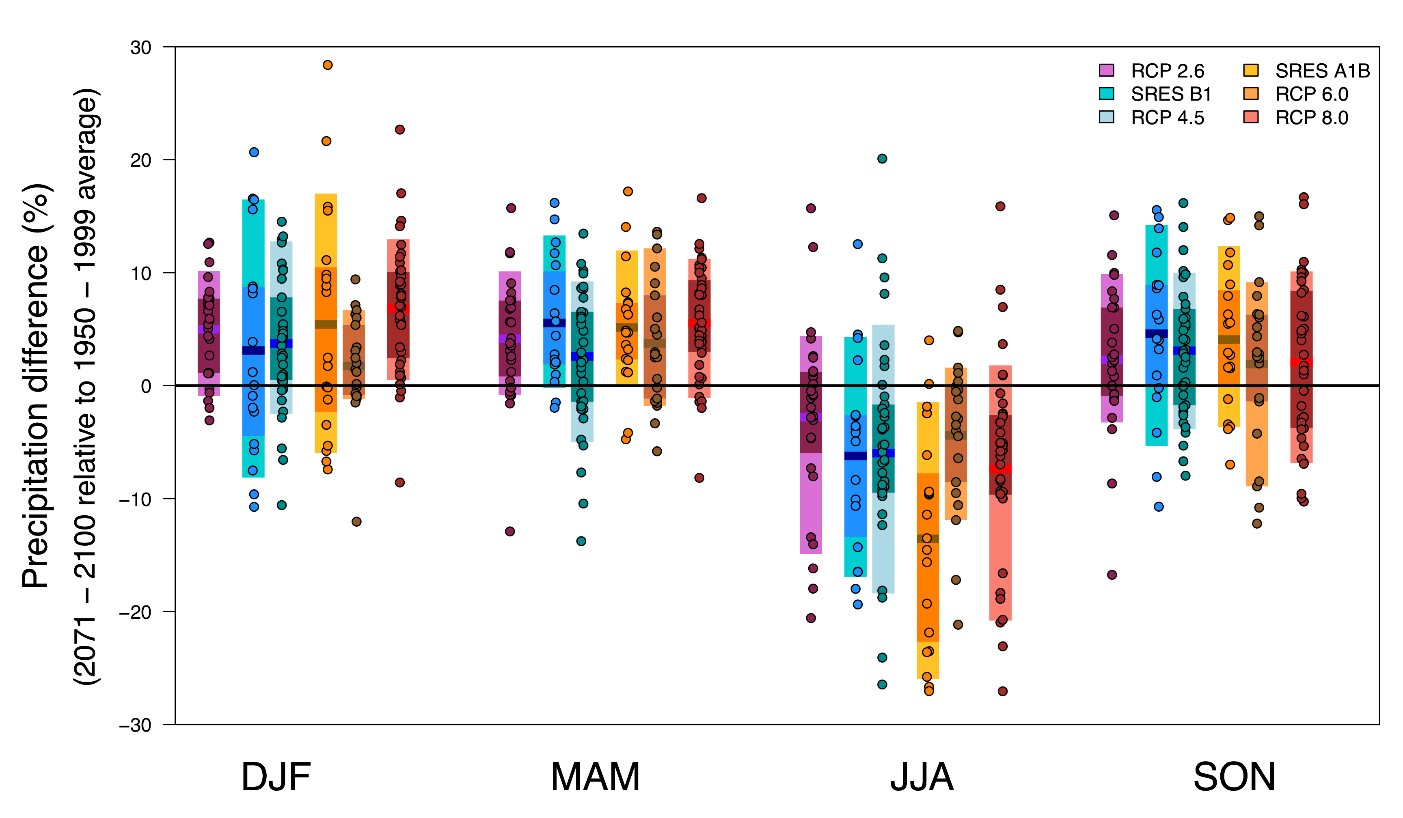
Projected Changes in Seasonal Precipitation
Winter Spring Summer Fall
Some models show large seasonal changes
Data source: Abatzoglou (2014)
Notes:
19
Changes in annual mean and seasonal precipitation (2041-2070 divided by 1950-1999) averaged across the NW, calculated from CMIP3-SRES and CMIP5-RCP simulations. Each dot represents one model, and the light and dark shaded boxes indicate respectively the 1-sigma departure from the mean and the 95% confidence interval on the estimation of the mean. Means are indicated by thick horizontal lines in the boxes.

Slide 20
Projections for the Yakima Basin
Precipitation* (% change) | 2020s (2010 – 2039) | 2040s (2030 – 2059) | 2080s (2070 – 2099)
Annual | + 0.22% | + 2.1% | + 4.9%
Cool season (Oct – Mar) | + 2.3% | + 5.4% | + 9.6%
Warm season (Apr – Sep) | - 4.2% | - 5.0% | - 4.7%
Temperature* (°F change) | 2020s (2010 – 2039) | 2040s (2030 – 2059) | 2080s (2070 – 2099)
Annual | + 2.1 | + 3.7 | + 6.3
Cool season (Oct – Mar) | + 1.9 | + 3.3 | + 5.8
Warm season (Apr – Sep) | + 2.4 | + 4.1 | + 6.8
*Compared to 1970 – 1999 averages
Vano et al. 2010

Slide 21
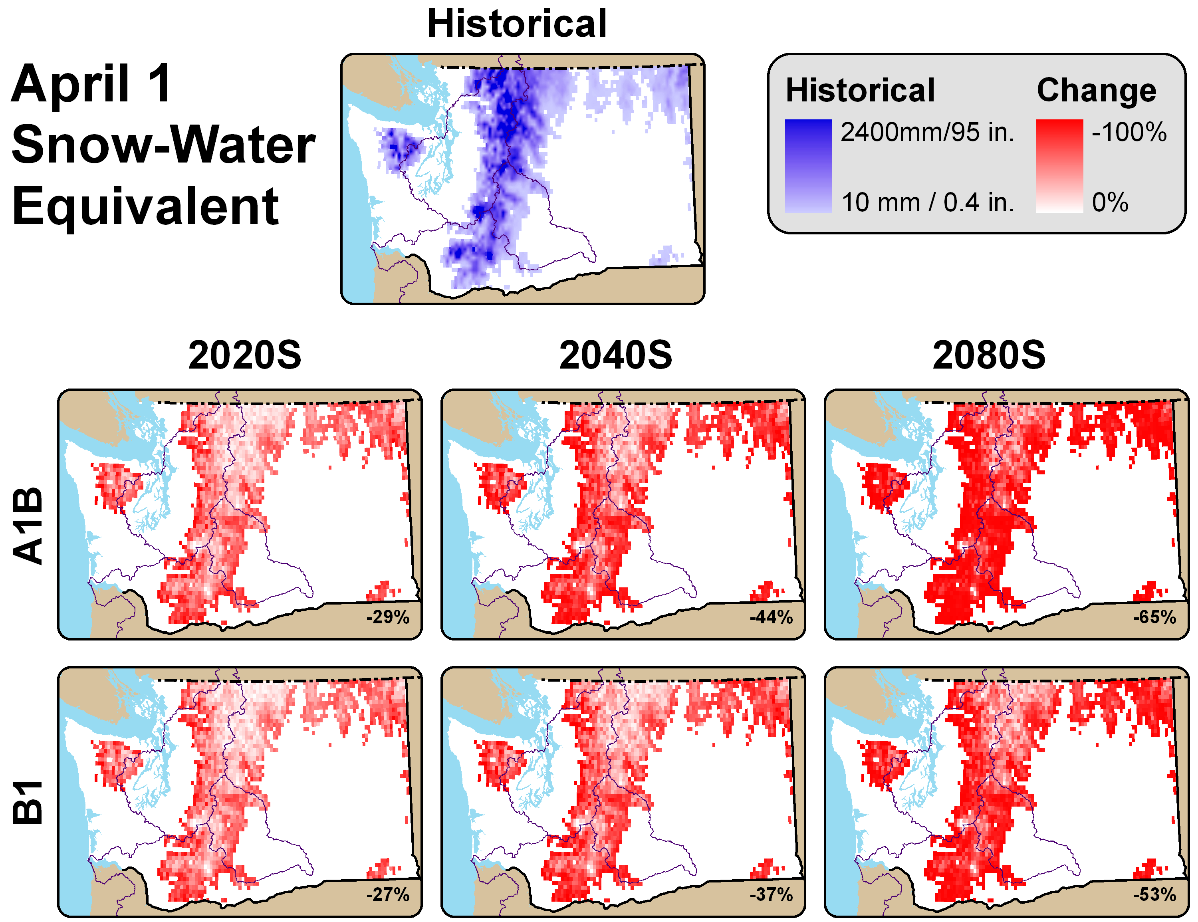
Primary Driver: Loss of Snow Cover
Snow Water Equivalent responses in the Yakima Basin?
-29%
-44%
-65%
As temperatures warm, more winter precipitation projected
to fall as rain rather than stored as snow.
Spring snowpack is projected to decline, especially in warmer mid-elevation basins.
Snowpack projected to melt earlier with warmer spring temperatures.
Notes:
Elsner, M.M. et al. 2009: Implications of 21st Century climate change for the hydrology of Washington State (in review)
These maps show the future projections for April 1st snowpack for the two scenarios as a percent change from the historical conditions (1970-1999).
Snow-dominant basins are sensitive, especially near the present-day snowline as the snowline moves up in elevation
Rain-dominant basis (i.e., warmer, lower elevation basins where the dominant form of winter precipitation is rain) are least sensitive to snowpack losses since there is little to no snow accumulation in these basins. Spring snowpack also declines because of warmer spring temperatures, which cause earlier snow melt.
The implications are greatest for watershed basins fed by a mix of rain and snowmelt because these basins are found at mid-elevation where are few degrees of warming pushes average winter temperatures above freezing for longer periods of the winter season. This will result in more winter precipitation falling as rain, rather than snow.
We can see in the next slide how this might affect streamflow in a mixed-runoff basin -->
21

Slide 22
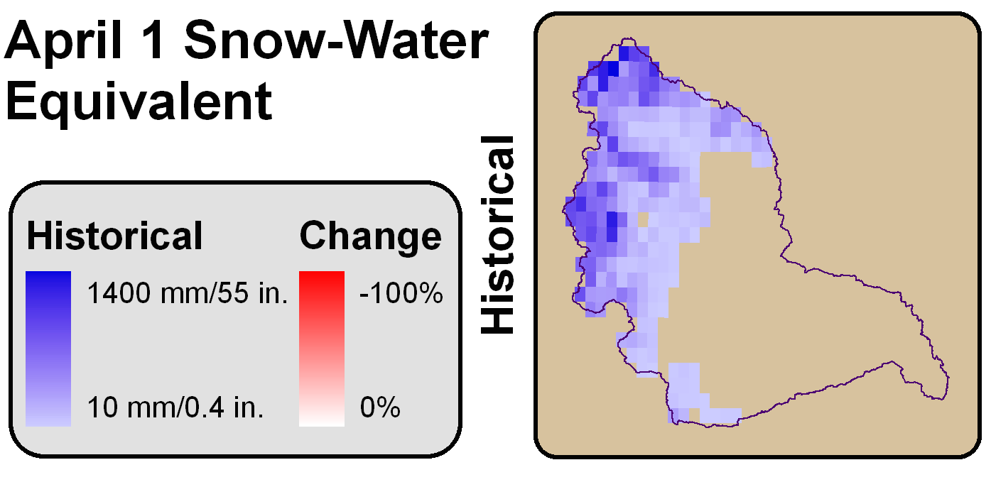
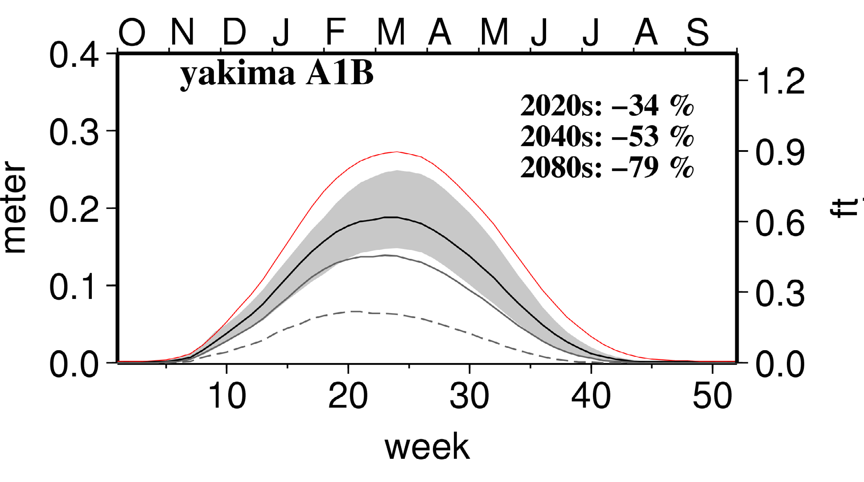
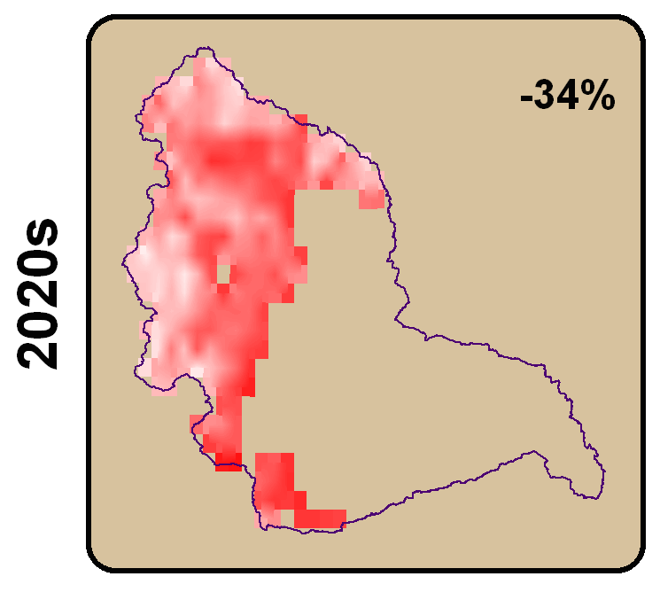
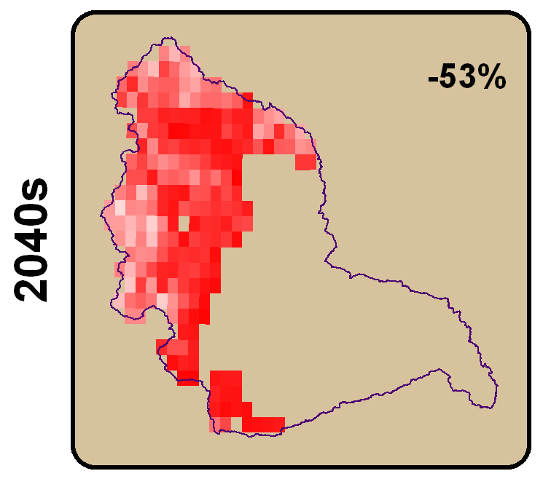
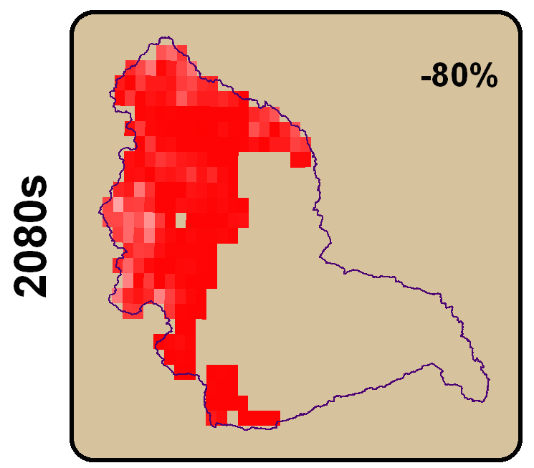
Snowpack considered the Yakima’s 6th reservoir
Other 5 man-made structures can store ~30% of annual runoff (peak storage in June)

Slide 23
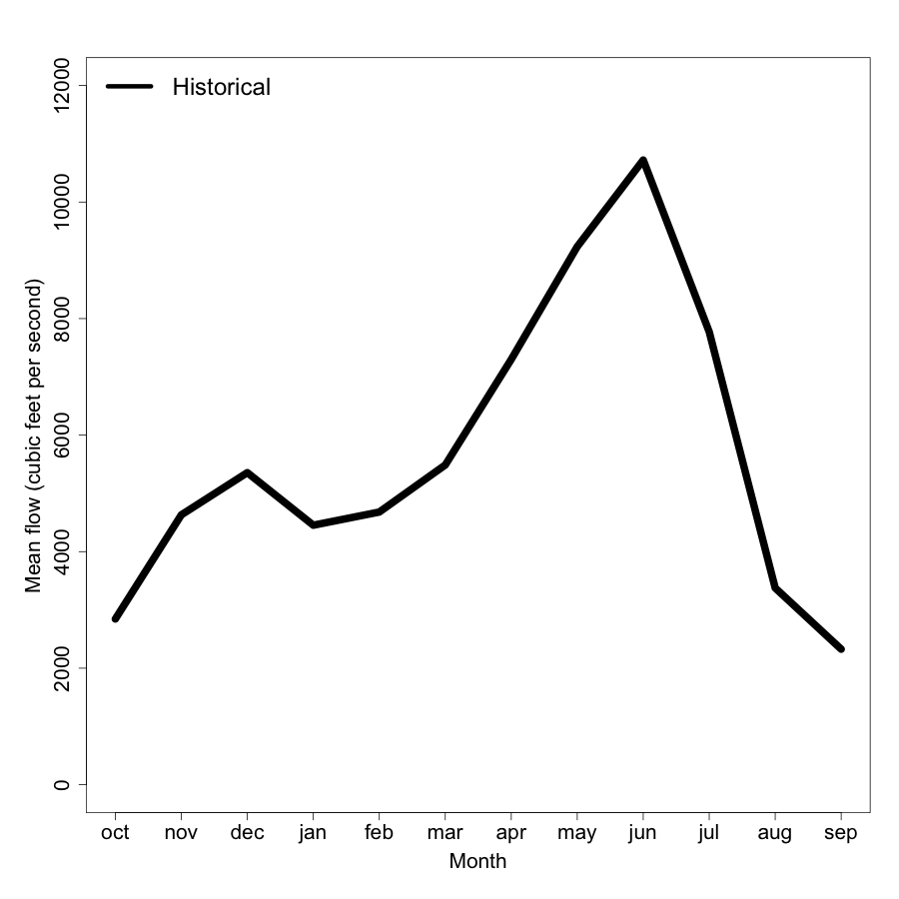
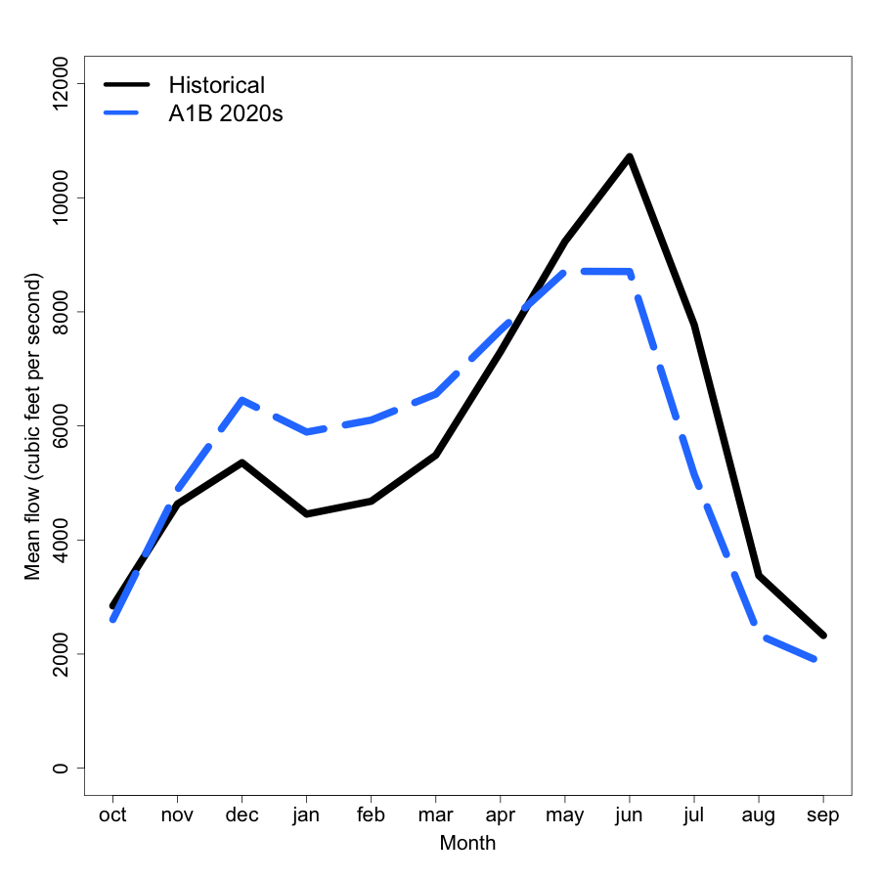
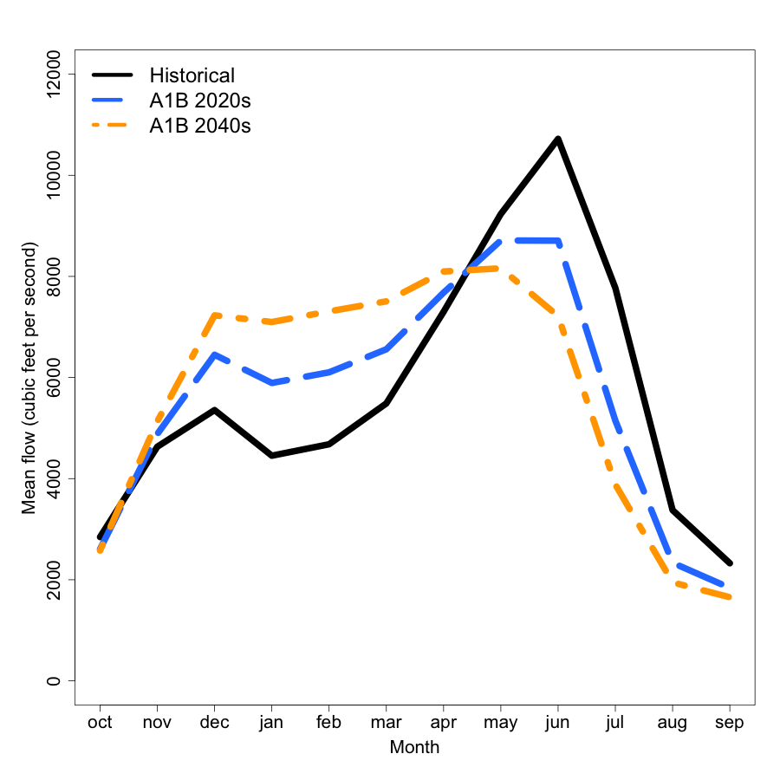
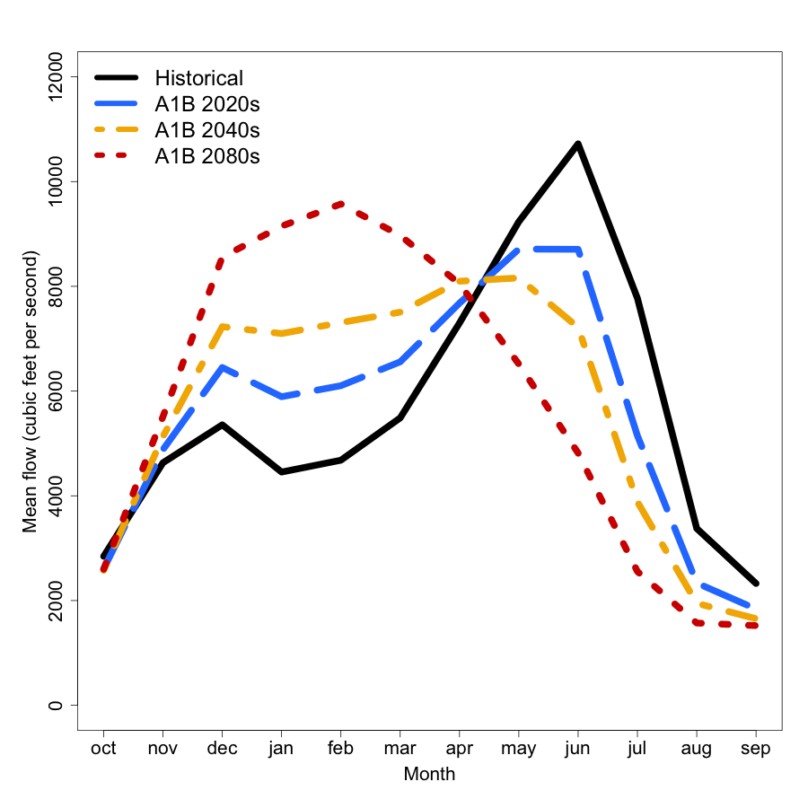

Slide 24
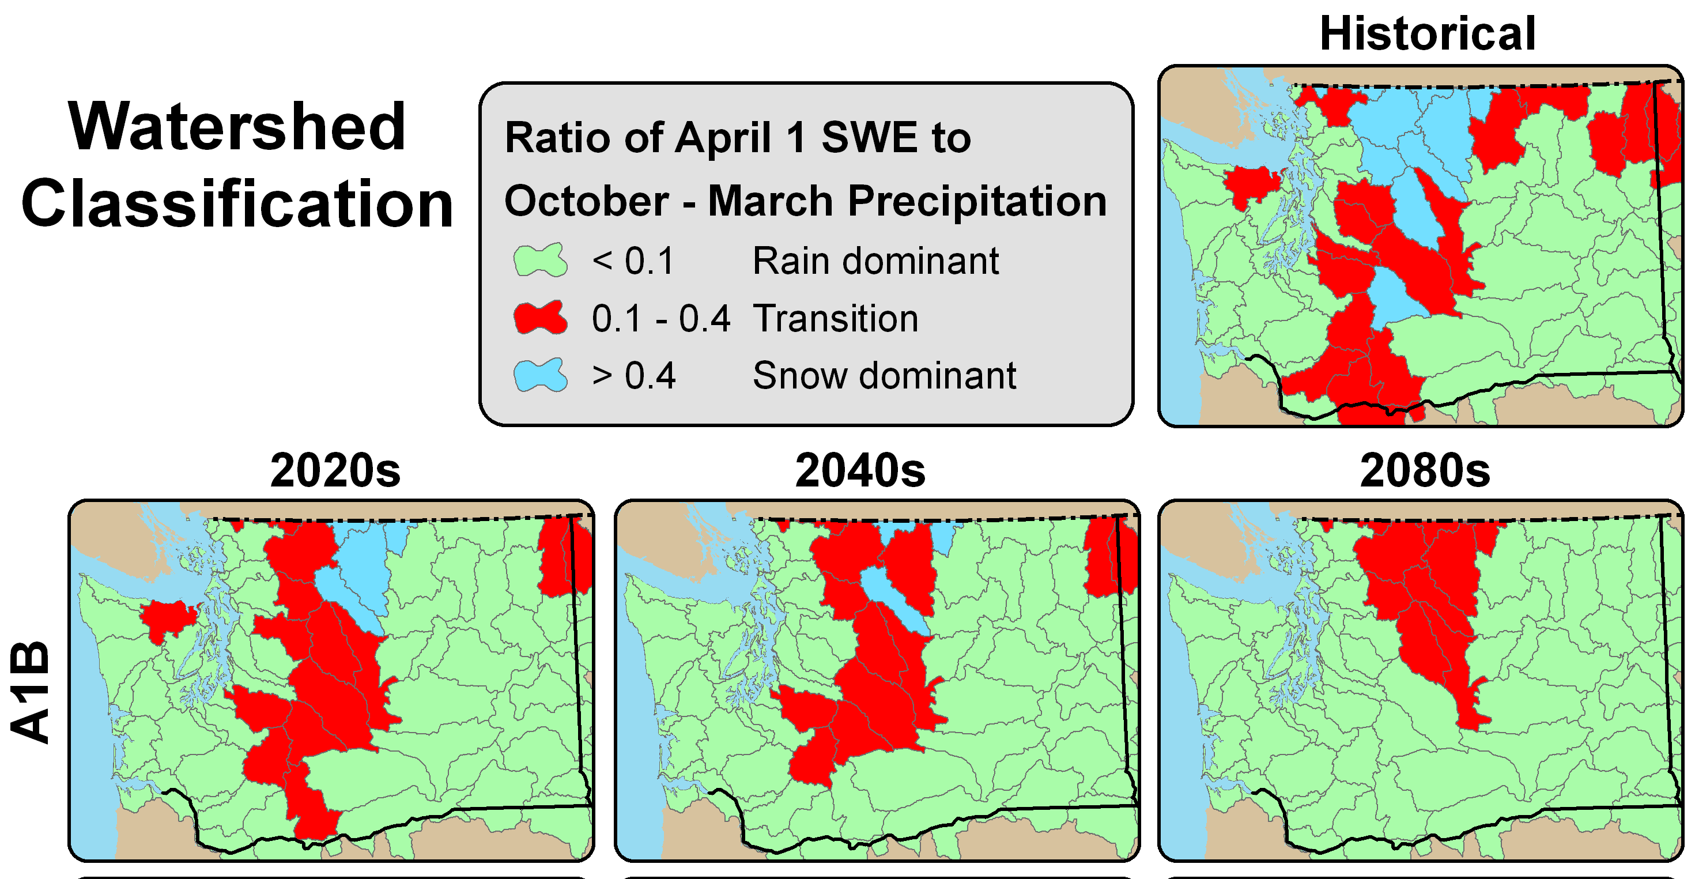
An overall transition from snow-dominant → mixed run-off → rain dominant basins as more precipitation falls as rain

Slide 25
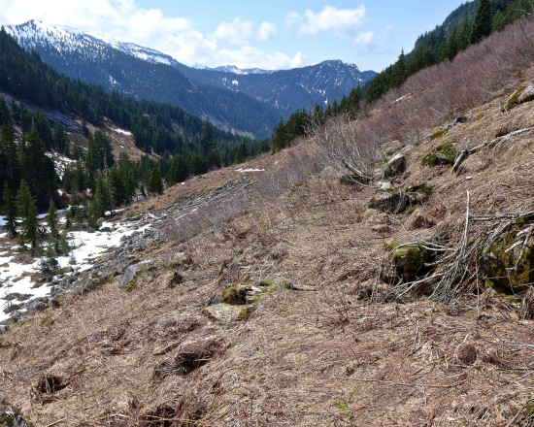
What to expect for water resources in the Yakima Basin
Canoe Peak. Credit: Monty Vanderbilt , March 2015
Notes:
Photo from http://crosscut.com/2015/03/problem-low-snowpack-not-water/

Slide 26
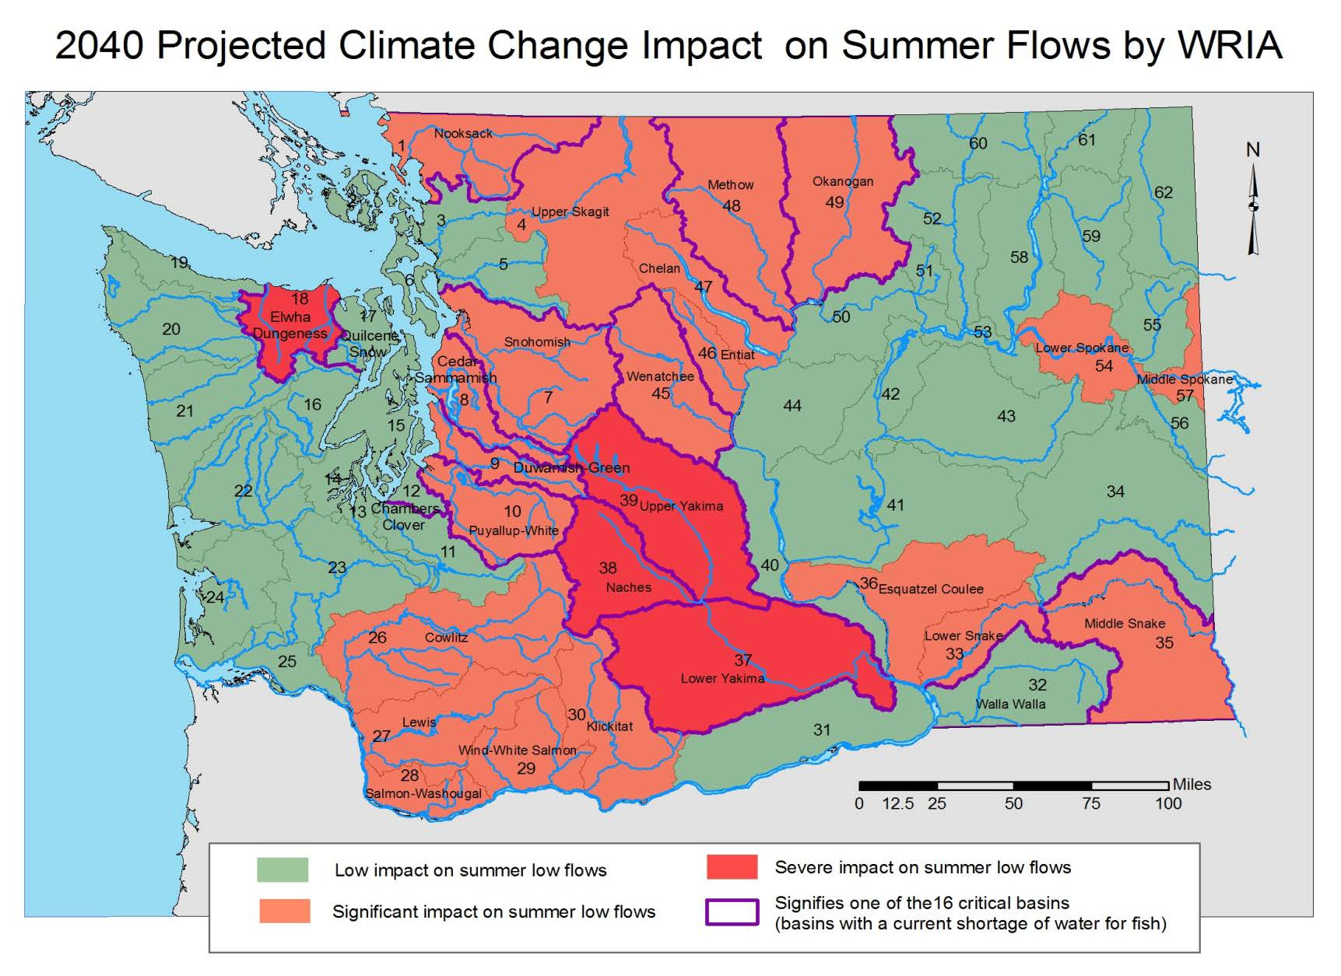
Source: Yakima Basin Integrated Water Resource Management Plan

Slide 27

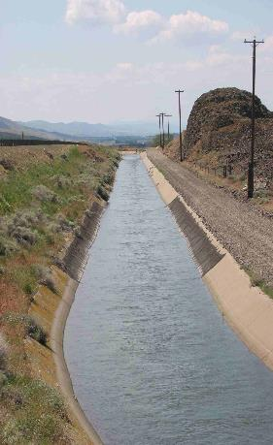
Increased Competition for Summer Water Supplies: Irrigation
Projected change in water shortage* (% of years) in the Yakima Basin for a moderate greenhouse gas scenario (A1B):
Historically (1979-1999): 14%
Projected (2020s): 32%
Projected (2040s): 36%
Projected (2080s): 77%
*Based on water prorating for junior water users
(< 75% of current operations)
(Vano et al. 2010)
Notes:
Water shortage determined by junior water rights holders undergo substantial prorating of deliveries (reductions.
Yield declines for apples and cherries estimated: 20 – 25% (2020s), 40 – 50% (2080s) for junior water holders

Slide 28
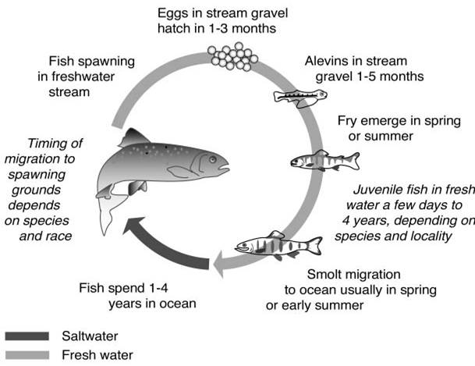
Increased Stress for Salmon
Floods
Early peak flows
Warm, low
streamflow
??
Notes:
Thermal barriers to migration for salmon: 70-72°F (21-22°C)
The key for understanding climate change impacts on salmon comes with understanding the cumulative impacts of all the factors that influence salmon during their life cycle. Climate change (global warming) can be considered as being a part of habitat change and habitat degradation, but the ultimate impacts of climate change on NW salmon cannot be assessed in isolation from the impacts of other factors influencing habitat, or harvest and hatchery practices. This framework also suggests that at least some of the negative impacts of climate change on salmon can be mitigated by alleviating existing negative impacts on salmon that come with other aspects of habitat, hatchery and harvest practices.
Floods: higher winter streamflow can lead to more streambed scouring events
Early peak spring floods: could lead to a disconnect between when estuary-bound migrating juveniles need the increased streamflow and when the water is there to carry the juveniles out (the water may come too early)
Warm, low summer streamflows: Warm, summer streamflows can cause stress or create thermal barriers to salmon living in summer streams or migrating in summer back to their spawning grounds. Thermal stress typically begins when average air temperature exceeds 68F; thermal barriers exist when average air temperature exceeds the 70-72F range.
Questions about the ocean: We do not know how climate change will alter coastal ocean conditions and, in turn, affect salmon.

Slide 29
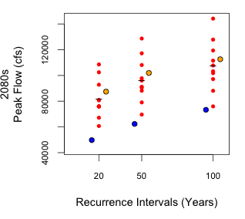
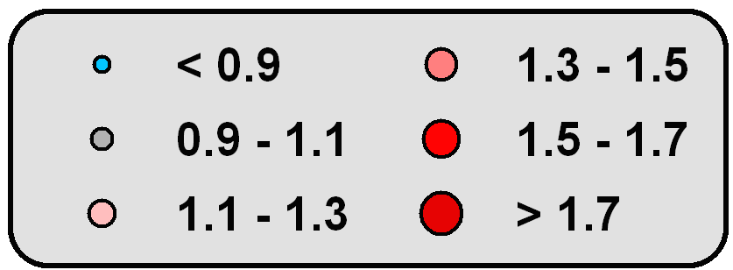
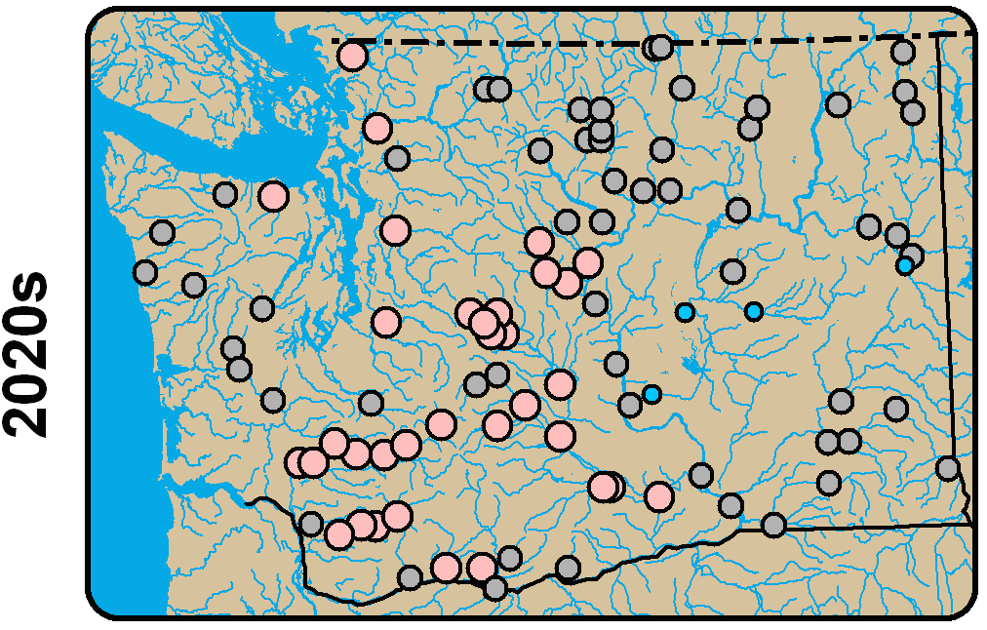
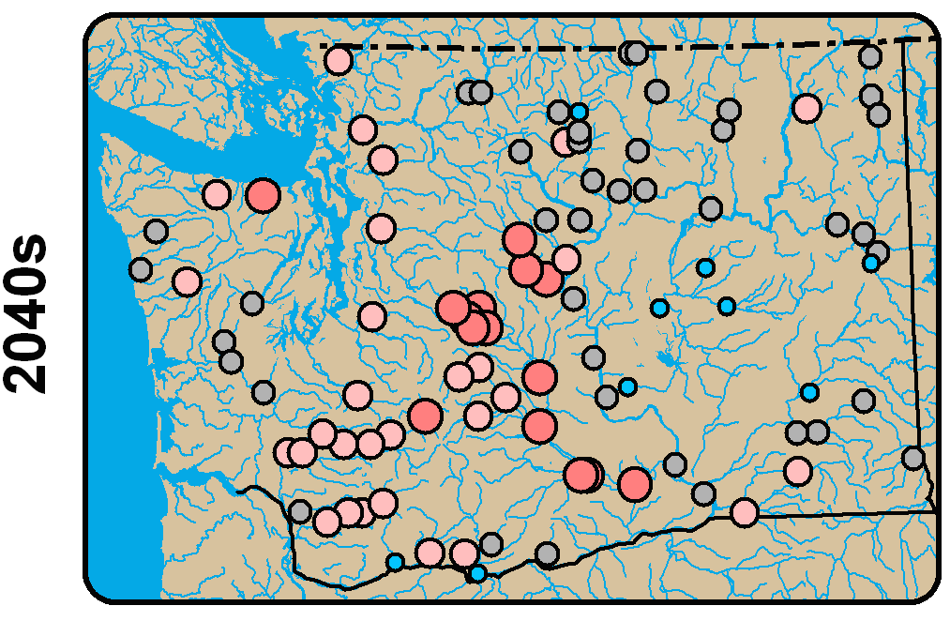
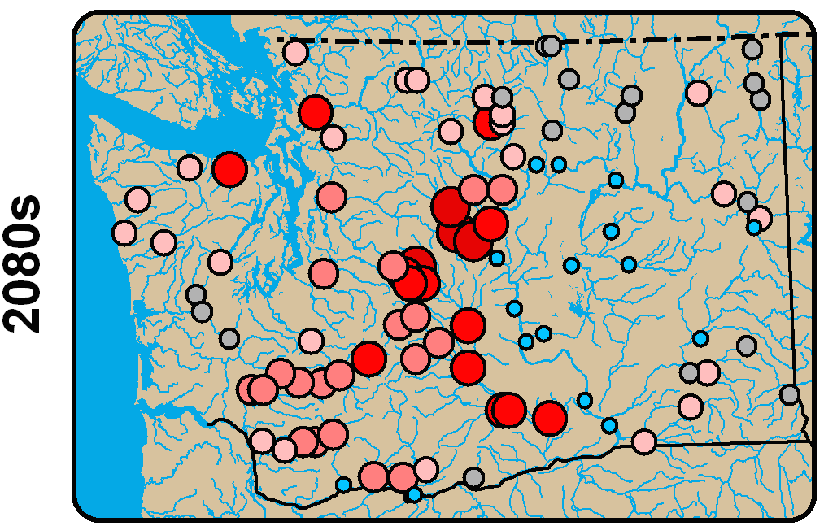
Increased Floods in Sensitive Basins
Yakima River at Parker
Ratio of the 20-year flood magnitude for a moderate scenario
(Future / Historical)
2020s
2040s
2080s
Yakima 20-year flood magnitudes range +20% to +120% for the 2080s
Mantua et al. 2010, Tohver et al. 2014

Slide 30
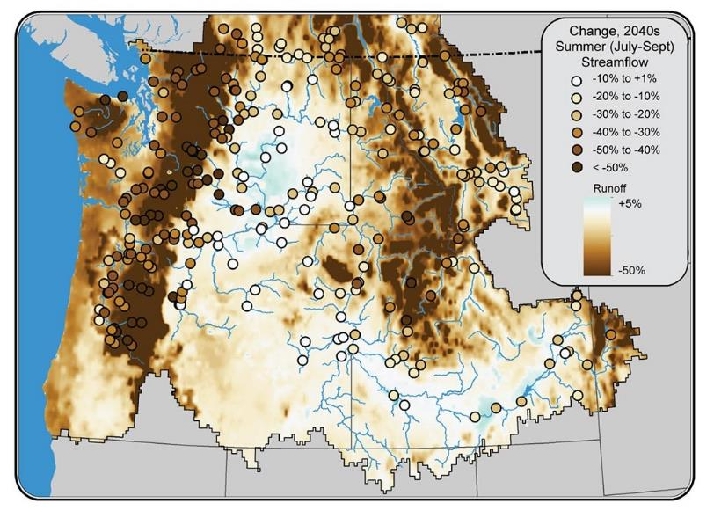

Reduced Summer Streamflows
Watersheds with significant groundwater contributions to summer streamflow may be less responsive to climate change than indicated here. Figure source: National Climate Assessment Figure 21.2b.
Notes:
Figure caption from National Climate Assessment:
Natural surface water availability during the already dry late summer period is projected to decrease across most of the Northwest. The map shows projected changes in local runoff (shading) and streamflow (colored circles) for the 2040s (compared to the period 1915 to 2006) under the same A1B scenario.² Streamflow reductions such as these would stress freshwater fish species (for instance, endangered salmon and bull trout) and necessitate increasing tradeoffs among conflicting uses of summer water. Watersheds with significant groundwater contributions to summer streamflow may be less responsive to climate change than indicated here.³

Slide 31
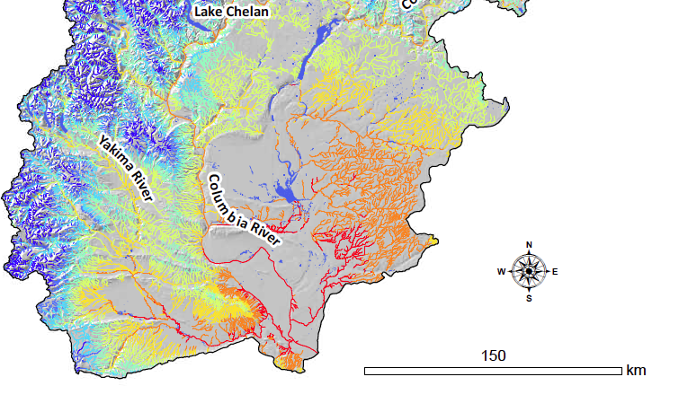
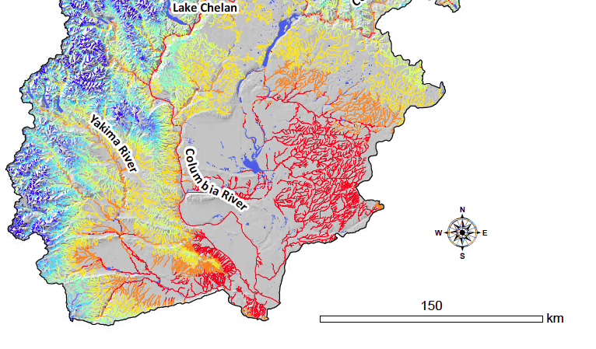
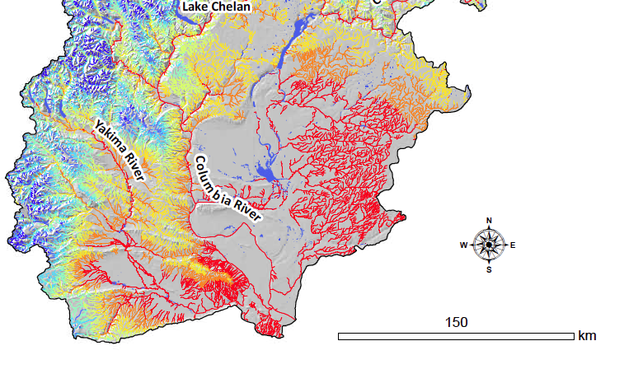


Summertime Stream Temperature
Thresholds for Fish
Historical (1993 – 2011)
2040s
2080s
http://www.fs.fed.us/rm/boise/AWAE/projects/NorWeST.html

Slide 32

Increasing Summer Soil Moisture Deficit
450 mm = ~17 inches
25 mm = ~1 inch
Littell et al 2011; data source: http://cses.washington.edu/cig/data/wus.shtml
Notes:
Littell, J.S., M.M. Elsner, G. Mauger, E. Lutz, A.F. Hamlet,, and E. Salathé. 2011. Regional Climate and Hydrologic Change in the Northern US Rockies and Pacific Northwest: Internally Consistent Projections of Future Climate for Resource Management. Report available online here.
The deficit season occurs when occurs when potential evapotranspiration exceeds precipitation and soil storage has reached 0. This is a time when there is essentially no water for plants. (PET > AET)

Slide 33


Increased wildfire risk
Area burned by fire in the Columbia River Basin is projected to double by 2020s, triple by 2040s, x5 by 2080s (relative to median for 1916-2006). (Littell et al. 2010, 2012)
Discovery Fire burns near volatile stands of
insect-damaged trees, 2009, DNR
Notes:
Wildfire suppression costs have increased as fire seasons have grown longer and the frequency, size, and severity of wildfires has increased due to changing climatic conditions, drought, hazardous fuel buildups, insect and disease infestations, nonnative invasive species, and other factors. Funding has not kept pace with the cost of fighting fire. Over the last 10 years, adjusting for inflation, the Forest Service has spent an average of almost $1.13 billion on suppression operations annually.
http://content.govdelivery.com/accounts/USDAOC/bulletins/102c14b
2009 Discovery Fire burns near volatile stands of insect-damaged trees, DNR
Https://www.flickr.com/photos/wastatednr/3773164066/in/set-72157621770445607
The area burned by fire regionally (in the U.S. Columbia Basin) is projected to double or triple (medium scenario, (A1B)), from about 425,000 acres annually (1916-2006) to 0.8 million acres in the 2020s, 1.1 million acres in the 2040s, and 2.0 million acres in the 2080s.
Median regional (WA, OR, ID, w. MT) area burned is projected to increase from about 0.2 million ha (0.5 M ac, 1980-2006) to 0.3 million hectares (0.8 M ac) in the 2020s, 0.5 million ha (1.1 M ac) in the 2040s, and 0.8 million ha (2.0 M ac) in the 2080s (average of CGCM3 and ECHAM5 GCM simulations under the SRES-A1B emissions scenario, Littell et al. 2010). The probability of exceeding the 95th percentile area burned for the period 1916–2006 increases from 0.05 to 0.48 by the 2080s (Littell et al. 2010). The probability of exceeding the late 20th century historical (1980-2006) 95th percentile under expected future hydroclimate (Elsner et al. 2010; Mote and Salathé, 2010, for SRES-A1B and SRES-B1 ensemble averages of 20 and 19 GCM realizations for the 2020s, 2040s, and 2080s) is a range of 0 to 30% for non-forested systems, 1 to 19% for the western Cascade Range, and 0 to 76% for the eastern Cascade Range, Blue Mountains, and Okanogan Highlands (after Littell et al. 2010). No statistical relationships could be constructed for the Oregon Coast Range and Olympic Mountains, though climate effects on fire in those ecosystems are evident in the recent paleoecological record (Henderson et al. 1989) and the consequences of rare events are extreme (>0.5 million ha burned in single events).
There is greater uncertainty about impacts to western WA/OR forests than interior PNW forests.
Changes in forest fire risk: Higher fire frequency and higher fire intensity expected, especially in drier interior PNW where fuel hazard is high. Increases in area burned projected. Increased potential for regional/landscape scale fires (regional synchronization of fuel availability)
As temperature increases, the atmosphere evaporates more water from the landscape, plant tissues, and fine fuels
This produces larger than normal, and more connected areas of depleted fuel moisture during the fire season
Regional synchronization of fuel availability occurs
Fire “blowups” are driven by extreme weather, but are contingent on climatically-driven fuel moisture.

Slide 34


Increased wildfire risk: +2.2 F
National Resource Council 2011
Notes:
Map indicates the increases in area burned that would result from the regional temperature and precipitation changes associated with a 2.2°F global warming100 across areas that share broad climatic and vegetation characteristics.101 Local impacts will vary greatly within these broad areas with sensitivity of fuels to climate.14

Slide 35
Examples of Potentially Affected Decisions: Impacts on Water Management and Salmon
Yakima River Basin Integrated Water Resource Management Plan: Key Elements
Flow management (timing, volume)
Habitat restoration project planning, implementation
Culvert sizing, construction
Hatchery management
Invasive species management
Harvest rates/limits
Flood management
Fish Passage
Fish Habitat Enhancement
Modifying Existing Structures and Operations
Surface Storage
Market-based Reallocation
Groundwater Storage
Enhanced Water Conservation
Notes:
Not meant to be an inclusive list

Slide 36



The Climate Impacts Group
www.cig.uw.edu
cig@uw.edu
Ingrid M Tohver
itohver@uw.edu
Notes:
Photo - Yakima River Canyon: https://www.flickr.com/photos/hershman/6098432509/

