Slide 1

Trends in Demographic and Phenotypic
Traits of Hatchery- and Natural-Origin
Upper Yakima River Spring Chinook Salmon
C. M. Knudsen¹, W. J. Bosch^{2,}
Fritts³, M. V. Johnston², C. Stockton³,
and D. E. Fast²
¹ Oncorh Consulting
² Yakama Nation
³ Washington Department of Fish and Wildlife

Slide 2
Objectives
Compare NO, SH and HC populations over brood years 2002 to 2010 for age 4’s.
  Compare differences in Length (POHP) and estimate trends over time.
HC vs SH Minijack rate comparisons.
  Trends over time.
  Revisit the Feed Ration Study (BY2002-2004)

Slide 3
Population Definitions
Natural Origin (NO) – progeny of naturally spawning parents. Parents could be natural or hatchery origin.
Hatchery Origin
  Standard Hatchery (SH) Origin – Parental broodstock of NO only, one generation of domestication. Used to supplement the naturally spawning population, an integrated hatchery program.
  Hatchery Control (HC) Origin – Parental broodstock of hatchery origin only. Multiple generations of domestication. Are not allowed to naturally spawn, a segregated hatchery line.

Slide 4
HC vs SH Comparisons
Both have parents artificially spawned, share hatchery rearing and post-release environments (fresh and saltwater)
SH returns have experienced a single generation of hatchery influence (NO parents)
HC returns have experienced multiple generations of hatchery influence (HC parents)
Differences in their phenotypic traits should be expressions of genetic differences due to the additional generations of hatchery influence experienced by the HC line
Notes:
Gets us out of the problem of having genetic and environmental effects mixed up and unable to tease them apart. Charlie Waters will be speaking later about these types of comparisons using genomic data

Slide 6
Objective 1
  Compare differences in Length (POHP) and trends over time.

Slide 7
Age 4 POHP Length
1 Generation Difference
2 Generations Difference
3rd Gen
63
61
POHP length (cm)
59
HC
SH
NO
57
2006
2007
2008
2009
2010
2011
2012
2013
2014
Return year

Slide 8
Pairwise Regressions of POHP
SH vs NO
Adj R² = 0.879, df = 9
p < 0.001
HC vs NO
Adj R² = 0.746 df = 9
p = 0.002
HC vs SH
Adj R² = 0.852, df = 9
p < 0.001

Slide 9
Age 4 POHP Length
In 17 of 18 pairwise comparison NO age
4 fish are larger than either SH or HC fish.
63
NO
SH
HC
61
POHP length (cm)
59
57
2006
2007
2008
2009
2010
2011
2012
2013
2014
Return year

Slide 10
Age 4 POHP Length
63
NO
SH
HC
61
POHP length (cm)
59
57
2006
2007
2008
2009
2010
2011
2012
2013
2014
Return year

Slide 11
2
SH and HC lines are
Diverging by 0.11 cm/year
1
(SH-HC) POHP (cm)
0
Adj R² = 0.463
df = 7, p-value = 0.03
-1
2002
2004
2006
2008
2010
Brood Year

Slide 12
Differences From NO Population
Mean NO-HC difference = 1.2 cm
Mean NO-SH difference = 0.8 cm
Equal means p-value = 0.09
Both slopes not significantly different from 0
3
2
(NO-Population) POHP (cm)
1
0
Difference
NO-HC
NO-SH
-1
2002
2004
2006
2008
2010
Brood Year

Slide 13
Objective 2:
HC vs SH Minijack rates
Trends over BY2002 to BY2010
Revisit the Feed Ration Study (BY2002-2004)

Slide 14
Slopes and means not sign. different
Adj. R² = 0.378, p = 0.002, slope = 3%/year
SH
HC

Slide 15
Paired Differences: SH and HC MiniJack Proportions
HC and SH are converging
Adj. R² = 0.398, df = 8, p = 0.041

Slide 16
HC vs SH Minijack rates
Revisit the Feed Ration Study (BY2002-2004)

Slide 17
Feed Ration Study Design
50% of hatchery production was reared on a High Ration diet and 50% on a Low Ration diet.
Replicated over 3 brood years (2002-2004).
There were two populations treated: HC and SH.
Genetic effects on Treatments were controlled.

Slide 18
Controlling for Genetic (Family) Effects
There are 9 pairs of raceways at CESRF: 8 SH pairs and 1 HC pair.
Each RW in a pair was randomly assigned a Treatment: High or Low Ration.
Eggs from approximately 24 females were divided in half and allocated to each raceway.
Treatments within pairs (High and Low Ration) were represented by the same families.
Differences in traits are strictly environmental, not genetic.

Slide 19
Body Size-Time Growth Trajectory With
Reaction Norms for Maturation
These fish mature
and leave the cohort
Year 2
Maturation
Will mature in
Year 3
Body size
Maturation Threshold
Year 1
Maturation
Maturation Threshold
Year 1
Year 2
Time

Slide 20
Body Wt Over Time Feed Study
NOAA Acclim.
Sampling
LO 02
20
HI 02
Maturation
Threshold Period
LO 03
High ration
HI 03
15
LO 04
HI 04
Low ration
Mean Body wt (g)
10
On avg. High
33% heavier
5
0
Apr
May
Jun
Jul
Aug
Sep
Oct
Nov
Dec
Jan
Feb
Mar

Slide 21
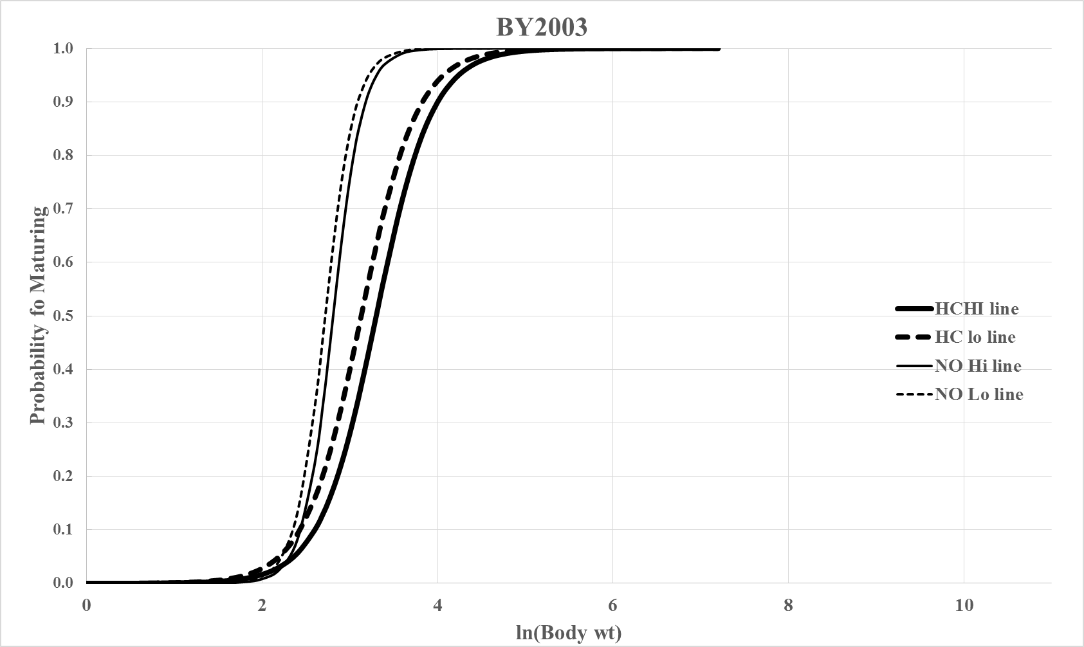
Logistic Regression: ln(Body wt) vs Prob. Maturation
HC High
HC Low
SH High
SH Low

Slide 22
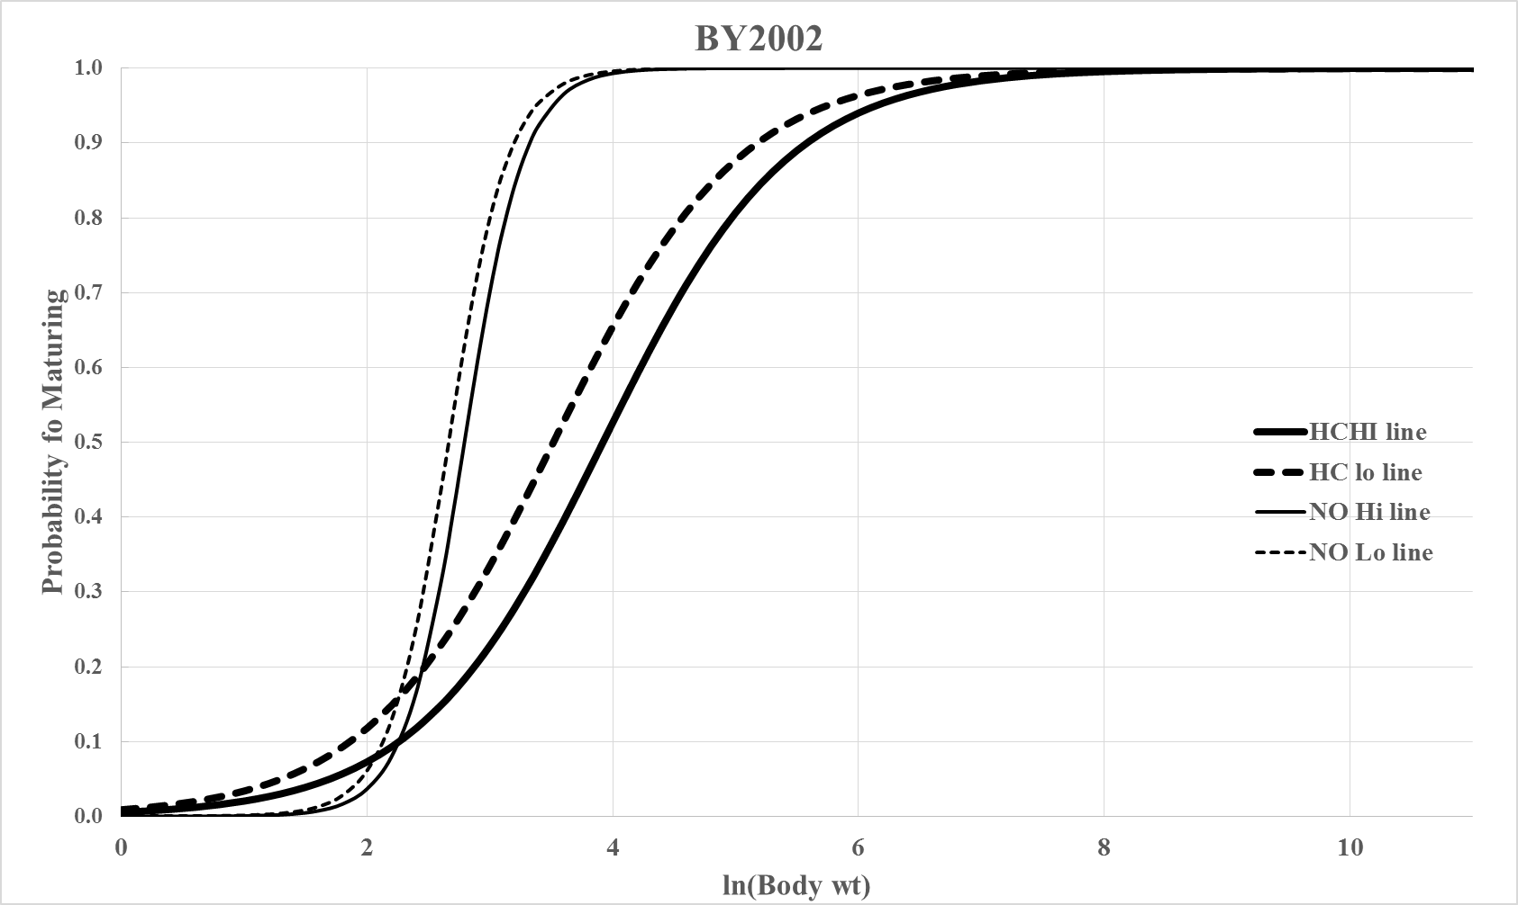

Parameter | Estimates | Z | p-value
Constant | 10,333.027 | 3.086 | 0.002
BY | -5.167 | -3.091 | 0.002
Treatment | -0.538 | -1.956 | 0.050
Origin | 6.313 | 2.344 | 0.019
ln(Body wt) | -3,626.768 | -2.910 | 0.004
BY * ln(Body wt) | 1.814 | 2.914 | 0.004
Origin * ln(Body wt) | -2.795 | -2.782 | 0.005
HC High
HC Low
SH High
SH Low
ln(Body wt)
ln(Body wt)
ln(Body wt)

Slide 23
Summary Objective 1
All 3 populations are highly correlated in size over time (R²>0.75, p<0.01), due to very similar freshwater and ocean rearing environments.
Age 4 NO fish are larger in 94% (17 of 18) of the pairwise comparisons.
SH fish are larger that HC (8 of 9 years).
SH and HC populations are diverging in length at the rate of 0.1 cm/year.

Slide 24
Summary Objective 2
Minijack temporal trends of SH and HC were equal (no significant difference in slopes or means).
Both SH and HC minijack rates were significantly increasing over time (3% per yr).
HC and SH minijack rates show are converging, becoming more similar.

Slide 25
Summary Objective 2 cont’d
The HC population’s norm of reaction for maturation from the logistic regression showed significant variation over the 3 years of the feed study
In comparison, the SH population was very stable.
More work needed here.

Slide 26
Acknowledgements
Charlie Strom, DJ Brownlee, Greg Strom, Simon Goudy,
and Quinn Jones (CESRF) helped process and sample fish.
Mark Johnston and his crew collected and sampled fish
at Roza.
WDFW personnel Jamie Schlump, Brian Johnson,
Danielle Rockey, Rebecca Powell, and Matt Sizer helped
sample during the spawning season.
BPA provided funding.

Slide 28
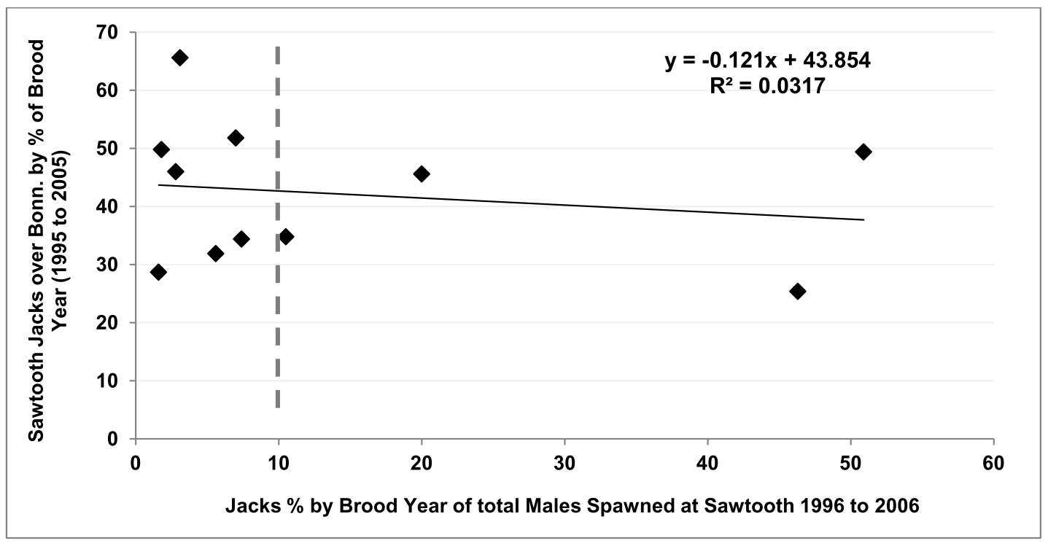
Does the proportion of jacks used as broodstock affect subsequent jack production?
Taken from: Cassinelli, et al. 2012. 2011 CALENDAR YEAR HATCHERY CHINOOK SALMON REPORT: IPC AND LSRCP MONITORING AND EVALUATION PROGRAMS IN THE STATE OF IDAHO. IDFG Report Number 12-02.

Slide 29
Return Years 2001 to 2012

Slide 30
2001 to 2014 Return Years

Slide 31
20
T-test Mean difference=0
Mean difference = 3.8 days
t = 3.47, df = 13,
p-value = 0.004
15
10
Temporal Trend Regression
Adj. R² = 0.050, p-value = 0.22
Difference (Hatch-NO) Passage Date Roza
5
0
-5
2000
2005
2010
2015
Return Year

Slide 32
Instantaneous Growth Rate (IGR)
HC
0.000
SH
NO
-0.001
-0.002
-0.003
Females
Males
Instan. Growth Rate
-0.004
-0.005
-0.006
-0.007
2008
2009
2010
2011
Return year
Notes:
Figure 8. Mean Instantaneous growth rate (+ 1 se) for HC (♦), SH (■), and NO (▲) age 4 fish from return years 2008, 2009, 2010 and 2011. Males are indicated by gray symbols and females by black symbols.

Slide 33
Age 4 Roza Body Mass
5.0
NO
SH
HC
4.5
Body weight (kg)
4.0
3.5
3.0
2006
2007
2008
2009
2010
2011
2012
2013
2014
Return year

