Slide 1
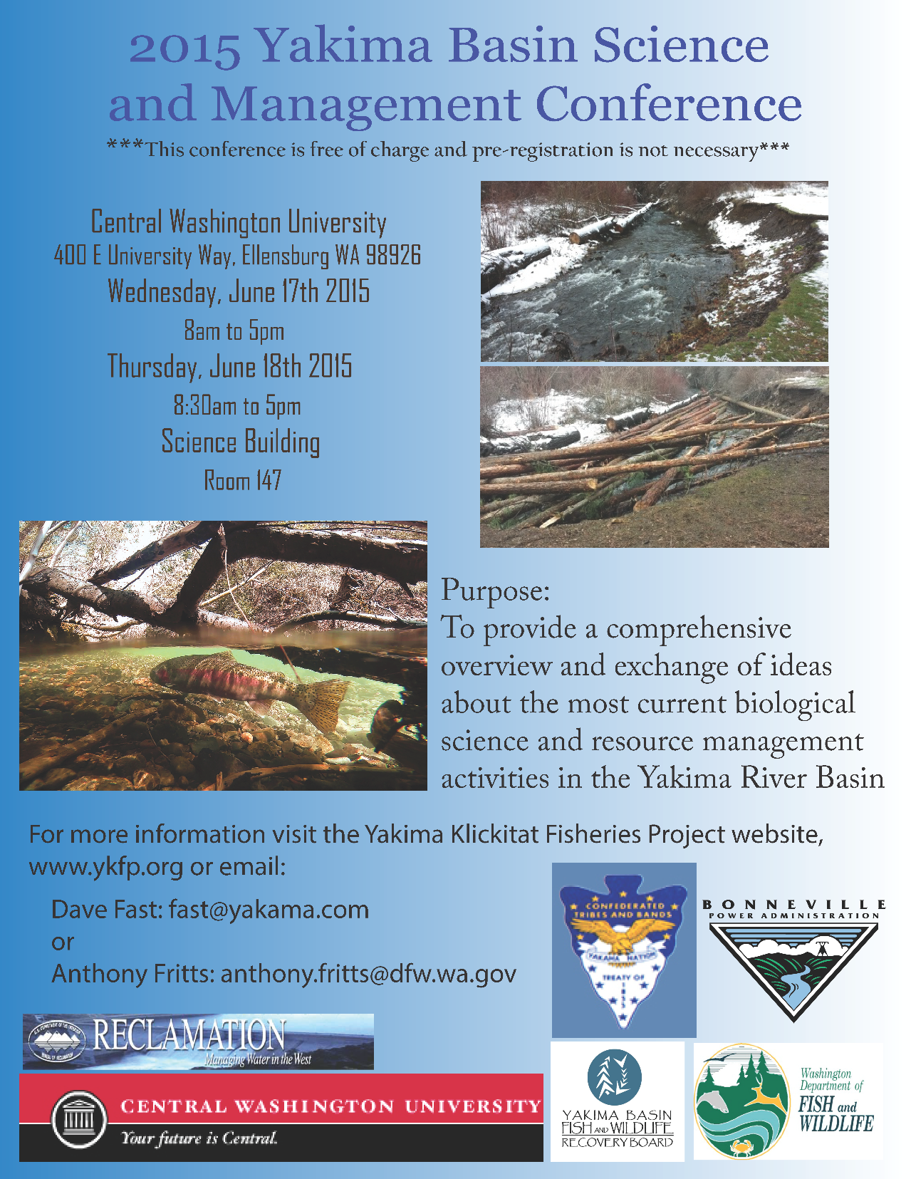

Slide 2
New Study In Yakima Basin
Paul Pickett from the Department of Ecology in Yakima is looking for some help. He is launching a study of the mainstem Yakima River, looking temperature, dissolved oxygen, and pH. The first phase of his study is to collect existing information on these parameters and the ecosystem functions that affect them. If you know of any data sets, modeling studies, or other information on temperature, DO, and pH in the mainstem Yakima River, please contact him here at the conference, or put your name on the sign-up sheet in the lobby, or grab a flyer from the reception table.

Slide 3
2015 Yakima Basin Science & Management Conference – Wednesday June 17 Dave Fast
Registration
Dave Fast – YN Fisheries | Introduction to Conference
Alex Conley – YBFWRB | Overview of Habitat Activities in the Yakima Basin
Brian Saluskin – YN | Cle Elum Sockeye Reintroduction/Passage
Andrew Matala - CRITFC | Genetic monitoring of sockeye salmon: evaluating relative productivity among two donor stocks
Break
Joel Hubble - BoR | Status of Juvenile Fish Passage Design for Cle Elum
Vince Bryan III - WHOOSH | WHOOSHH – Potential Adult Passage Design
Ian Courter - MHE | Assessment of Stream Flow Effects on Smolt Survival Below Roza Dam
Russell Perry – USGS | Assessment of Passage Route Effects on Smolt Survival at Roza and Prosser Dams
Walter Larrick – BOR | Yakima Basin Integrated Plan – Early Implementation
Salmon Lunch
Ingrid Tohver UW/CIG | Climate Change in the Yakima Basin: Implications for Aquatic Habitat and Water Management
Scott Nicolai - YN | Yakima River Edge Habitat project, update on Teanaway pilot restoration

Slide 4
FISHERIES OVERVIEW
Salmon Extinction in the Yakima Basin
    “Not an Option!” or
    “The Preferred Alternative?”

Slide 5
THE SALMONID EXTINCTIONS:
SOCKEYE – THE FIRST TO GO. EARLY 1900’S
SUMMER CHINOOK – 1970’S
COHO – 1980’S
THE THREATENED ONES
STEELHEAD
BULL TROUT
THE OTHERS:
LAMPREY (FUNCTIONALLY EXTINCT)

Slide 6
Historic Salmon Runs Modified from Alex Conley
Species/Run | Estimates | Current Status | Low | Year | 2014
Spring Chinook | 200,000- 500,000 | Supplemented Population | 666 | 1995 | 10,205
Fall Chinook | 38,000- 100,000 | Supplemented Population | 523 | 1988 | 7,792
Summer Chinook | ?? | Extirpated 1970’S Began Reintroduction 2008 | - | till 12 | 1,513
Coho | 40,000 150,000 | Extirpated 1980’S Reintroduced 1997 | - | till 93 | 24,420
Sockeye | 100,000 200,000 | Extirpated Early 1900’s Reintroduction 2009 | - | Till 2009 | 2,676
Steelhead | 30,000 100,000 | Wild Population (ESA) Kelt Reconditioning | 505 | 1996 | 4,141
Total | 408,000- 1,050,000 |  |  |  | 50,747
Bull Trout | ?? | Wild Population (ESA) |  |  | 2500 to 3000 adults
Lamprey | ?? | Wild Population |  |  | 0 to 87 adults

Slide 7
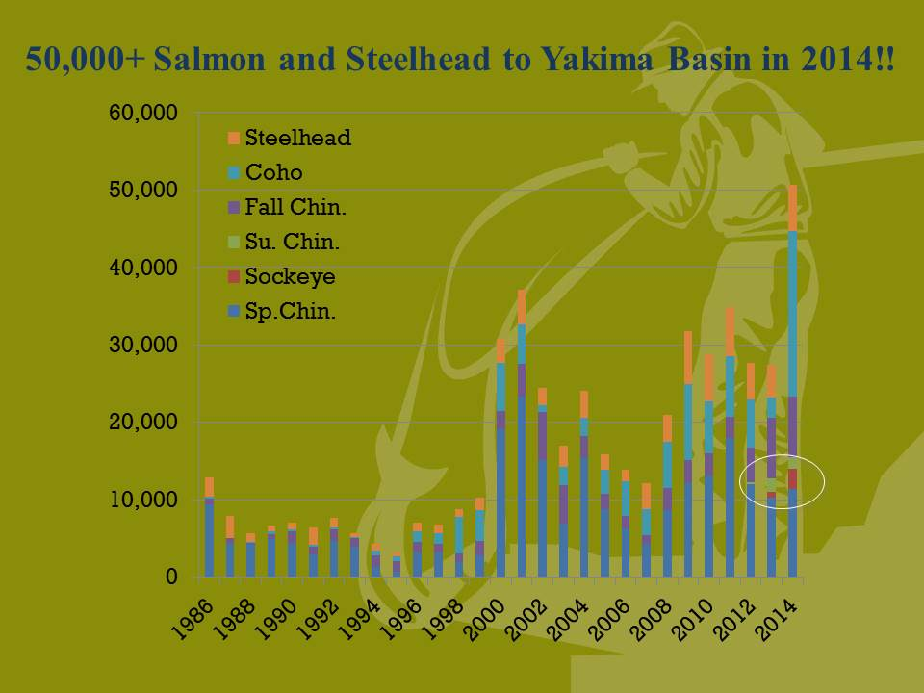

Slide 8
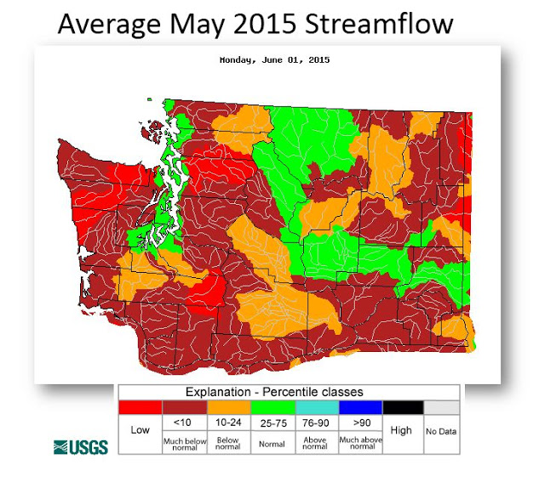

Slide 9


