Slide 1
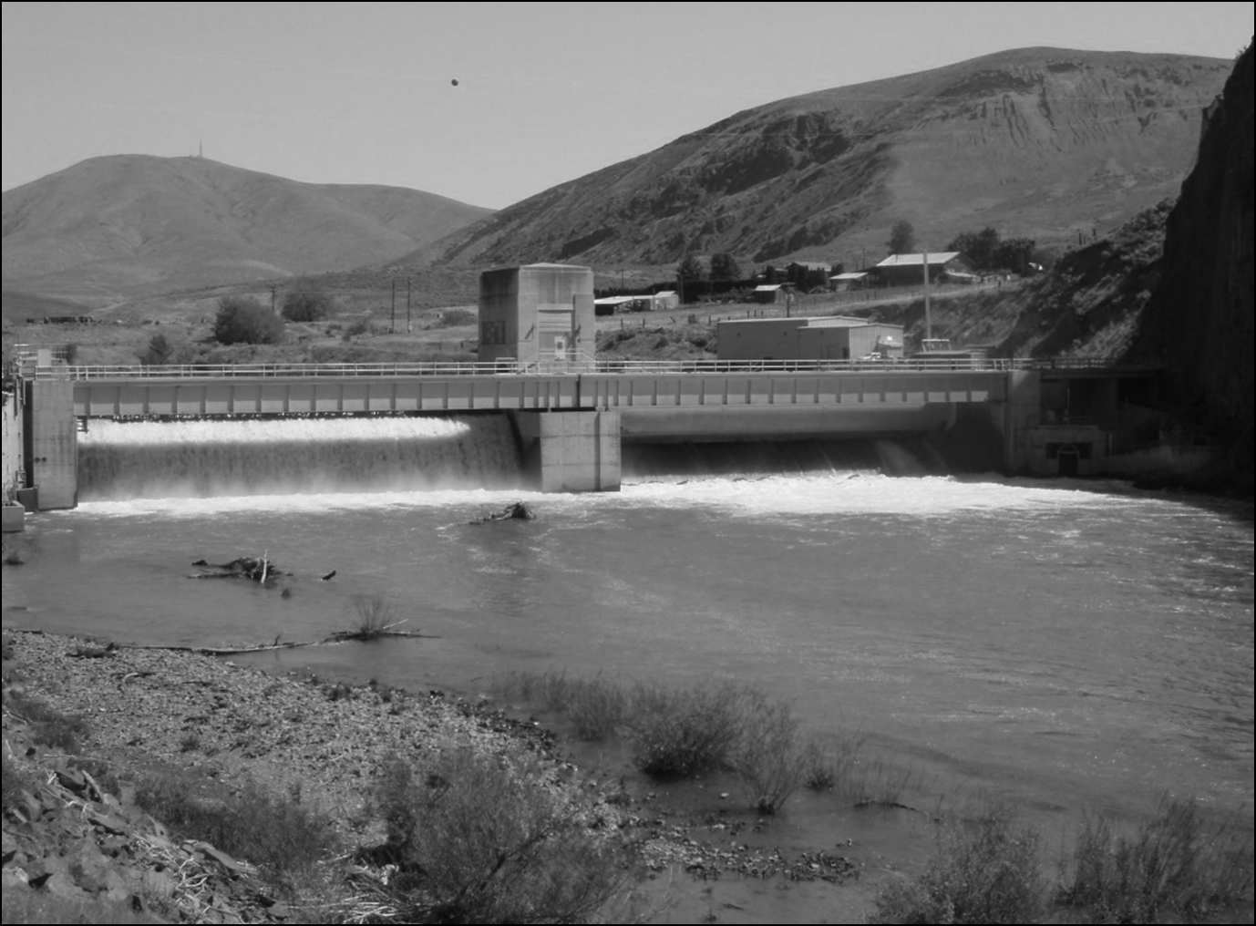


Survival and Passage of Juvenile Chinook Salmon Smolts
at Roza Dam
Russell Perry
Toby Kock
Ian Courter
Tommy Garrison
Yakima Science Conference
17 June 2015
U.S. Department of the Interior
U.S. Geological Survey

Slide 2

Quantifying Mortality due to
Dam Passage
Tailrace
Survival
probability
Effect of
dam passage
Dam
Roza Reach discharge (cfs)
1

Slide 3
Overview
Focus on passage routes at Roza Dam
  Bypass
  East Gate
  West Gate
Route-specific survival
  Does effect of discharge differ among routes?
  Is survival lower for some routes?
Effect of dam operations on passage
  Proportion of fish using each route
Effect of passage on total survival
2

Slide 4
Passage routes at Roza Dam
3

Slide 5
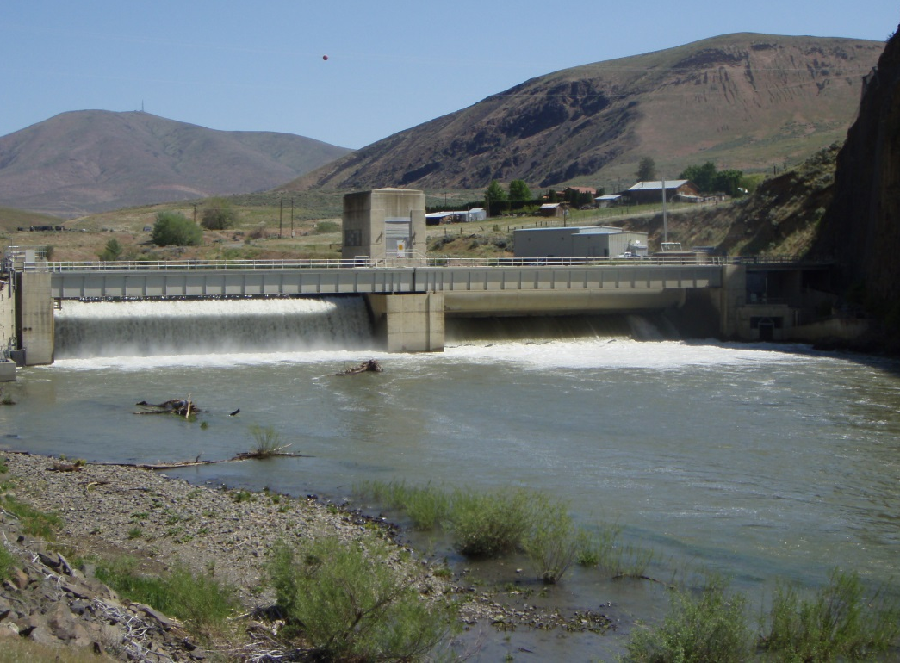
East Gate and West Gate
High Flow
West Gate
East Gate
4

Slide 6
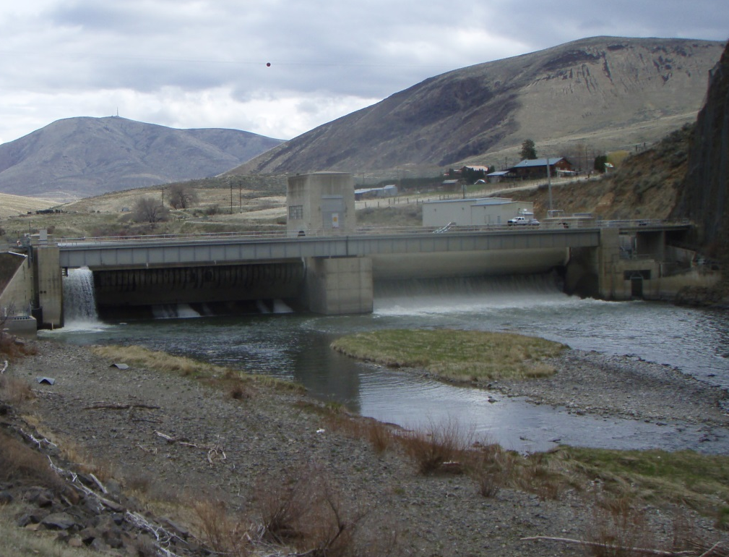
East Gate and West Gate
Low Flow
West Gate
East Gate
4

Slide 7
Route-Specific Survival Methods
2013 & 2014 data only
CJS survival model
  - Only fish detected within passage routes
Sample sizes
  - West Gate = 338
  - East Gate = 198
  - Bypass = 124
5

Slide 8
Model Selection
Individual covariates
  Passage route
  Roza Reach discharge on day of passage
Alternative models
  Passage route only
  Discharge only
  Route * Discharge
Used AICc model selection criterion
6

Slide 9
Model Selection Results
Model | Number of parameters | AICc | ΔAICc
Route * Discharge | 22 | 1411.5 | 0
Passage route | 19 | 1421.7 | 10.3
Discharge | 18 | 1423.8 | 12.3
About AICc:
  - Lower is better fitting model
  - ΔAICc > ~2-4 indicates support for lowest AICc model
7

Slide 10
East and West Gate Survival
West Gate
East Gate
Survival
probability
Roza Reach discharge (cfs)
8

Slide 11
Bypass Survival
Survival
probability
Roza Reach discharge (cfs)
9

Slide 12
All Passage Routes
West Gate
East Gate
Survival
probability
Bypass
Roza Reach discharge (cfs)
10

Slide 13
Passage Analysis Methods
Multinomial Regression
  Analogous to logistic regression
  3 events instead of 2
Probability of passing through each route
  Bypass, East Gate
  Baseline category = West Gate
Individual covariates based on day of passage
  Bypass + Canal discharge
  West Gate discharge
  East Gate discharge
  Day of year
Selected among alternative models
  Show only best fit model
11

Slide 14
Variables in Best-Fit Model
Bypass passage probability
Bypass discharge (+)
East Gate discharge (-)
East Gate passage probability
East Gate discharge (+)
West Gate discharge (-)
East x West (-)
Day of year (+)
12

Slide 15
Effect of Bypass + Canal Discharge
Bypass
East Gate
West Gate
Passage
probability
Bypass + canal discharge (cfs)
13

Slide 16
Effect of East and West Gate Discharge
East Gate
West Gate
Passage
probability
East Gate discharge (cfs)
West Gate discharge (cfs)
14

Slide 17
Combining Passage and Survival
Models to Predict Daily Dam Survival
Roza
Reach
discharge
(cfs)
Spring of 2013
West Gate
Survival
probability
Bypass
East Gate
Total survival for all routes
15

Slide 18
Conclusions
Flow effects differed among routes
  Low flow = low survival for all routes
  High flow increased East and West, but not bypass
Dam operations affect passage
  Route discharge increases passage for that route
  and decreases passage through other routes
Passage affects total survival
  Shifts fish among high- and low-survival routes
Models provide a useful management tool
  Simulate effects of dam operations on passage and survival
16

Slide 19
Acknowledgements
Funding provided by:
U.S. Bureau of Reclamation
Yakima Basin Joint Board
U.S. Bureau of Reclamation
Joel Hubble
Quentin Kreuter
Jeff Sullivan
Ron Moores
Chris Lynch
Jason Hennessey
Systems Operations Advisory Committee
David Child, JB
John Easterbrooks, WDFW
Mark Johnston, YN
Jeff Thomas, USFWS
Yakama Nation Fisheries
Mark Johnston
Joe Hoptowit
Ray Decoteau
Antoine Marek
National Marine Fisheries Service
Sean Gross
Dale Bambrick
US Fish and Wildlife Service
Pat Monk
Jeff Thomas
Yakima Basin Joint Board
David Child

