Slide 1
Yakima Mainstem Edge Project, Teanaway Restoration
Scott Nicolai
Yakama Nation YKFP
Notes:
Thanks to NOAA and usfws

Slide 2
Notes:
We think this is unnatural. It is not! This is how streams are supposed to look!
Shifting baseline – streams in logged, roaded, grazed, developed areas do not look like this anymore.

Slide 3
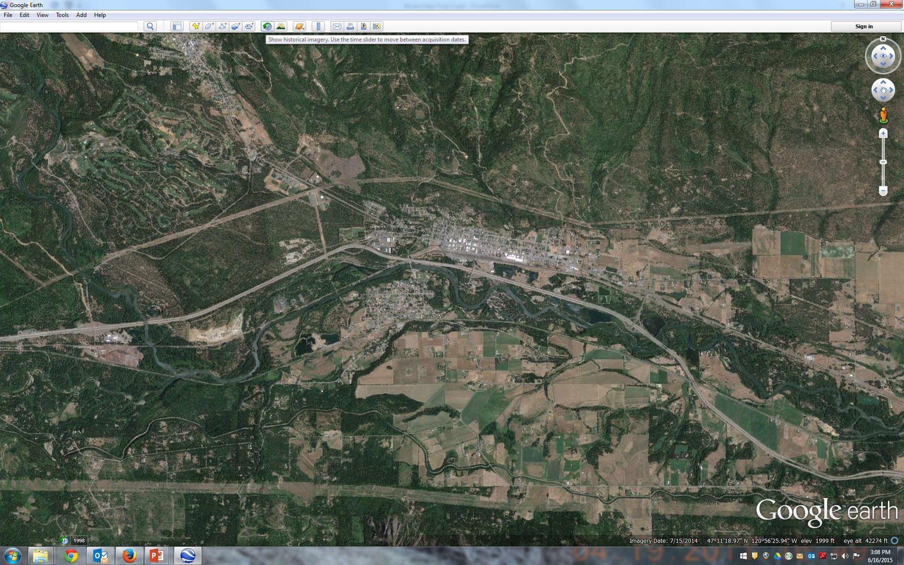

Slide 4
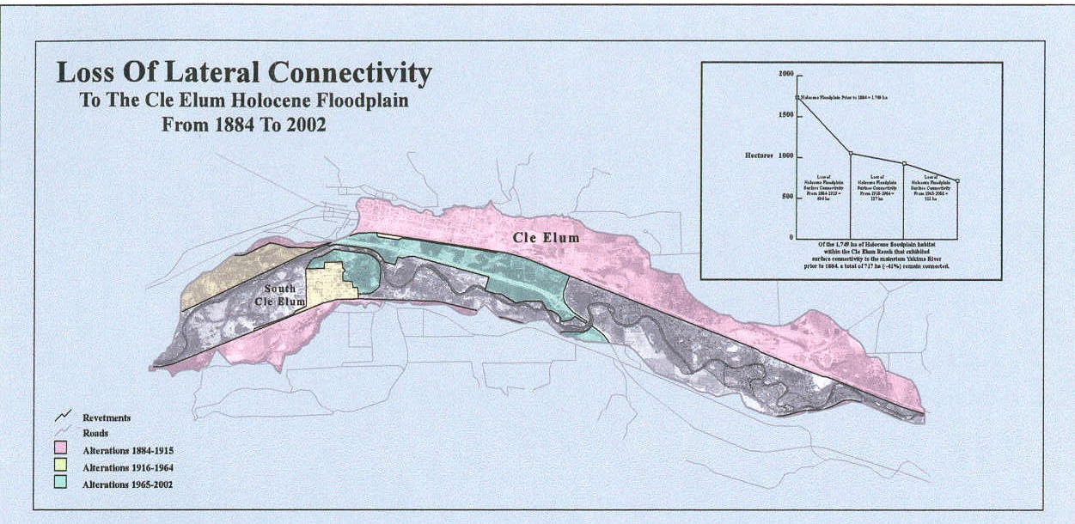

Slide 5
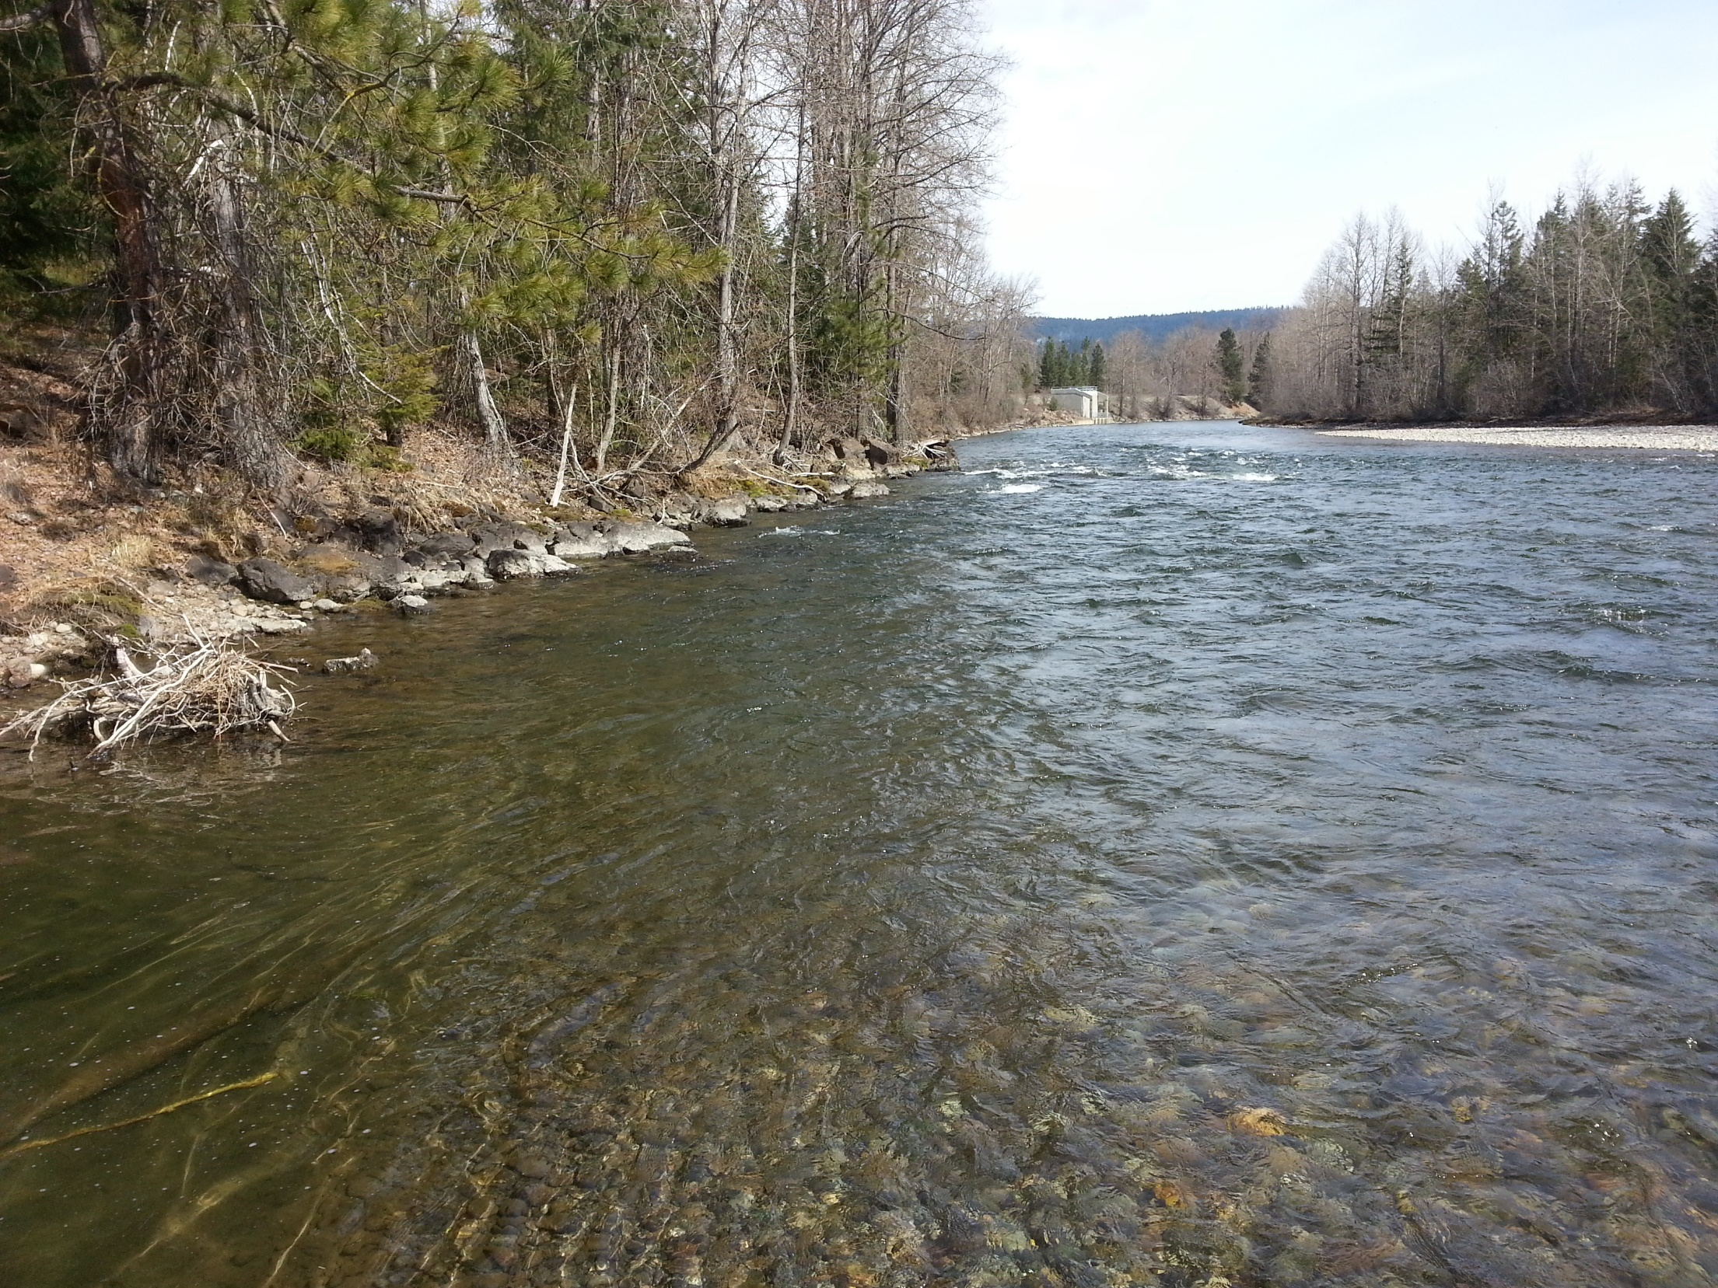

Slide 6
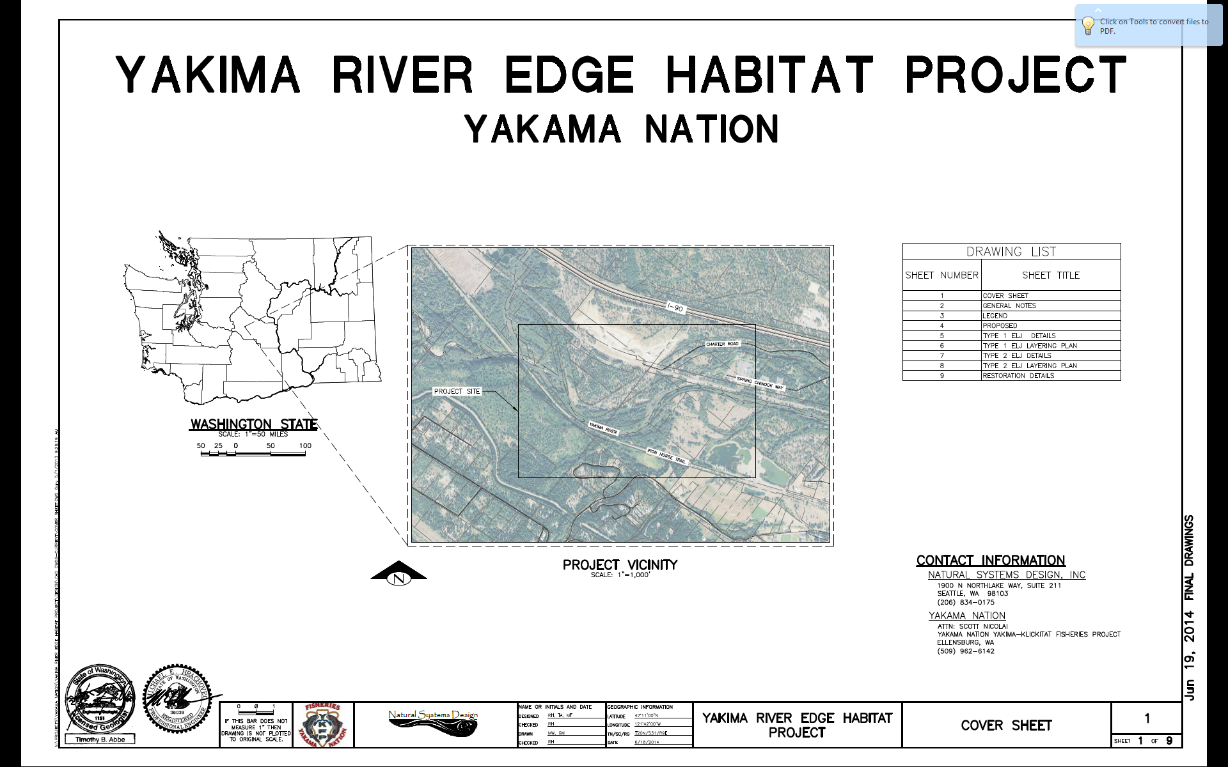

Slide 7
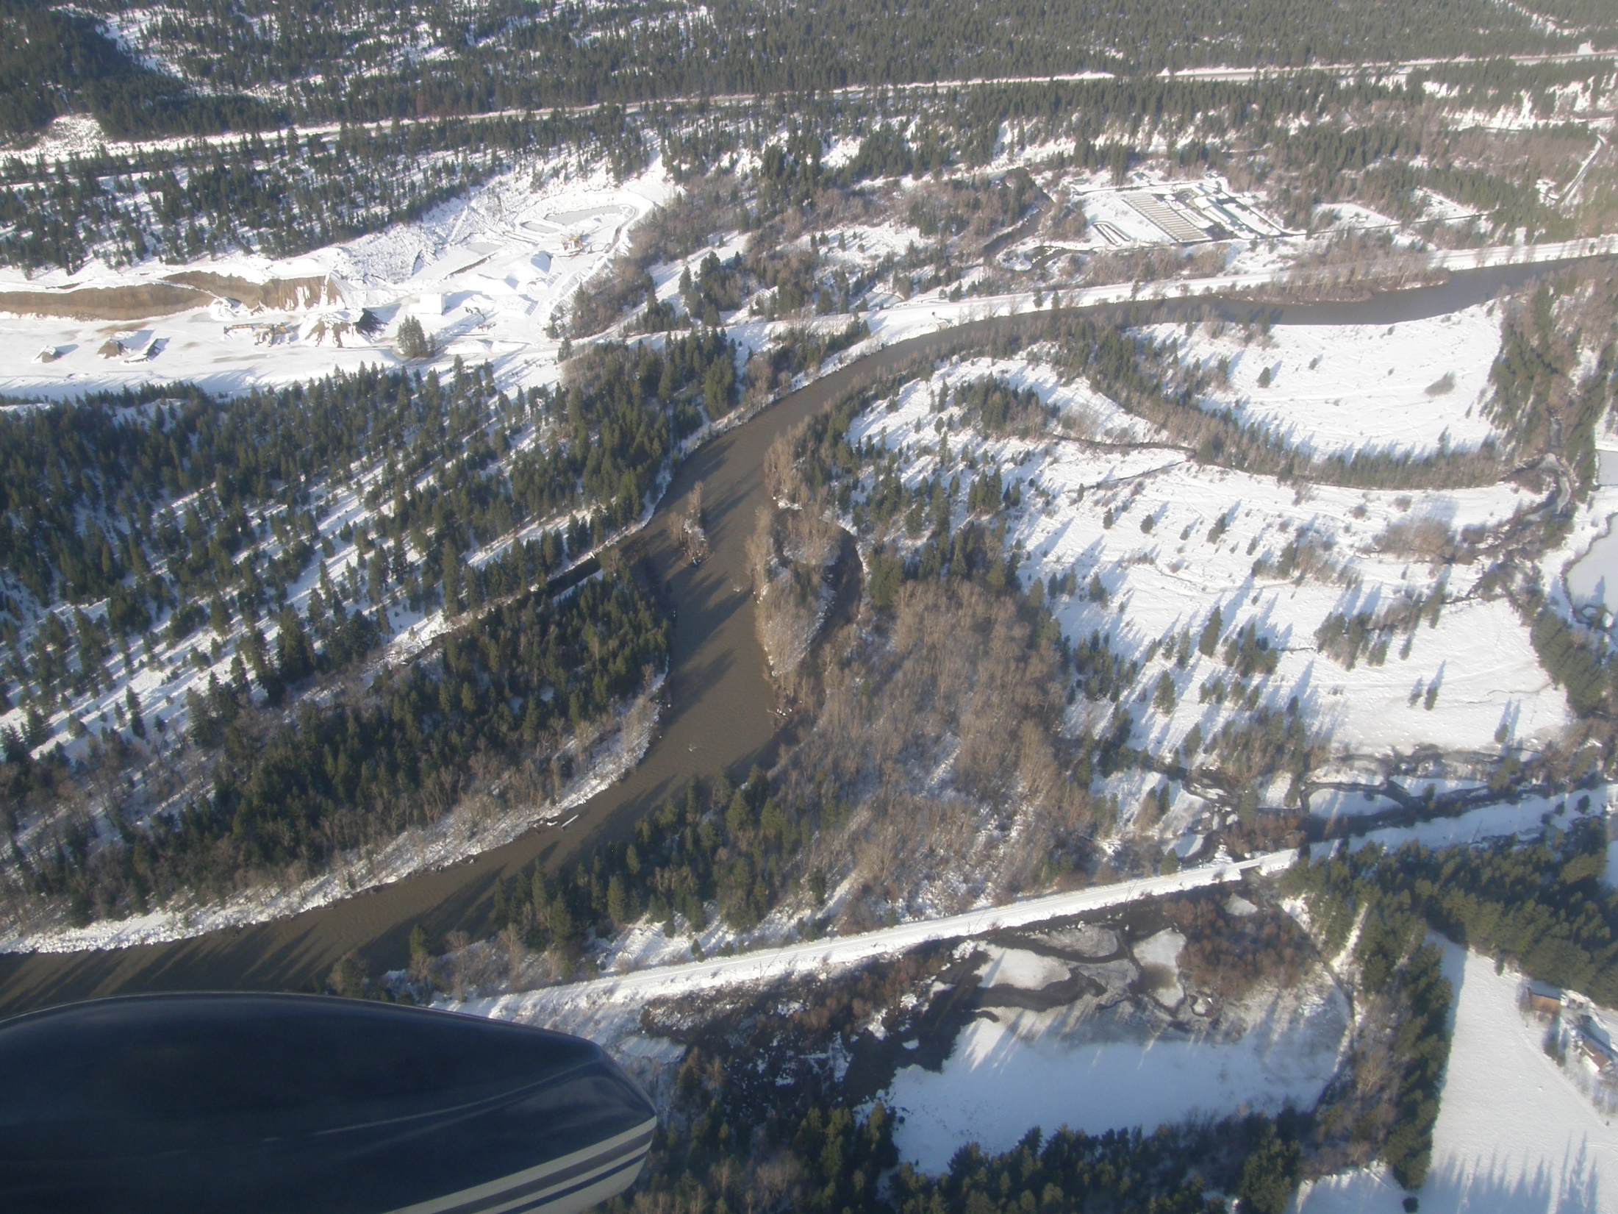

Slide 8
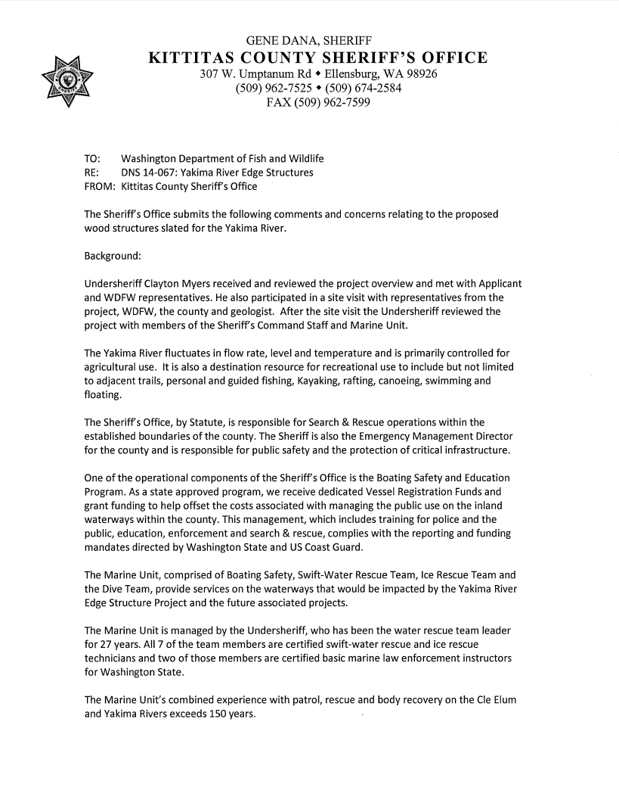
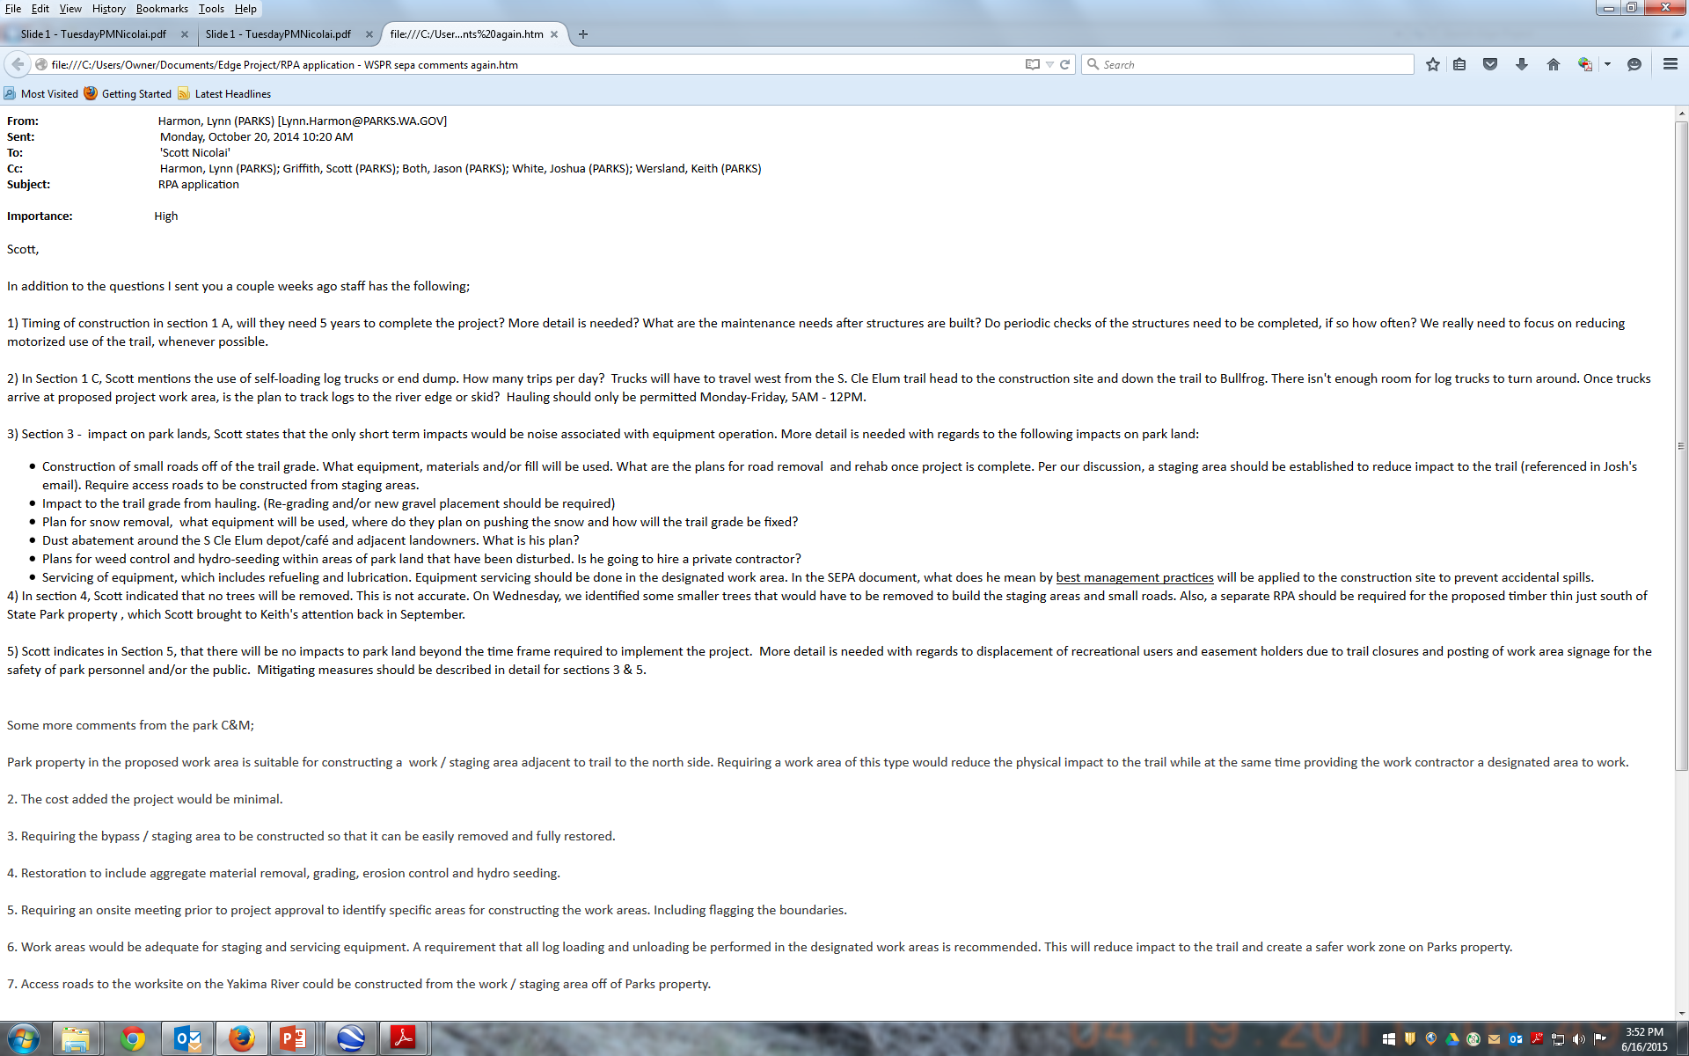
State Environmental Policy Act Comments:
Public Safety …
Impacts to Trail …

Slide 9
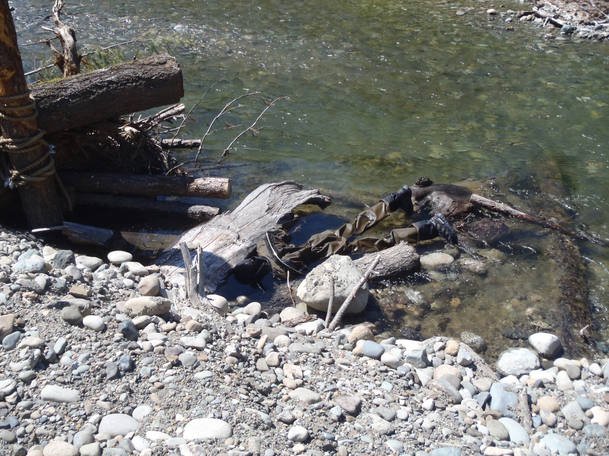

Slide 10
Response to SEPA Comments:
Reduced Scope of Work

Slide 11
Response to SEPA Comments:
Reduced Scope of Work
Delayed restoration on Washington State Parks Trail

Slide 12
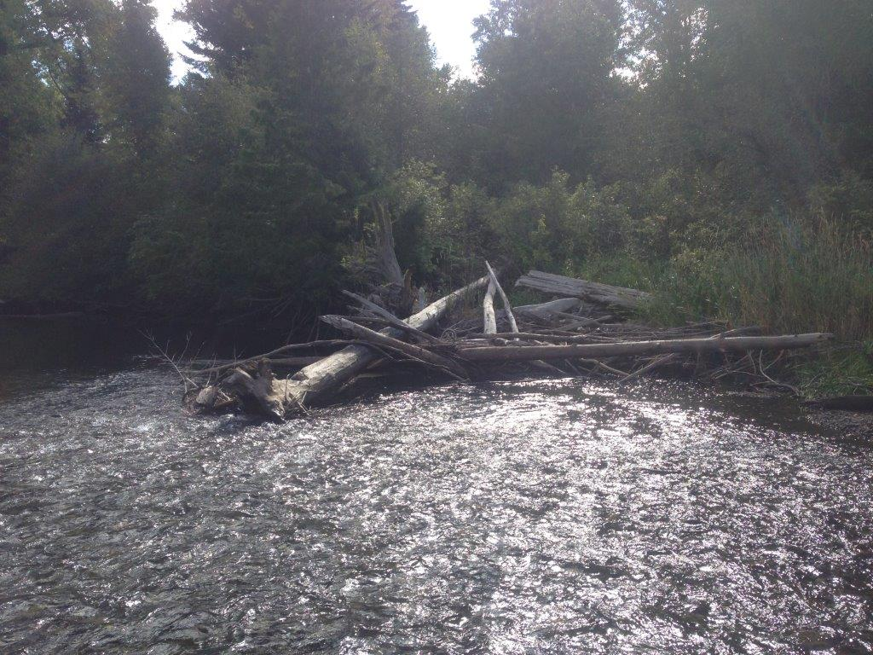
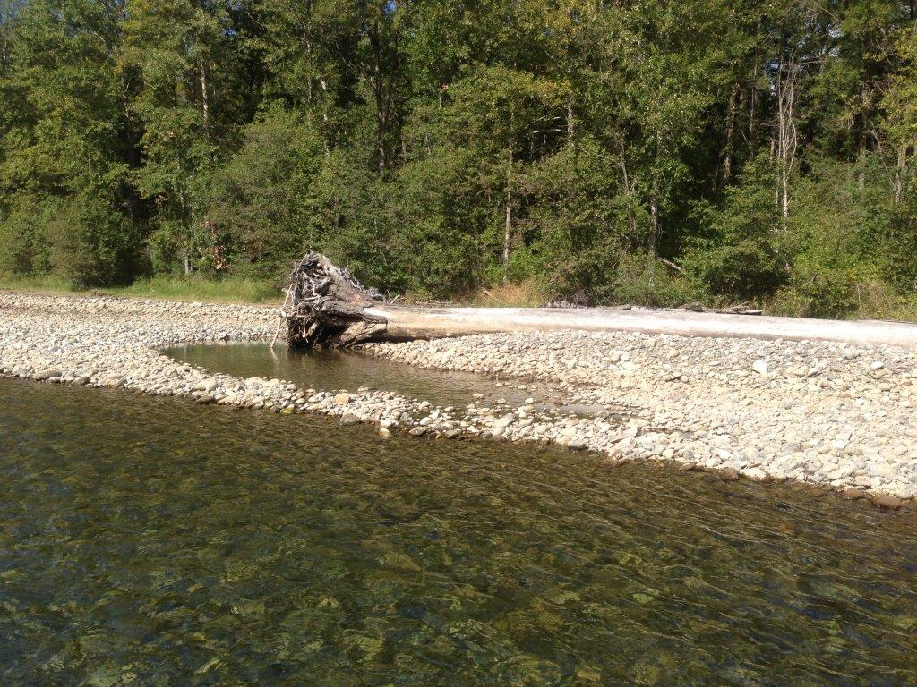
Edge Analogs

Slide 13
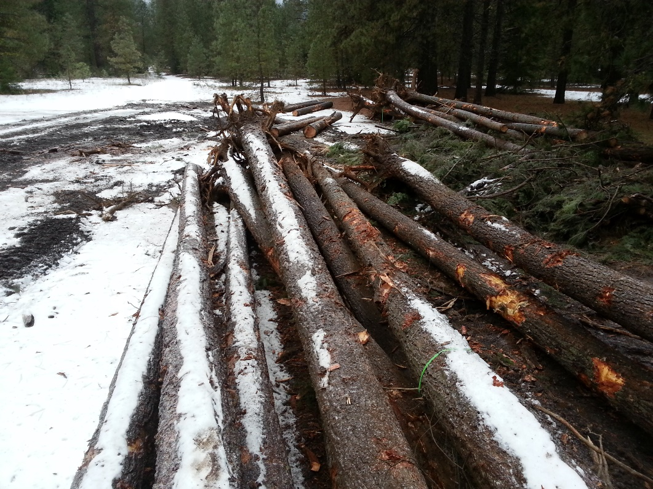
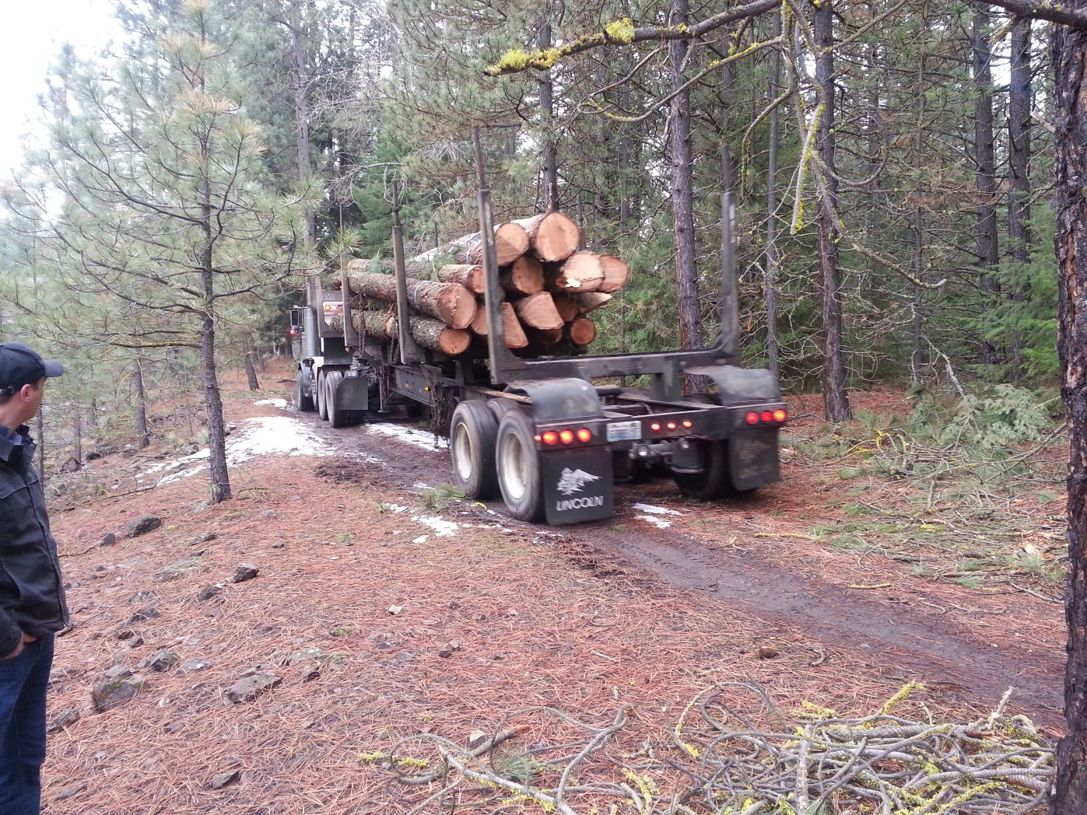
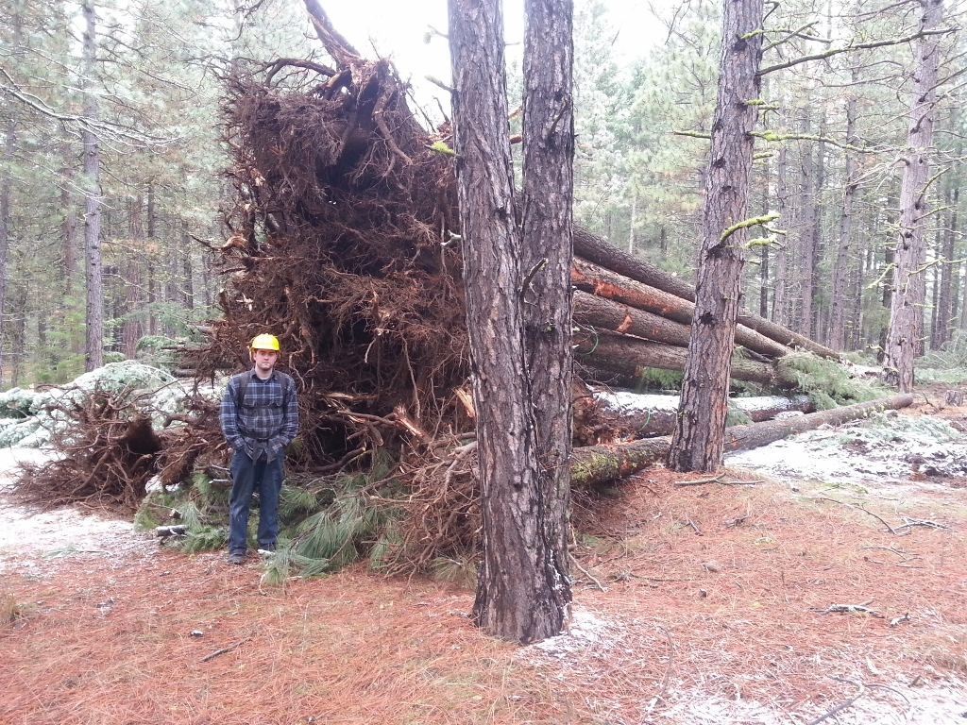
Locally Harvested Restoration
Material:
Reduces Cost!
Higher Quality Material!

Slide 14
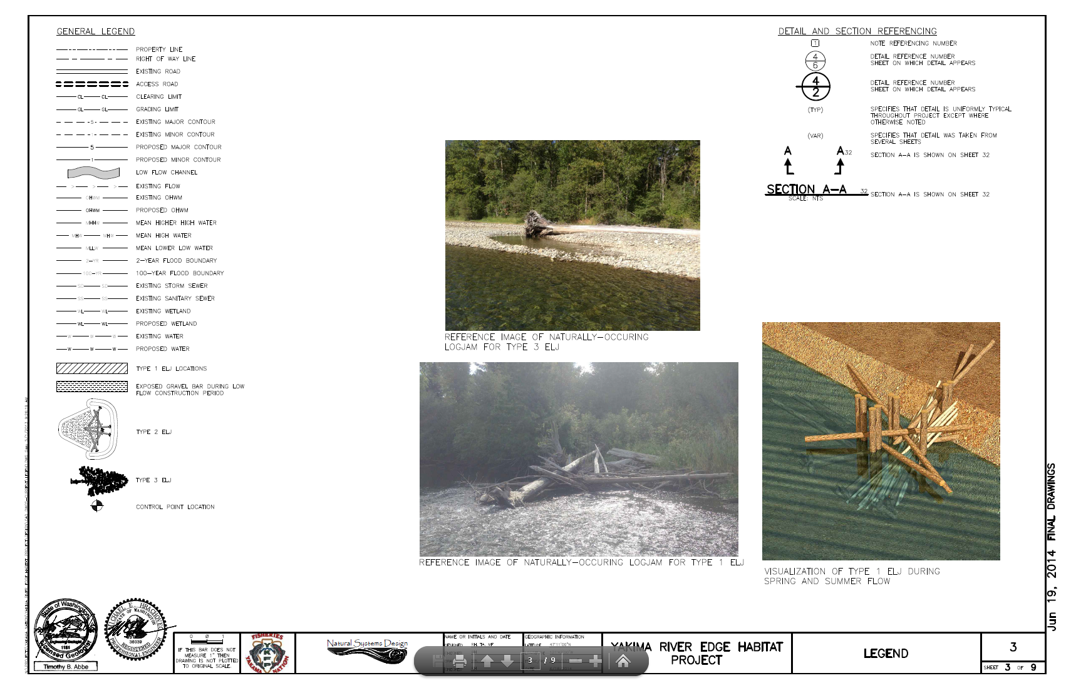

Slide 15
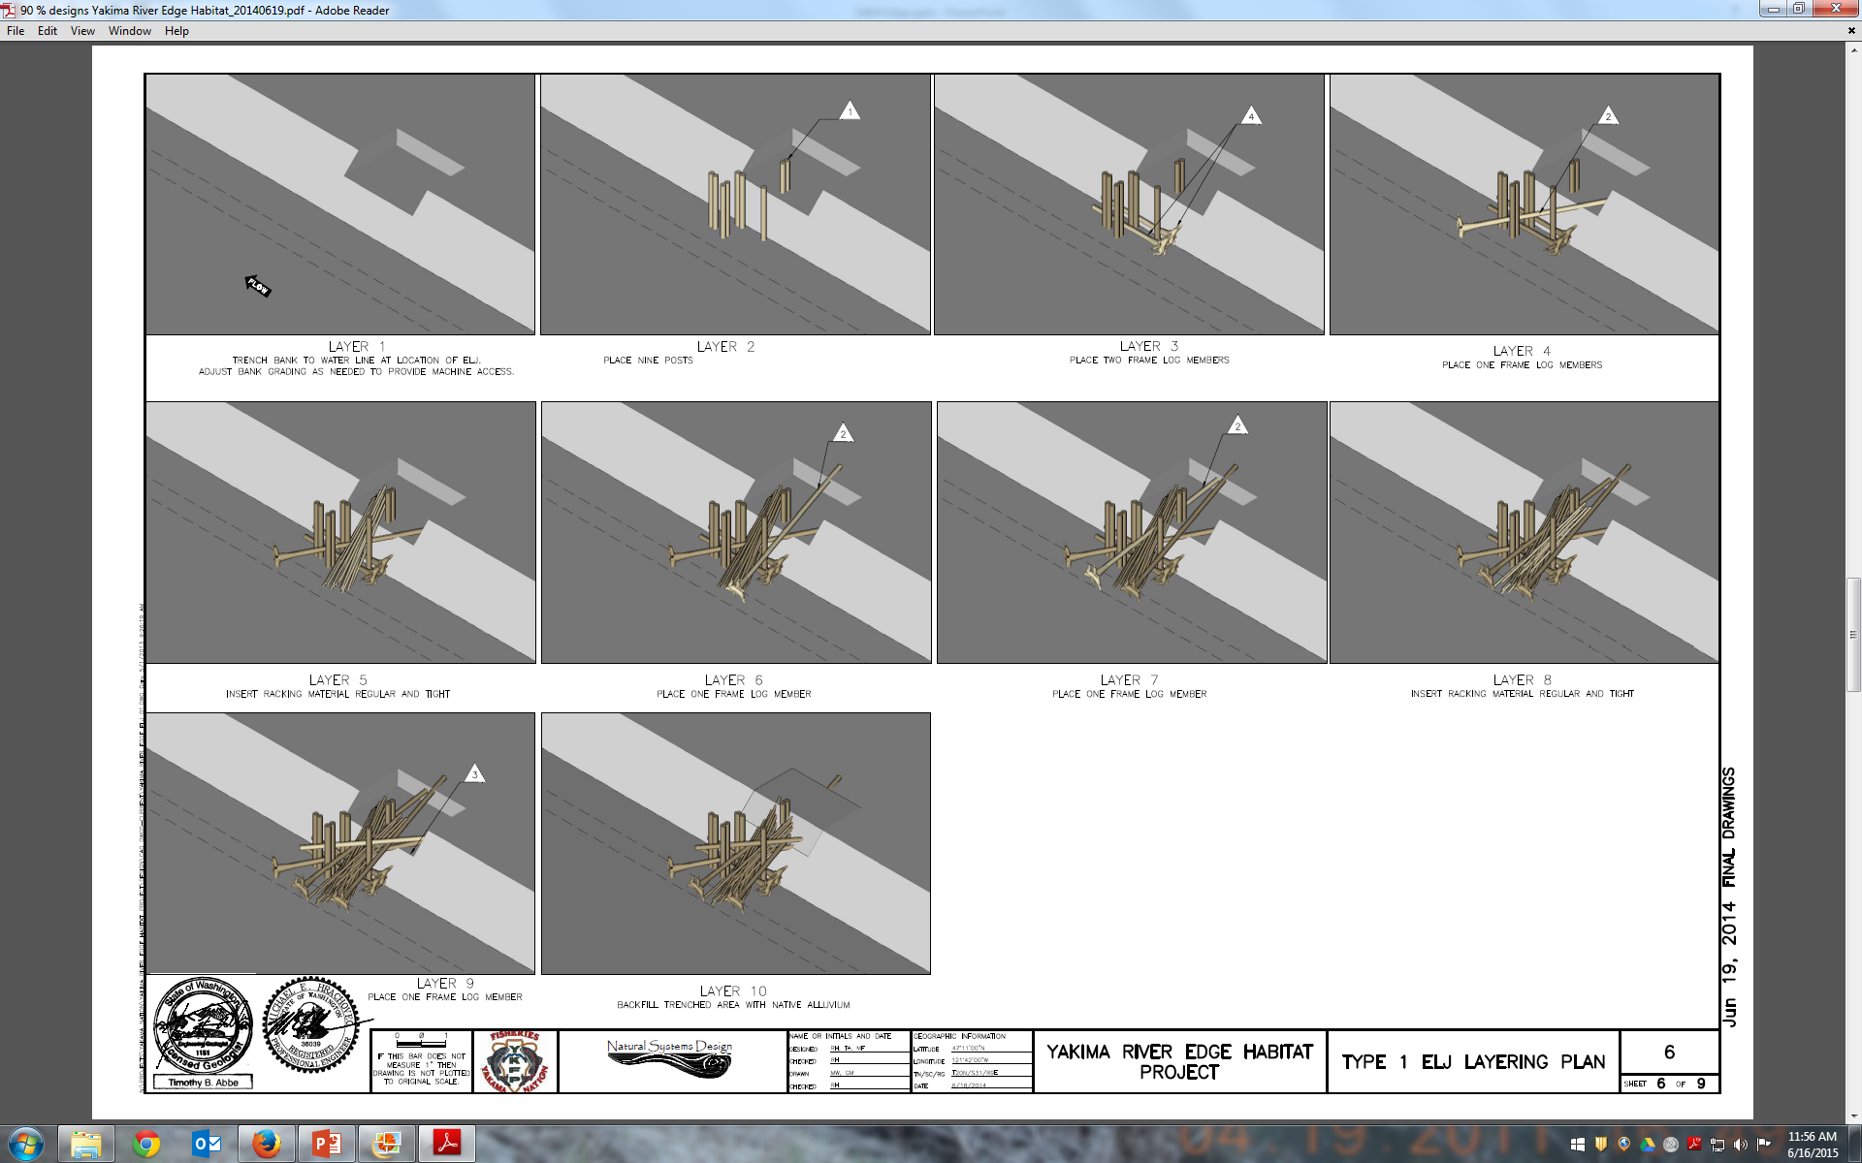

Slide 16
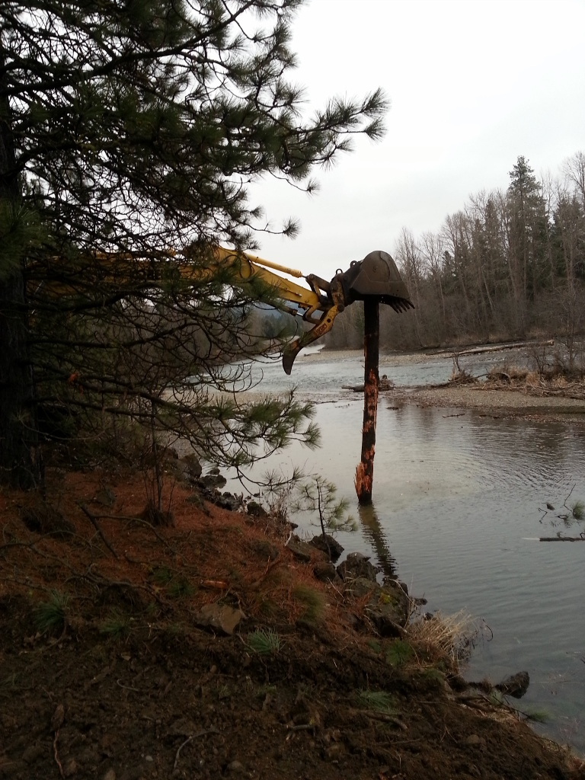
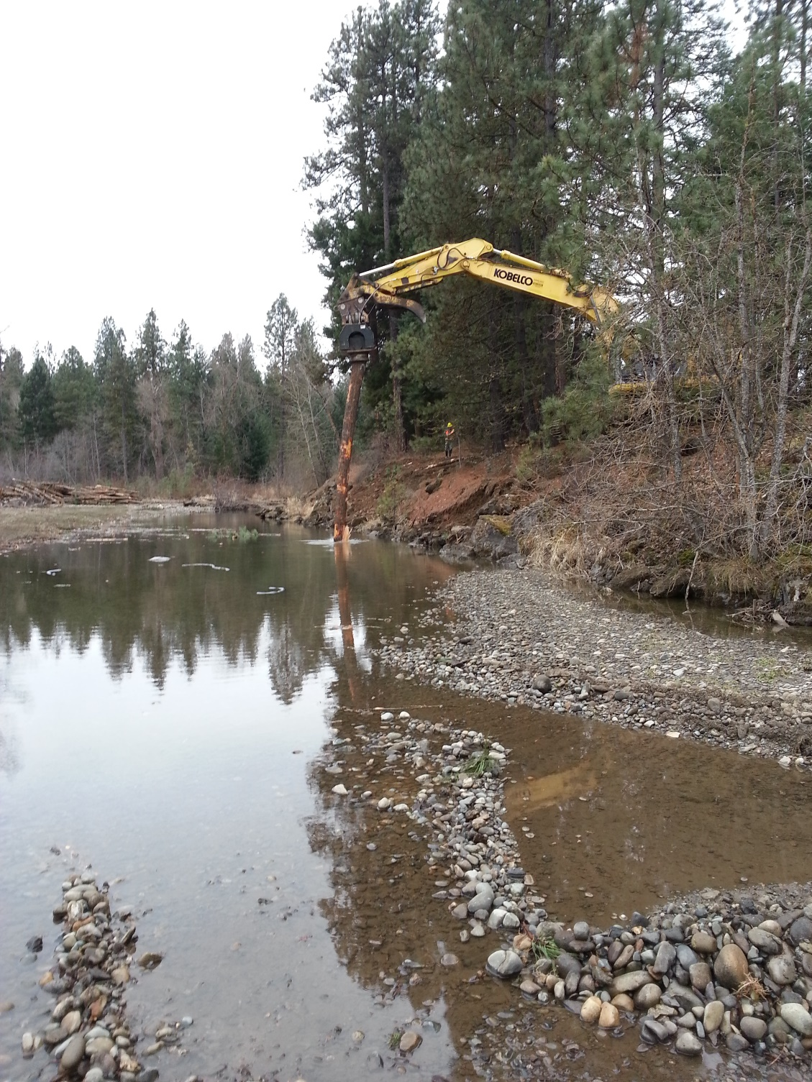

Slide 17
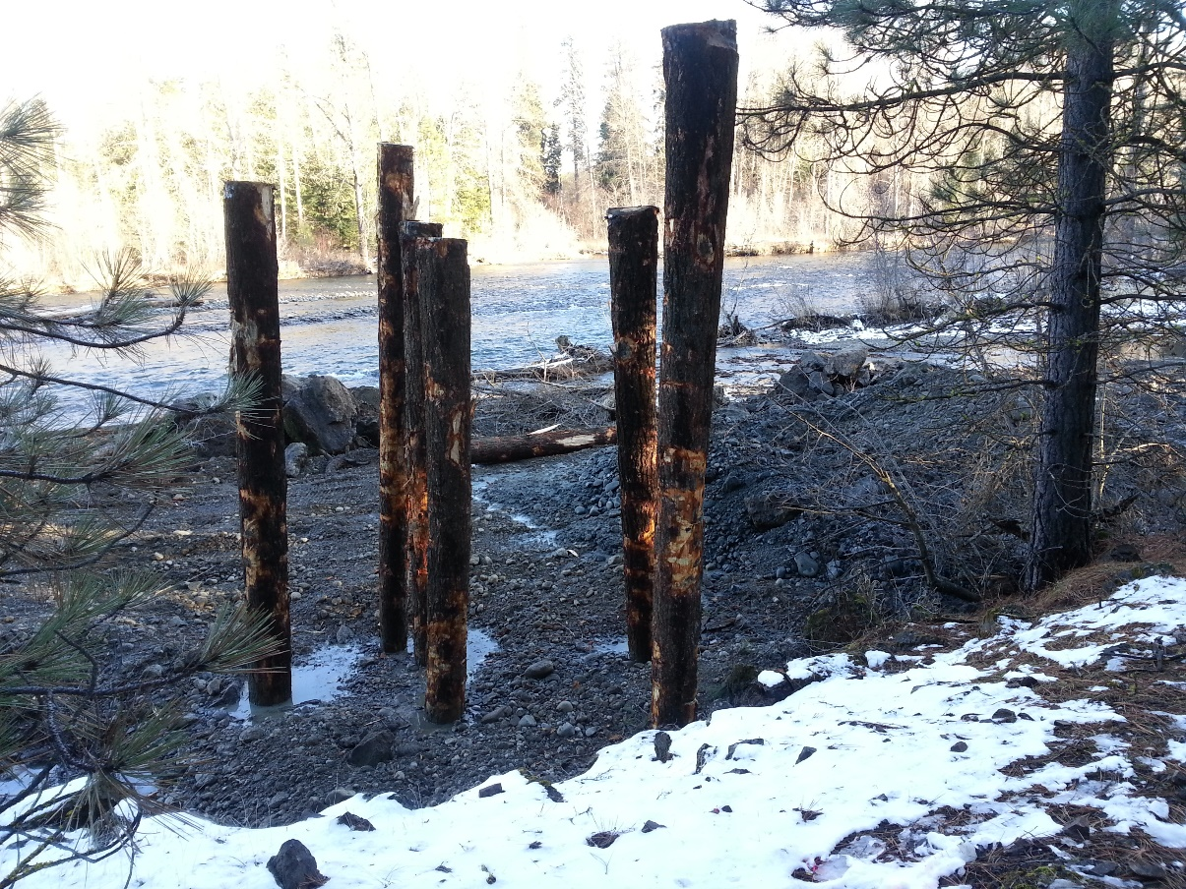
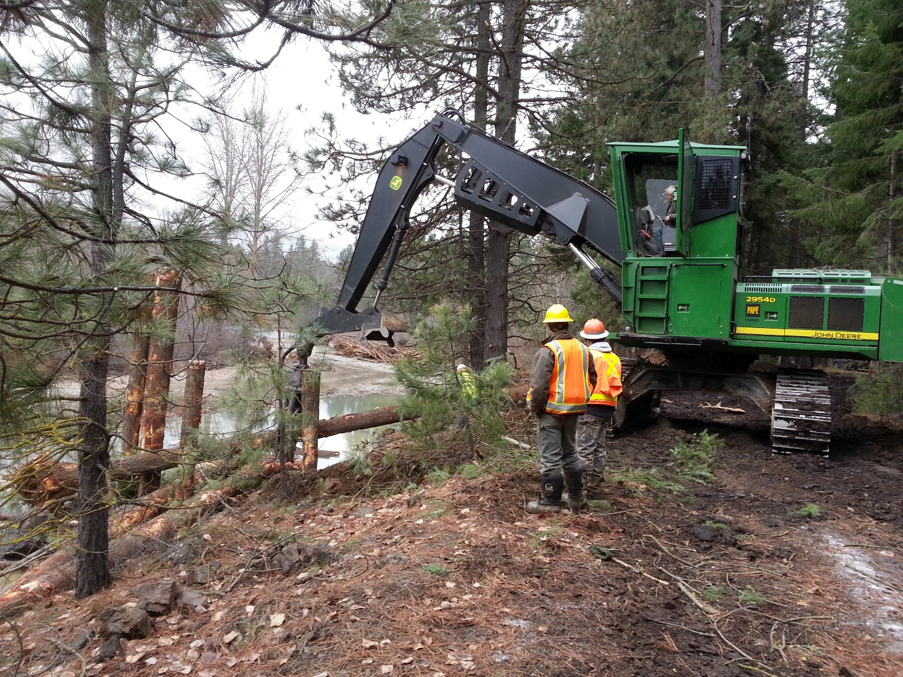

Slide 18
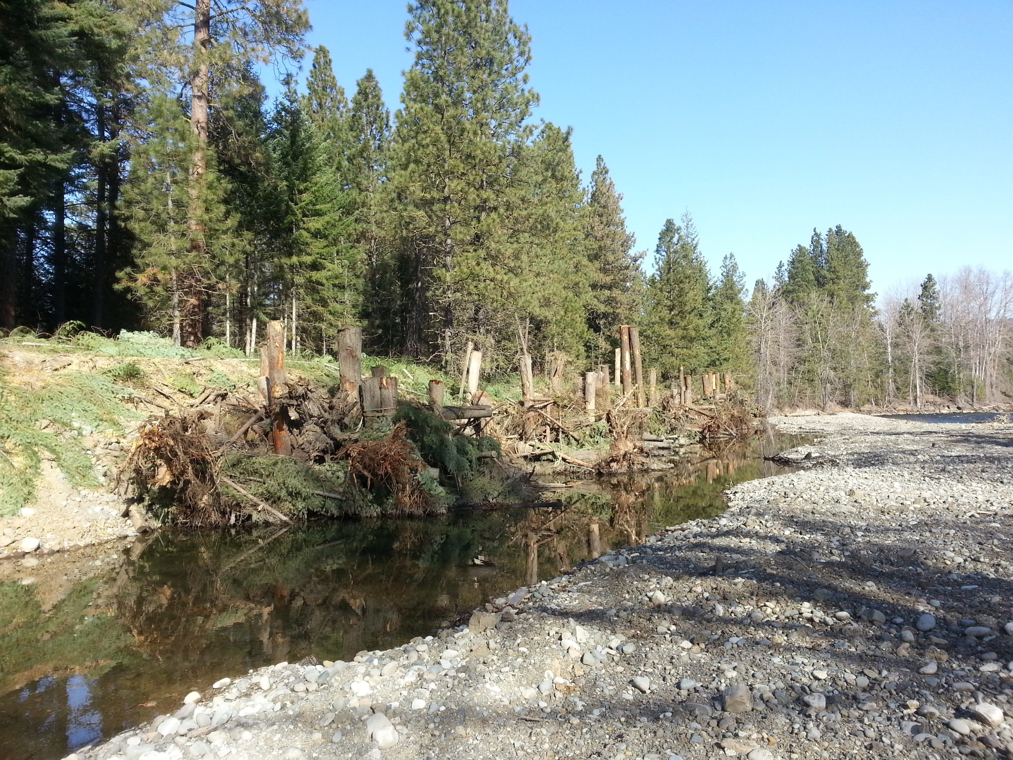

Slide 19
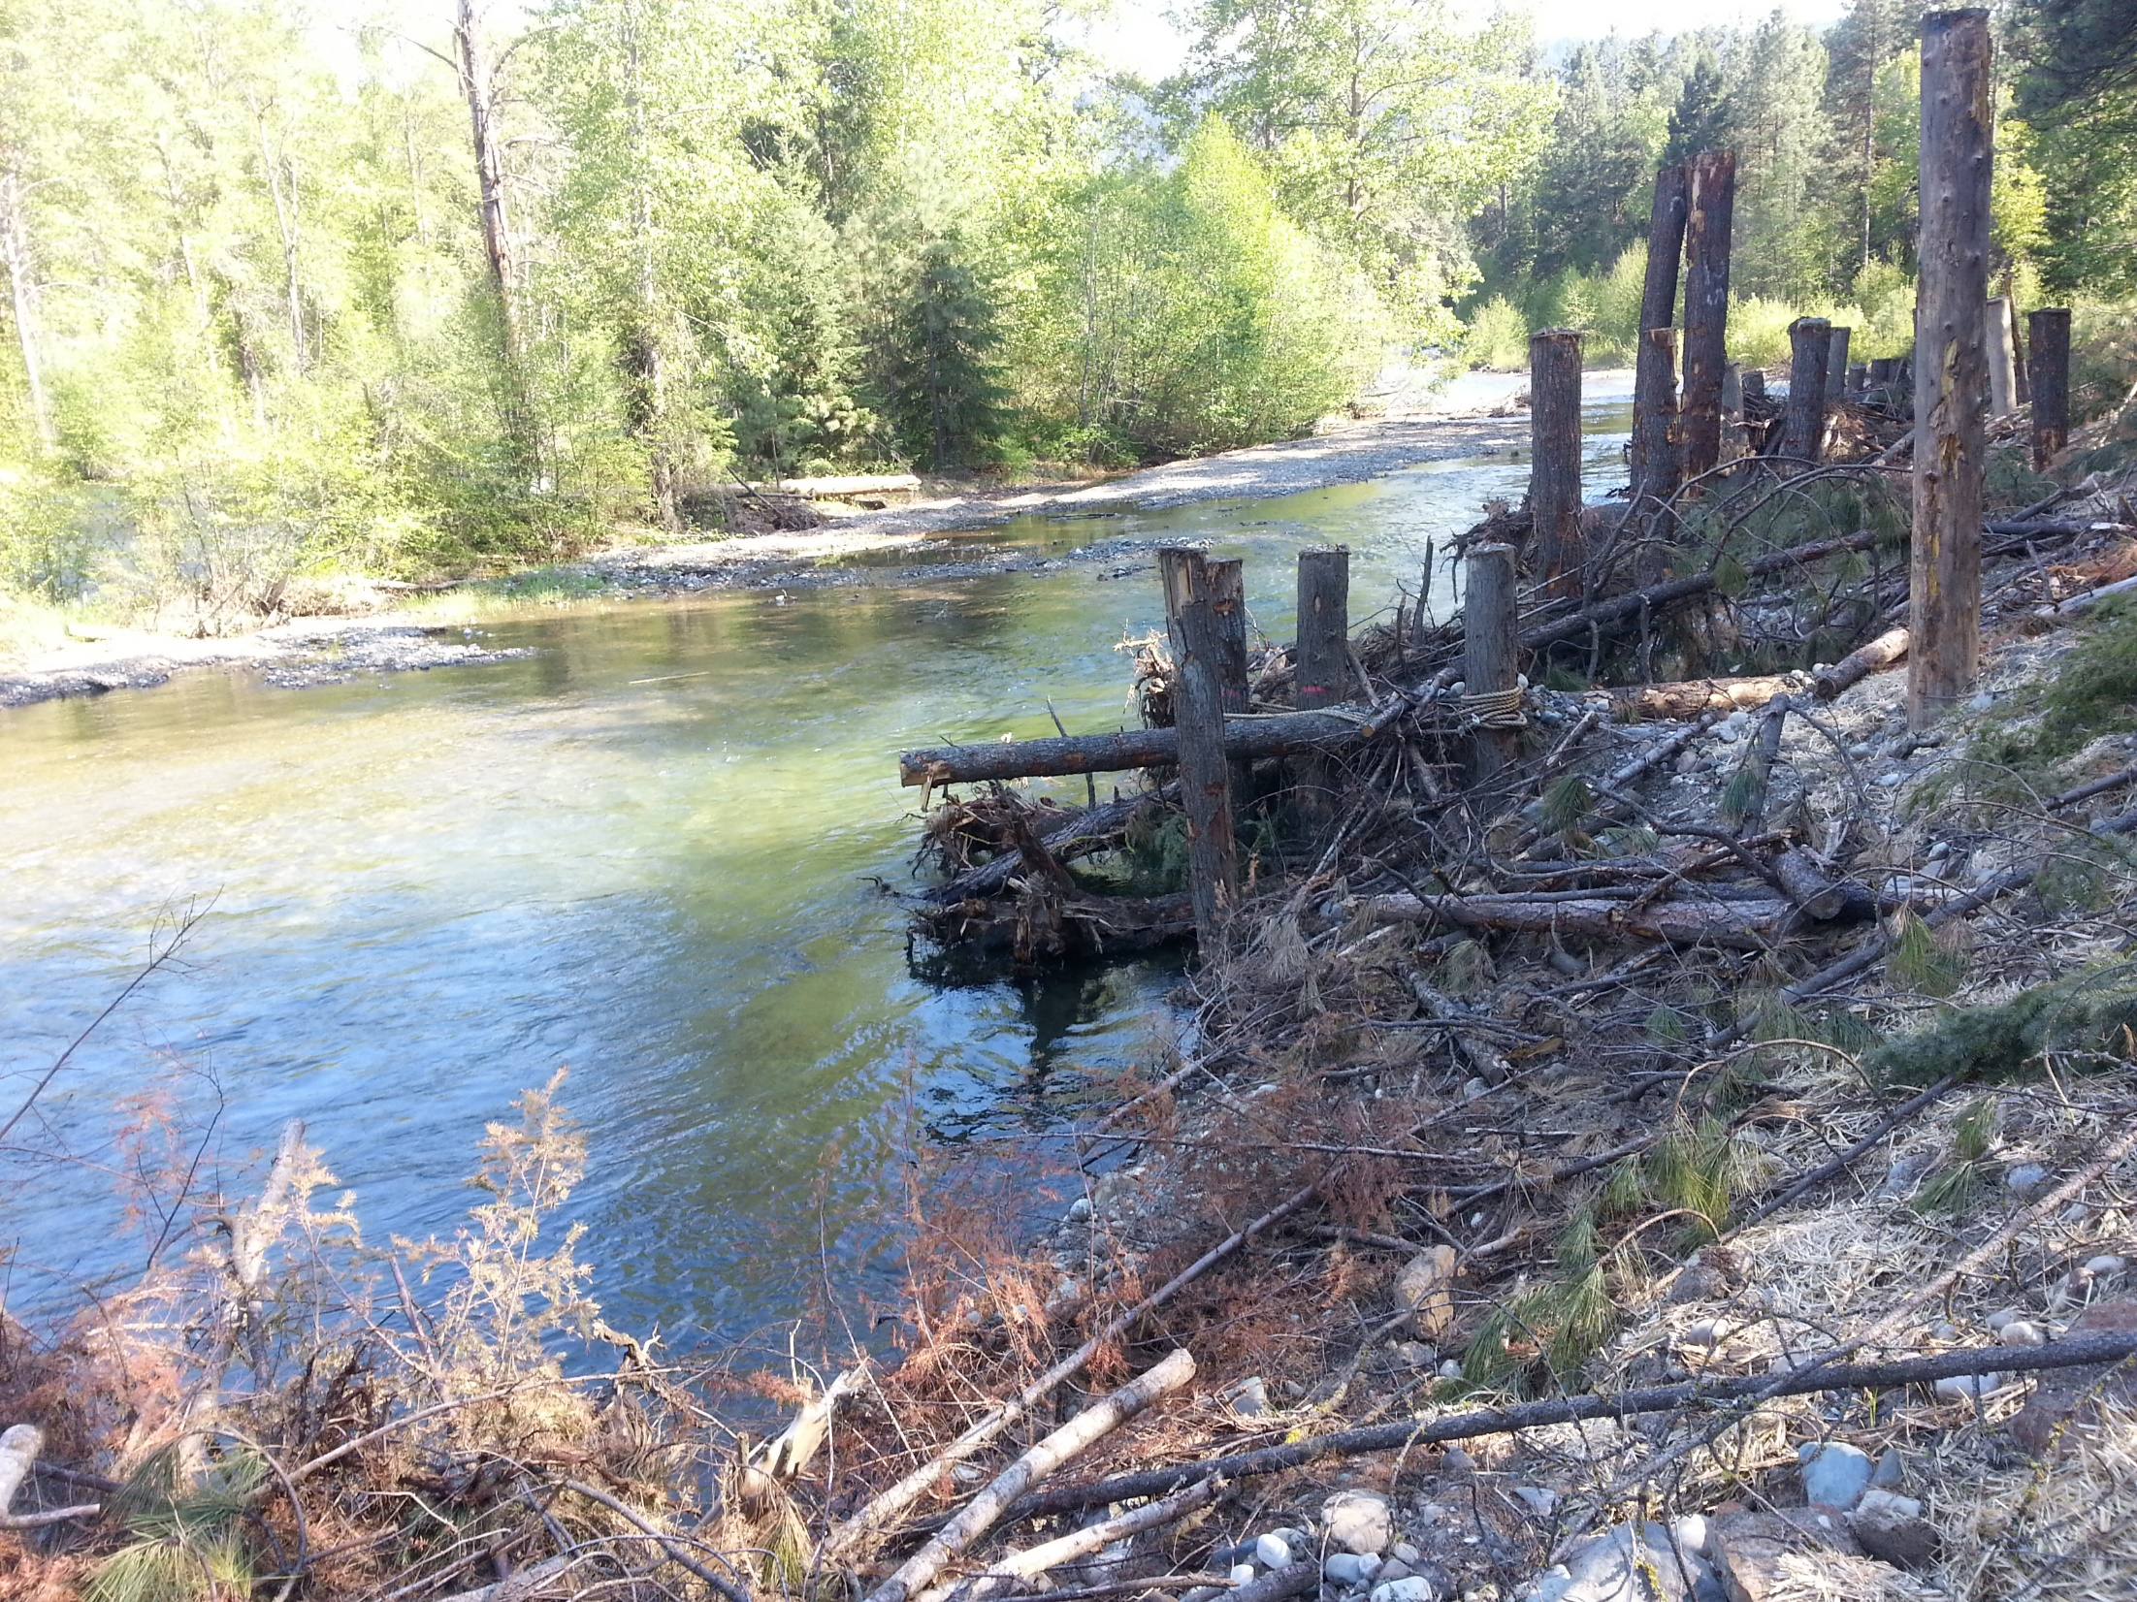

Slide 20
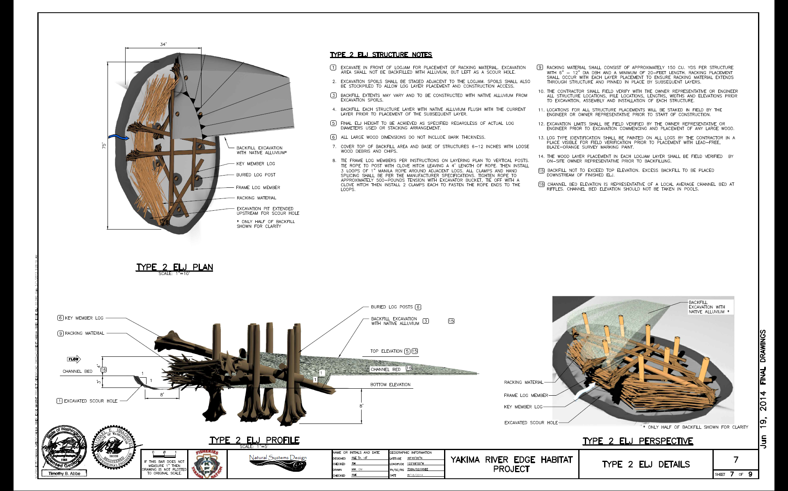

Slide 21
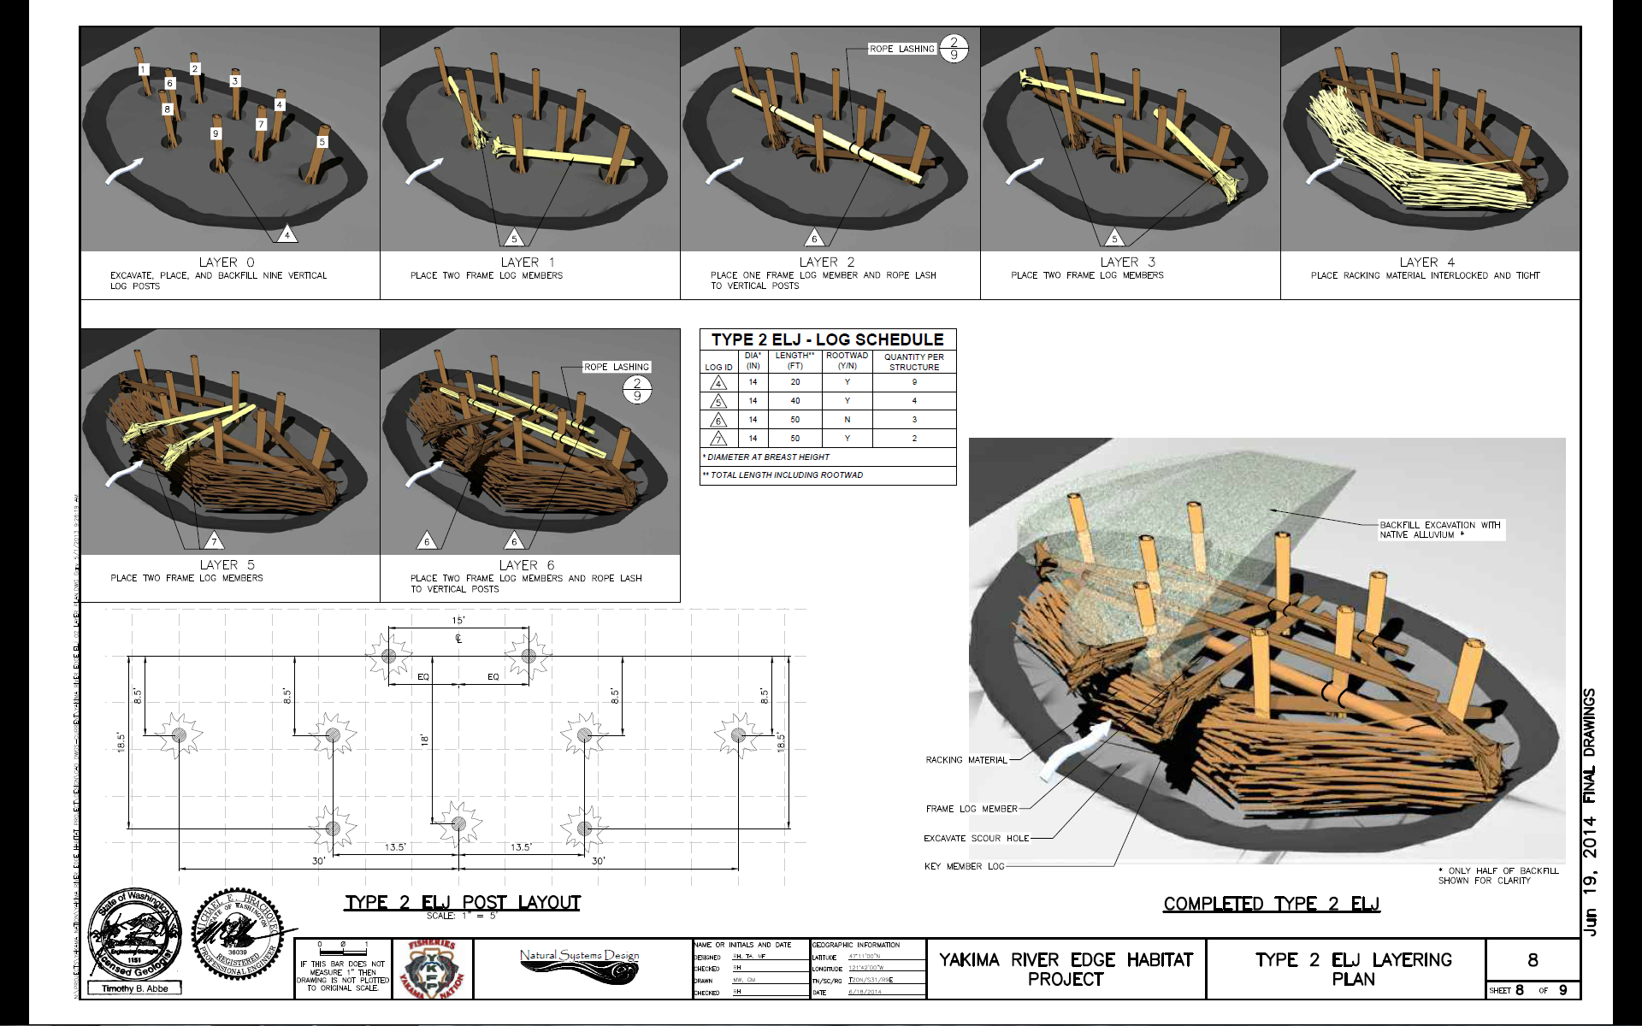

Slide 22
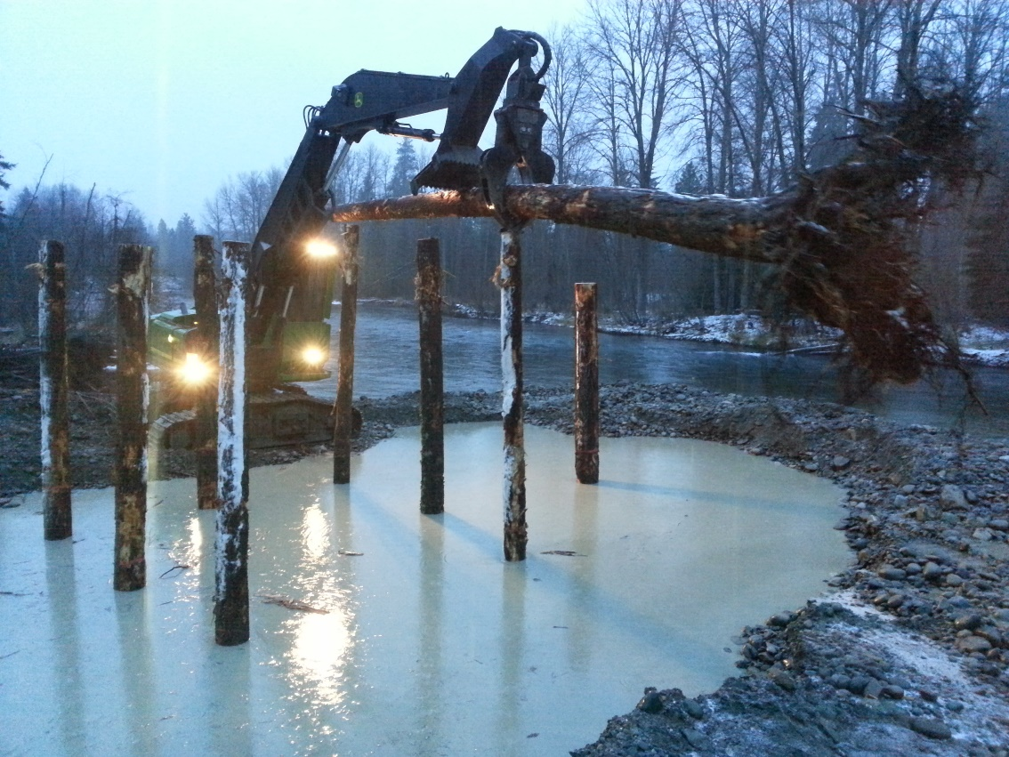
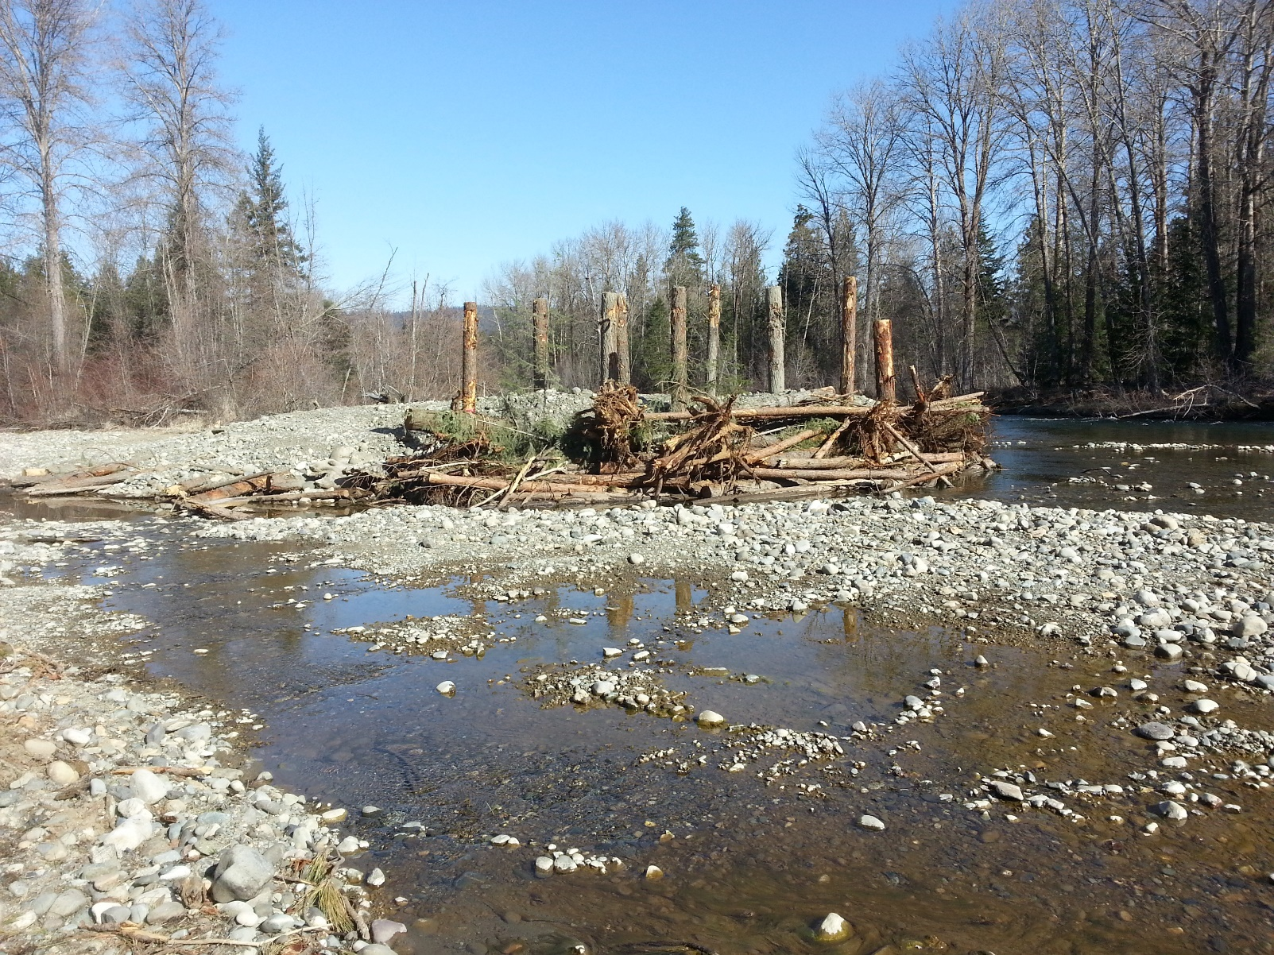
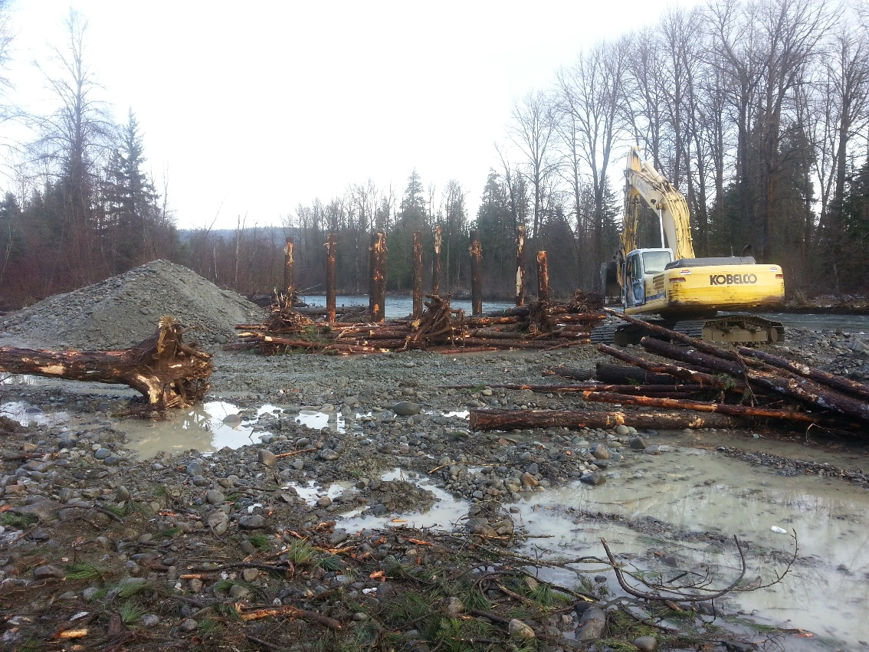

Slide 23
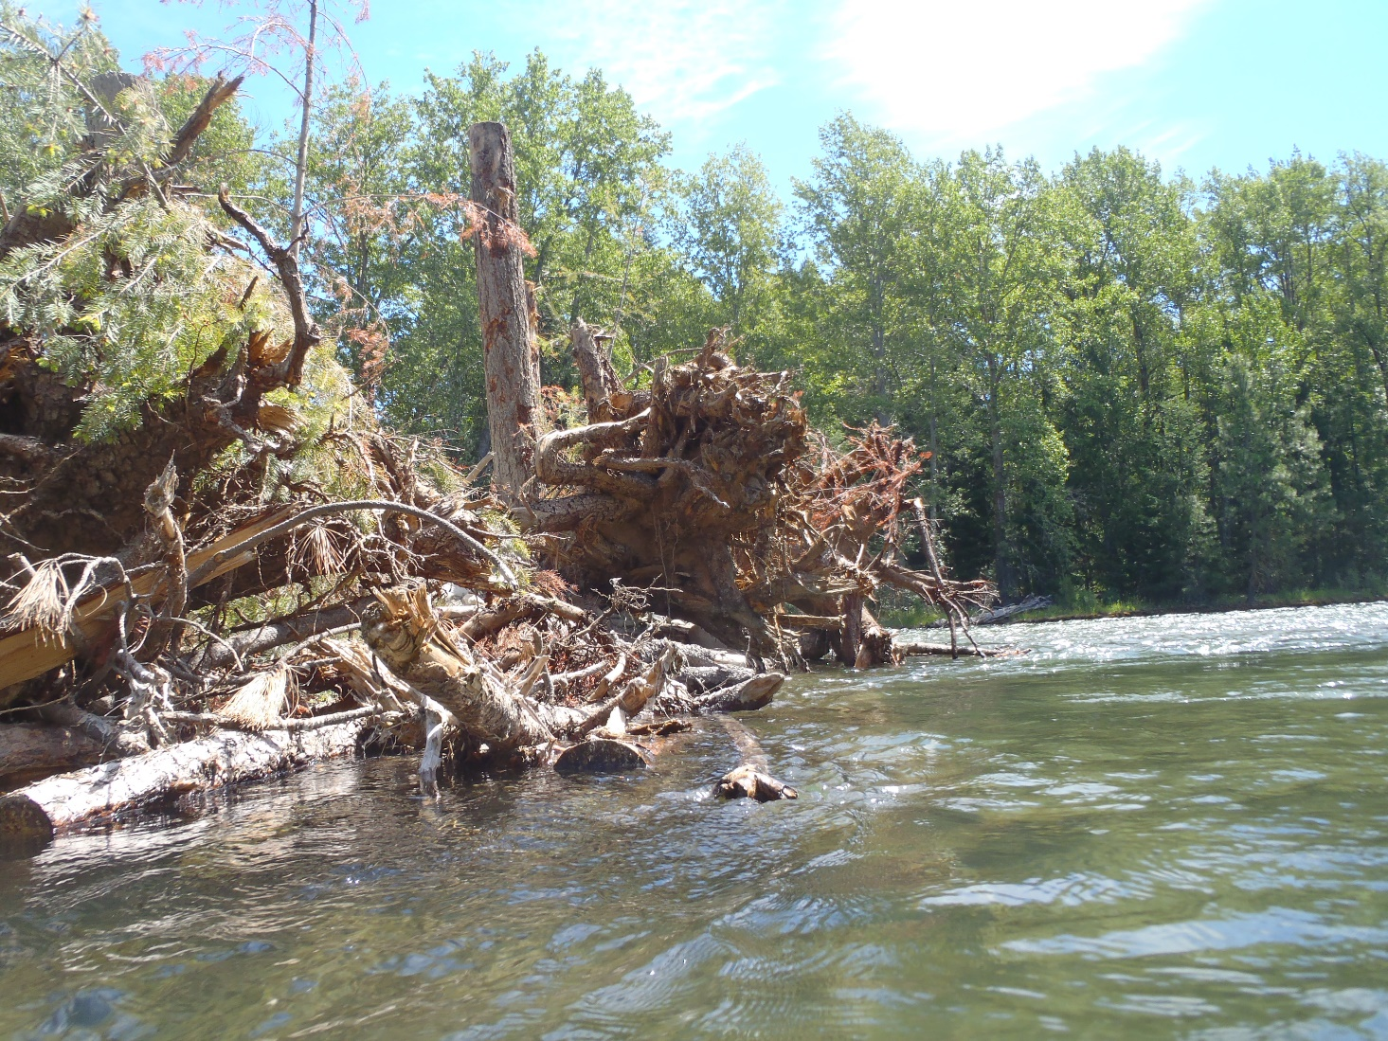
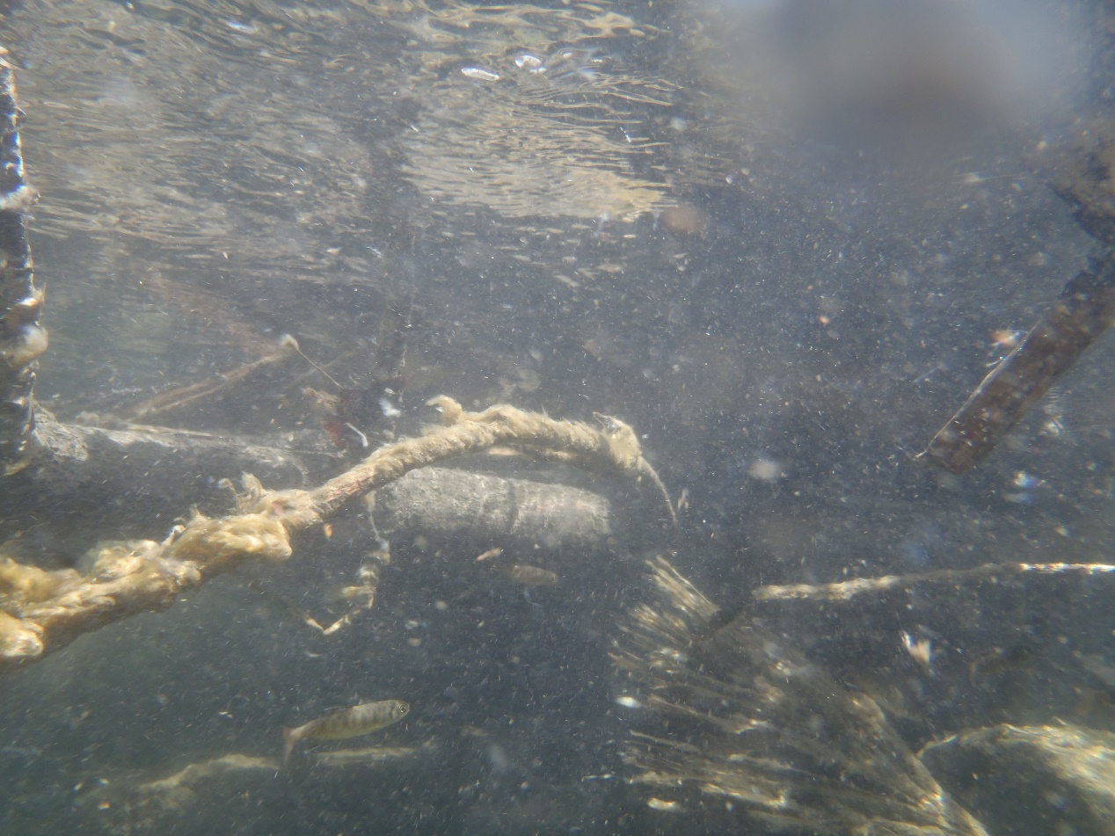

Slide 24
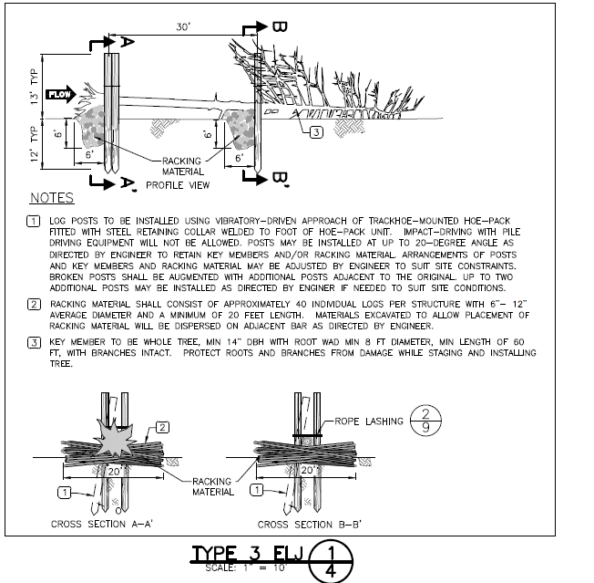

Slide 25
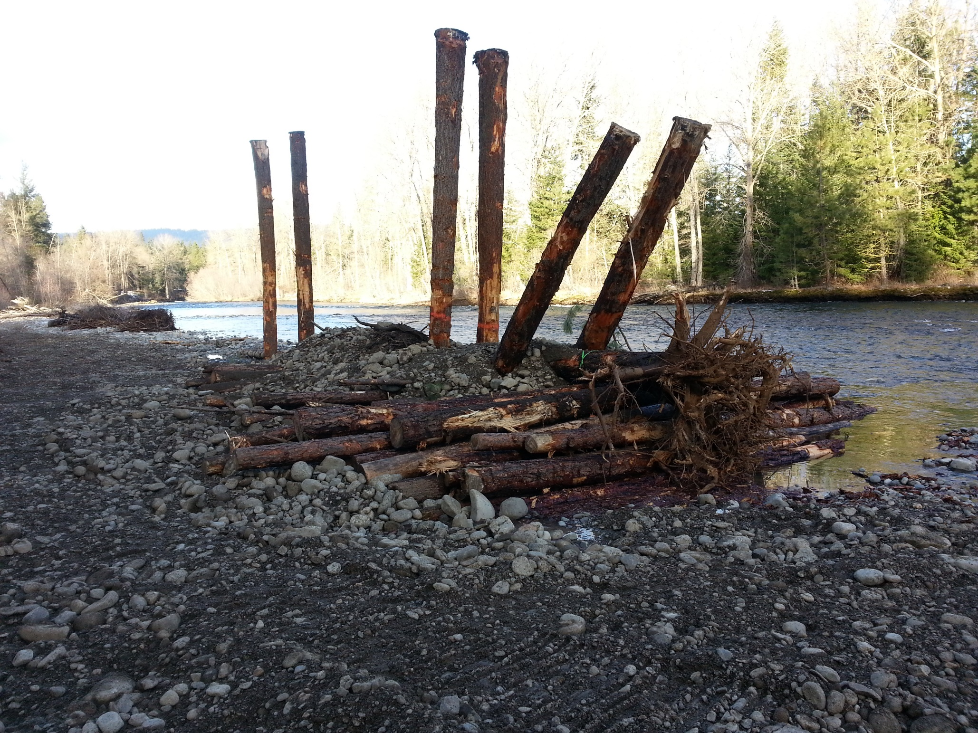

Slide 26
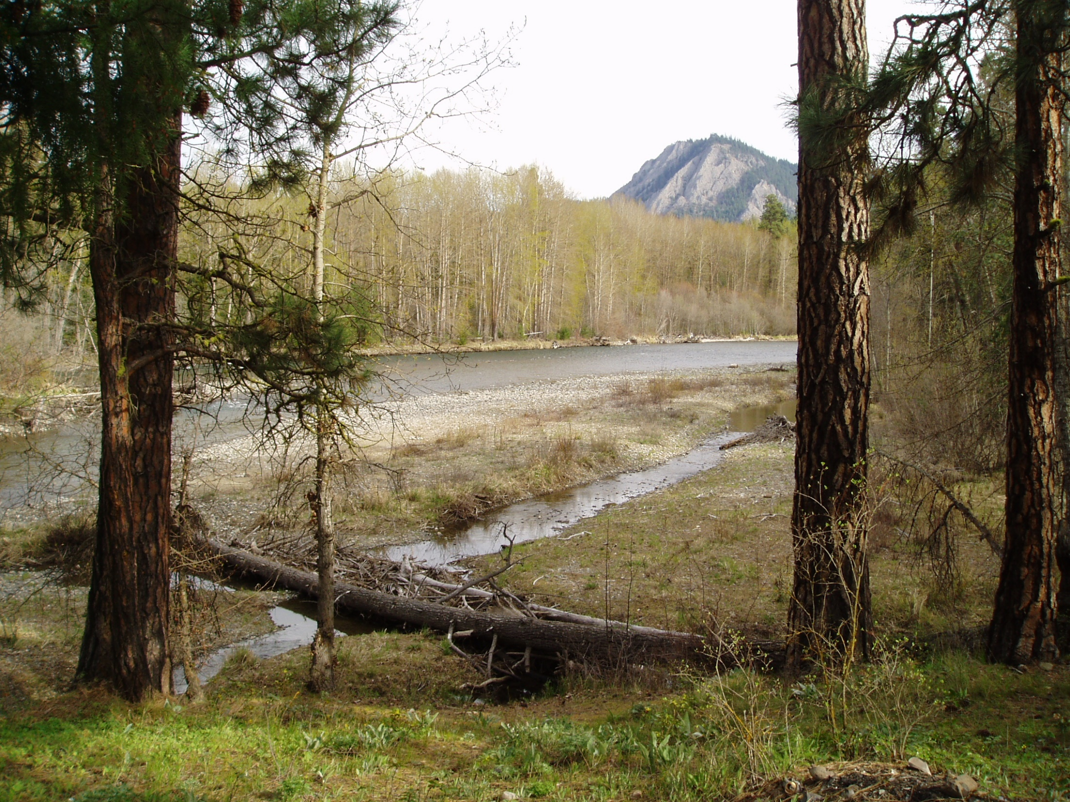

Slide 27
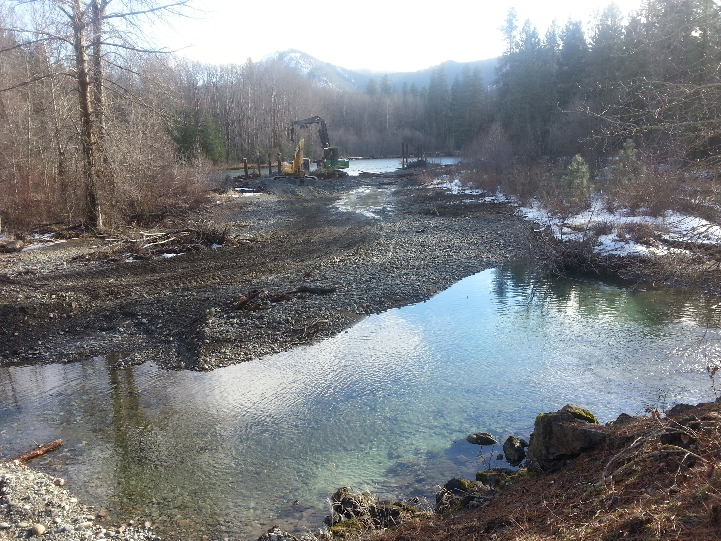

Slide 28
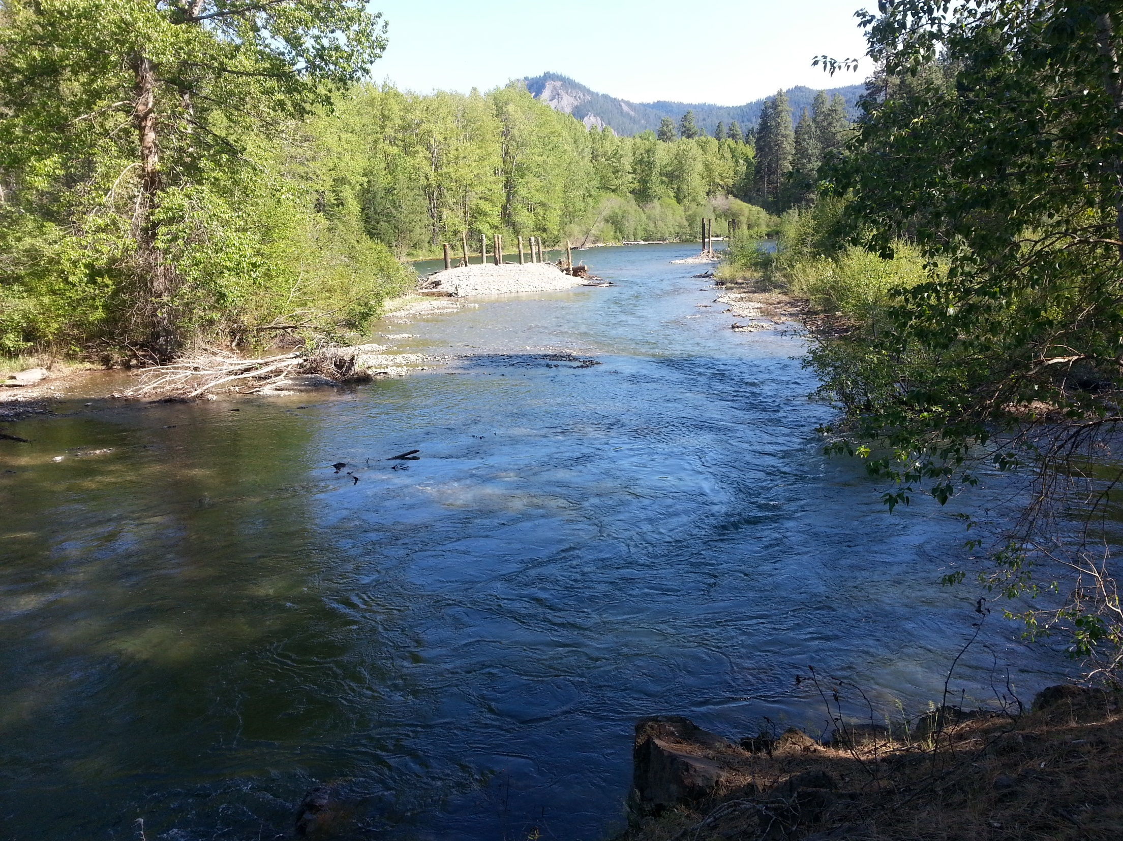

Slide 29
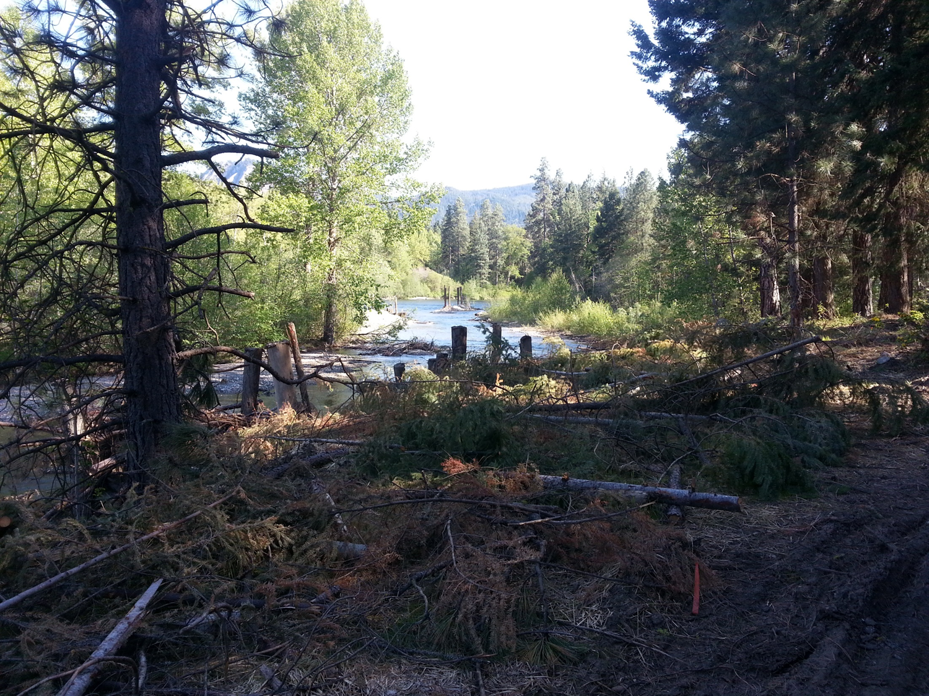

Slide 30
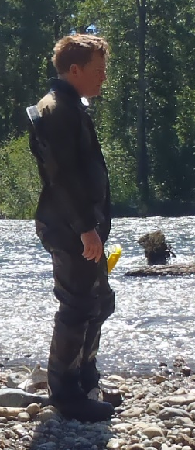
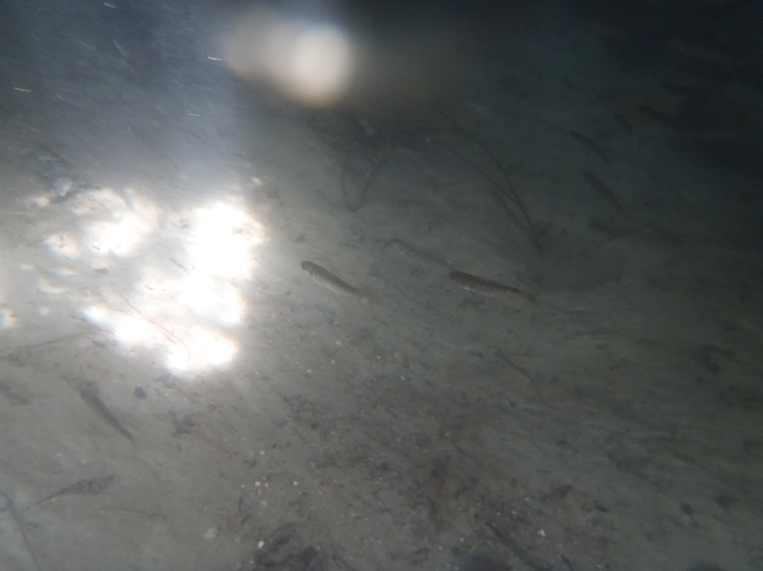
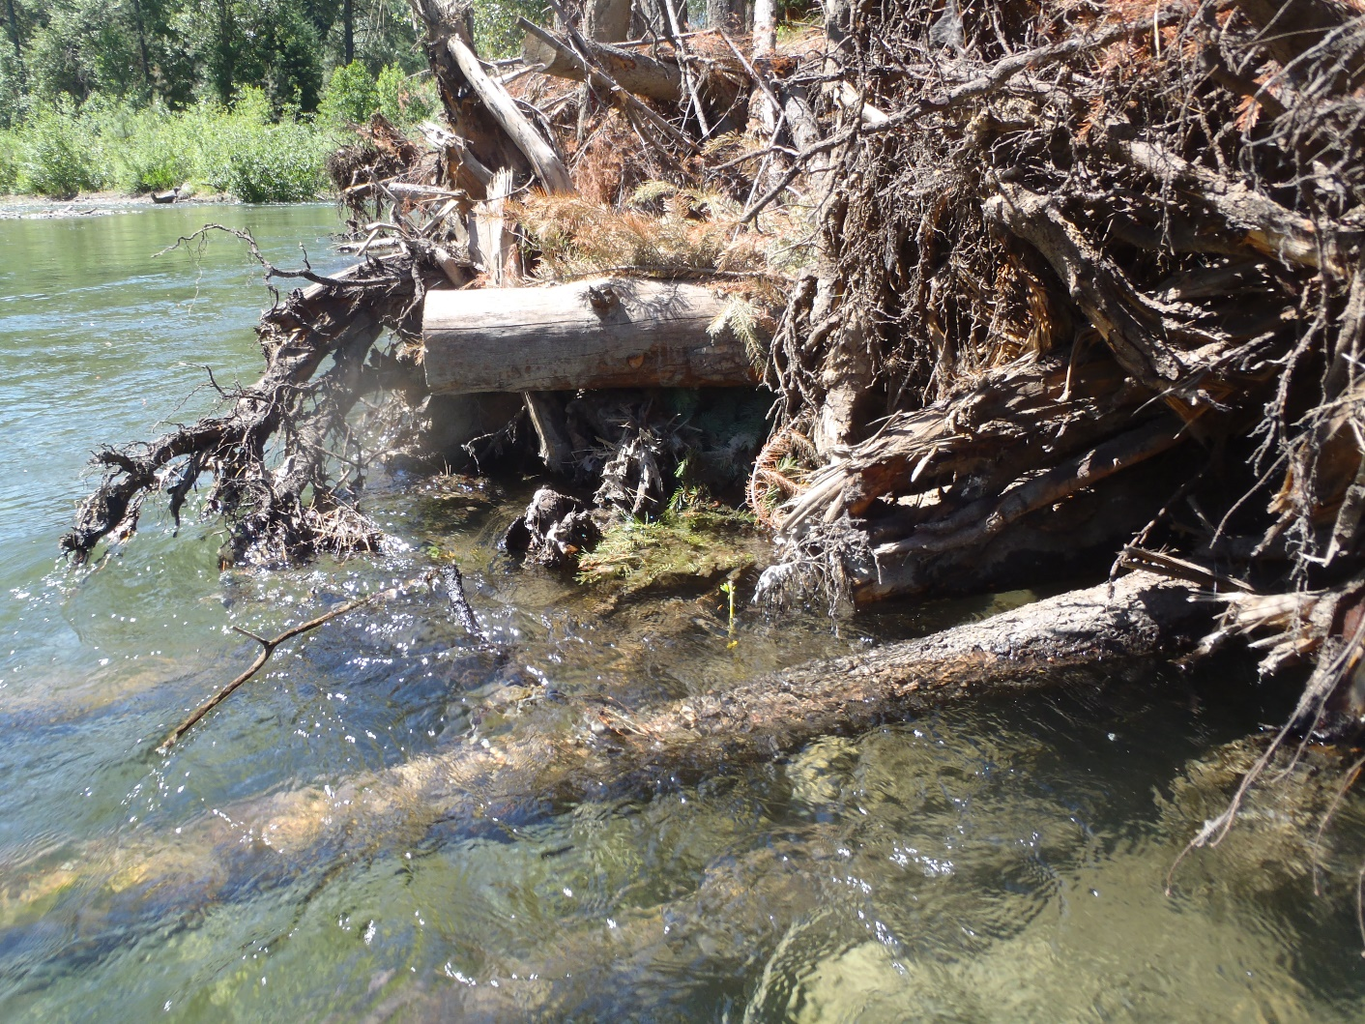
Project Monitoring

Slide 31
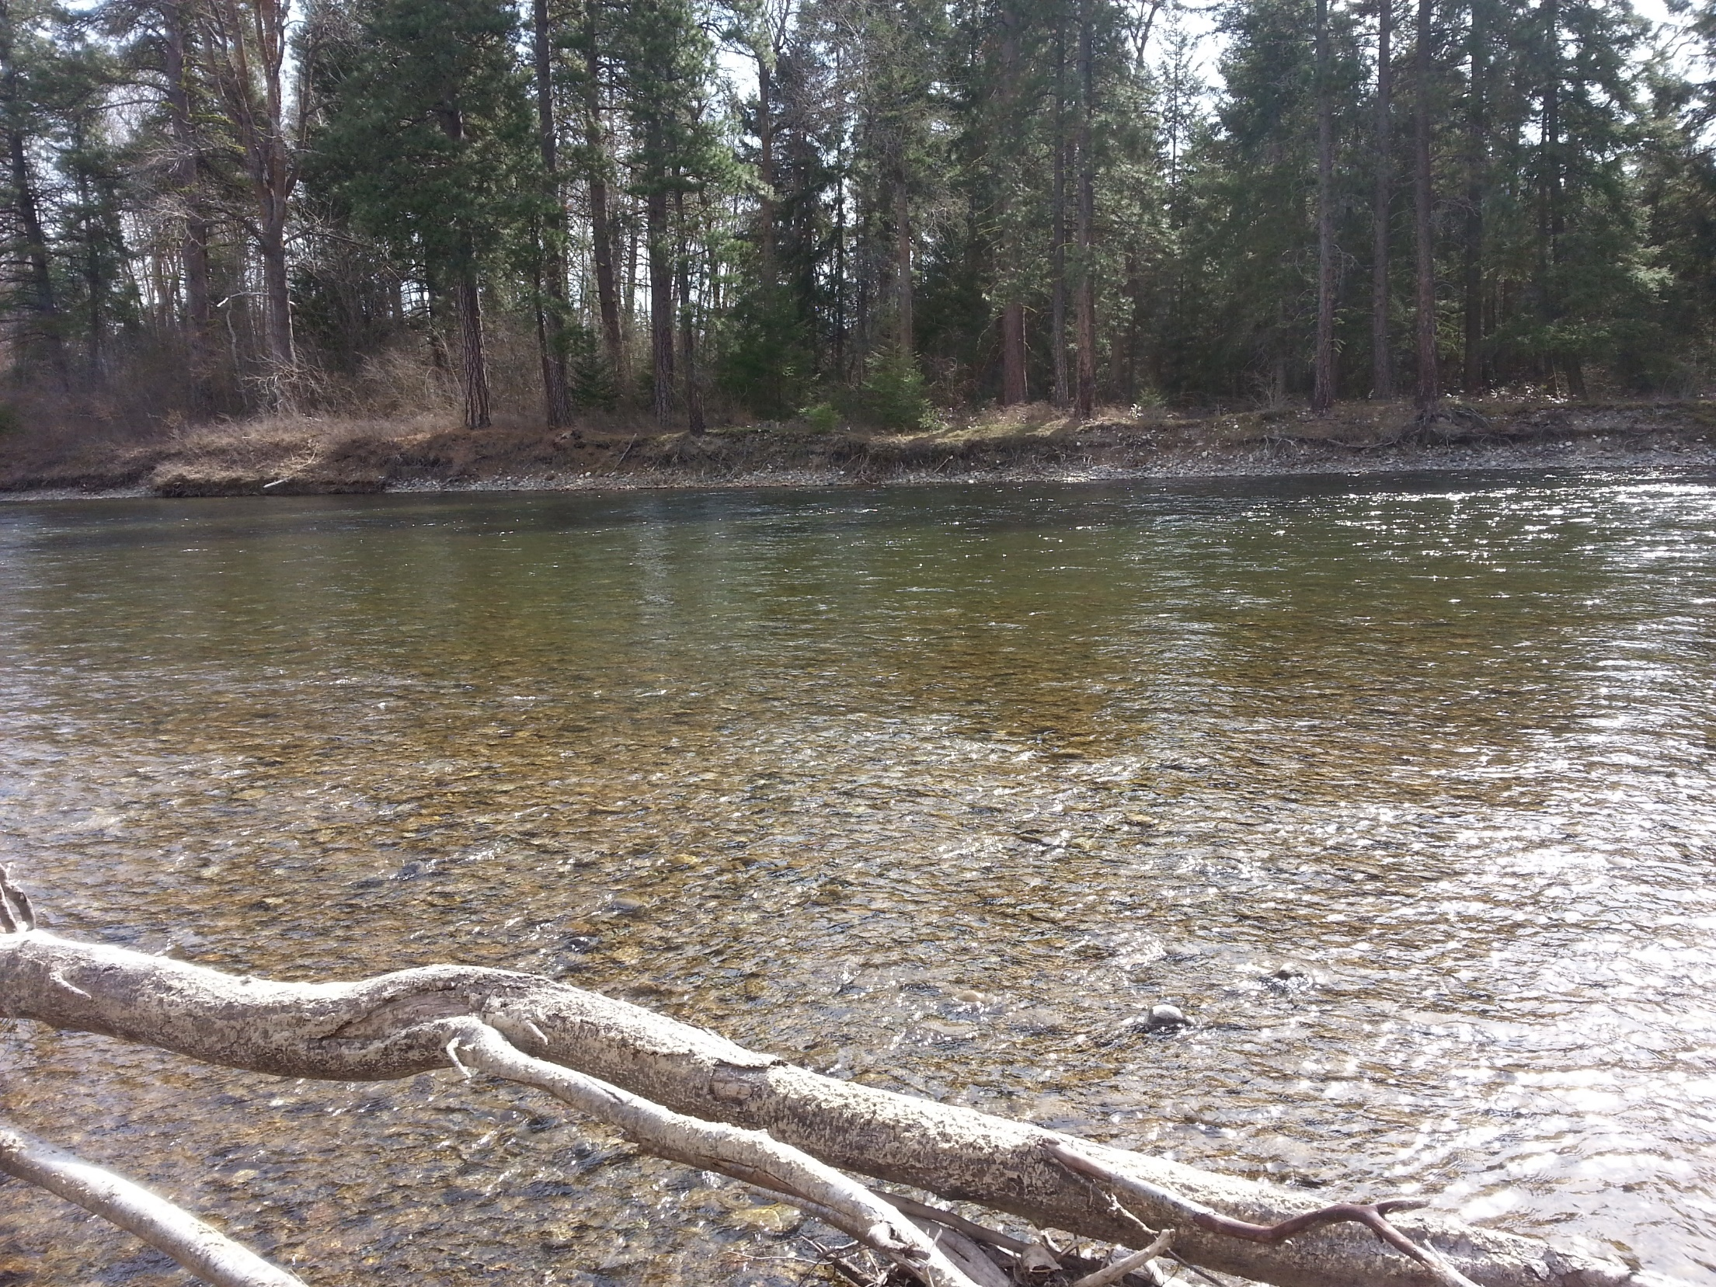
Next work site…

Slide 32
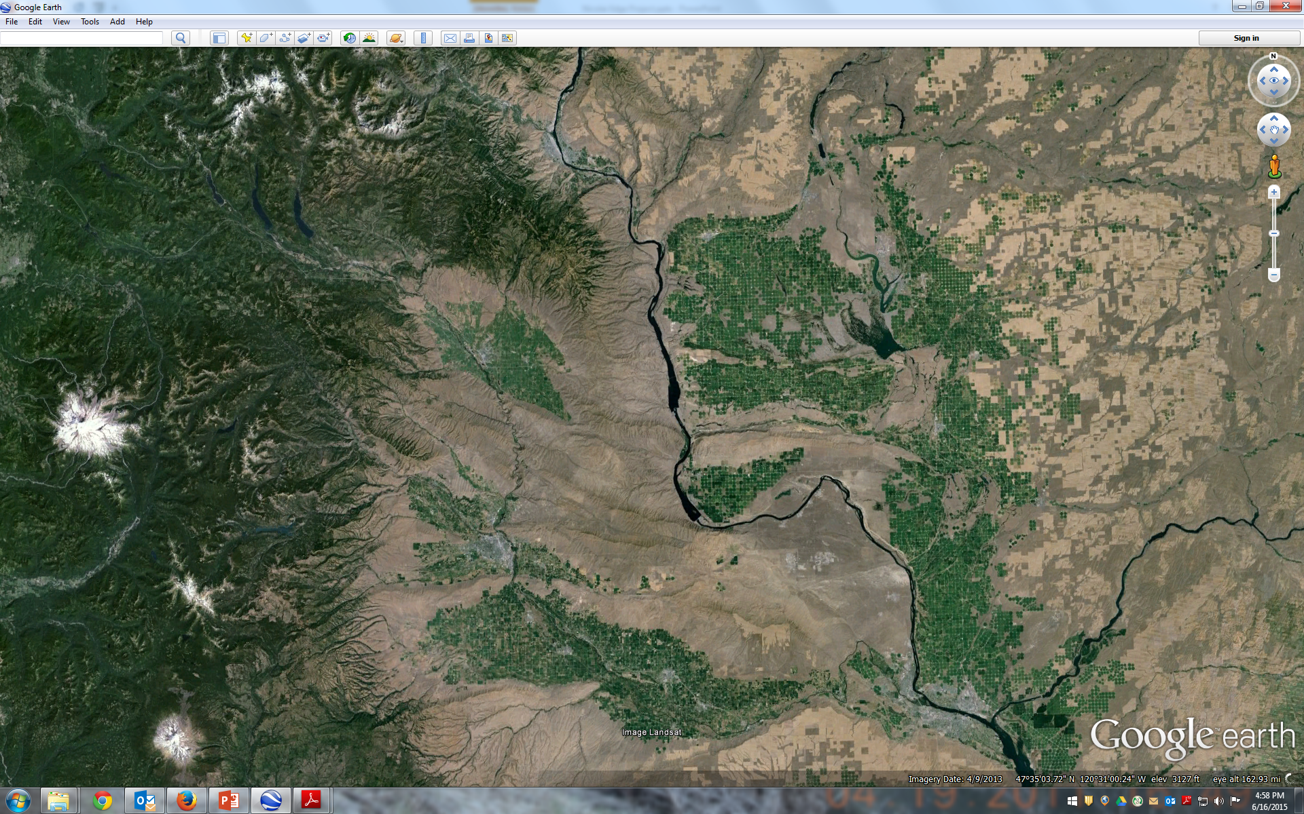
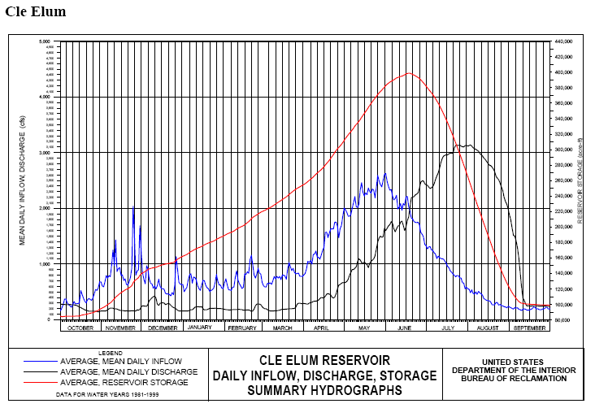
Other Locations?

Slide 33
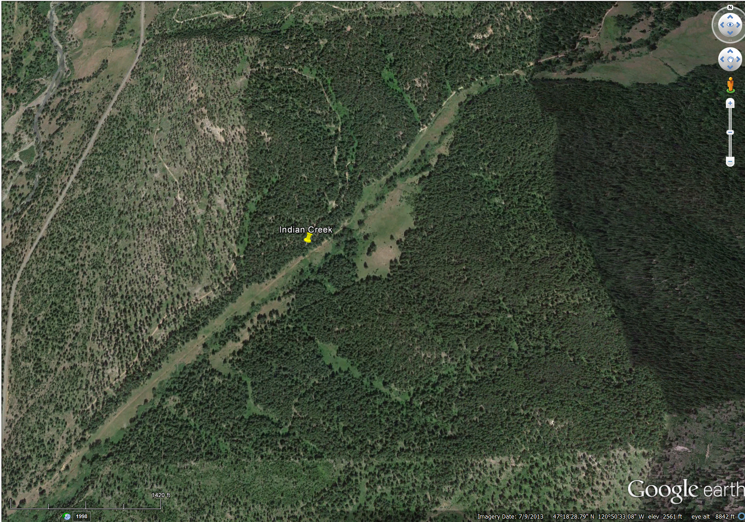
UPDATE: Indian Creek Restoration Project
T21N R16E W.M., Section 16

Slide 34
Teanaway Community
Forest Land
Notes:
Scott

Slide 35
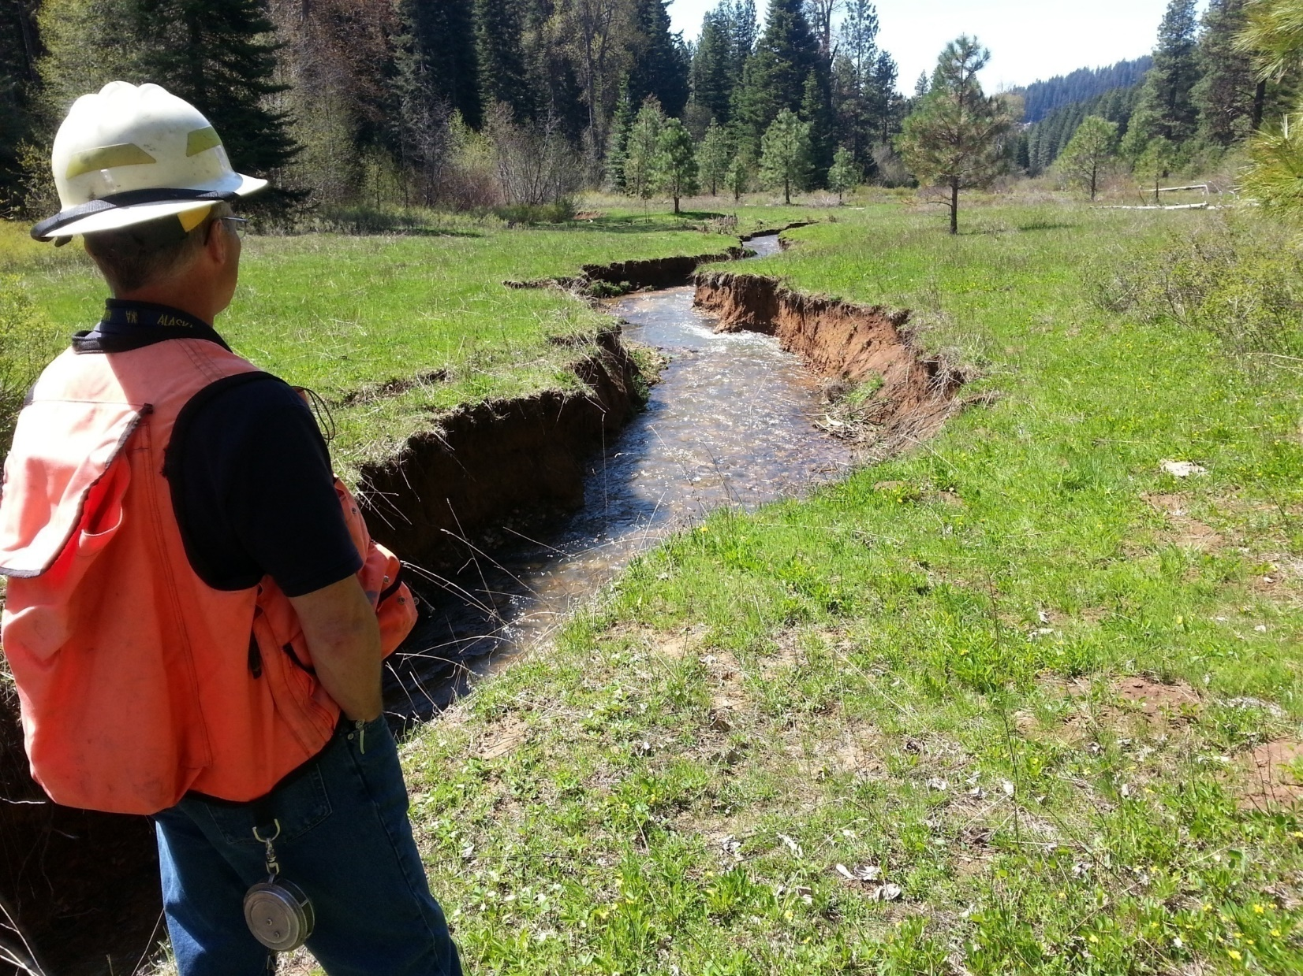
This stream has lost it’s “rebar”.
Channel Incision!
Dry Meadows!
Notes:
Why would you add wood to the stream here?
Look at the ponderosa pines on the former wet meadow. The groundwater table is not being recharged during floods! Instream flows are diminished! Flood peaks are higher! The stream is a ditch!
Left alone, this stream may never recover from channel incision.
This watershed has already experienced diminished summer flows, warmer maximum temperatures and earlier runoff. Our climate change consideration is less water for fish and irrigation, warmer stream temperatures, more frequent flooding. So,,, adding wood is a good idea to ameliorate these future impacts.

Slide 36
Indian Creek Restoration Project
Approximate instream wood replenishment locations
Notes
25 total wood replenishment locations
30 logs placed at each site including 8 with rootwads

Slide 37
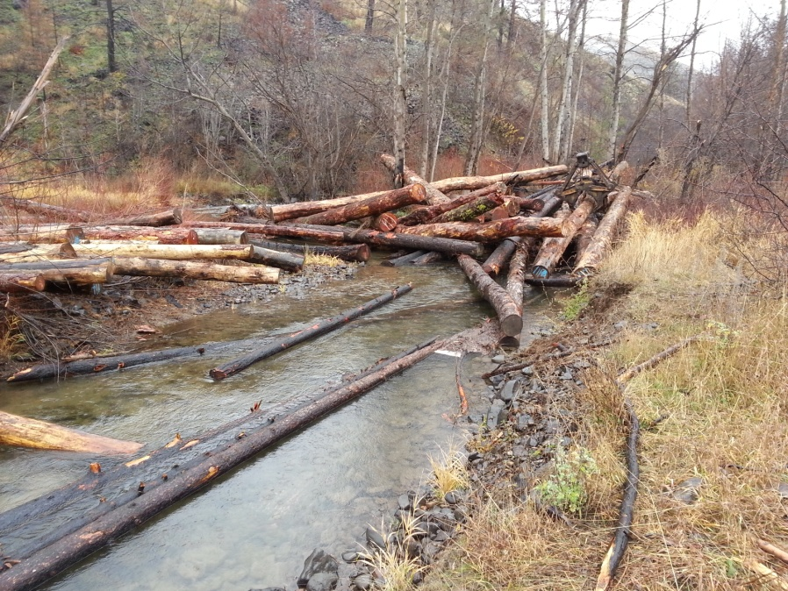
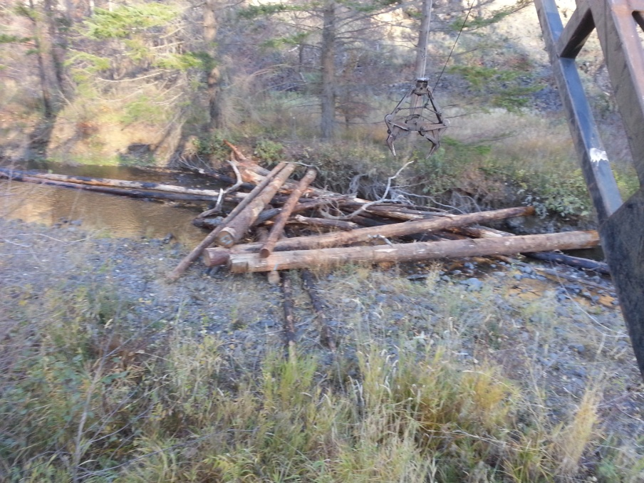
Indian Creek Restoration Project
Stream channel cross-section
Before
Notes
Not to scale
25 wood replenishment jams are proposed in this phase
Each would include 30 logs, 8 logs will include rootwads
Photographs of typical replenishment jams shown below
After

Slide 38
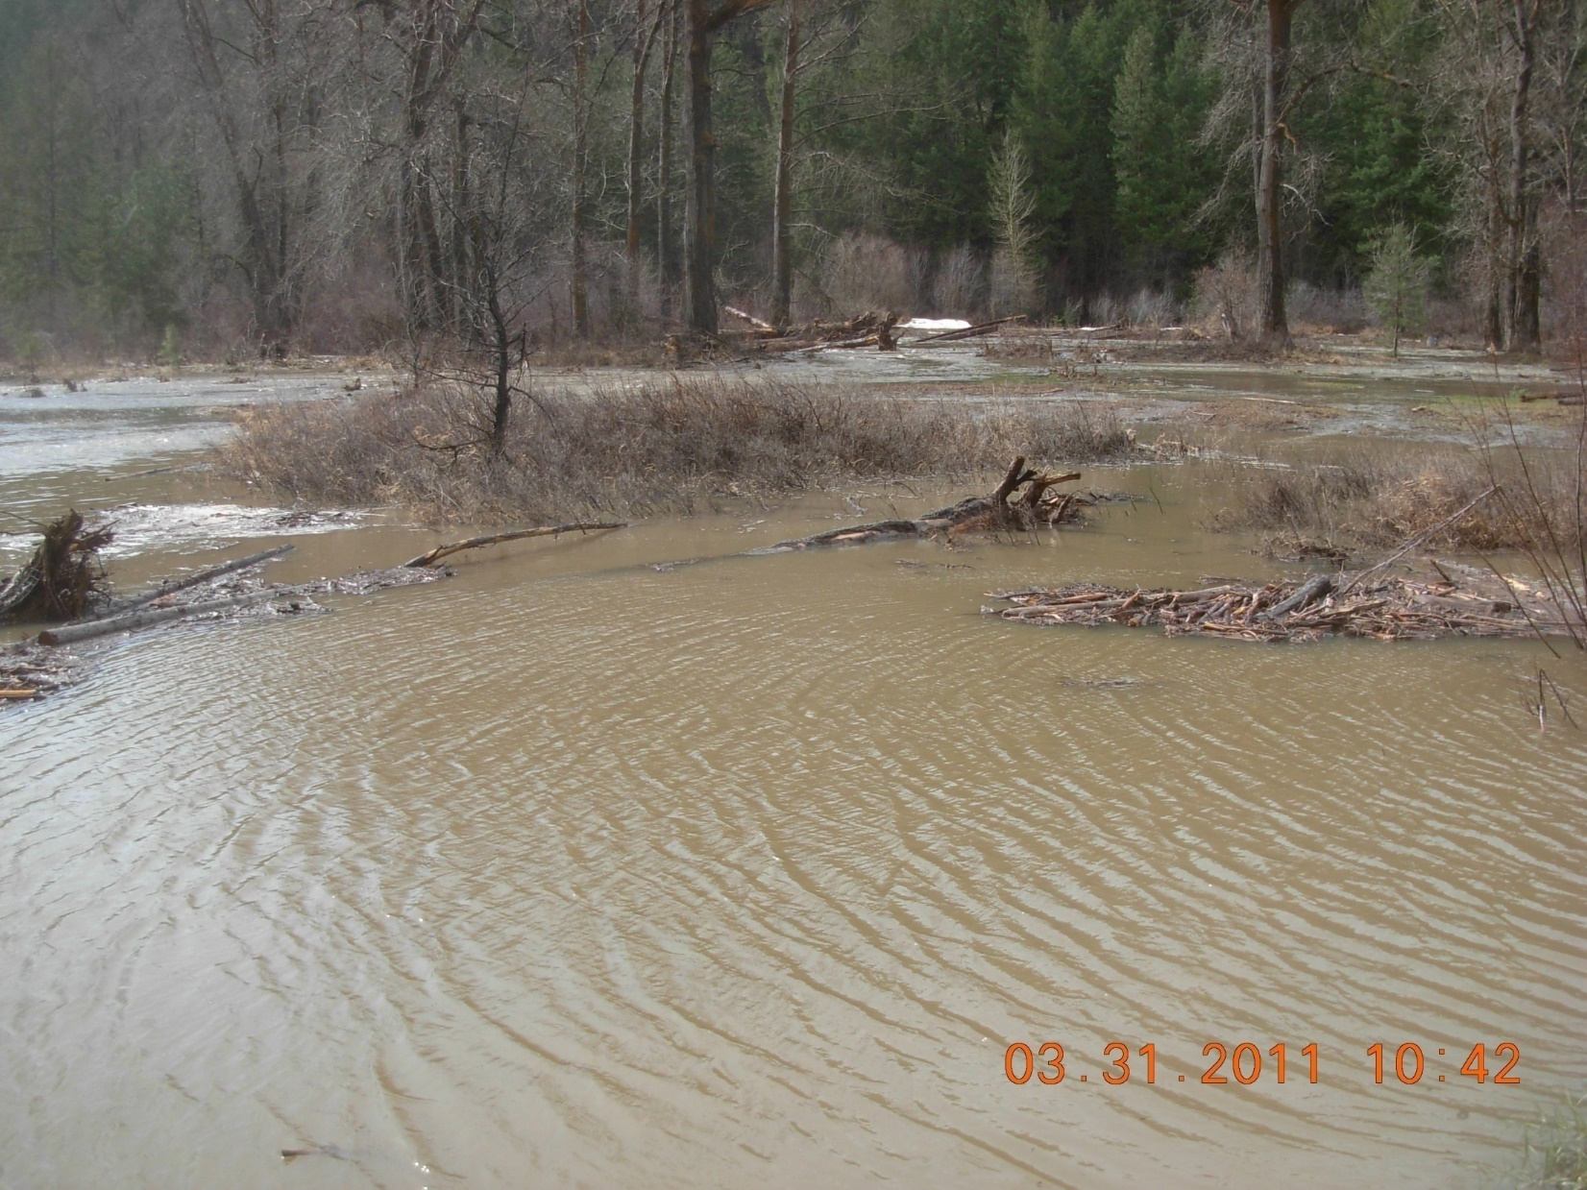
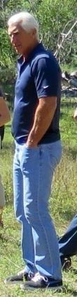
Notes:
Selling the public – spread the water out across the unencumbered floodplains! Good for irrigation! Good for fish! Good for flood hazard reduction! Hopefully the congressman is impressed!

Slide 39
Permitting, Licensing, Use Agreement Process…
Lengthy!

Slide 40
