Slide 1
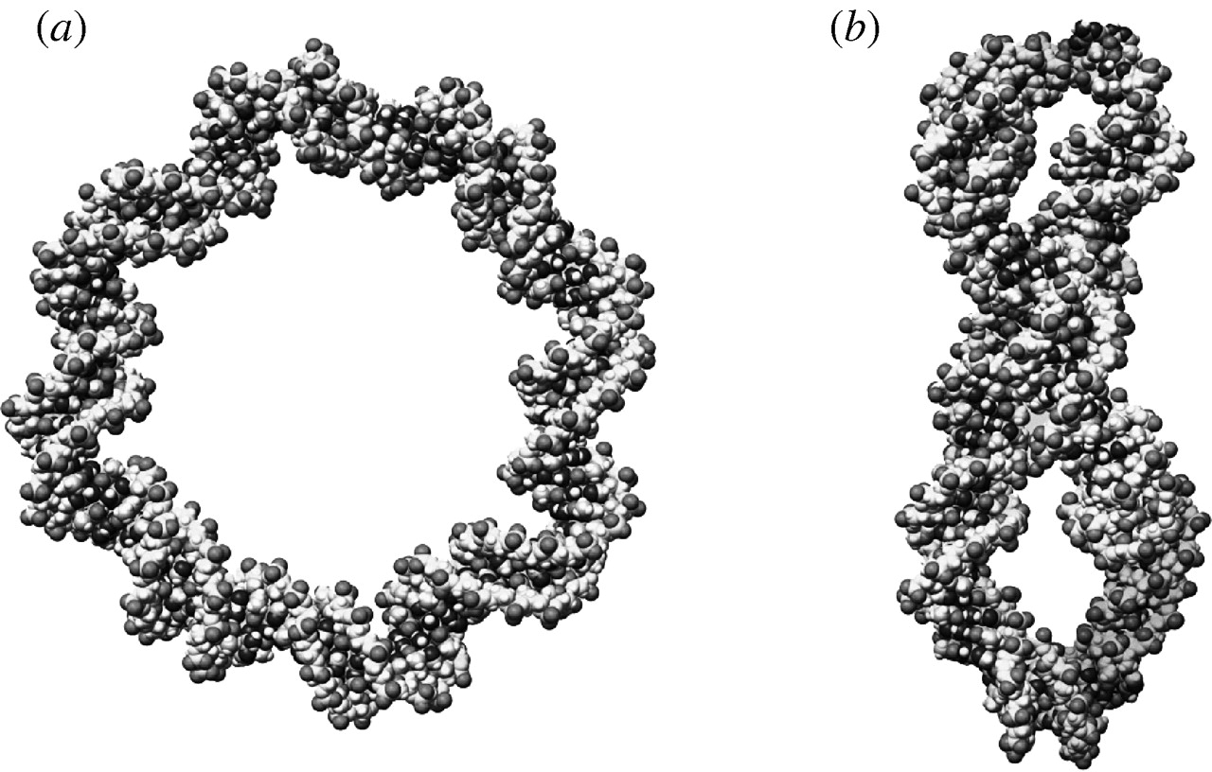
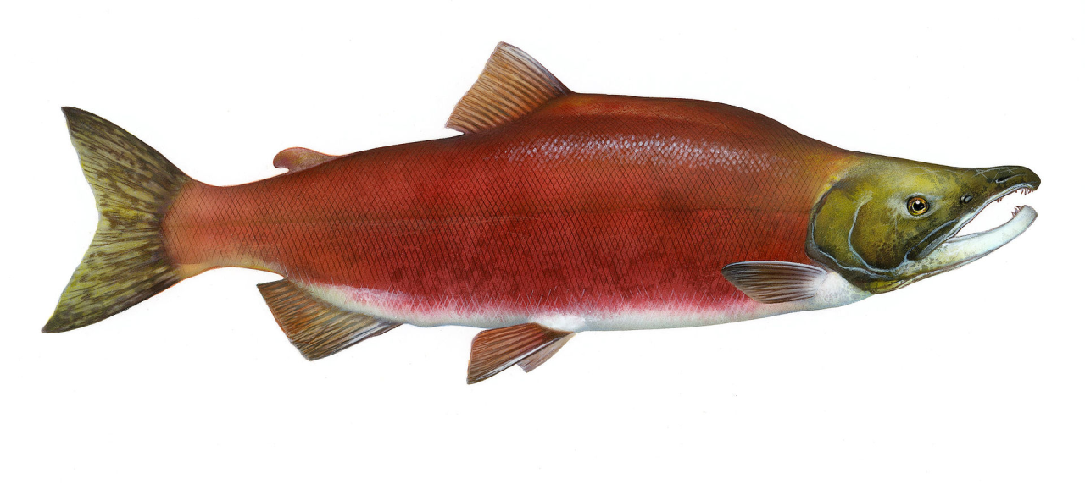


Genetic monitoring of sockeye salmon
reintroduction into Cle Elum Lake
Timothy Knepp
Andrew P. Matala, Peter F. Galbreath
Columbia River Inter-Tribal Fish Commission
Brian Saluskin, Mark Johnston
The Confederated Tribes and Bands of the Yakama Nation

Slide 2
Outplanted stocks: Life history
Okanogan
Wenatchee
Cle Elum Lake
PRD
Wenatchee: cold, typical
Okanogan: warmer, eutrophic
  age-4 & age-5
  Sept. & Oct.
  above lake (↓shore)
  1 year
  earlier (?)
  yearling ~83mm
  Adult age
  Spawn time
  Habitat
  Juvenile rearing
  Juvenile migration
  smolt size
  age-3 & age-4
  Oct. & Nov.
  index river reaches
  1 to 2 years
  later (?)
  yearling >100mm
Notes:
Lake Osoyoos has a higher production of planktonic biomass. Details of the procedure used as the basis to differentiate smolt stock of origin (Fryer 1994, 1995).

Slide 3
M&E: questions & objectives
Stocks well differentiated (genetically distinct)
Will one “outperform” the other?...reproductive success
Will stocks interbred...hybrids more productive?
factors disproportionately favoring one stock?

Slide 4
yes
Estimate stock proportions
(outplants, juveniles, adult returns)

Slide 5
Adult PRD outplants
Variable, dominated by OK
Wenatchee
Okanogan
2011
n=4,500
2012
n=10,000
2013
n=4,000
2014
n=10,000

Slide 6
Juvenile outmigrants
Variable, possible age structure, possible non-random samples
Wenatchee
Okanogan
2012
n=193
2013
n=379
2014
n=103

Slide 7
Roza Dam: Adult returns
Wenatchee
Okanogan
2009
n=17
2010
n=40
pre-reintroduction

Slide 8
Roza Dam: Adult returns
Wenatchee
Okanogan
2009
n=17
2010
n=40
2012
n=154
2013
n=691
2014
n=2,576
pre-reintroduction
natural-origin Cle Elum progeny

Slide 9
Acclimation / behavior:
(juvenile growth & migration)
Notes:
Break this out by year

Slide 10
Annual variation in size
2012
138
142
Cle Elum Lake outmigrants
sample proportion
fork length (mm)
Notes:
Break this out by year

Slide 11
Annual variation in size
2012
138
142
Cle Elum Lake outmigrants
sample proportion
fork length (mm)
2013
108
126
sample proportion
fork length (mm)
Notes:
Break this out by year

Slide 12
Annual variation in size
2012
138
142
Cle Elum Lake outmigrants
sample proportion
fork length (mm)
2013
108
126
2014
102
111
sample proportion
sample proportion
fork length (mm)
Wenatchee tend to be larger
fork length (mm)
Notes:
Break this out by year

Slide 13
Acclimation / behavior:
(adult return time & size-at-age)
Notes:
Break this out by year

Slide 14
2014 Return: daily counts
Bonneville Dam
Counts (% total return)
July 1

Slide 15
2014 Return: daily counts
~ 1 week: Bonn to PRD
Priest Rapids Dam
Counts (% total return)
July 9

Slide 16
2014 Return: daily counts
~ 2 weeks: PRD to Wells
Wells Dam
Counts (% total return)
July 14

Slide 17


2014 Return: daily counts
~ 4 week lag
no stock difference
Counts (% total return)
Roza Dam: August 9

Slide 18
returning adult size distribution
Age structure appears typical of donor populations
female
50.3
45.4
male
51.1
45.9
2-salt
2-salt
1-salt
1-salt
% total return (by stock)
fork length (cm)
fork length (cm)

Slide 19
Acclimation / behavior:
(spawn time & distribution)
Notes:
Break this out by year

Slide 20
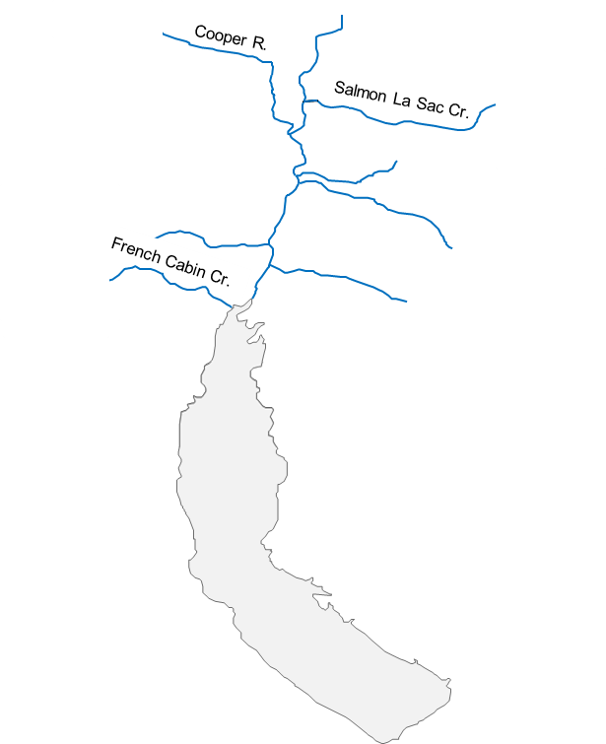

Carcass Surveys: Reach #1
Wenatchee
Okanogan
reach #1
(n = 61)
% reach total
collection date

Slide 21
Carcass Surveys: Reach #2
Wenatchee
Okanogan
reach #2
(n = 91)
% reach total
collection date

Slide 22
Carcass Surveys: Reach #3
Wenatchee
Okanogan
reach #3
(n = 198)
% reach total
collection date

Slide 23
Carcass Surveys: 2011-2014
Summary among all three river reaches
overall temporal distribution
cumulative (by stock)
% total
% total
sample date
sample date

Slide 24
M&E Summary:
(what I think is occurring)
Notes:
Break this out by year

Slide 25
Influence on migration - temperature

Slide 26
Multiple juvenile age groups
Cle Elum Lake outmigrants
yearling
smolts
age-2
smolts
% sample
fork length (mm)
WE ~ dominated by age-2; (typical is 1 year lake rearing)
Notes:
Break this out by year

Slide 27
Multiple juvenile age groups
Cle Elum Lake outmigrants
yearling
smolts
age-2
smolts
% sample
fork length (mm)
WE – appear to be largely all one age class
Age structure of adults appears typical of donor populations
WE ~ dominated by age-2; (typical is 1 year lake rearing)
OK – adapted to eutrophic conditions
OK – smaller; slower growth in Cle Elum?
Notes:
Break this out by year

Slide 28
Different spawning habitat
Wenatchee – primarily inlet streams
Okanogan – primarily shore/beach
outplant release ~ July
n=61
gillnet by-catch
Oct. 29th – Nov. 5th
Support: 100% of near shore captures are OK

Slide 29
Different spawning habitat
Wenatchee – primarily inlet streams
Okanogan – primarily shore/beach
entrainment
2009 Roza
2010 Roza
dam and spill
Support: 23 outplants recaptured at Roza (all OK)

Slide 30
Different spawning habitat
Wenatchee – primarily inlet streams
Okanogan – primarily shore/beach
reach #3: nearest lake
Support: majority of recovered OK carcasses (93%)

Slide 31
Little to no reproductive interaction – NO HYBRIDS
Concluding points
Important future M&E: what will the F2’s do?
Reproductive isolation: stocks >99% pure
- no hybrids among emigration juveniles
- no hybrids among returning adult progeny
age-structure differs by donor stock-of-origin
- partially characteristic of natal regions
- new environment imparts some unique differences

Slide 32
Little to no reproductive interaction – NO HYBRIDS
Concluding points
Important future M&E: what will the F2’s do?
Reproductive isolation: stocks >99% pure
- no hybrids among emigration juveniles
- no hybrids among returning adult progeny
age-structure differs by donor stock-of-origin
- partially characteristic of natal regions
- new environment imparts some unique differences
Both stocks reproductively successful
- utilizing all available habitat
- high genetic variability

Slide 33
Little to no reproductive interaction – NO HYBRIDS
Okanogan
2010
outplants
2011
outplants
2010
outplants
2011
outplants
Not sampled
?
Not sampled
?
age-2
age-1
age-2
age-4
age-3
age-4
2013
smolts
2014
smolts
2014
adults
2015
adults
Not sampled
?

Slide 34
Little to no reproductive interaction – NO HYBRIDS
Wenatchee
2010
outplants
2011
outplants
2010
outplants
2011
outplants
Not sampled
?
Not sampled
?
age-2
age-1
age-2
age-4
age-5
age-4
2013
smolts
2014
smolts
2014
adults
2015
adults
Not sampled
?

Slide 35
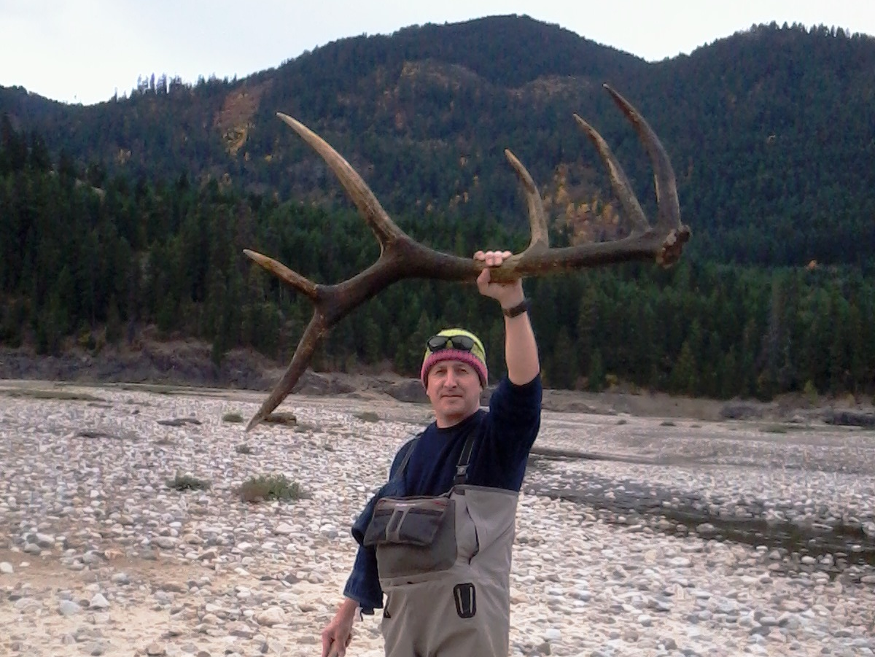



That’s all!
Mark Johnston, YN field technical staff,
Roza and Chandler technical staff
Supplementation ACCORDS project
- (Peter Galbreath)
Nick Hoffman, Travis Jacobson, Shawn Narum

