Slide 1
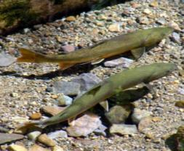
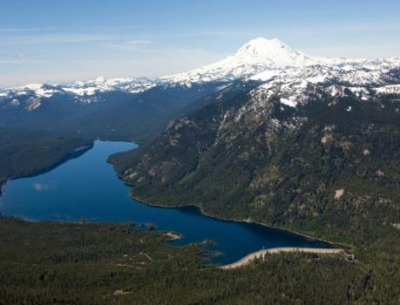
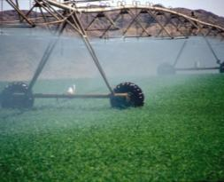
Yakima River Basin Integrated Water Resource Management Plan - Update
Yakima Basin Science and Management Conference
June 17, 2015
Presented by:
Walter Larrick, Reclamation

Slide 2
Outline
Integrated Plan Background and Overview
Teanaway Community Forest
Habitat/Watershed Protection and Enhancement
Enhanced Water Conservation
Current Status of Initial Development Phase
Schedule

Slide 3
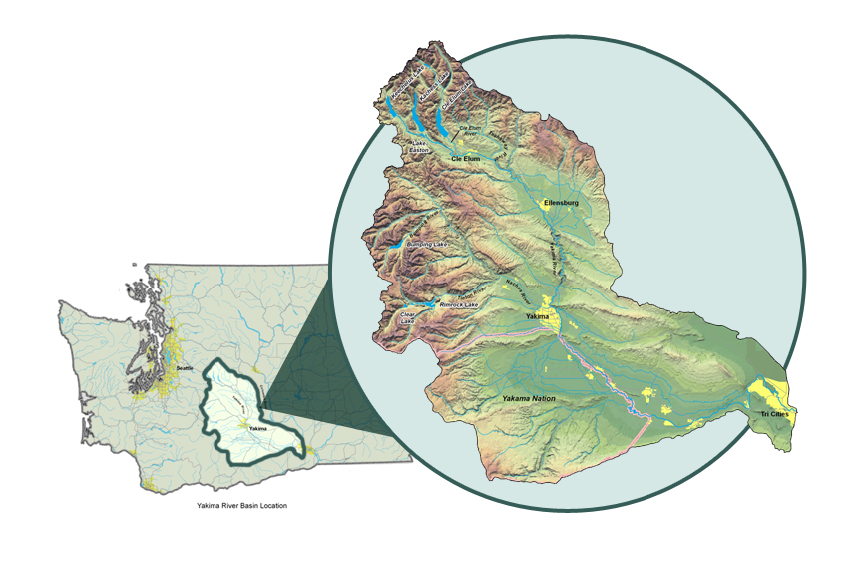
Yakima River Basin: Overview
6,155 Square Miles
Population 360,000
Second-largest agricultural-producing region in America
  $1.8 billion Ag; $2.3 billion food-processing industry
  Apples, wine grapes, hops, hay
Salmon and Steelhead Runs
  Second only to Snake River
Diverse outdoor recreation
  Pack and saddle, hiking, dirt biking, camping, fishing, hunting, snowmobiling

Slide 4
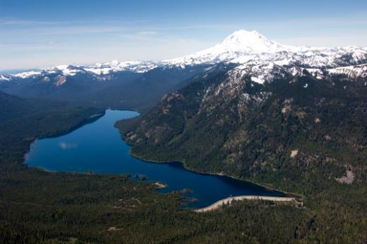
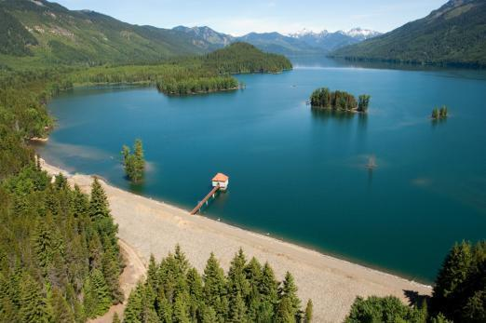
Yakima River Basin Water Management
Managed by Bureau of Reclamation
5 reservoirs with 1M acre-feet of capacity (average annual runoff 3.3M acre-feet)
Snowpack is the “sixth reservoir”
Irrigation deliveries:
1.7M acre-feet

Slide 5
Water Problems in the Yakima River Basin
Adjudication ► 30+ year effort to determine rights
Droughts/Water Shortages ► 1 year out of 4 since 1990
Anadromous fish runs ► Not sustainable
    Sockeye, Chinook, coho, steelhead, bull trout ► Extirpated, reduced, and/or threatened (800,000 historical; now averaging 15,000-20,000).
Climate change ► Runoff timing changed and changing; creating less snow and less summer water

Slide 6
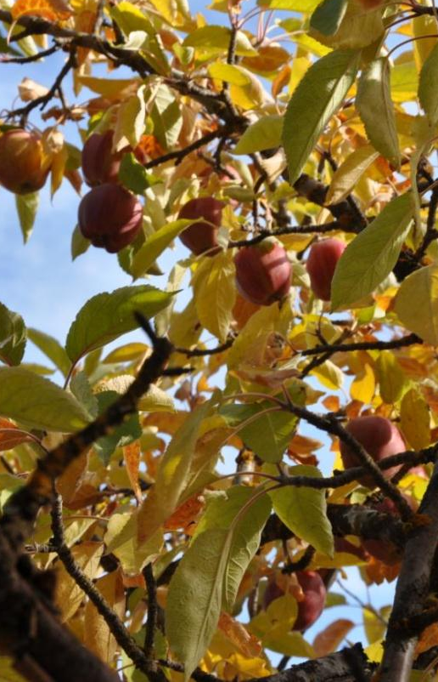
Declining Water Supply
Surface water is over-appropriated
Droughts in 1992-1994, 2001 and 2005
Proratable irrigation districts reduced to as little as 37% of allotments
Snowpack declining (12-71% runoff)

Slide 7
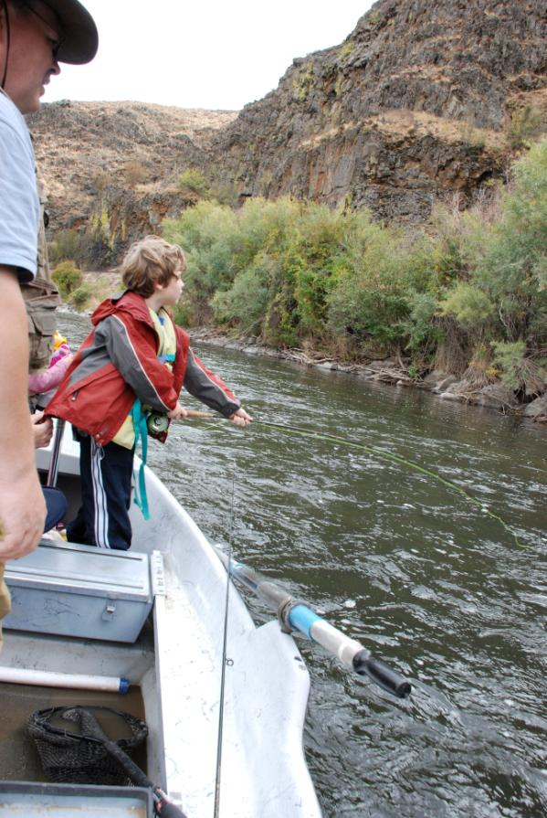
Reduced Fisheries
Historic salmon and steelhead run
  800,000 fish
Average run size last 10-15 years
  15,000-20,000 fish
Native coho, sockeye and summer Chinook extirpated
  Coho reestablished, sockeye being reestablished
Spring and fall Chinook
  Seriously reduced
Steelhead and bull trout
  ESA Threatened species

Slide 8
An Emerging Solution
Yakima River Basin Integrated Plan Goals:
  Provide opportunities for ecological restoration and enhancement, including fish passage
  Improve water supply during drought years
  (70% proratable supply)
  Provide for efficient and adaptable water supply management
  Contribute to sustainable economy and environment

Slide 9
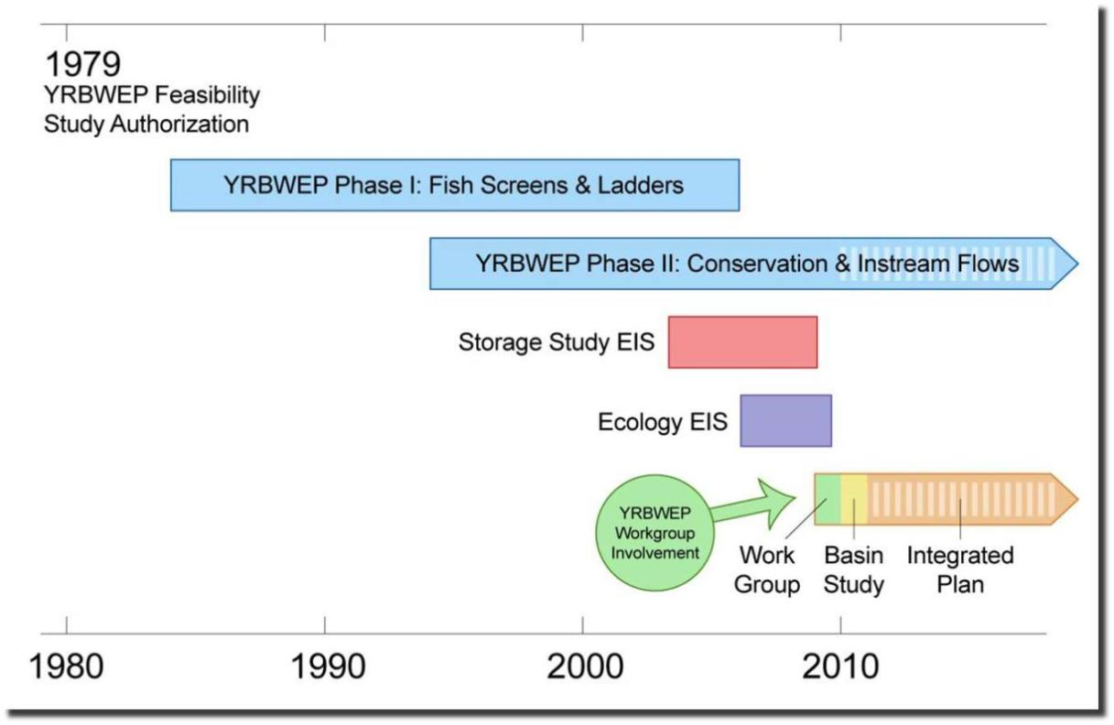
Yakima River Basin Water Enhancement Project Timeline

Slide 10
YRBWEP Workgroup Members
Federal Agencies
  Bureau of Reclamation
  National Marine Fisheries Service
  U.S. Fish and Wildlife Service
  U.S. Forest Service
Yakama Nation
  Yakama Nation Natural Resources
  Yakima/Klickitat Fisheries Project
Washington State Agencies
  Department of Ecology
  Department of Agriculture
  Department of Fish and Wildlife
  Department of Natural Resources
Local Governments
  Benton County
  Kittitas County
  Yakima County
  City of Yakima
Irrigated Agriculture
  Kennewick Irrigation District
  Kittitas Reclamation District
  Roza Irrigation District
  Sunnyside Valley Irrigation District
  Yakima-Tieton Irrigation District
Other Stakeholders
  American Rivers
  Yakima Basin Fish & Wildlife Recovery Board
  Yakima Basin Storage Alliance
  Trout Unlimited

Slide 11
Yakima Integrated Plan: Keys to Future Success
Integrated Plan applies a collaborative approach that uses a range of tools for synergistic problem-solving to address multiple challenges
Interior’s Strategic Plan FY2014/FY2018
  Manage Water and related resources in the Columbia River
    Support elements of the Yakima Basin Integrated Plan that are cost-effective and have a strong Federal interest
Strengthening Tribal Nations
  Tribal Trust, Treaty and Other Responsibilities
Endangered Species
  Protect and recover the Nation’s fish and wildlife populations with partner’s, including states.
Climate Change and Resilience
  Better ensure the future of watersheds against the impacts of climate change

Slide 12
Integrated Water Resource Management Plan (IWRMP)
Seven elements:
  Fish passage at existing reservoirs
  Habitat protection and enhancements
  New or expanded storage reservoirs
  Groundwater storage
  Enhanced conservation
  Market-based reallocation of water resources
  Structural and operational changes to existing facilities
Notes:
Conservation only will not solve basin water problems
Storage only will not solve basin water problems

Slide 13
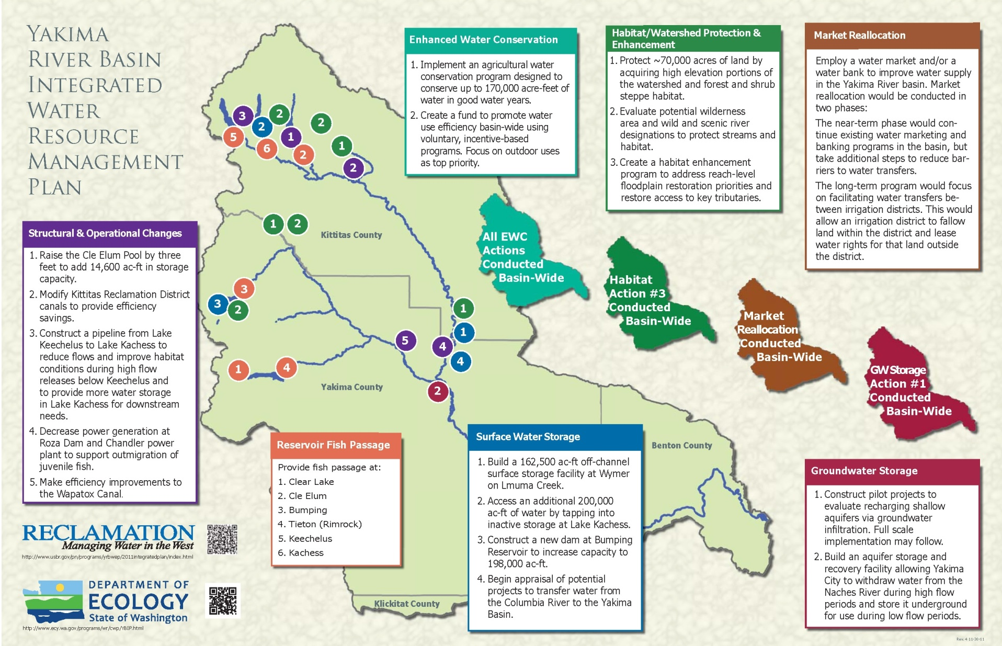
Plan Overview

Slide 14
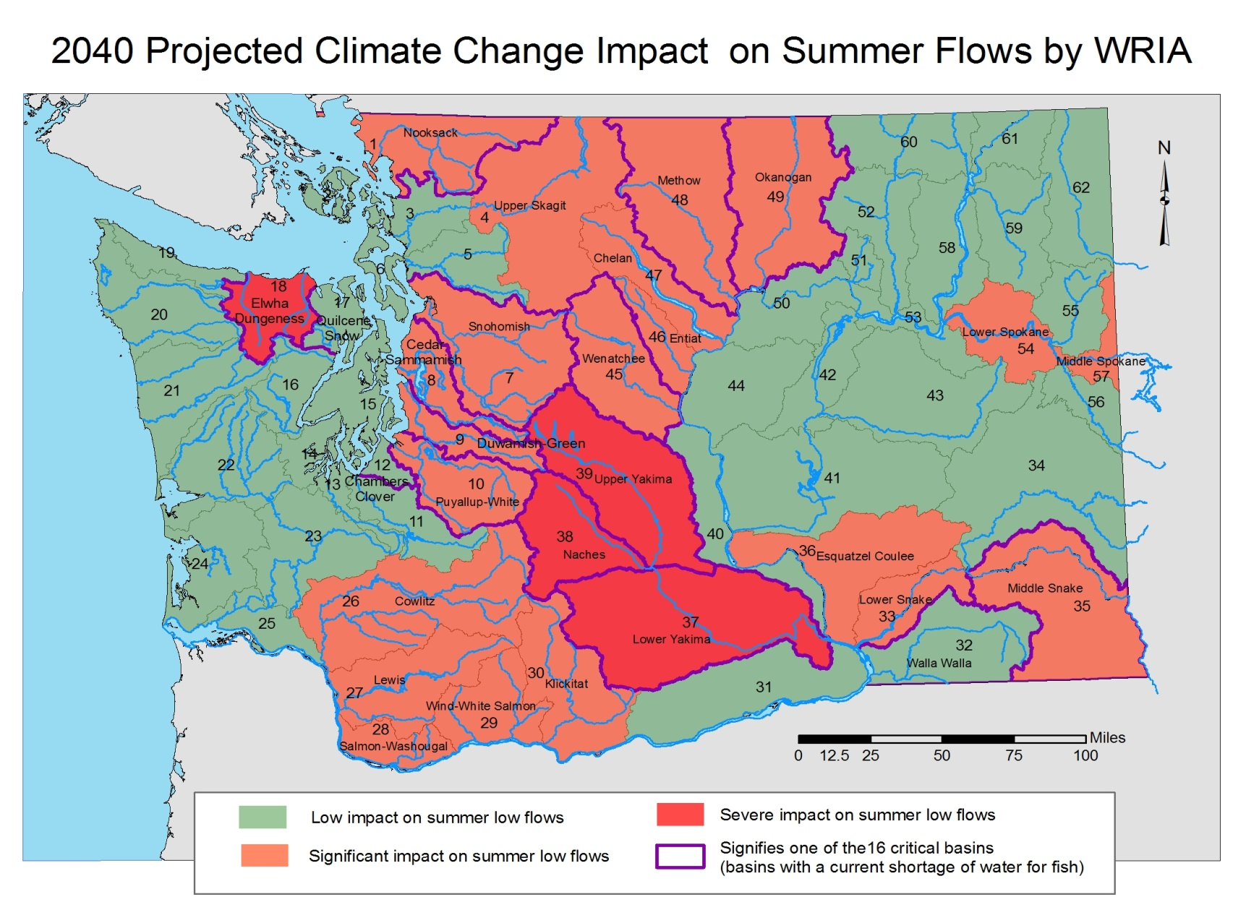
Climate Change Forecast

Slide 15
Climate Change Scenario Results
Average April 1 TWSA (MAF)
Notes:
Preliminary IWRP – is the basis for the Basin Study

Slide 16
Climate Change Scenario Results
Average Irrigation Proration Level
Notes:
Preliminary IWRP – is the basis for the Basin Study

Slide 17
Ongoing Projects
Kachess Drought Relief Pumping Plant
Keechelus-to-Kachess Conveyance
Bull Trout Enhancement
Wymer Dam and Reservoir
Bumping Dam and Reservoir Enlargement
Cle Elum Pool Raise
Cle Elum Dam Fish Passage Facilities
Tieton Dam Fish Passage Facilities Study
Clear Lake Dam Fish Passage
Groundwater Storage – Basinwide Analysis
Groundwater Storage – City of Yakima Aquifer Storage and Recovery (ASR)
Manastash Creek Conservation and Tributary Enhancement
Habitat Enhancement and Agricultural Conservation Projects
Teanaway Community Forest

Slide 18
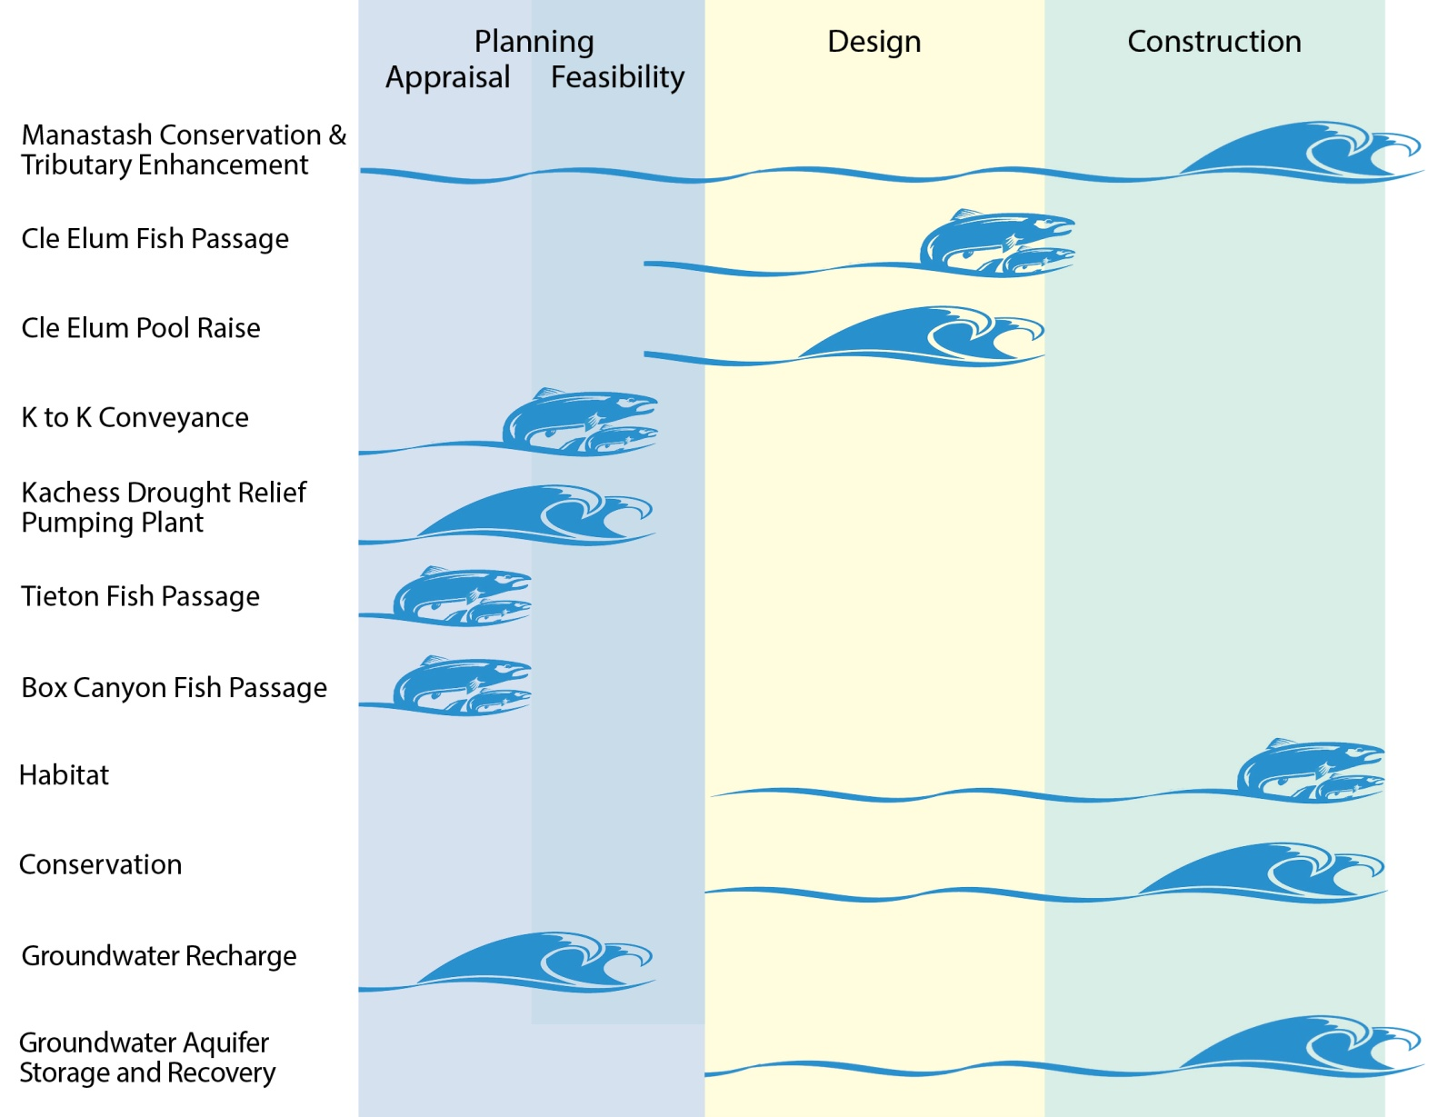
Accomplishments 2013-2015

Slide 19
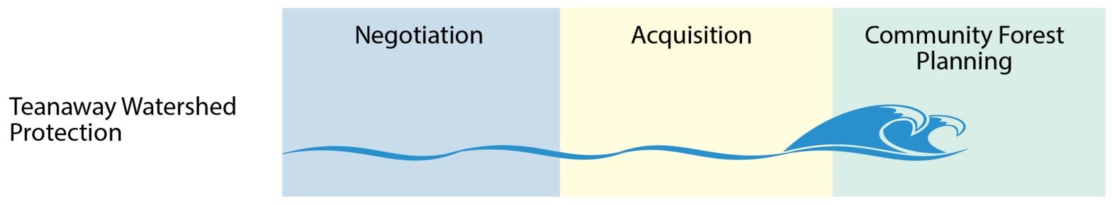
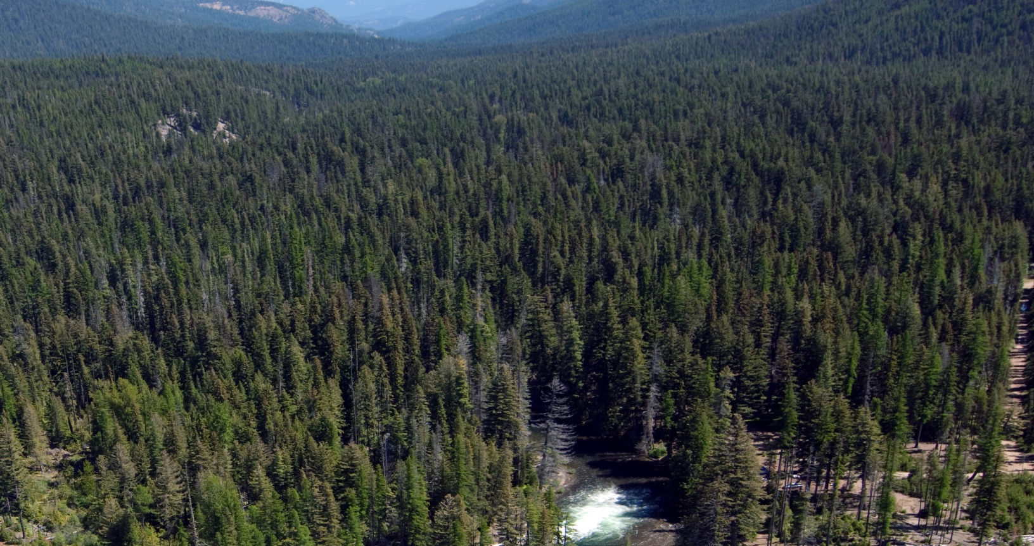
Accomplishments 2013-2015

Slide 20
Structural and Operational Changes

Slide 21
Structural & Operational Changes
Raise the Cle Elum Pool by 3 feet, adding 14,600 acre-feet to storage
  Final EIS released
  Radial gate modification design complete
  Construction could begin Fall 2015, contingent on completion of environmental compliance and funding.
Modify Kittitas Reclamation District canals for efficiency savings
  Manastash Creek Restoration - construction complete on Lateral 13.8 and project is operating successfully
  KRD working on developing other projects with coordination with NMFS and Yakama Nation
  Pilot project in process this year for tributary enhancement during drought year

Slide 22
Structural & Operational Changes (con’t)
Construct a pipeline from Keechelus to Kachess to reduce flows and improve habitat conditions during high-flow releases below Keechelus and to provide more water storage in Lake Kachess for downstream
      Draft EIS released to public
      Feasibility study in process
Decrease power generation at Roza Dam and Chandler Power Plants to support outmigration of juvenile fish
  Chandler
    Reviewing Chandler Pumping Plant electrification
  Roza
    Conducted 3-year study; draft final report - May 2015
    Defined flow-to-survival rate in reach
    Survival rate based on dam operations

Slide 23
Bull Trout Enhancement
Reclamation and Ecology have coordinated with USFWS, USFS, Yakama Nation, WDFW, and NMFS to formulate Bull Trout Enhancement program.
  Gold Creek
  Cold Creek
  Nutrient
  Assessments
BTE is part of all action alternatives in KKC/KDRPP EIS
MOU with Reclamation, Ecology, YN, USFWS, WDFW, USFS

Slide 24
Reservoir Fish Passage

Slide 25
Reservoir Fish Passage
Clear Lake Dam
Third year of study completed
Cle Elum Dam
  Construction to begin Fall 2015
Bumping Dam
Tieton Dam
  Appraisal Assessment to be complete Fall 2015
Keechelus Dam
Conceptual Design Report drafted, to be finalized after meeting with Yakima Storage Dam Fish Passage Core Team mid-June.
Kachess Dam
Conceptual Design Report drafted, to be finalized after meeting with Yakima Storage Dam Fish Passage Core Team in mid-June.

Slide 26
Surface Water Storage

Slide 27
Surface Water Storage
Build 162,500 acre-feet off-channel surface storage facility at Wymer on Lmuma Creek
Key Consideration Analysis and WDFW surveys in process
Access an additional 200,000 acre-feet of water by tapping into inactive storage at Lake Kachess
  Draft EIS released to public
  Feasibility study in process
Construct a new dam at Bumping Reservoir to increase capacity to 190,000 acre-feet
Key Consideration Analysis and WDFW surveys in process
Begin appraisal of potential projects to transfer water from the Columbia River to the Yakima Basin.

Slide 28
Groundwater Storage

Slide 29
Groundwater Storage
Construct pilot projects to evaluate recharging shallow aquifers via groundwater infiltration. Full-scale implementation may follow.
Initial siting analysis complete, pilot study in process
Build an aquifer storage and recovery facility allowing City of Yakima to withdraw water from the Naches River during high-flow periods and store it under-ground for use during low-flow periods.
City of Yakima began recharging water to the aquifer in March 2015, under a temporary ASR permit issued by Ecology.

Slide 30
Enhanced Water Conservation

Slide 31
Enhanced Water Conservation
Implement an agricultural water conservation program designed to conserve up to 170,000 acre-feet of water in average water years
  Completed 5 out of 7 projects for 2013-2015
  Water savings 2,874 acre-feet, in addition to the 40,000 acre-feet that has been acquired through YRBWEP.

Slide 32
Habitat/Watershed Protection and Enhancement

Slide 33
Habitat/Watershed Protection and Enhancement
Protect ~ 70,000 acres of land by acquiring high-elevation portions of the watershed and forest and shrub-steppe habitat
Over 55,000 acres of land has been acquired
Create a habitat enhancement program to address reach-level floodplain restoration priorities and restore access to key tributaries
  5 out of 14 projects for 2013-2015 have been completed
  3,170 acres of floodplain connectivity
  47,921 acres forested lands in little Naches
  1.9 cfs winter stock in trust Nov-Mar in Manastash Creek
  5 miles of improved instream flow in Cle Elum River side channel

Slide 34



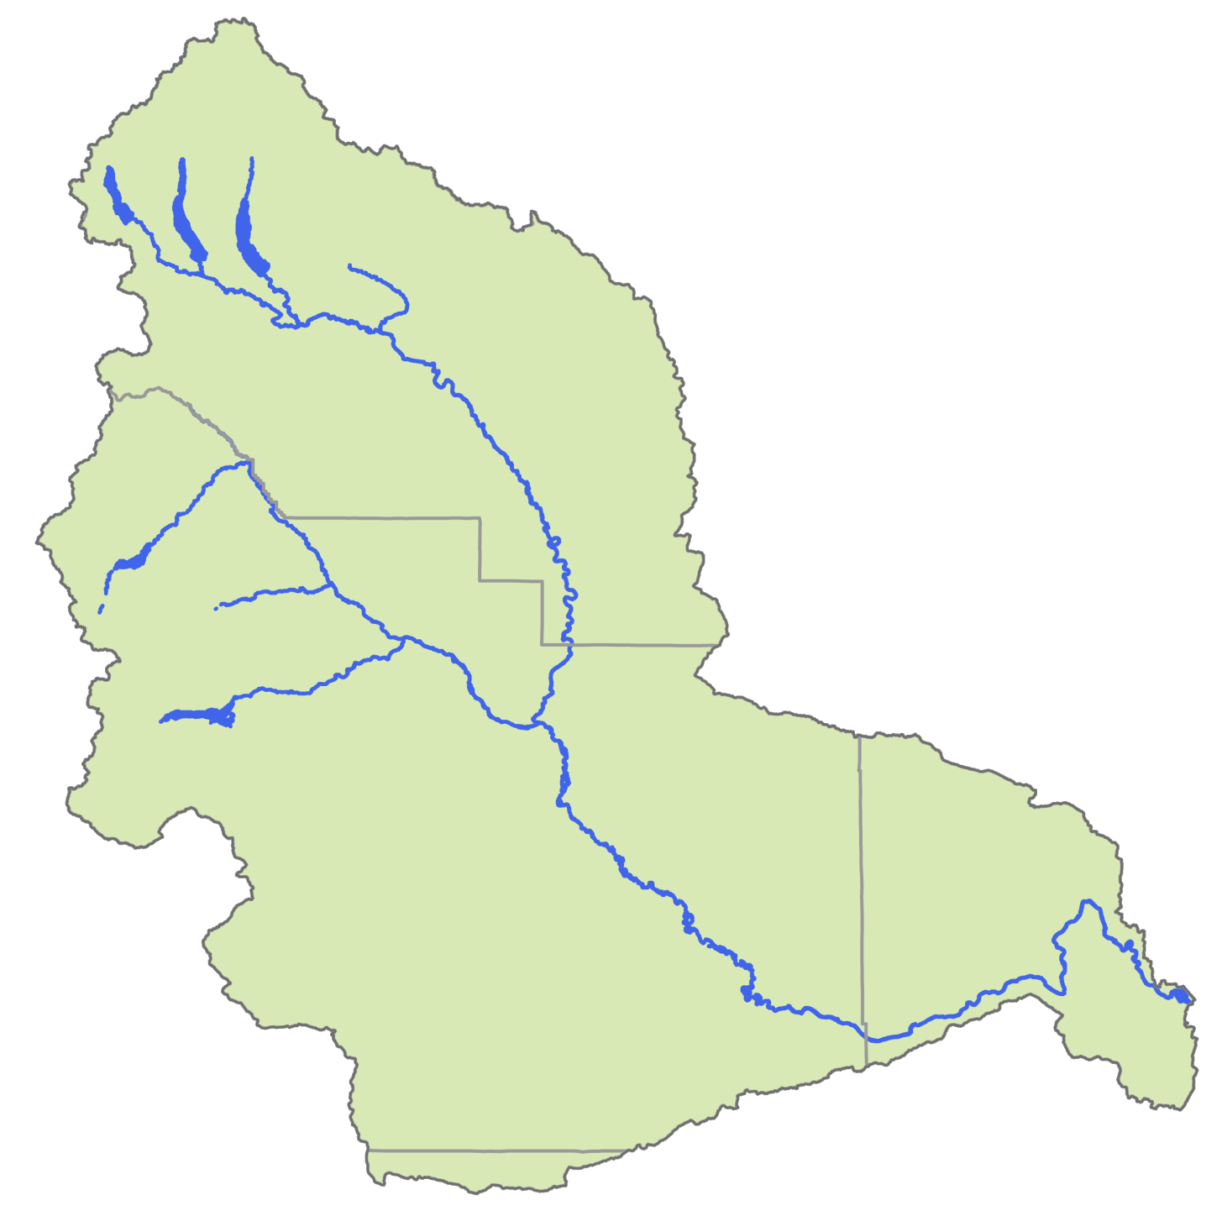


Habitat
Enhancement
Projects
Yakima Integrated Plan
Habitat Enhancement/Enhanced Agricultural Conservation Projects
2013-2015
Agricultural
Conservation
Projects
Gap-to-Gap Outfall Relocation
Toppenish Fan
Bateman Island Causeway Modification Conceptual Design
Bull Trout Task Force Habitat Improvements
Gold Creek Habitat Assessment and Conceptual Design
Reed Diversion design Barrier Removal
Little Rattlesnake Road Decommissioning
Cle Elum River Side Channel Restoration Project, Phase 2
Gap-to-Gap Property Acquisitions
Upper Wapato Riparian Restoration
Ellensburg Water Company / Coleman Creek Restoration
Reed Diversion Barrier Removal
Trout Meadows Acquisition / Enhancement
Manastash/ Little Naches Land Acquisition
Kennewick Irrigation District (KID) Division IV Lining
Wapato Irrigation Project (WIP) Piping Lateral 4-414C
Wapato Irrigation Project Piping Satus East Lateral E73
Manastash Creek, Anderson Diversion Irrigation Water Acquisition
Manastash Creek Sprinkler Conversions
Yakima-Tieton Irrigation District (YTID) Feasibility Study – Tieton to Ahtanum Exchange
Manastash – Consolidated Pipeline & Manastash Water Ditch Association (MWDA) Pipeline Construction
(Spring 2016)
5
4
Basinwide Project
(Oct 2015)
8
(Spring 2016)
14
(Spring 2016)
(Fall 2015)
5
4
11
6
7
12
(Fall 2015)
7
13
(Spring 2016)
6
1
9
(Spring 2016)
3
2
10
(Spring 2016)
2
(Fall 2016)
1
3
(Spring 2016)

Slide 35
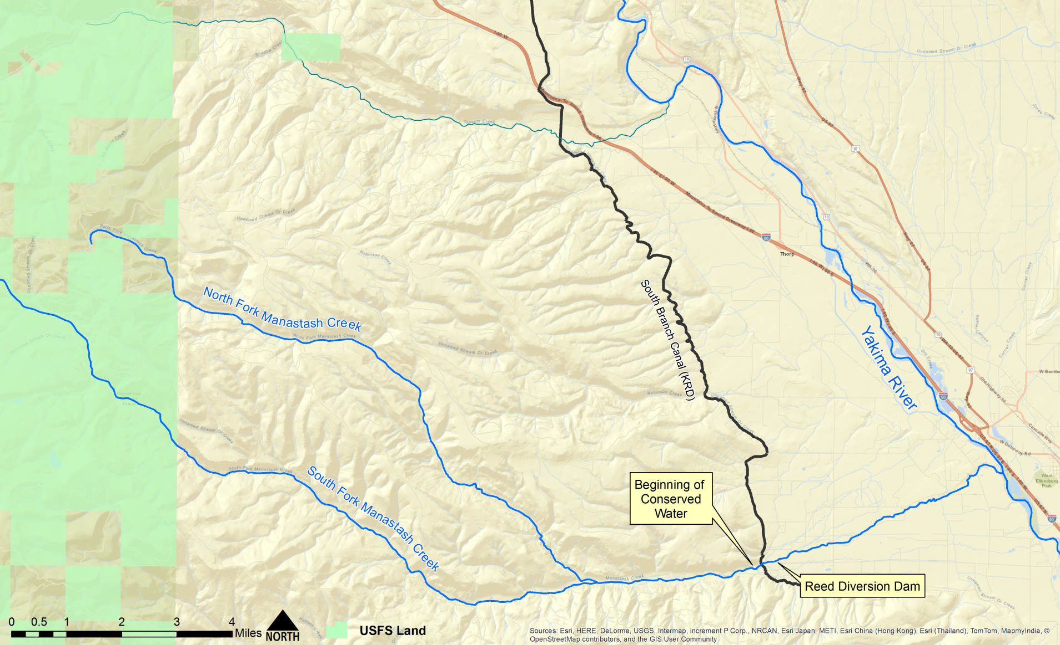
Manastash Creek Conservation & Tributary Enhancement
Notes:
Replace with schematic

Slide 36
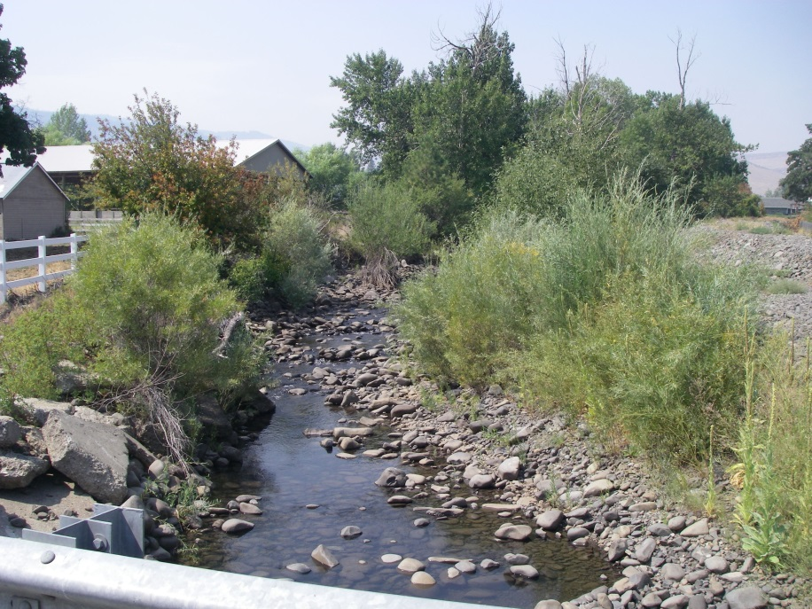
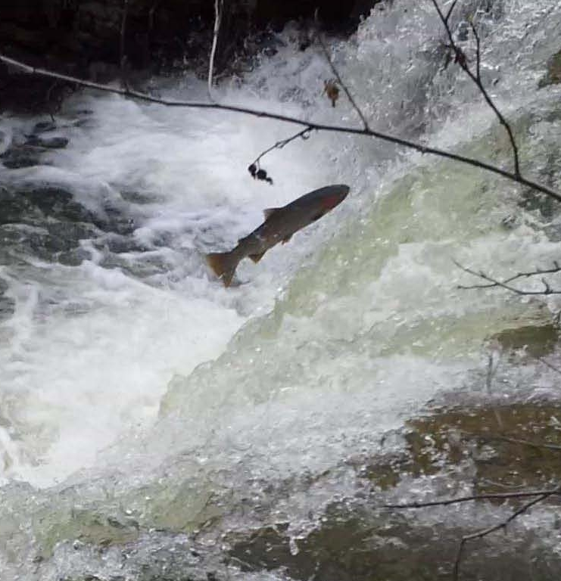
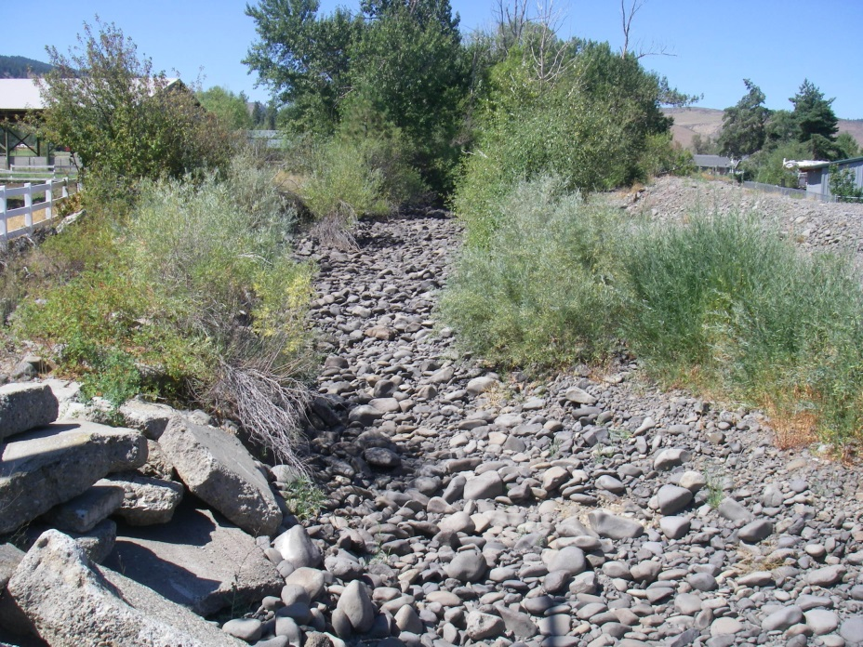
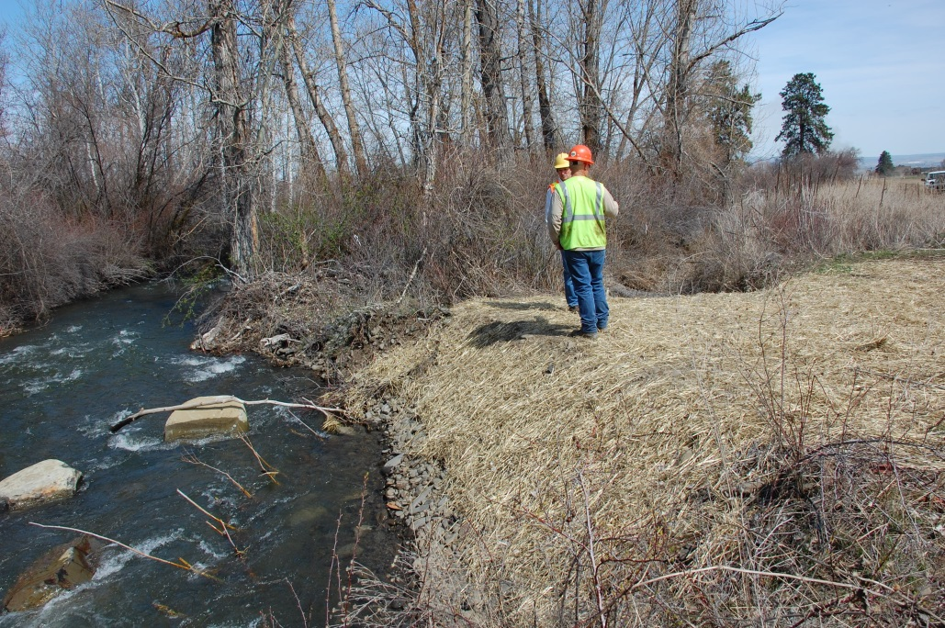
Manastash Creek – Before and After

Slide 37
Market Reallocation

Slide 38
Market Reallocation
Employ a water market and/or a water bank to improve water supply in the Yakima River basin. Market reallocation would be conducted in two phases.
The near-term phase would continue existing water marketing and banking programs in the basin, but take additional steps to reduce barriers to water transfers.
The long-term program would focus on facilitating water transfers between irrigation districts. This would allow an irrigation district to fallow land within the district and lease water rights for that land outside the district.
Yakima County and Kittitas County continue to work on procedures to enable property development that rely, in part, on acquisition of water or mitigation credits from willing sellers.
Governor Inslee issued a drought declaration affecting the Yakima River basin, and this will enable the Department of Ecology to lease water from willing sellers to meet certain needs within the basin this year.

Slide 39
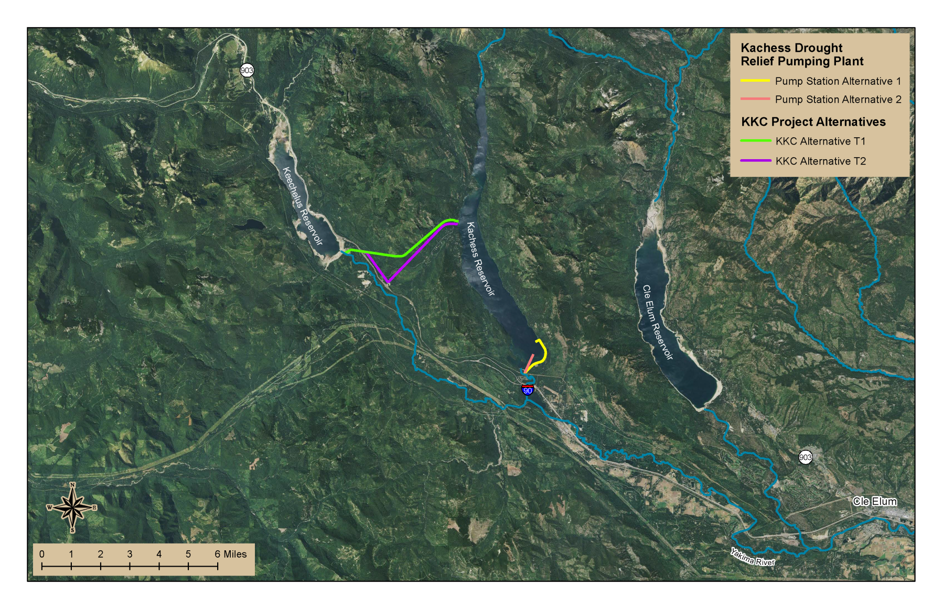
Project Locations
Keechelus-to-Kachess Conveyance
Kachess Drought Relief Pumping Plant
Cle Elum Pool Raise
Cle Elum Dam Fish Passage

Slide 40
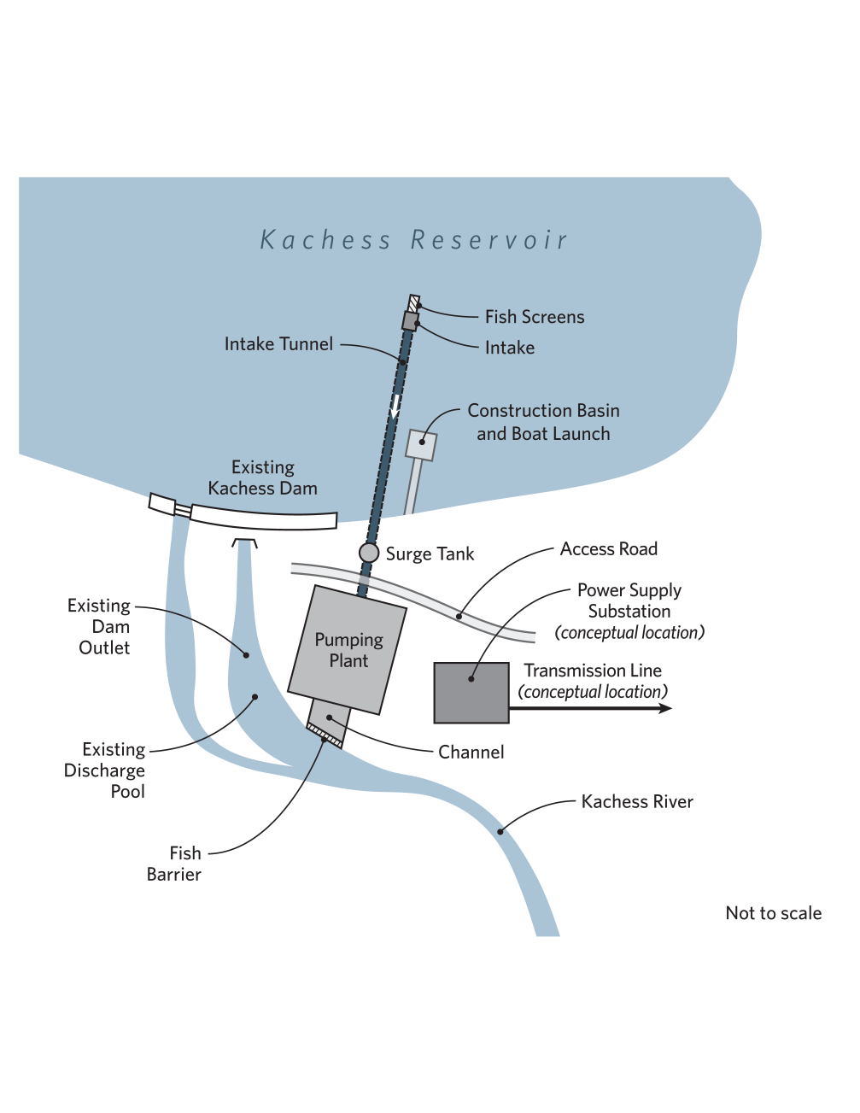
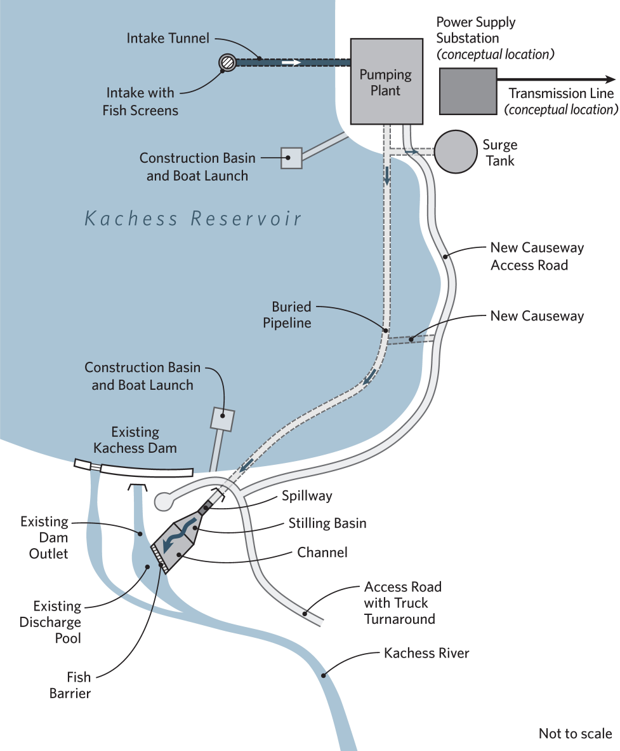
Kachess Drought Relief Pumping Plant
Alt. 1 - East Shore Pumping Plant Alt. 2 - South Pumping Plant
Notes:
Need slide of schematics from EIS similar to slide 18

Slide 41
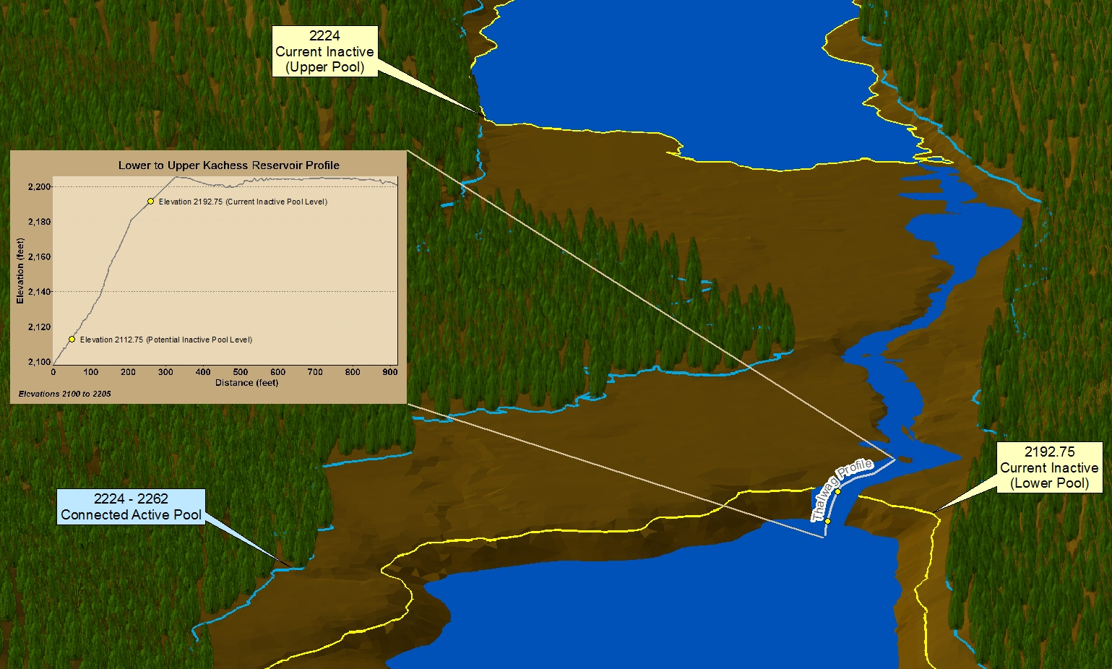
Kachess Drought Relief Pumping Plant
Area between upper and lower reservoirs

Slide 42
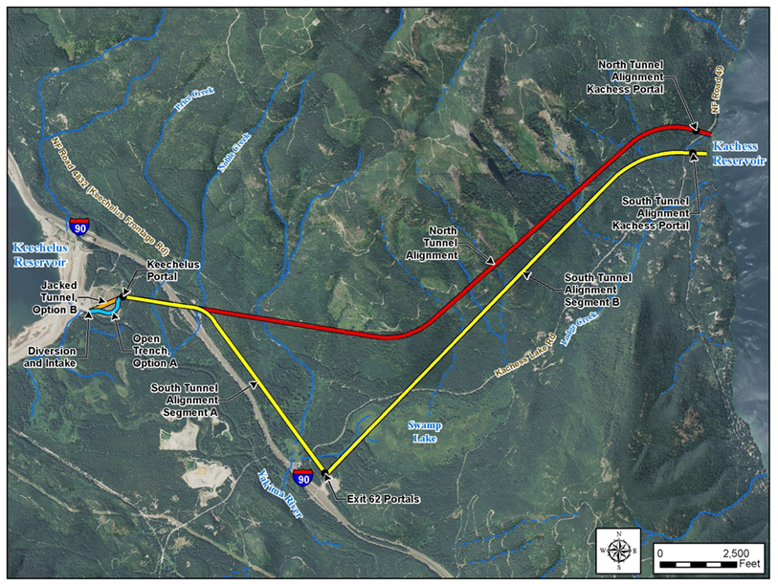
Keechelus-to-Kachess Conveyance
North Tunnel and South Tunnel Alternatives

Slide 43
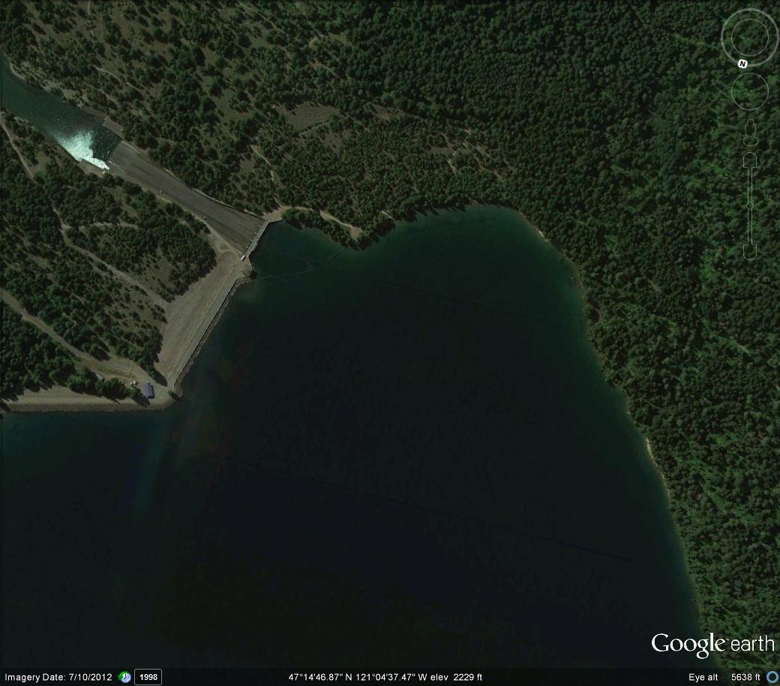
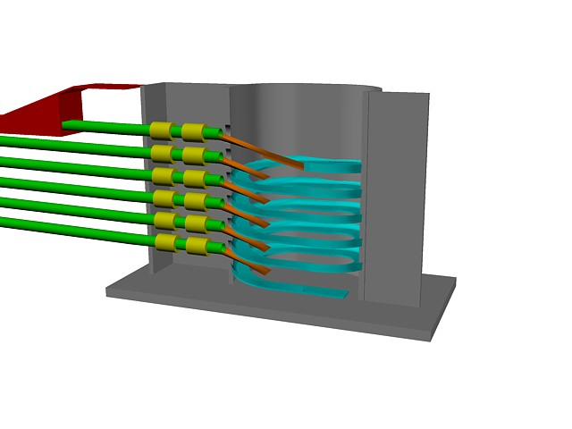
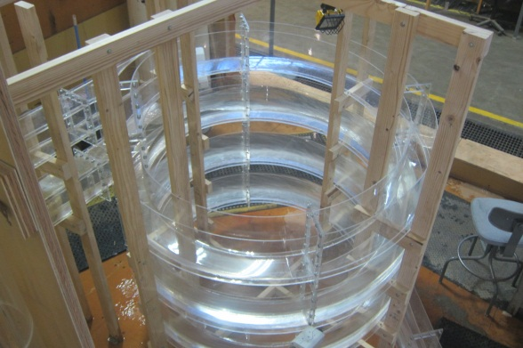
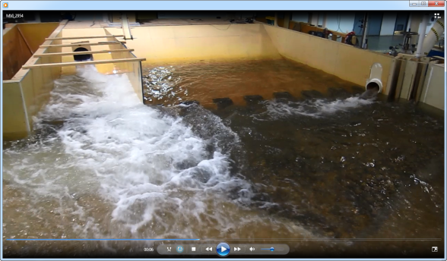
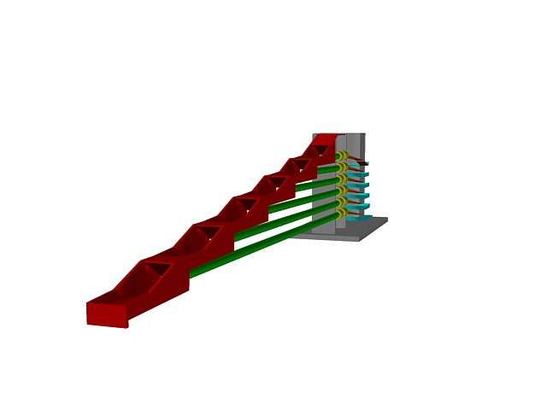
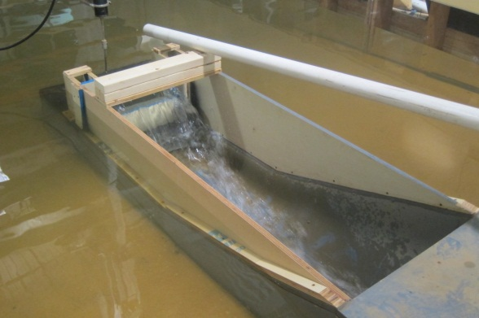
Helix Conduit Structure
Adult Collection Facility
Downstream Passage Conduit
Cle Elum River
Spillway
Flow
Inlet Ramp
Cle Elum Dam
Splitter Wall to reduce recirculation
Cle Elum Reservoir Forebay
Cle Elum Dam
Fish Passage Facilities
Flow
Ramped Weir Crest Design
May 24, 2013

Slide 44
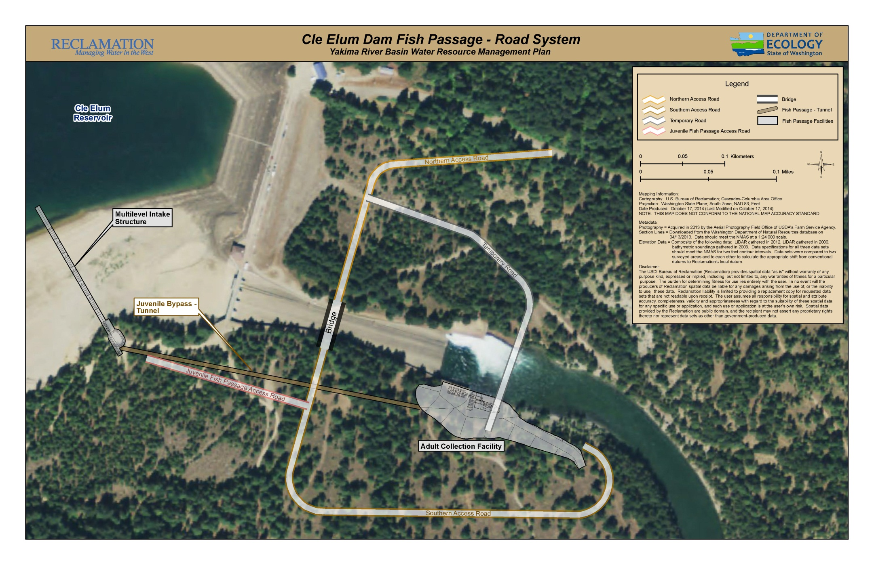

Slide 45
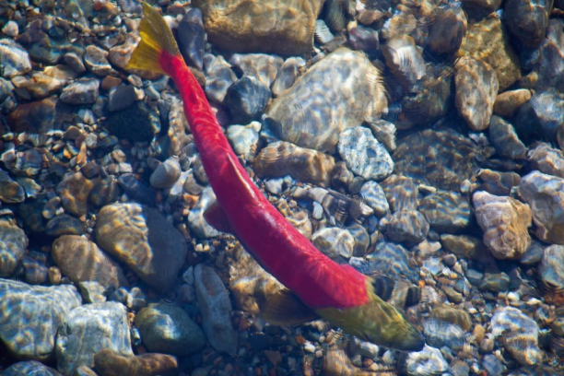
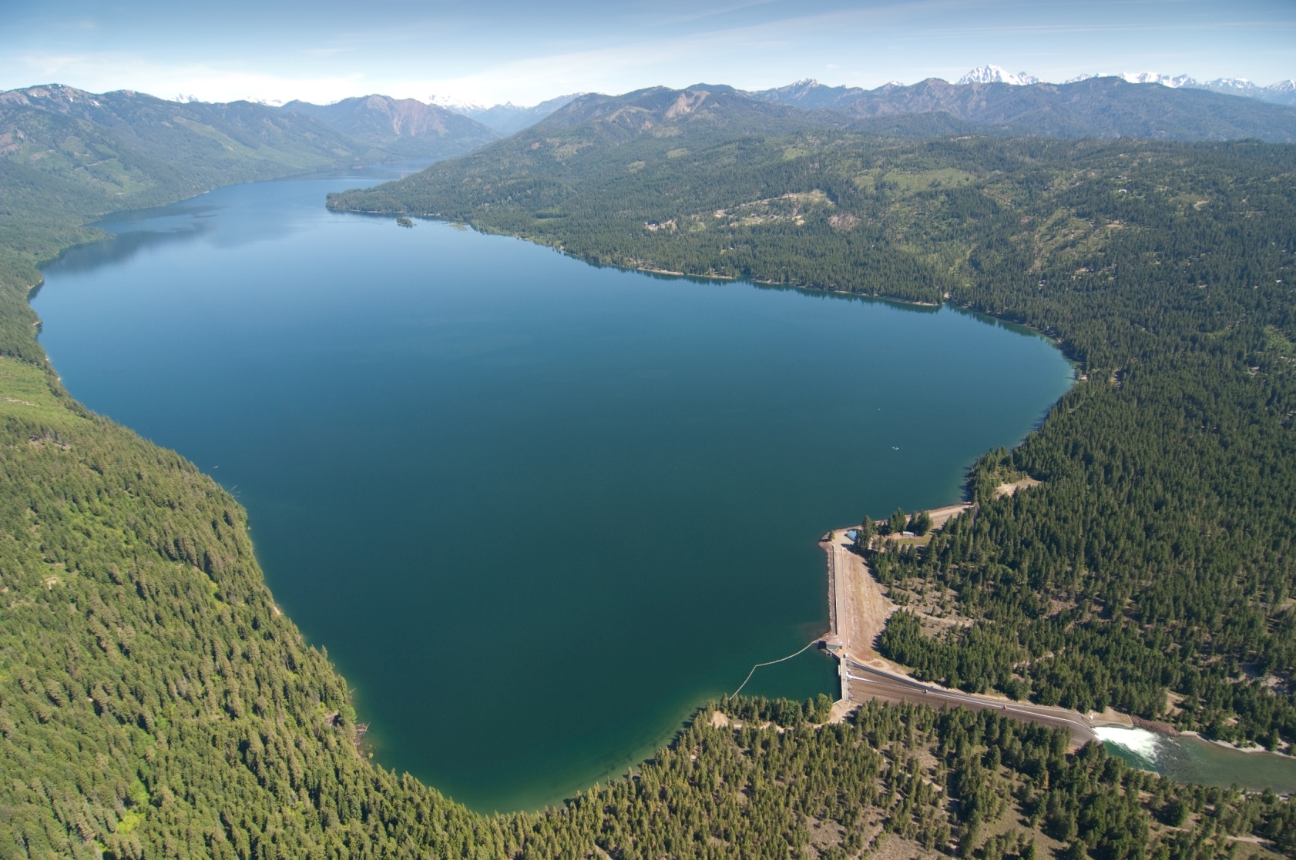
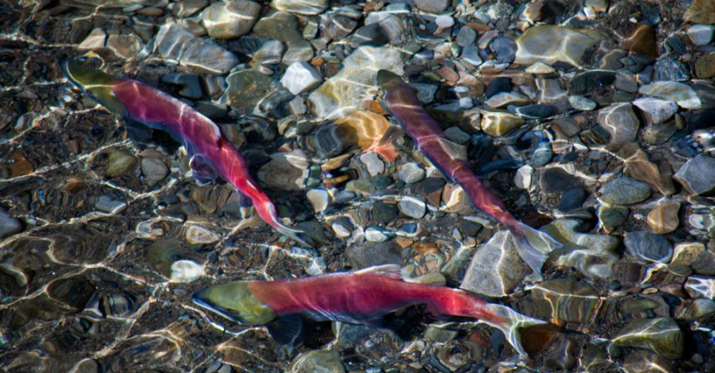
2013 - First Sockeye to be born and raised in the Yakima River Basin in over 100 years to return, released into Cle Elum Lake
Year | Spawning sockeye released in reservoir | Returning Sockeye
2009 | 1,000
2010 | 2,500
2011 | 4,100
2012 | 10,000
2013 | 4,000 | 800
2014 | 10,000 | 2,600

Slide 46
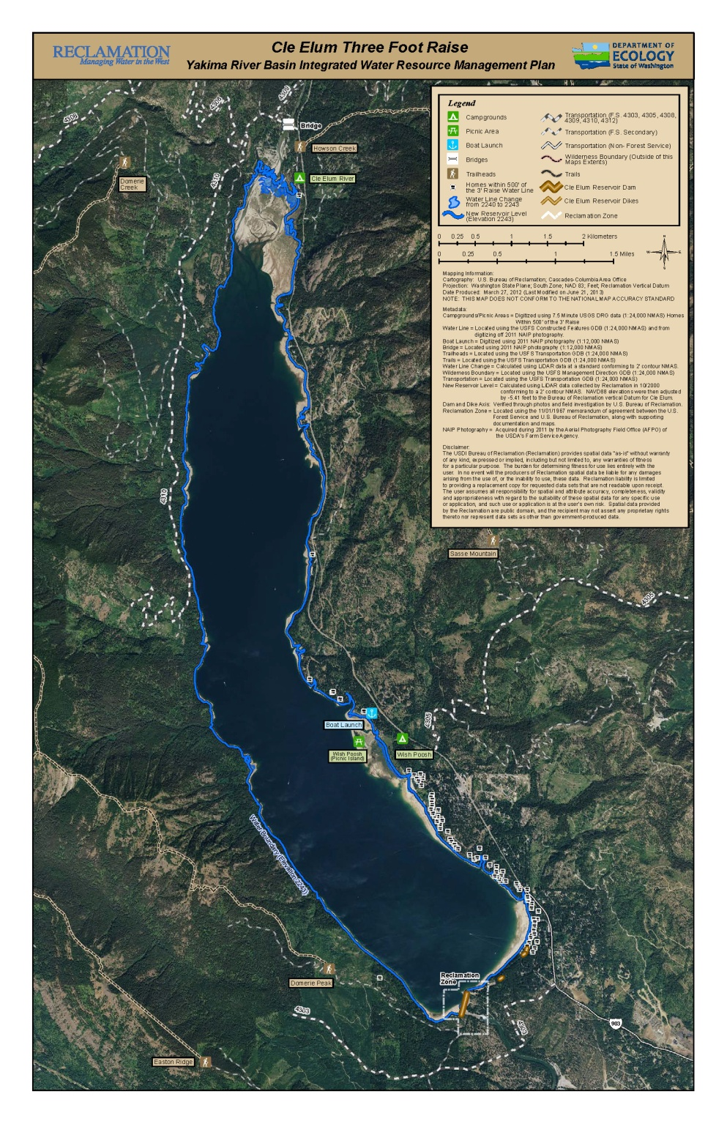
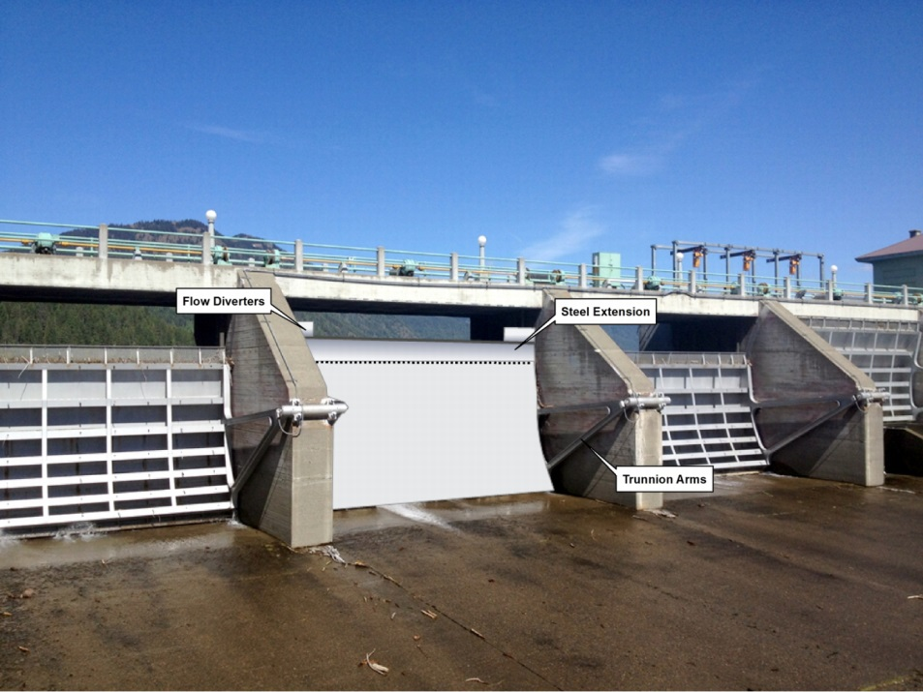
Cle Elum
Pool Raise
Cle Elum Radial Gates - Modifications

Slide 47
What about Wymer and Bumping?
Not included in the Initial Development Phase
Ongoing Analysis:
  Key Consideration Analysis - Engineering
  Geologic Investigations
  Seismic Evaluation
  State and Federal Endangered Species Surveys
Next steps
  Decision which project to advance first
  Feasibility Study
  Environmental Compliance
  Authorization/Appropriations

