Slide 1
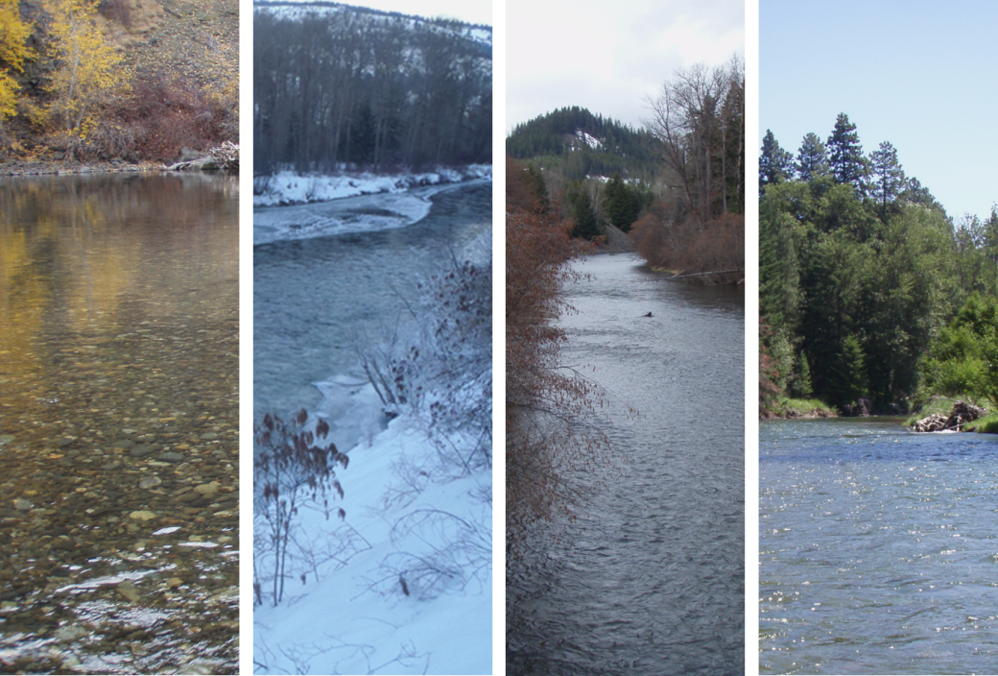
Yakima River Basin Spring Chinook Competition and Capacity Studies; Early Growth and Development
Christopher Johnson¹, Trenton De Boer¹,
Nick Mankus¹, and Phil Roni²,
¹Washington Department of Fish and Wildlife
Ecological Interactions Team
Ellensburg, Washington
²Watershed Program
Northwest Fisheries Science Center
Seattle, Washington

Slide 2
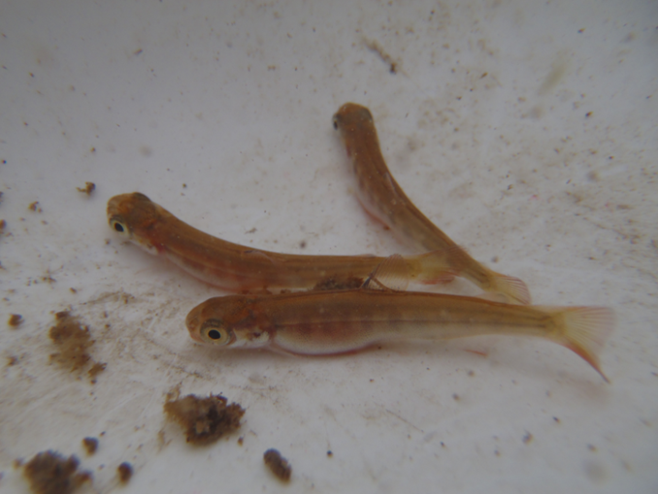
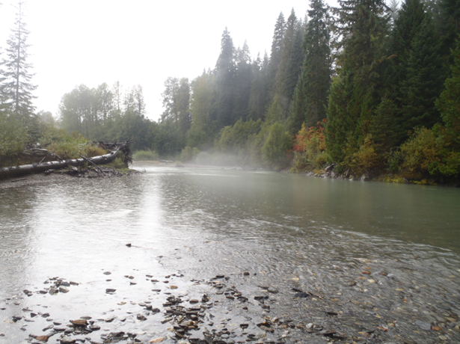
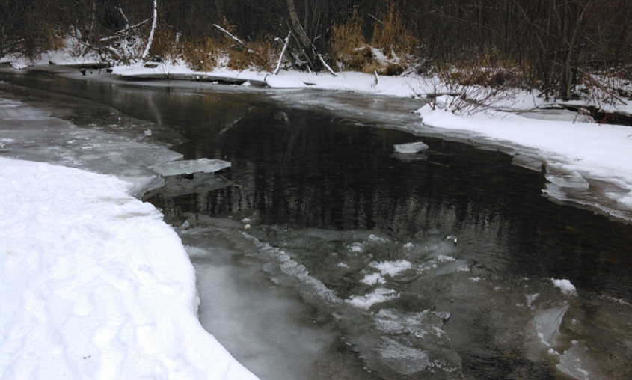
Life-stage specific measures of productivity
Identifying and evaluating differences in survival, development, and/or growth, attributable to environmental factors; over large spatial and temporal scales
Incubation conditions
Developmental rates
Emergence timing
Post-emergence growth

Slide 3
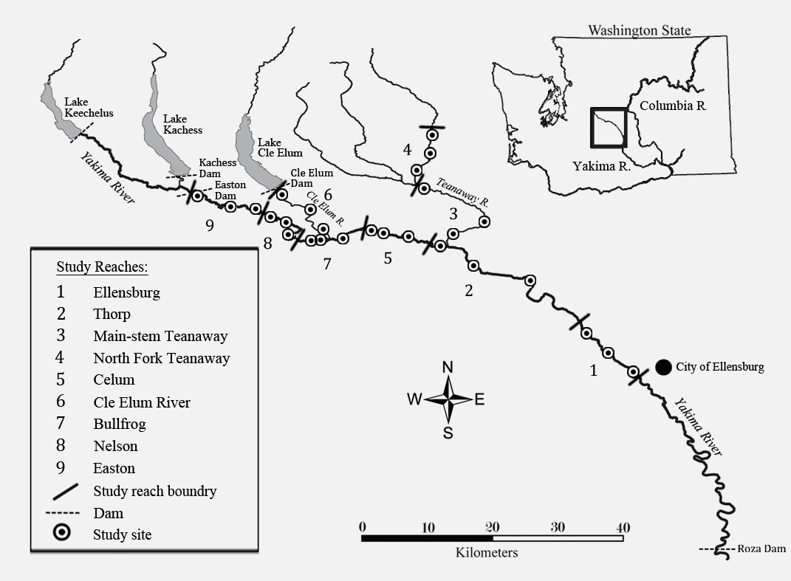
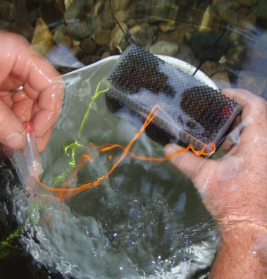
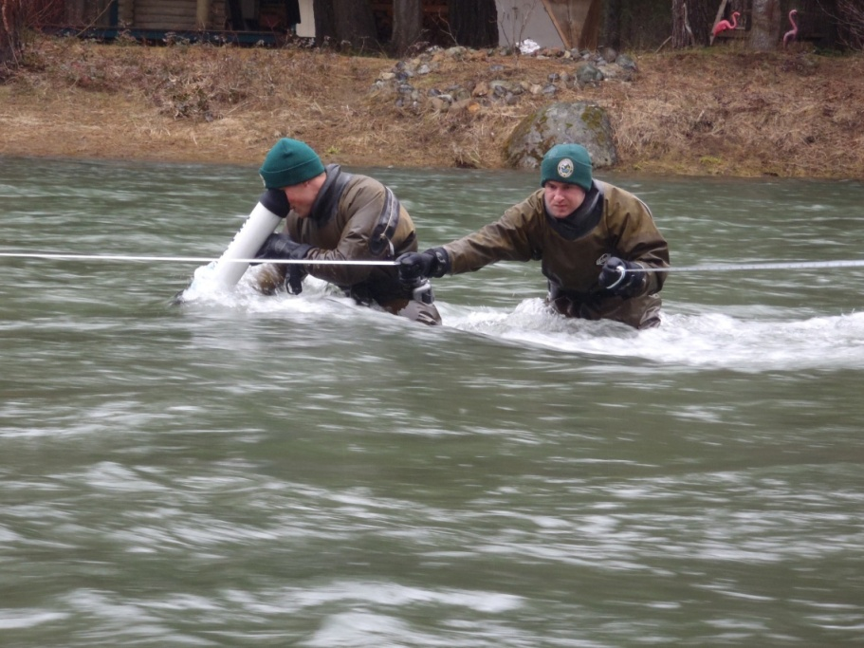
Incubation conditions Egg-to-Fry Survival Study 2009-2012
Nine study reaches, 2009-2013 brood years. Controlled parental cross, egg deposition, and spawn timing. n = 81 artificial redds/year
Water temperature recorded hourly at 31 locations throughout the upper Yakima River
Estimates of survival and developmental stage at approximately 50% emergence based on temperature unit accumulation (900 ATU)
Johnson, C. L. P. Roni, G. R. Pess. 2012. Parental effect as a primary factor limiting egg-to-fry survival of spring Chinook salmon in the upper Yakima River basin. Transactions of the American Fisheries Society 141(5):1295-1309

Slide 4
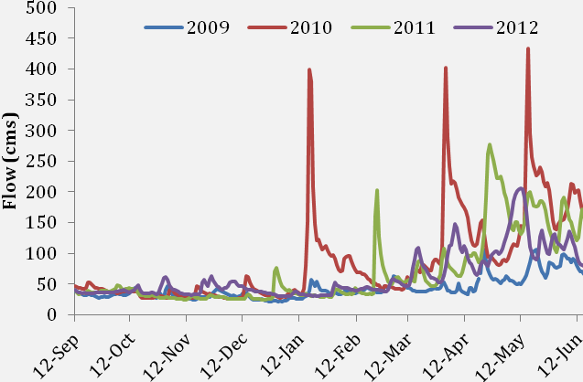
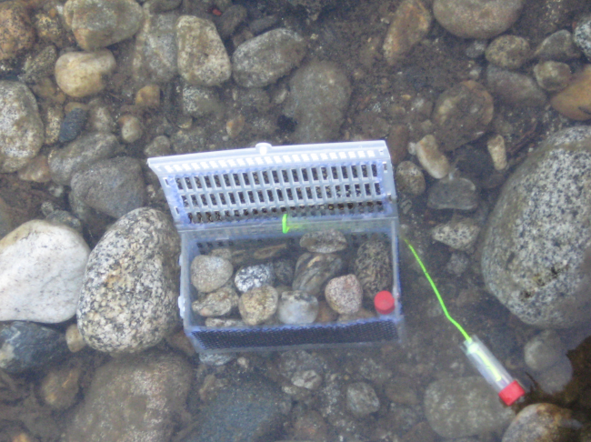
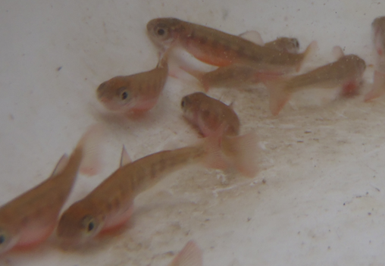
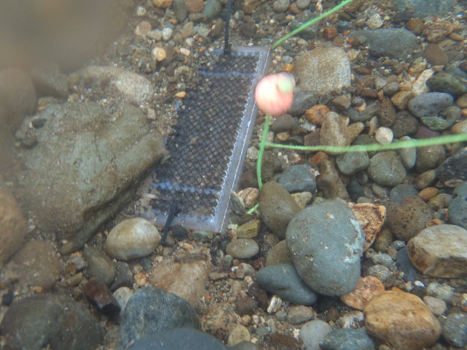
Incubation conditions Egg-to-fry survival study 2009-2012
ANOVA (P-values)
Brood Year | Parental | Environmental
 | Survival
2009 | < 0.01 | 0.06
2010 | 0.73 | < 0.01
2011 | < 0.01 | 0.65
2012 | 0.01 | 0.11
 | Development (k_{D})
2009 | < 0.01 | < 0.01
2010 | < 0.01 | < 0.01
2011 | < 0.01 | < 0.01
2012 | < 0.01 | < 0.01
Figure from Roni et al. (in prep)
Notes:
Slide okay
These study results got us thinking a bit more deeply about developmental rates, and the relationship between developmental rates and temperature, and with other environmental factors such as fines and dissolved oxygen.
And what this study found was that the magnitude of environmental affects to survival differed among years, with parental cross appearing to be a larger factor in years where conditions were seemingly more favorable to incub
The years depicted year are brood. I need to change these so that they track with the later work, especially when showing the relatively higher productivity from brood year 2009 in comparison to other years.

Slide 5
Developmental stage 900 accumulated thermal units
CER k_{D} = 1.9861
Twy k_{D} = 1.8779

Slide 6
Upper Yakima River thermal unit accumulation
Notes:
Slide okay
Note here that the thermal sums model would account for differences in the rate of temperature accumulation, but does not account for compensatory mechanisms affecting developmental rates when conditions are less than ideal (too warm or too cold). Or for environmental factors which might otherwise limit development, such as fine sediment infiltration and/or dissolved oxygen availabiltiy.
How might this have looked prior to any of the dams? Do we have data like that?
Upper county irrigation appears to have taken hold around 1902. Keechelus was built in 1917 (earth fill), Kachess in 1912 and Cle Elum in 1933.

Slide 7
Literature assessing relationships between temperature and developmental rate of Chinook salmon 1901-1990
Wallich, C. 1901. A method of recording egg development, for use of fish culturists. United States Bureau of Fisheries, Washington D. C., Rep. Commissioner of Fisheries for 1900, Fisheries Document 452: 185-194
Seymour, A. H. 1956. Effects of temperature upon young chinook salmon. PhD. Thesis. University of Washington, Seattle Wash. xi-+127p.
Alderdice, D. F., and F. P. J. Velsen. 1978. Relation between temperature and incubation time for eggs of Chinook salmon (Oncorhynchus tshawytscha). Journal of the Fisheries Research Board of Canada 35:69–75.
Heming, T. A. 1982. Effects of temperature on utilization of yolk by Chinook salmon (Oncorhynchus tshawytscha) eggs and alevins. Canadian Journal of Fisheries and Aquatic Sciences 39:184–190.
Beacham, T. D., and C. B. Murray. 1990. Temperature, egg size, and development of embryos and alevins of five species of Pacific salmon: a comparative analysis. Transactions of the American Fisheries Society 119:927–945

Slide 8
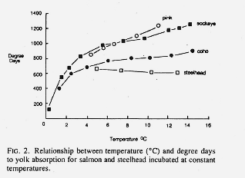
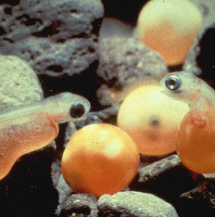
Factors influencing salmonid developmental rates
krisweb.com
Figure: Brannon (1987)
Compensatory mechanisms result in the ability to maintain synchronous emergence under variable environmental conditions, and have been noted among salmonid species, populations, and subpopulations (Brannon et al. 1987; Whitney et al. 2014).
Limiting factors: Fine sediment accumulation/availability of dissolved oxygen (Chapman 1988; 2014; Greig et al. 2005; Malcolm et al. 2011), high or low temperatures (Beacham and Murray 1990; Heming 1982), variation in temperature (Steel et al. 2012).

Slide 9
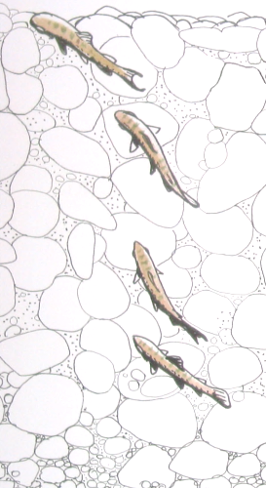
Spring Chinook development and emergence
Acquisition of habitat¹
Competitive ability²
Predator avoidance³
Post-emergence growth⁴
krisweb.com
Image: fedflyfishers.org
²Andersson, M. Å., U. W. Khan, Ø. Øverli, H. M Gjøen, and E. Höglund. 2013. Coupling between stress coping style and time of emergence from spawning nests in salmonid fishes: Evidence from selected rainbow trout strains (Oncorhynchus mykiss). Physiology & Behavior 116:30-34.
²⁻³Brännäs, E. 1995. First access to territorial space and exposure to strong predation pressure: a conflict in early emerging Atlantic salmon (Salmo salar L.) fry. Evolutionary Ecology 9:411-420.
³Brannon, E. L. 1987. Mechanisms stabilizing salmonid fry emergence timing. p. 120-124. In H. D. Smith, L. Margolis, and C. C. Wood, editors. Sockeye salmon (Oncorhynchus nerka) population biology and future management. Canadian Special Publication of Fisheries and Aquatic Sciences: 96.
¹⁻⁴Quinn, T. P. 2005. The behavior and ecology of Pacific salmon and trout. University of Washington Press, Seattle Washington.

Slide 10
Developmental Incubation Pods (DIPs) pilot study
Controlled for parental effects
Cle Elum River, Main-stem Yakima River, and Teanaway River study locations
Ten pods/study area (pilot)

Slide 11
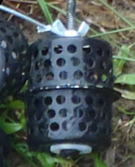
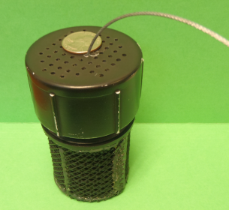
Developmental rates 2014-15 Pilot Study
1/8-inch in diameter
< 1/8-inch in diameter
2015 Design

Slide 12
Developmental rates Estimated emergence
Homogeny of slopes: P = 0.40
Bullfrog vs. CER, ANCOVA: P < 0.01

Slide 13
Upper Yakima River temperature

Slide 14
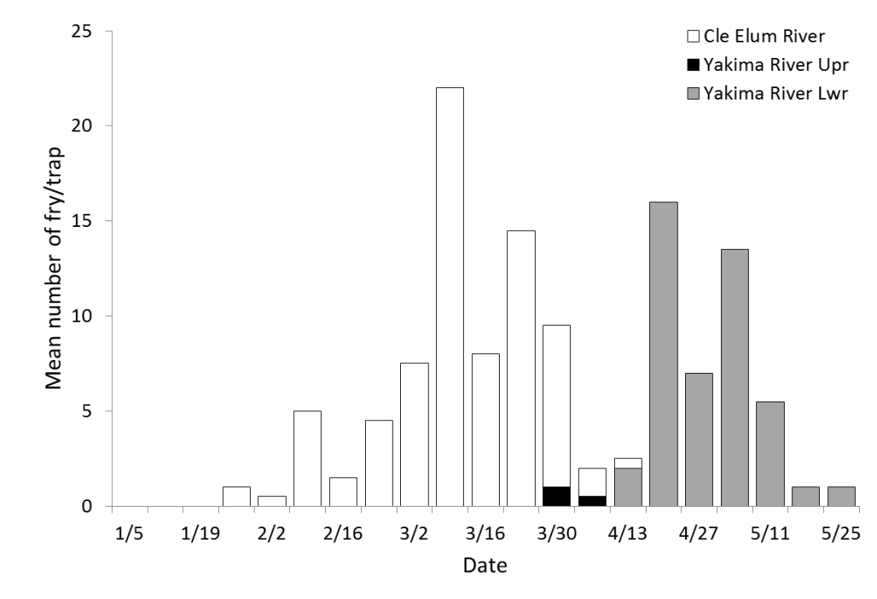
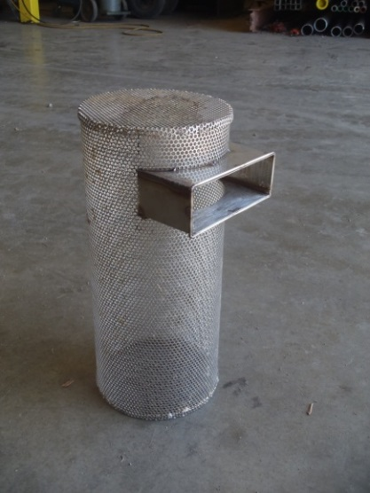
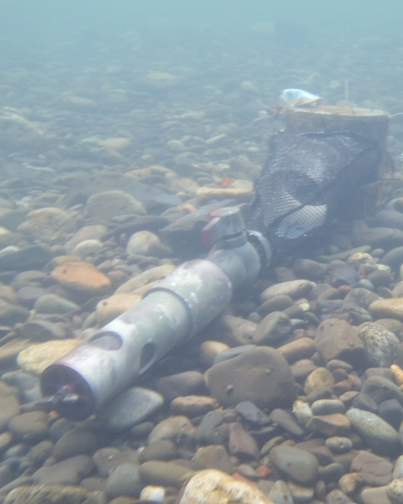
Emergence Timing

Slide 15
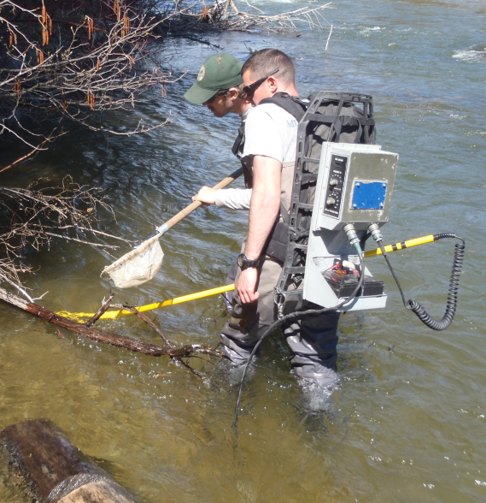
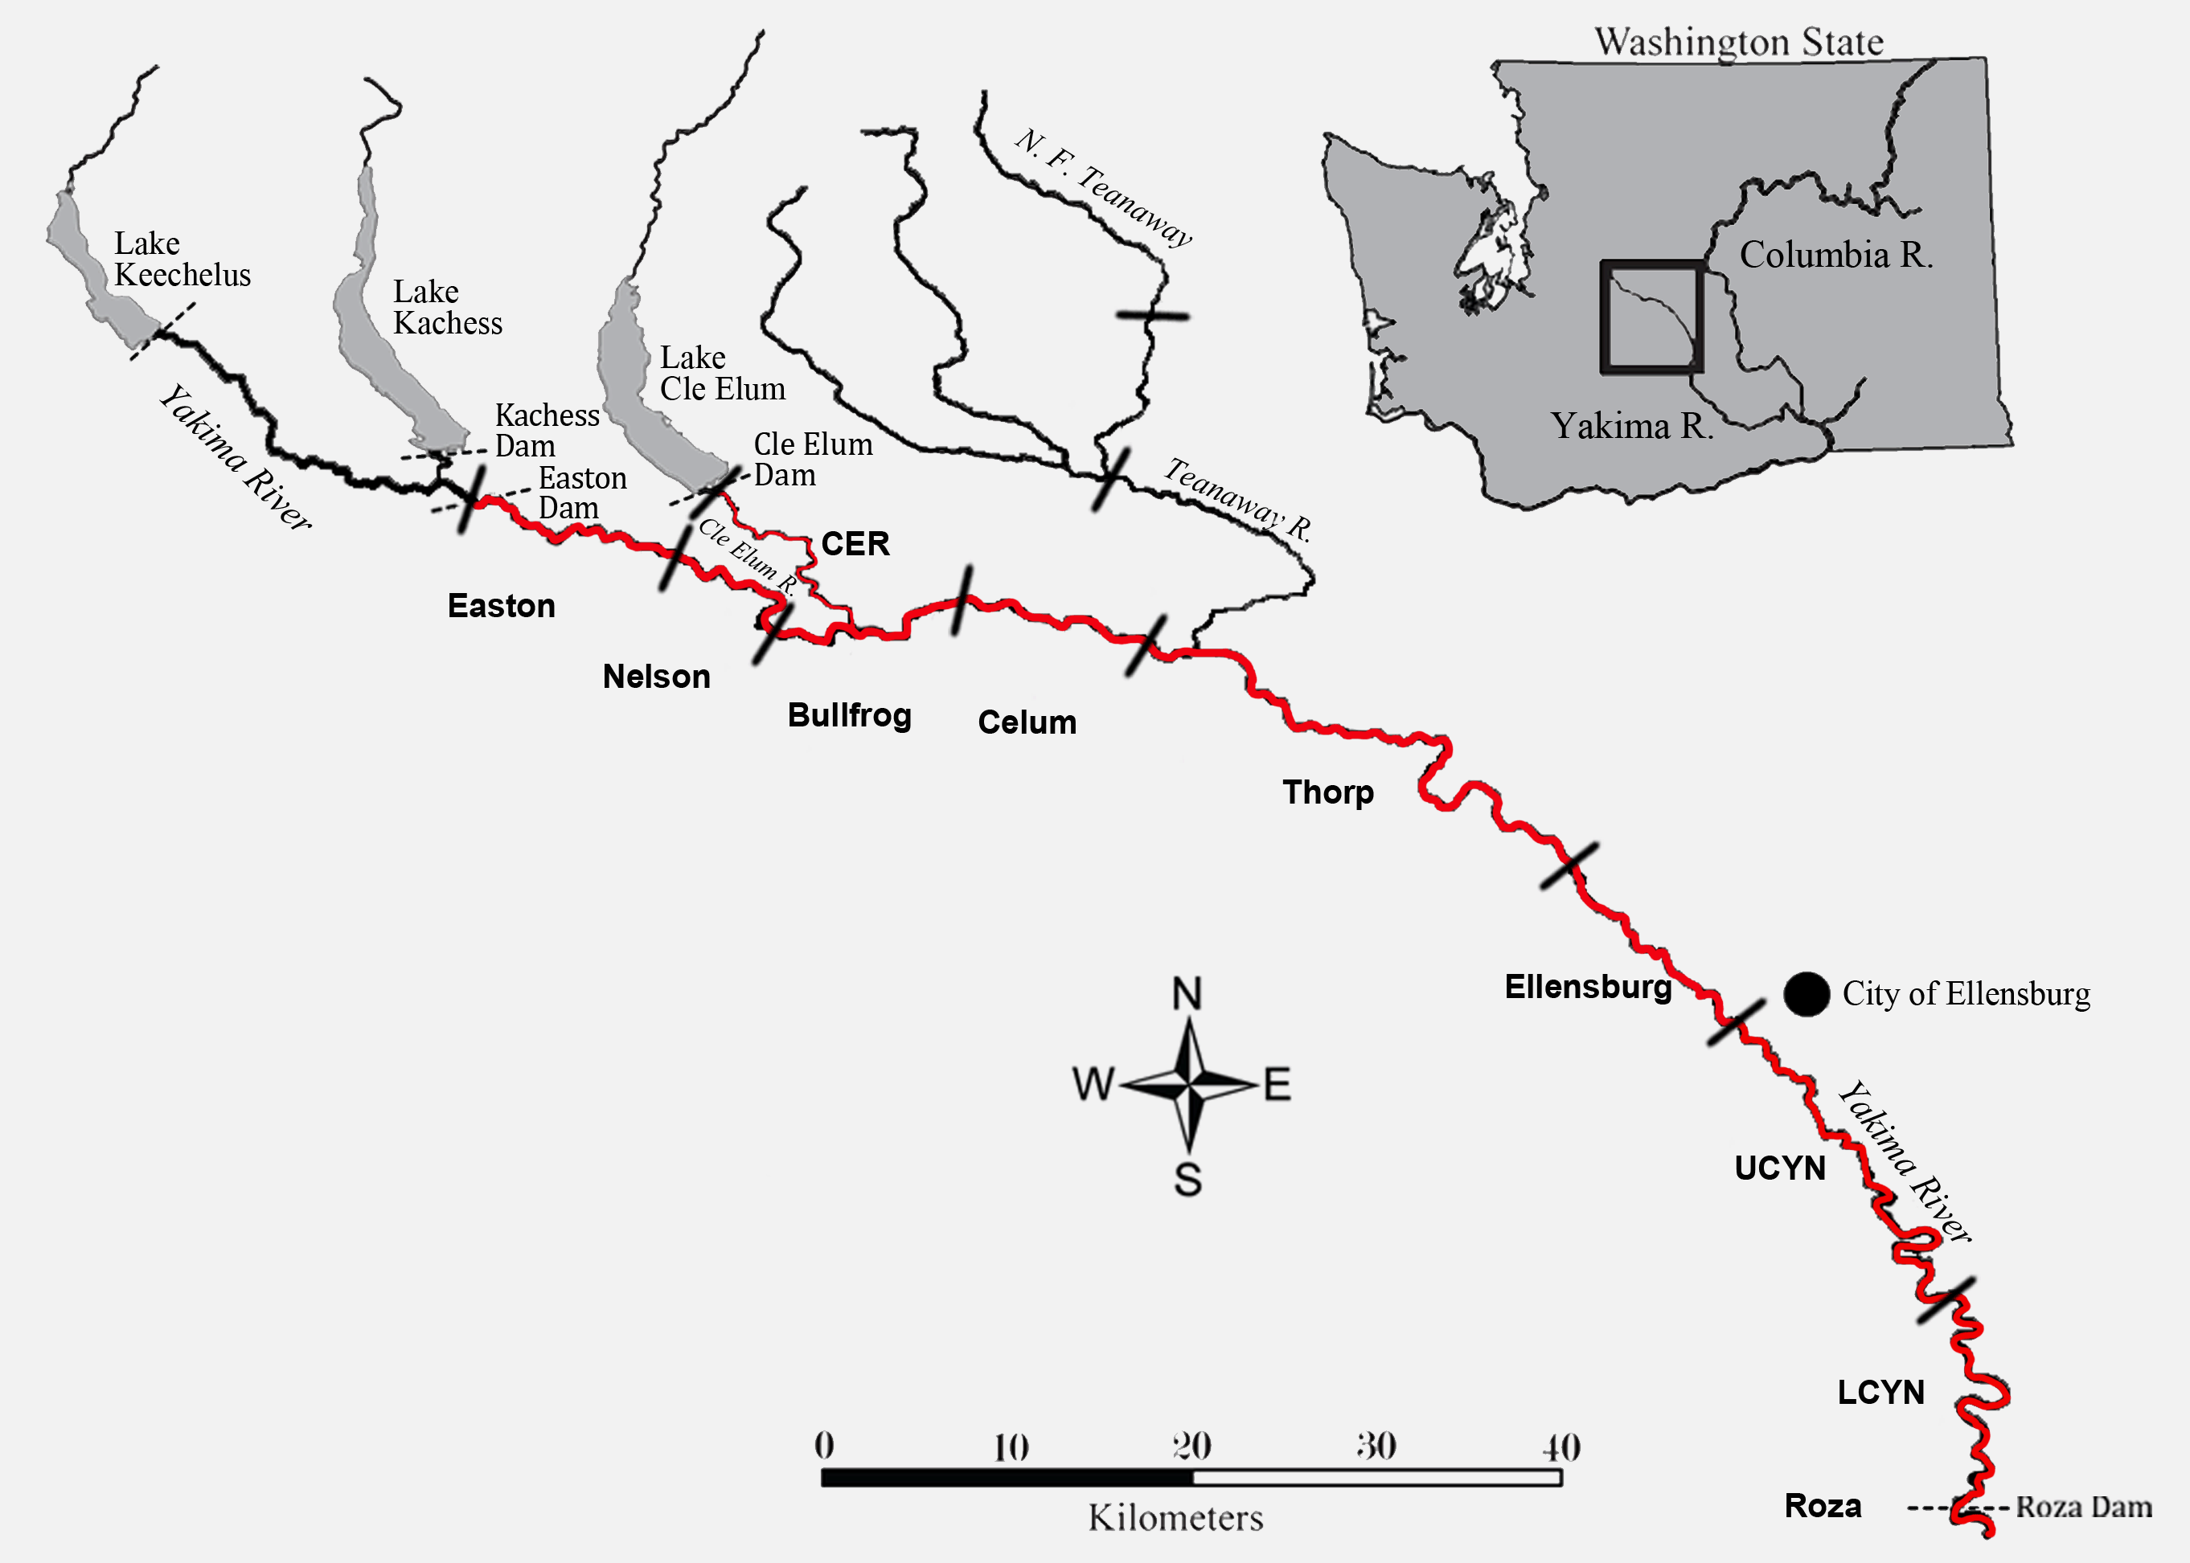
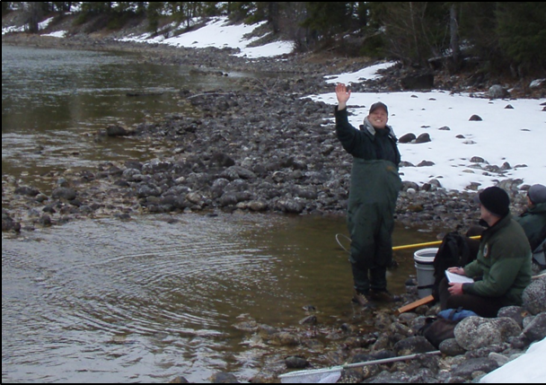
Post-Emergent Growth Study area

Slide 16
Post-Emergent Growth
Main-stem Yakima River

Slide 17
Summary
Both parental and environmental factors appear to have an effect on early survival.
Indirect evidence (k_{D} within egg boxes at recovery) suggest differential development, attributable to reach specific environmental conditions.
Preliminary data suggests differences in the rate of development among study reaches, likely occurring in early stages of development
Preliminary data suggest differences in the timing of emergence among study reaches, corresponding with observed alevin development over time.
Post-emergent growth rates also appear to correspond with reach scale differences in developmental rate and emergence timing.
Additional information: WDFW, YKFP WDFW M&E Report, 5/1/2012 - 12/31/2013 Annual Report to Bonneville Power Administration, 1995-063-25. Submitted December 2014; Available (soon) www.bpa.gov

Slide 18
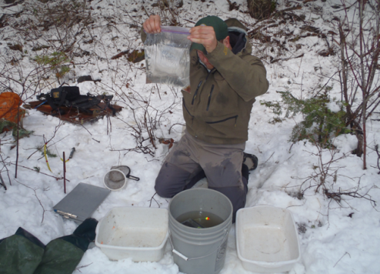
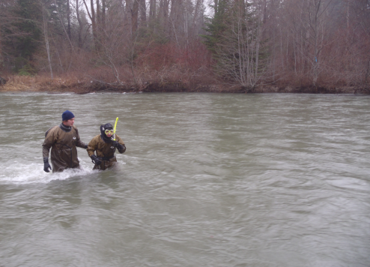
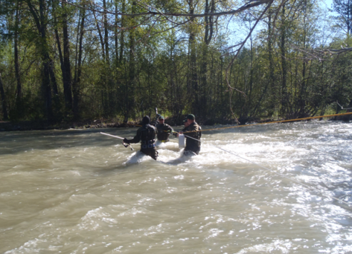
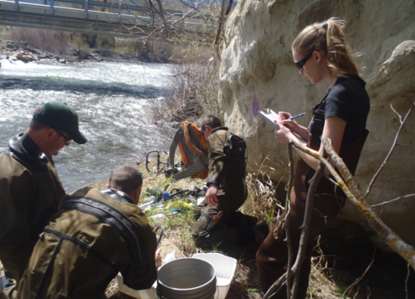
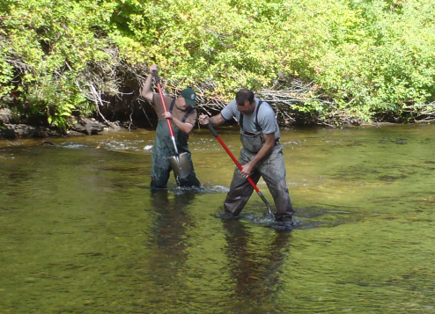
Acknowledgements
WDFW:
Trenton De Boer, Nick Mankus, Tim Webster, Scott Coil, Anthony Fritts, Gabriel Stotz, Danielle Sevold, Krystal Rodriguez, Gabriel Temple, Nicole Stokes, Molly Kelly, Zack Mays, Tanya Lamb, Steve Schroder, Chad Stockton, Cole Barret, Kyle Hatch, Bryan Bachman-Rhodes, Matt Sizer, Ben Backstrom, Mike Tonseth, Andrew Murdoch, Kevin White, Clint Deason Diana Dechand, Chad Herring, Cade Linquist, Charles (Ian) Coon, Zack Lessig.
YKFP:
Charlie Strom and the CESRF Staff, Dave Fast
BPA:
Patty Smith
Michelle O’Malley
Oncorh Consulting:
Curt Knudsen
NOAA:
George Pess
Andy Dittman
Gabriel Brooks
Grant County PUD:
Todd Pearsons
Southampton University:
David Sear

Slide 19
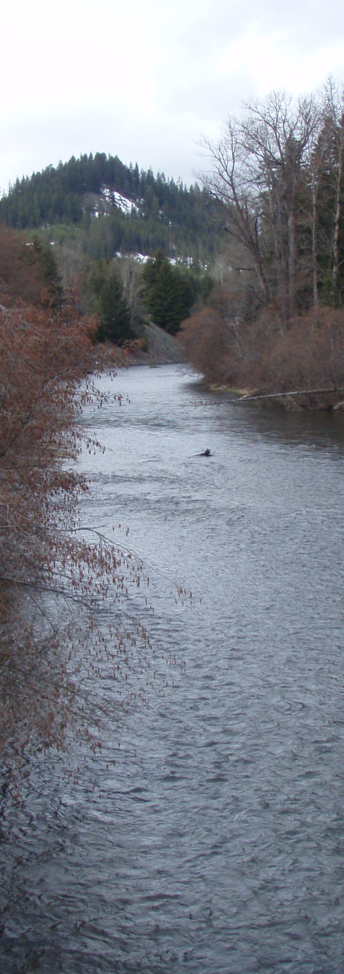
End

