Slide 1

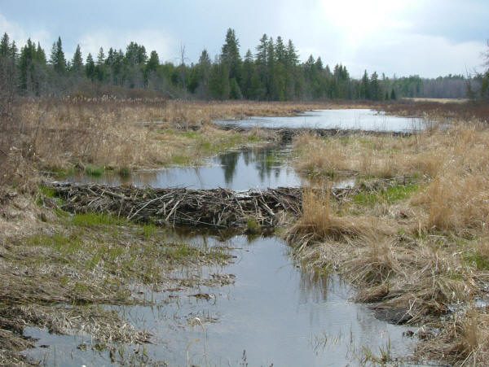
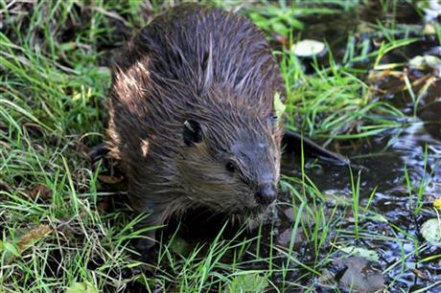
A Holistic Approach to Watershed Restoration through Beaver Relocation

Slide 2
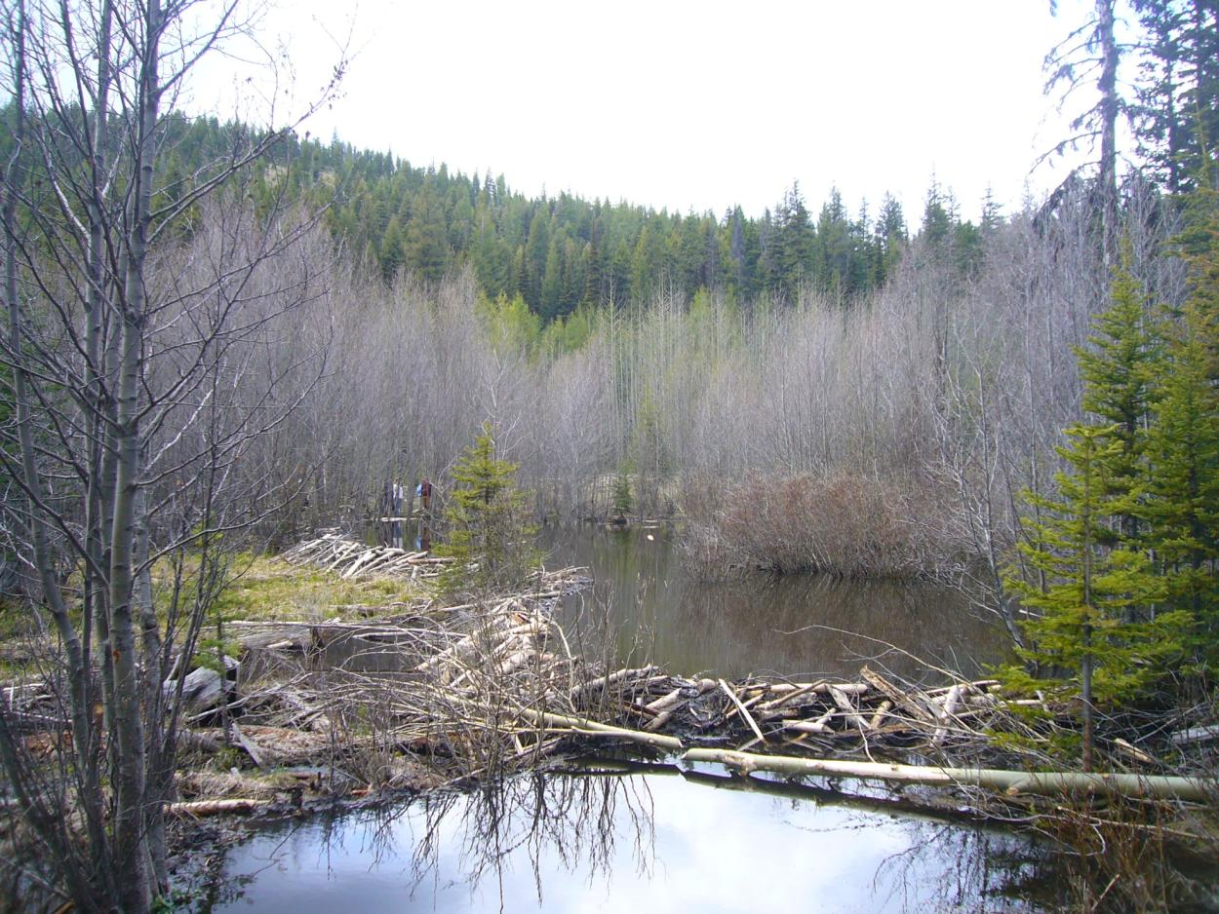
Notes:
Beavers are a keystone species that many other species depend on. They store water, create pools, reconnect floodplains, and can lessen the impacts of drought and flooding. We weren’t the first ones to recognize the beaver’s importance on the landscape and we definitely won’t be the last.

Slide 3
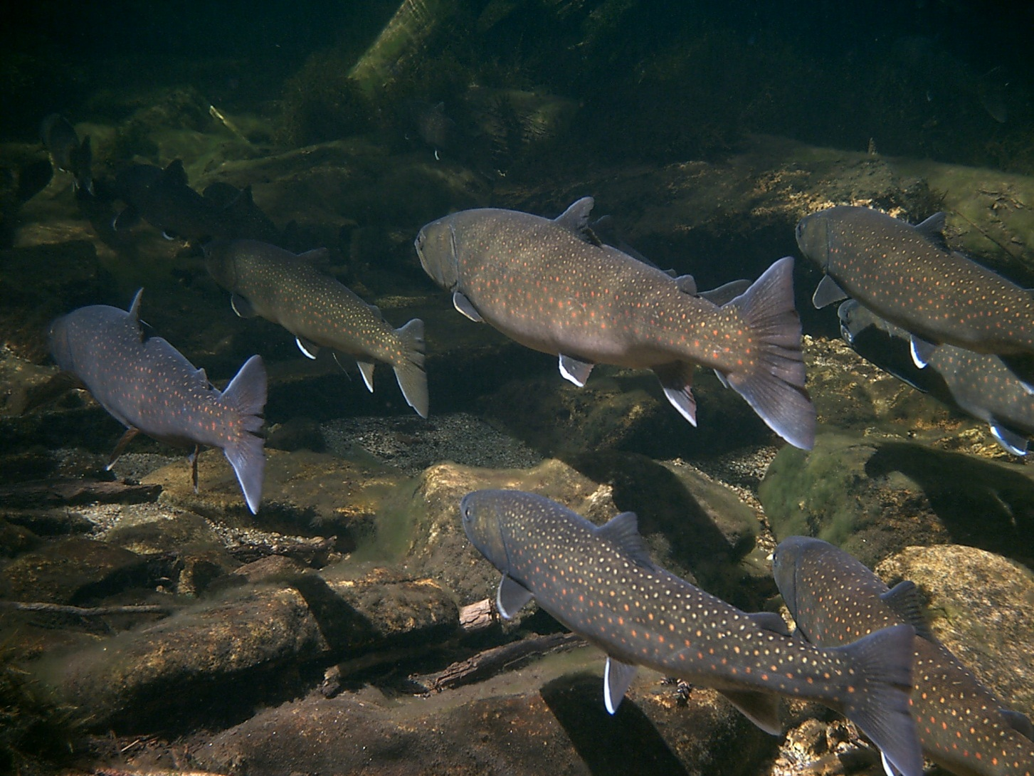
Salmon, Trout & Beaver
Photo: Caleb Zurstadt
Notes:
Murphy 1989. Coho and Sockeye had higher fitness and survival in beaver ponds.
Pollock et al. 2004 Beavers critical in recovering Coho in Stilliguamish.
Nickelson et al., 1992 a. b. Importance of beaver-created winter habitat for Coho in Oregon.
Jakober et al., 1988 Reported both bulltrout and cutthroat trout overwintering in beaver ponds.

Slide 4
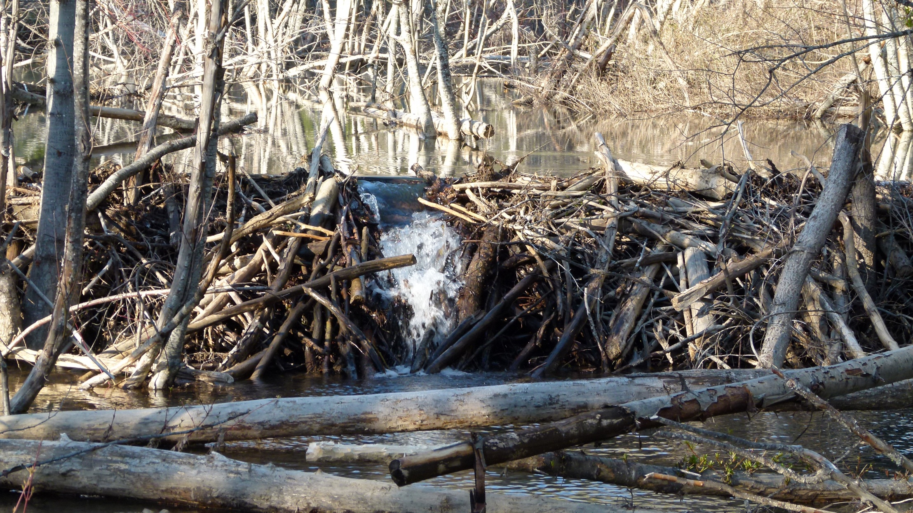
Fish Passage
Notes:
WDFW & YN Telemetry studies of Steelhead in Umtanum Creek showed adult steelhead passing upward of 6 foot dams, and numerous dams. Telemetry in Wenas Creek also showed Steelhead moving upstream of multiple dams.
Bryant 1984. Beaver dams up to 2m high didn’t prevent adult Coho from migrating past them.
Gard 1961, Found that Brown, Brook, Rainbow all passed a series of 14 dams in Sagehen Cr., both upstream and downstream in Spring, Summer and Fall. The lowest dam was only passed in downstream direction.

Slide 5
 | Ameliorate H2O temp increase | Ameliorate base flow decrease | Ameliorate peak flow increase | Increase salmon resilience
Remove barrier/culvert
Reconnection of floodplain features
Beaver Reintroduction
Reduce water withdrawls
Grazing removal
Addition of log structures
Restoration Techniques
Notes:
Beechie et al 2012 found beaver reintroduction to be the most effective at ameliorating climate change impacts.

Slide 6

1923-
today

Slide 7
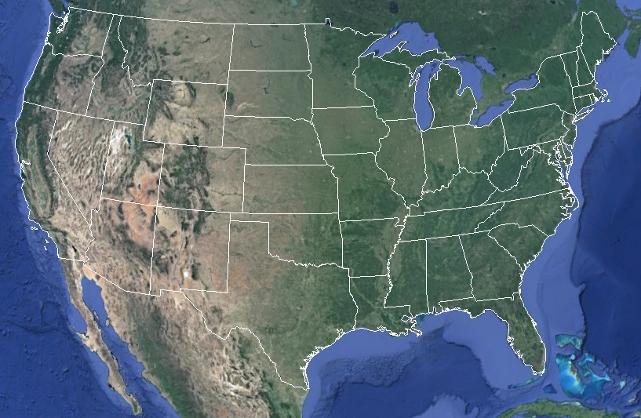

Slide 8
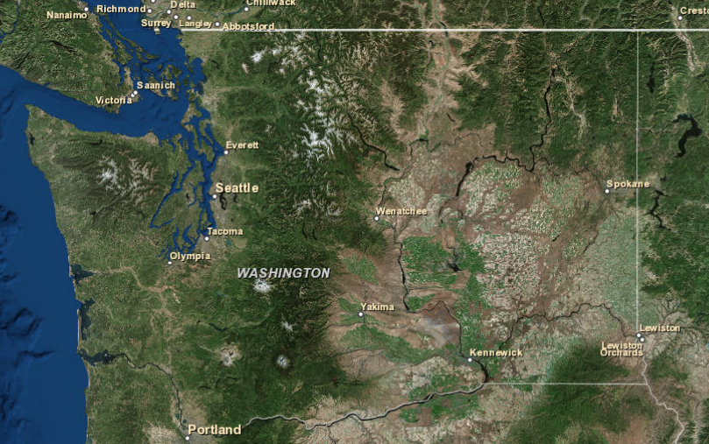

WA State Beaver Management
W
Notes:
WA is the beaver state!

Slide 9





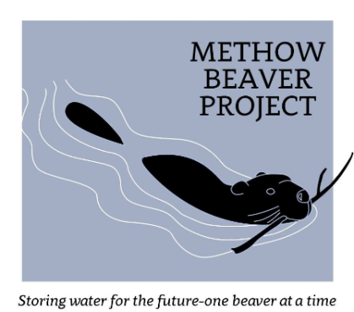



WA Beaver Working Group
Notes:
Collaborate approach to better beaver management state wide.
WA State Beaver Guidebook– depicts natural history of beavers, climate change, and depicts case studies of beaver relocation projects.

Slide 10
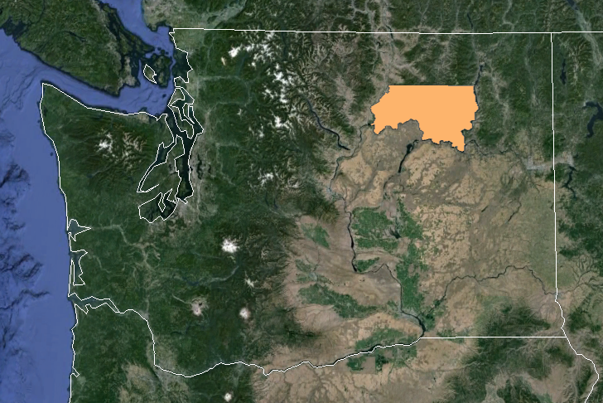

WA Beaver Working Group
Began:1960’s
Moved: Hundreds of beavers!

Slide 11
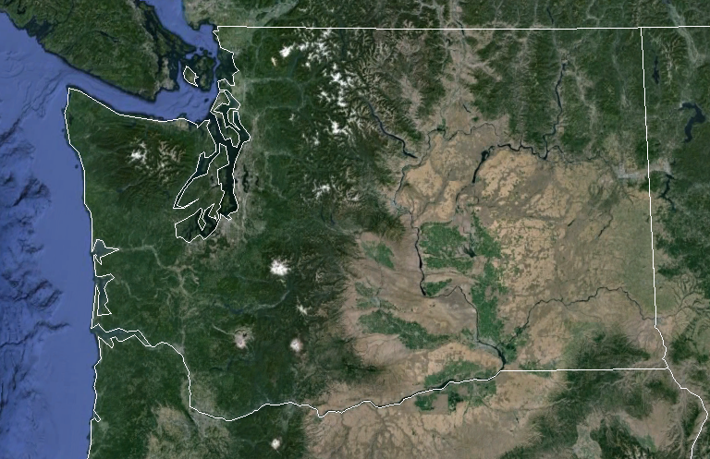

WA Beaver Working Group
Began: 2008
Moved: 240 Beavers
Temp & Water Storage

Slide 12

WA Beaver Working Group
Spokane Lands Council
Began: 2009 Habitat Modeling
Moved: 75 Beavers
Policy changers!

Slide 13

WA Beaver Working Group
Began: 2011
Moved: 130 Beavers
Mitigation: Deceivers & Levelers
Yakima Basin Beaver
Project

Slide 14
WA Beaver Working Group
Began: 2013
Moved: 9 Beavers
Tonasket Ranger District

Slide 15
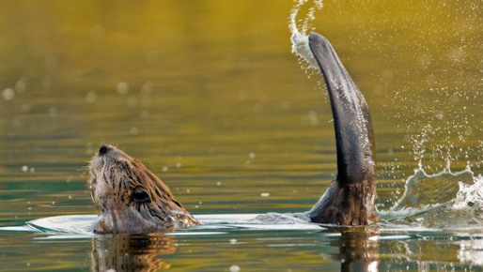
WA Beaver Working Group
The Sky Beaver
Project
Began: 2014
Moved: 24 Beavers
Mitigation: Deceivers & Levelers

Slide 16
WA Beaver Working Group

Slide 17

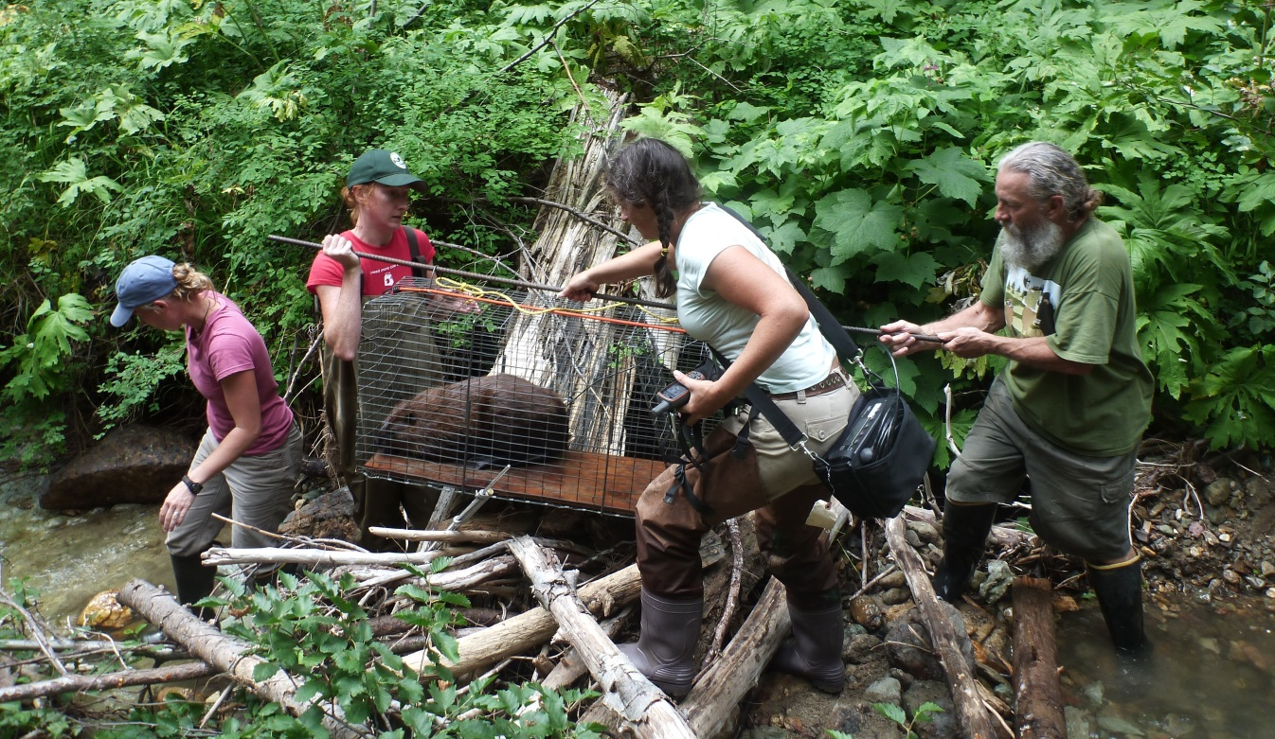
Yakima Basin Beaver Reintroduction Project

Slide 18
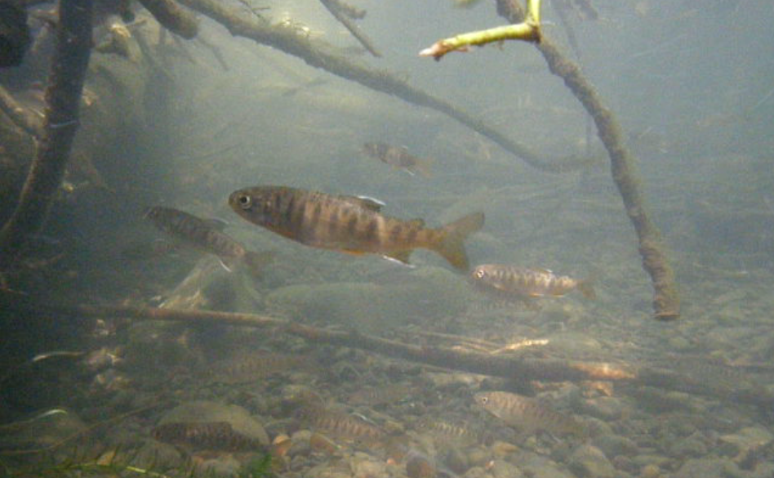
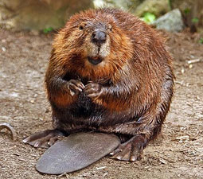
Goal: Increase stream complexity and riparian system function through beaver reintroduction
Notes:
We estimate that each beaver successfully restored into a watershed conservatively provides $8-10,000 worth of restoration value in terms of Ecosystem Services. Services include: Sediment Retention, storing and re-timing water, riparian habitat restoration, wetland habitat, aquatic habitat, nutrient retention, water temperature, flood resilience, stream system resilience.

Slide 19
Yakima Basin Watershed

Slide 20
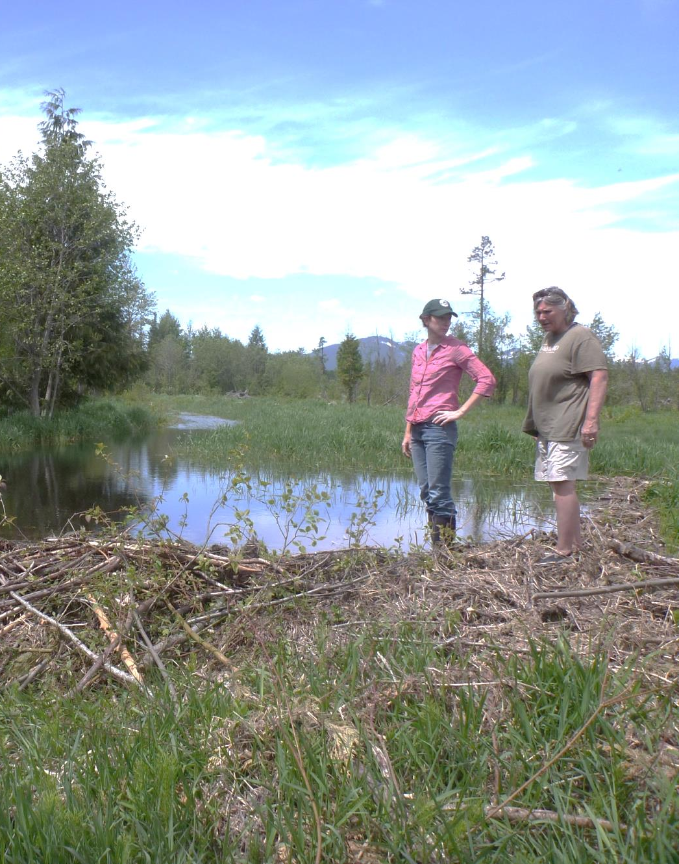
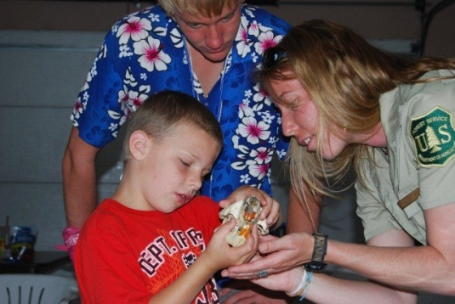
*Outreach to over 28,000 residents
*140+ landowners

Slide 21

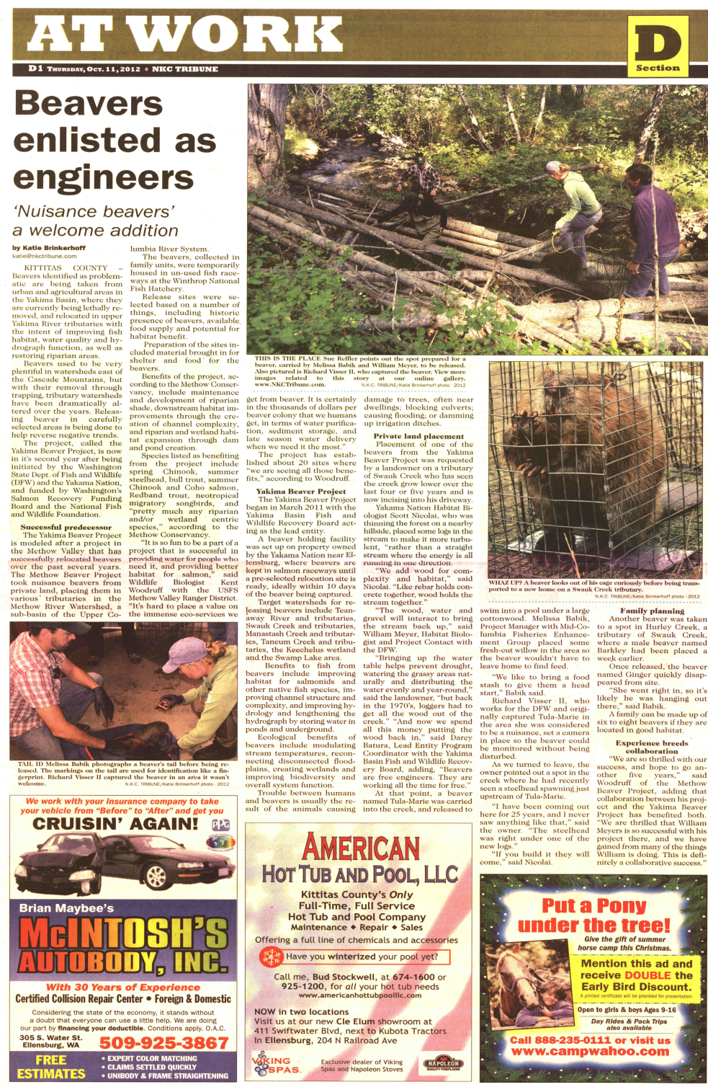
*Media- NPR, CBS, Newspapers

Slide 22
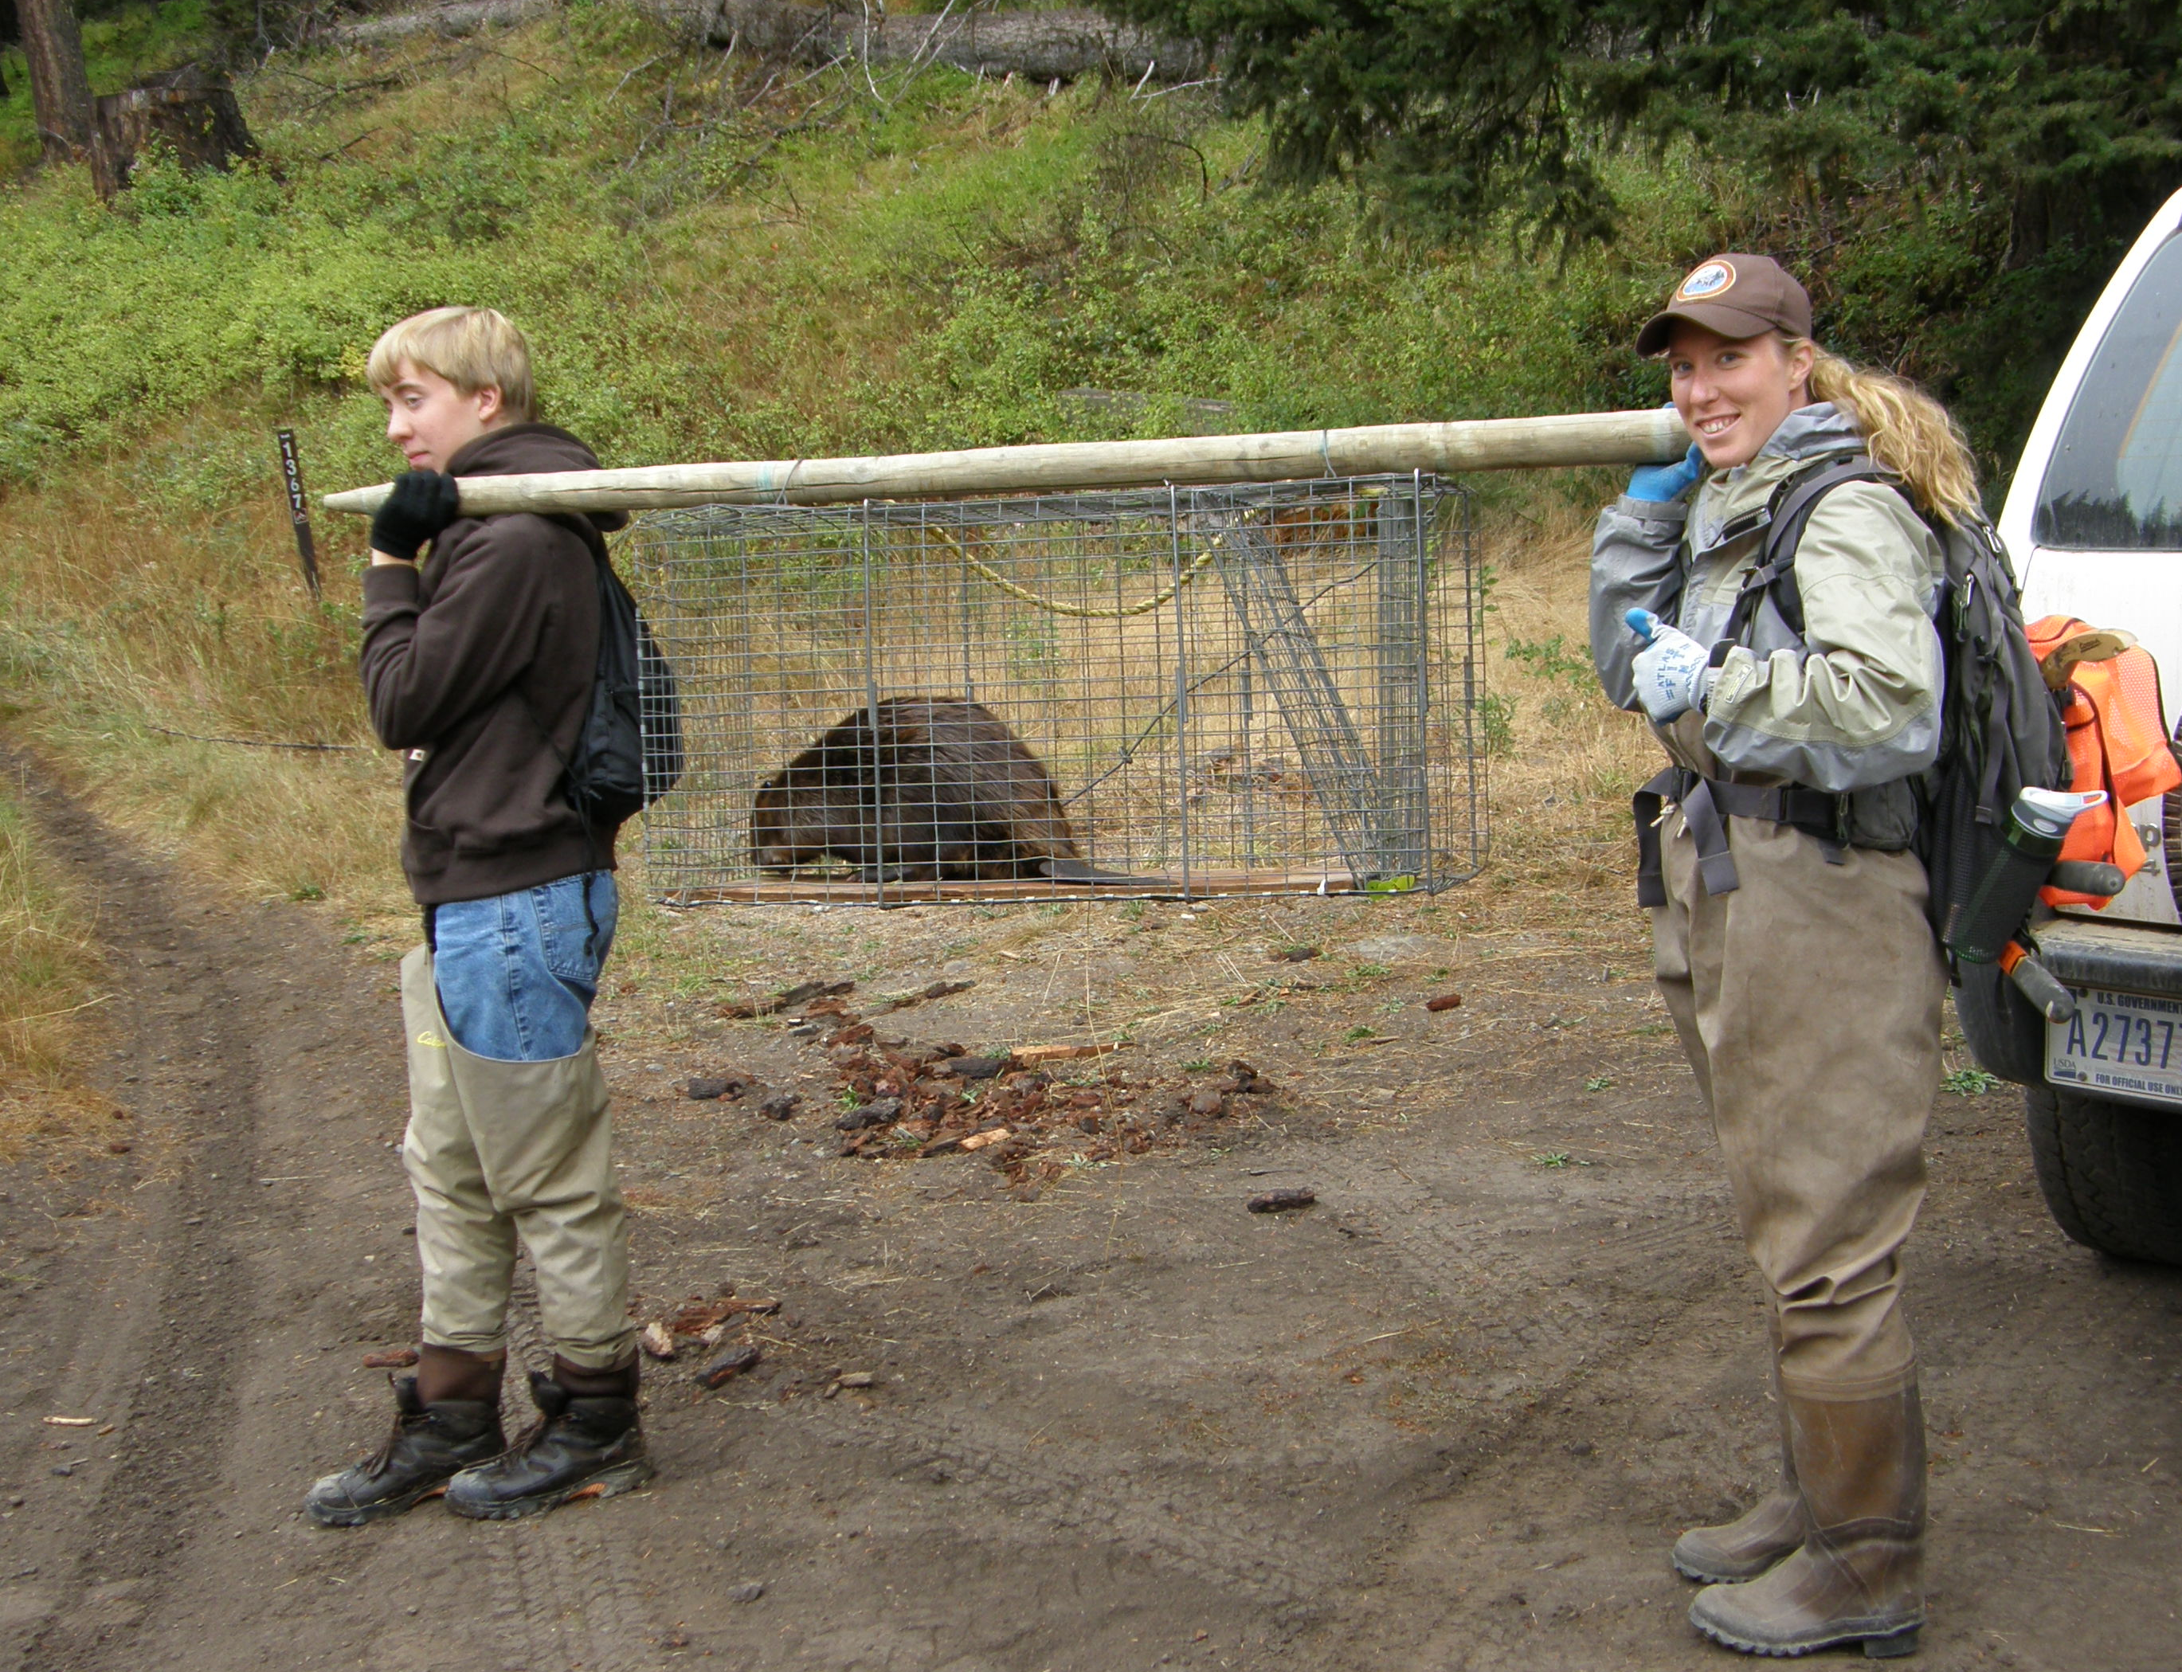
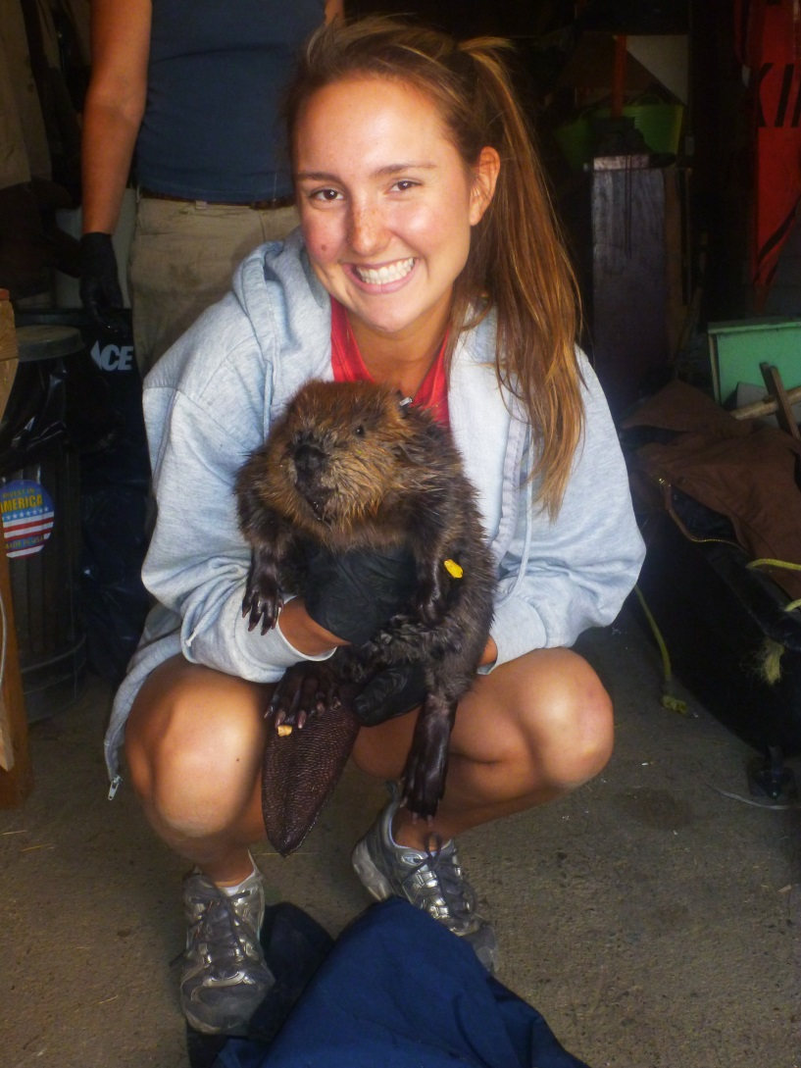
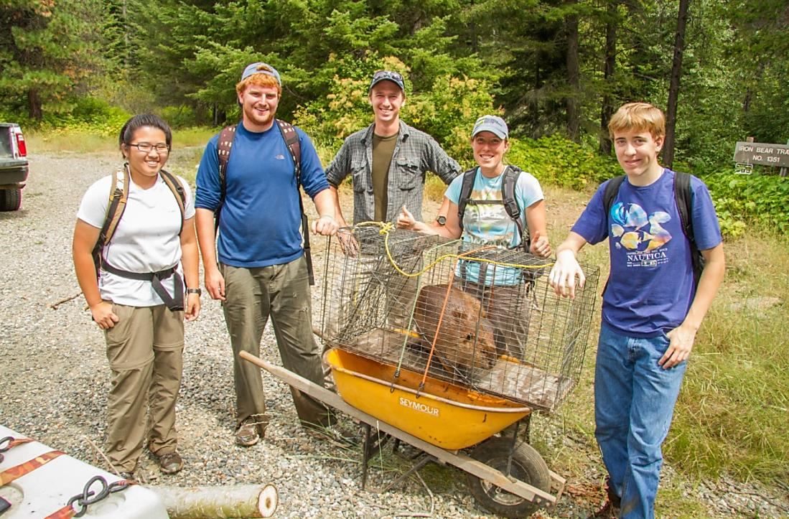
*Community Involvement
3,987 hours

Slide 23
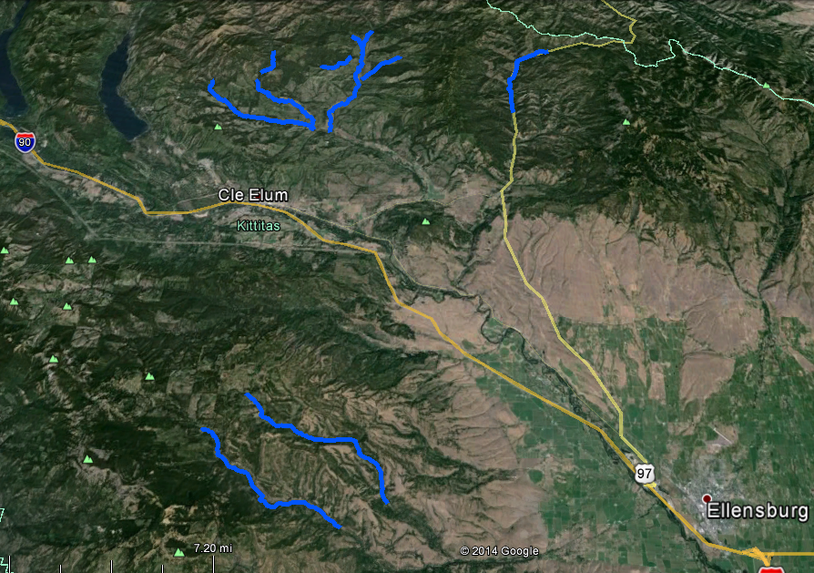
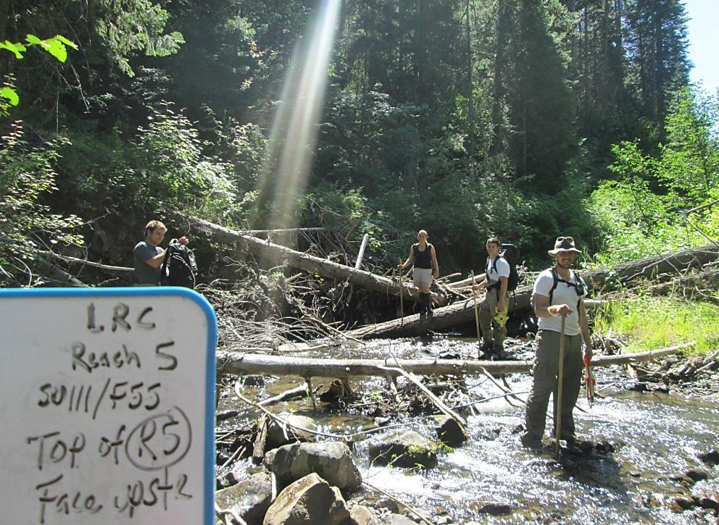
NF Teanaway
MF Teanaway
Swauk
WF Teanaway
49 stream miles surveyed
NF Manastash
SF Manastash
Notes:
Staff surveyed more than 49 stream miles and found newly established beaver colonies.

Slide 24
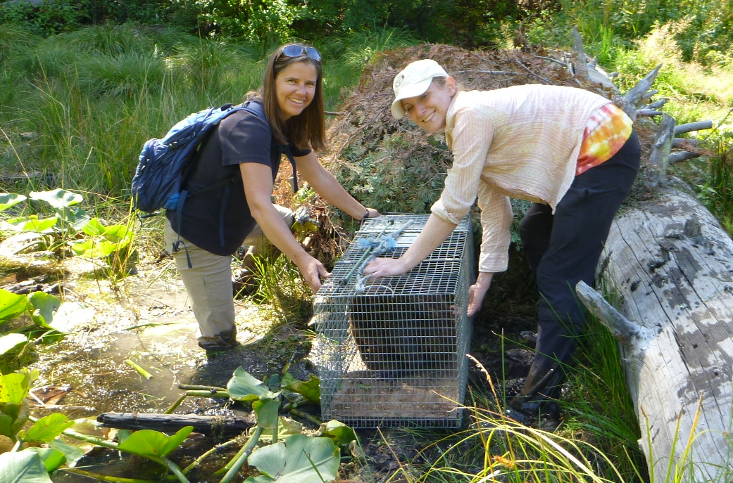
Relocated 130 Nuisance Beavers

Slide 25
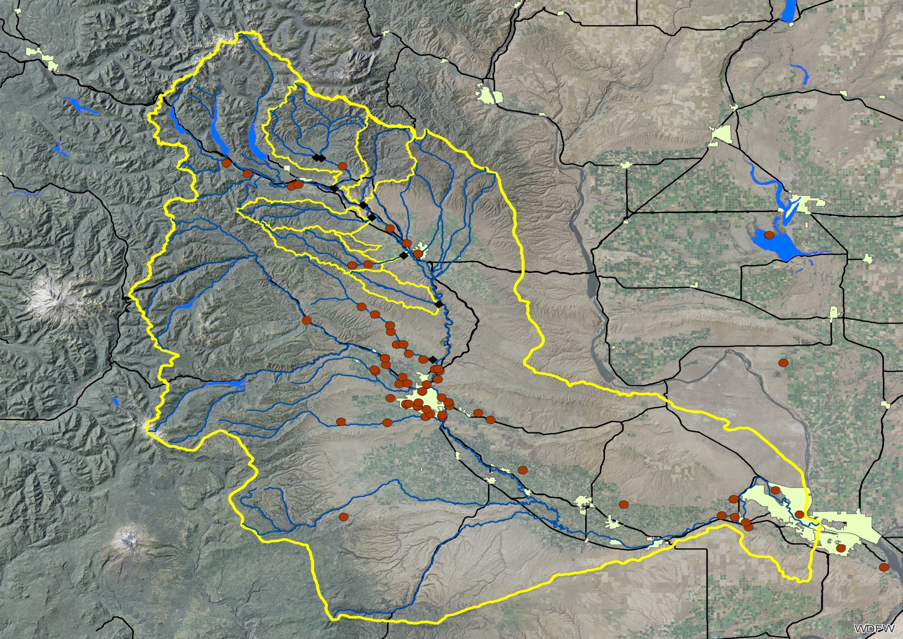
WDFW Nuisance Beaver
N
= WDFW 2000-2009
Ellensburg
Yakima
Tri- Cities

Slide 26
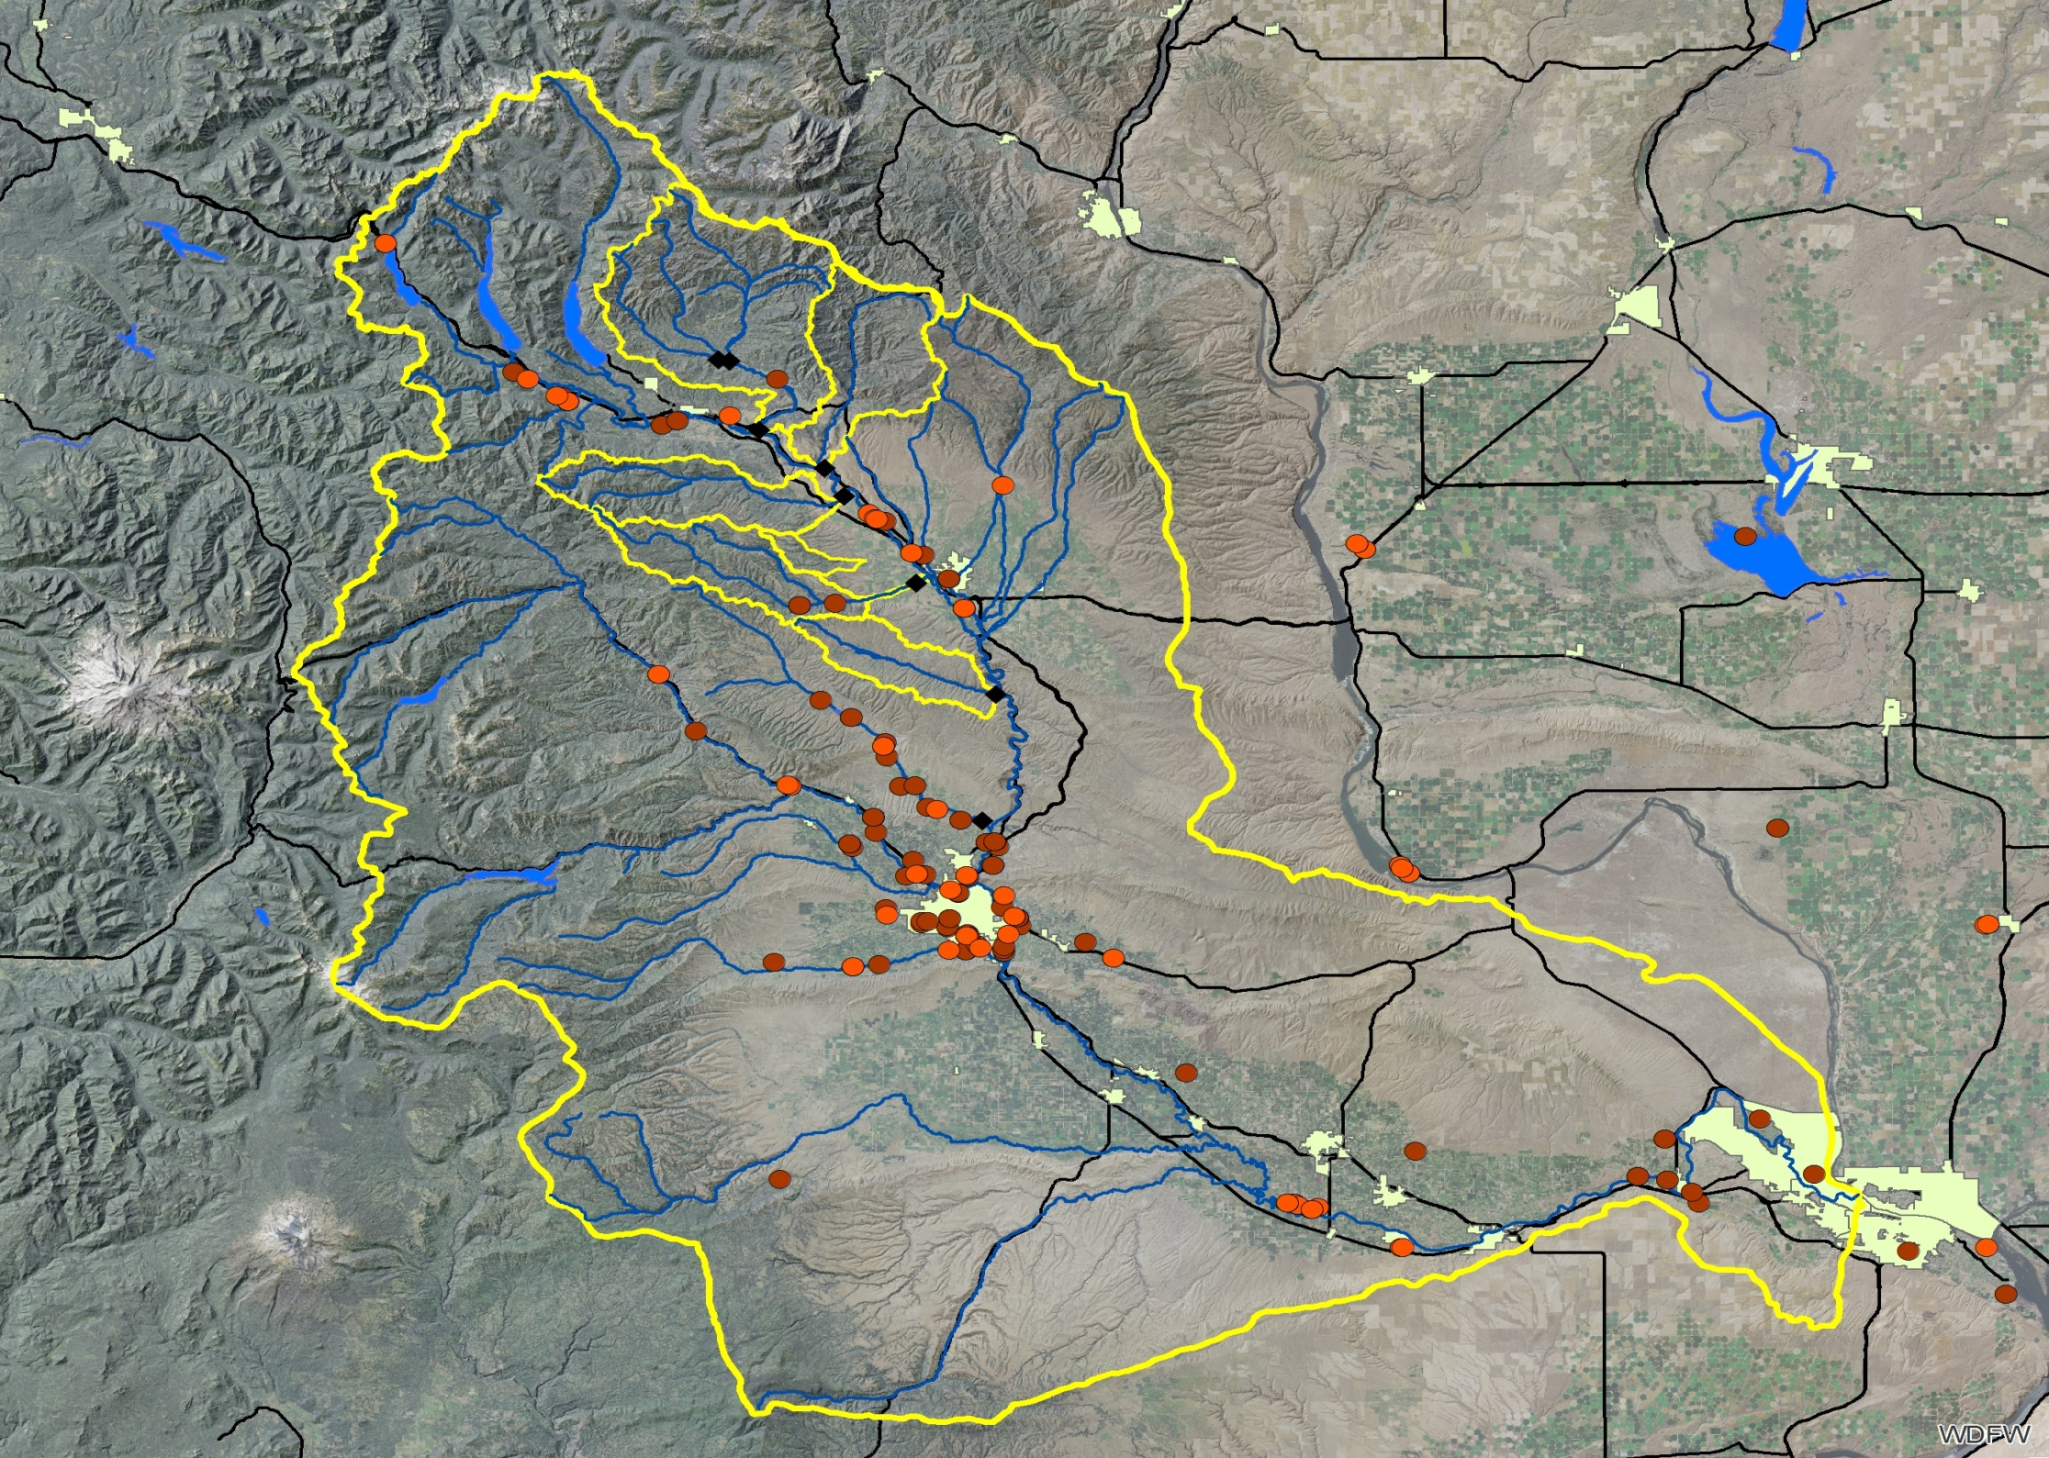
WDFW and YBP Nuisance Beaver
N
= WDFW 2000-2009
= YBP 2011-2014
Ellensburg
Yakima
Tri- Cities

Slide 27
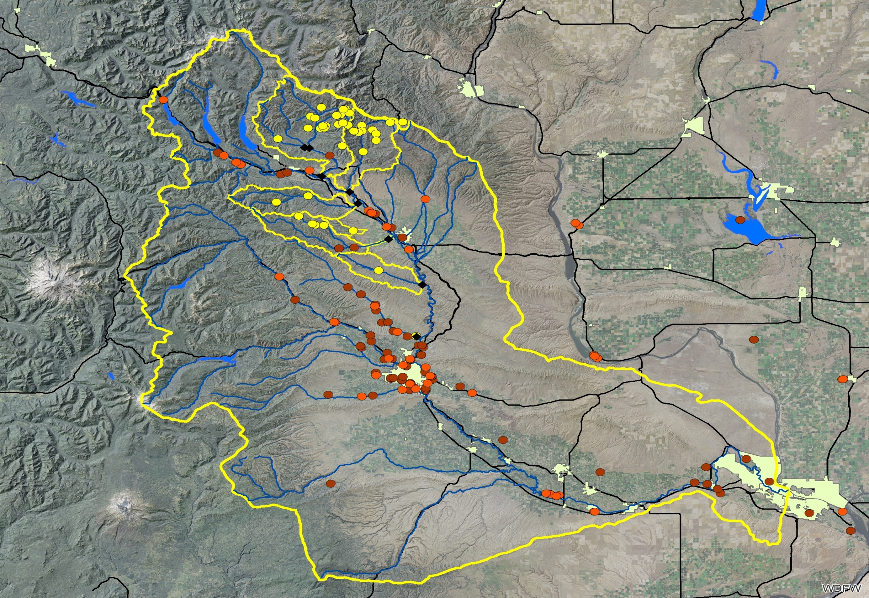
Beaver Relocations
N
= WDFW 2000-2009
= YBP 2011-2014
= YBP Release sites
Ellensburg
Yakima
Tri- Cities

Slide 28
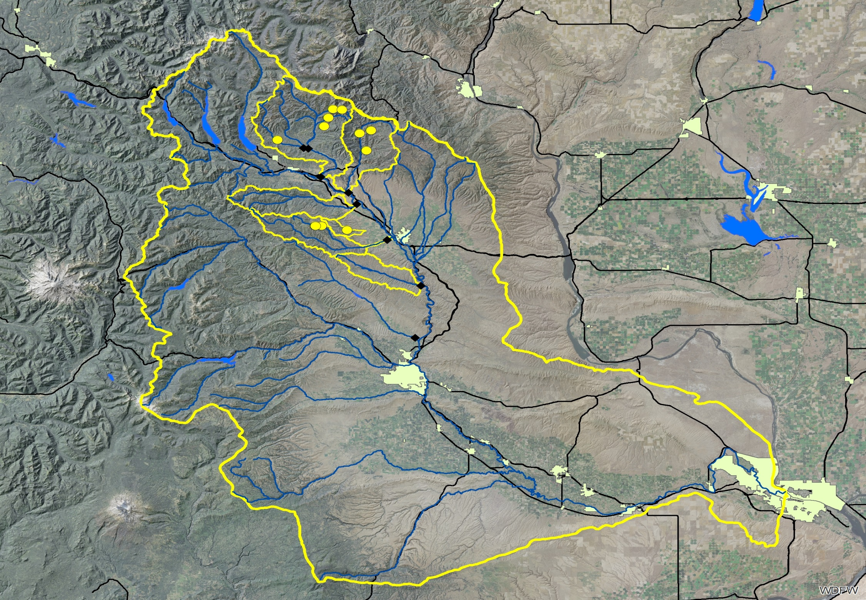
Beaver Successful Establishments
N
= YBP Successful
Reintroductions
Ellensburg
Yakima
Tri- Cities

Slide 29
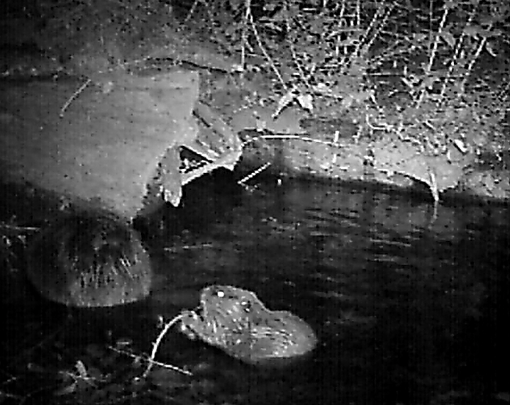
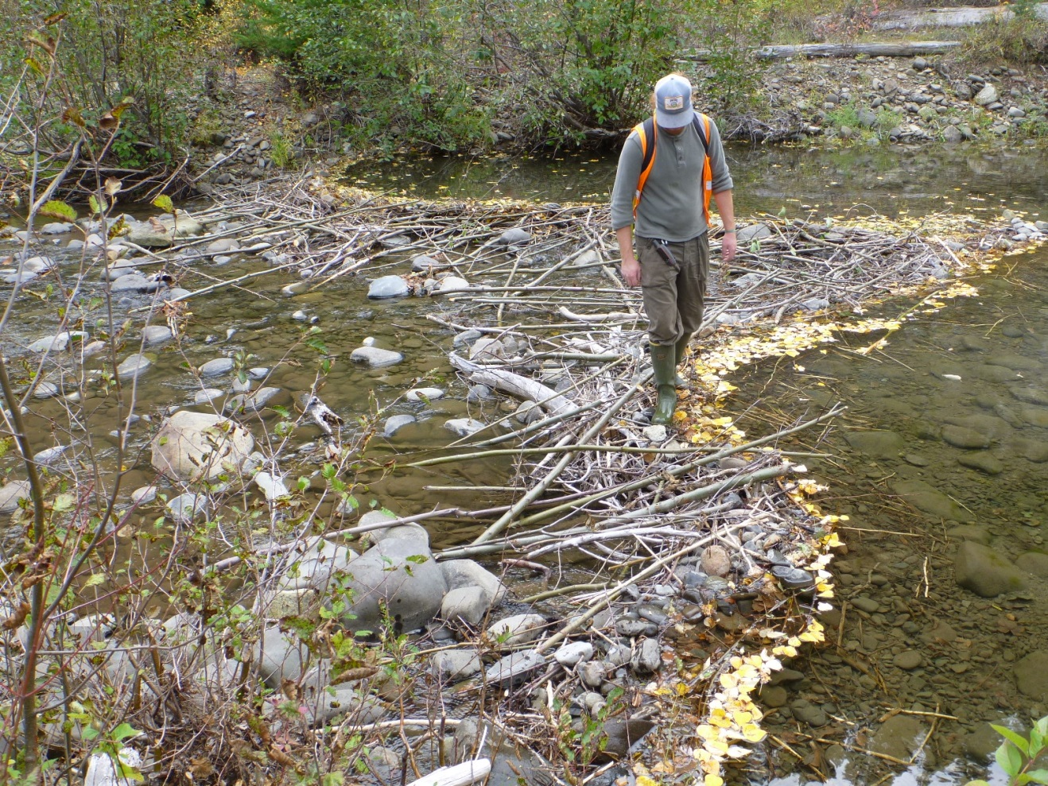
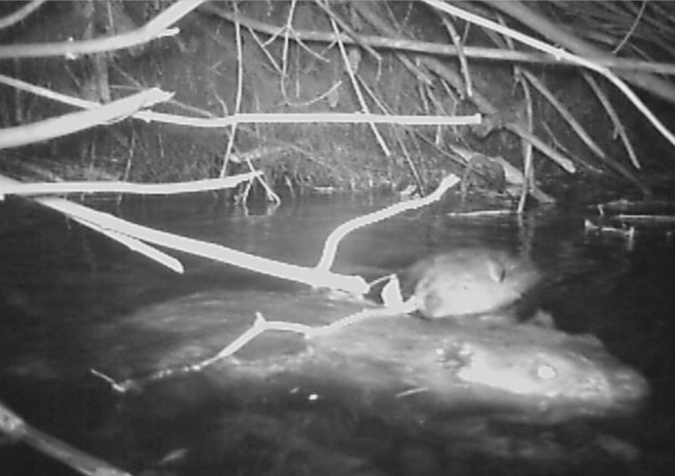
Monitoring
Ear Tag
14 colonies successful

Slide 30
Water Storage
7.9 million gallons/ yr

Slide 31
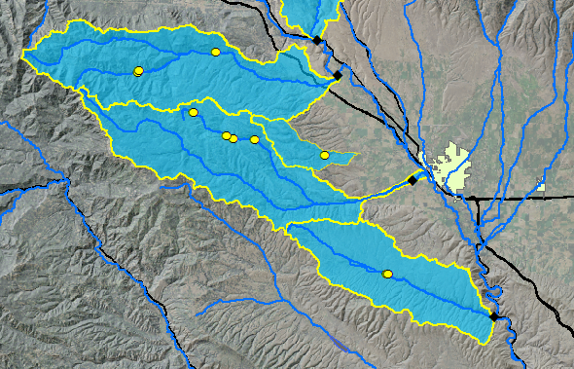
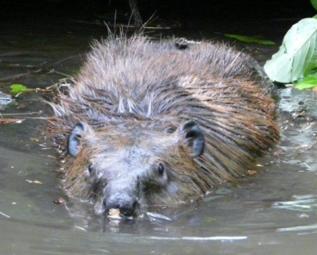
Beaver Movement
= Release sites
= PIT Tag readers
Taneum
Manastash
Umtanum
“Goldie”
Notes:
Goldie was a juvenile female trapped from Priest Rapids

Slide 32
Beaver Movement
= Release sites
?
= PIT Tag readers
Taneum
Manastash
Umtanum
“Goldie”
Notes:
Goldie was a juvenile female trapped from Priest Rapids

Slide 33
Beaver Movement
= Release sites
?
= PIT Tag readers
Taneum
~2.7 Years
~ 27 miles
Manastash
Umtanum
“Goldie”
Notes:
Goldie was a juvenile female trapped from Priest Rapids

Slide 34
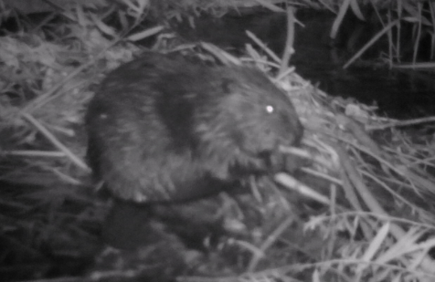
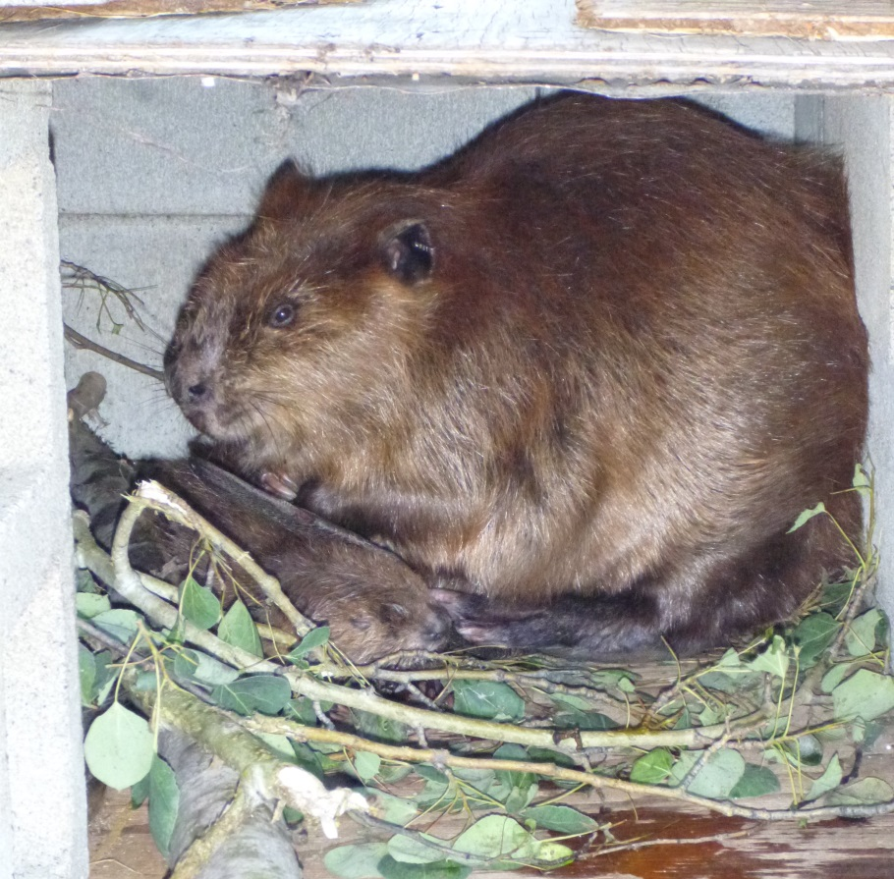
Challenges/ Lessons Learned
PIT tag detection
Ear Tag retention
Family bonds
No Ear Tag!
Beavers Move!

Slide 35
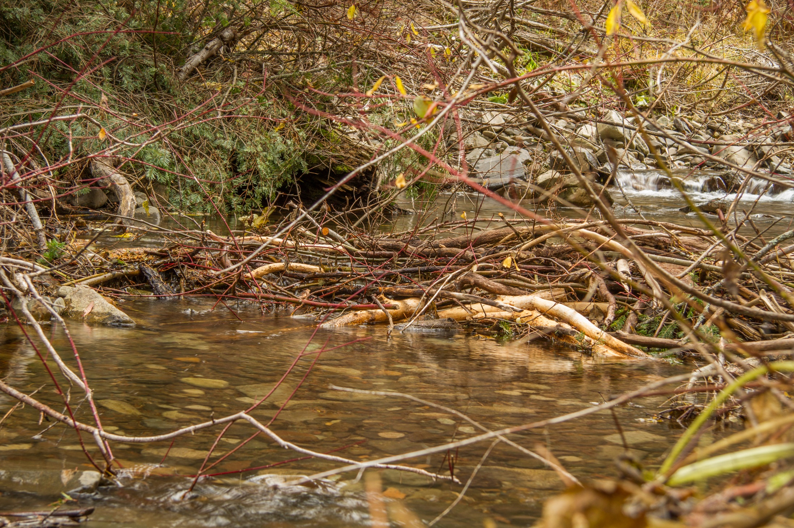
Results 2 months
Notes:
Initial dam construction at relocation site (Bear Creek, Tributary to N.F. Teanaway River) 2 months after release. Relocation site is the dark burrow on the left.

Slide 36
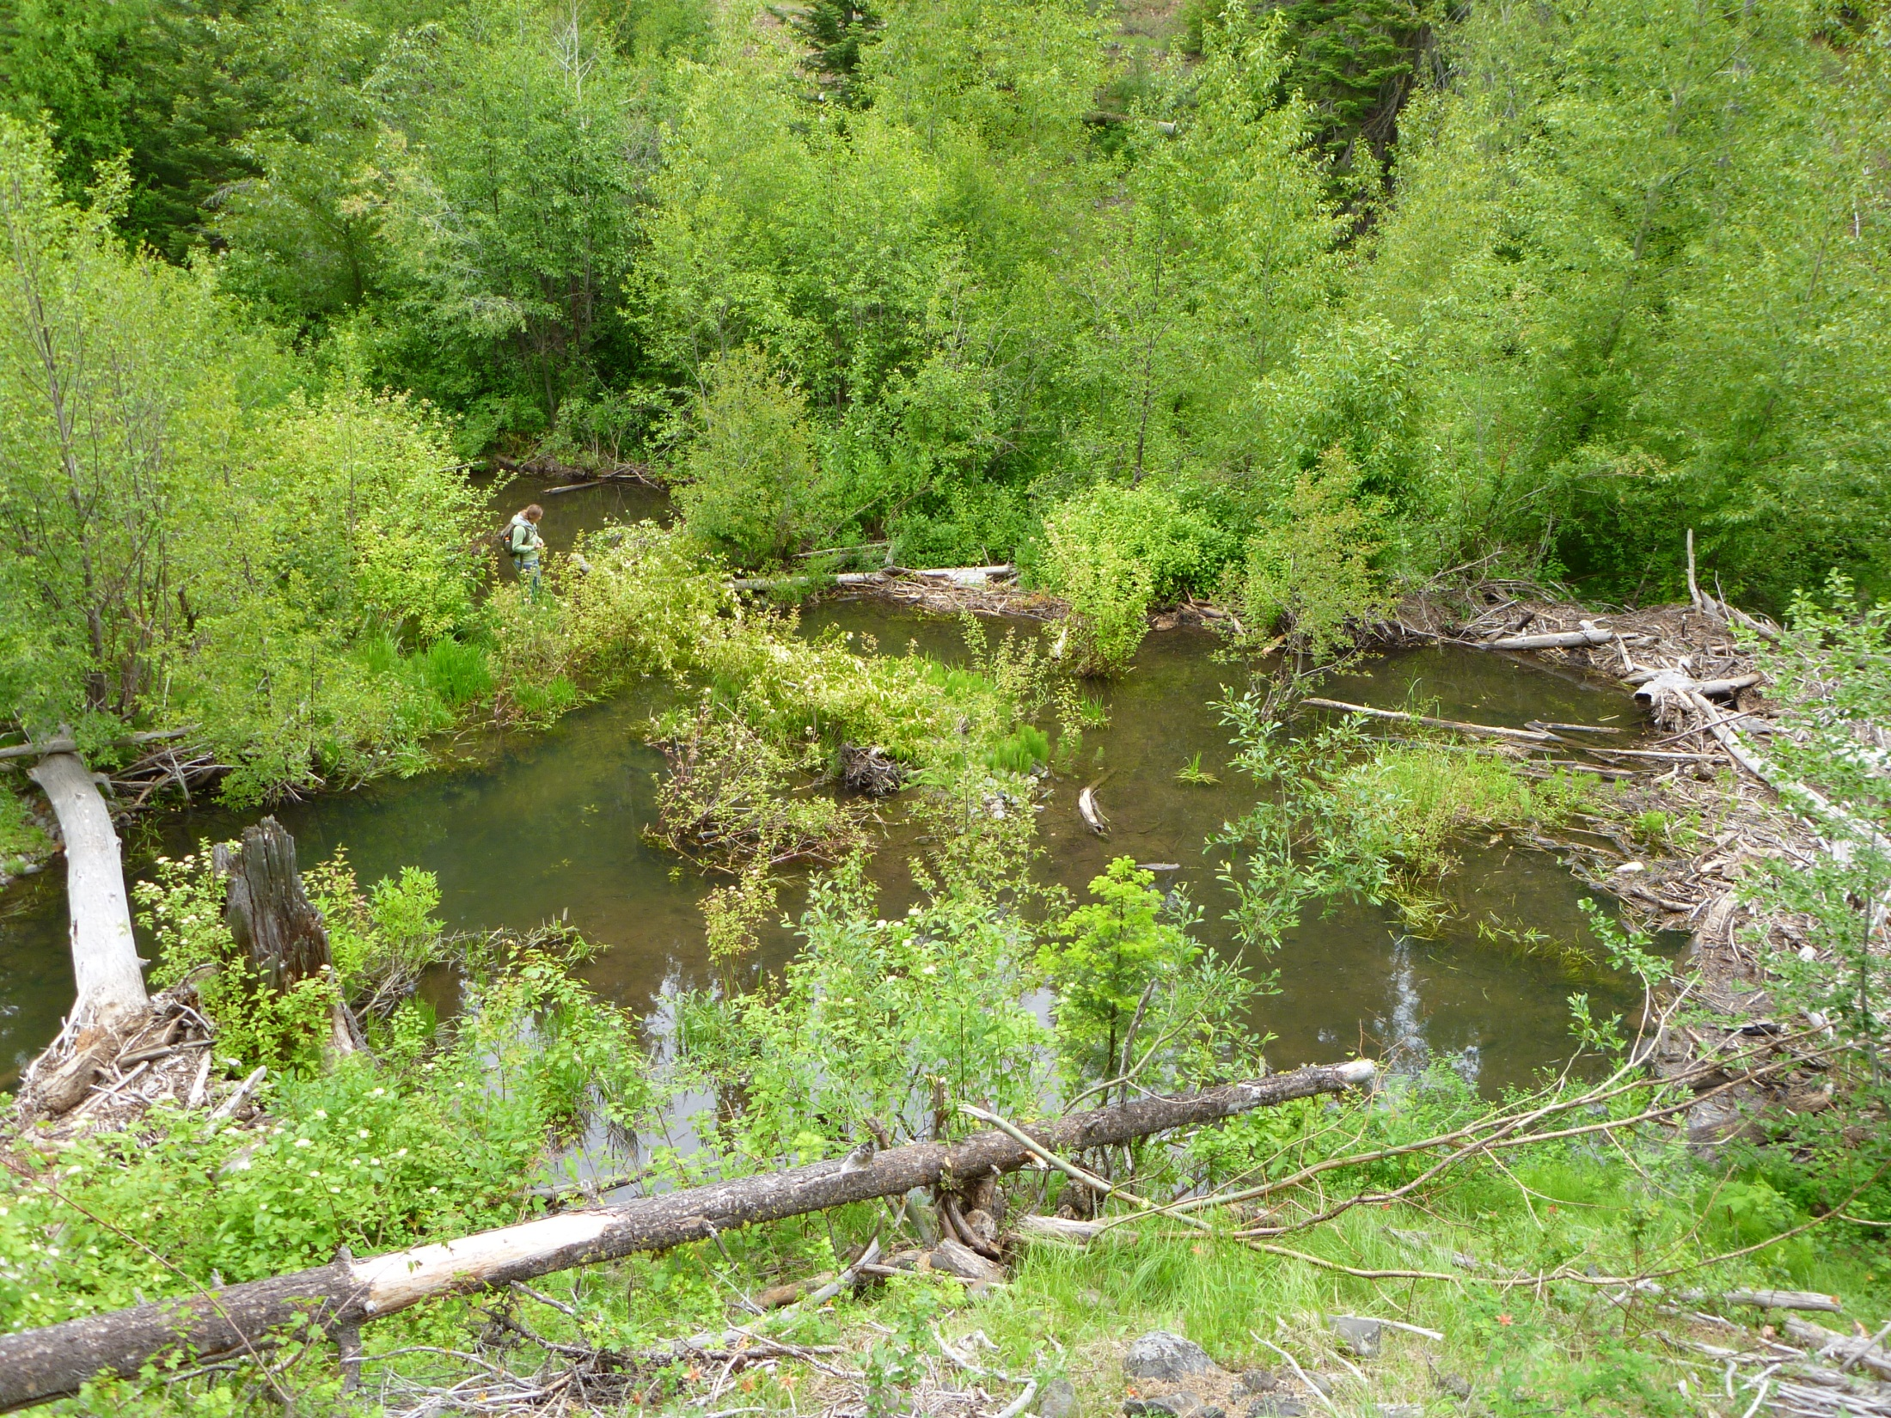
Cool Clean Complex Connected
Results 2 years
Notes:
Our successful NF Manastash release site ~1.5 years (2 winters) after release. The beavers built a large pond complex against a natural log jam in the stream and began flooding more riparian to access food and build lodges. Beavers frequently capitalize on large wood complexes in natural jams, and this is why we plan on targeting the introduced LWD jams that YN and MCRFEG will place in the coming years.

Slide 37
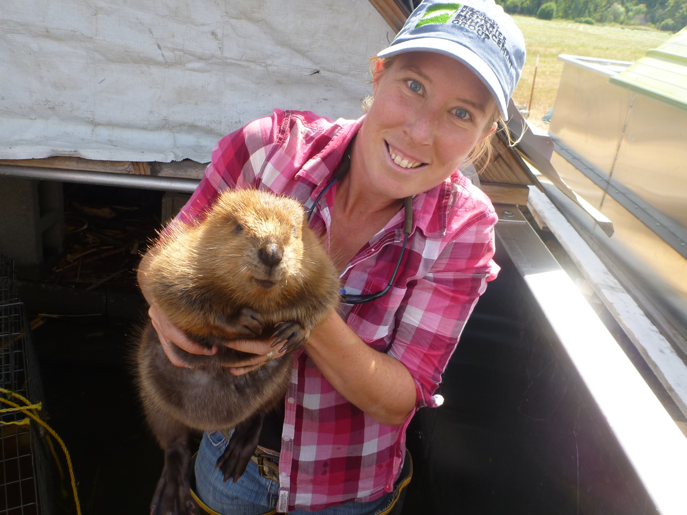
Thank You!

Slide 38
Pollock 2003 calculation
Number of successful sites * Average pond surface area per site (m²/site) * infiltration rate (m/s)* number of days of infiltration * conversion factor = volume of groundwater storage (m³/yr)
12 * 170.5 m² * 0.0000004 *365 * 86,400 = 25,809 m³/yr = 25 million liters/yr = 6.6 million gallons/ yr
Where:
Number successful sites 2011-2014 = 12 sites
Average pond surface area/successful site = 170.5 m²/site
Infiltration rate = 0.0000004 m/sec (Pollock et al., 2003)
Number of days of infiltration = 365 days (ponds are observed to have water year-round)
Conversion factor = 86,400 (converting from per seconds to days)

