Slide 1
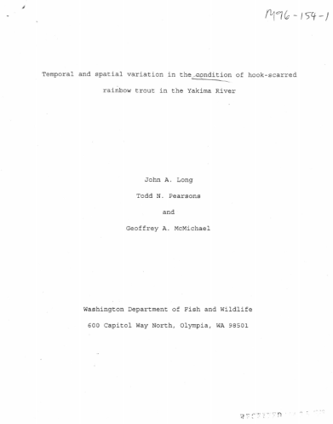
The influence of 25 years of catch and release fishing regulations on hook-scarring, size, and abundance of Yakima River rainbow trout
Presented By: Gabriel M. Temple¹
John A. Long¹, Todd N. Pearsons², and Geoffrey A. McMichael³
Yakima Basin Science and
Management Conference
Central Washington University
June 18, 2015
¹WDFW
²Grant County PUD
³Mainstem Fish Research

Slide 2
Project Updates-
NTTOC Monitoring
http://orafs.org/hatchery-vs-wild-salmonid-symposium-research-management-and-reform-in-the-pacific-northwest/
Resident/Anadromous O. mykiss interactions study
http://www.ptagis.org/resources/pit-tag-workshops/2015-workshop

Slide 3
The influence of 25 years of catch and release fishing regulations on hook-scarring, size, and abundance of Yakima River rainbow trout
Presented By: Gabriel M. Temple¹
John A. Long¹, Todd N. Pearsons², and Geoffrey A. McMichael³
Yakima Basin Science and
Management Conference
Central Washington University
June 18, 2015
¹WDFW
²Grant County PUD
³Mainstem Fish Research

Slide 4
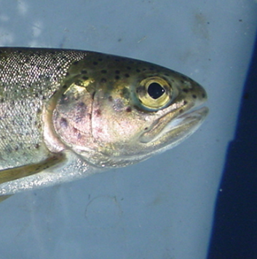
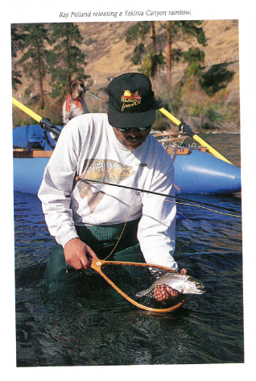
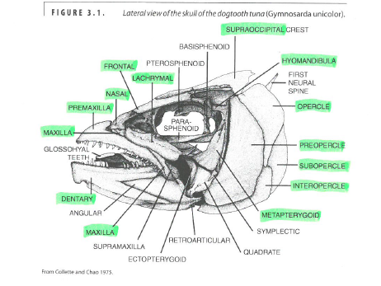
Hook-scarring / hooking injury
Probasco, 1994: Yakima River Journal

Slide 5
Catch-and-Release
First documented as a management tool in the mid-1950’s – ‘Fishing for Fun’ in the Smoky Mountains
Recycling of fish to provide a ‘quality experience’ for many anglers
Schill et al. 1986: Yellowstone Cutthroat caught on average 9.7 times in a 3 month period in 1981
Vincent 1984: document increased fish abundance and size following implementation

Slide 6
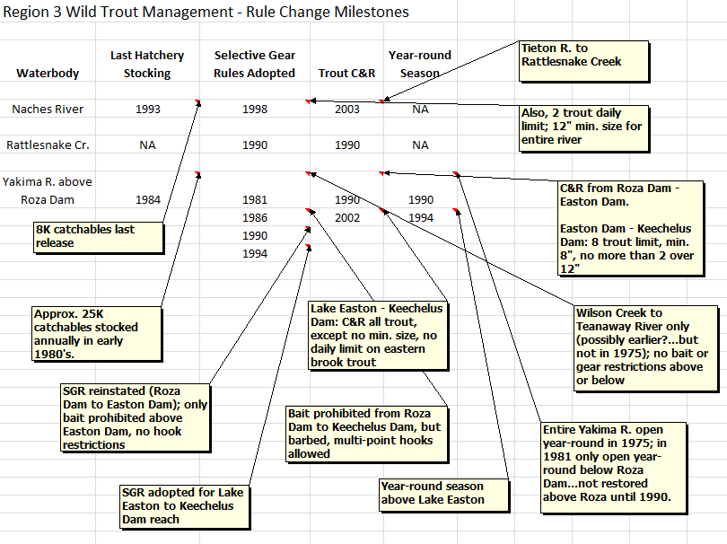
Fishing Regulations - Recent

Slide 7
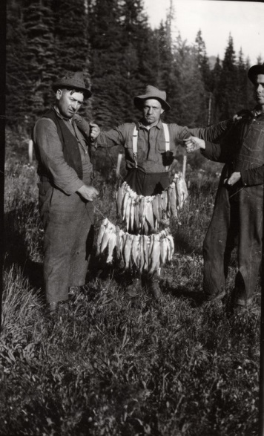
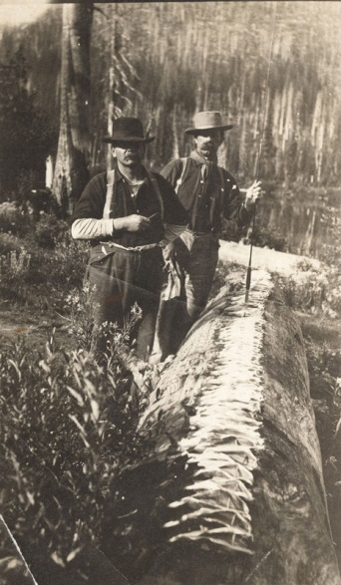
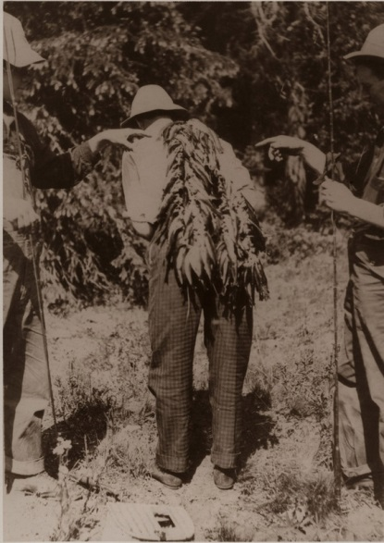
Fishing Regulations - Historical
Frank Abbot- Cle Elum Circa 1930
1910
Naneum Creek. 1914
Fish Lake 1930

Slide 8
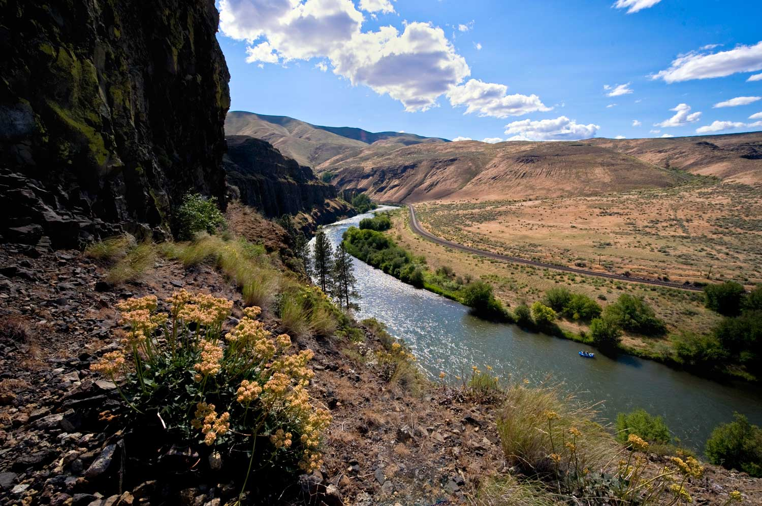
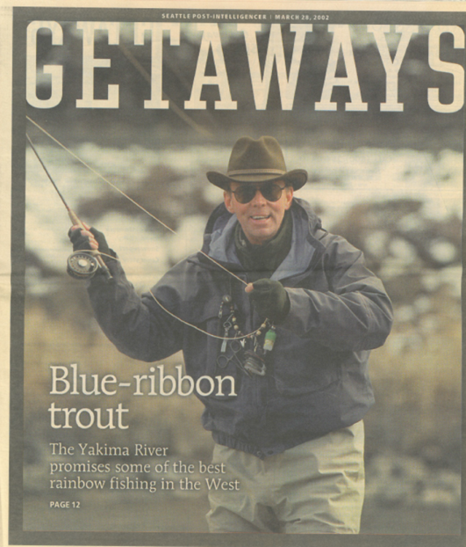
Yakima River- Current

Slide 9
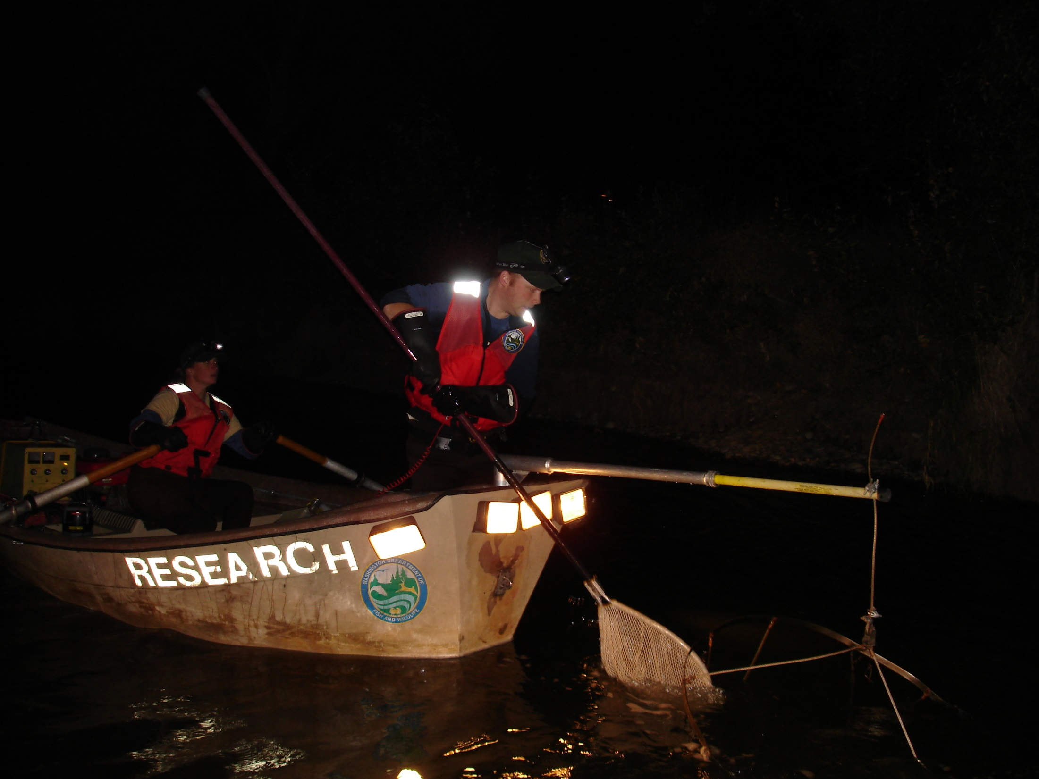
Yakima Rainbow Trout Abundance

Slide 10
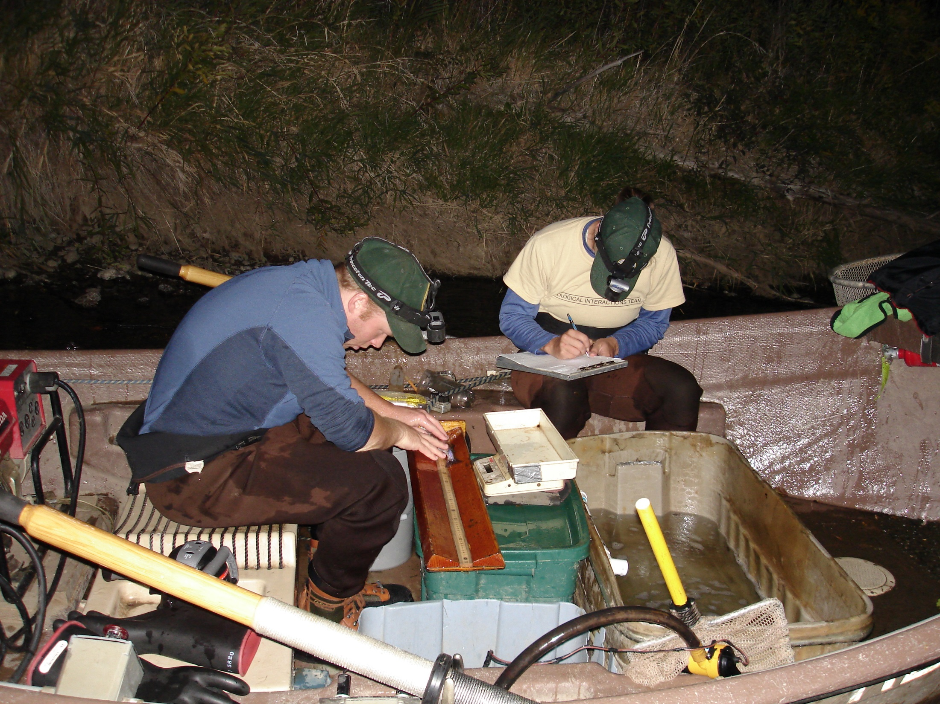
Yakima RBT Hook-scarring

Slide 11
Kittitas County Guide License Sales – annual 1994 to 2014

Slide 12
Yakima RBT Hook-scarring

Slide 13
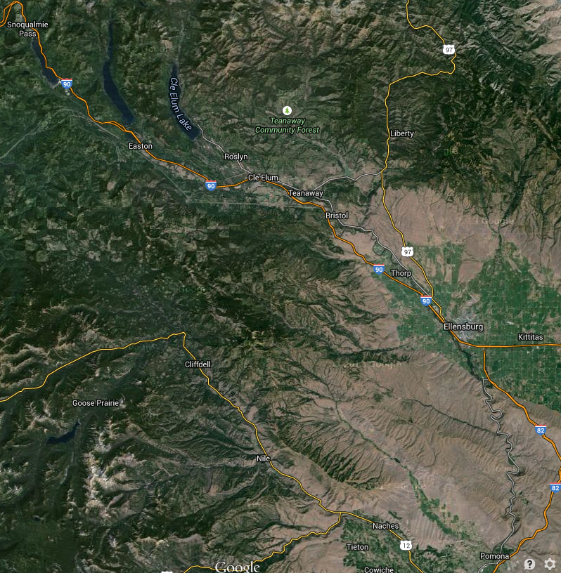
Hook-scarring by Section

Slide 14
Hook-scarring by Section

Slide 15
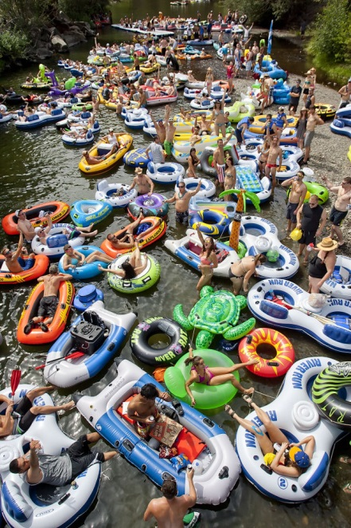
Hook-scarring by Section

Slide 16
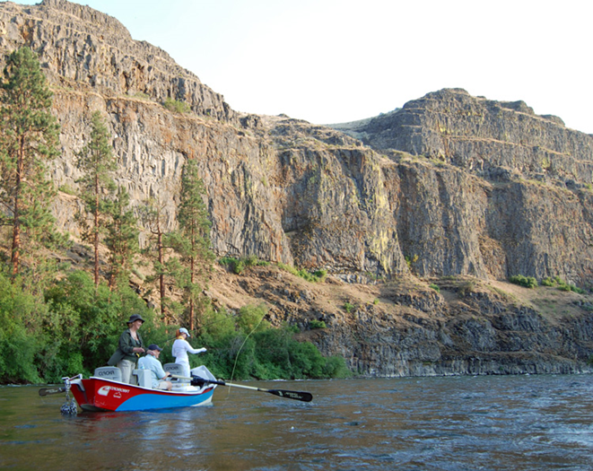
Bank Orientation

Slide 17
Size Trend

Slide 19
Note the scale- the difference is like 1.5g

Slide 20
What Drives Recruitment?

Slide 21
Effort Correlations

Slide 22
Summary
Yakima Trout population appears to be gradually increasing
Fishing effort appears greater now then in the 1990’s
Number of fish exhibiting hooking injuries is fairly constant
Higher injury rates with decreased elevation
Average size of individual trout decreasing slightly
Hooking injuries reduce trout “condition”, although difference is small
Hooking injuries are somewhat related to bank orientation (probably resulting from water management)
Index of fishing effort appears to have less influence on variation in recruitment than other factors

