Slide 1
Reproductive Success of Artificially Reconditioned Kelt Steelhead in the Yakima River
Jeff Stephenson, Dave Fast, Bill Bosch, Joe Blodgett, Ryan Branstetter, Andy Pierce, Shawn Narum, Doug Hatch

Slide 2
Acknowledgements
Tracy Hauser (BPA)
Chris Frederiksen (YN)
Jeff Trammell (YN)
Tim Resseguie (YN)
Todd Newsome (YN)
Ryan Deknikker (YN)
Bill Fiander (YN)
Jeremiah Newell (CRITFC)
Bobby Begay (CRITFC)
CRITFC Genetics Crew
Prosser Hatchery Crew

Slide 3
Outline
Provide some background on the kelt reconditioning program
Present research questions for this study
Preliminary results and some interpretation of parentage analysis

Slide 4
Natural Reproductive Success
Seamons & Quinn 2010 studied 19 Brood years of a wild population of steelhead
Theorized that: “lifetime reproductive success (LRS).…. should scale with the number of breeding seasons”
Found that: female repeat spawners had “nearly twice” the success of one time spawners
Notes:
“all other things being equal, the lifetime reproductive success (LRS) of iteroparous and semelparous individuals should scale with the number of breeding seasons”

Slide 5
Life history of natural kelts in Yakima
Spawning
Kelts
Incubation
Rearing
Resident
Upstream Migration
Outmigration
Estuary & Ocean
Notes:
70 and 12-15 comes from Fredriksen
7.2 is from published research on open ocean

Slide 6
~70% of the Yakima run is moving downstream of Prosser
Spawning
Kelts
Incubation
Rearing
Resident
Upstream Migration
Outmigration
Estuary & Ocean
Notes:
70 and 12-15 comes from Fredrickson
7.2 is from published research on open ocean

Slide 7
~70% of the Yakima run is moving downstream of Prosser
Spawning
Kelts
Incubation
Rearing
Resident
Upstream Migration
Outmigration
Estuary & Ocean
12% to 35% survival of Yakima kelts to the ocean
Notes:
70 and 12-15 comes from Fredrickson
7.2 is from published research on open ocean

Slide 8
~70% of the Yakima run is moving downstream of Prosser
Spawning
Kelts
Incubation
Rearing
Resident
Upstream Migration
Outmigration
Estuary & Ocean
12% to 35% survival of Yakima kelts to the ocean
high seas samples contain 7.2% previous spawners
Notes:
70 and 12-15 comes from Fredrickson
7.2 is from published research on open ocean

Slide 9
~70% of the Yakima run is moving downstream of Prosser
Spawning
Kelts
Incubation
Rearing
Resident
Upstream Migration
Outmigration
Repeat spawners typically comprise 60% consecutive and 40% skips.
Estuary & Ocean
12% to 35% survival of Yakima kelts to the ocean
high seas samples contain 7.2% previous spawners
Notes:
70 and 12-15 comes from Fredrickson
7.2 is from published research on open ocean

Slide 10
~70% of the Yakima run is moving downstream of Prosser
Spawning
2.7% of the run at Prosser are natural repeat spawners
Kelts
Incubation
Rearing
Resident
Upstream Migration
Outmigration
Repeat spawners typically comprise 60% consecutive and 40% skips
Estuary & Ocean
12% to 35% survival of Yakima kelts to the ocean
high seas samples contain 7.2% previous spawners
Notes:
70 and 12-15 comes from Fredrickson
7.2 is from published research on open ocean

Slide 11
Artificial Reconditioning In the Yakima River to date
Capture and feed for 6 to 9 Months
Collected 8,110 kelt steelhead
Reconditioned and released 3,305
Survival to release ~ 40%
Individual survival correlated with fish condition
Hatch et al. 2013. NAJFM 33(3)

Slide 12
Research Questions
Do artificially reconditioned kelt steelhead reproduce in the wild?
What is the relative reproductive success (RRS) of artificially reconditioned kelt steelhead?
What is the lifetime reproductive success (LRS) of artificially reconditioned kelt steelhead?

Slide 13
Logistical Issues
Limited power due to sampling a small proportion of the population
Incidental sampling of resident offspring
Need to know juvenile age
No data for skip spawners
No data for naturally reconditioned kelts
Currently have only two years of data

Slide 14
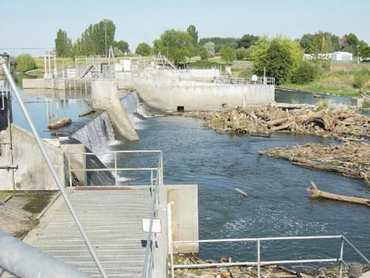
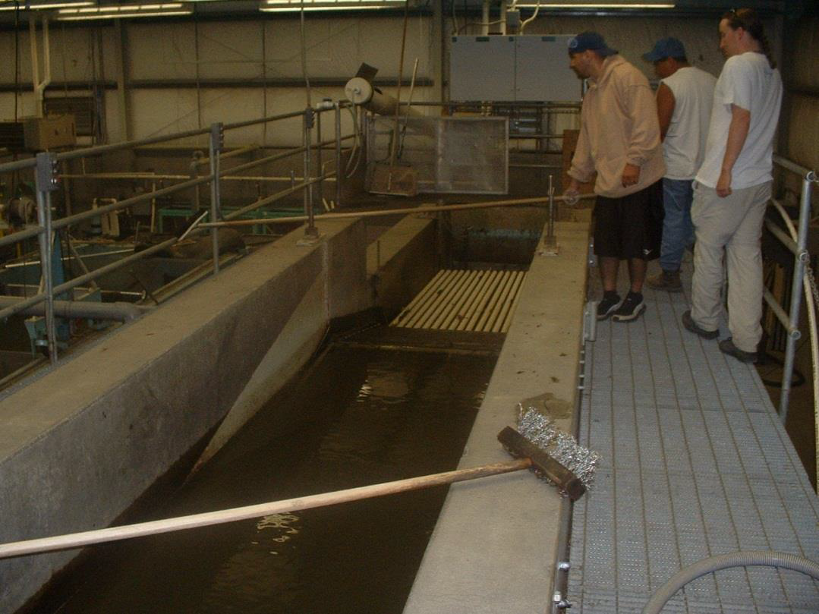
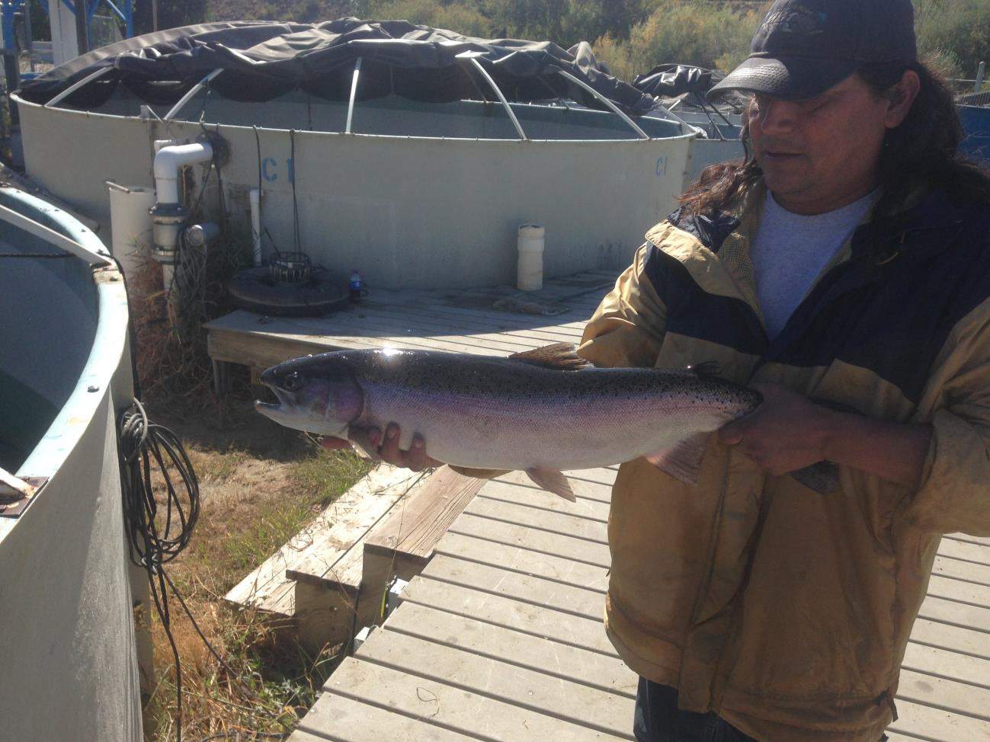
Parent Collections-Female Only
Pre-spawn maidens. Upstream at Prosser
Post-spawn maidens. Downstream at Chandler
Reconditioned Kelts. Upstream at Prosser
Includes known non-rematuring fish

Slide 15
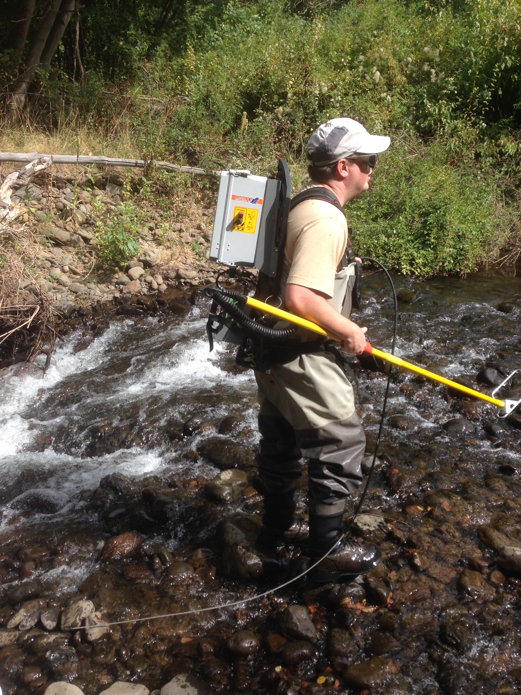
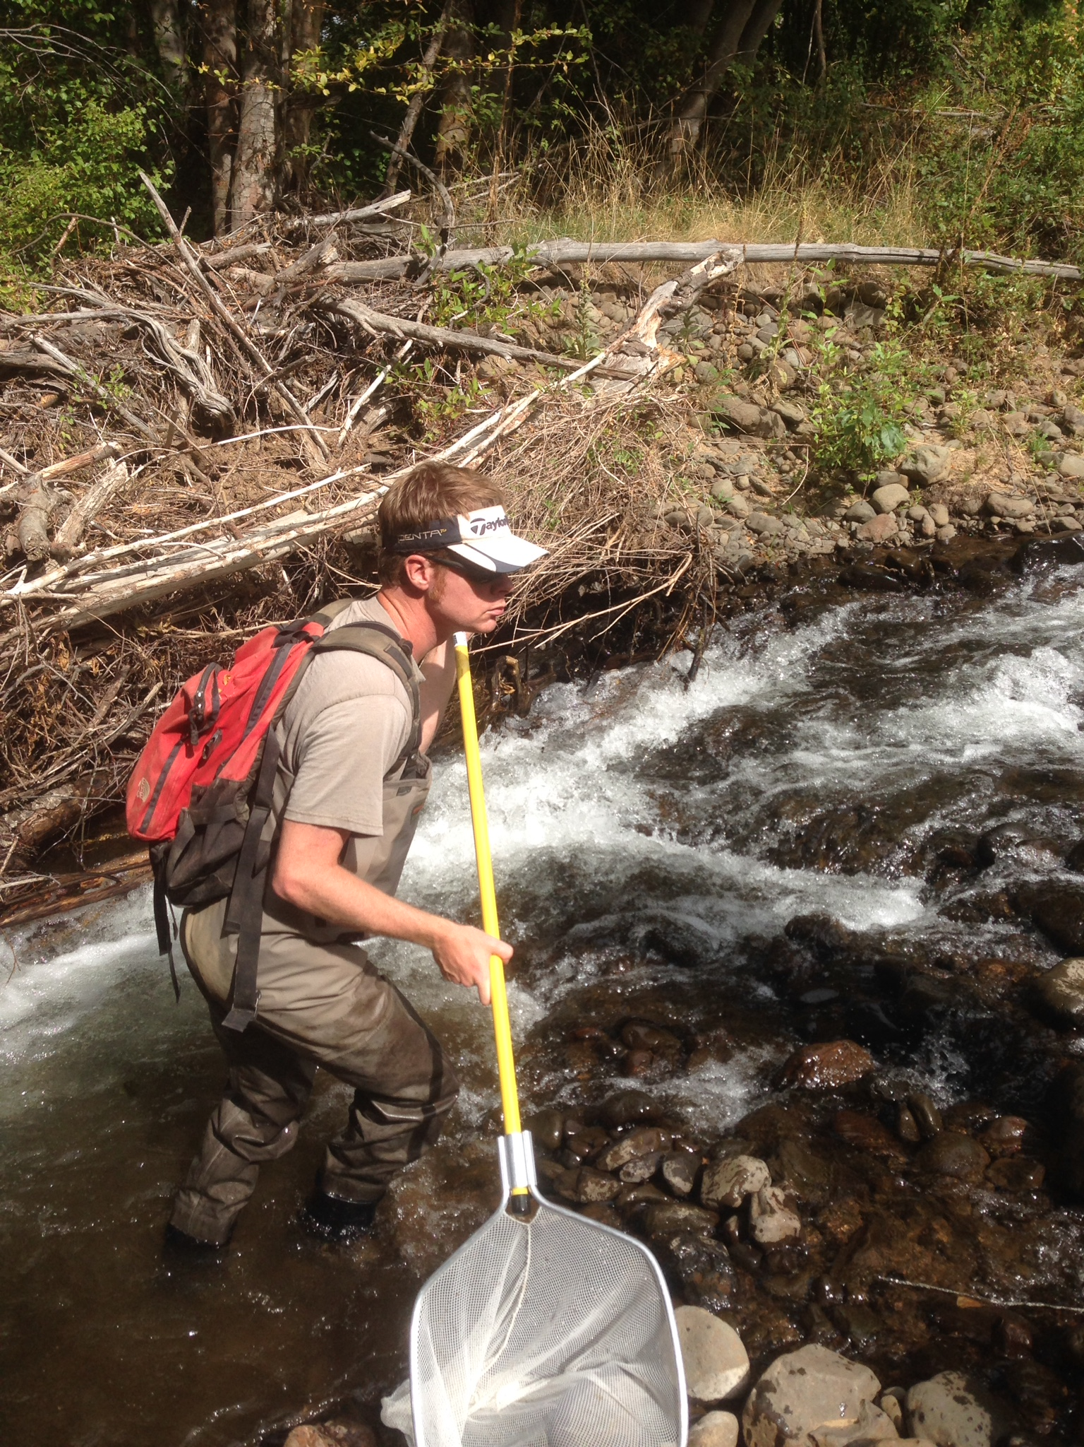
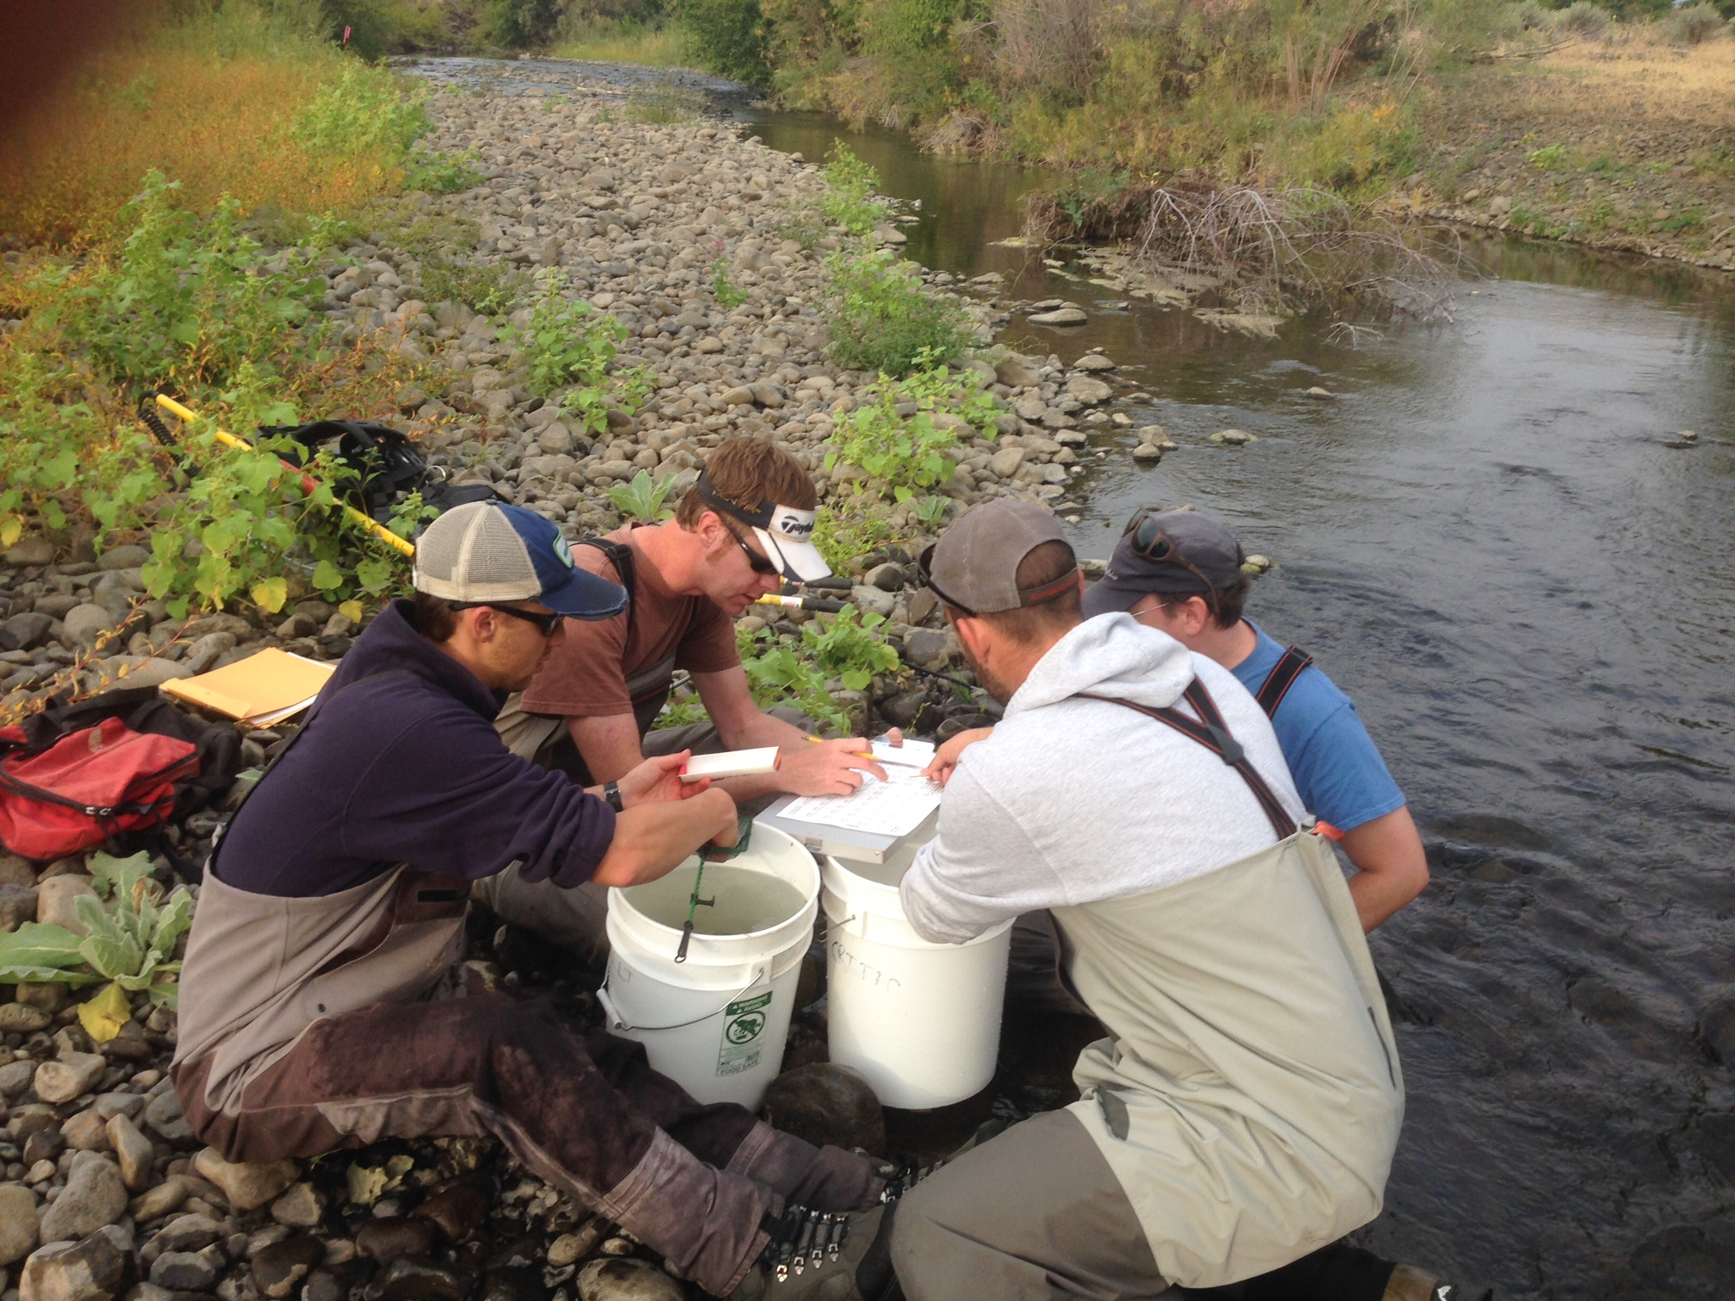
Offspring collections
Electrofished in August and September
Targeted areas with known steelhead spawning
Targeted age-0 young of the year

Slide 16
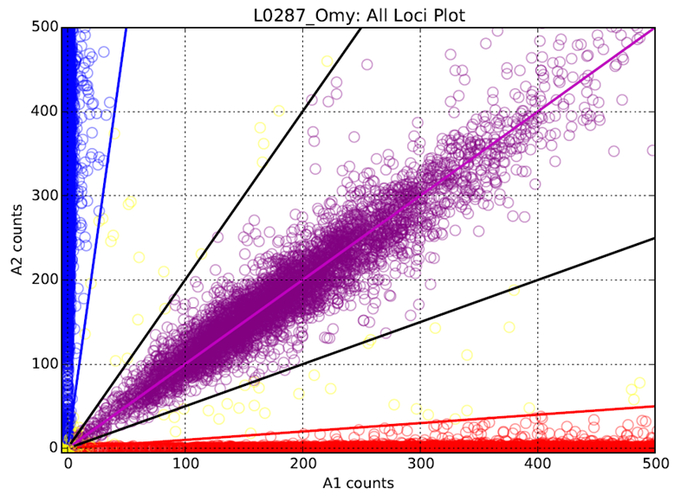
Genotyping Methods
Genotyped 192 SNP markers using targeted amplicon sequencing on Illumina Hiseq 1500
Dropped 40 markers
35 with low diversity (MAF < 0.05)
3 cutthroat diagnostic
1 poor genotypes
1 sex marker

Slide 17
Sample with Genotypes
1,440 Genotyped Parents
1,161 Genotyped Offspring
 | 2013 | 2014
Pre-spawn maidens | 306 | 287
Post-spawn maidens | 307 | 239
Reconditioned kelts | 209 | 92
 | 2013 | 2014
Satus Creek | 248 | 234
Toppenish Creek | 300 | 257
Naches River |  | 89
Big Creek |  | 19
Ahtanum Creek |  | 14

Slide 18
Parentage Method
Used the Program CERVUS
Simulations ran to determine a 99% confidence interval for LOD scores (natural log of overall likelihood ratio).
Progeny assignments were used if
Met 99% confidence interval
Had one or less mismatching loci. Allows for minor genotyping error

Slide 19
Parentage Results
Juveniles assignment rates
2013: 19% (105 of 548) to at least 1 parent
2014: 30% (148 of 491) to at least 1 parent
Parent assignment rates
2013: 5.6% (46 of 822) had at least 1 progeny
2014: 7.9% (49 of 618 ) had at least 1 progeny
Low detection rates are the result of the low proportions of parents and progeny sampled throughout the Yakima Basin

Slide 20
1. Do artificially reconditioned kelt steelhead reproduce in the wild?
Notes:
Data are preliminary. Parent populations may represent different proportions of the spawners within Satus and Toppenish creeks so don’t make any relative comparisions. Point of this graph is to demonstrate that yes reconditioned kelt steelhead do reproduce in the wild.

Slide 21
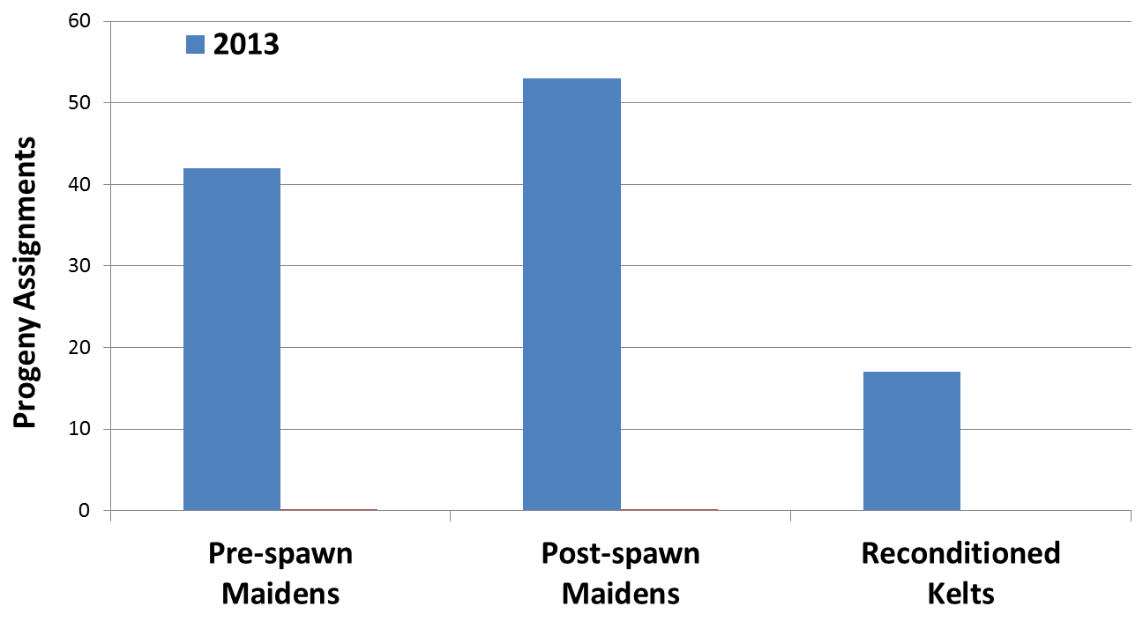
1. Do artificially reconditioned kelt steelhead reproduce in the wild?
Notes:
Data are preliminary. Parent populations may represent different proportions of the spawners within Satus and Toppenish creeks so don’t make any relative comparisions. Point of this graph is to demonstrate that yes reconditioned kelt steelhead do reproduce in the wild.

Slide 22
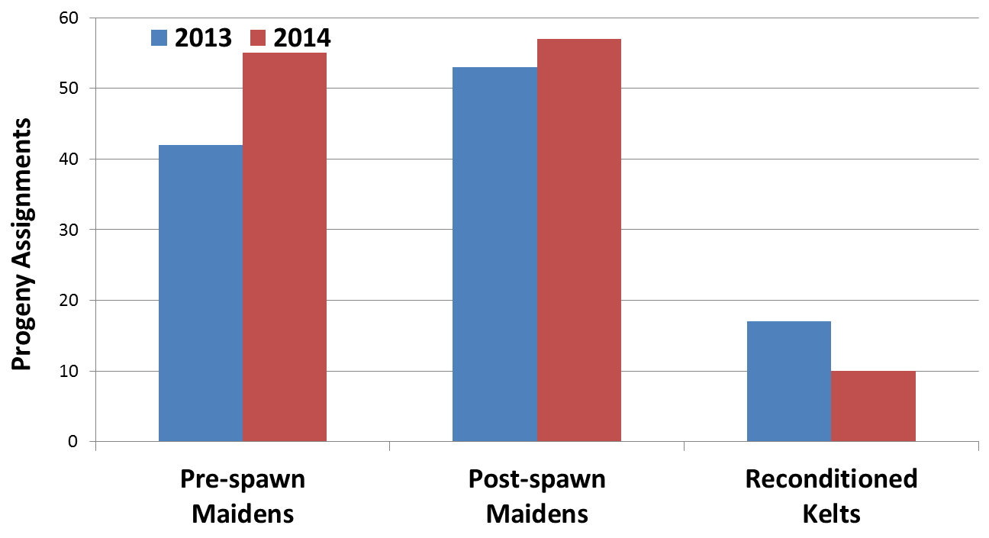
1. Do artificially reconditioned kelt steelhead reproduce in the wild? YES

Slide 23
2. What is the relative reproductive success of artificially reconditioned kelt steelhead? Standardized to pre-spawn maidens

Slide 24
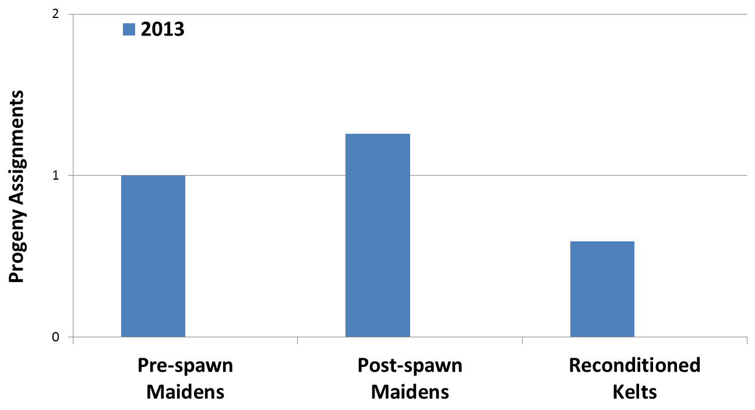
2. What is the relative reproductive success of artificially reconditioned kelt steelhead?

Slide 25
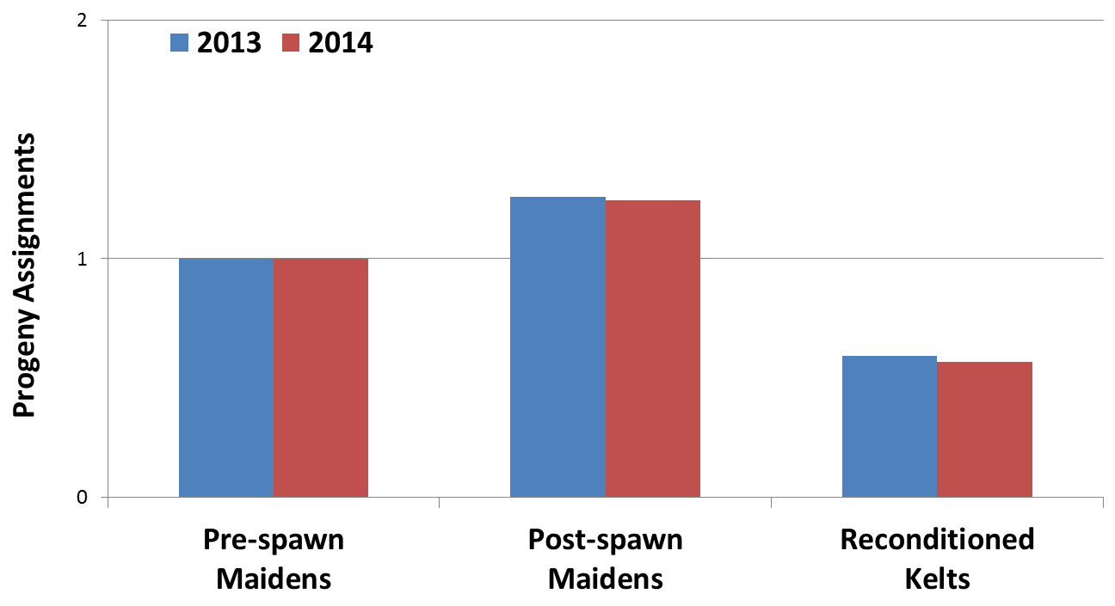
2. What is the relative reproductive success of artificially reconditioned kelt steelhead?

Slide 26
3. What is the lifetime reproductive success (LRS) of artificially reconditioned kelt steelhead

Slide 27
3. What is the lifetime reproductive success (LRS) of artificially reconditioned kelt steelhead

Slide 28
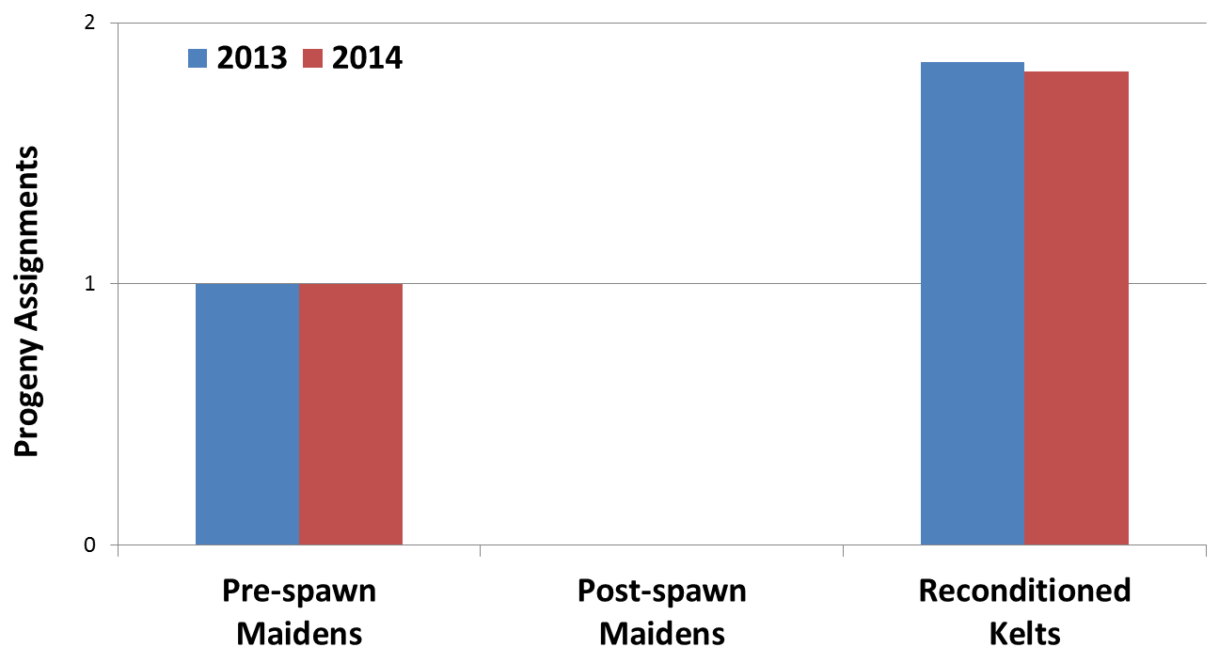
3. What is the LRS of artificially reconditioned kelt steelhead relative to first-time spawners?
1.83
“Almost twice”

Slide 29
Preliminary Conclusions
Kelts represent an important life history for steelhead
Reconditioned kelts reproduce in the wild
Reconditioned kelts had a LRS level similar to natural kelts (Seamons & Quinn 2010)
Reconditioned kelts have the potential to increase productivity of natural populations
Notes:
We have confirmed reproduction whenever we are able to identify areas with returning reconditioned kelts and sample non resident age zero juveniles.

