Slide 1
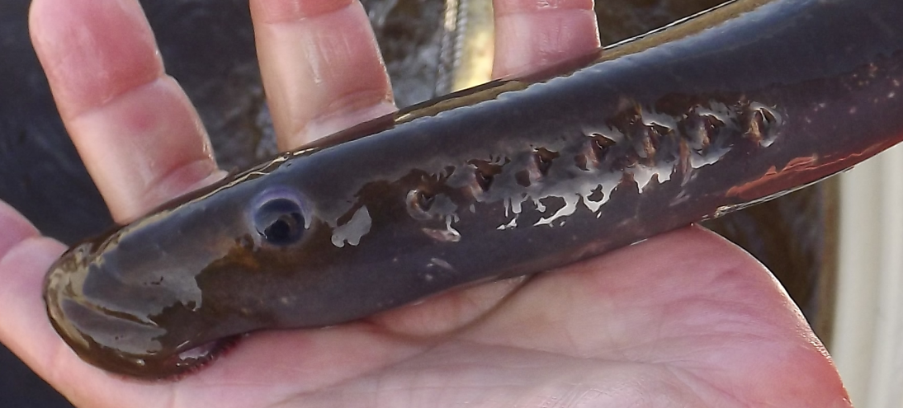
Pacific Lamprey Supplementation:
“Look out, propagated lamprey
coming near YOU!”
Yakama Nation
Ralph Lampman, Bob Rose, Patrick Luke, Dave’y Lumley, Tyler Beals, and Frank Spillar
Notes:
Supplementation Research for Pacific Lamprey Recovery: Dialogue on Benefits and Risks.

Slide 2
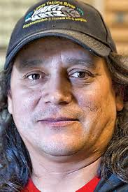
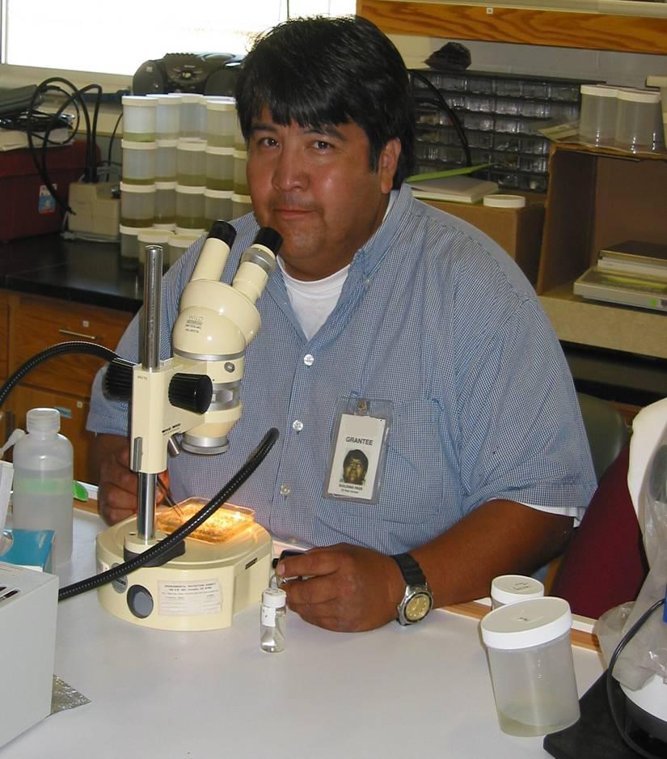
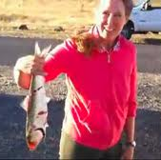
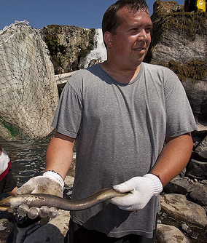
Shout-Out for Everyone Helping
Notes:
Tedious work

Slide 3
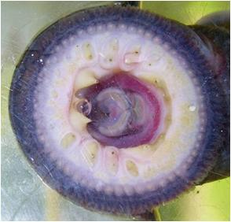
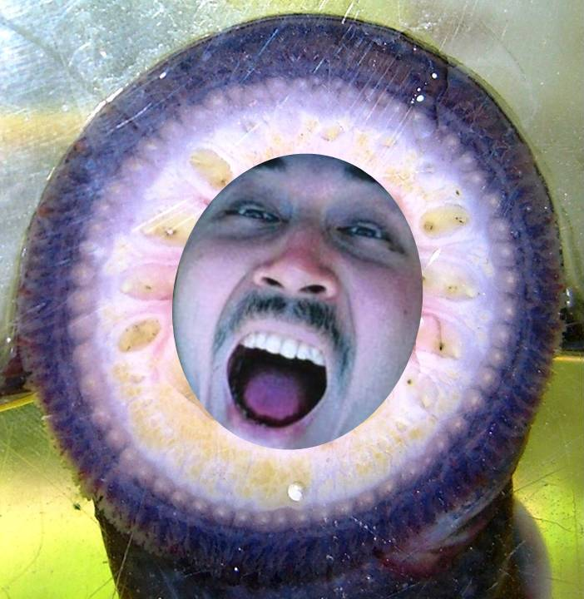
Outline
Background
Outplanting Plans
Updates on Art. Prop. & Rearing

Slide 4
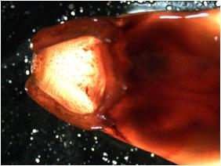
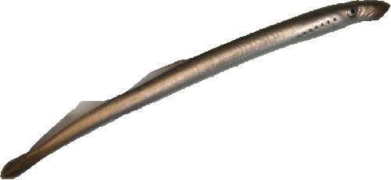
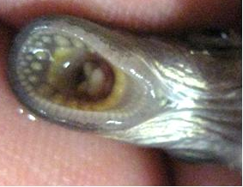
Pacific Lamprey (Entosphenus tridentatus)
10 – 200 mm
Ammocoete
(larva)
Freshwater
100 – 190 mm
Macrophthalmia
(lamprey smolt)
Heading to Ocean
330 – 800 mm
Adult
(spawning)
Return to Freshwater
Notes:
Ammocoete - Undeveloped eyes
Macrothalmia – develop eyes, sucking disk, and silver body
Adult – sharp teeth on sucking disk, cusps and laterals

Slide 5
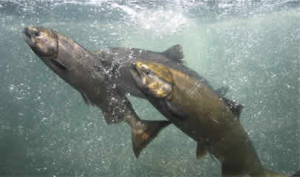
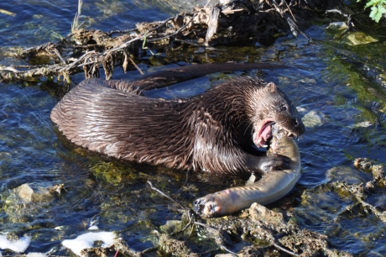
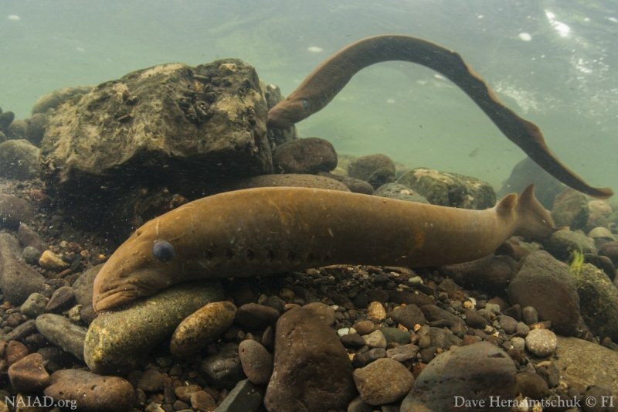
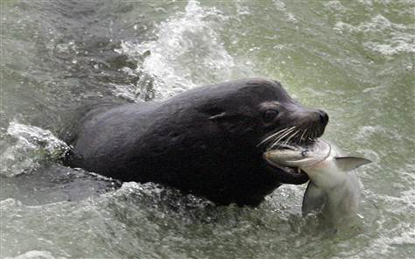
Why Should We Care?
Tribal Culture & Food Source
Food for Numerous Species
Willamette Falls
Paddy Halpin
Buffer for Salmon Predation
“Farmer of the Underwater World”
Janet Jenson / AP
H. Shirakawa
Notes:
Served important role for Native Americans culturally, medicinally, and for subsistence
Oldest vertebrate species on this earth

Slide 6
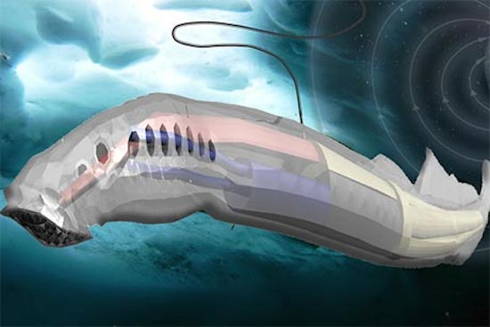
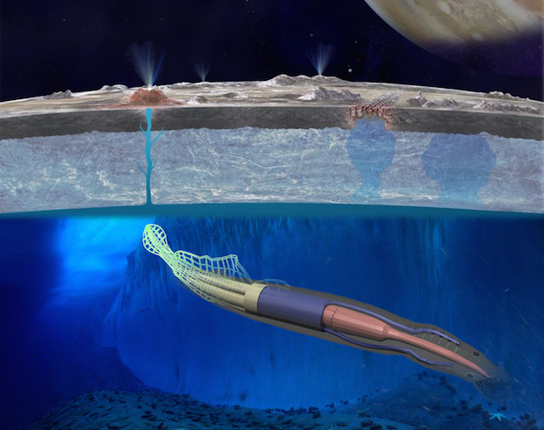
“Eel-like robot could explore extraterrestrial oceans” (CBS News)
Cornell Uni. ($100,000 grant) to develop a lamprey-like autonomous robot that could explore Europa (Jupiter’s moon)’s subsurface ocean.
Harvest powers from locally changing magnetic fields!

Slide 7
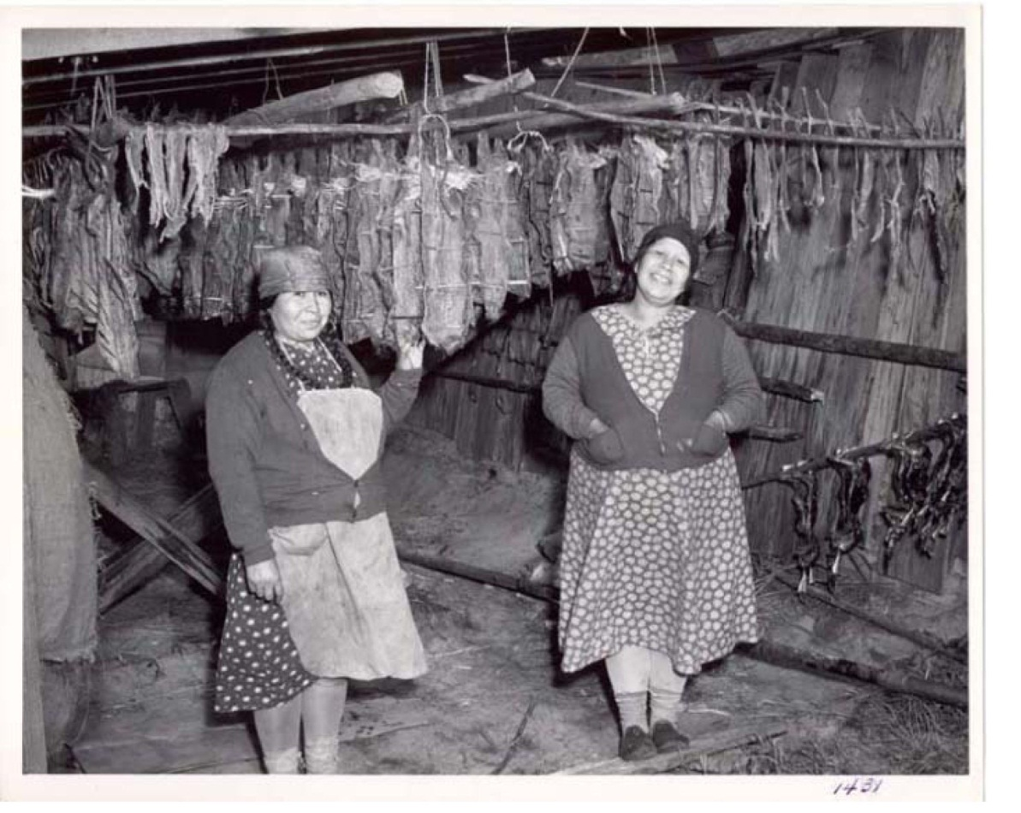
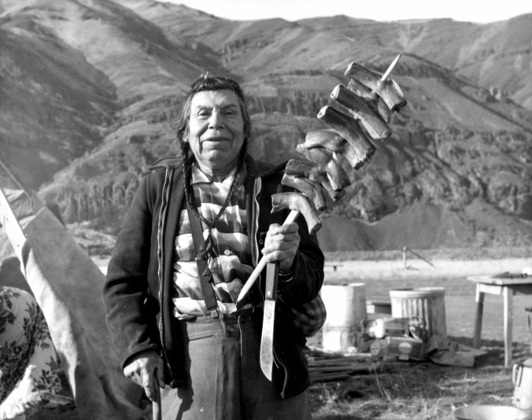
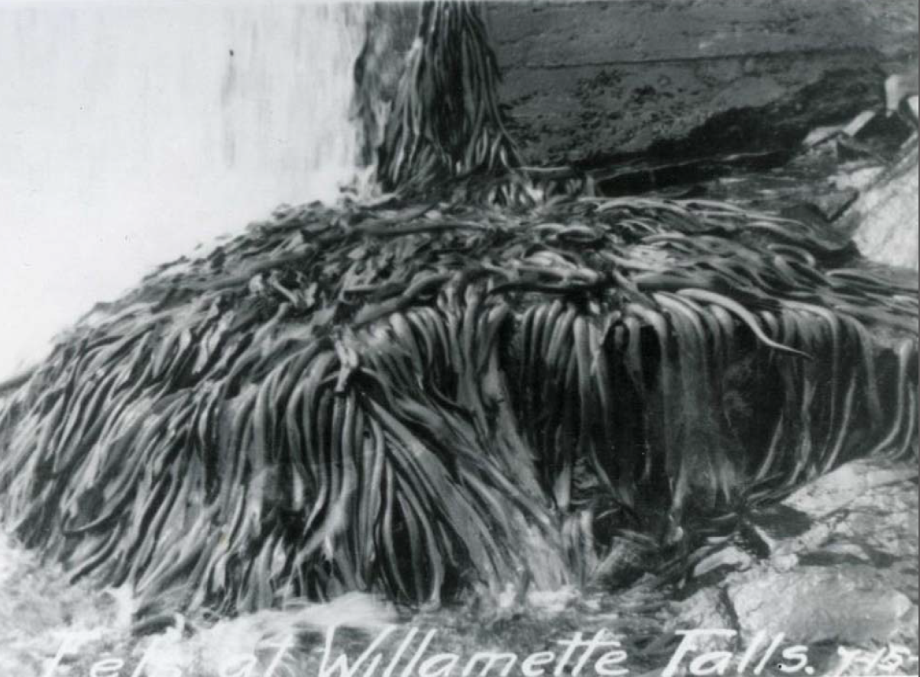
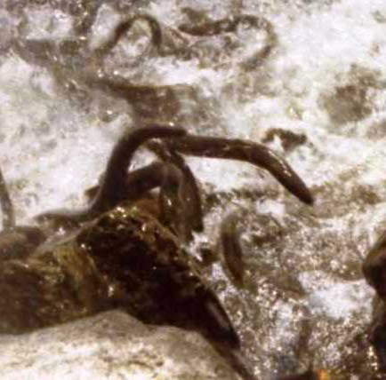
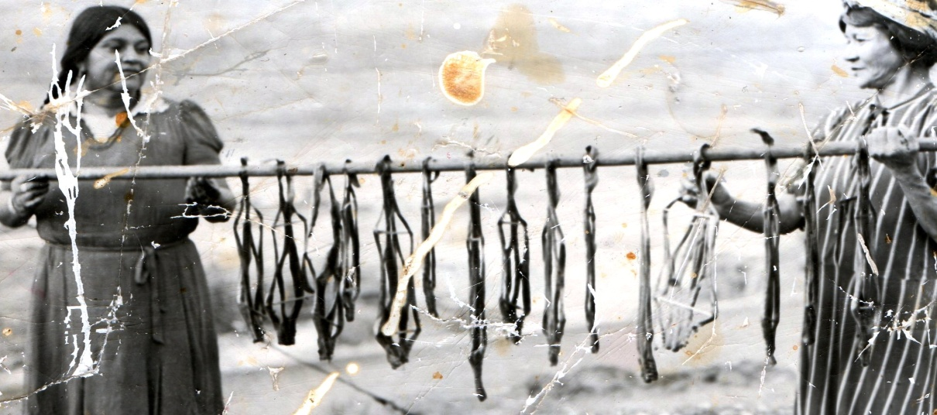
Notes:
Sustenance, medicine, lamprey oil for skin & ailing body parts, ear aches, hair oil
Oldest vertebrate species on earth, cambrian period (540 million years ago) – formation of eye
Lamprey may be responsible for the first formation of eyes, which is the most intricate sensory organs that facilitated the amazing explosion of diversity on earth… and we are all here because of that

Slide 8
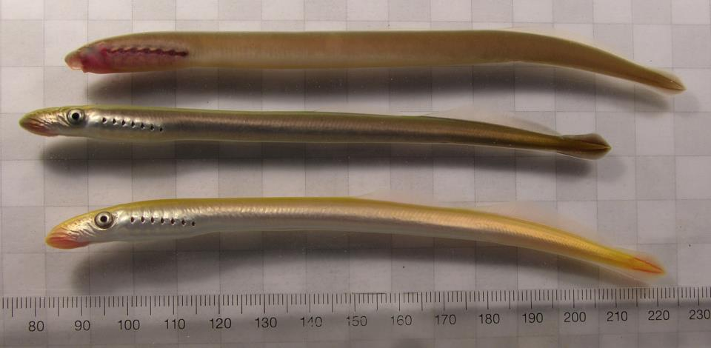
Why Supplement?
To prevent extinction (reintroduction) & supplement low populations
Allow lamprey to serve their ecological roles
To rear lamprey needed for survival studies (juvenile passage = black box)
To better understand population dynamics & life stage specific survival rates in nature
Notes:
Salmon ISAB 2003-03 definition = management strategy that uses artificial production for the purpose of attempting to rebuild depressed natural salmon & steelhead populations. Pacific lamprey supplementation is defined here as an interim production facilitation strategy that supports region-wide efforts to reduce known threats to self-sustaining (natural) productivity. Facilitation actions include either the translocation of surplus adults from one watershed to a watershed with poor adult recruitment, or artificial propagation of larvae (ammocoetes) and juveniles (macrophthalmia) in a hatcheryfor release into a watershed that is underseeded.
Supplementation is defined in this report to be a management strategy that uses artificial production for the purpose of attempting to rebuild depressed natural salmon and steelhead populations. “integrated natural-origin/hatchery-origin population by allowing at least some of the released hatchery-origin fish that return as adults to spawn in the wild among natural-origin adult fish” “use broodstock each generation in the hatchery that is drawn, in whole or in part, from local natural-origin fish.

Slide 9
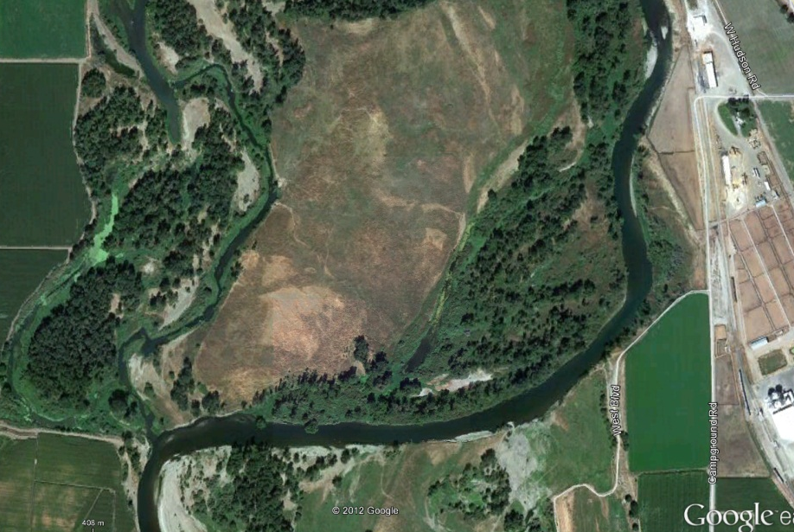
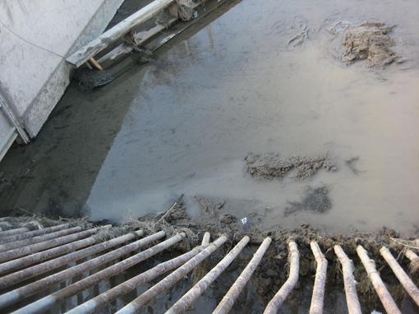
Optimal Release Sites
Side Channels
Acclimation Ponds
Canals
Notes:
Acclimation ponds such as for coho (Holmes Property)

Slide 10
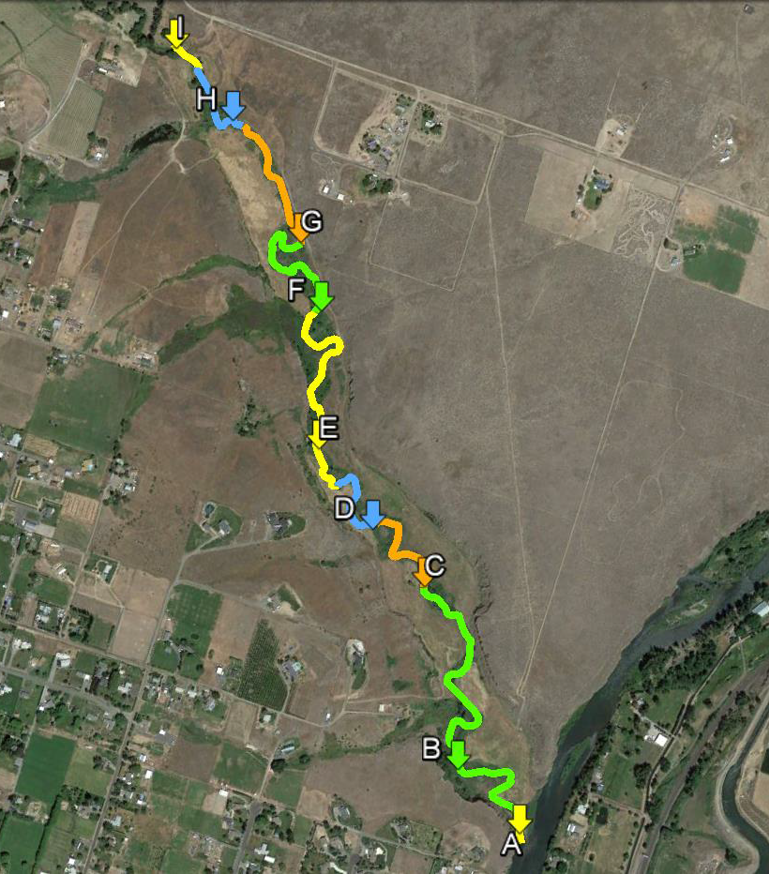
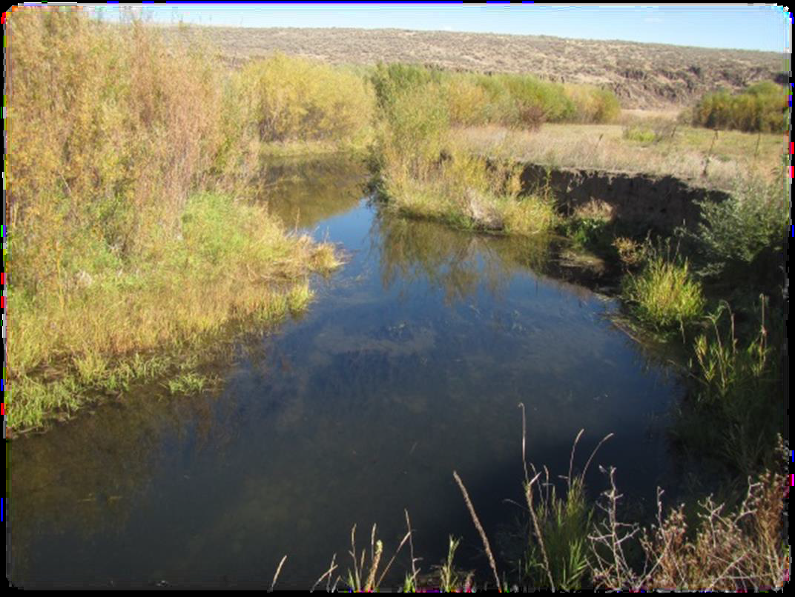
Lower Wenas Site (Yakima, WA)
Year 1 Only
Habitat Area =
8101 m²
Carry Capacity = 49,475 larvae

Slide 11
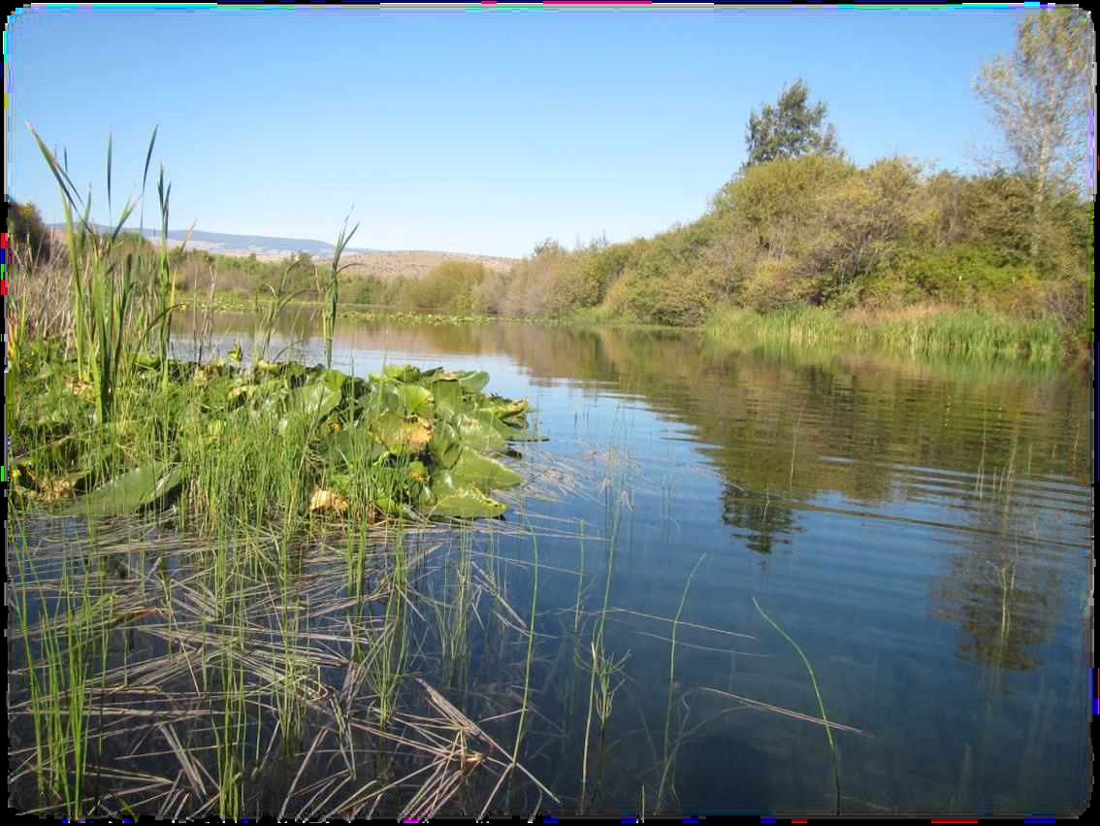
Holmes Acclimation Site (Ellensburg, WA)
Year 2-3
Habitat Area =
17,414 m²
Carry Capacity = 149,600 larvae

Slide 12
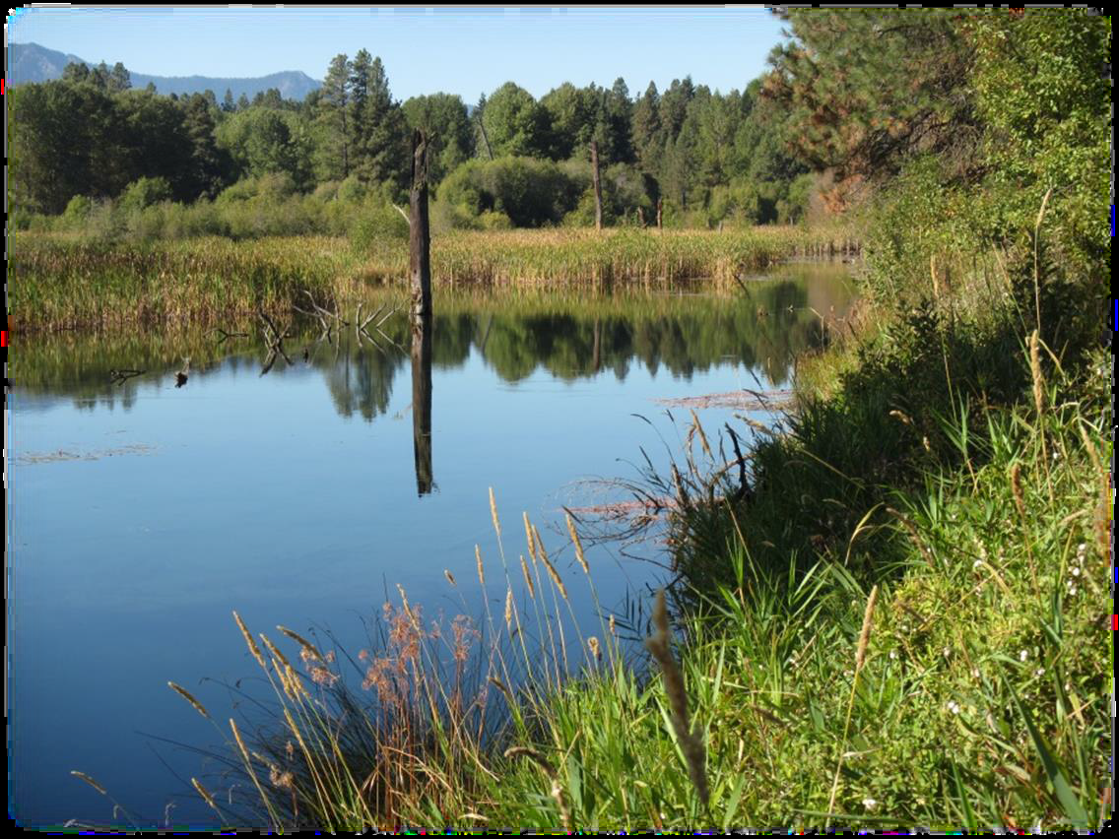
Cle Elum Hatchery Site (Cle Elum, WA)
Year 1-3
Habitat Area =
45,896 m²
Carry Capacity = 291,530 larvae

Slide 13
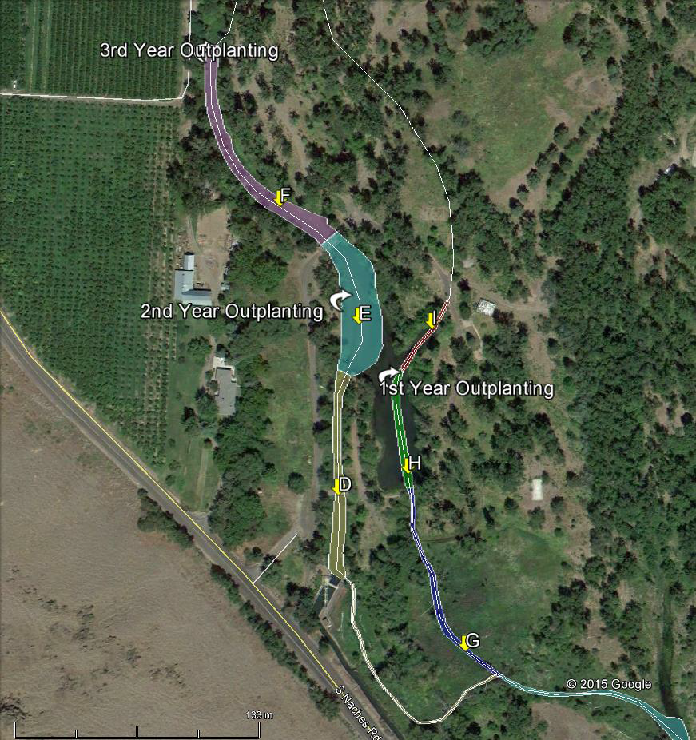
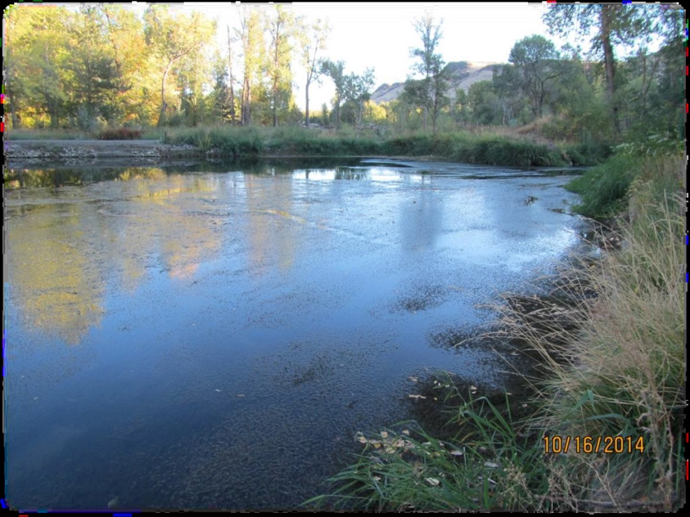
Eschbach Park Site (Naches, WA)
Year 1-3
Habitat Area =
23,425 m²
Carry Capacity = 197,636 larvae

Slide 14
Art. Prop. & Rearing Protocols
New AFS Book “Jawless Fishes of the World”
Notes:
49 page chapter on this subject

Slide 15
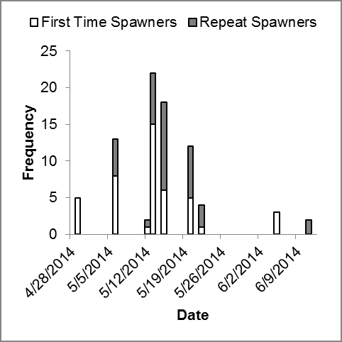
Propagation
Notes:
Timing of sexual maturation varies
(collaboration is key! preservation methods?)

Slide 16
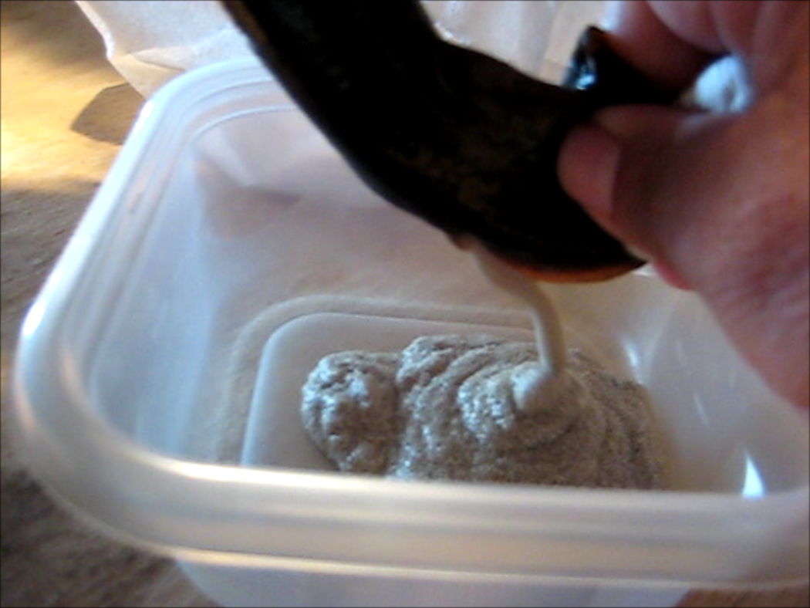
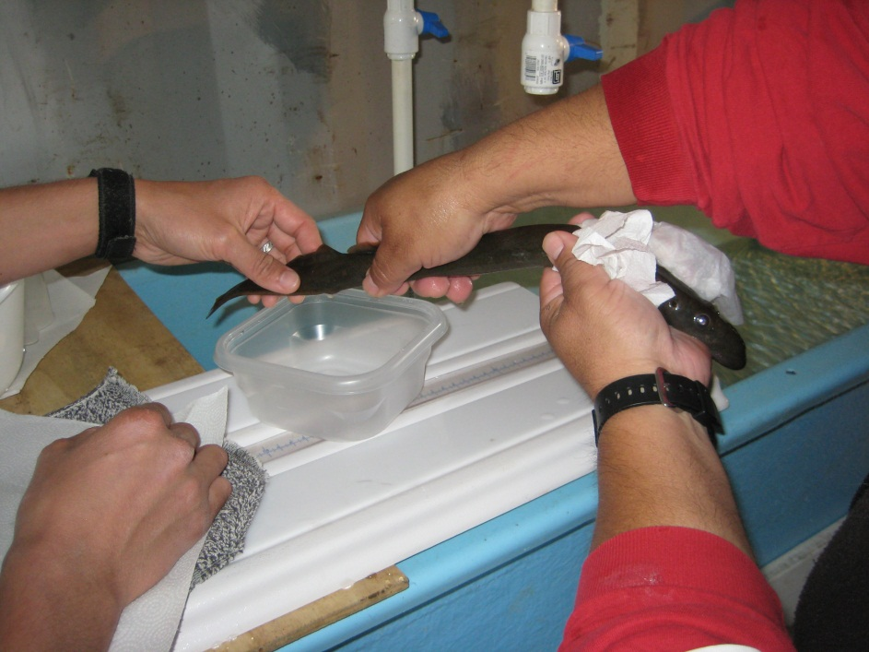
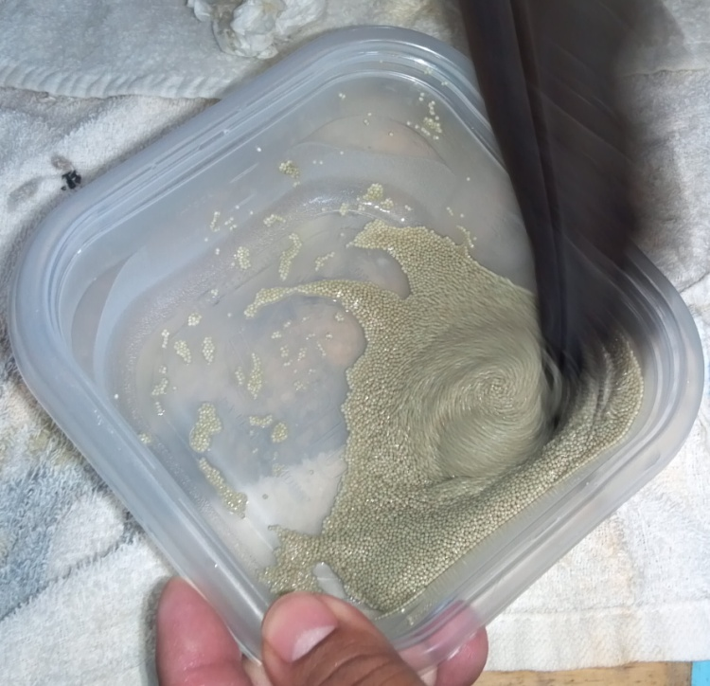
Propagation
Eggs (70~190 g)
*Ave. 33% of body weight
*Ave. 90,000 eggs
Milt (0.1~9.0 g)
*Ave. 2.0 ml
*repeat spawn in 2 days
Egg stickiness & buoyancy
Notes:
Dry squeezing method works great (great way to test for readiness / sexual maturity) vs. cutting the belly open (eggs)?
Cryopreservation?
Best mixing ratio of gametes for genetics conservation & productivity?

Slide 17
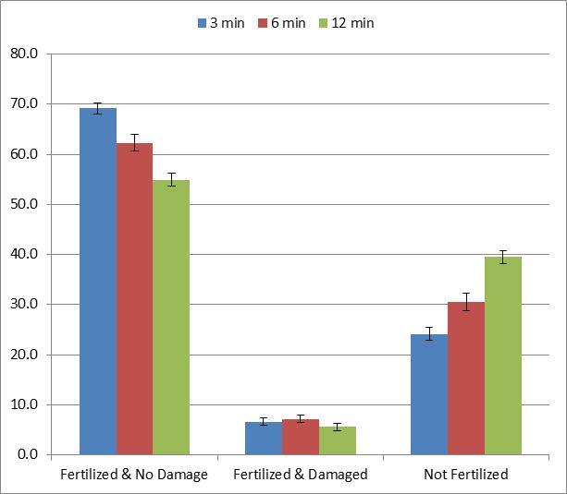
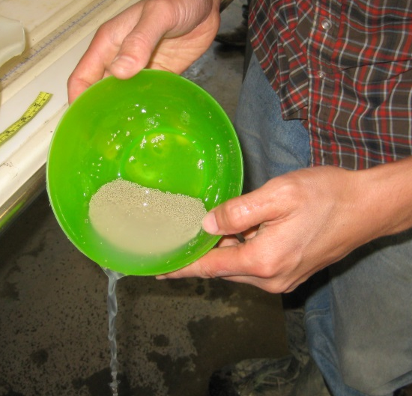
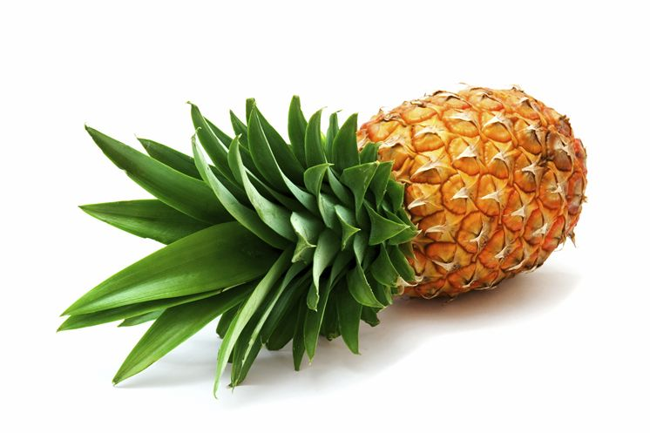
Egg Fertilization
Reduced wait time works better (3 vs. 6 vs. 12 min)
1-2 min mixing in 1% pineapple juice eliminates egg sticking
Rinsing 3 times increased hatching rates
Zip lock bag method comparable to bowl & feather
2:3 egg:water ratio, 2.5~5% milt optimal
Notes:
3 to 3 mixing (male/female) for spawning test with 12 treatments (+ 1 WB/P hybrid)
Examined the amount of wait time (for fertilization) – the shorter the better (3min)
Mixing before vs. after adding water – mixing before helped fertilize more, but also damaged more. Also, from pre-hatching (2nd) egg monitoring, mixing after water had better survival – therefore, the rate of fertilization may not always be the same as hatching success.
Rinsing eggs vs. no rinsing before putting them into heath trays. Although the “no rinsing” had higher fertilization, it didn’t result in higher hatching rates.
So you can just mention at the end of this slide that, better fertilization rate doesn’t always result in better hatching rate, so we need to be careful in how we examine these things.

Slide 18
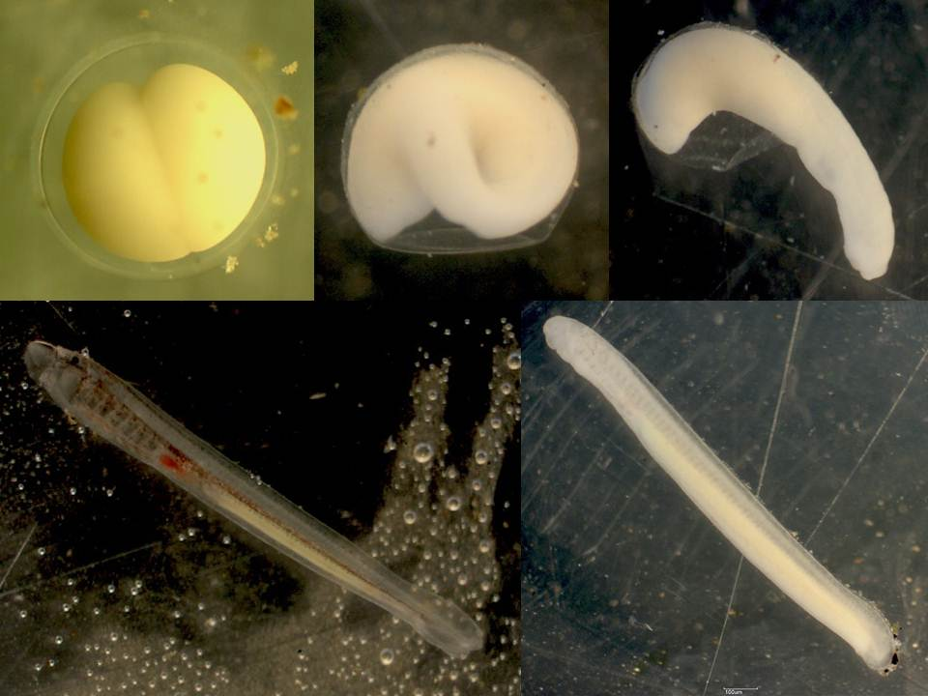
0.25 d
12 d
14 d (~200 dd)
eye spot
gills
gills
mouth
mouth
heart
heart
yolk sac
yolk sac
31 d (~10 d w/ yolk sac)
21 d
Notes:
Egg to prolarvae then larvae, formalin & hydrogen peroxide treatment
7-8 mm larvae

Slide 19
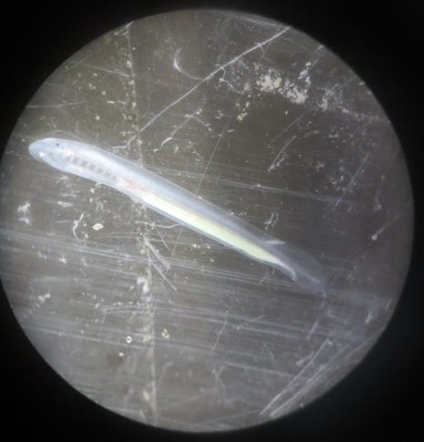
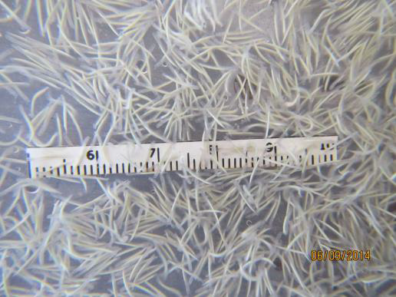
Prolarvae

Slide 20
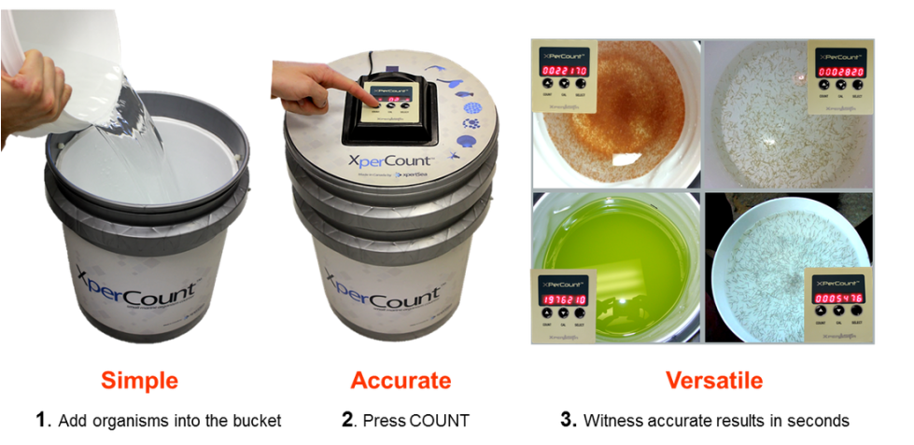
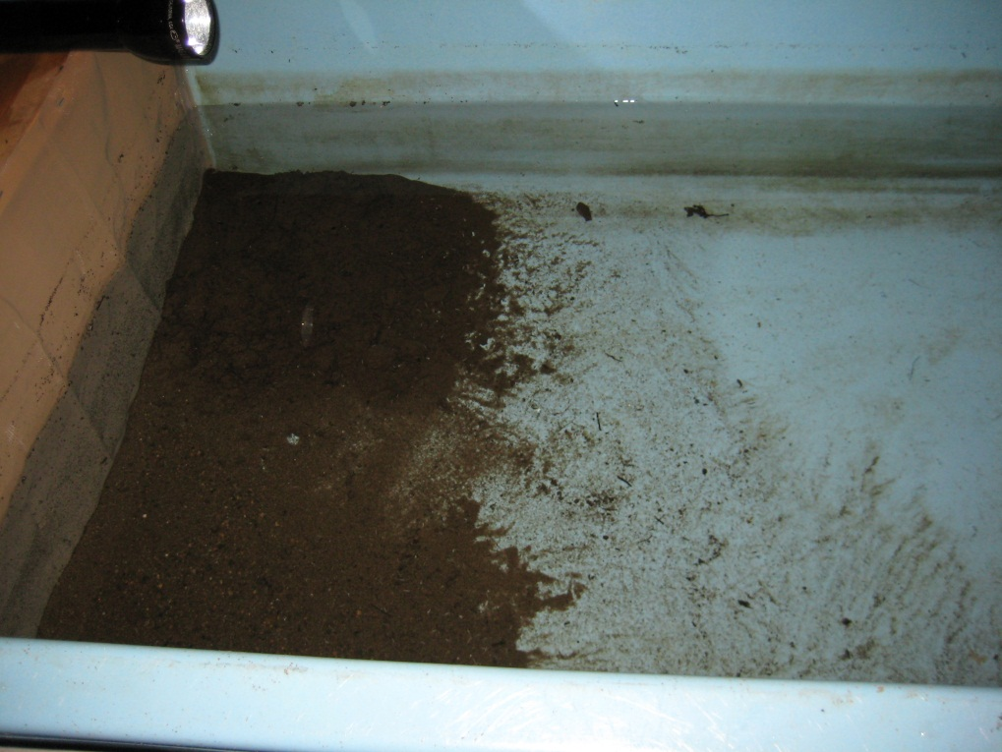
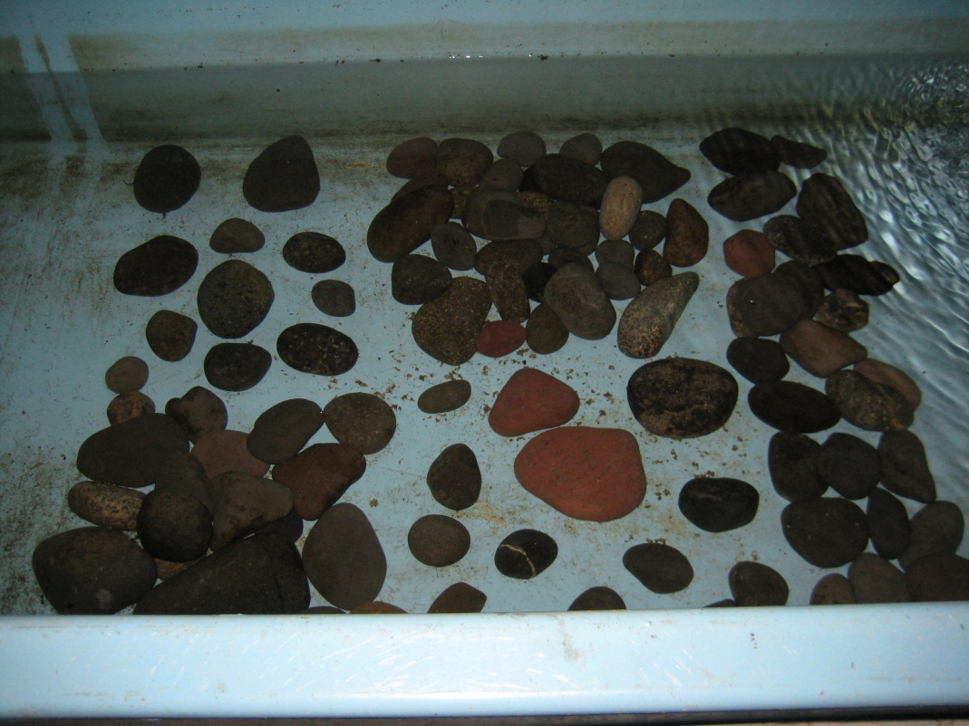
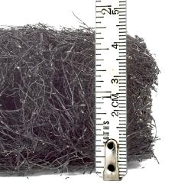
Prolarvae
Outlet
Water Source
OM
Sand
Notes:
In 2012, we tried a simple experiment and observed that prolarvae slowly transferred from cobble/gravel to fine sediment.
In 2013, we tried other substrate media (including bioballs), but spawn mat or no substrate at all had the best survival
Using XperCount device, we can count up to 200,000 7-8 mm prolarvae in 10 liters of water – still need to do more calibration, though.
In order to calibrate them, we have to manually count them, so we had to figure out the best way to estimate larvae number - the count is only as good as how much we can estimate numbers.
(The best way we found was to subsample in 10L of water using a turkey baster)

Slide 21
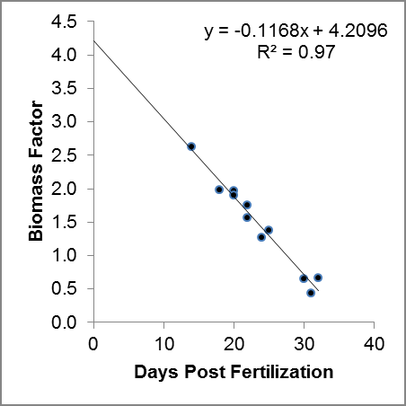
Begin hatching
Begin burrowing

Slide 22
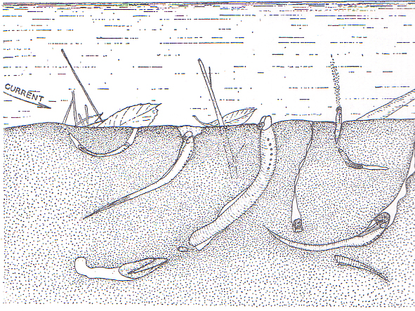
Larvae
Applegate 1950

Slide 23
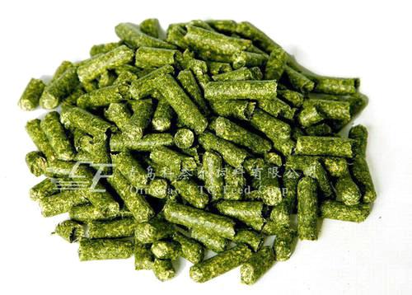
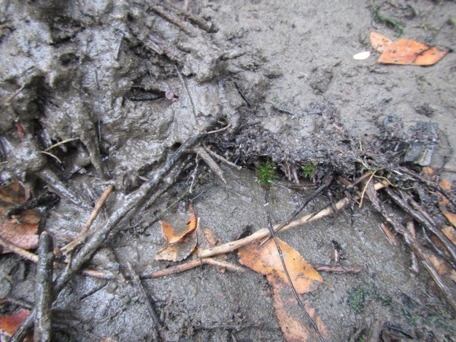
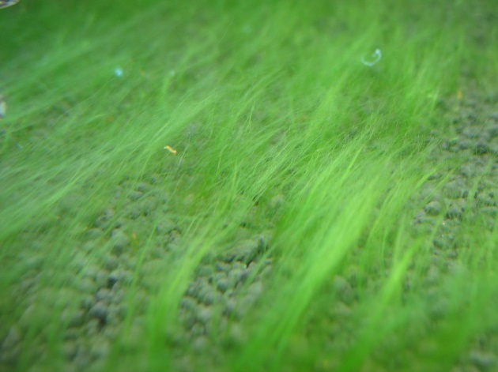
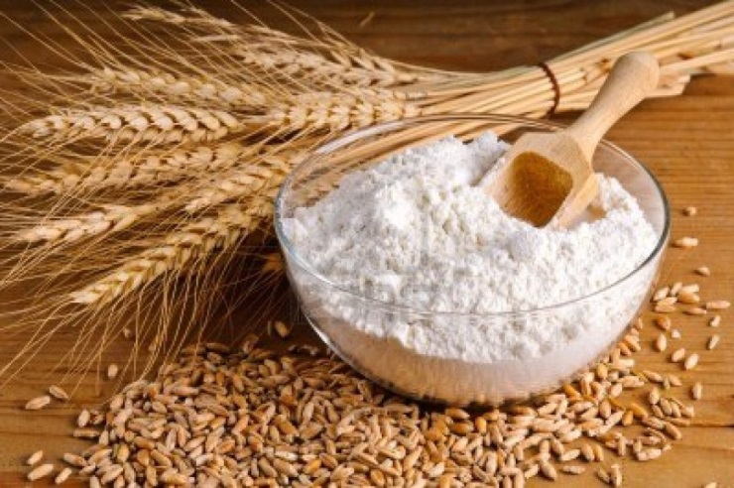
Types of Food Source
Organic Matter
Salmon Carcass
Algae
Alfalfa Pellets
Whole Wheat Flour
Aquatic Veg.
Straw
Active Dry Yeast
Notes:
D-xylose-fermenting and xylanase-producing yeast species from rotting wood of two Atlantic Rainforest habitats in Brazil.
The results of this work showed that rotting wood collected from the Atlantic Rainforests is a huge source of yeasts, including new species, with promising biotechnological properties.

Slide 24
Feed & Growth Rates
Feed per Fish Weight
Feed per Area

Slide 25
Density, Season & Growth Rates
Threshold:
100~125 g/m²
Start Density
(<125 g/m²)
Season
(winter = high, summer = low)

Slide 26
Tank Settings and Gear
Notes:
7ft shallow tanks

Slide 27
Life Stage Survival Rates
Bottleneck
Life Stage

Slide 28
Space Requirement
Space (m²) Needed for 100,000 individuals
Eggs = 0.13
Prolarvae = 2.0
3 month old = 14
6 month old = 97
9 month old = 199
1 year old = 319
2 year old = 1205
3 year old = 2889
4 year old = 5553
↓
In Growth Rate
Notes:
Equivalent to one female’s eggs

Slide 29
Back to the Wild!
Adult Translocation

Slide 30
Acknowledgement
Partnership is key to our success!

