Slide 1
Oak Creek Using Wood for Floodplain Connectivity Phase 1
John Marvin
Yakama Nation – Yakima/Klickitat Fisheries Project
Yakima Basin Science & Management Conference
June 18, 2015

Slide 2
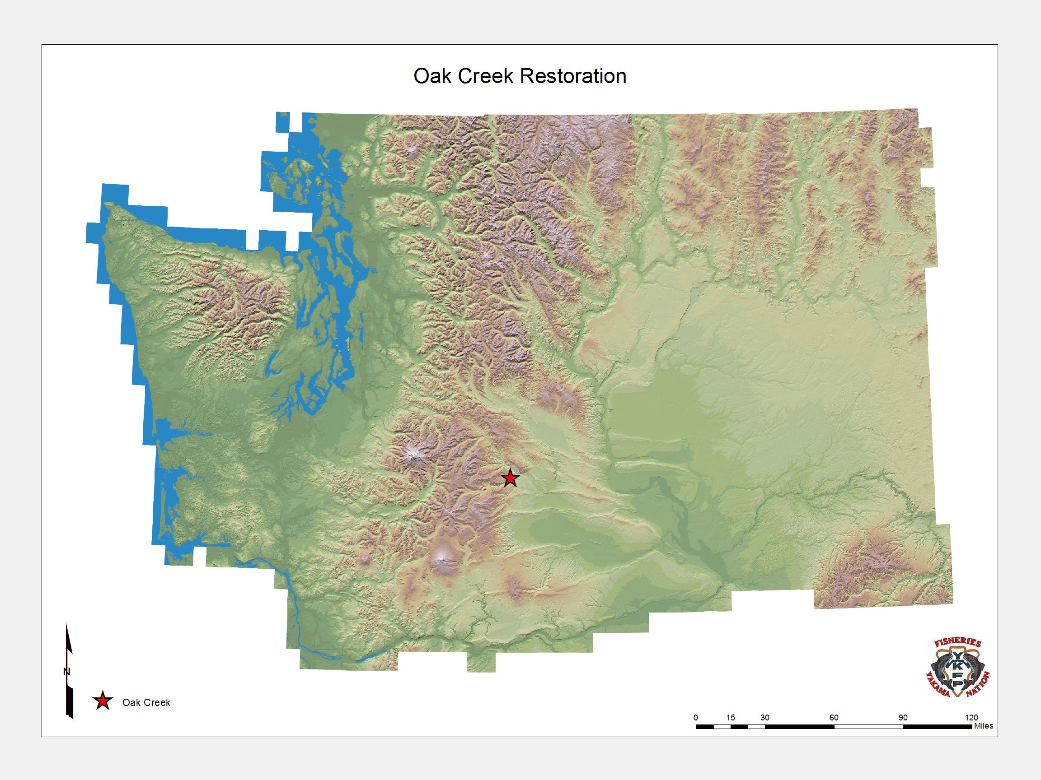

Slide 3
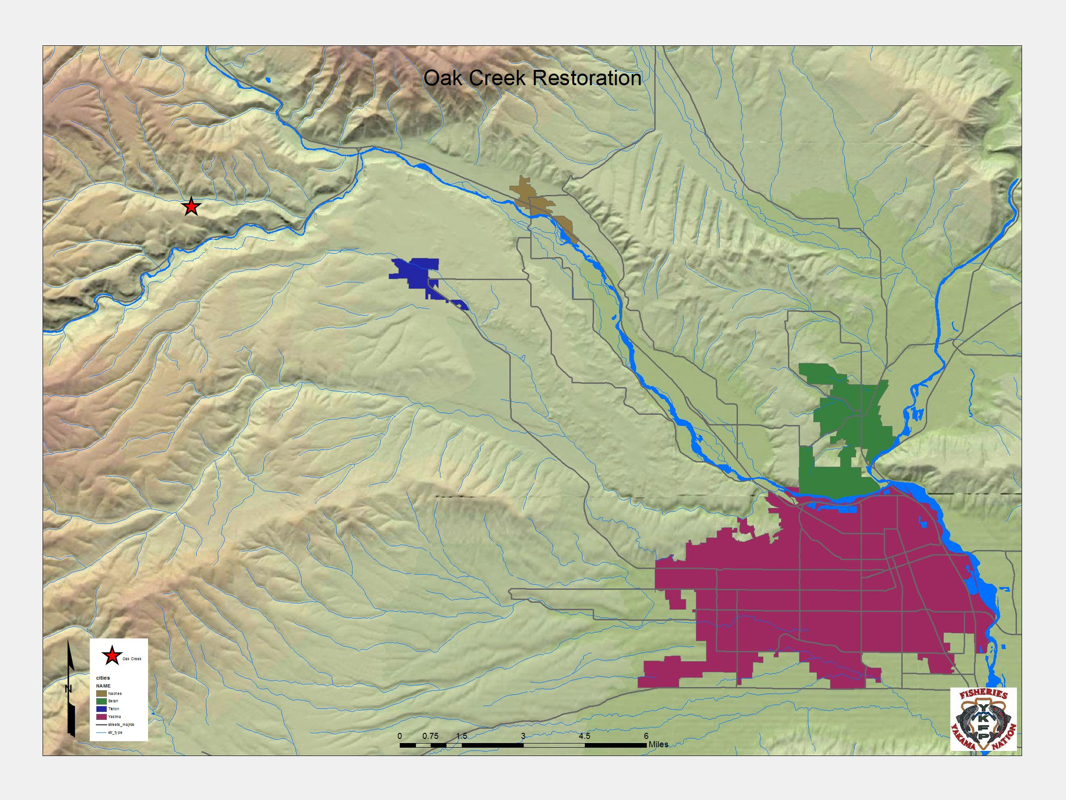

Slide 4
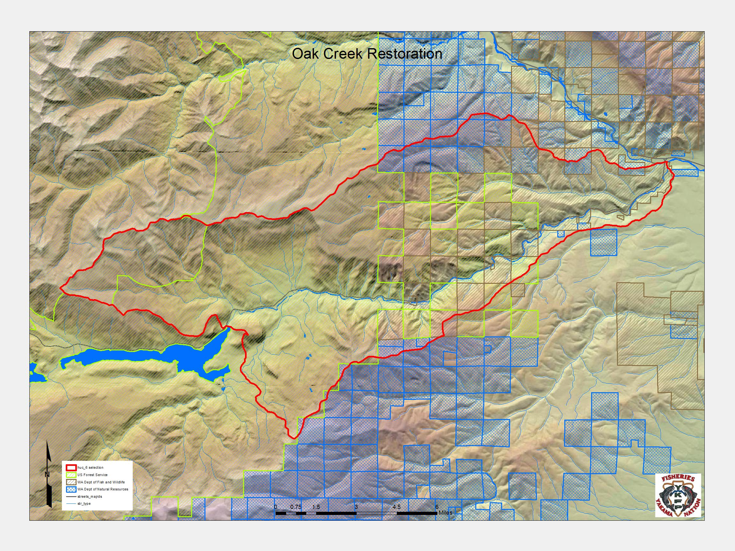

Slide 5
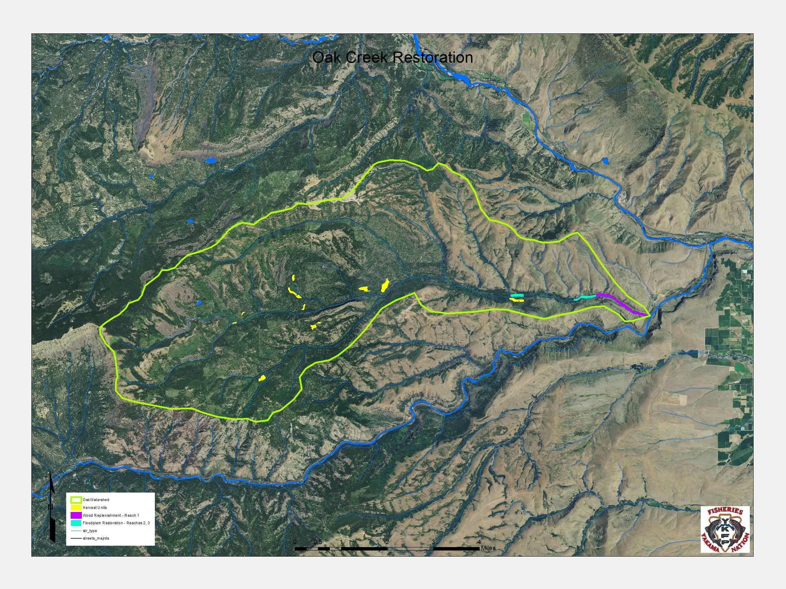

Slide 7
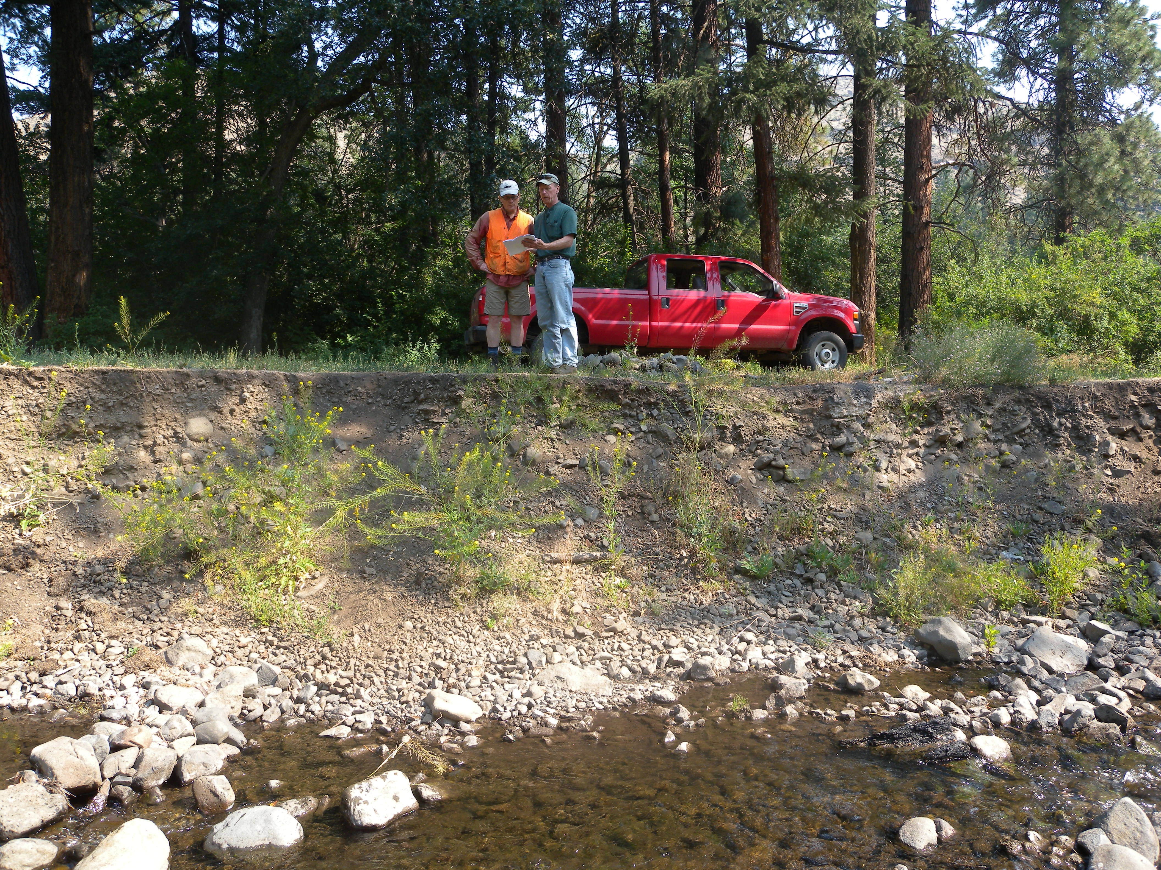
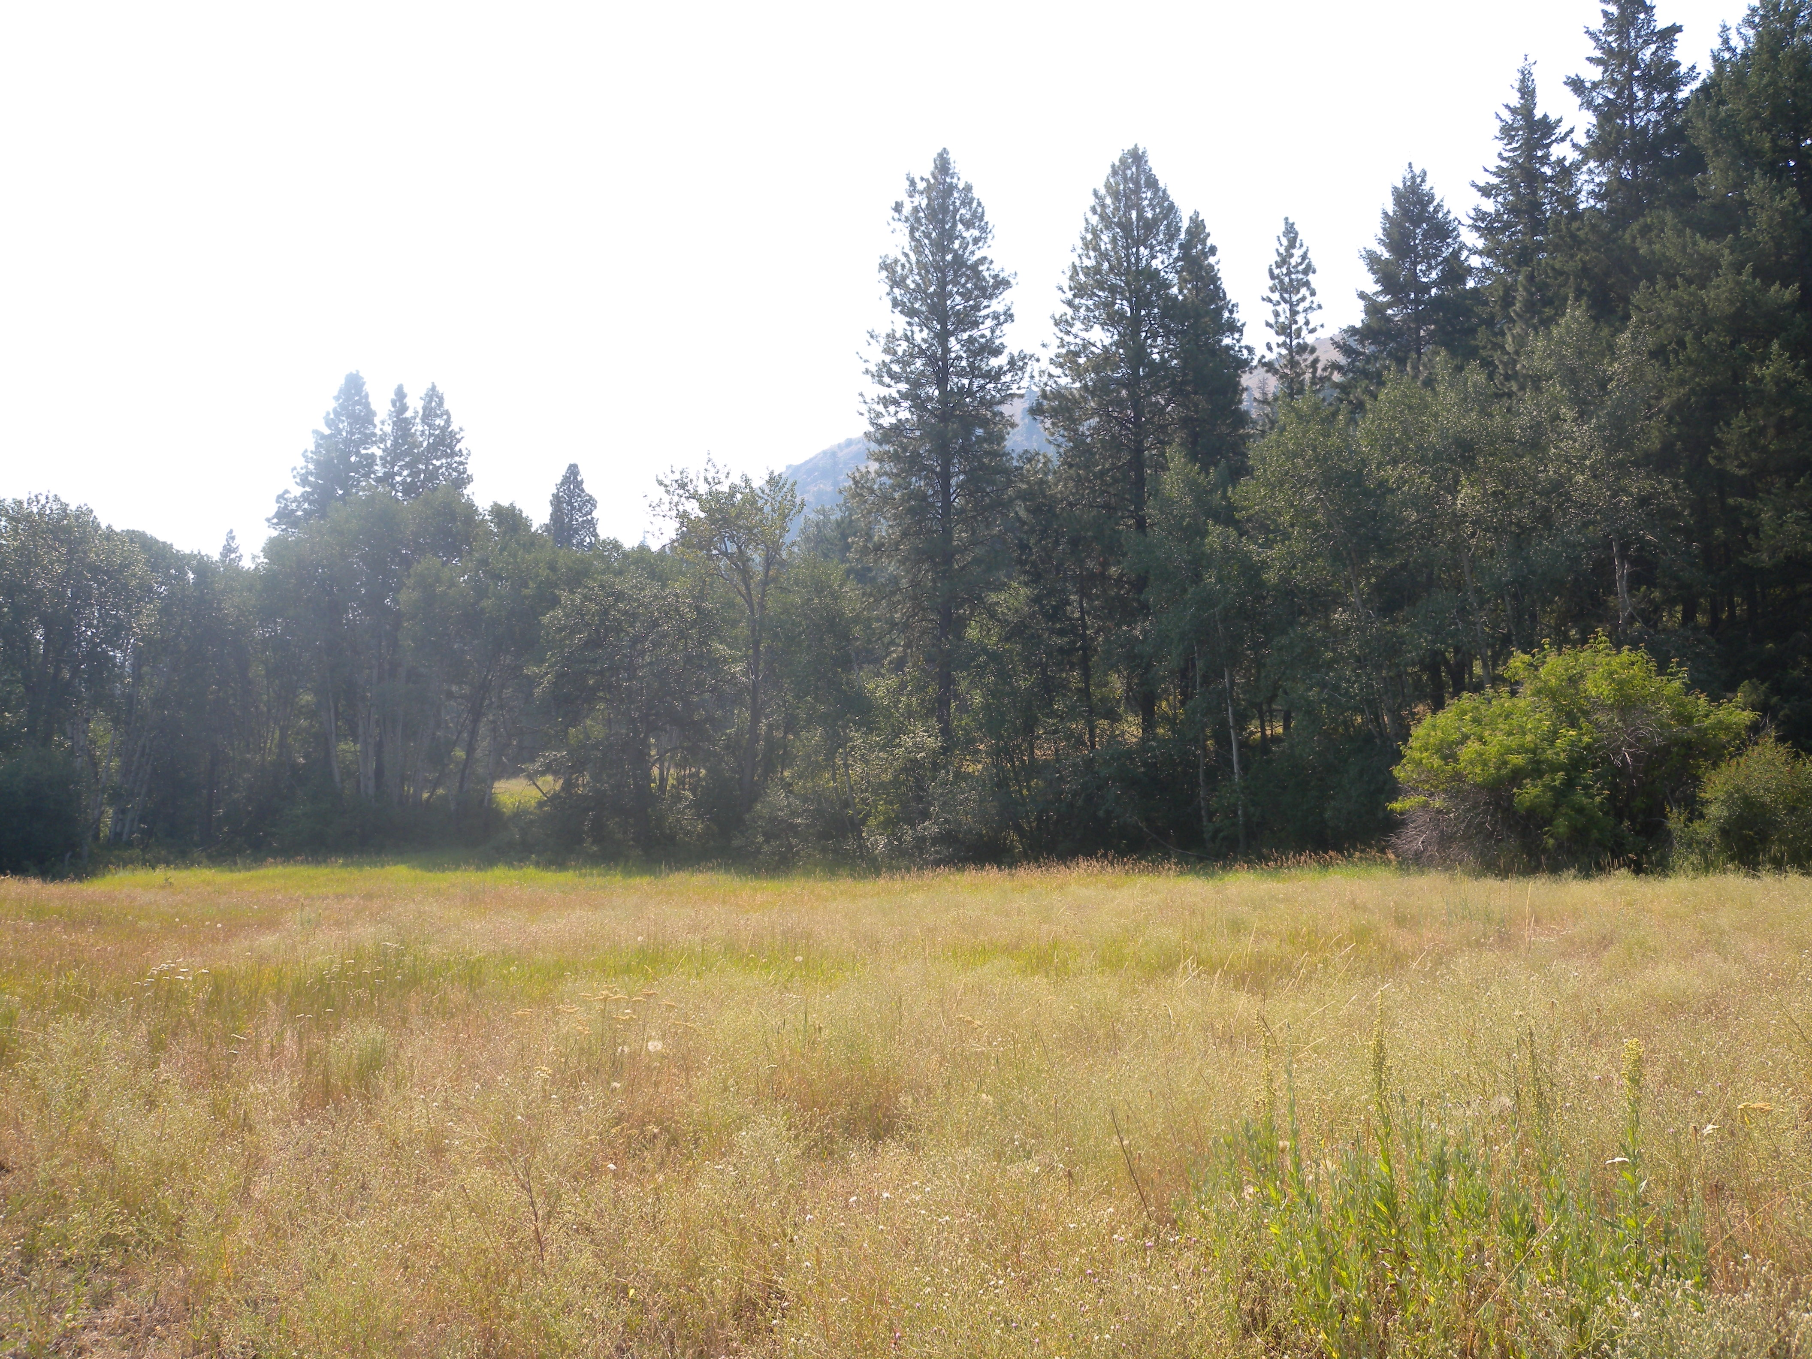
Oak Creek Restoration

Slide 8
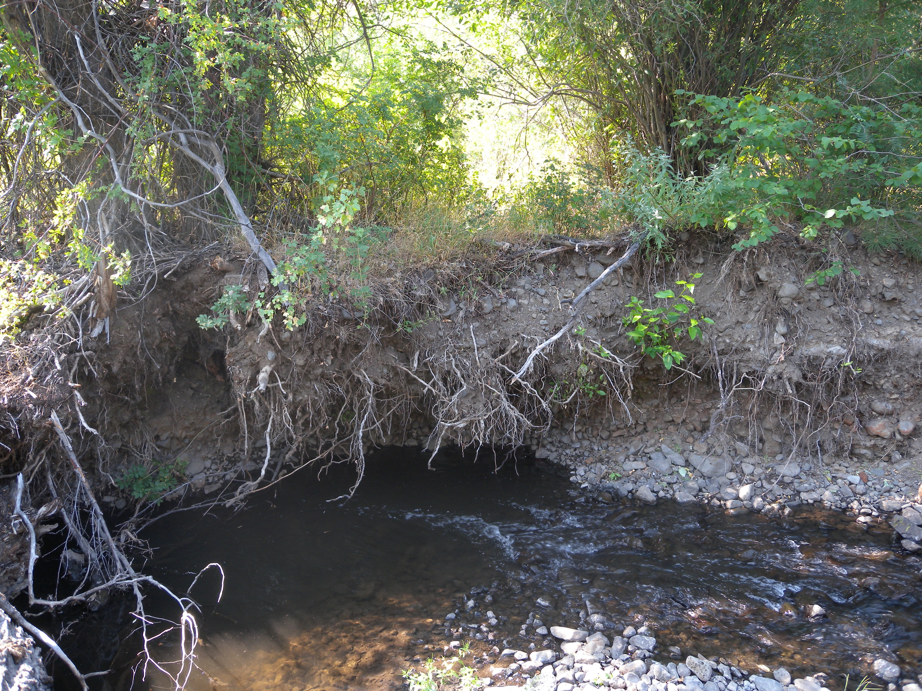
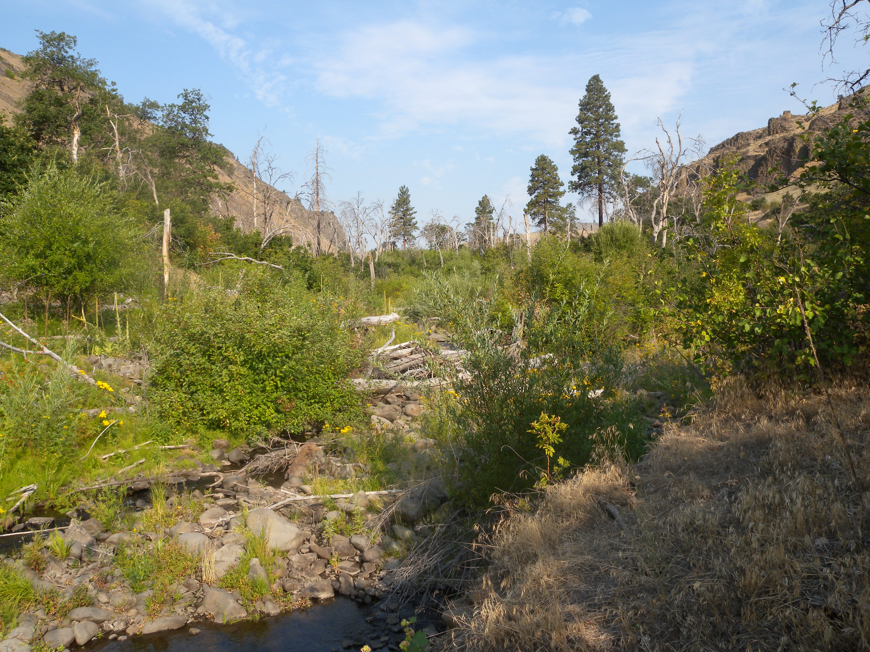

Slide 9
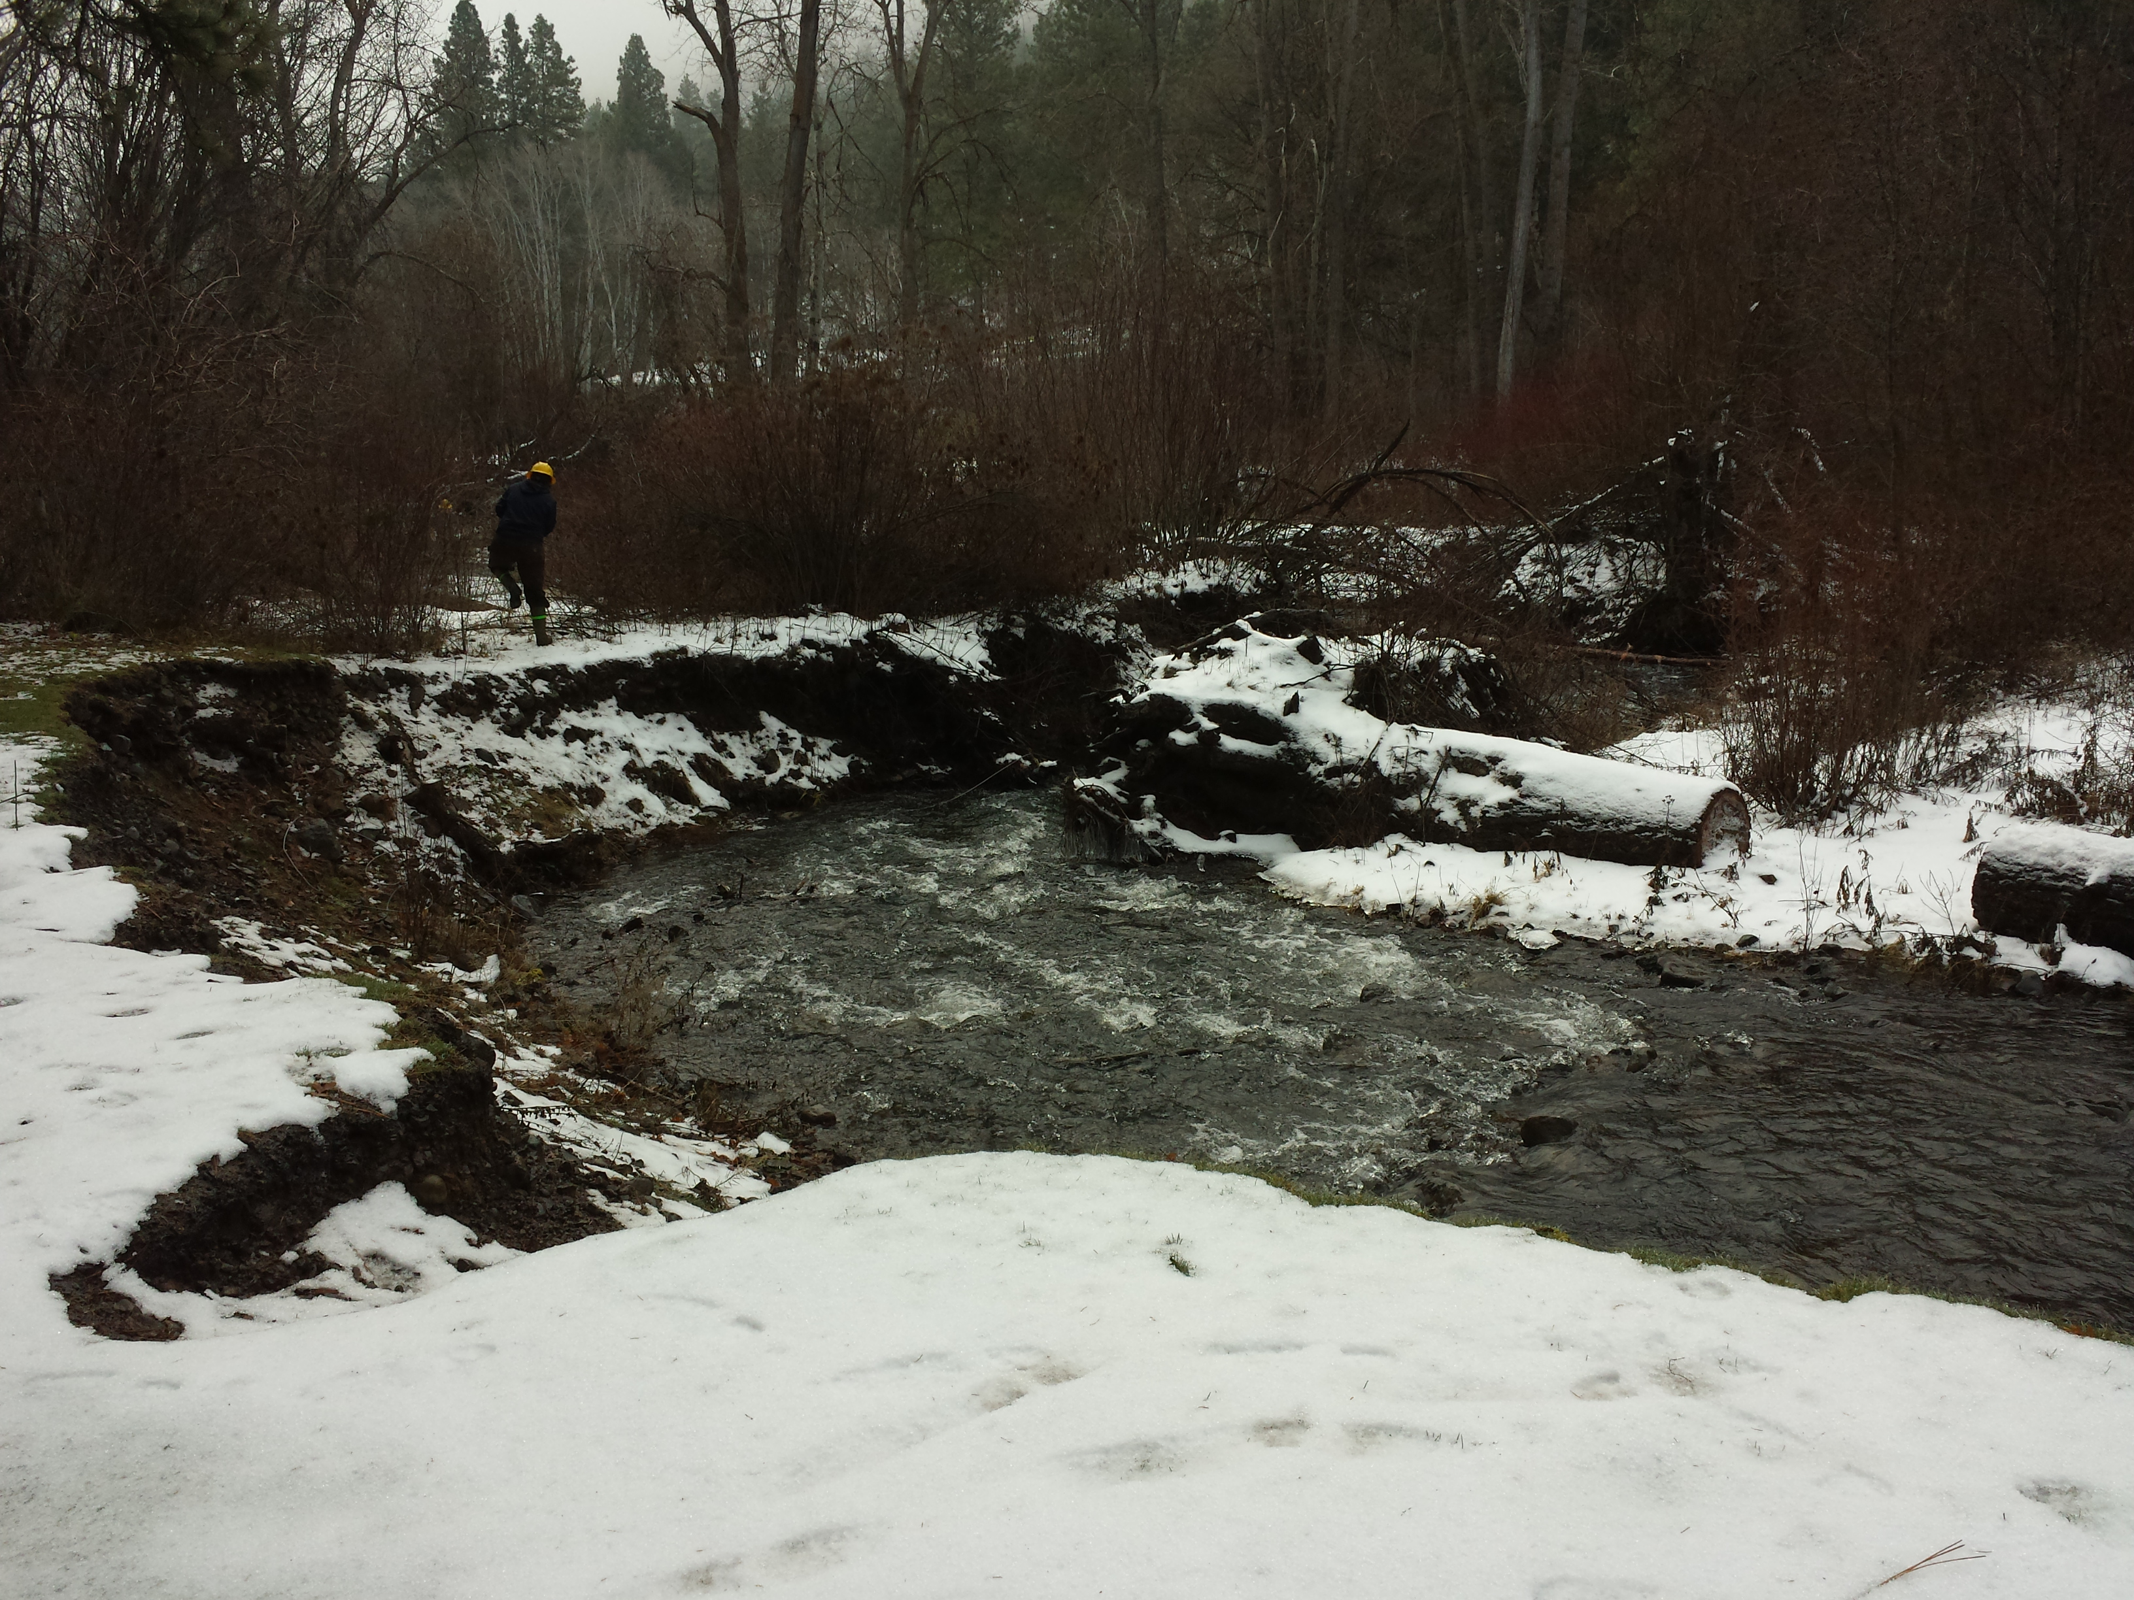
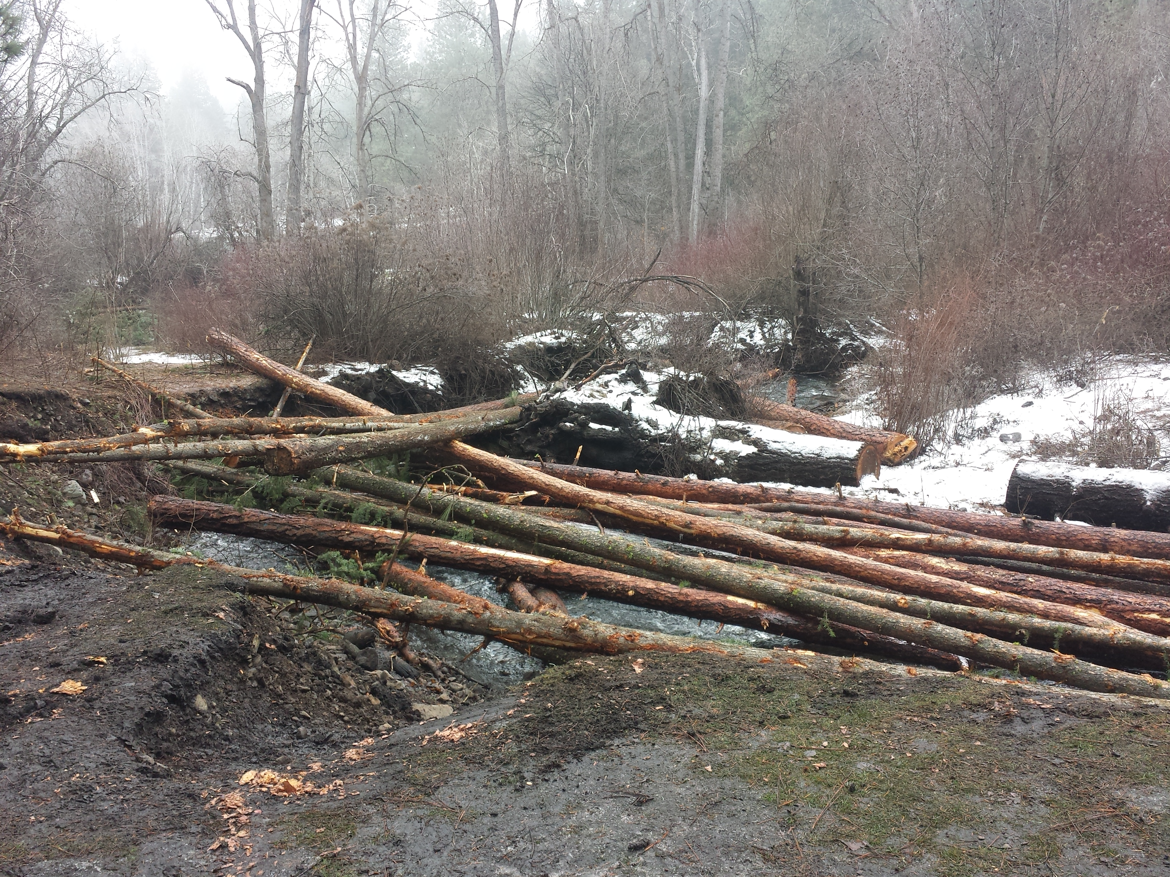

Slide 10
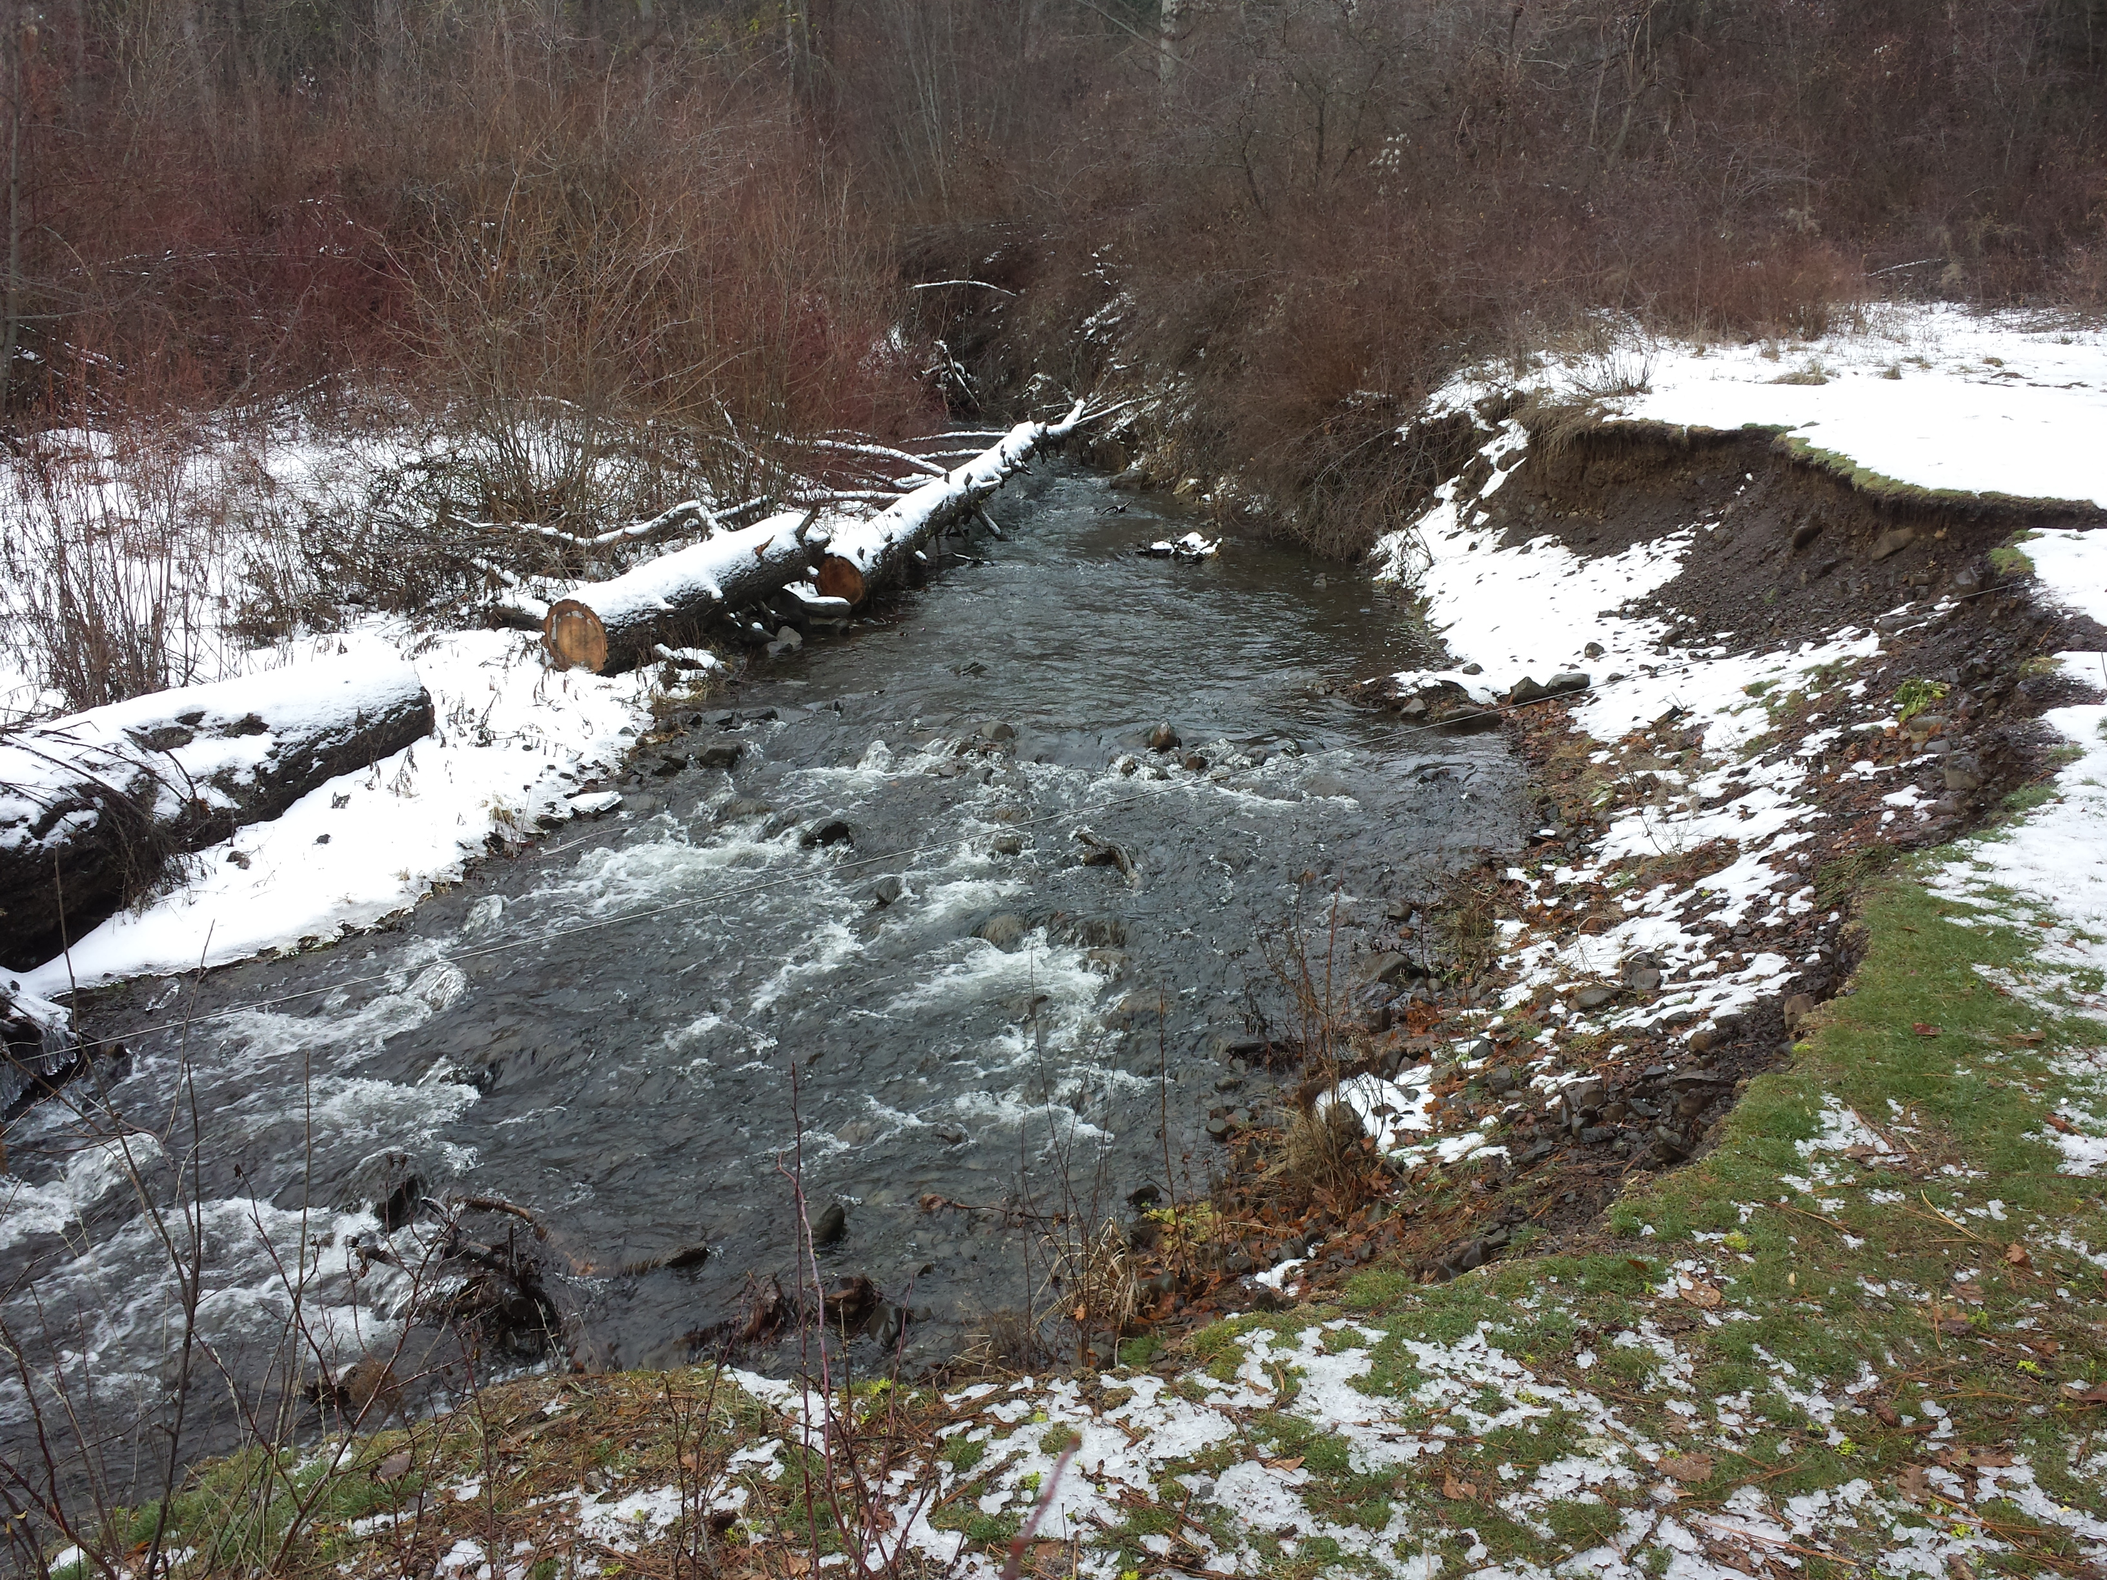
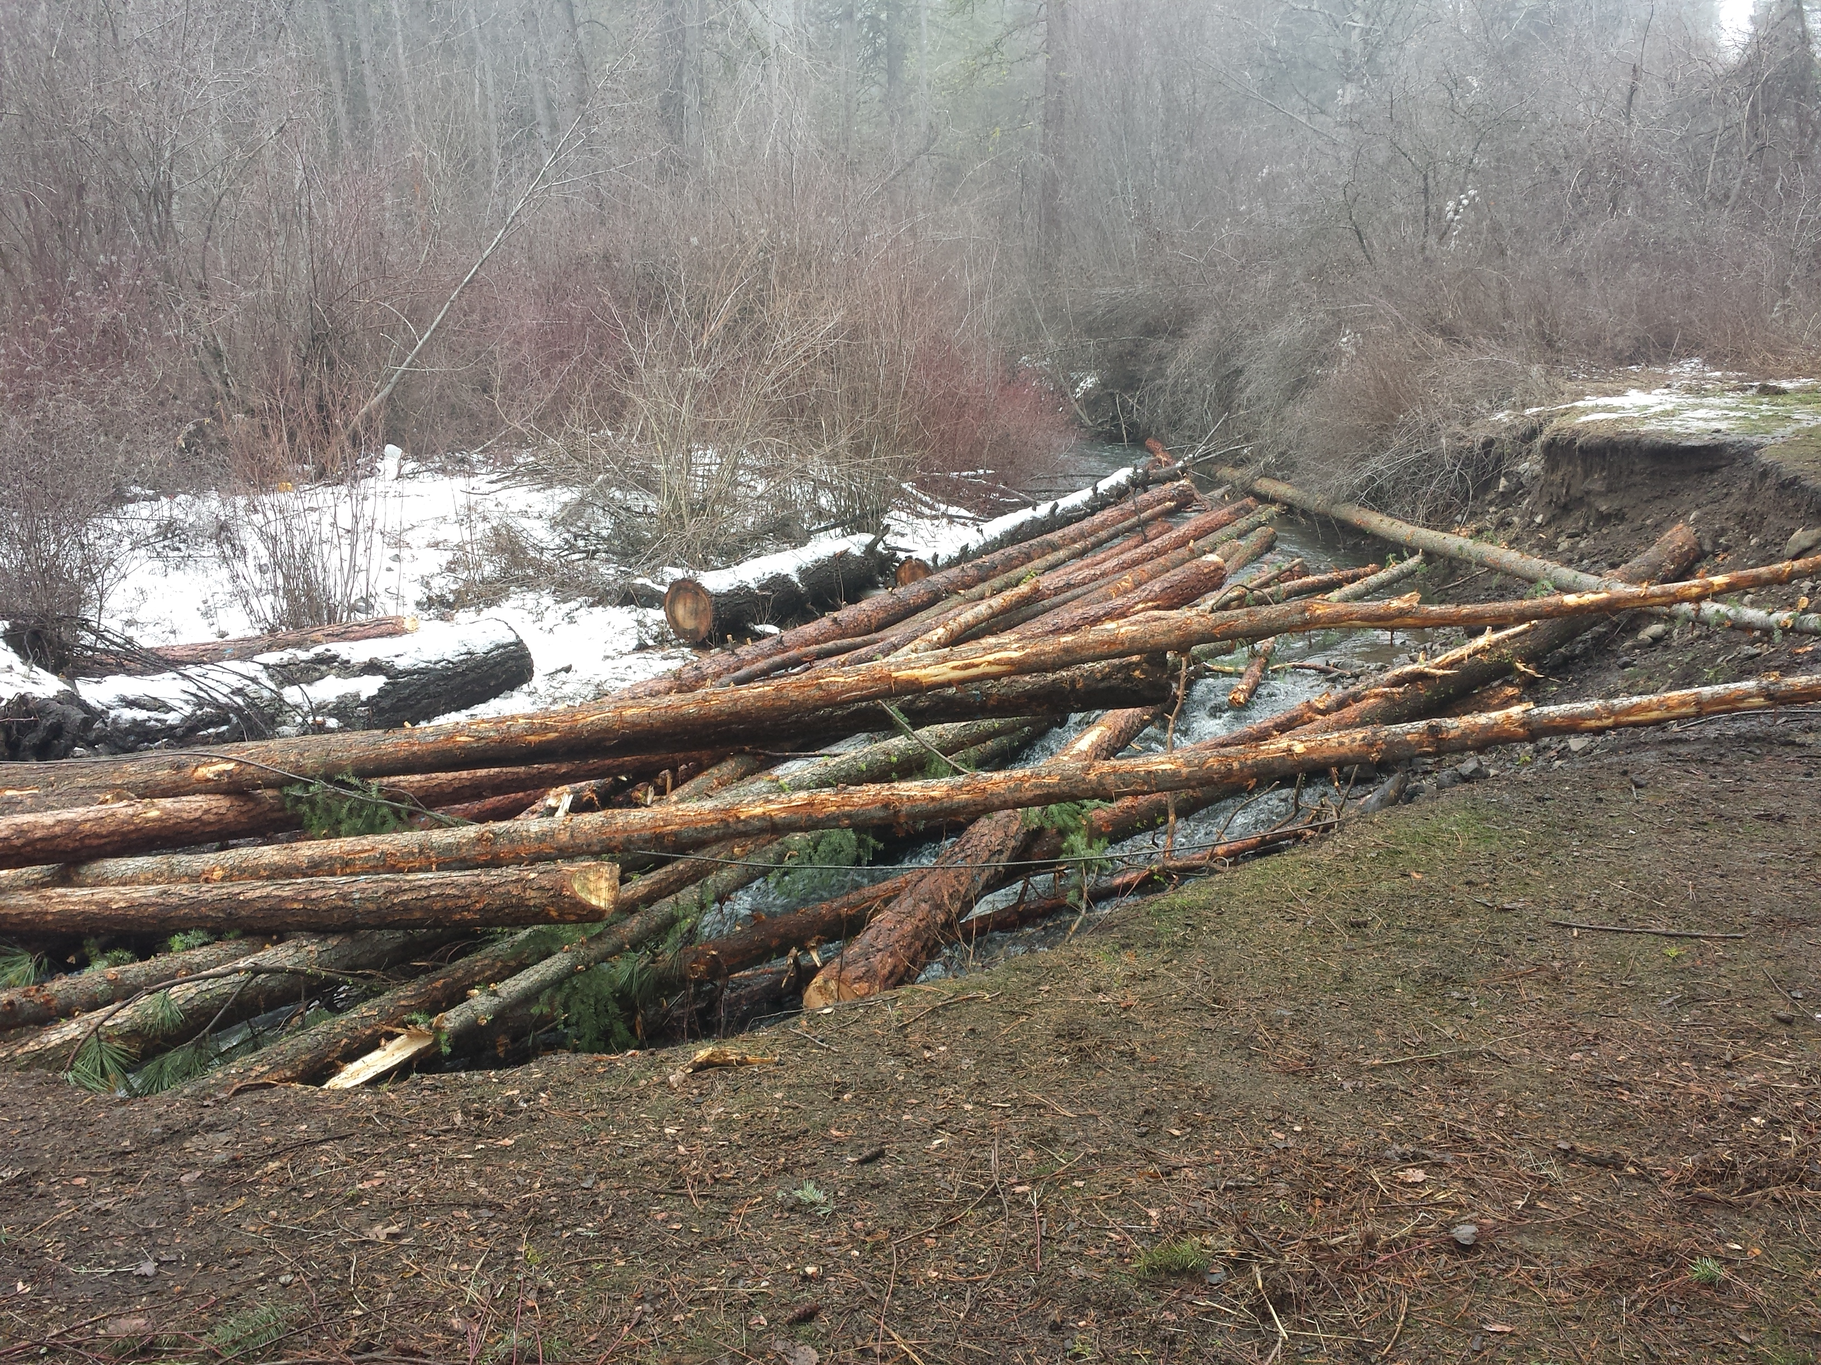

Slide 11
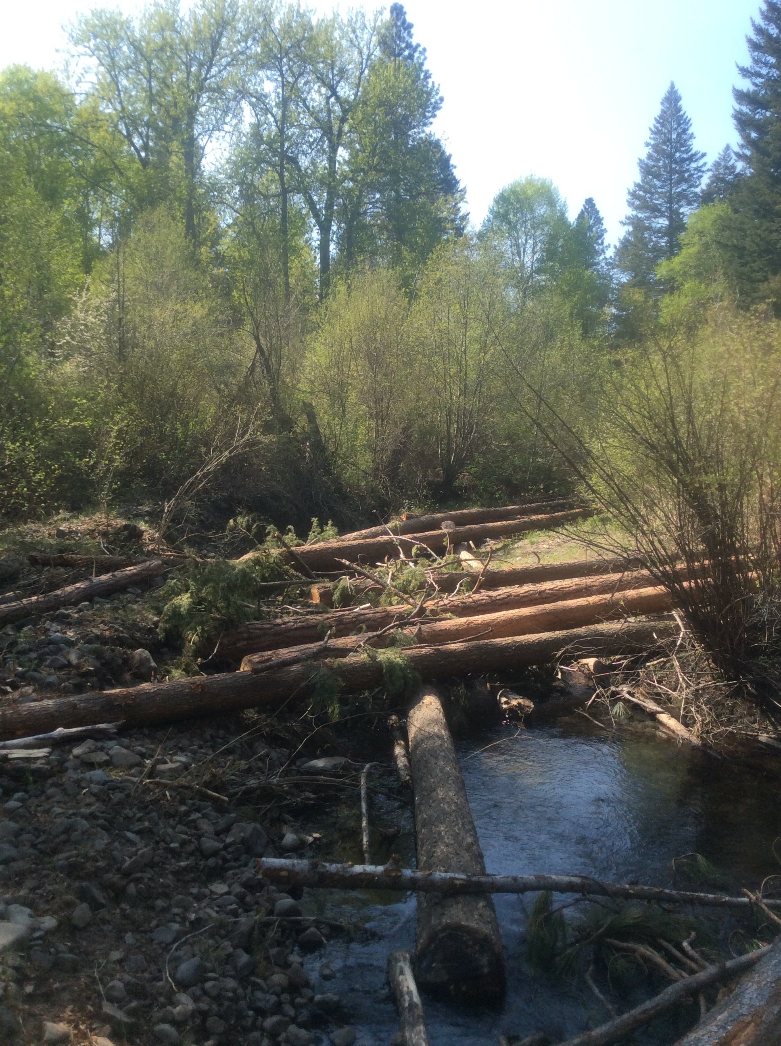
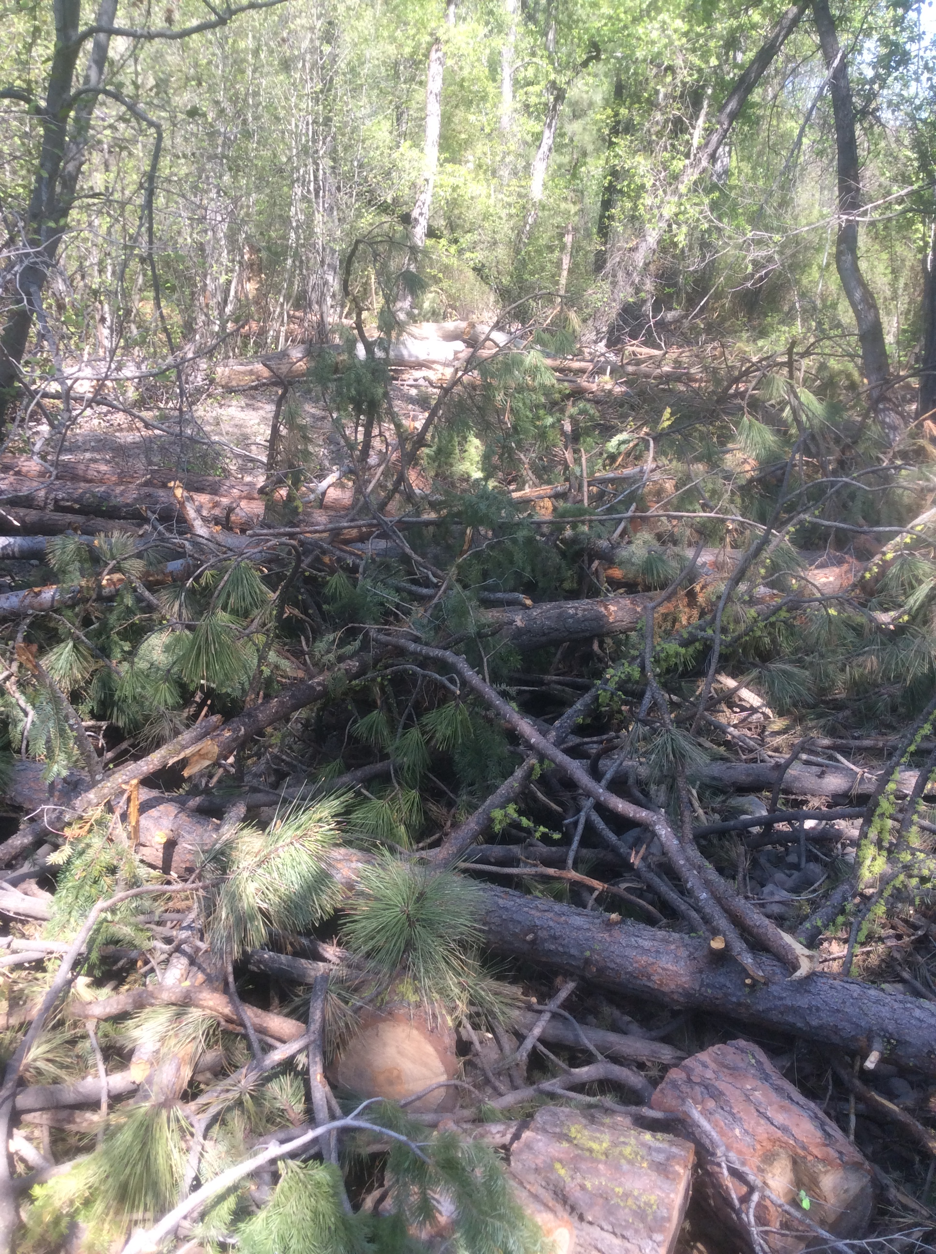

Slide 12
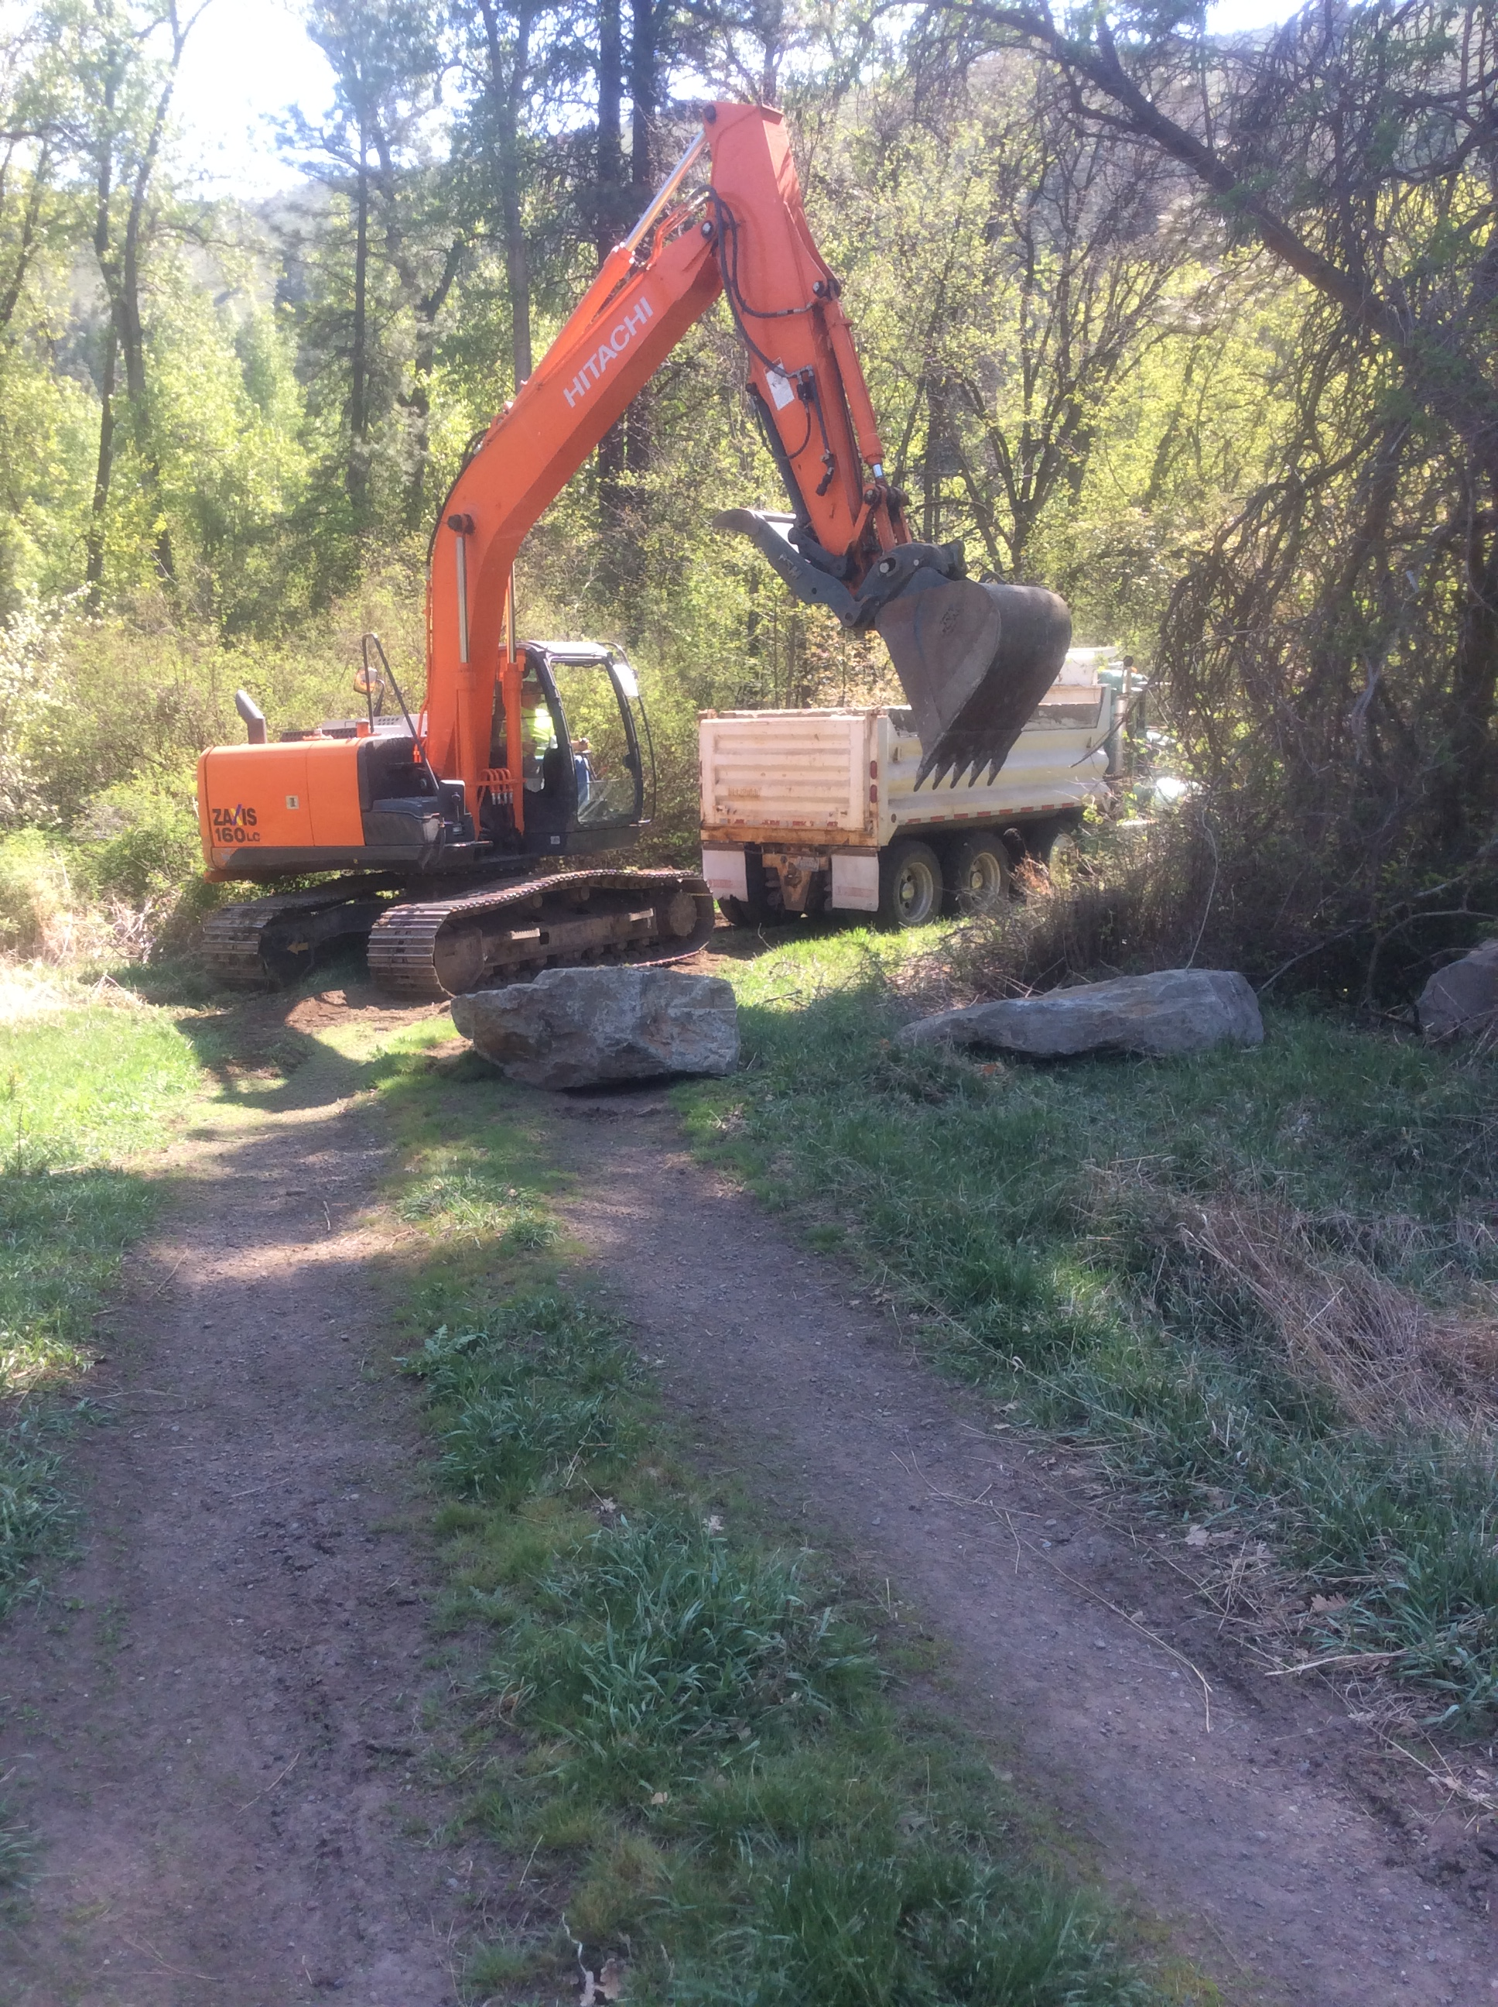
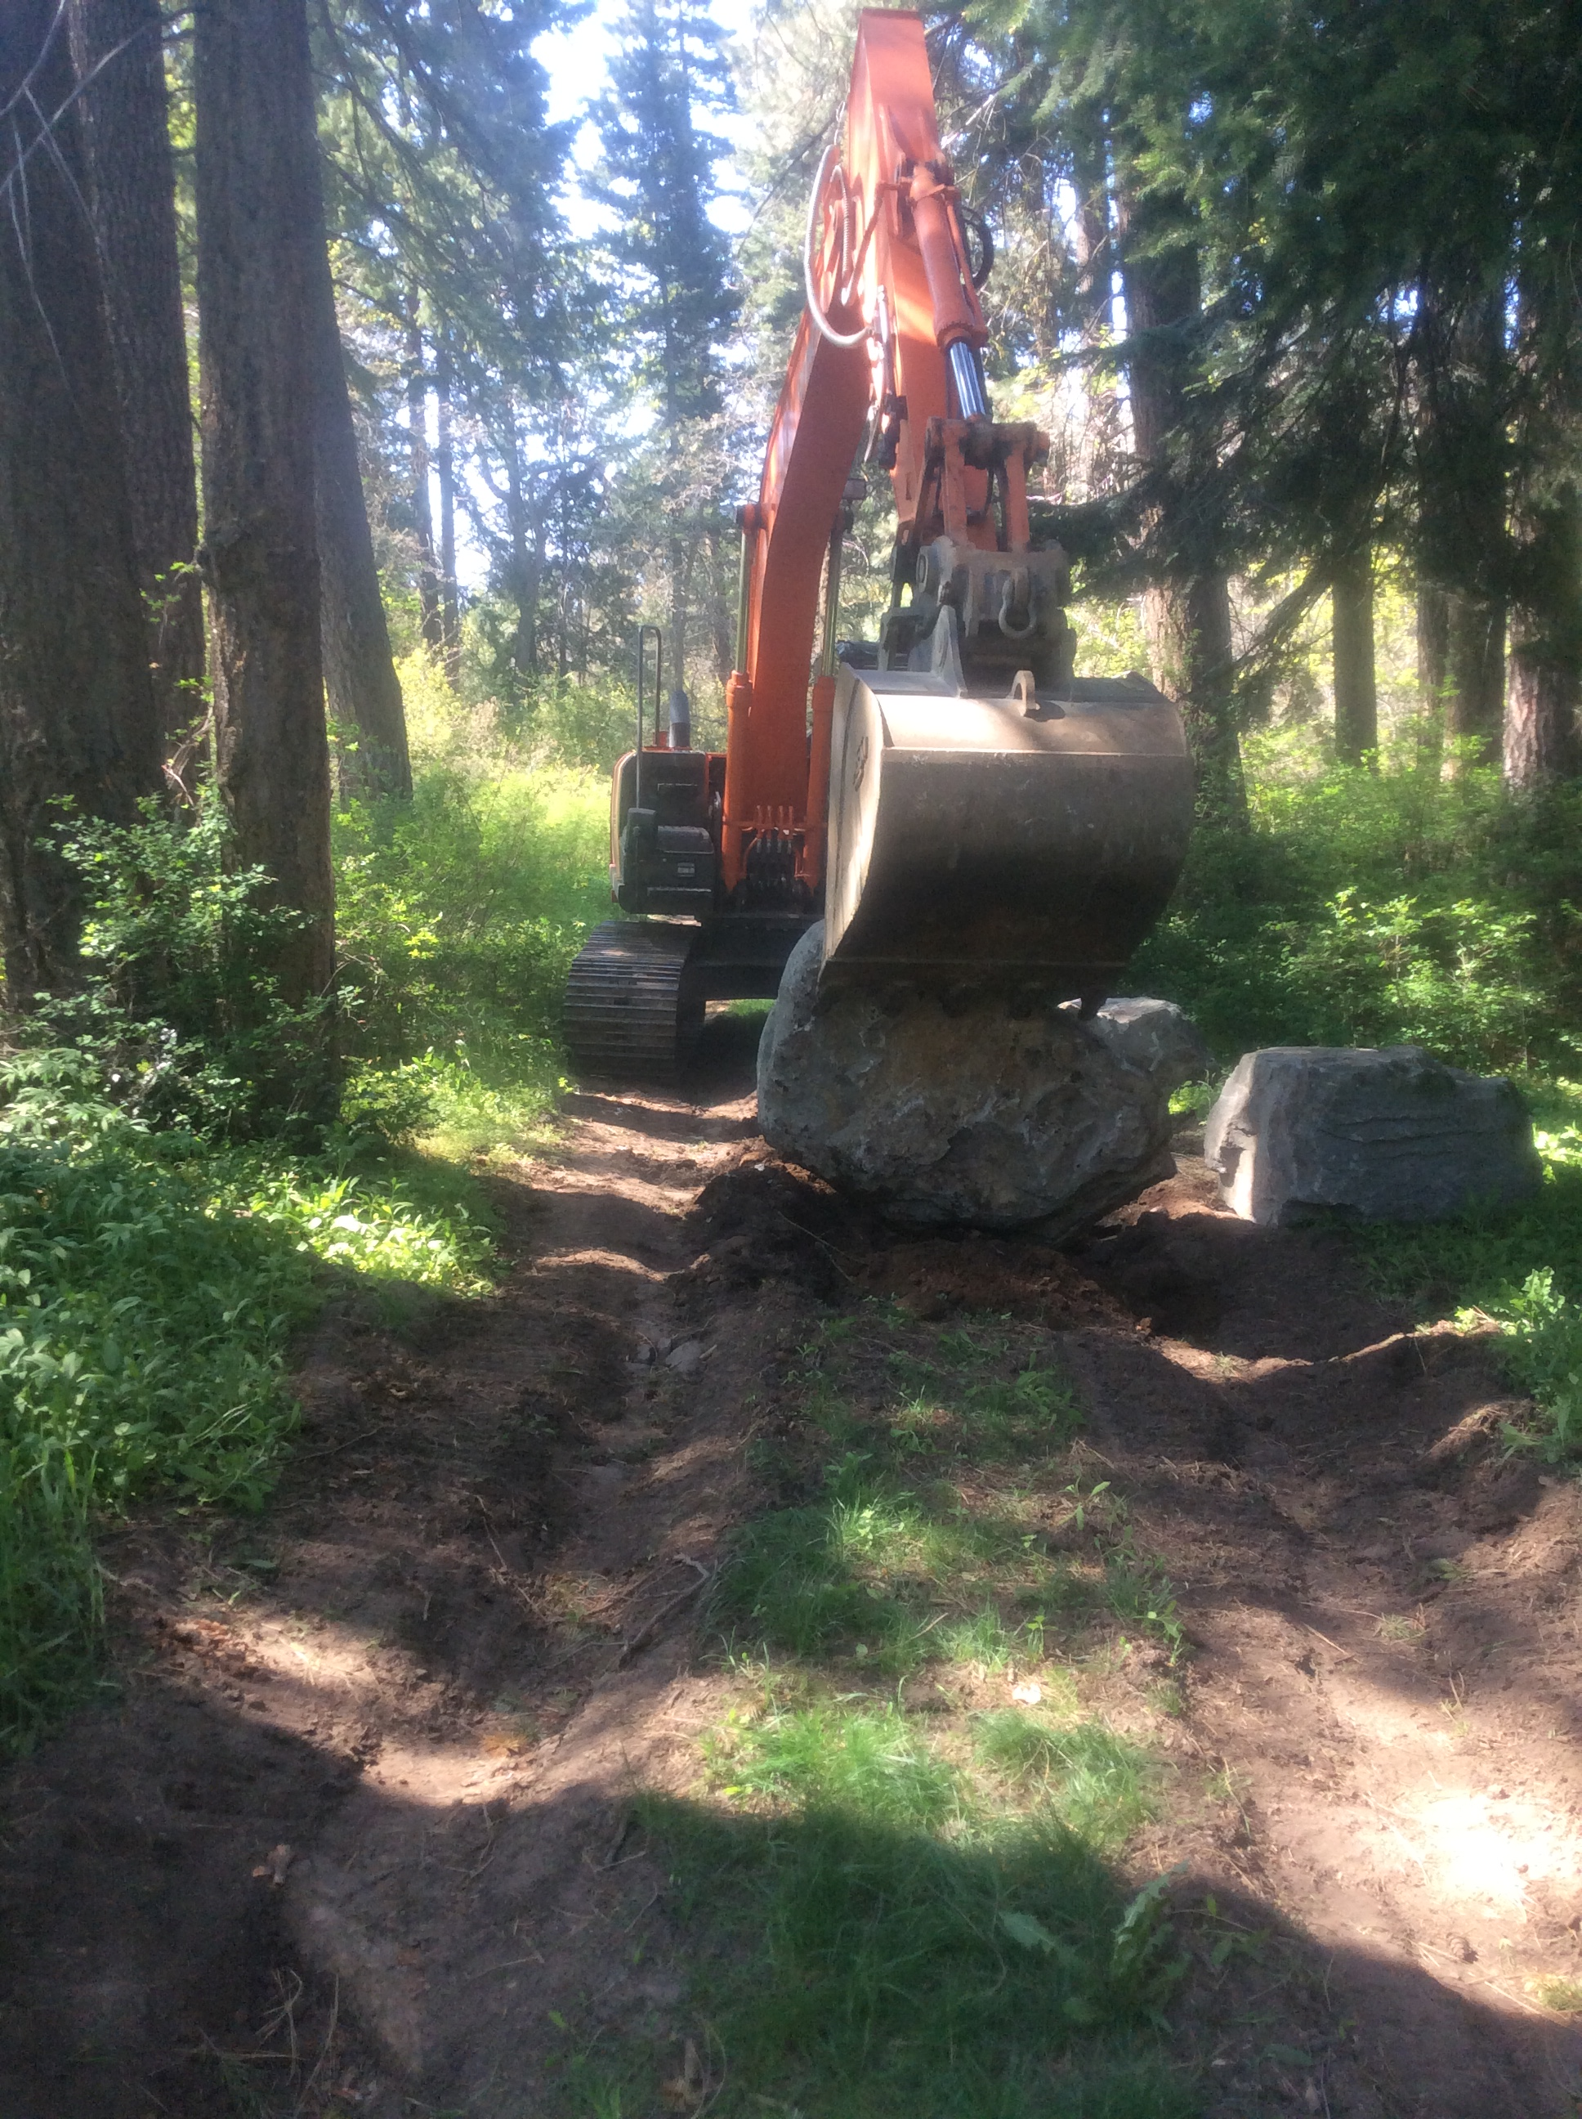

Slide 13
Oak Creek - Using Wood for Floodplain Connectivity Phase 1
Special Thanks to:
Ernest Farmer, Hazael Reynosa and Crew WCC
Ross Huffman, Eric Bartrand WDFW
Matt Dahlgreen TNC
Garren Andrews WDNR
Jim Matthews YN
Kelly Clayton YN
Scott Nicolai YN
Shirley Alvarado YN
Michelle O’Malley BPA

