Slide 1
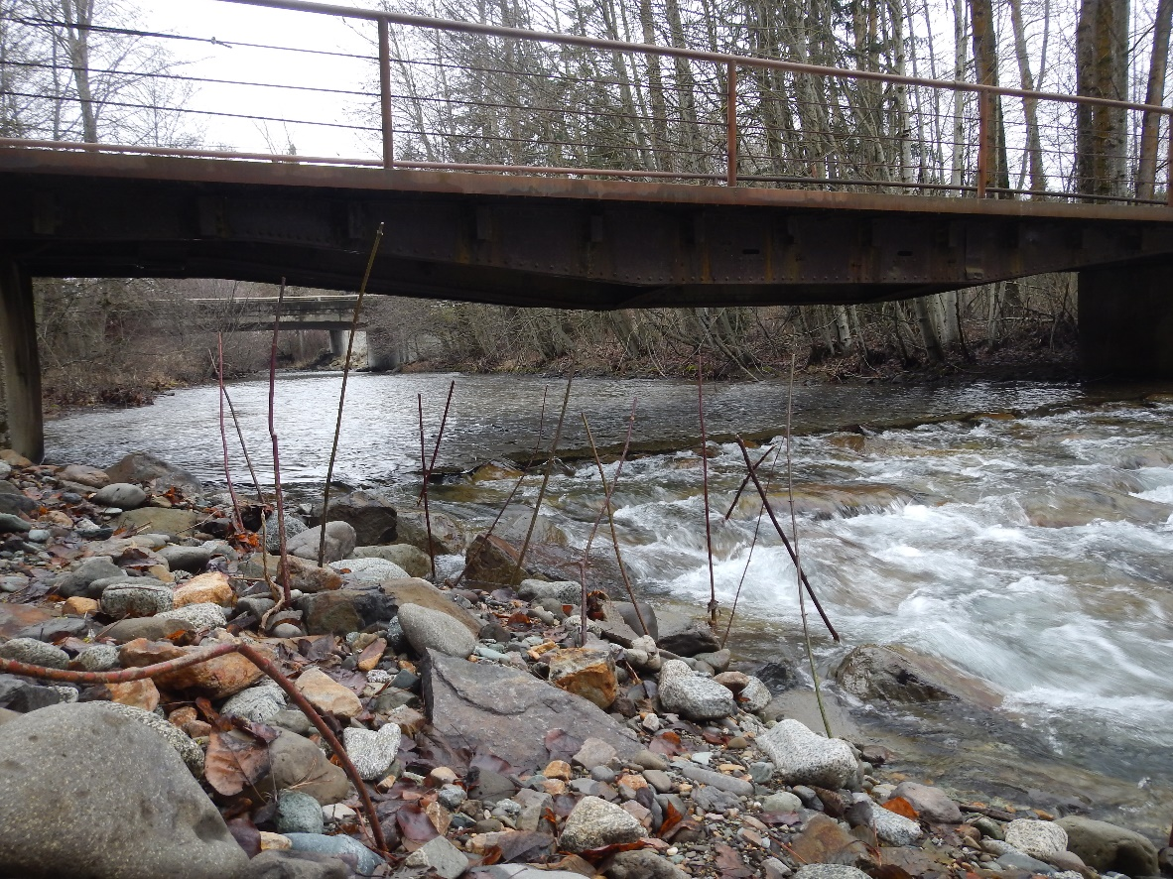
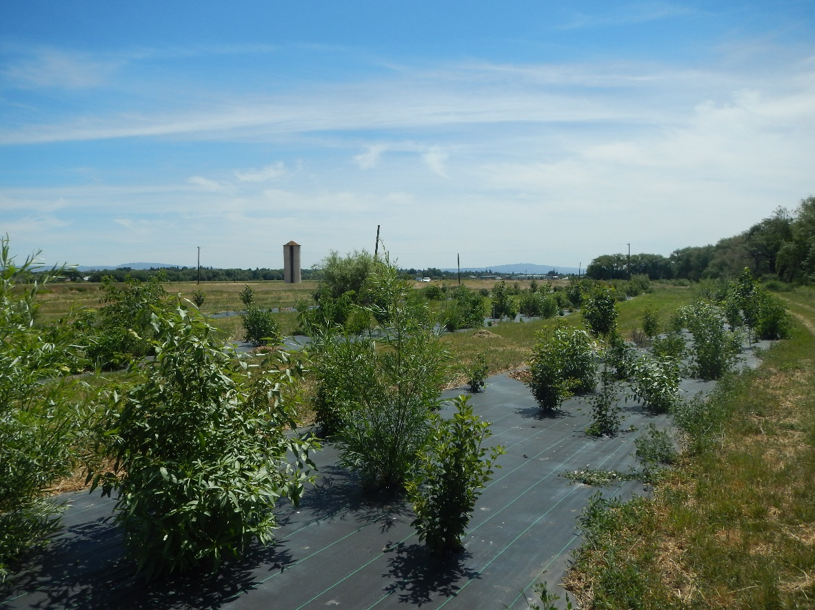
Kelly Clayton
Yakama Nation Fisheries
Big Creek Fish Passage Project
Pott Road CREP project
Ensign Ranch, Cle Elum, WA
Reecer Creek, Ellensburg, WA

Slide 2
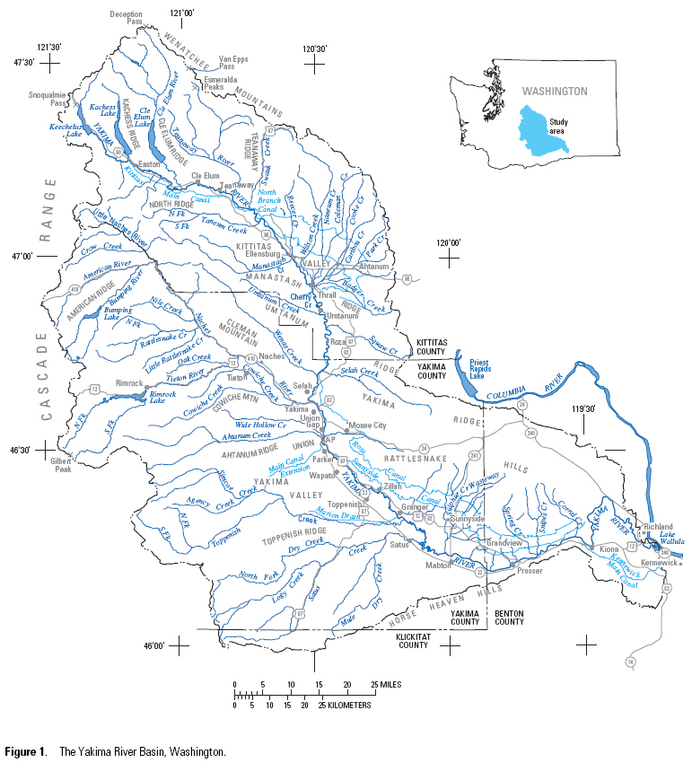
Big Creek

Slide 3
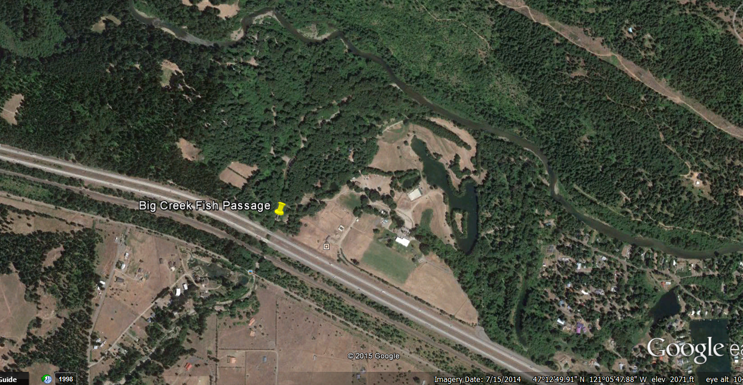

Slide 4
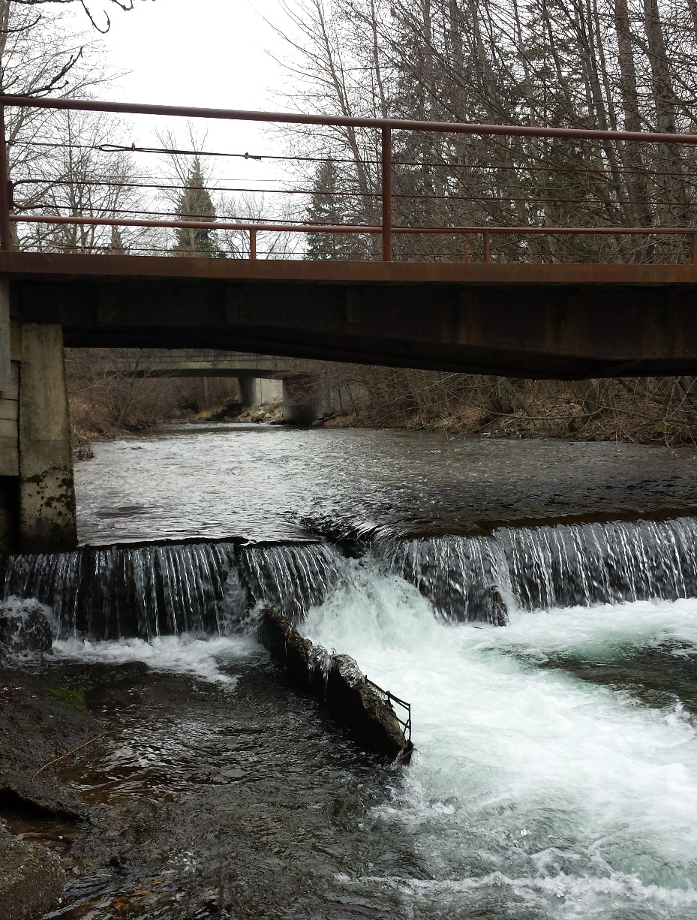
1986 – Fishway constructed

Slide 5
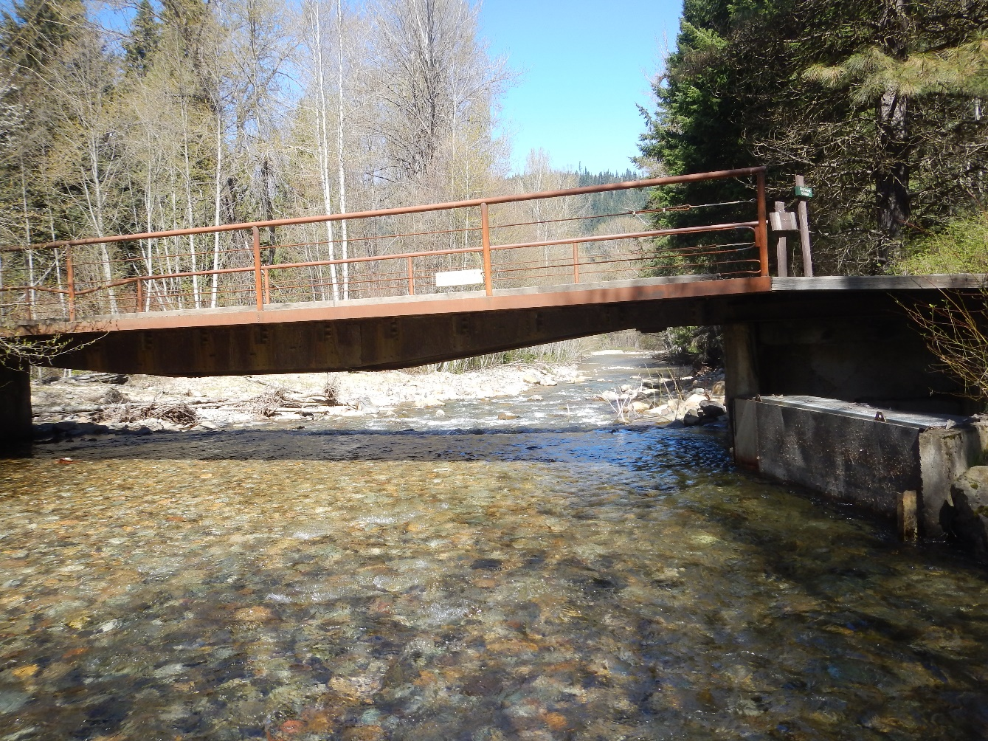
1987 – screen installed

Slide 6
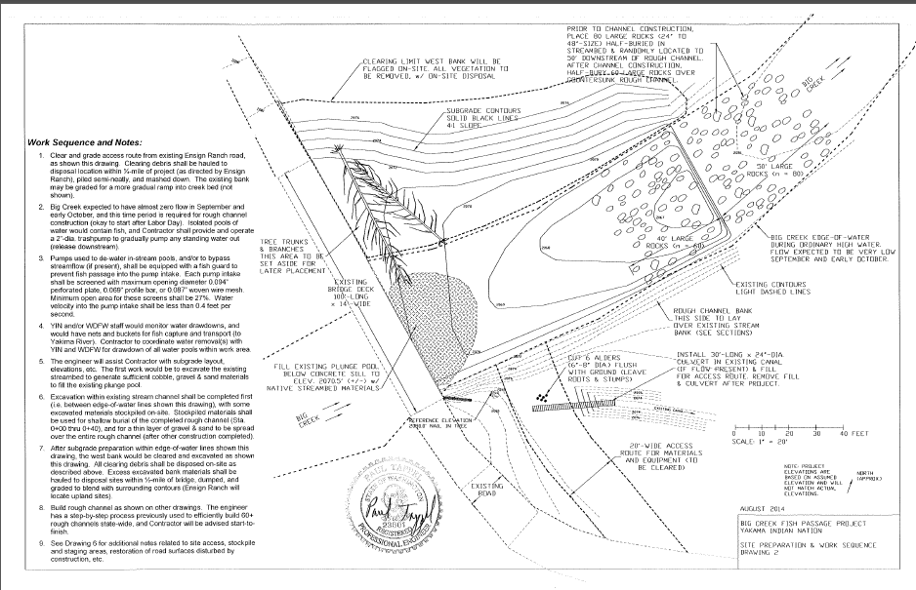

Slide 7
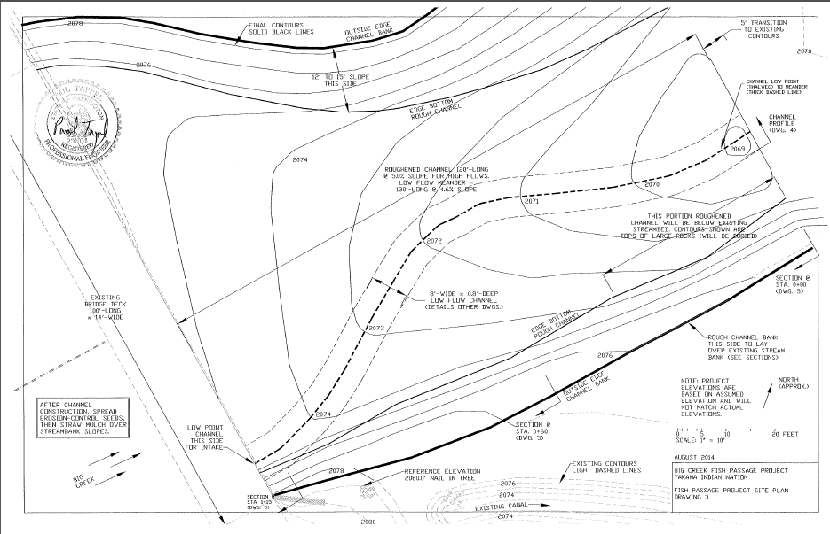

Slide 8
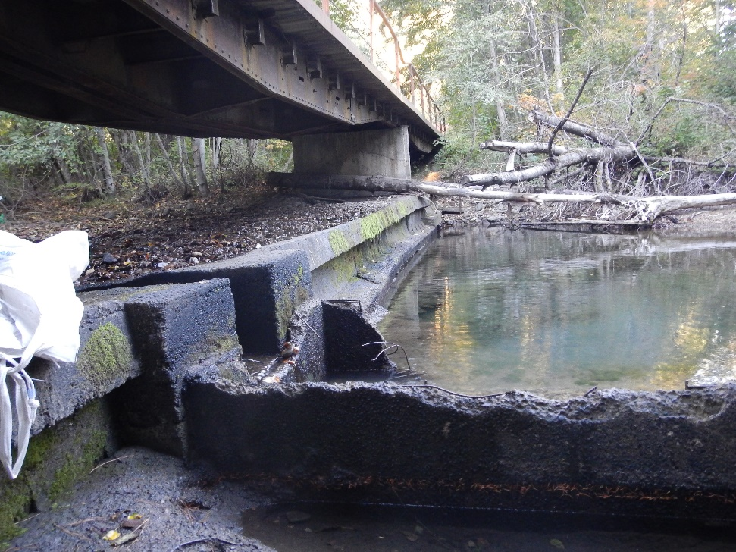

Slide 9
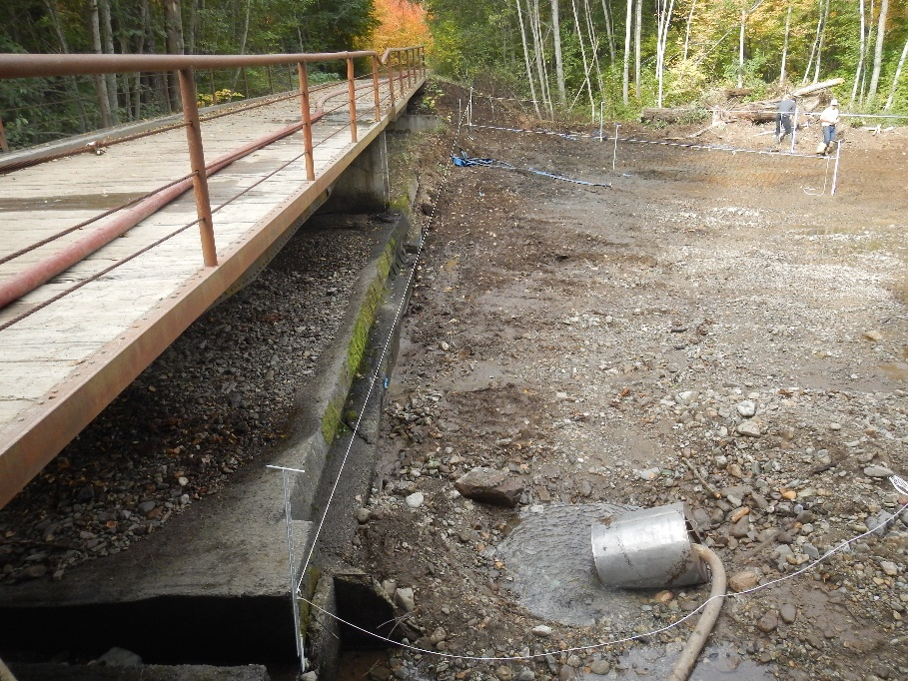

Slide 10
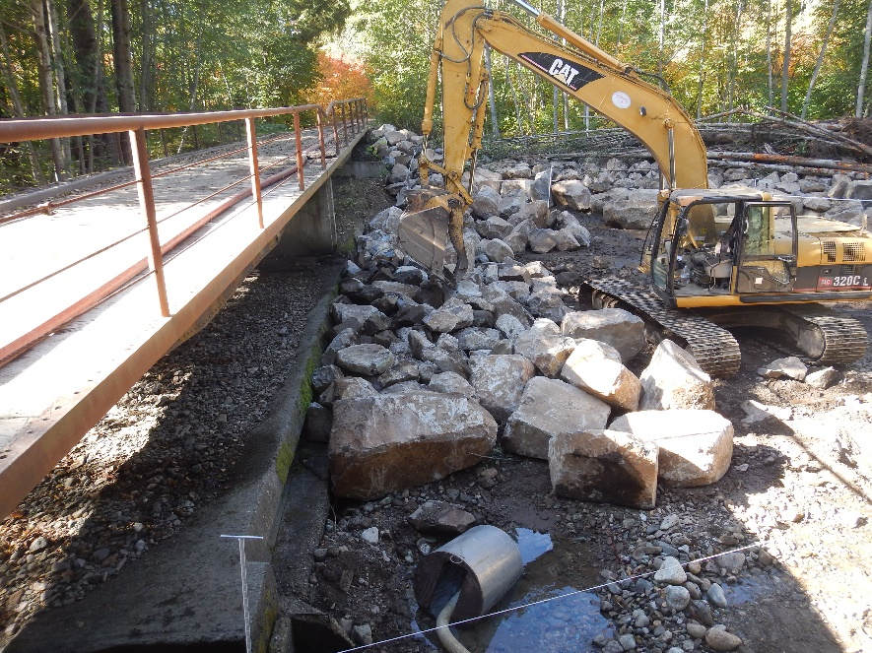

Slide 11
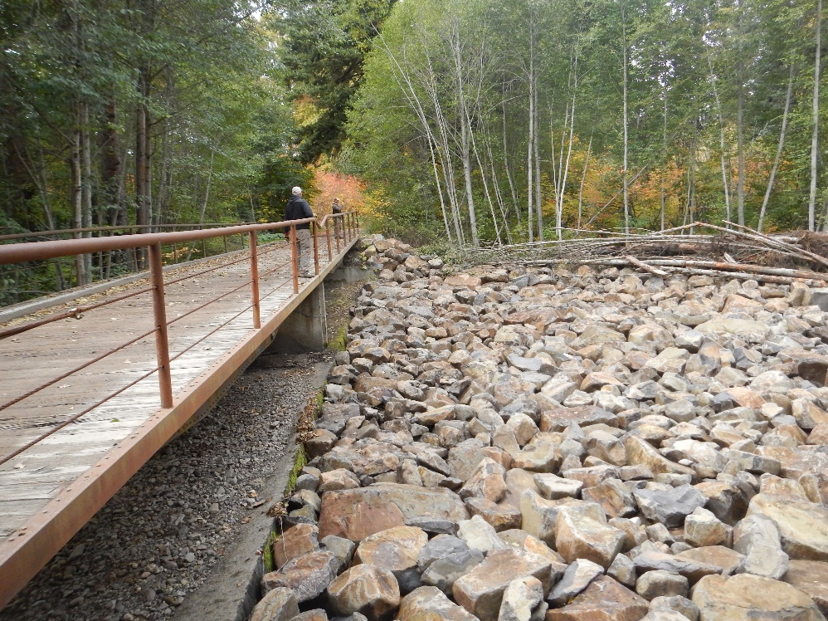

Slide 12
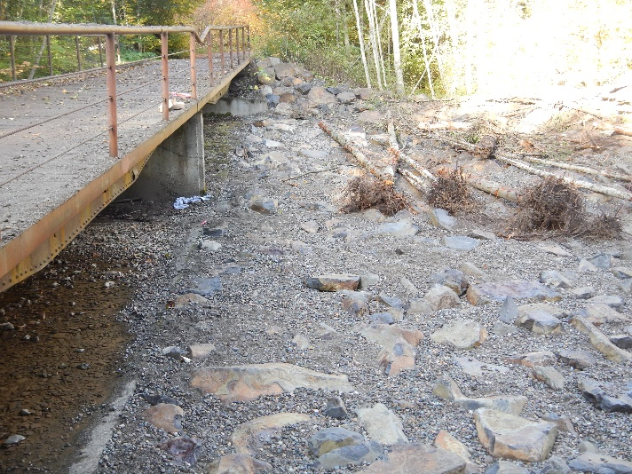

Slide 13
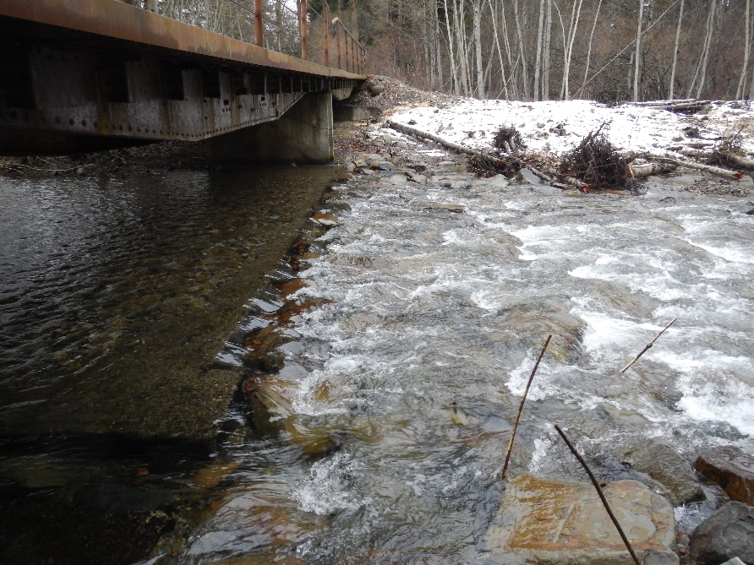

Slide 14
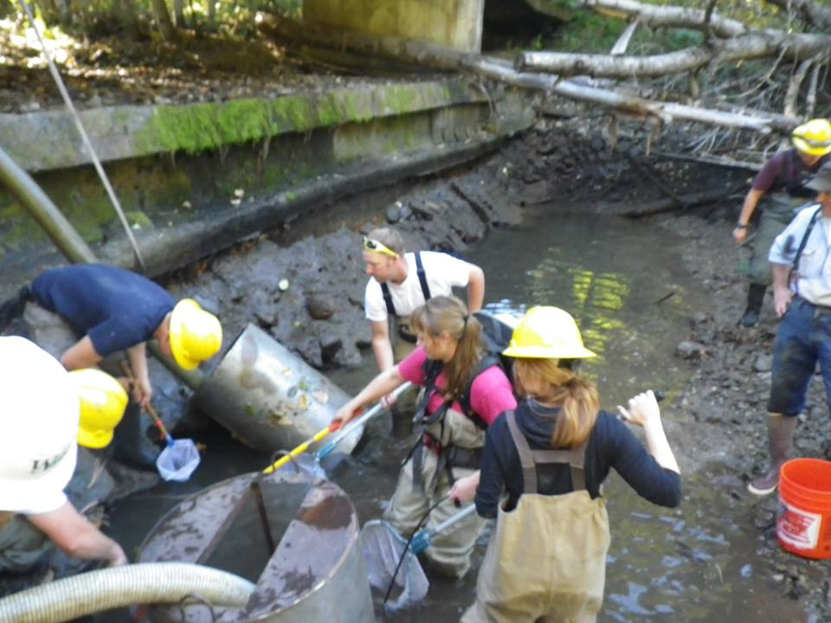
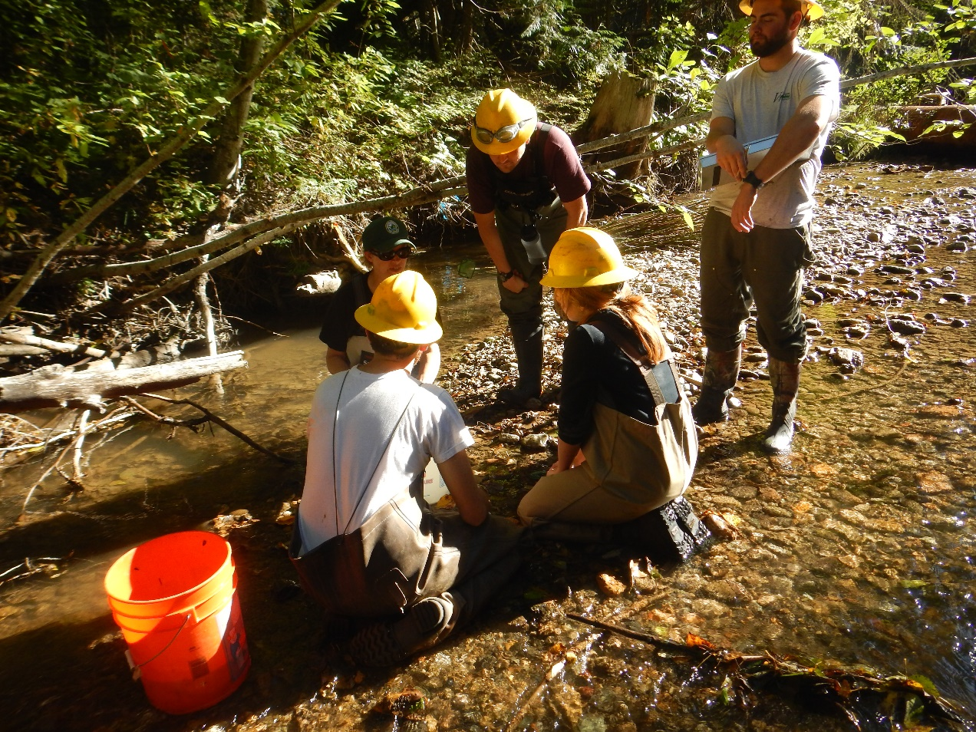
Fish rescue results:
91 O. mykiss
30 spring chinook juveniles
294 coho juveniles
274 sculpins (not identified to species)
7 crayfish
1 Pacific Giant Salamander

Slide 15
Fish rescue results:
91 O. mykiss
30 spring chinook juveniles
294 coho juveniles
274 sculpins (not identified to species)
7 crayfish
1 Pacific Giant Salamander
415 salmonid species!

Slide 16
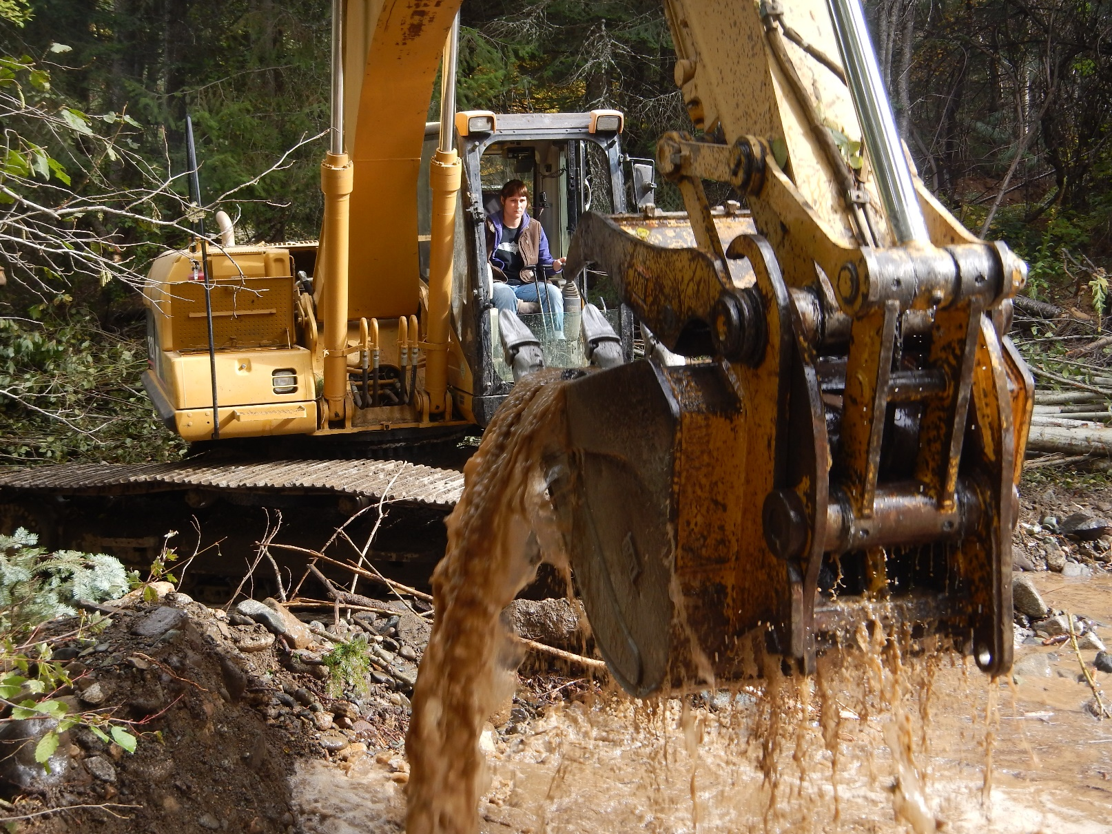
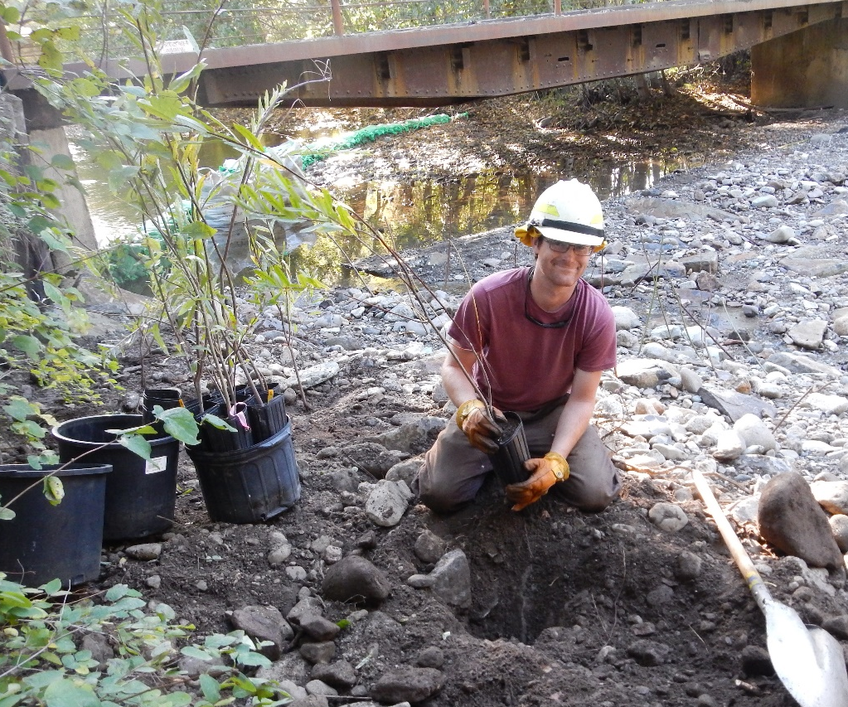
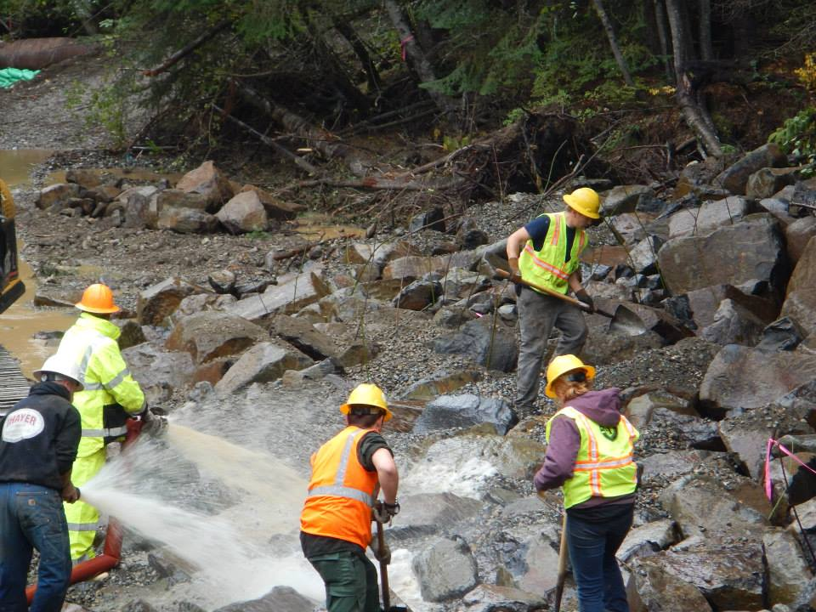

Slide 17
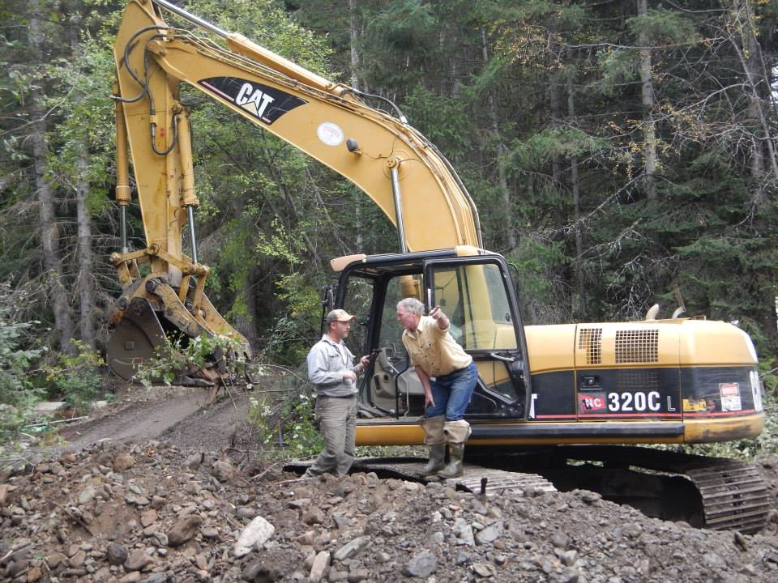
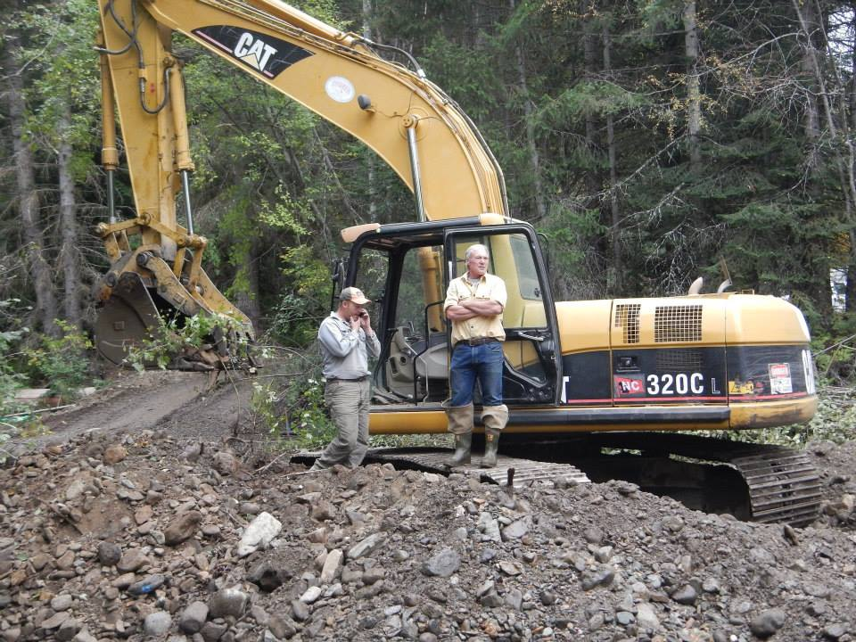

Slide 18
Eagle Scout Projects…

Slide 19
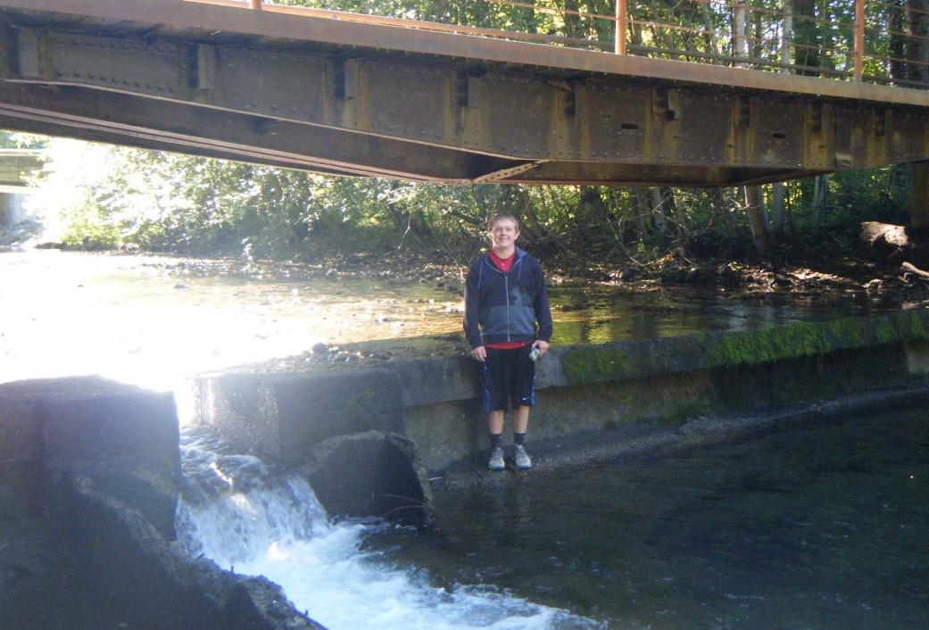
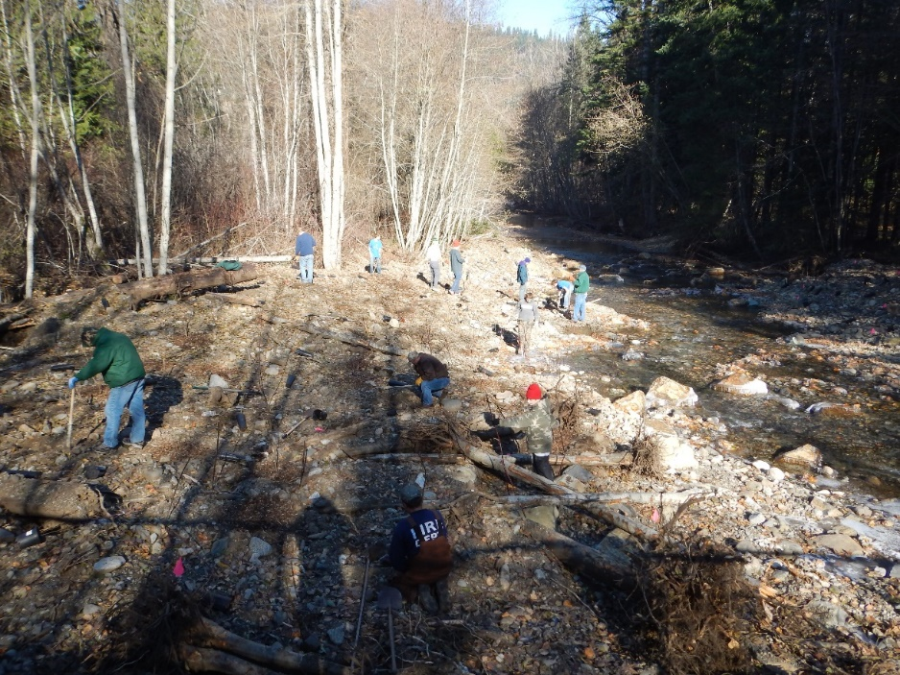
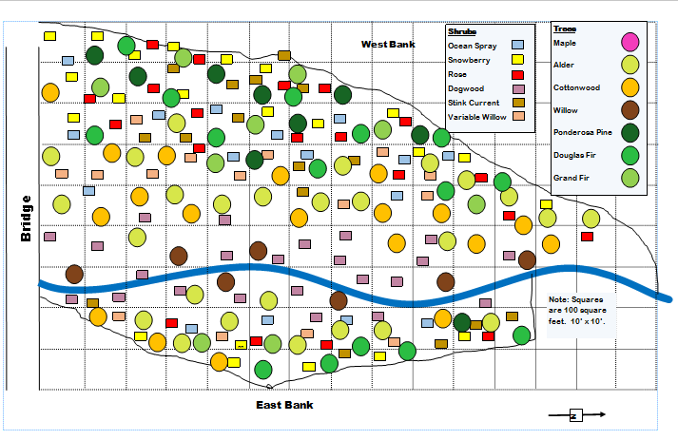
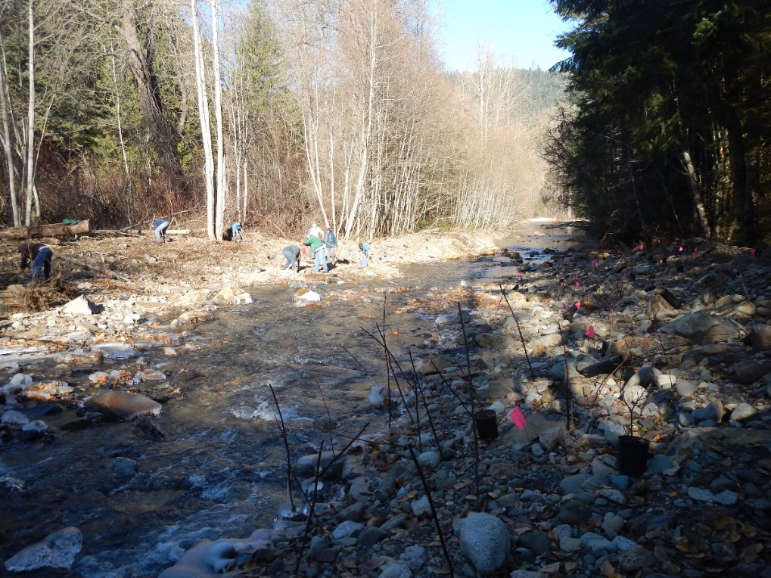
Jacob Jewett
Re-vegetation design and implementation
November 2014

Slide 20
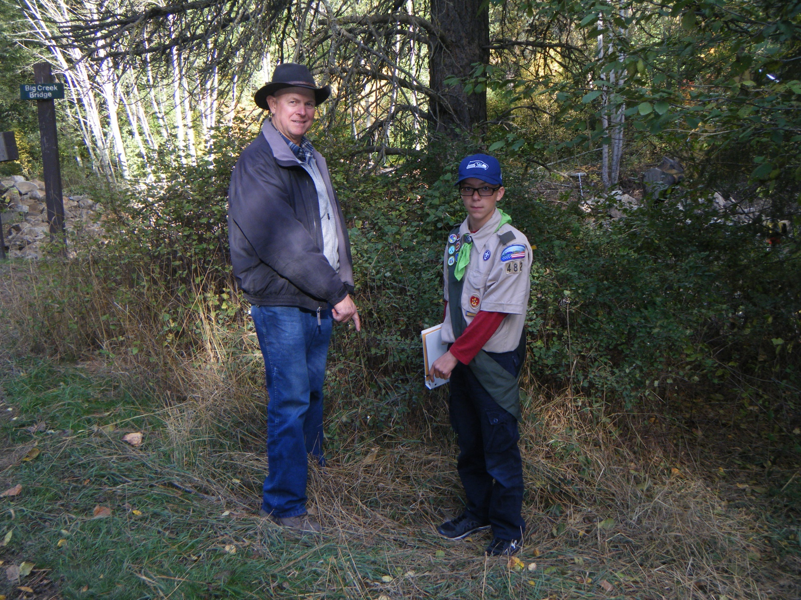
Dean Child
Design and build educational board
Summer 2015

Slide 21
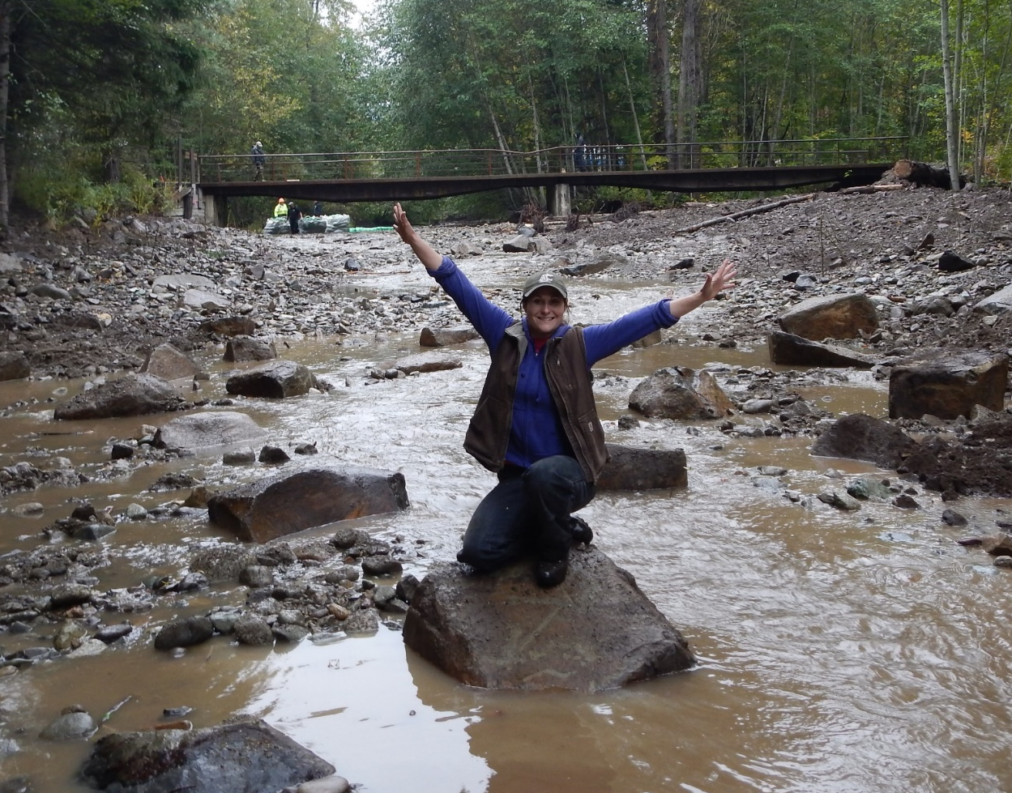
Thank you!!!
Jennifer Nelson, WDFW
Shirley Alvarado, YN admin
Rachel Castilleja, YN admin
Michelle O’Malley, BPA COTR
Jenny Lord, BPA EC
Paul Tappel, engineer
Thayer Excavating
LDS church
Washington Conservation Corps
YN Cultural staff
Washington Water Trust

Slide 22
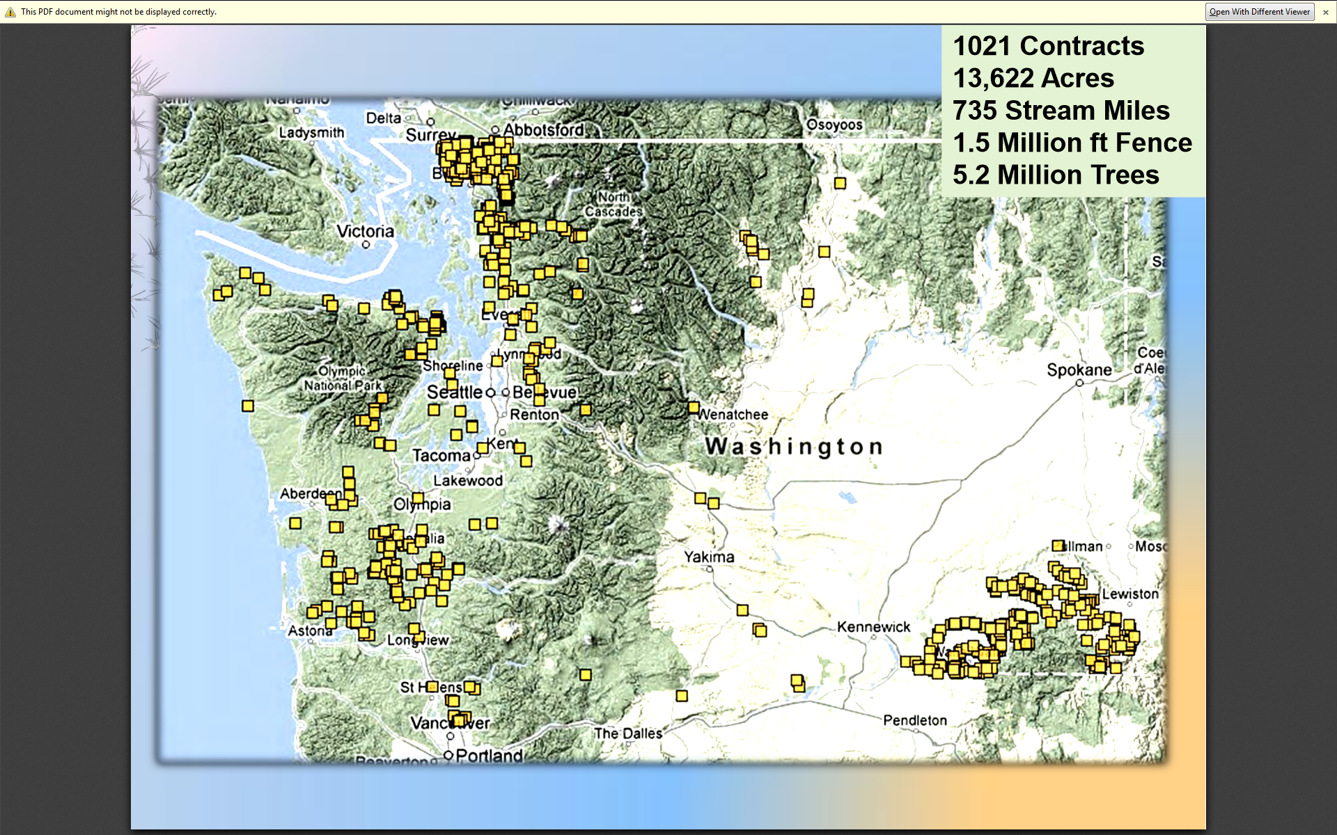

Slide 23
Reecer Creek

Slide 24
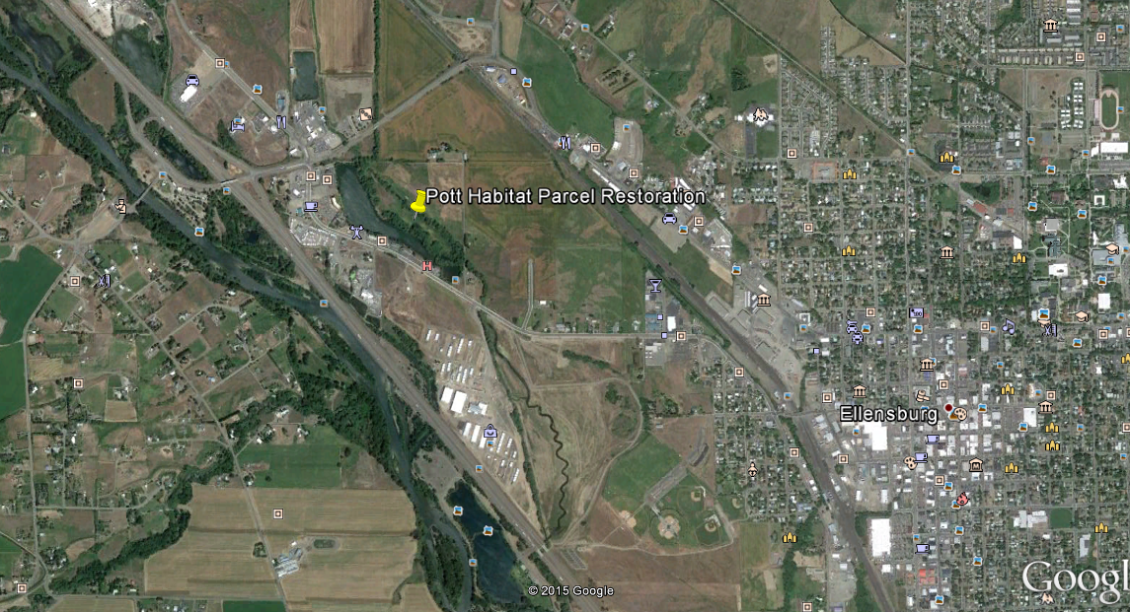

Slide 25
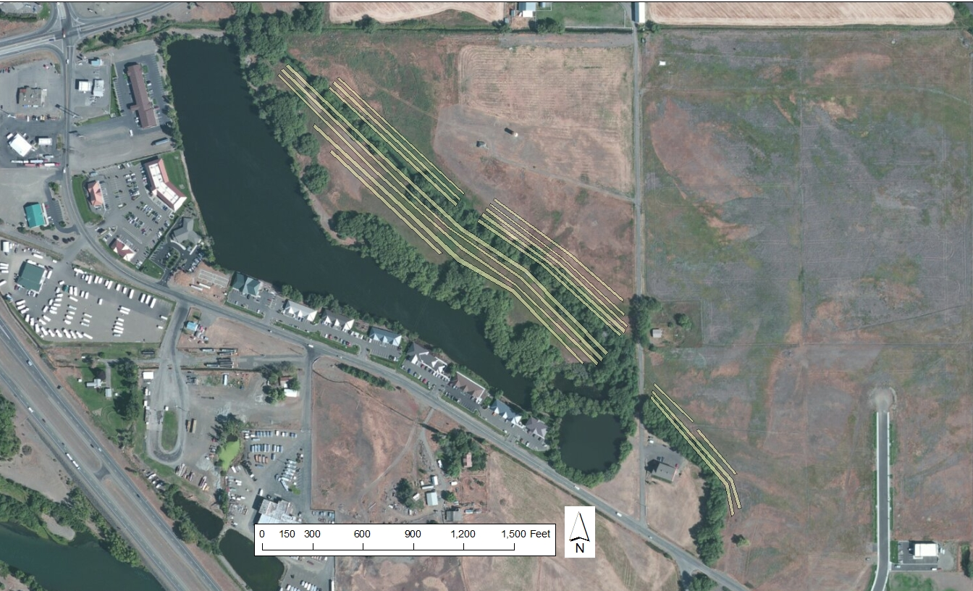

Slide 26
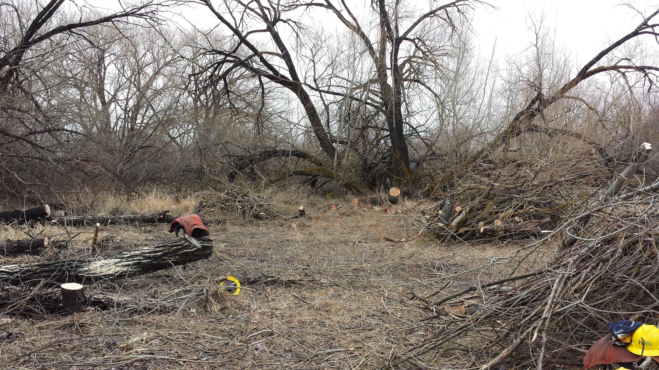

Slide 27
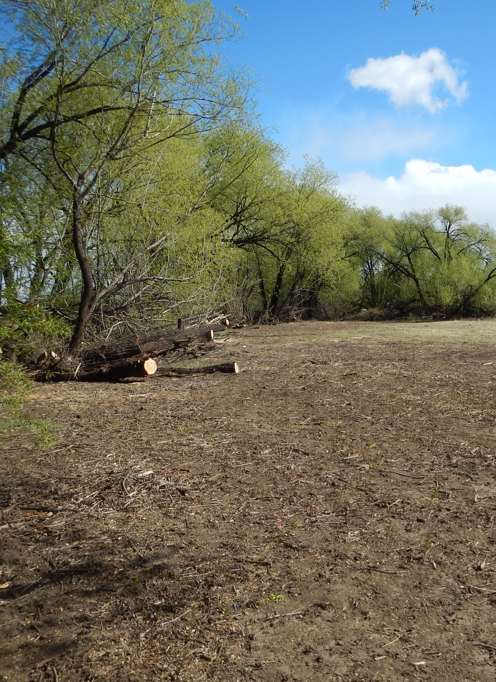
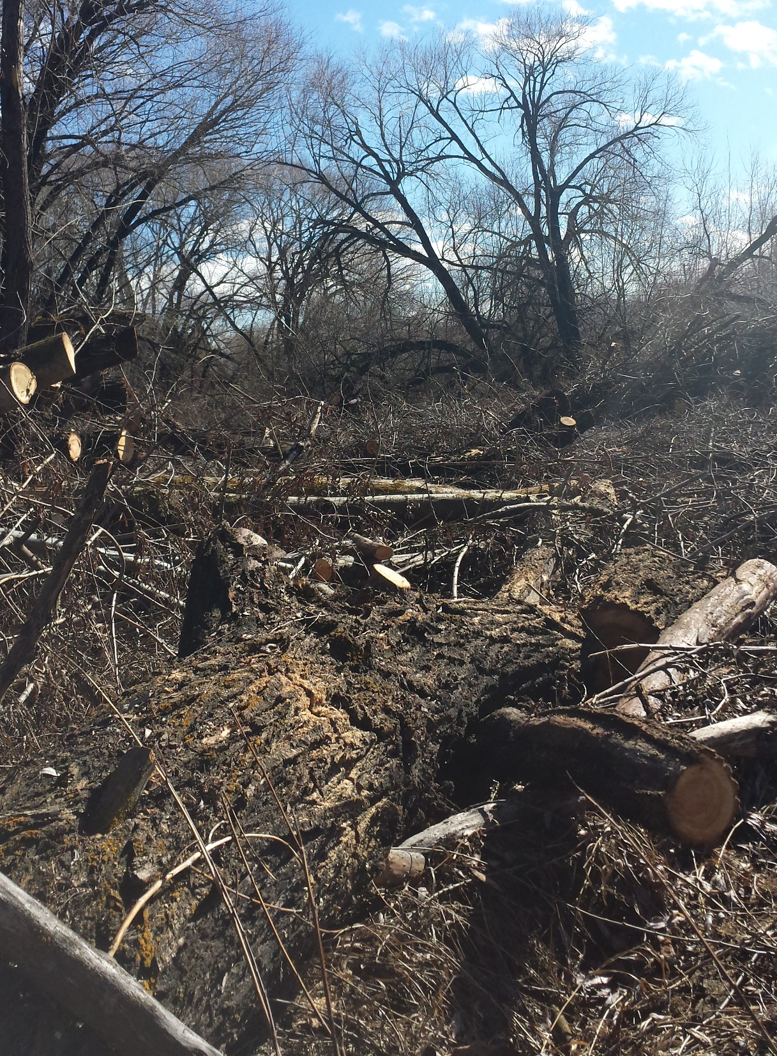

Slide 28
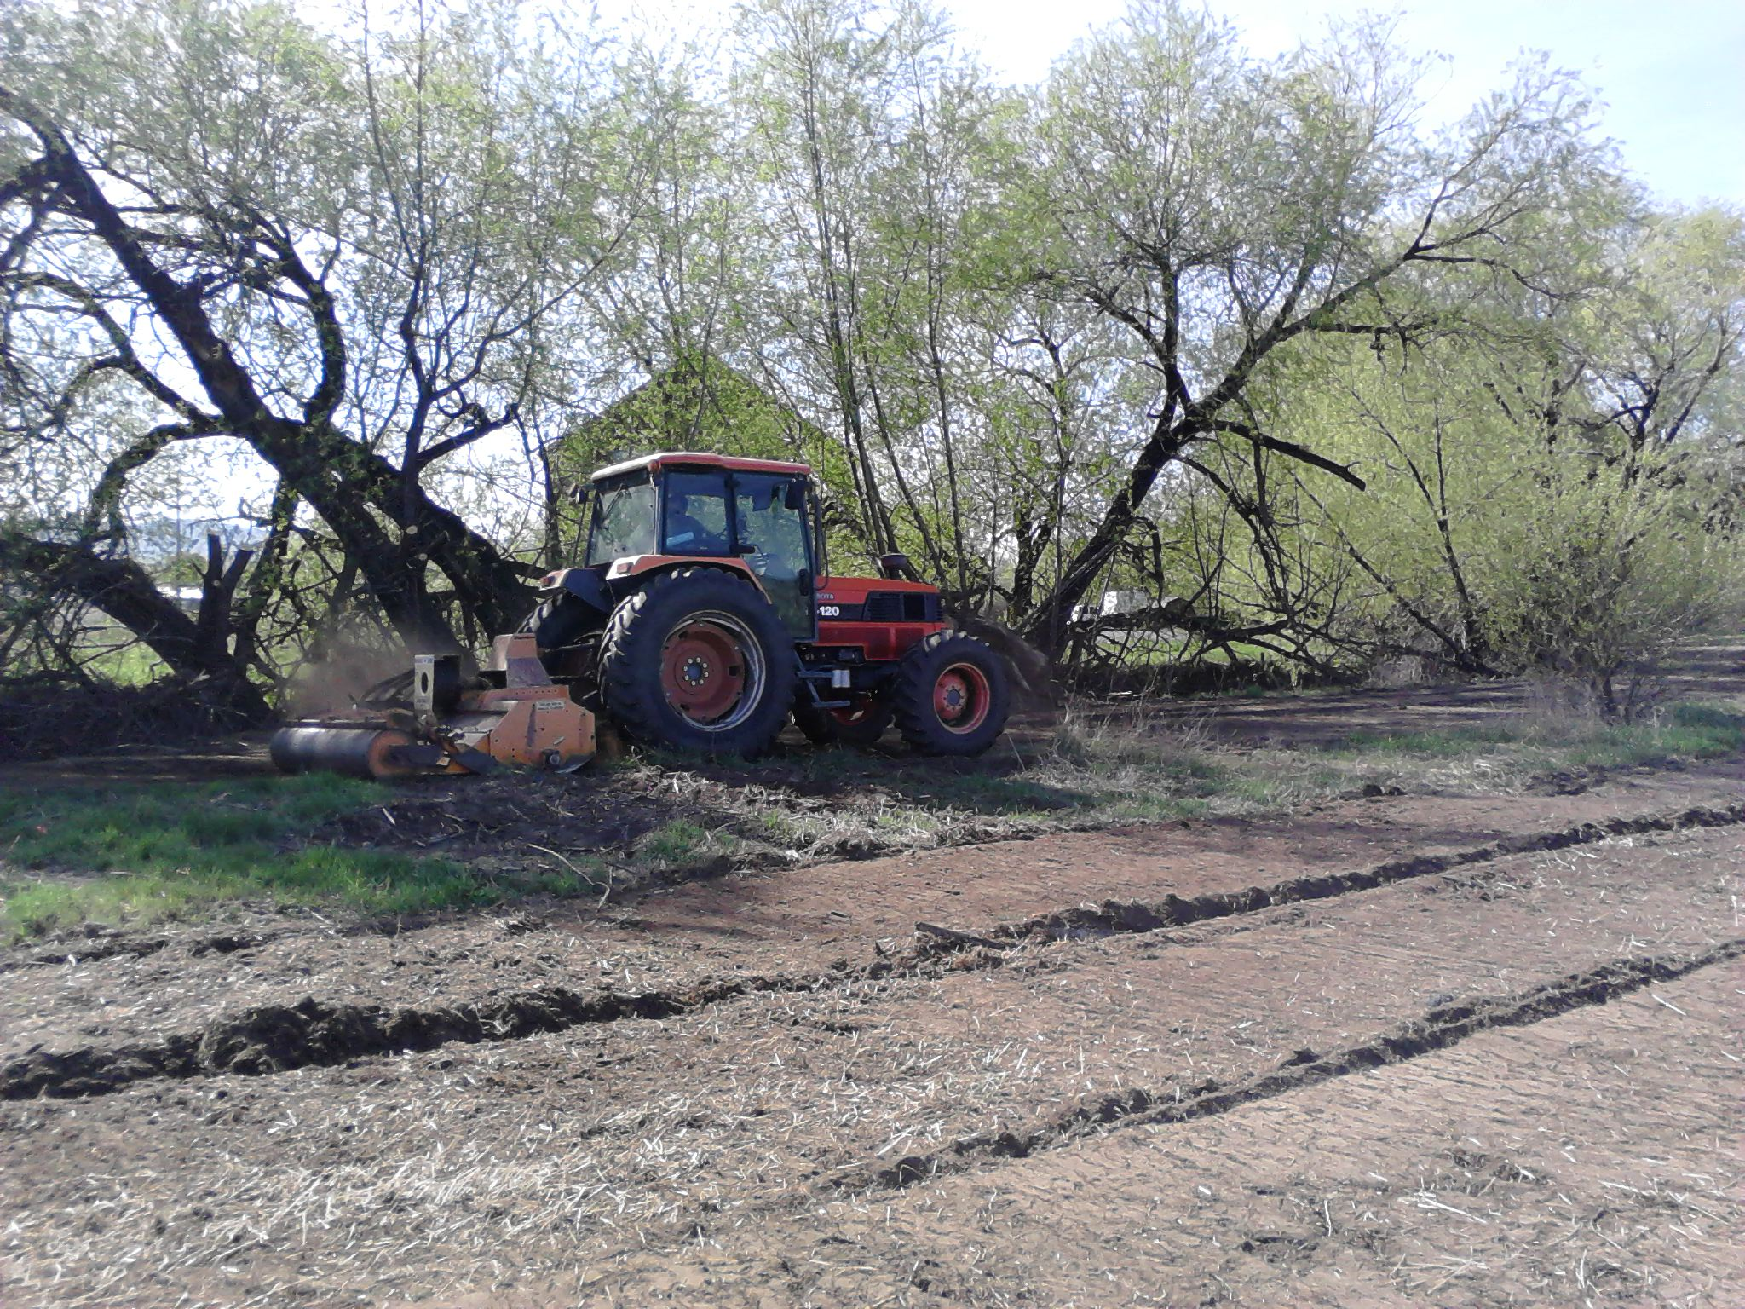

Slide 29
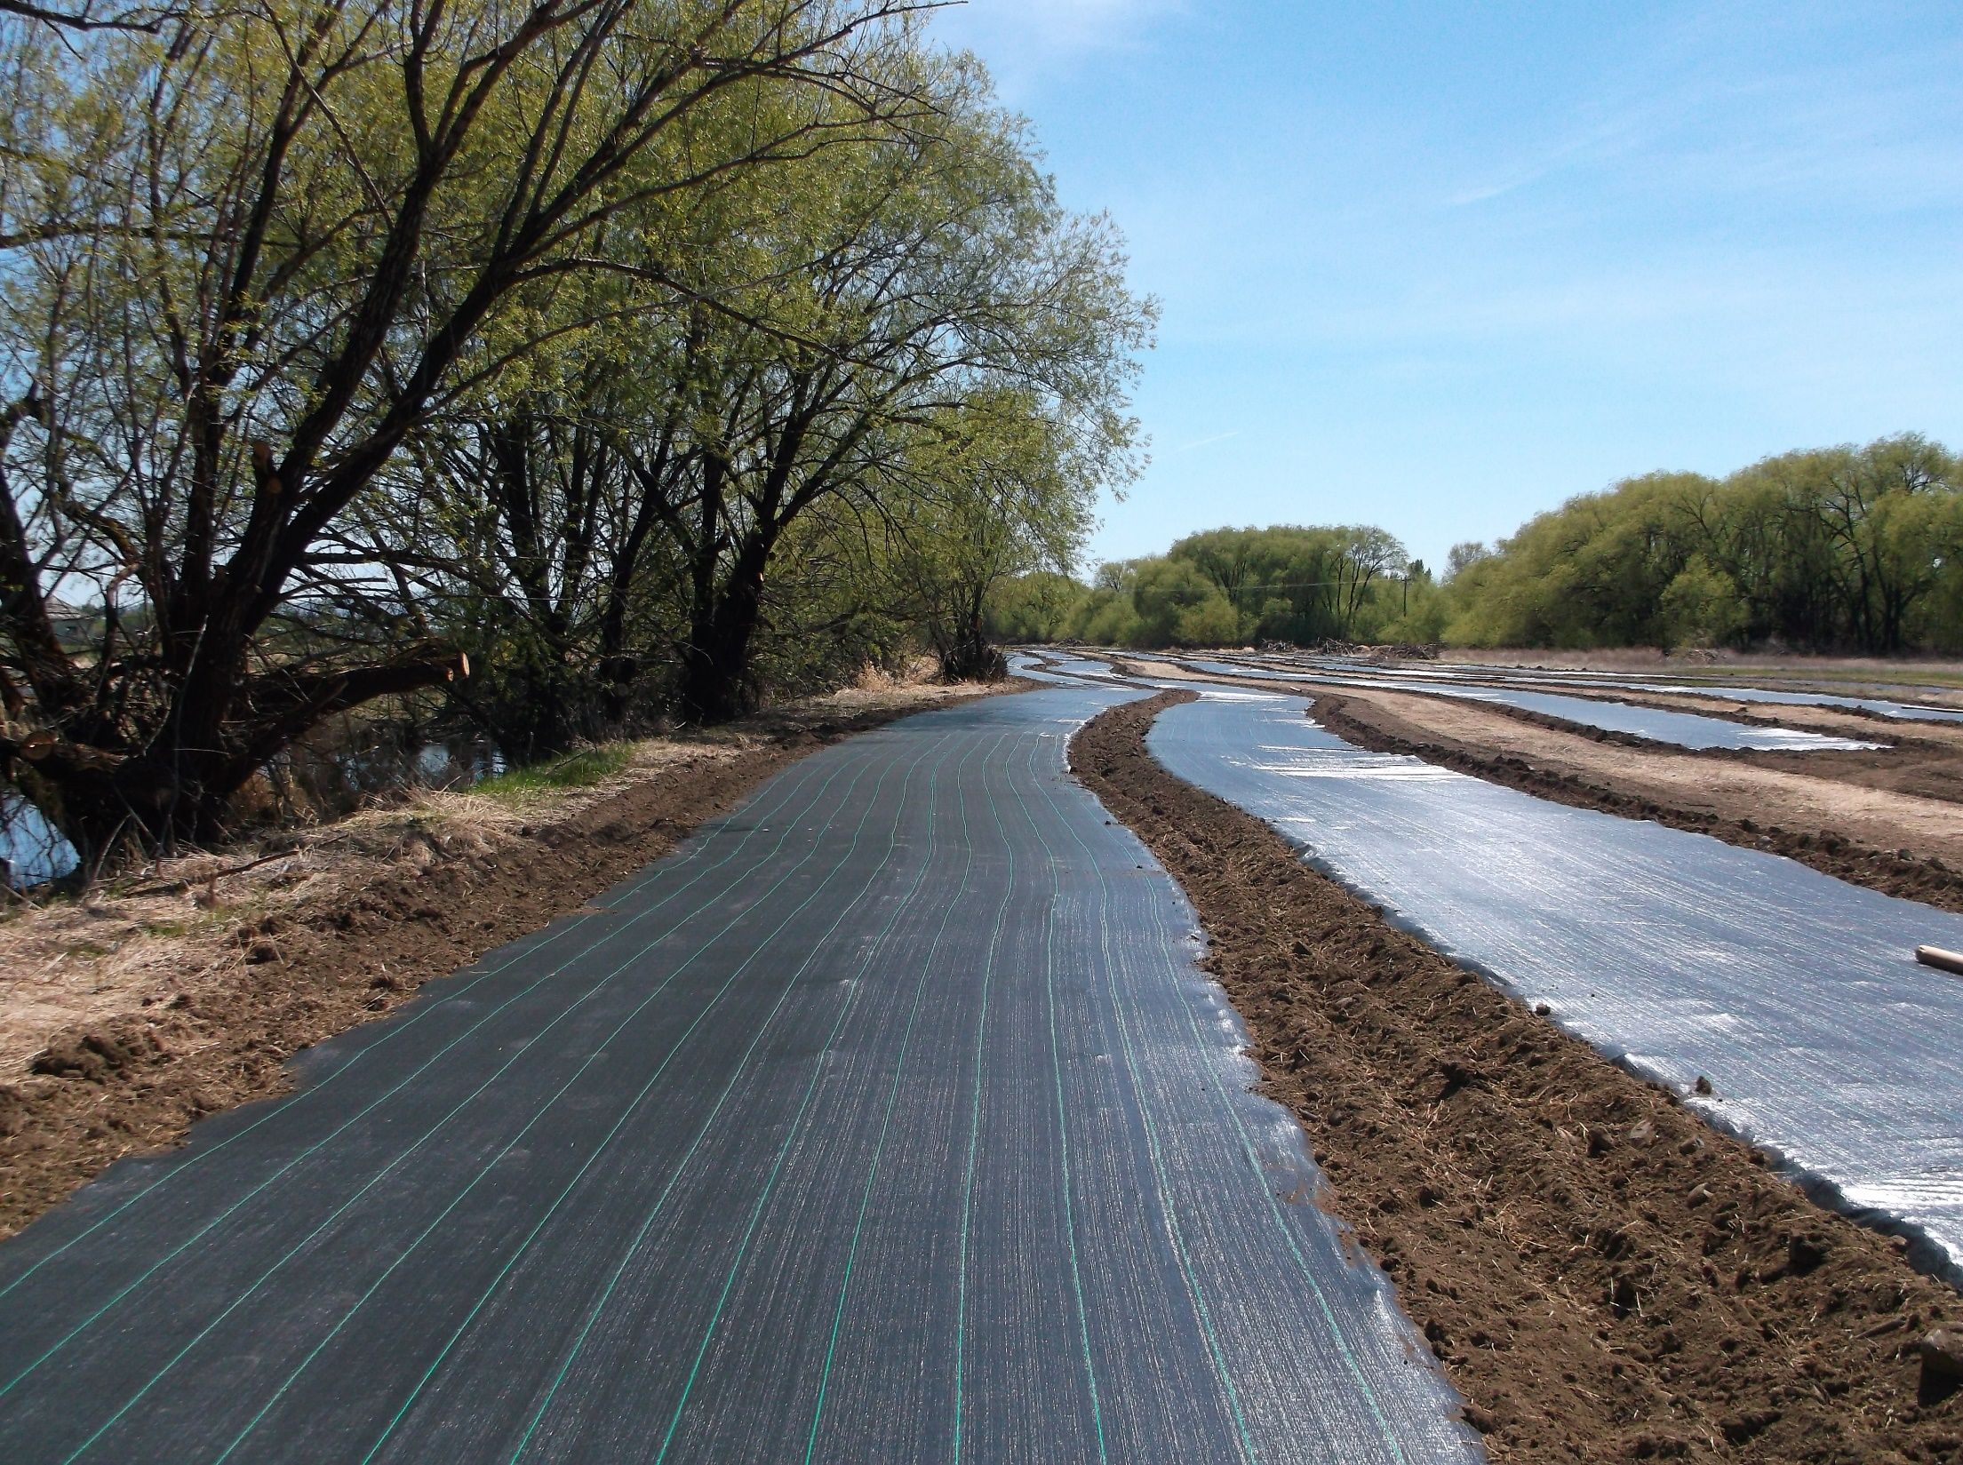

Slide 30
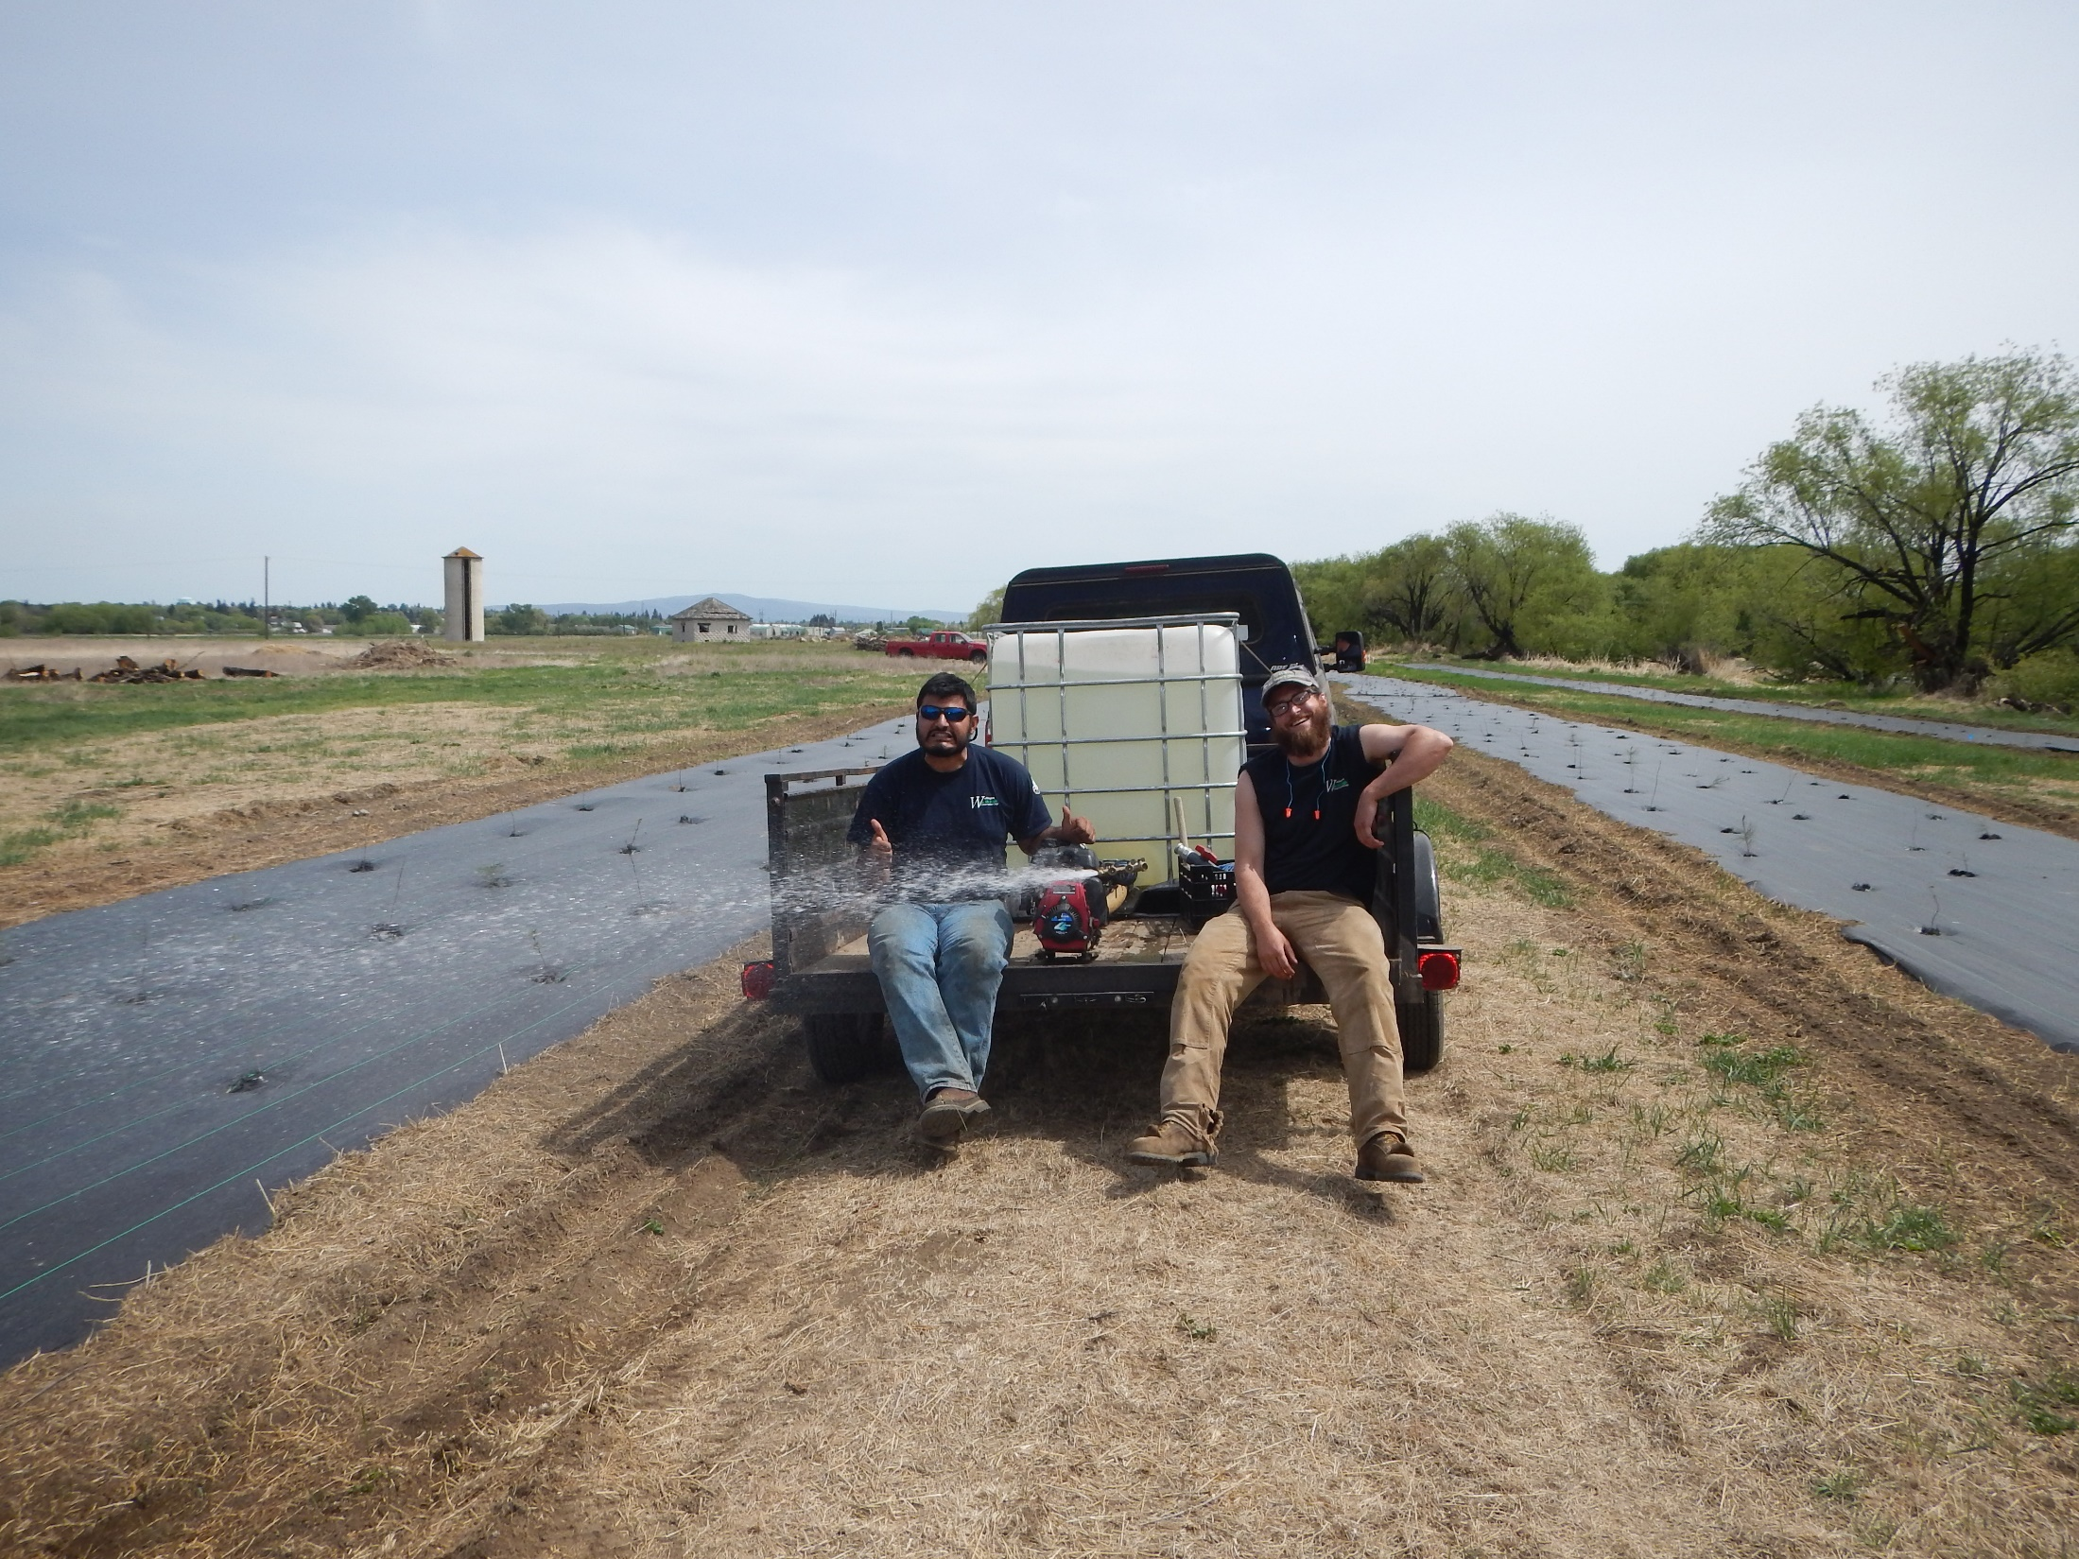

Slide 31
1 year later….

Slide 32
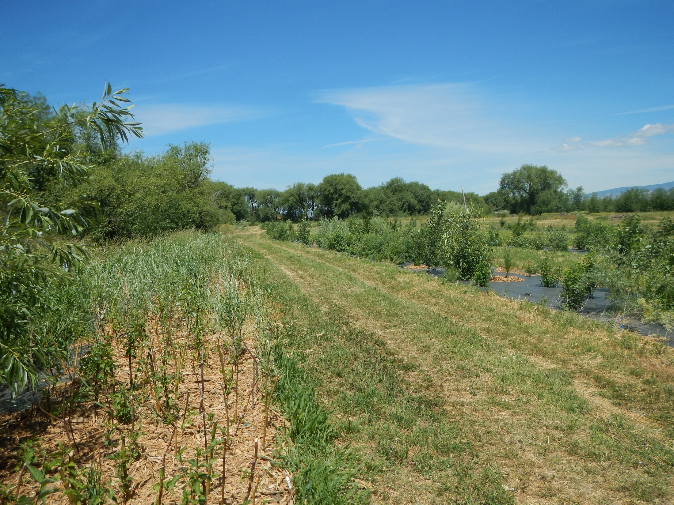

Slide 33
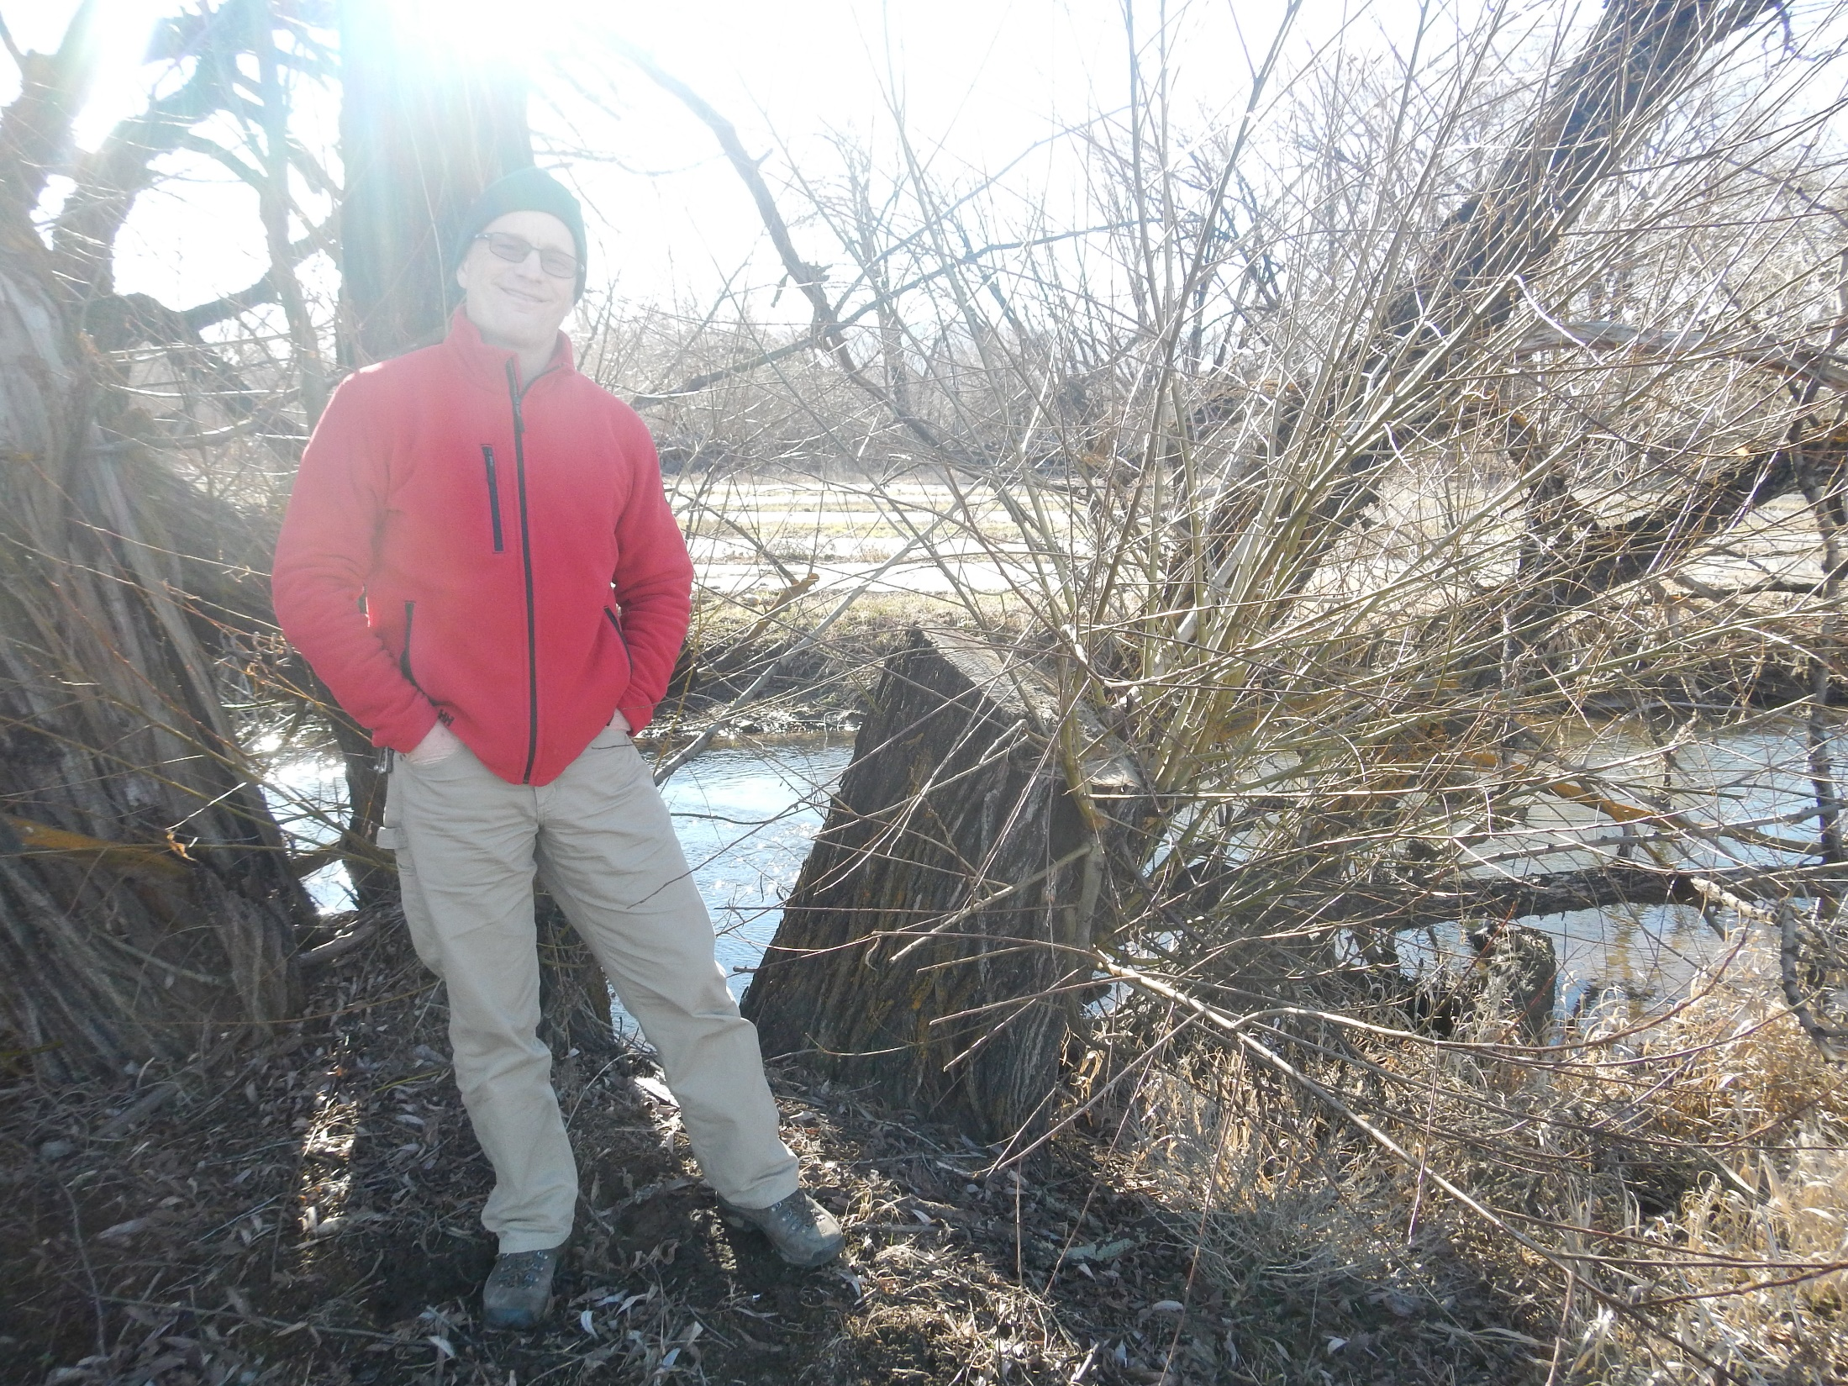

Slide 34
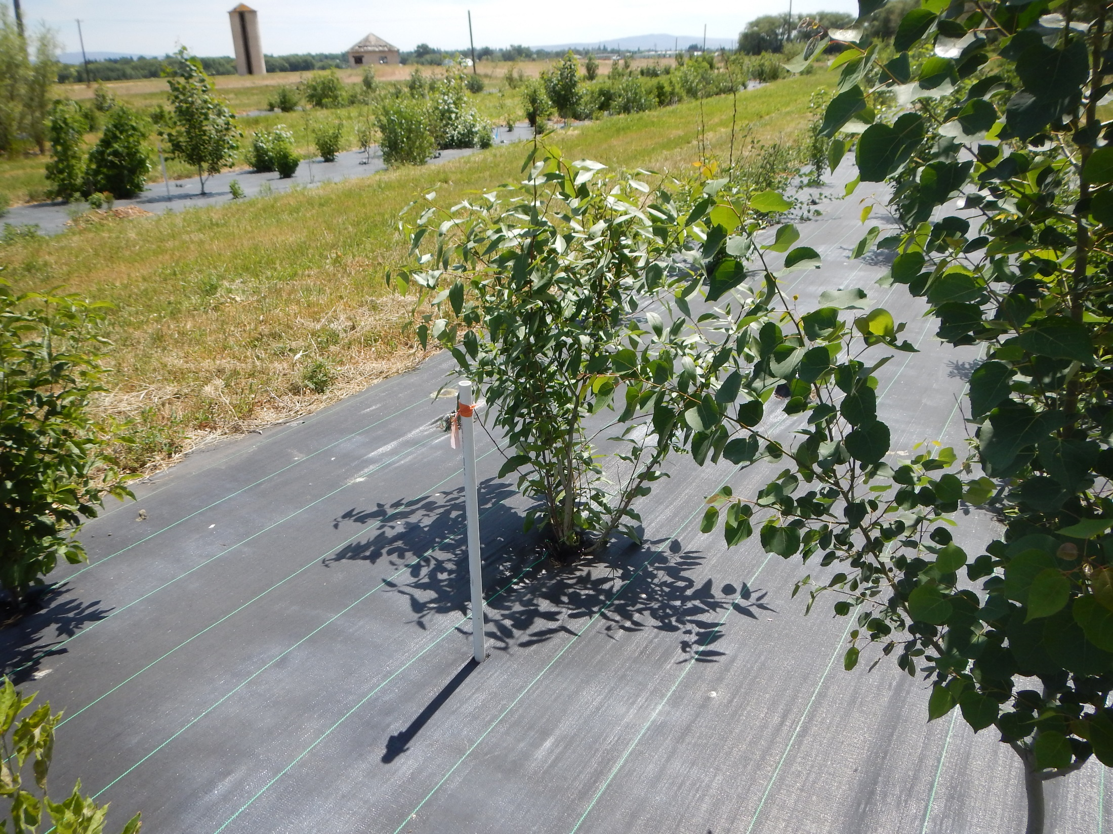

Slide 35
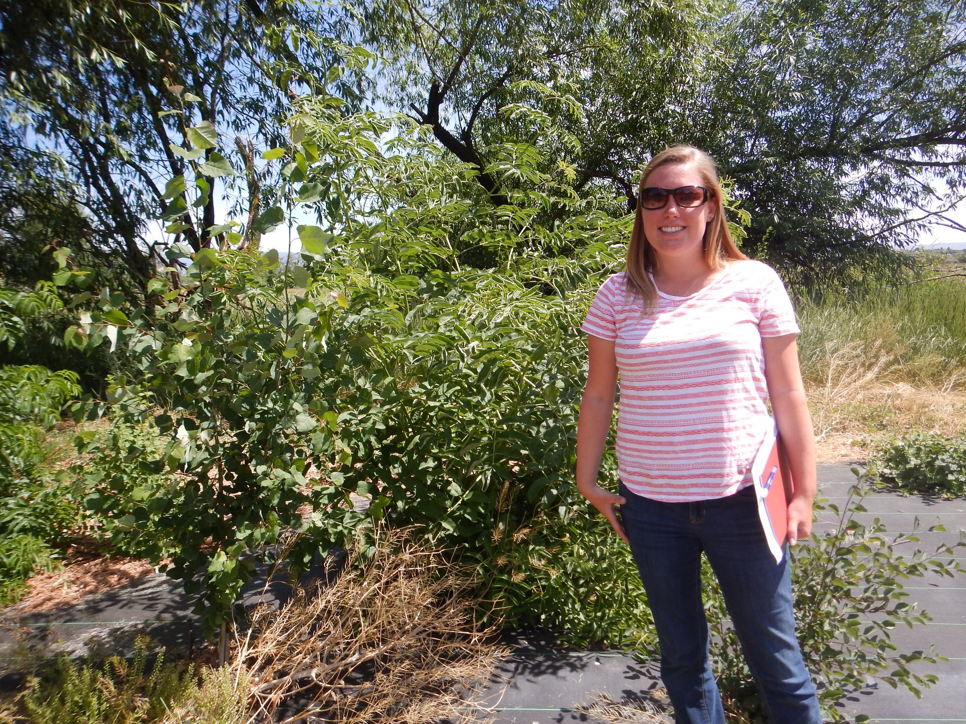

Slide 36
Thank you!!!!!
Salmon Recovery Funding Board
Scott Nicolai, YN
Ida Ike, YN admin
Mid-Columbia Fisheries Enhancement Group
Washington Conservation Corps
Jennifer Nelson, WDFW
Mike Denny, Walla Walla Conservation District
Natural Reclamation Service

