Slide 1
Clear Creek Dam Fish Passage Assessment
2012-2016
USFWS: Jeff Thomas, Pat Monk, Rob Randall
USBR: Arden Thomas, YRBWEP
WDFW: Eric Anderson, John Easterbrooks

Slide 2
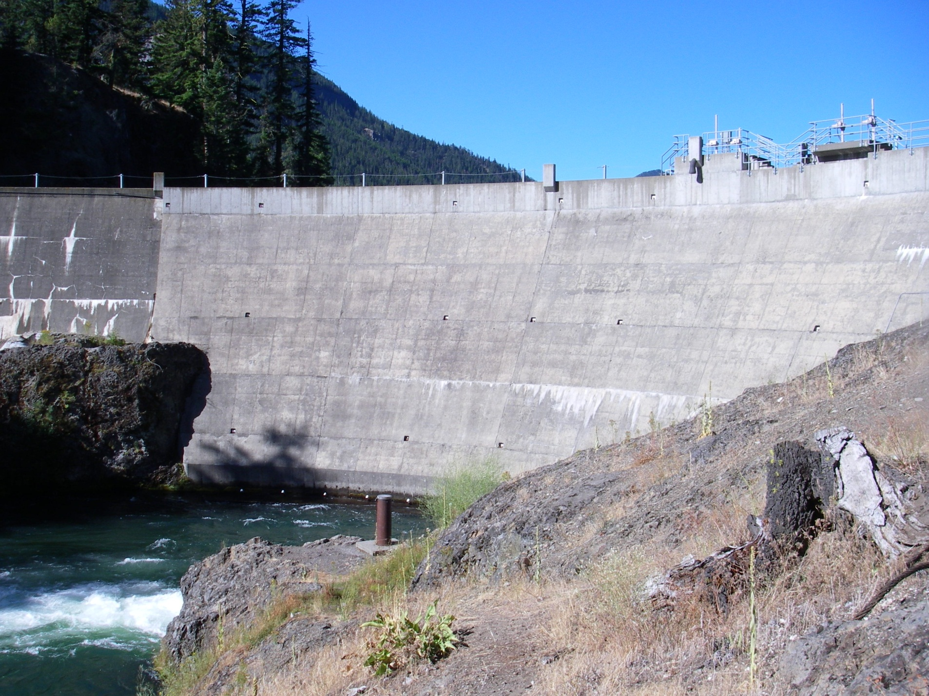
Originally built in 1914. Impounds Clear Lake with an active capacity of 4,400 acre-feet.

Slide 3
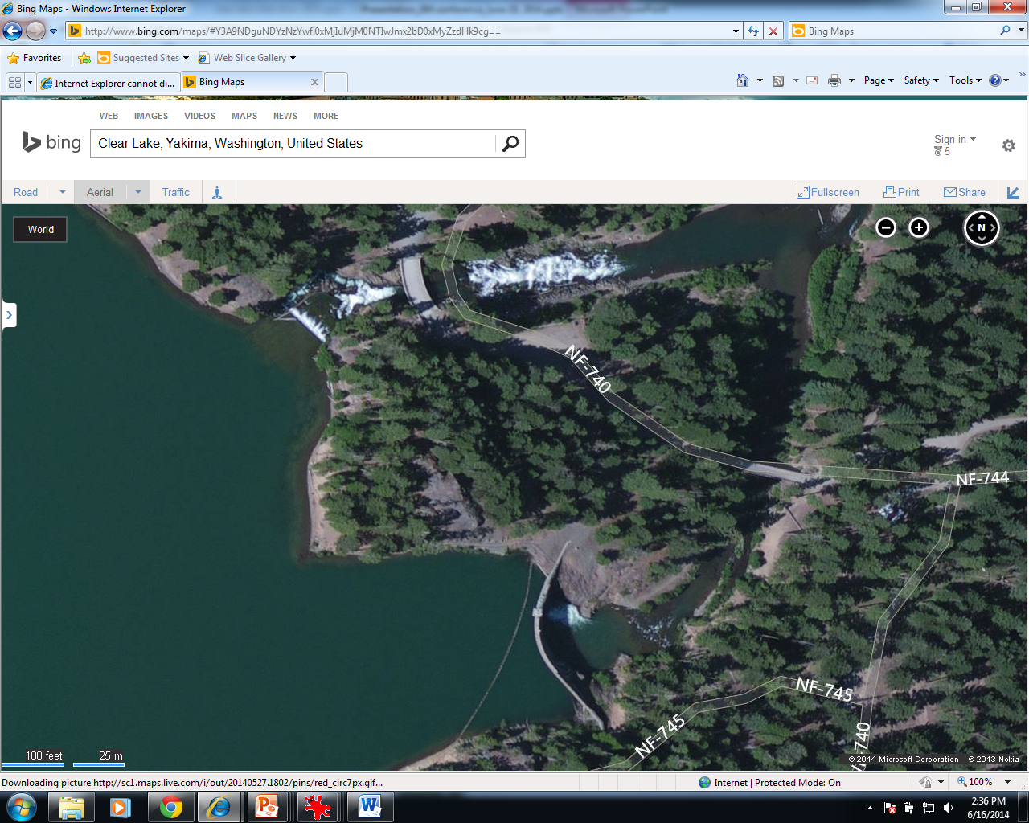

Slide 4
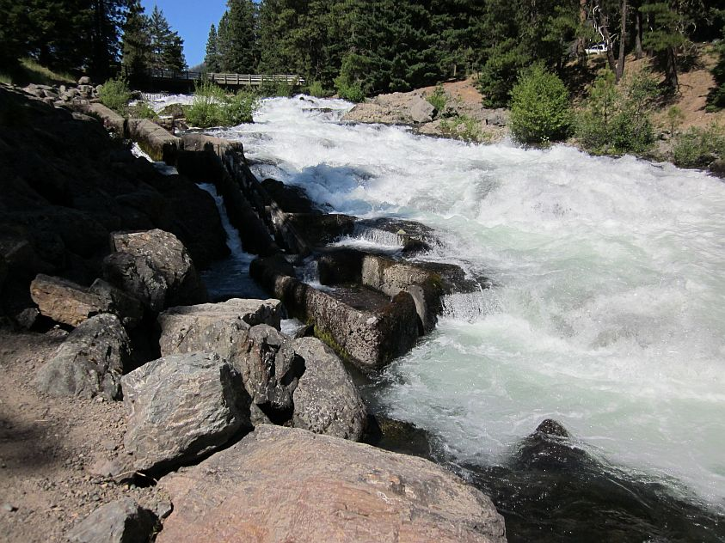

Slide 5
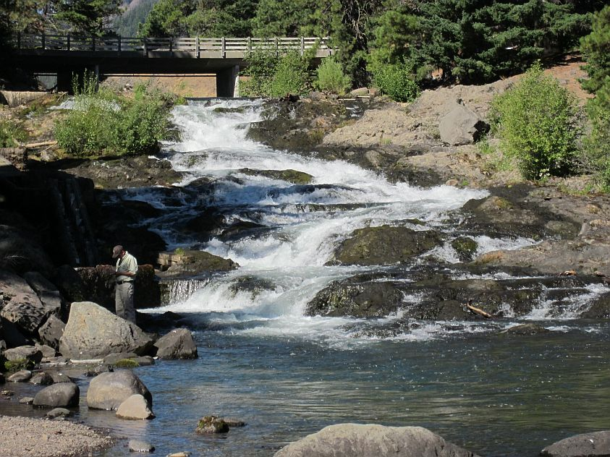

Slide 6
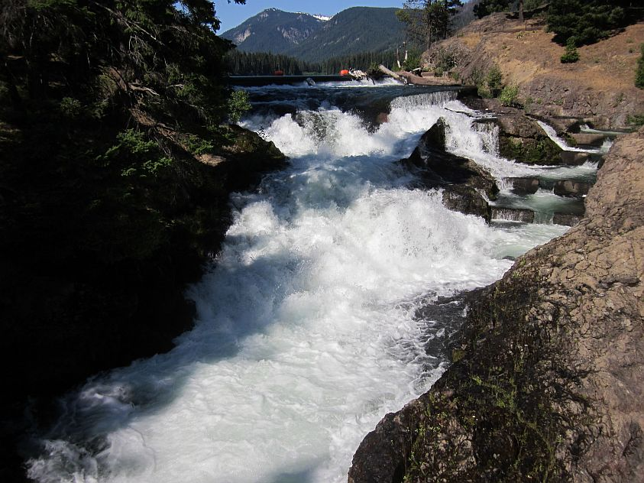

Slide 7
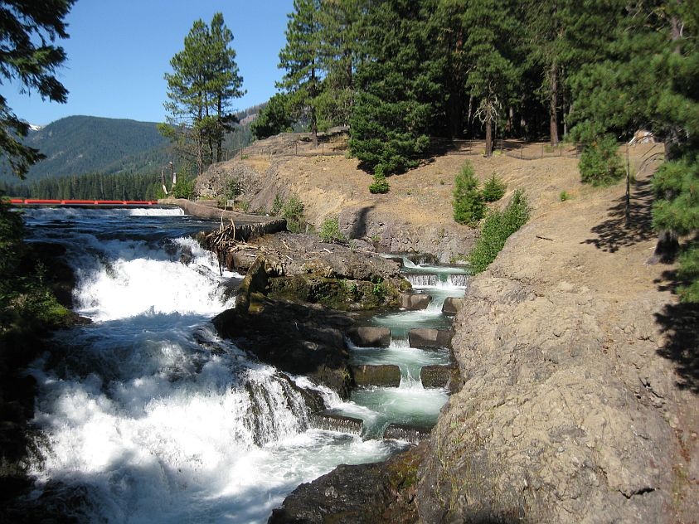

Slide 8
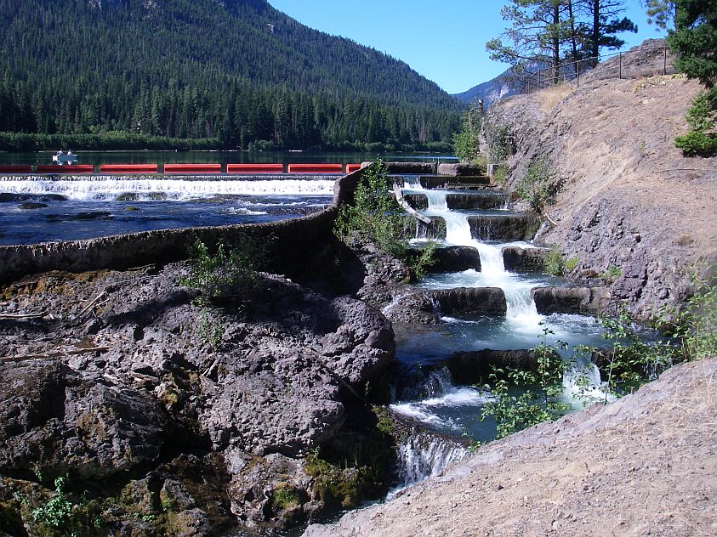

Slide 9
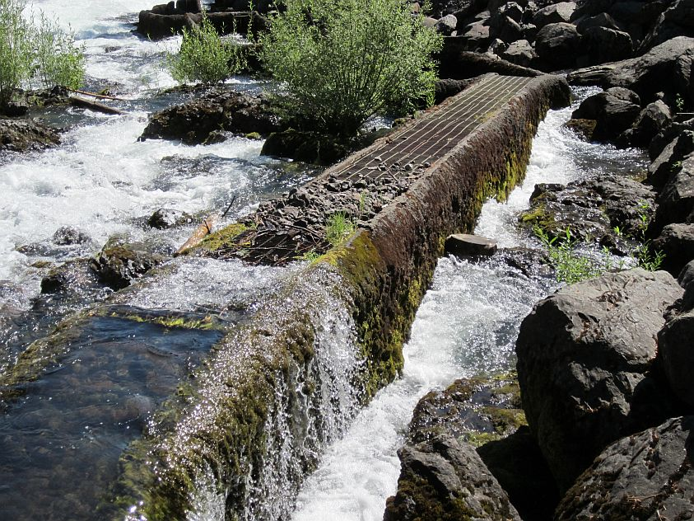

Slide 10
Study Objectives
Determine if and when bull trout attempt to migrate past Clear Creek Dam
Assess passage success under various flow conditions
Determine post-spawn migration timing and extent of Clear Lake use
Ancillary objectives include determining spawning frequency, collecting genetic samples, and estimating the size of the NF Tieton bull trout population

Slide 11
Study Methods
Trap post-spawn fish in September in the NF Tieton River using a picket-weir box trap
Surgically implant 23mm Half-Duplex PIT tags
Obtain genetic samples and collect other data
Construct PIT tag detection arrays at key locations
Collect movement data
Notes:
Obviously you have a lot to talk about here and not all that much time to do it. I have included some photos in the next few slides which you will have to move through quickly. May not want to use all of them. FYI the trap was located 6.5 miles above Clear Lake (about 3.75 miles below the barrier waterfall at the upstream terminus of the spawning reach). The NF antenna is 0.75 mile above Clear Lake.

Slide 12
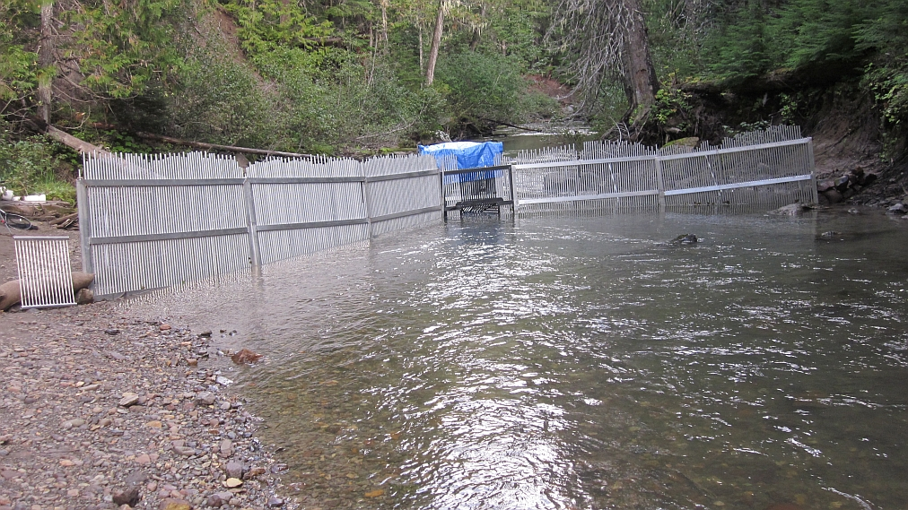
Trap located in the Goat Rocks Wilderness, 6.5 miles above Clear Lake

Slide 13
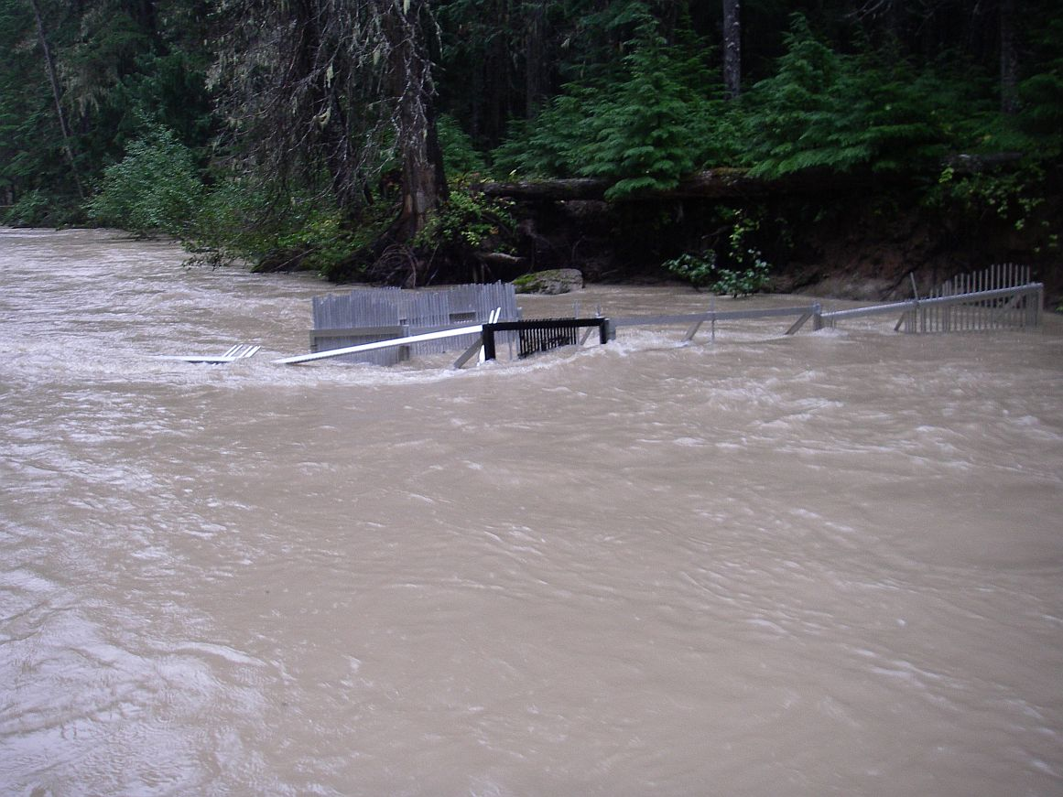
September 29, 2013

Slide 14
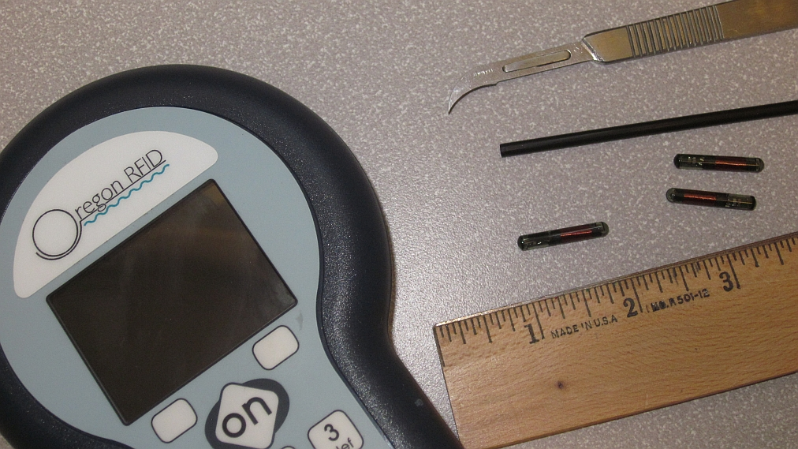

Slide 15
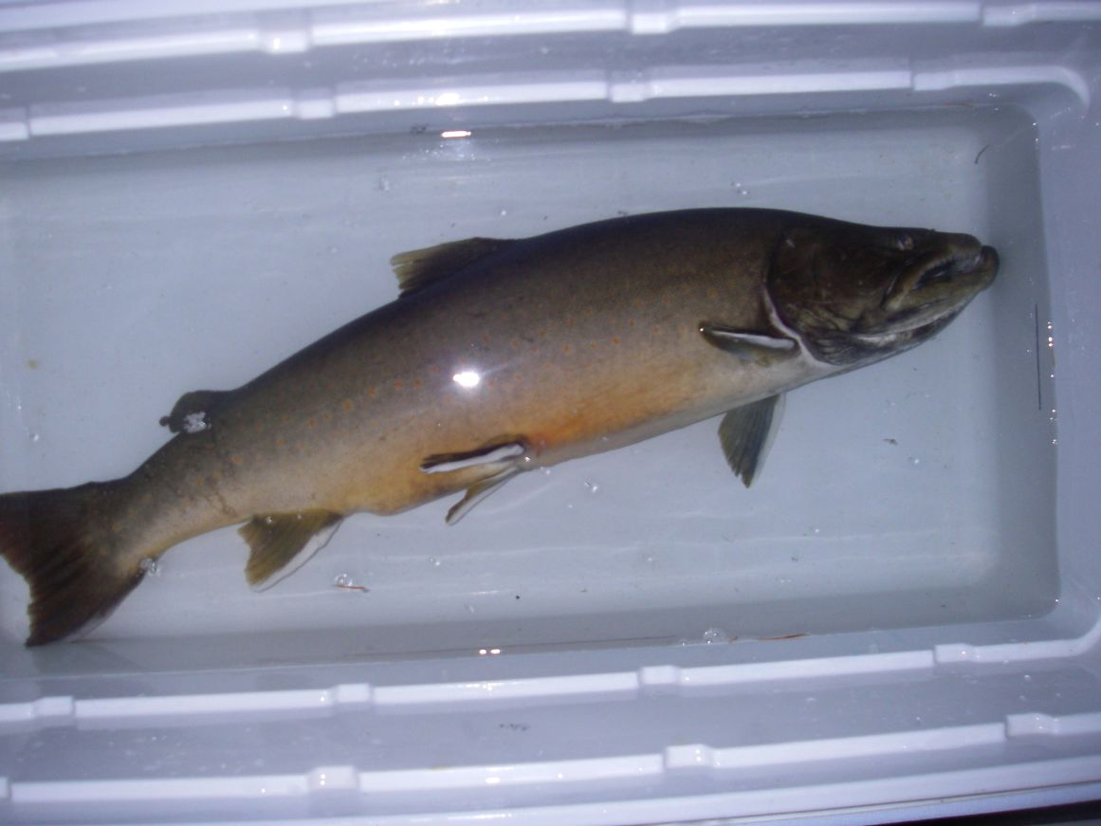

Slide 16
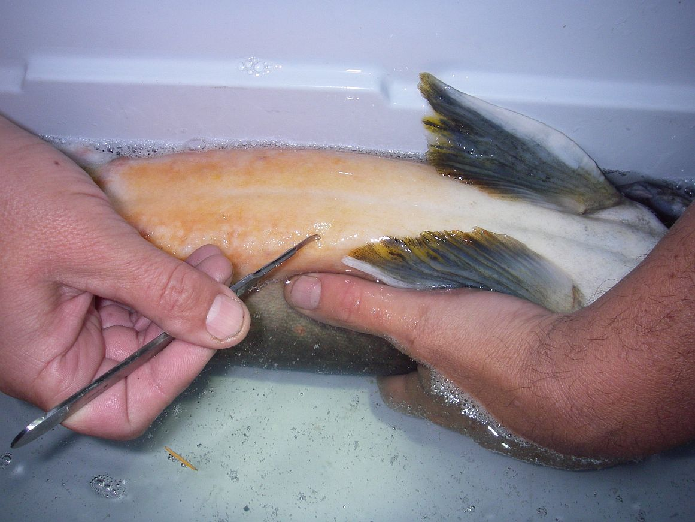

Slide 17
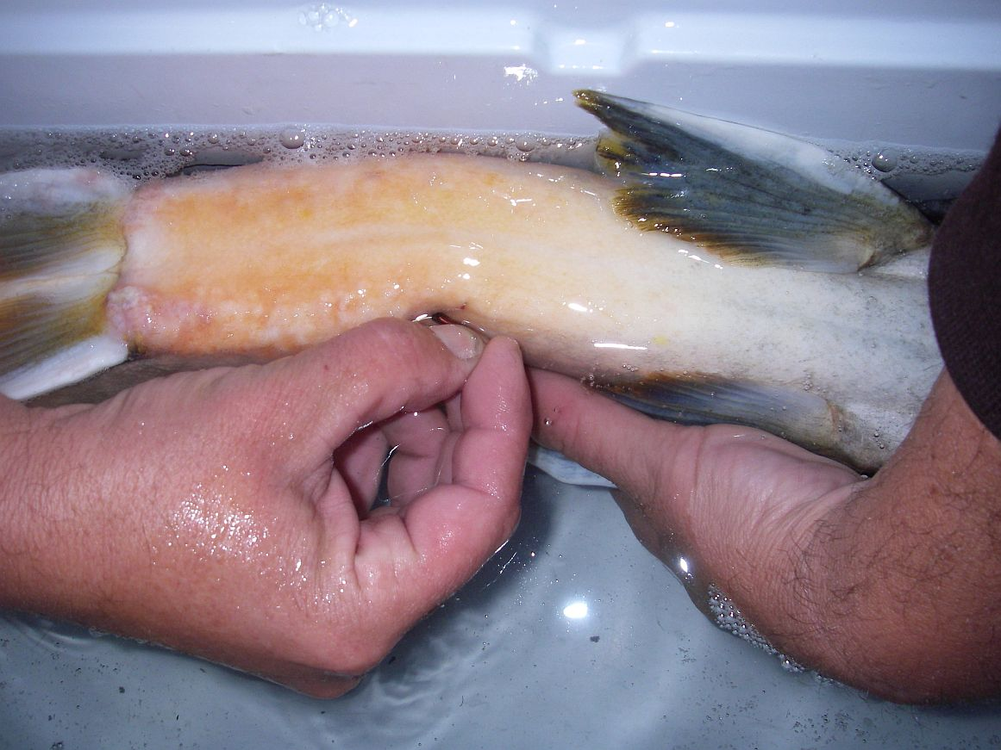

Slide 18
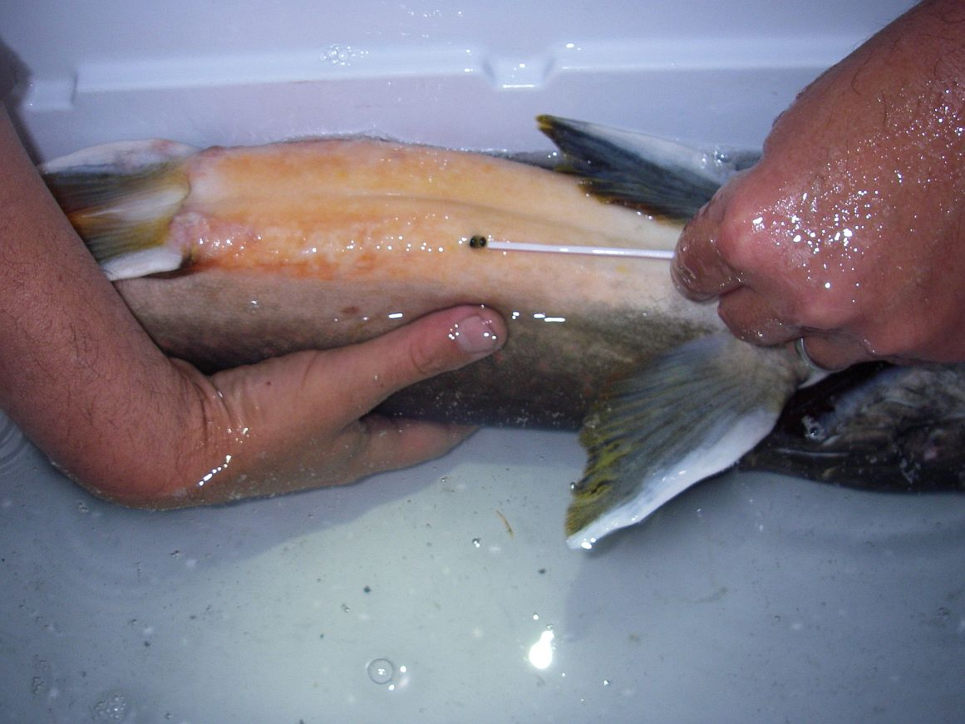

Slide 19
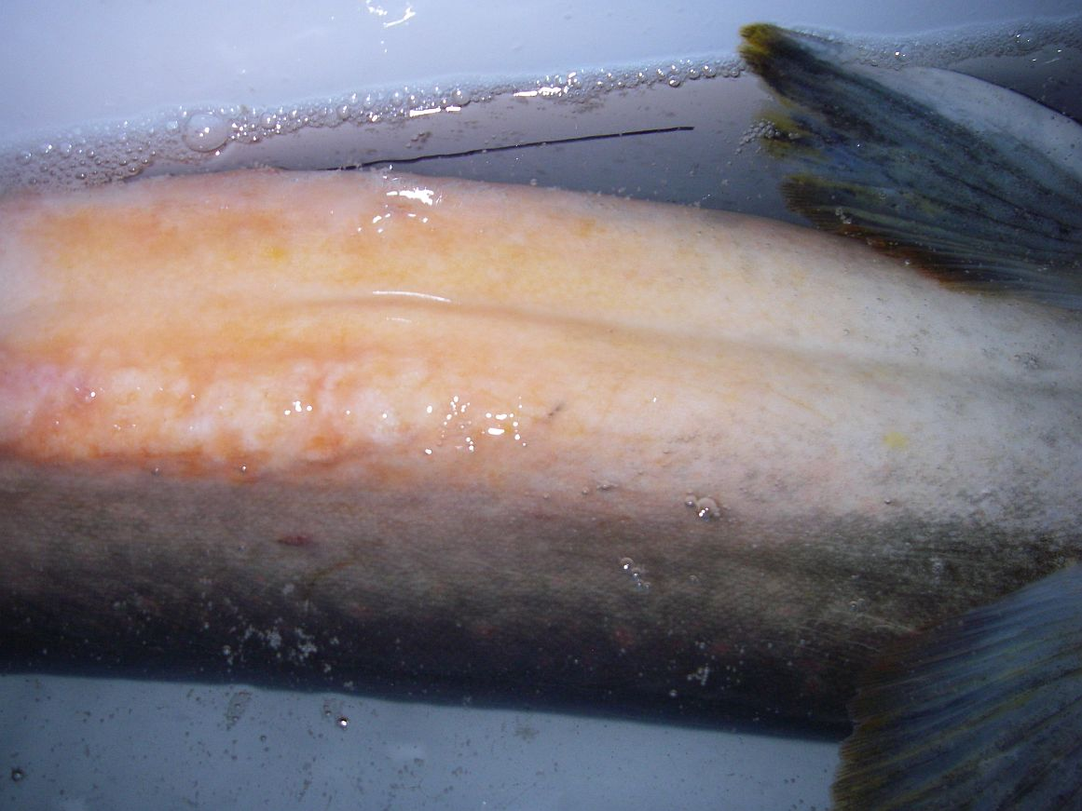

Slide 20
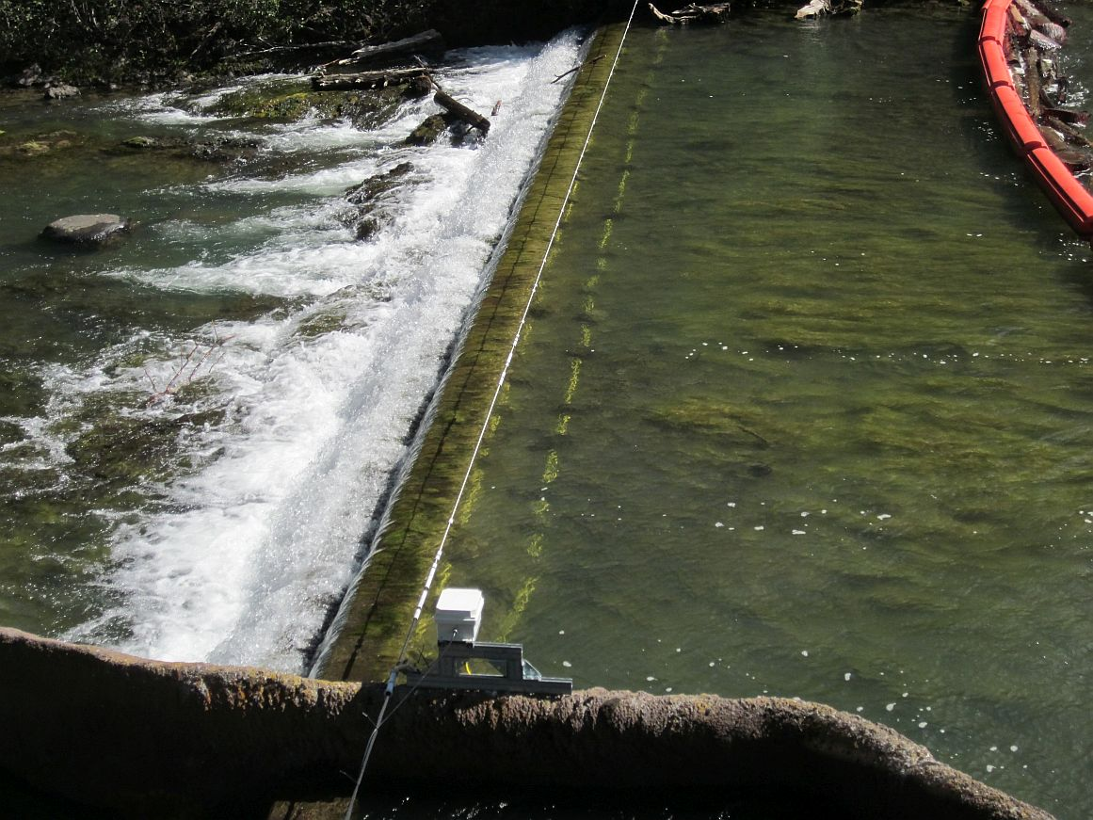

Slide 21
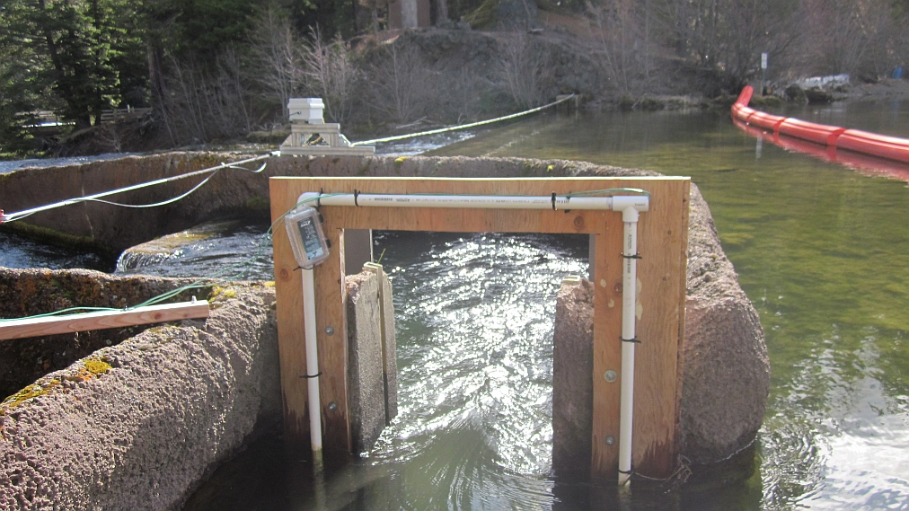

Slide 22
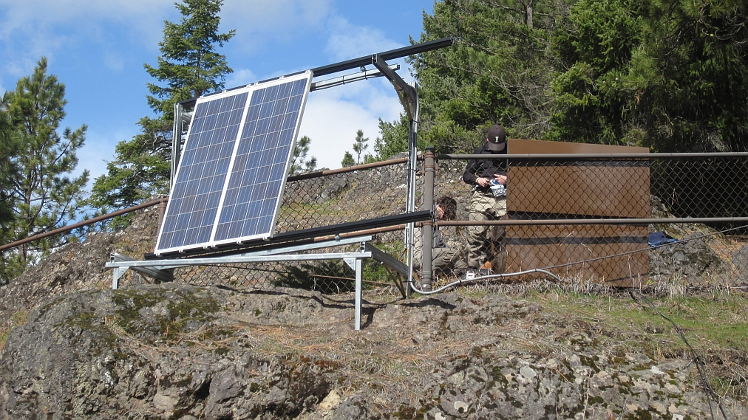

Slide 23
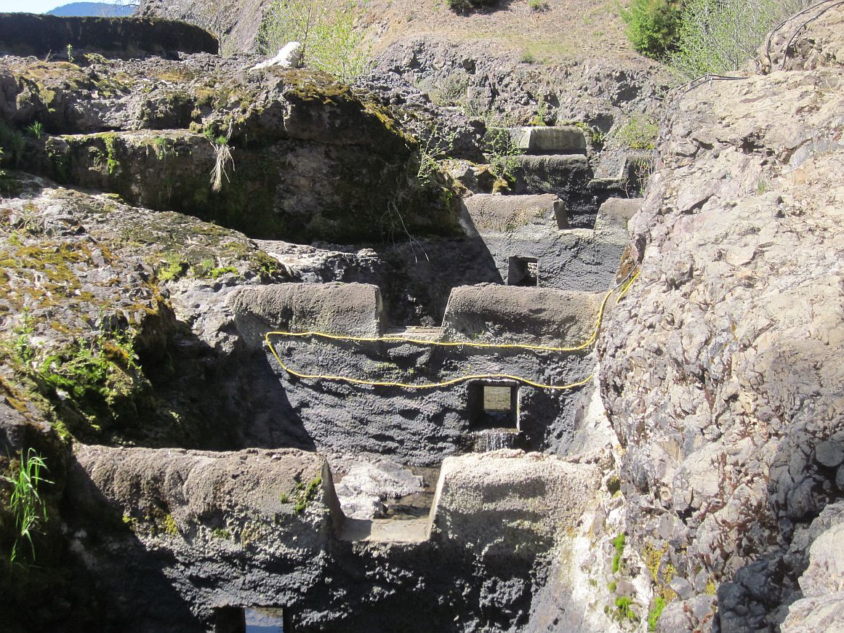

Slide 24
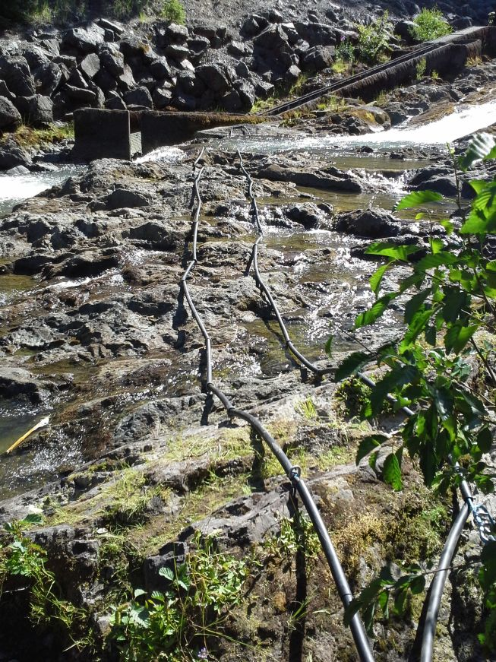

Slide 25
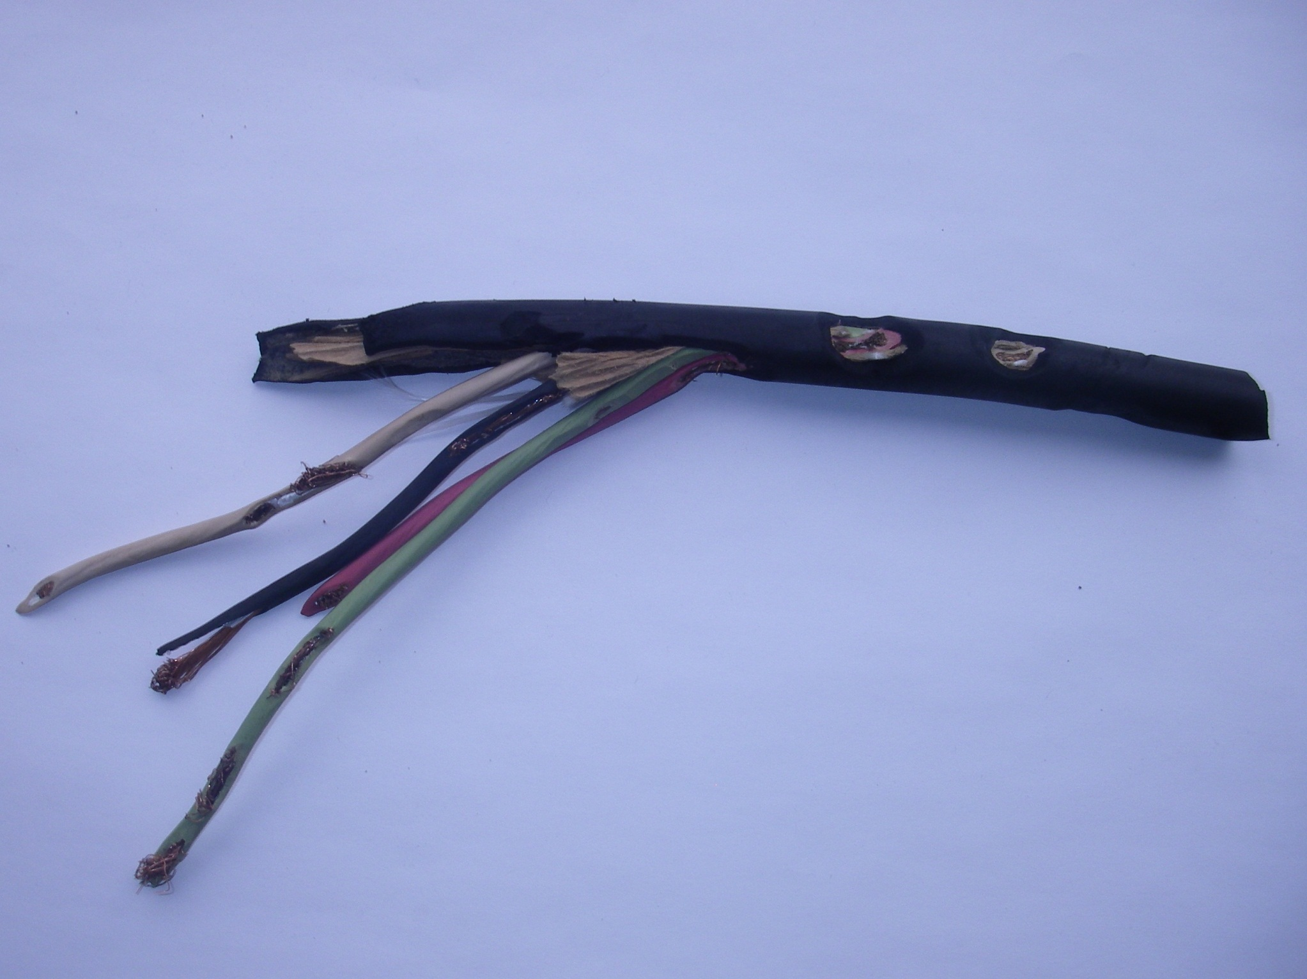

Slide 26
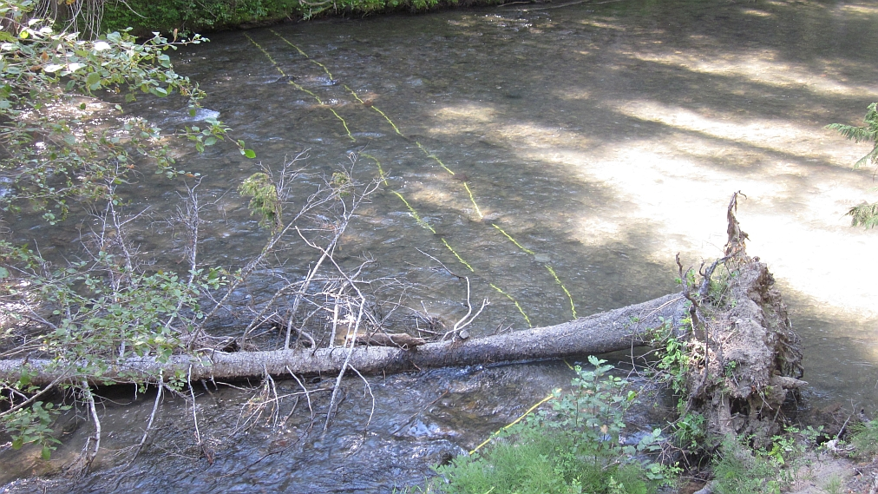

Slide 27
PIT-tagging results to date
Trap was operated for three weeks in September for the last three years (2012-2014)
29 adult bull trout tagged (14 males, 15 females)
In 2014, five bull trout were tagged; seven fish were captured that had been tagged in either 2012 or 2013
10 bull trout (four males and six females) were caught and PIT-tagged directly below Clear Creek Dam while angling on July 31, 2014 (a genetic sample was obtained from one other)
A total of 39 adult bull trout have now been tagged
Notes:
.

Slide 29
What Have We Learned So Far?

Slide 30
Status of tagged fish
24 of the 39 bull trout PIT-tagged in the first three years of the study were detected at least once in 2014
Five of the 10 fish tagged in 2012 were not detected or recaptured in 2014; three of these were detected in 2013; two have not been re-encountered after tagging
All but one of the 14 tagged in 2013 were detected in 2014
All five of the bull trout tagged at the trap in 2014 were subsequently detected leaving the NF Tieton River
Only one of the 10 fish tagged below the dam last July was later detected
Notes:
.

Slide 31
Genetic Analyses
Genetic samples from 40 adult bull trout captured between 2012 and 2014 were analyzed by the WDFW’s Molecular Genetics Lab
34 of these fish were pure bull trout from the NF Tieton population
Six were bull/brook trout hybrids, apparently first generation
The analysis revealed that all 11 of the bull trout sampled below Clear Creek Dam in July, 2014 were pure bull trout from the NF Tieton population
Notes:
.

Slide 32
Where do these bull trout live?
18 of the 24 bull trout tagged in 2012 and 2013 apparently never left Clear Lake as they were never detected either leaving or coming back, yet were all detected up the NF Tieton River in either or both 2013 and 2014
One of the five fish tagged in 2014 was confirmed leaving the lake
So most of this population resides in Clear Lake, right?
This conclusion is confounded by the fact that the 11 fish captured below the dam in 2014 were all pure NF Tieton bull trout (a 12th fish captured below the dam was a recapture of a fish tagged in 2012)
Notes:
.

Slide 33
Are bull trout unable to ascend the spillway channel?
Have only detected three that have tried
One was successful twice (2013 and 2014). This female, tagged in 2012, has been our most detected fish. We learned this past January that she is a hybrid
Two, including one caught below the dam in 2014, tried and failed to make it up the spillway channel
Caveats…
Notes:
.

Slide 34
What is the size of the NF Tieton population?
Don’t really have an answer for that question yet but will be developing a mark-recapture estimate this year
An estimate of the Effective Population Size (Ne) was calculated by WDFW’s Molecular Genetics Lab from 40 genetic samples collected from 2012 and 2014
For the three years combined Ne values ranged from 18-21 individuals (95% CI: 8-58)
These numbers indicate that the NF Tieton population is relatively small and could be at risk of a loss of genetic variation
Notes:
.

Slide 35
2015 Activities
We will not be trapping any more bull trout this year
We hope to capture 10-12 “new” bull trout below the dam. Genetic samples will be obtained from these fish and they will be PIT-tagged
Keep all of our PIT tag detection arrays operating and collecting data as deep into the fall as is possible

Slide 36
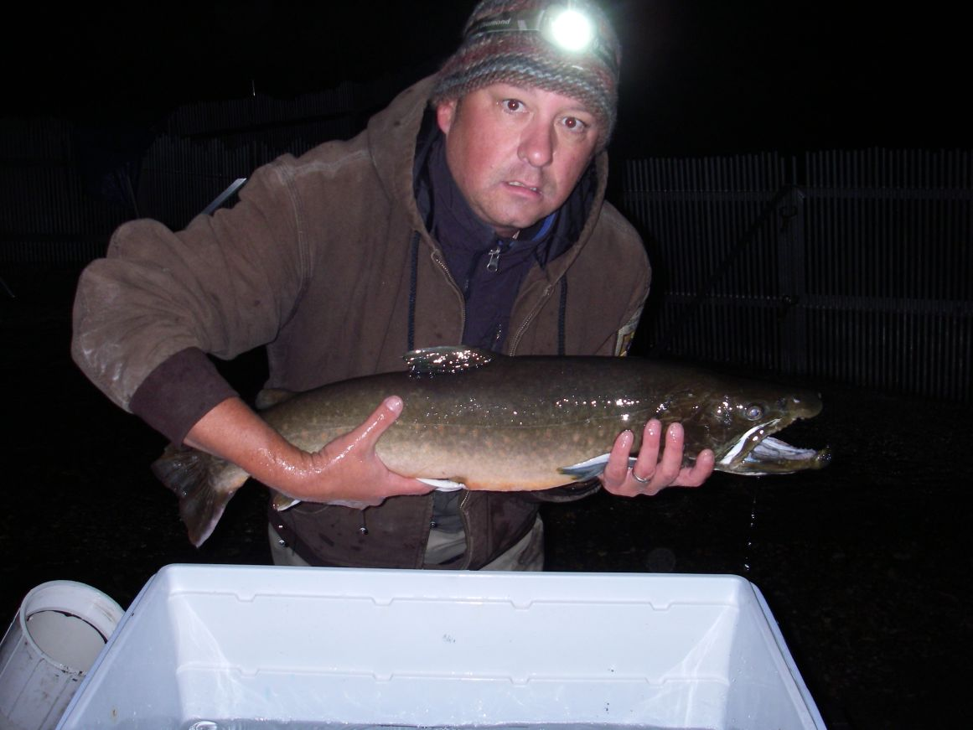
Thanks to Cassandra Anderson with the Mid-Columbia Fisheries Enhancement Group and BTTF, WDFW’s Region 3 Screen Shop, and a special thanks to Mo Small and Sarah Bell with the WDFW Molecular Genetics Lab for their excellent work

