Slide 1
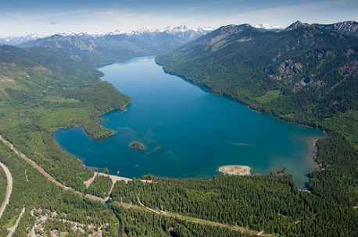
Food web structure of Kachess and Keechelus Reservoirs: identifying and quantifying important interactions for bull trout
Adam G. Hansen
David A. Beauchamp
Matt Polacek
Notes:
Recently I’ve been working in the Yakima River Basin of WA trying to understand how the management of different reservoirs in the basin are influencing the food web structure of those reservoirs, but with particular emphasis on how water management is impacting the threatened populations of adfluvial bull trout that inhabit these systems. This project is a collaboration with numerous different agencies.

Slide 2
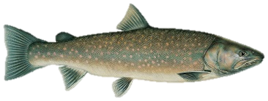
Primary use: irrigation demand
Keechelus
Cle Elum
Kachess
Low abundance
Reiss et al. (2012)
Bumping
Projects proposed:
(1) Keechelus-to-Kachess conveyance to capture excess water from Keechelus drainage
Rimrock
(2) Pumping plant to access 200,000 ac-ft of currently inactive storage in Kachess during periods of drought
Notes:
This irrigation demand is fed by five reservoirs. As part of a new plan to meet demand given an uncertain climate future, the BOR has proposed two different projects or alterations to how water is managed in the basin. These two projects involve Keechelus and Kachess Reservoirs, and are currently going through the NEPA review process. First is the KK…..

Slide 3
Impacts on bull trout?
Contemporary food web structure: identify and quantify key predator-prey interactions
Notes:
So the question is how will new water management impact bull trout? Before we can assess potential impacts, we need to characterize the contemporary food web structure of these reservoirs as a baseline. Here, we’re really identifying and quantifying key predator-prey interactions as they relate to bull trout.

Slide 4
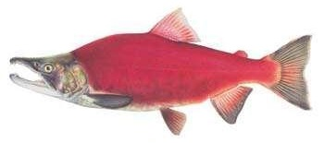
Stocking records: kokanee fry
May-June
Kachess
Keechelus

Slide 5
Objectives and Approach
Characterize food web structure with stable isotopes
Identify key interactions as they relate to bull trout (BLT) and kokanee (KOK)
Evaluate foraging and growth environment for BLT & KOK
Thermal structure, food supply, density/distribution
Drives predation mortality, food availability, growth, survival
Relative importance of food supply, temperature, predation as limits to production of key species
Bioenergetics modeling to quantify key interactions and carrying capacity: consumption demand vs. food supply for BLT, KOK, other predators
Notes:
Our approach is pretty straight forward.

Slide 6
Objectives and Approach
Characterize food web structure with stable isotopes
Identify key interactions as they relate to bull trout (BLT) and kokanee (KOK)
Evaluate foraging and growth environment for BLT & KOK
Thermal structure, food supply, density/distribution
Drives predation mortality, food availability, growth, survival
Relative importance of food supply, temperature, predation as limits to production of key species
Bioenergetics modeling to quantify key interactions and carrying capacity: consumption demand vs. food supply for BLT, KOK, other predators
Notes:
Our approach is pretty straight forward.

Slide 7
Stable Isotope Analysis
Using chemical signatures of fish and invertebrates (ratio of carbon [¹³C and ¹⁴C] and nitrogen [¹⁴N and ¹⁵N] isotopes) to understand food web linkages → you are what you eat
(2) Nitrogen → position in food web (1° producer to top predator)
(3) Carbon → primary energy source (offshore vs. littoral)

Slide 8
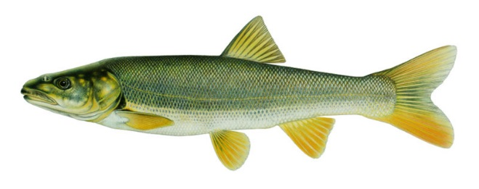
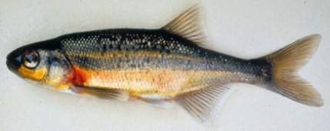
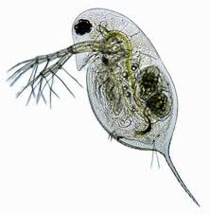
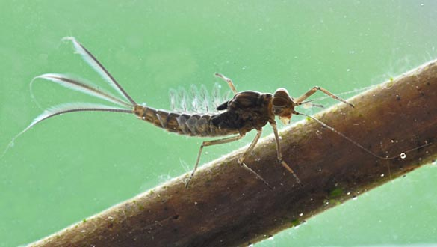
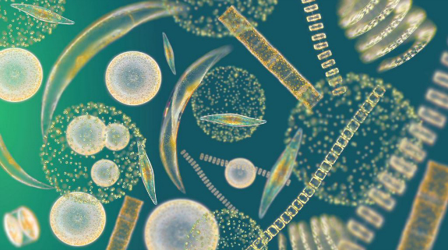
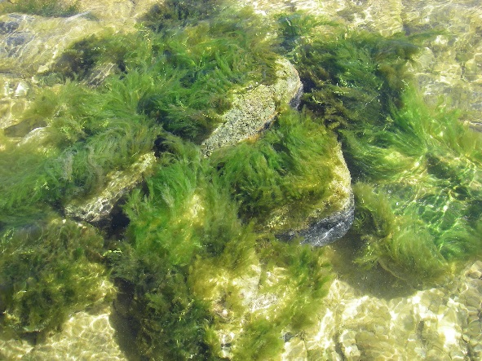
Top predators
2° consumers
Nitrogen
1° consumers
1° producers
Pelagic
Carbon
Benthic

Slide 9
BLT samples
Archived: N = 8
Predatory
Archived: N = 1
Current: N = 1
Primary consumer
More extensive draw-down
Erodes littoral production
Littoral/
benthic
Pelagic
Notes:
Here are the stable isotope data that we have collected so far in Kachess on the left and Keechelus on the right. The nitrogen signatures on the y-axis are giving an indication of trophic position, and the carbon signatures on the x-axis are providing an indication of the dominant source of energy or energy pathway, benthic production in littoral habitats, versus production in the offshore pelagic habitats that are feeding higher trophic levels. The first result that I want to point out

Slide 10
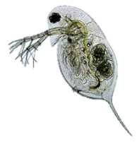
Predatory threat dependent on size (Kachess):
Burbot
Littoral/
benthic
Increasing reliance on pelagic resources
Predatory
Bull trout
Pikeminnow
Prey fish
Predatory >300 mm
Pelagic
Notes:
From our stable isotope data, we also know that the predatory threat of burbot or NPM on kokanee or other important prey for bull trout.

Slide 11
Predatory threat dependent on size (Keechelus):
Littoral/
benthic
Diet, seasonal thermal structure, size-structure, distribution, thermal tolerance
Predatory
Bull trout
Burbot
Pikeminnow
Prey fish
Piscivorous >300 mm
Pelagic
Notes:
From our stable isotope data, we also know that the predatory threat of burbot or NPM on kokanee or other important prey for bull trout.

Slide 12
Offshore fish distribution: August 2014 (Kachess)
Trawl catch: mostly kokanee, some pygmy whitefish
21-22°C
8-18°C
4-7°C

Slide 13
Summary: stable isotopes
Keechelus driven heavily by pelagic production (eroded benthic production from extensive draw-down over growing season)
Implication: more burden on pelagic energy pathways important for BLT in Kachess with KDRPP
Top predators: adult BLT, large burbot, large NPM
Kokanee and other pelagic prey important for adult BLT
Daphnia/other ZOOP important for kokanee
Large burbot could be important predator on KOK & juv. BLT

Slide 14
Going forward:
What is the seasonal predation impact of burbot and pikeminnow on KOK/other prey versus bull trout?
How will new water management influence limnology (e.g., thermal structure, food supply), and in turn, baseline food web interactions?
Important data gap: Size/age at reservoir entry, habitat use, predation risk for juv. & sub-adult bull trout.

Slide 15
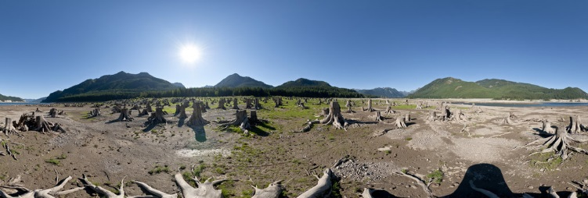
Questions?

Slide 16
Reintroduction of sockeye salmon net benefit for bull trout?
Notes:
These systems are also on the docket for reintroducing anadromous salmonids, particularly sockeye salmon. So, this work is really serving two purposes. Aside from informing the role of bull trout in these food webs, we can use this information to help calibrate our expectations for how sockeye salmon might perform in these systems. These reservoirs do contain kokanee. So, understanding what might be limiting the growth, consumption, and survival of kokanee

Slide 17
(1) Consumption from “natural cohort” of KOK << available biomass in metalimnion over growing season
(2) Within physical/ecological constraints could support (stock) 2-3x more KOK
~1.0 million 40-300 mm pelagic fish in August
(3) Low to intermediate feeding rates (19-55% Cmax): food limitation or limited feeding near surface?
(4) Limited by temp and predator avoidance
Notes:
Look at functional response for kokanee.

Slide 18
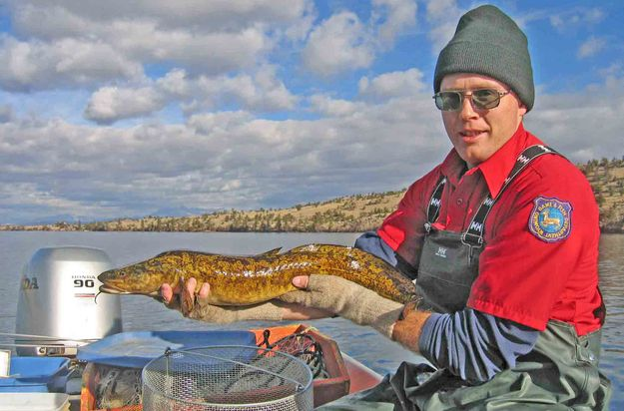

Slide 19
Relate ecology to water management
Identify management targets that attempt to avoid adverse impacts
Reduce volume by ~90%
High compression of cold water habitat
Potential for high predation mortality
Suspension of sediments, access to spawning tribs, downstream impacts
Notes:
An end goal to this work is to try and relate the ecology of these systems to water management, with the purpose of identifying management targets that attempt to avoid adverse impacts. For example, here I’m showing the total storage capacity or volume of Kachess Reservoir as a function of surface elevation, again in relation to the elevation of the outlet and the new proposed pump intake.

Slide 20
Baseline (1997-2009)
Spillway
Outlet
Pump intake

Slide 21
Baseline vs. KDRPP + KKC (1997-2009)
Spillway
Outlet
70% of proratable water rights
Predation?
Drought
Pump intake

Slide 22
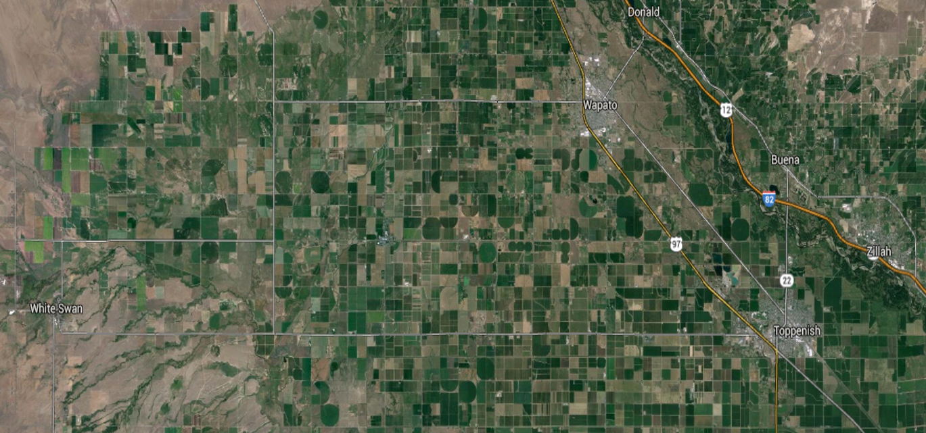
Project Background
Agricultural economy valued at $3.4 billion
Heavy irrigation demand (1,000 mi²; hops, wine grapes, field crops, cherries, apples, beef)
Demand not met in drought years – uncertain climate future
Notes:
Agriculture drives the economy in the Yakima Basin. There’s about 1,000 mi2 of irrigated lands. A problem that the BOR and irrigators have consistently run into is that irrigation demand is not met during periods of drought, which has led to some severe economic losses in past years. So right now, there is quite a bit of concern about what a changing climate is going to mean for agriculture and the economy in the Yakima basin.

Slide 23
Baseline vs. KDRPP + KKC (1981-1996)
Spillway
Outlet
70% of proratable water rights
Predation?
Severe drought
Pump intake

Slide 24
Annual consumption of KOK by 25 bull trout in each size-class
From hydroacoustics

Slide 25
Kachess vs. Keechelus
Parameter | Kachess | Keechelus
Surface area (ha) | 1,837 | 1,039
Flushing rate (days) | 227 | 68
Max. depth (ft) | 430 | 310
Mean depth (ft) | - | 96
Surface elevation at full pool (ft) | 2,262 | 2,517
Elevation of outlet (ft) | 2,192 | 2,425
Active capacity (ac-ft) | 239,000 | 157,800
Drainage area (ha) | 16,472 | 14,167
Average annual runoff (ac-ft) | 213,398 | 244,764

Slide 26
Draw-down: July-August
Draw-down more extensive in Keechelus
~80 of 92ft
Draw-down: September-October
Pumping water from below here
~40 of 70ft
Potential to reduce elevation by additional 80ft (2,112 ft elev.)

Slide 27
Seasonal thermal environment
Temperature (°C)
Peak thermal stratification: August
Epilimnion: 0-10 m, 21-22°C
Gradual thermocline: 10-20 m, 8-18°C
Cold hypolimnion >20 m, 4-7°C
Notes:
Large changes in temperatures and very strong gradient in temp during peak thermal stratification. Key prey for kokanee, daphnia, kokanee, bull trout, and other potential predators on kokanee should be exhibiting some pretty strong responses to this thermal environment.

Slide 28
Food supply for kokanee
Expectation for Kachess and Keechelus year-to-year
Daphnia
Bosmina
Leptodora
Notes:
So based on the thermal environment, can kokanee access this higher concentration of Daphnia in warm epilimnion, or do they have to rely on lower food supply in the metalimnion?

Slide 29
Bioenergetic growth responses
Temperature (°C)
Kokanee: 19-55 % Cmax
Bull trout: 35-54 % Cmax

Slide 30
Summary: foraging-growth env.
Daphnia density highest in warm epilimnion (peaks in June)
Warm epilimnion avoided by kokanee. Likely reliant on lower food supply in metalimnion July-September
Kokanee, bull trout, and burbot should respond similarly to shifts in thermal environment
Average monthly thermal experience: COLD
Northern pikeminnow unlikely to significantly impact kokanee
Key data gap: seasonal diet of burbot and NPM

Slide 31
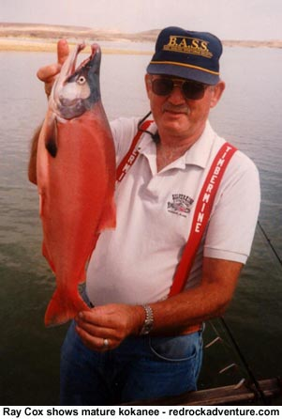
What’s limiting kokanee production in Kachess and Keechelus?
Temperature, food supply, predation?
(1) Seasonal carrying capacity of kokanee
(2) Predation by bull trout
Bioenergetics modeling: feeding rate & population-level consumption demand vs. biomass and production of key prey

Slide 32
Growth of kokanee
KOK captured Aug-Sept. in Kachess and Keechelus 2014
Size & age designations from Mongillo and Faulconer (1982)

Slide 33
Population dynamics of kokanee
(1) 365,801 KOK fry stocked into Kachess June 2014
(2) “Natural cohort” with annual recruitment: 365,000 fry (35 mm FL) April 1st
(3) Annual survival rate (S): 27%
N_{t} = N₀·e^{-Zt}
Z = -log_{e}(S)
(4) Spawning Sep. 1st at age-2 (50% of cohort) and age-3

Slide 34
Diet and thermal experience
Calendar day | Simulation day | Thermal experience (°C) | Daphnia | Copepods | Other
April 1st | 1 | 4.9 (6.9) | 0.010 | 0.919 | 0.071
May 1st | 31 | 5.5 (7.5) | 0.226 | 0.733 | 0.041
June 1st | 62 | 5.9 (7.9) | 0.672 | 0.316 | 0.012
July 1st | 92 | 6.4 (8.4) | 0.990 | 0.010 | 0.000
August 1st | 123 | 6.9 (8.9) | 0.990 | 0.010 | 0.000
September 1st | 154 | 6.7 (8.7) | 0.990 | 0.010 | 0.000
October 1st | 184 | 5.7 (7.7) | 0.990 | 0.010 | 0.000
November 1st | 215 | 4.7 (6.7) | 0.990 | 0.010 | 0.000
December 1st | 245 | 4.7 (6.7) | 0.010 | 0.980 | 0.010
January 1st | 276 | 4.7 (6.7) | 0.010 | 0.980 | 0.010
February 1st | 307 | 4.7 (6.7) | 0.010 | 0.980 | 0.010
March 1st | 335 | 4.7 (6.7) | 0.010 | 0.900 | 0.090
March 31st | 365 | 4.7 (6.7) | 0.010 | 0.918 | 0.072

Slide 35
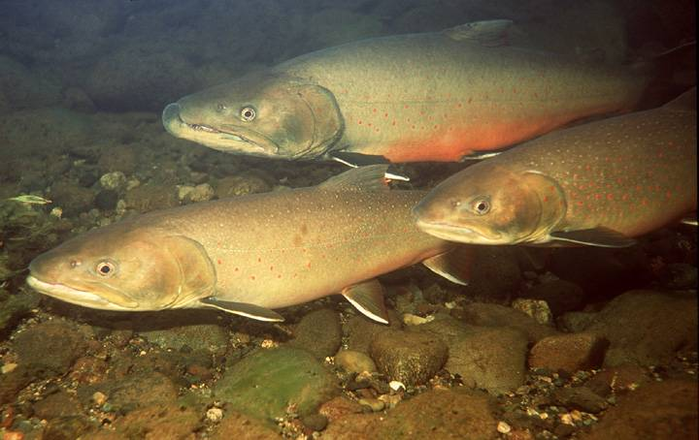
Bull trout
Very little is know about bull trout in Kachess and Keechelus
Low abundance (25-50 spawning adults), based on redd counts

Slide 36
Annual growth of 400-700 mm BLT tagged during spawning migrations in tribs of Rimrock and Bumping (James 2002)
Per-captia consumption of average individual in each size class?
Assumpitons: 100% diet of KOK, same thermal experience as KOK

Slide 37
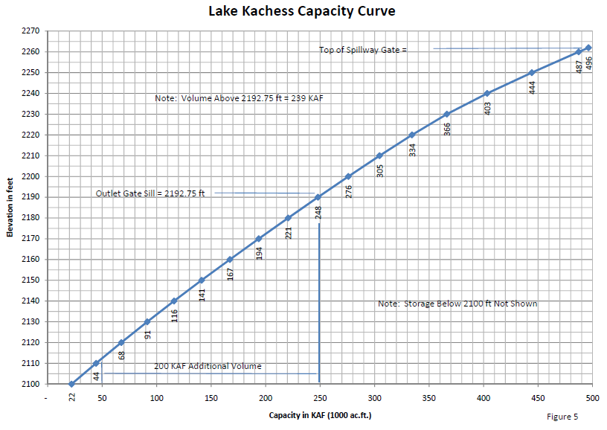

Slide 38
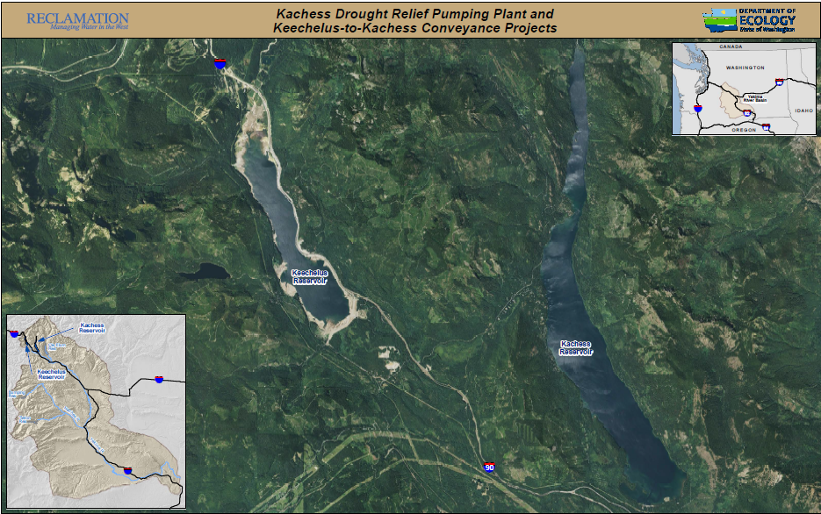
Don’t anticipate any measurable impact in Keechelus
Surface
400 cfs
Keechelus
Existing outlet
Kachess

Slide 39
Kachess pumping plant (KDRPP)
Crest of spillway
70 ft
Active: 239,000 ac-ft
Current outlet
Lower by additional 80 ft to access 200,000 ac-ft of inactive storage
Proposed pump intake
Notes:
To show you what I mean by inactive storage, here I’m showing a time series of the surface elevation of Kachess over four consecutive water years from 1998 to 2002 in relation to the elevation of the spillway, the current outlet on the dam, and the proposed pump intake. Water storage above the outlet is active, anything below is inactive. Right now, BOR can lower Kachess by ~70 ft. With the new pumping plant, they could lower Kachess by an additional 80 ft, thereby gaining access to an additional 200,000 ac-ft of water storage.

