Slide 1
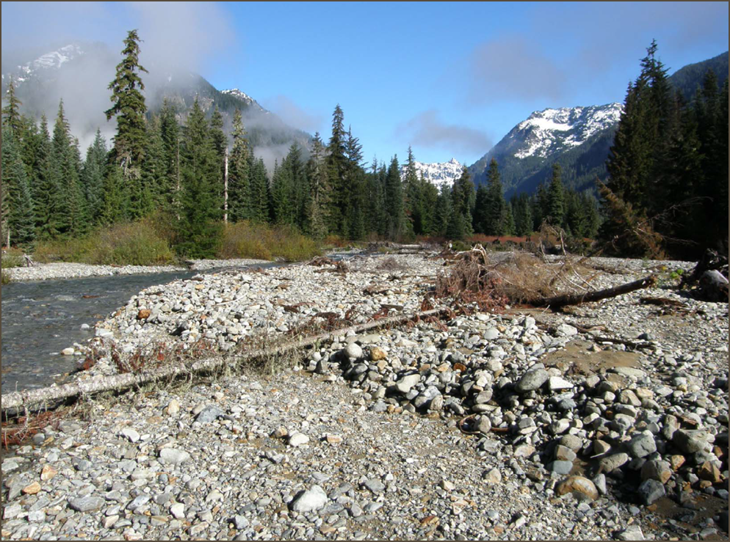

Gold Creek Habitat Assessment & Conceptual Design
Two Year Assessment Results
Conceptual Designs
Moving Forward

Slide 2
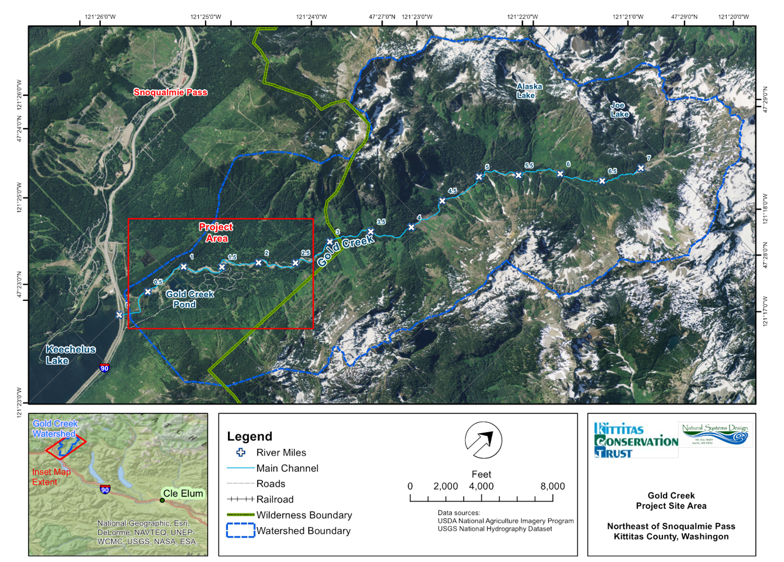
Project Location

Slide 3
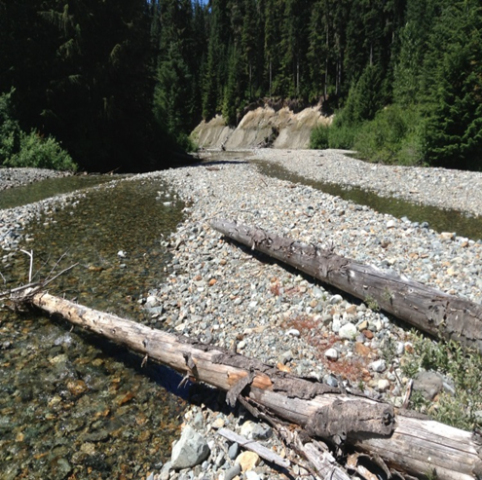
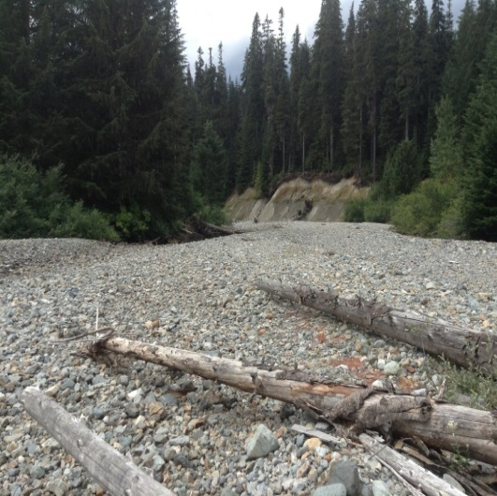
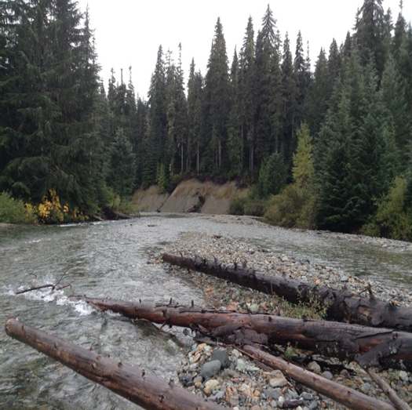
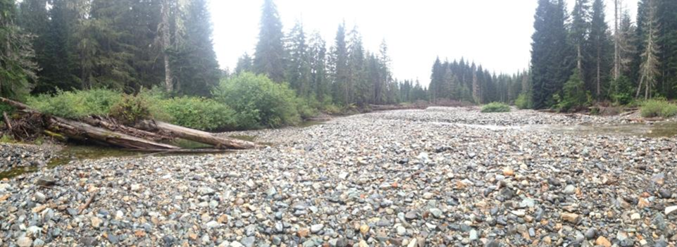
The Problem
7/26/2013
8/26/2013
10/2/2013
Habitat Degradation
Seasonal Dewatering

Slide 4
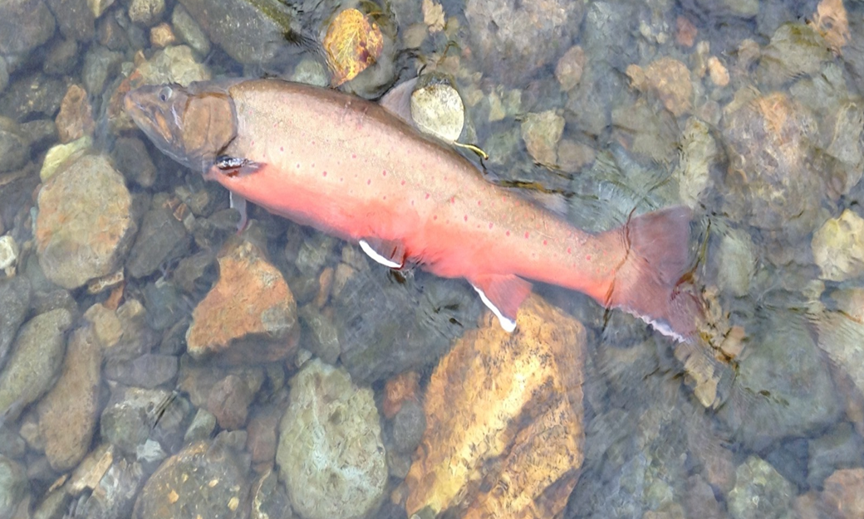
Project Goals
Identify the causal mechanisms of habitat loss and seasonal dewatering
Produce detailed conceptual design plans
Bull Trout – Salvelinus confluentus
Photo of stranded Bull Trout taken on 9/26/2013 in shallow riffle below Gold Creek Pond

Slide 5
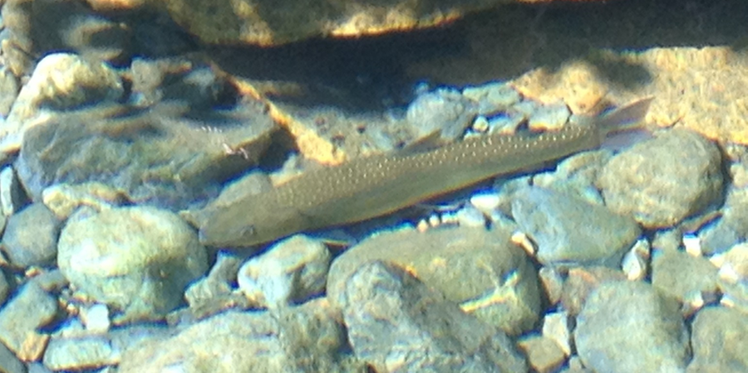
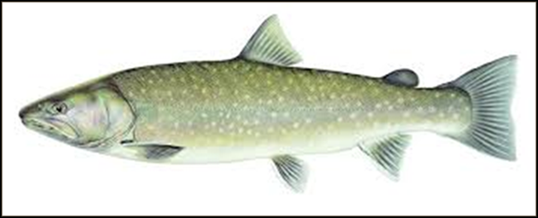
Why Gold Creek Restoration is Important
Bull Trout
Salvelinus Confluentus
One of only three know distinct populations left in the Upper Yakima Basin
The population is at high risk of extirpation
Gold Creek is the only tributary to Lake Keechelus that supports all life stages for Bull Trout

Slide 6
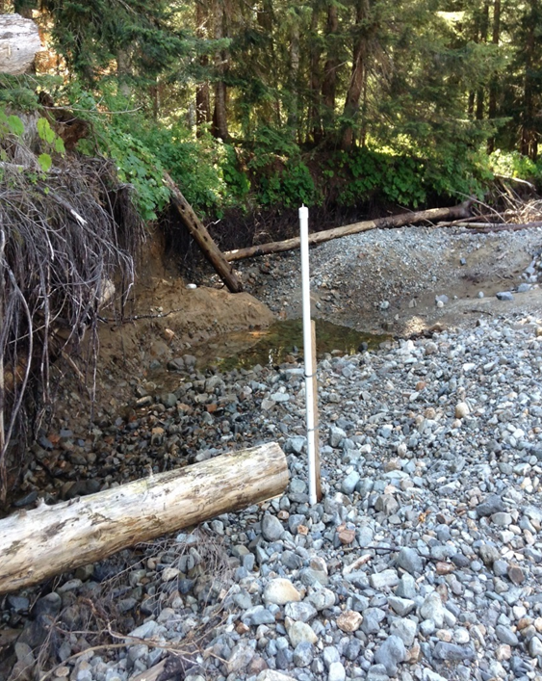
Project Status
Tasks Completed in 2013 – 2015:
Data Inventory and Gap Analysis
2013 & 2014 Hydrologic Assessments
Habitat Assessment
Geomorphic Assessment
Conceptual Design
Outreach
Inclusion in USBOR DEIS for KDRPP & K to K Projects
2015 SRFB Proposal for Phase 1 Instream Habitat Restoration (RM 1 – 2.1)

Slide 7
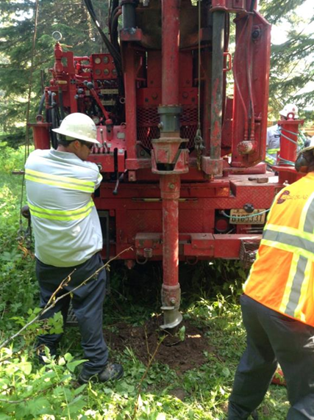
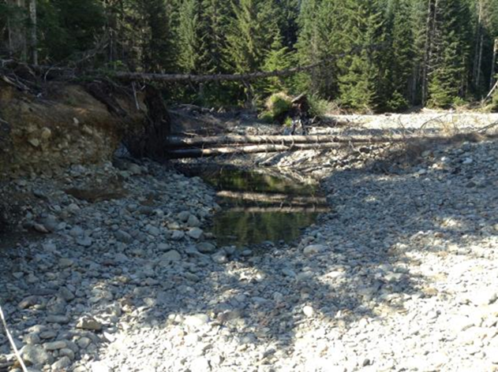
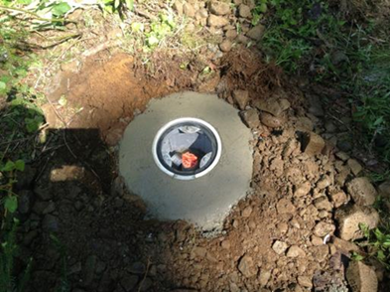
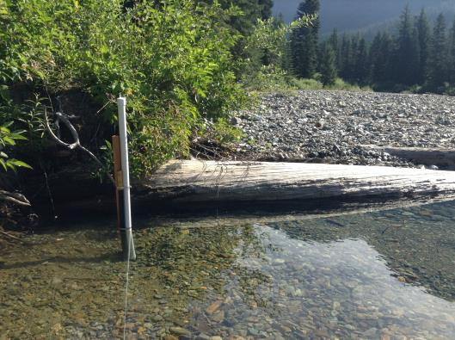
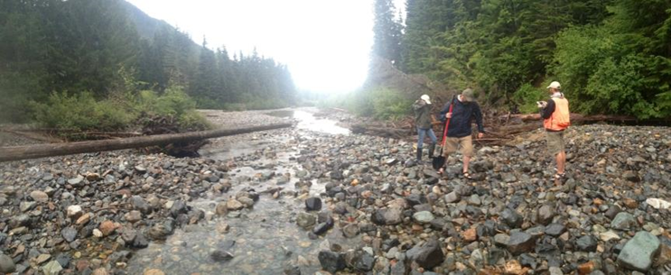
2014 Hydrologic Monitoring

Slide 8
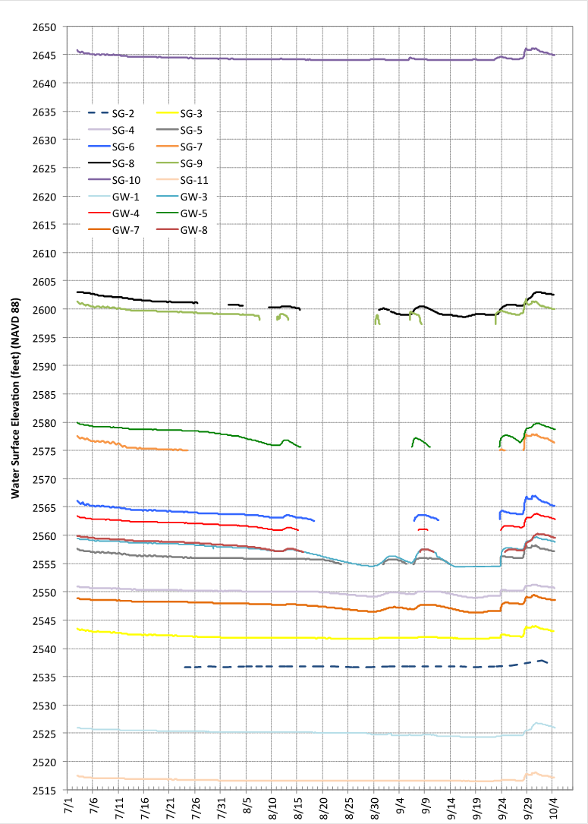
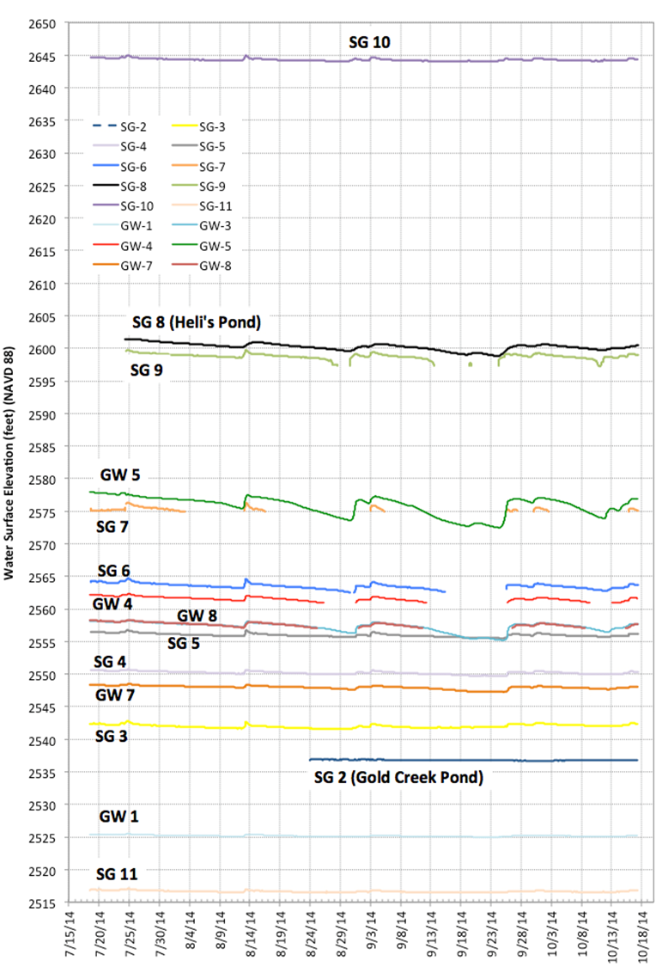
20144
2013

Slide 9
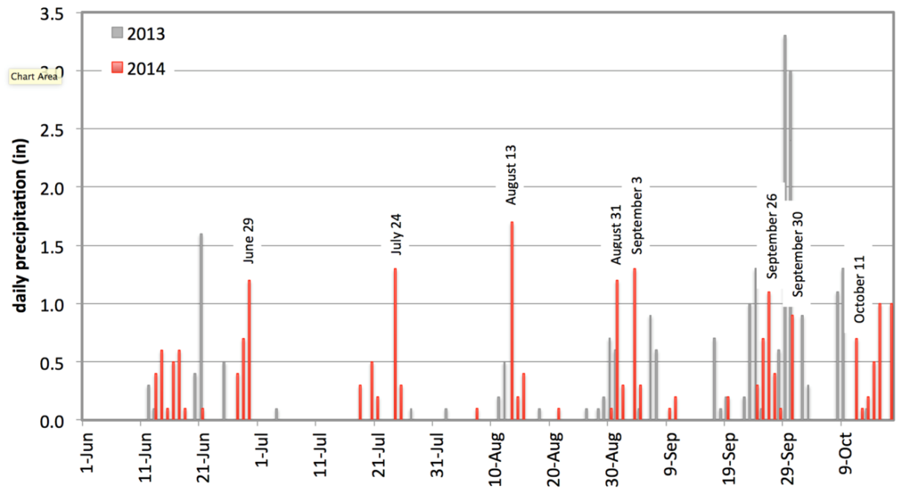
Rainfall
2013
Extended period of little to no rainfall from July to Mid- September
Extended period of seasonal dewatering
2014
Four rainfall events throughout the summer over 1”
Four distinct dewatering events through this same period

Slide 10
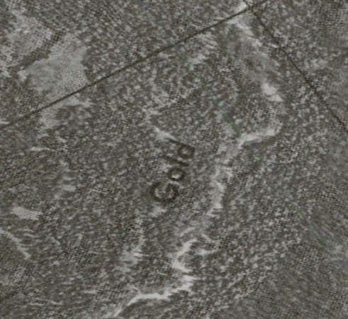
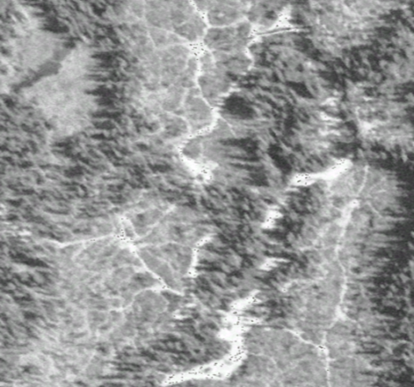
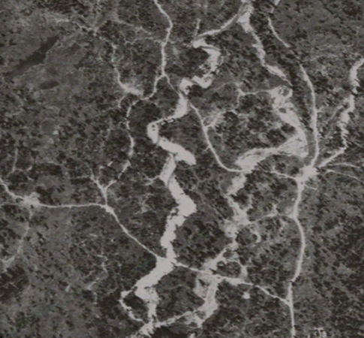
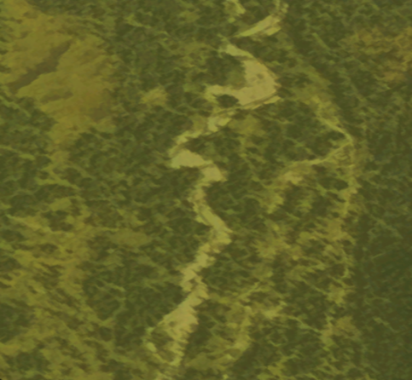
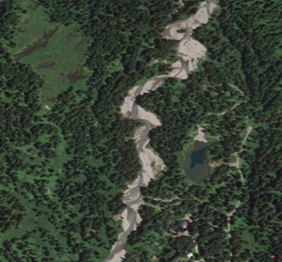
Geomorphic Assessment
1944
1957
1970
1985
Historic Disturbances
Mining
Lake Keechelus Dam & Reservoir Operations
Logging
Road Development
Residential Development
2015

Slide 11
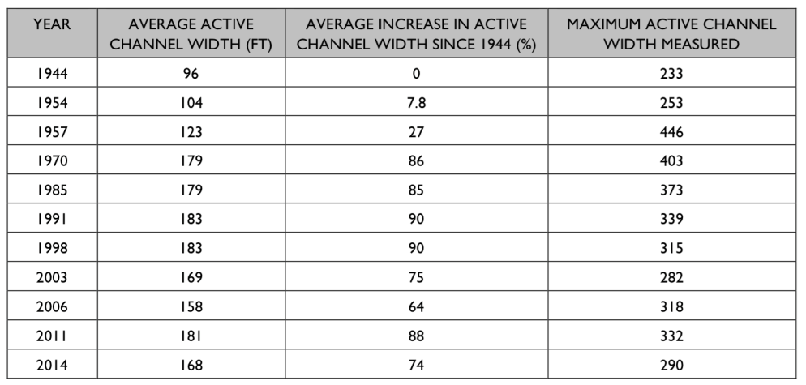
Geomorphic assessment
Historic disturbances
Accelerated widening following logging in the 1950’s
Average peak width in the 1990’s
Expansion greatest downstream of RM 1 and between RM 1.4 and 1.75
Current trends suggest the riparian trees are starting to achieve key size (60 years after logging)
  1
  2
  3
Stream discharge into creek bed (Q)
α
Surface area of creek bed (A)
↑ stream bed
surface area
= ↑ infiltration into
groundwater

Slide 12
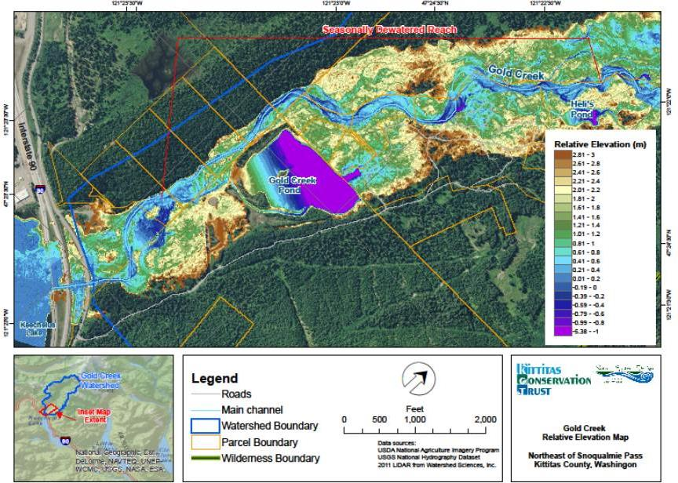
Gold Creek Pond
Influence of Gold Creek Pond
  Modifies groundwater gradient (estimated drop of 10’ from historic levels)
  Lower wse on eastern floodplain relative to western floodplain
  Orientation of Pond relative to valley axis
  WSE in Gold Creek Pond remains constant
  Groundwater elevations level closer to the Pond than further upstream
25º

Slide 13

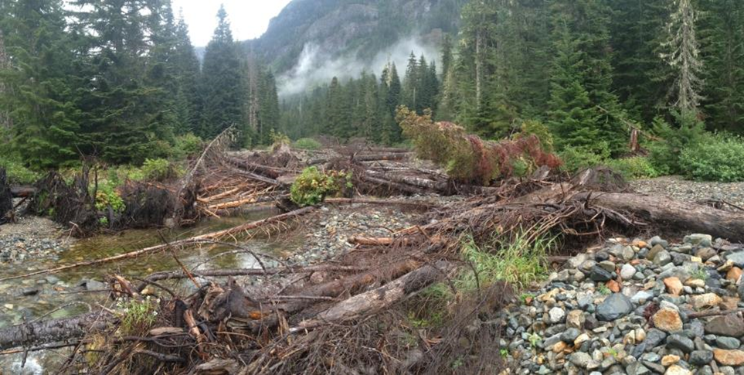
Instream Restoration
Restoration of forested floodplain
Restoration of historic channel widths
Roughened floodplain to confine flows and reduce infiltration area
Target sub-reaches with most significant widening
Use of large timber to provide bank strength

Slide 14
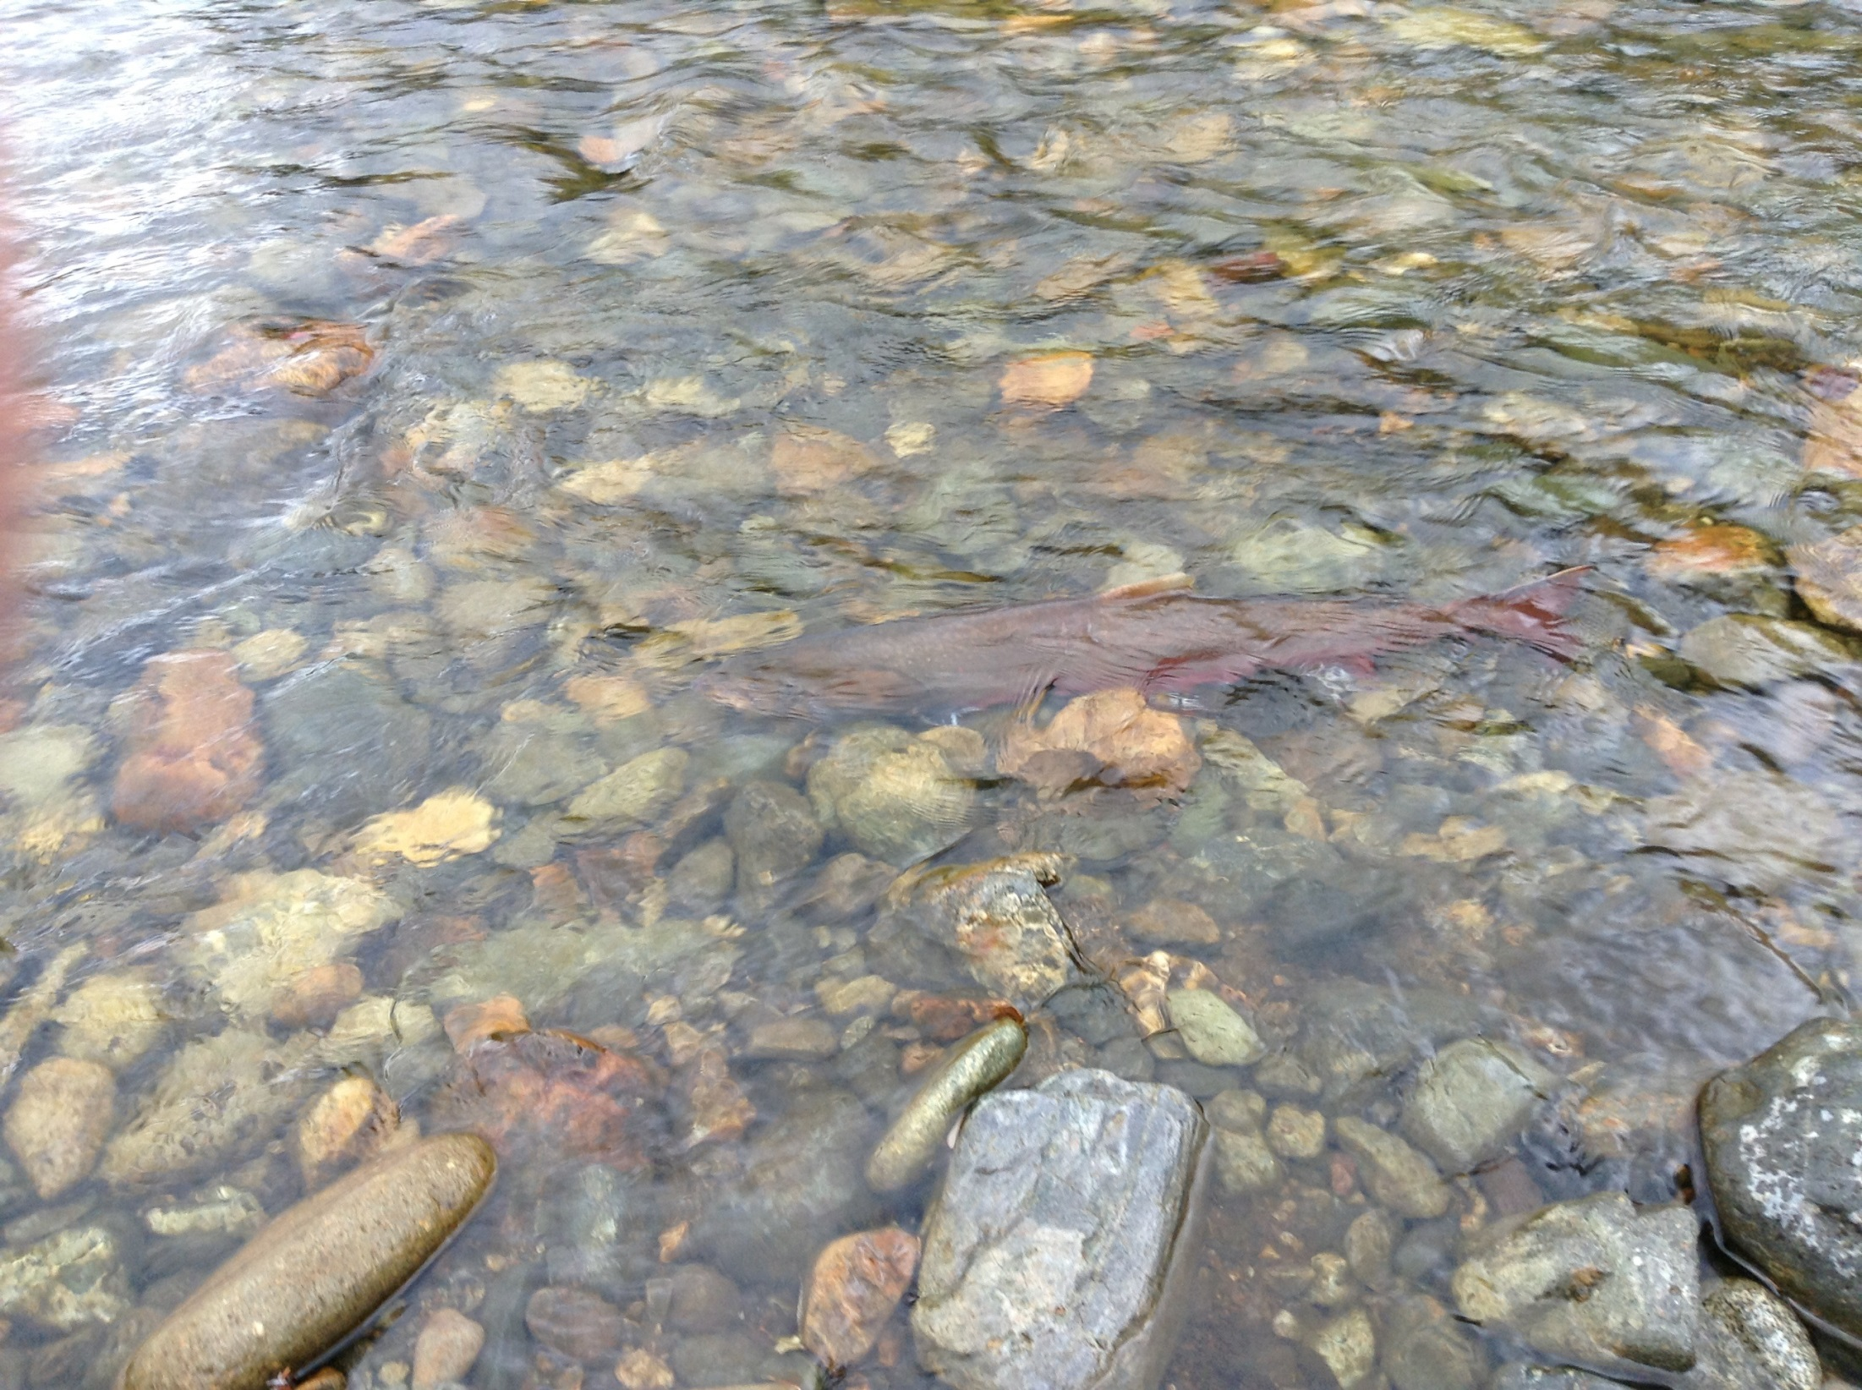
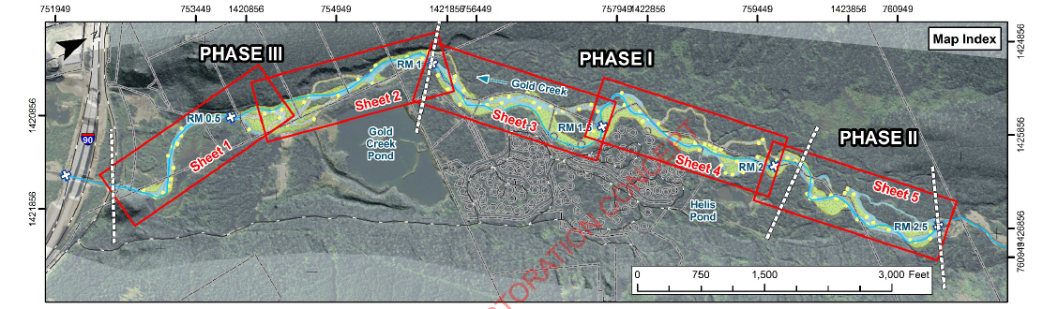
Restoration Concept
Channel Restoration Concept

Slide 15
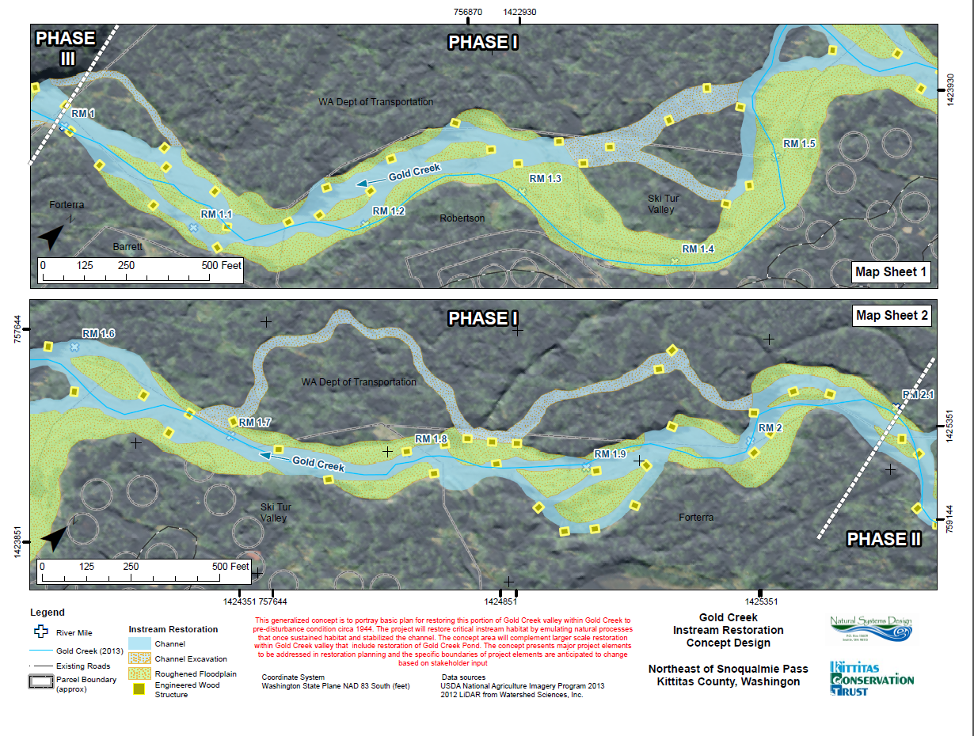
Gold Creek Instream Habitat Design #15-1153
2015 SRFB Project Proposal
PRISM #15-1153
RM 1 – 2.1
Main Dewatered Reach
Minimizes Impact to Bull Trout

Slide 16
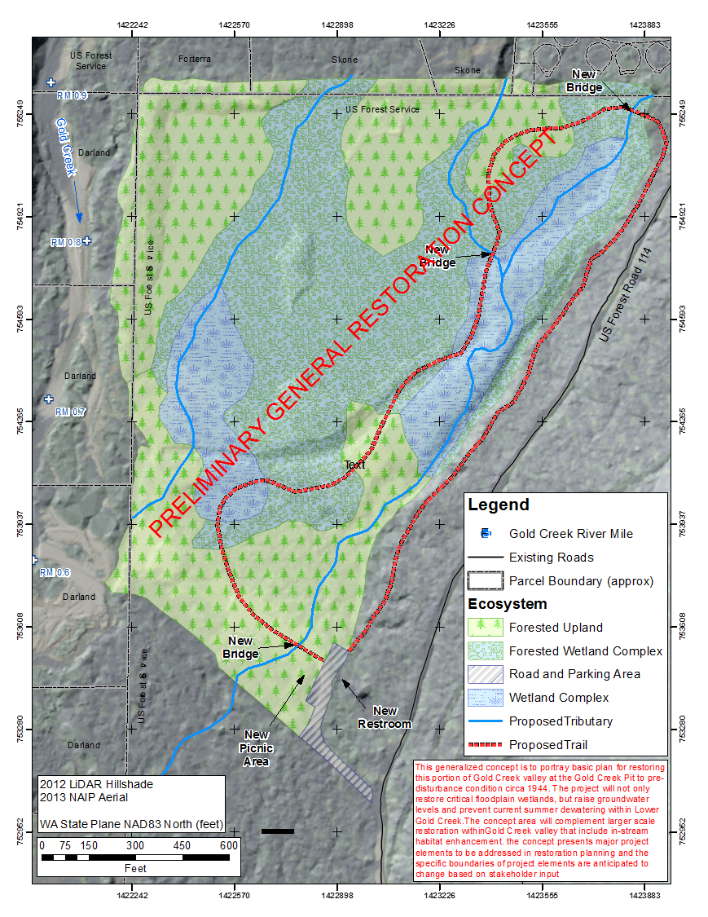
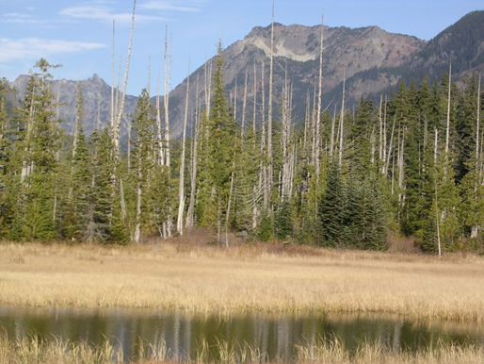
Concept designs
Gold Creek Pit Restoration
Restore Pre-Disturbance Condition
Wetland mosaic
  Forested wetlands
  Emergent wetlands
  Open water
Upland Forests
Tributary Re-Alignment

Slide 17
Concept designs
Drainage line restoration
During dewatering, relative elevation along pipe changes
Invert above groundwater table at upstream end
Invert below groundwater table at downstream end (observed at manholes 1, 9, 8)

Slide 18
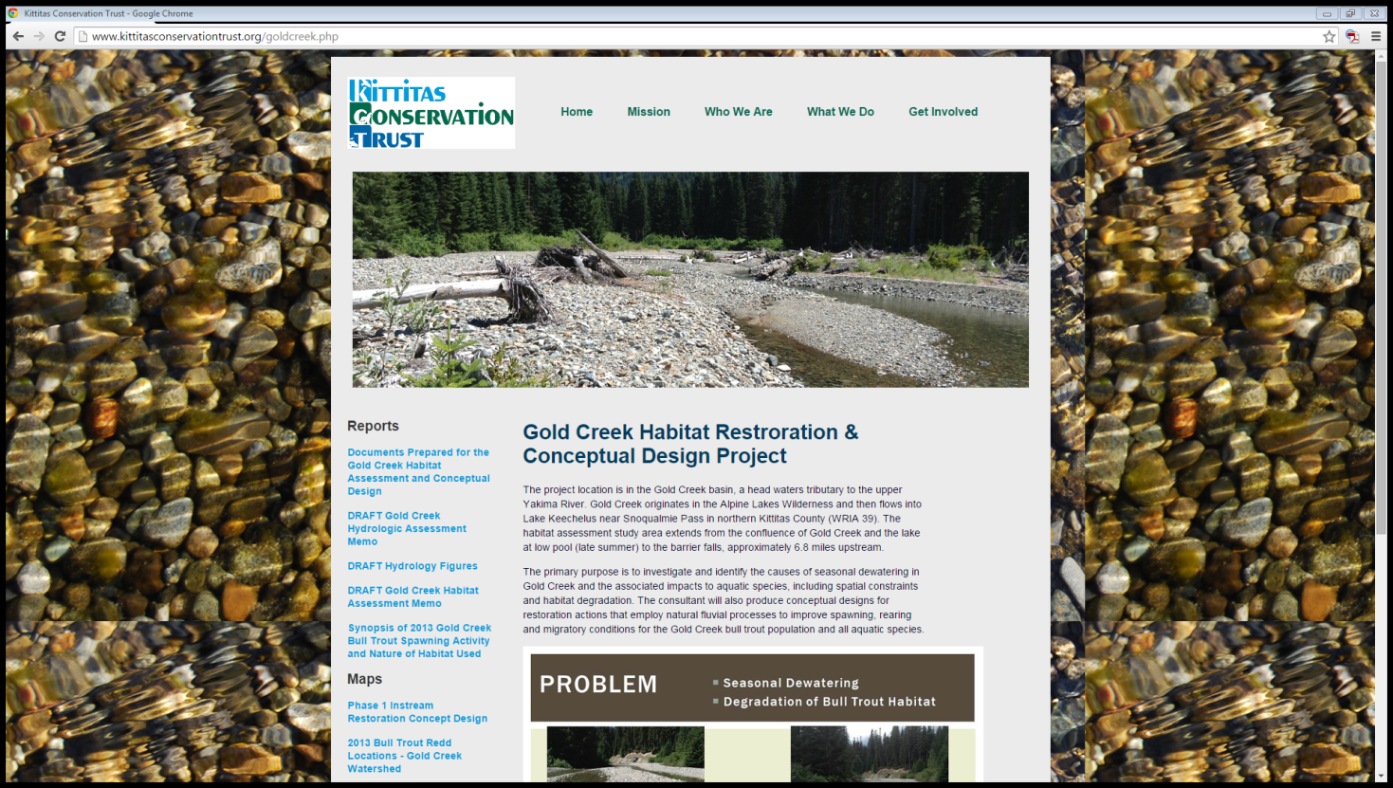
Documents can be found at: kittitasconservationtrust.org

