Slide 1
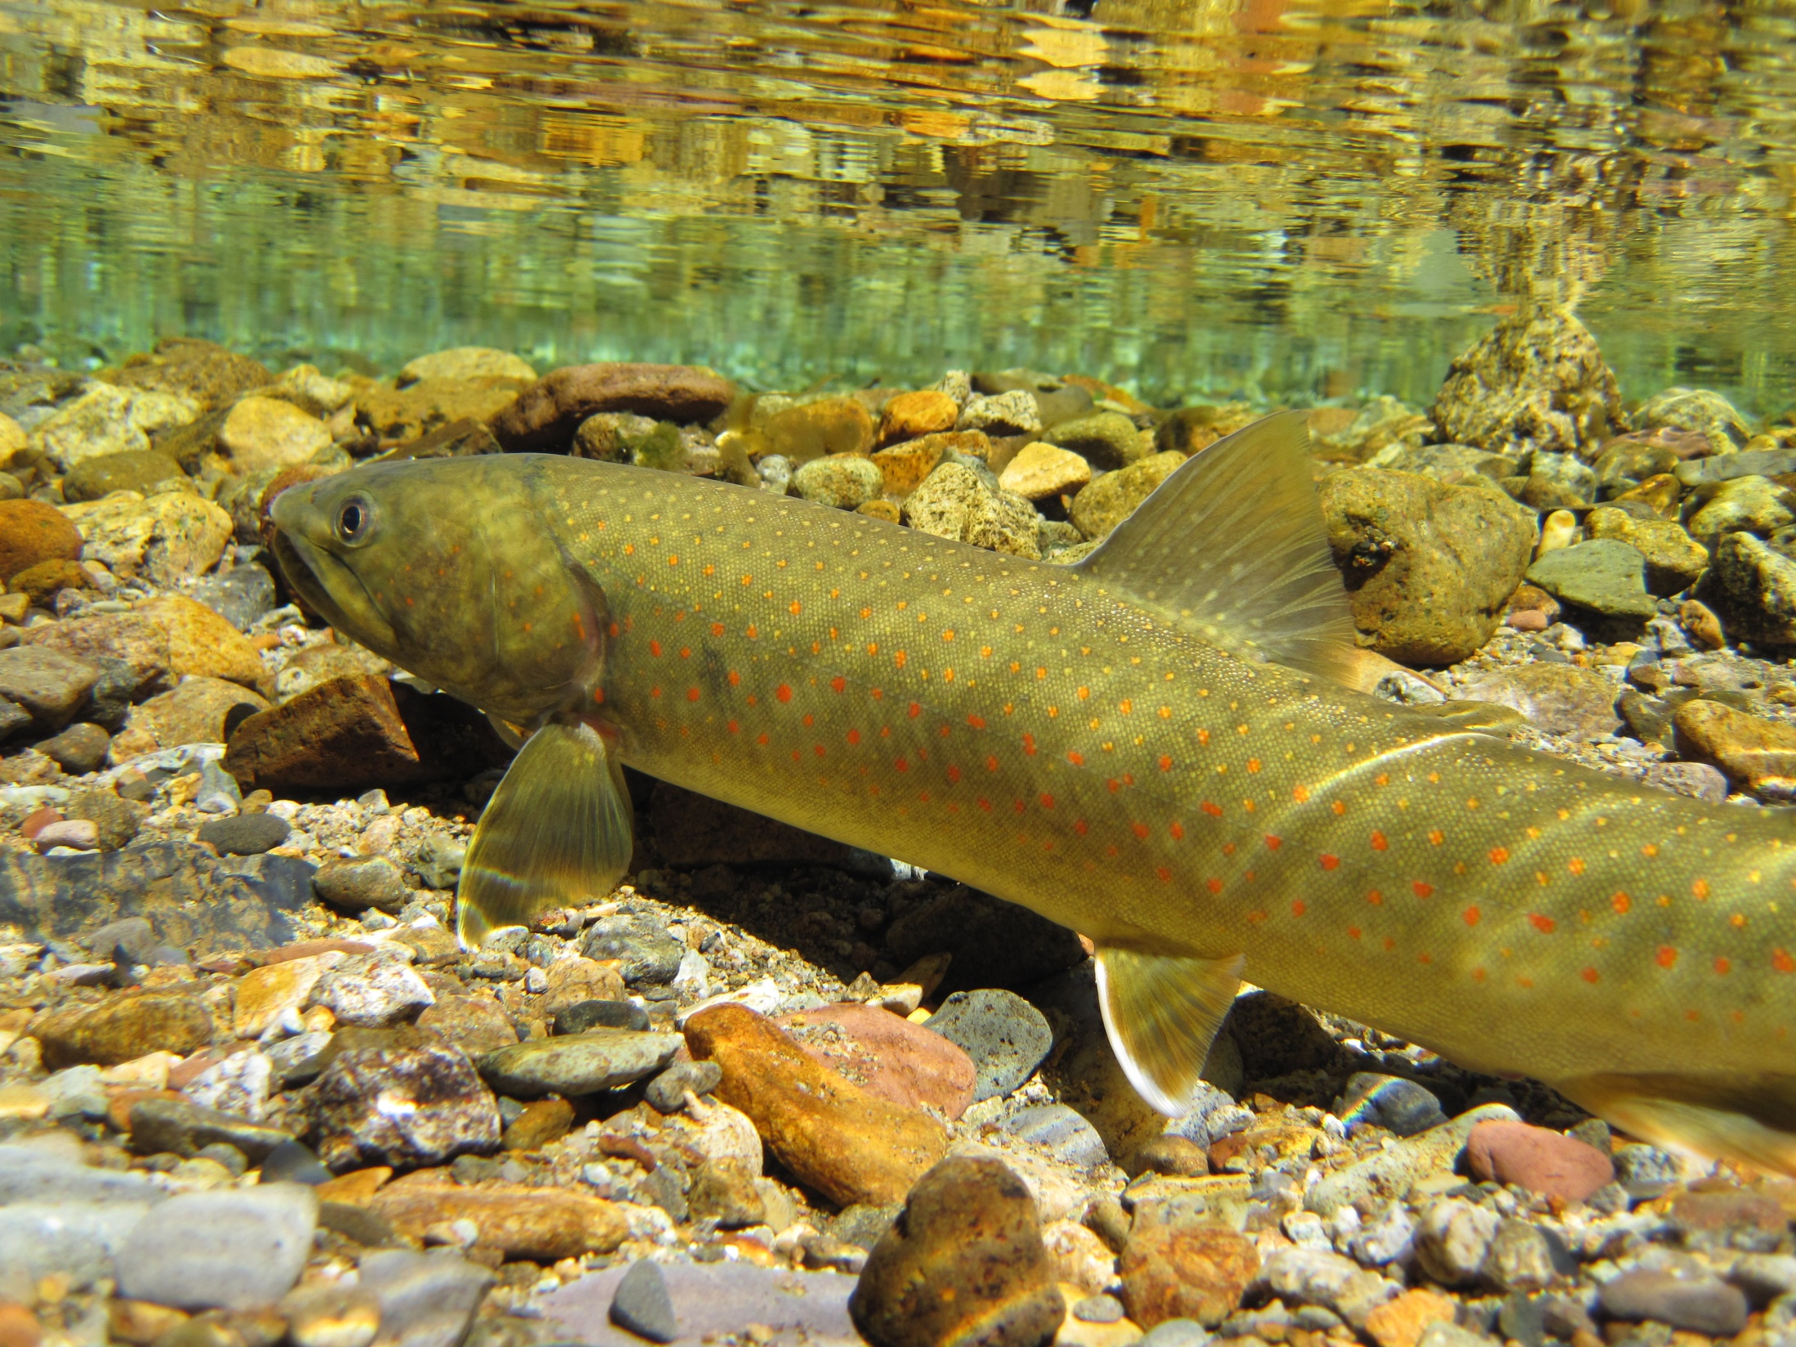
Yakima Bull Trout Abundance & Status
Eric Anderson – WDFW

Slide 2
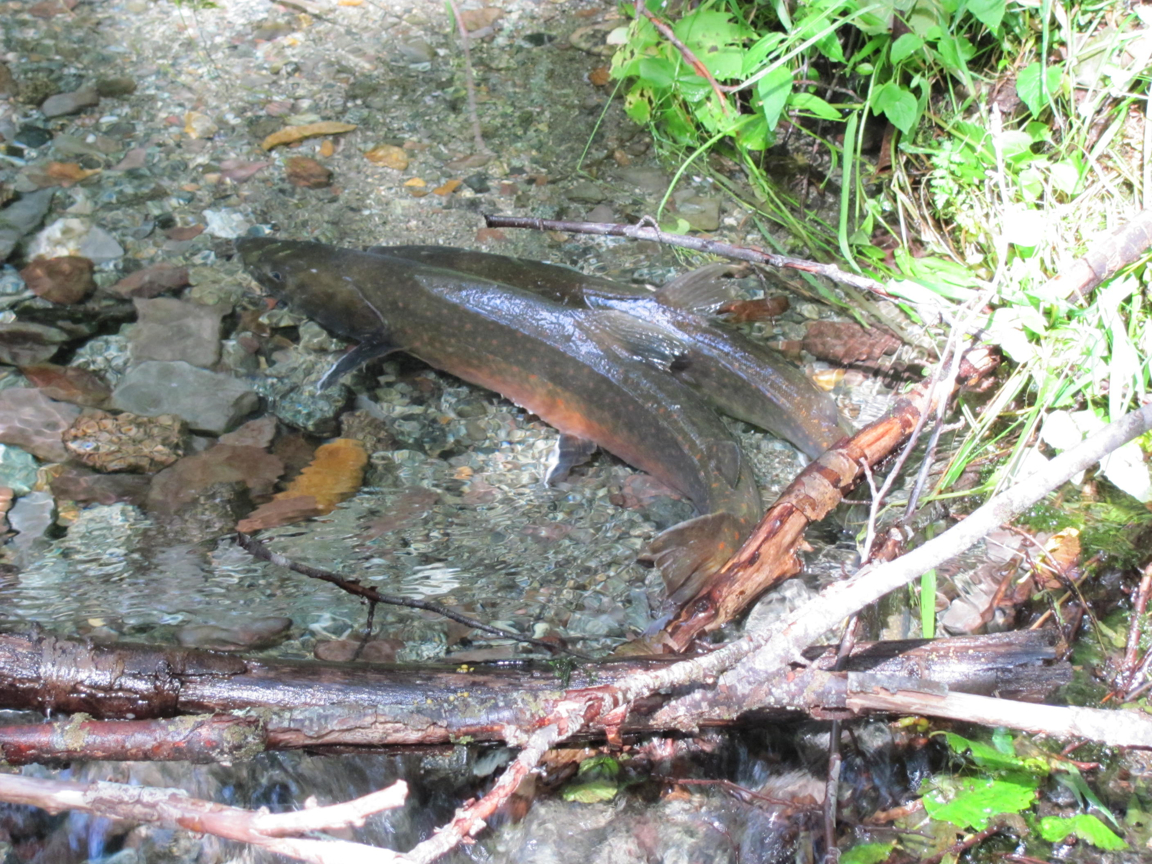
Acknowledgements
Cassandra Anderson - MCF
Nicole Fenton - Americorp
Jeff Thomas - USFWS
Pat Monk - USFWS
Brent Trim - USFWS
Robert Randall - USFWS
Judy Neibauer - USFWS
Gary Torretta - USFS
Paul James - CWU
Ashton Bunce - CWU
David Child - DC Consulting Arden Thomas - USBR
Joel Hubble - USBR
Tim Ressigue - YN
Jeff Trammell - YN
Paul Huffman - YN
William Meyer - WDFW
Jim Cummins - WDFW
John Easterbrooks - WDFW
Alex Conley - YBFWRB
Yuki Reiss - YBFWRB

Slide 3
Geographic Recovery Unit Area
Yakima Core Area - 15 local populations (12 gen. distinct)
Ahtanum, N.F Tieton, S.F Tieton, Indian, Rattlesnake, American, Crow, Deep/Up. Bumping (1), N.F. Teanaway, Kachess, Box, Gold, Cle Elum, Waptus, U. Yakima.
    One >200+ redd avg. (S.F. Tieton); Two >100+ redd avg. (Indian, Deep); Two avg. 30 - 40 redds (Amer. & Rattle)
    Remainder = 5 – 20 redds.
    Large Scale connectivity issues and high risk for climate change

Slide 4
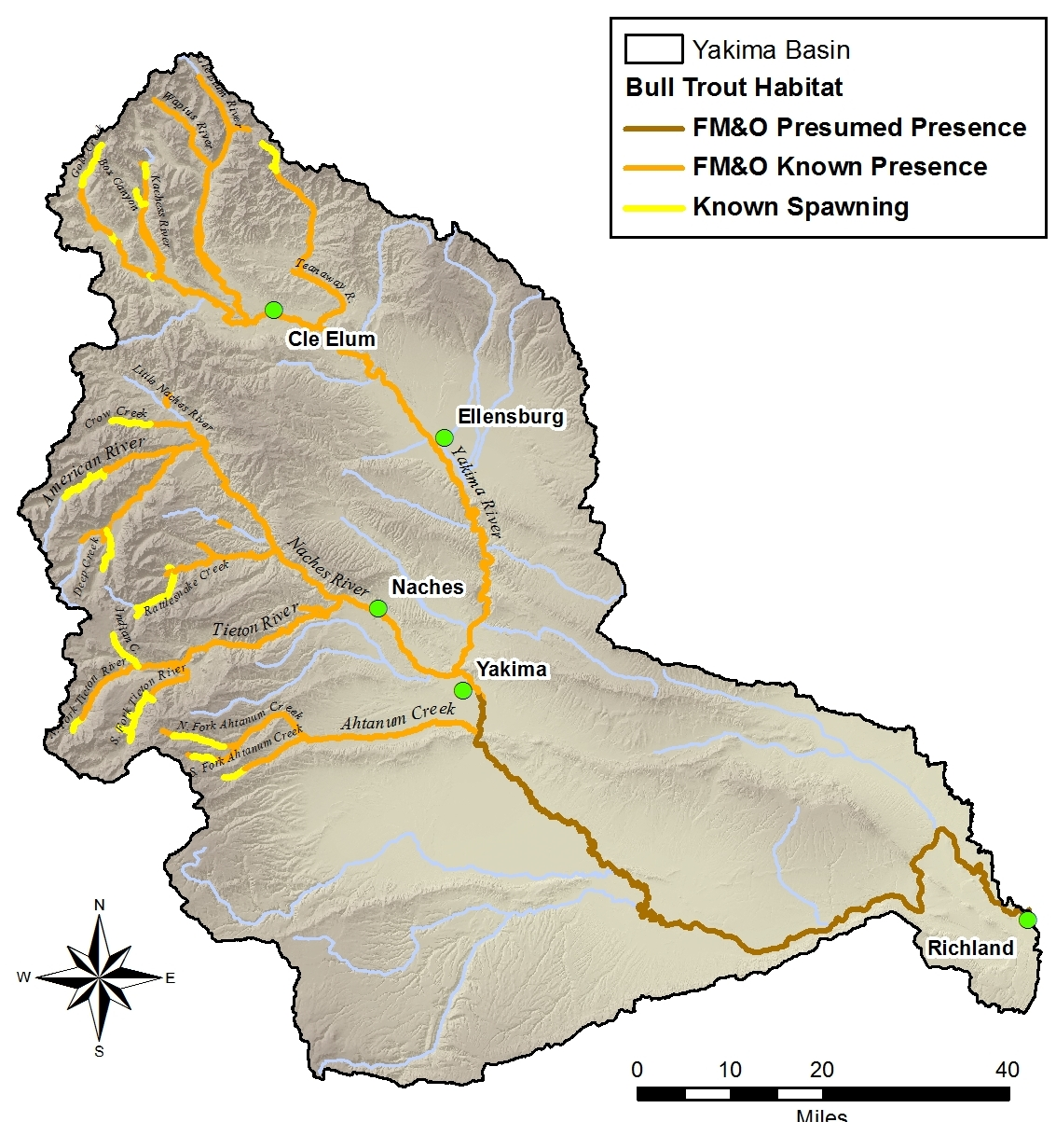
15 local populations:
9 adfluvial
4 fluvial
2 resident (semi-isolated)
7 U. Yakima (3 ext.)
8 Naches/Ahtanum
Redd count: 0 -- 207
(10 yr. avg.)

Slide 5
Naches Populations (Redds) -- 10 year avg.
Ahtanum Creek (R) – Ahtanum (14)
Naches River (F) – Rattlesnake (34), Crow (6), American (40)
Rimrock Lake (Ad) – Indian (108), SF Tieton (207), NF Tieton (19 – 8 yr avg.)
Bumping Lake (Ad) – Deep (137)

Slide 6
Up. Yakima Pop. (Redds) - 10 yr. avg.
Kachess Lake (Ad) – Box Canyon (13), Kachess (11)
Keechelus Lake (Ad) – Gold (16)
Cle Elum & Waptus Lakes (Ad) No confirmed redds, functionally extirpated
N.F. Teanaway River (F/R) – 5 redds in 10 years, functionally extirpated
Up. Yakima River (F) – 4 redds in 10 yr.

Slide 7
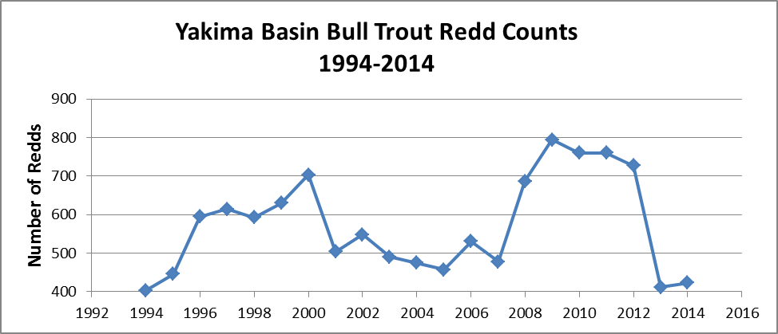

Slide 8
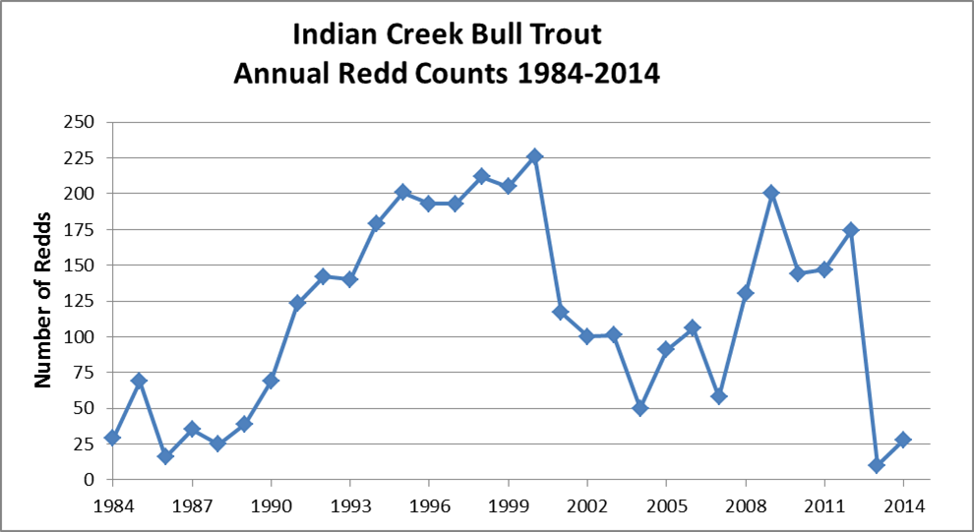

Slide 9
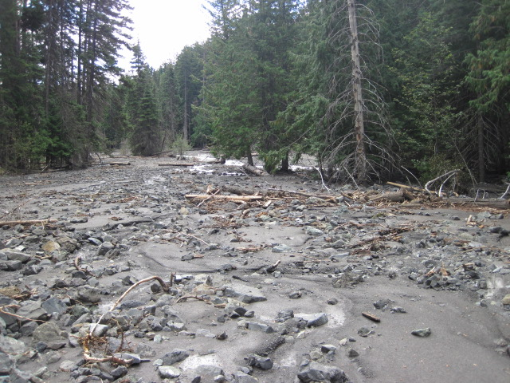
Indian Creek - North Spring Area

Slide 10
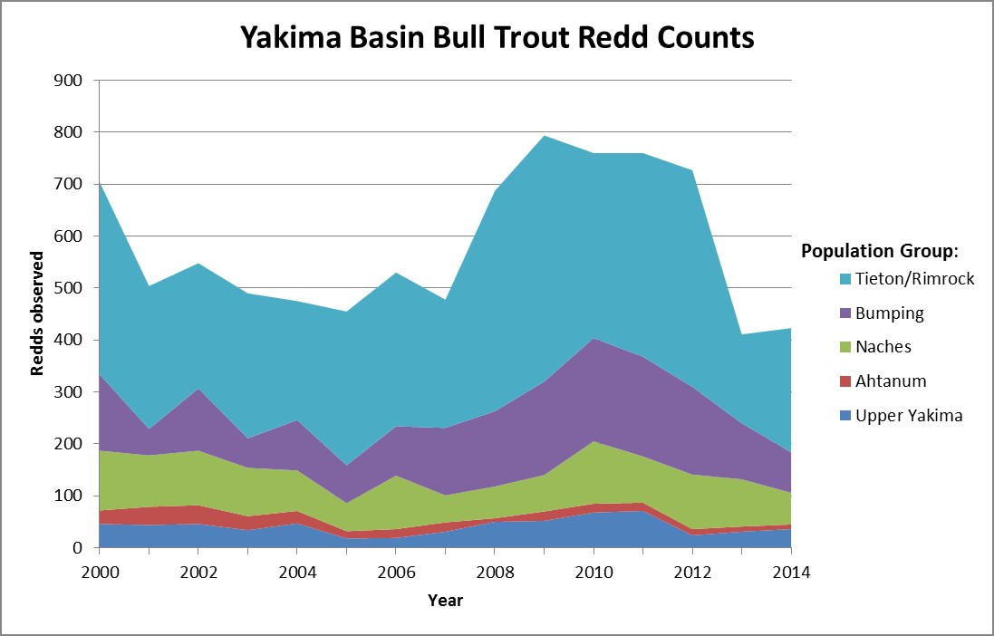

Slide 11
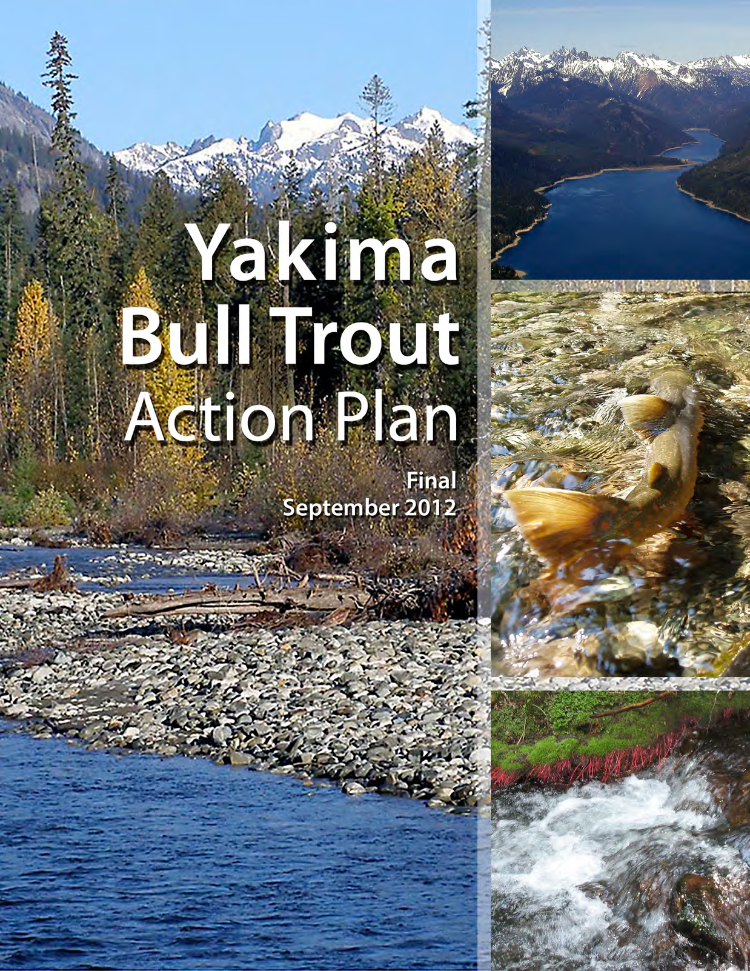
Yuki Reiss (YBFWRB)
Jeff Thomas (USFWS)
Eric Anderson (WDFW)
Jim Cummins (WDFW)
Input from Yakima Bull Trout Core Area Technical Team
Local Consensus on Prioritized Actions
Goal – ID specific actions that benefit bull trout in the basin
Coordinated with Judy Neibauer, USFWS
www.ybfwrb.org

Slide 12
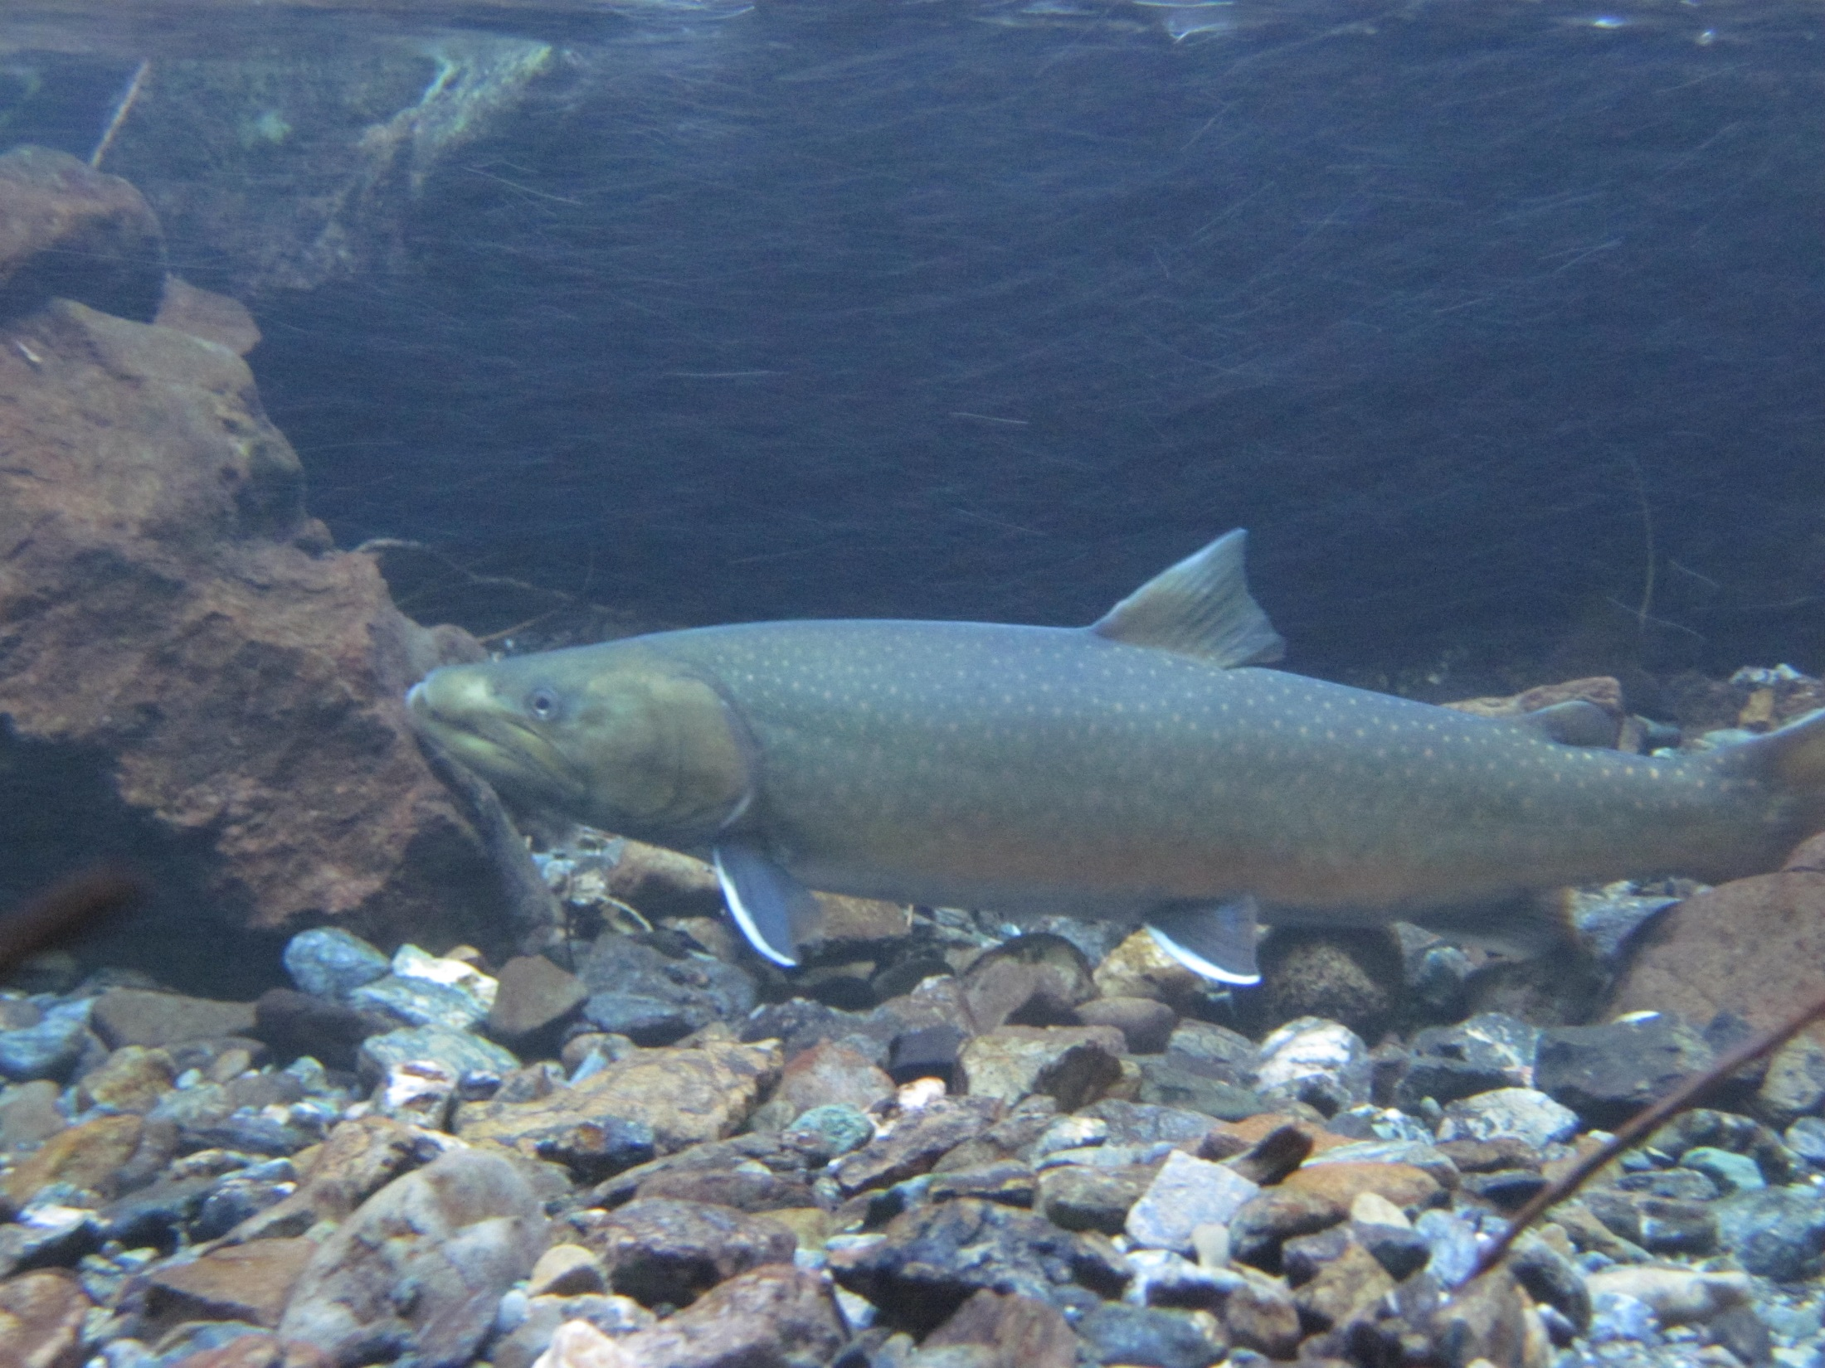
Population Information
Life history, connectivity, genetics, population monitoring history, redd count data, radio telemetry
Habitat overview, habitat monitoring history, threats analysis, maps
Prioritized population actions
Extensive Bibliography

Slide 13
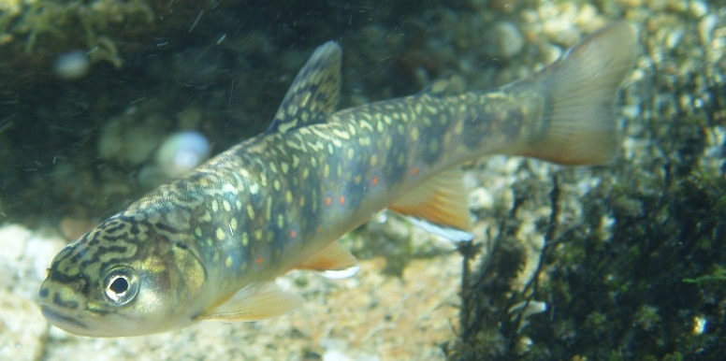
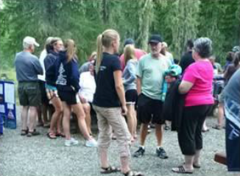
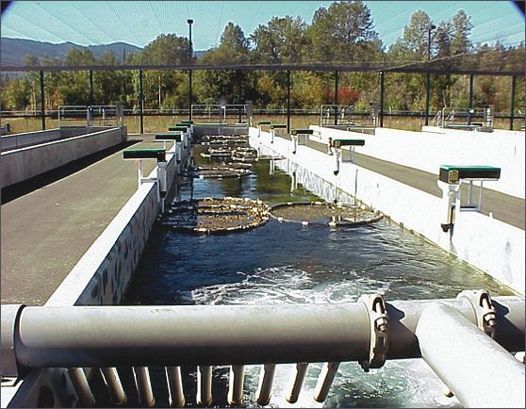
All Populations
Monitor - redd counts, temp.
brook trout introgression, etc.
Protect – spawning, rearing,
FMO
Educate the public - BTTF
Future
Potential supplementation or
transplantation for kick starting
weak or extirpated populations,
mitigation tool.
?

Slide 15
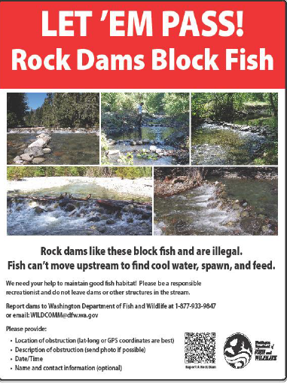

Slide 16
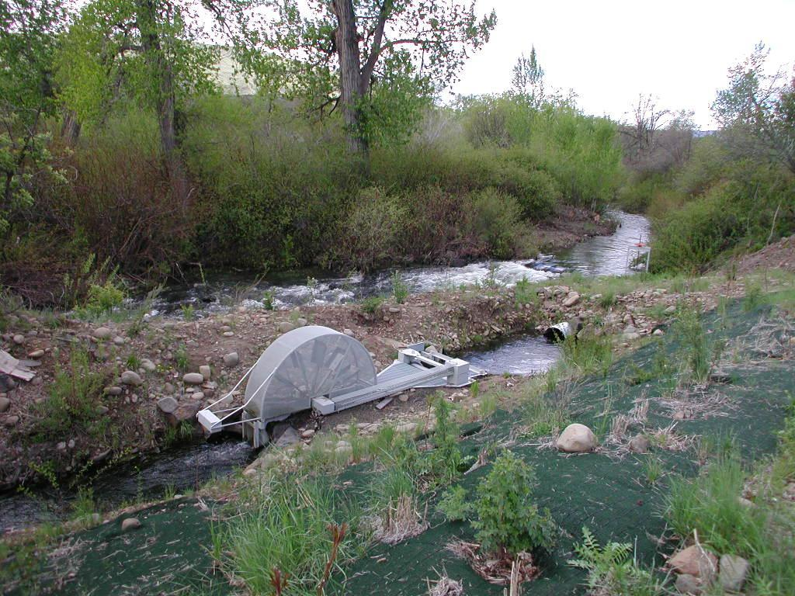
High Priority Action Populations
Ahtanum, Box Canyon, Crow, NF Tieton, Gold

Slide 17
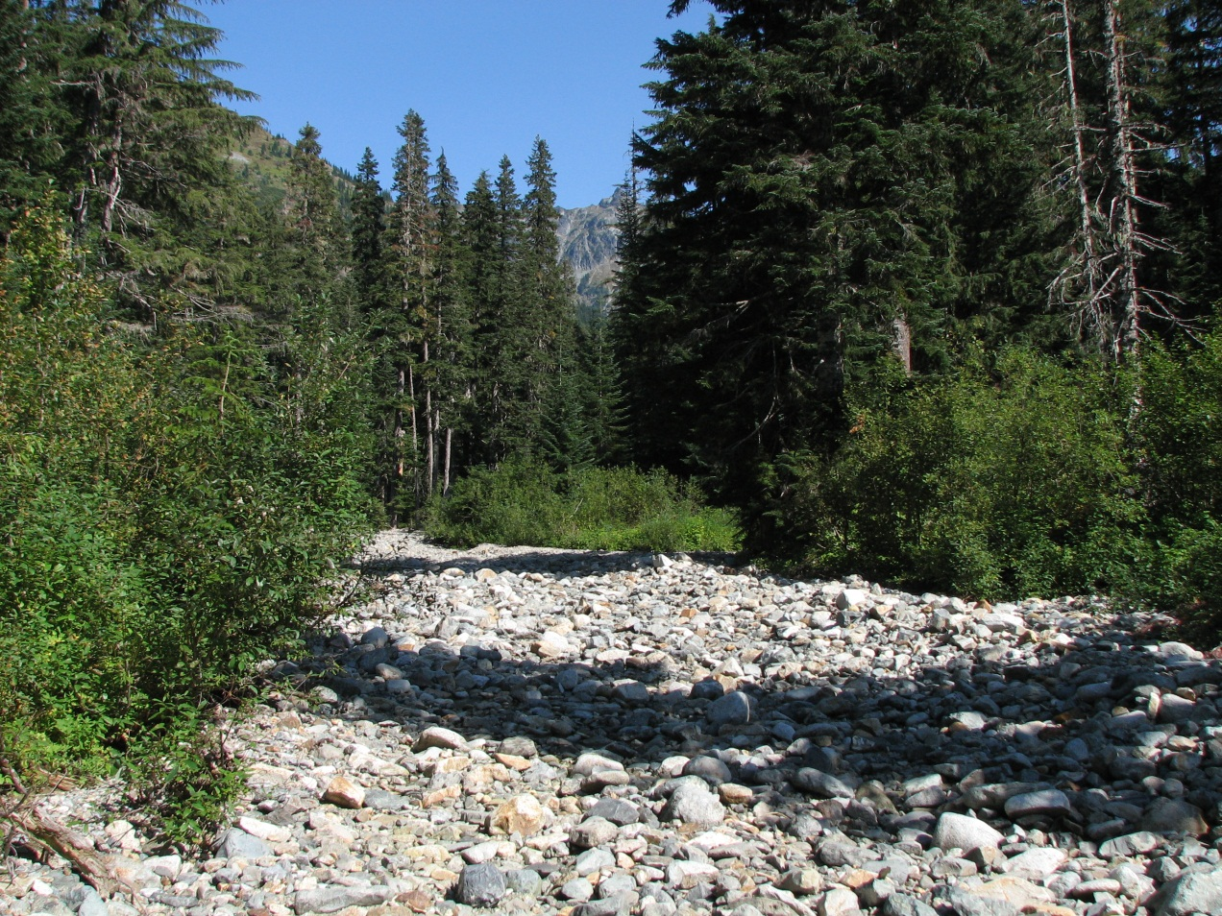
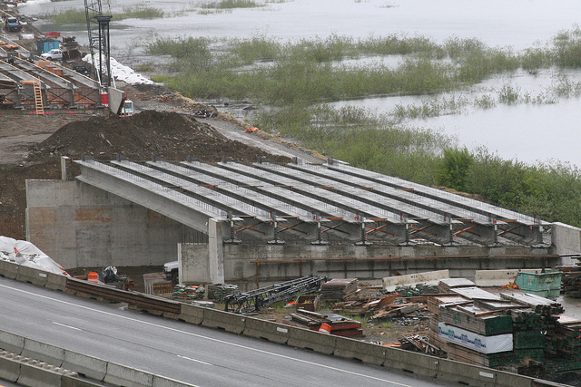
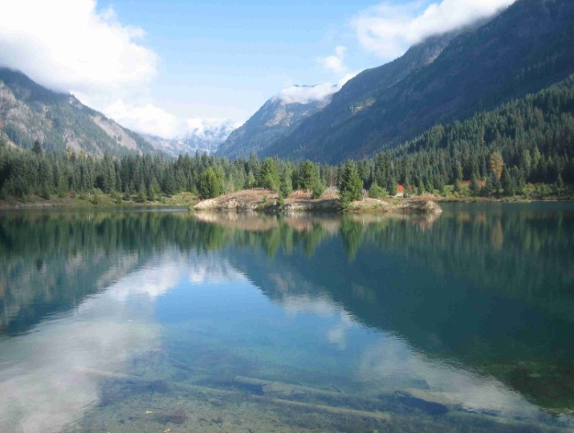
Gold Creek Habitat Assessment
Issues involving stream dewatering, habitat degradation, development, causing bull trout passage problems / mortality.
- managed by Kittitas Conservation Trust
- contract with Natural Systems Design
- Surfboard Funded Project

Slide 18
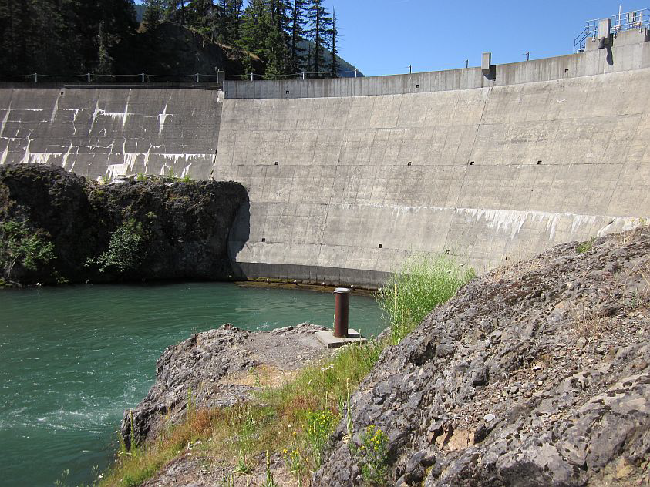
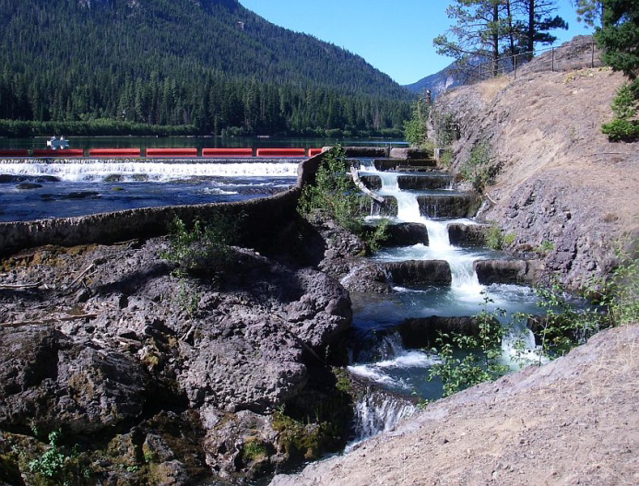
Clear Lake Dam Fish Passage Assessment
-- funded by USBR & USFWS
USFWS lead investigators, 3+ year study

Slide 19
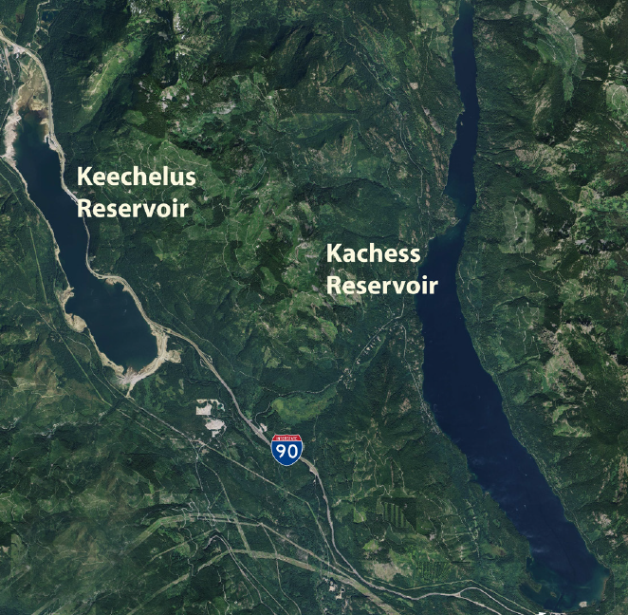
Food Web Structure of Kachess and Keechelus Reservoirs: Factors Limiting Bull Trout Production
-- Funded via Yakima Basin Integrated Plan
Investigators -- University of Washington & WDFW

Slide 20
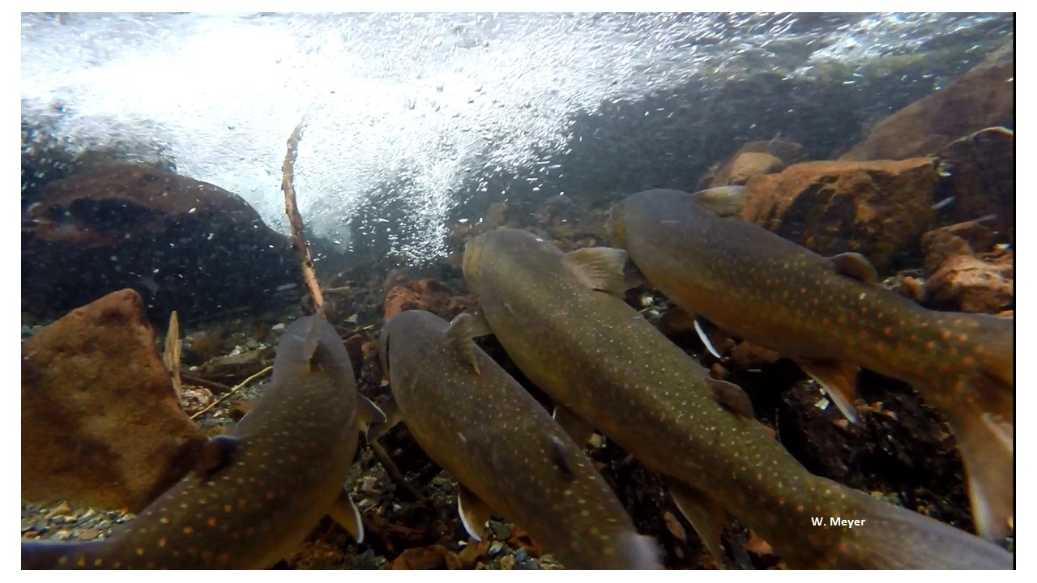
Questions / Comments?

