Slide 1
Bateman Island Causeway Conceptual Design
Mid-Columbia Fisheries Enhancement Group • Benton Conservation District
Gray and Osborne • Northwest Hydraulic Consultants
With support from the Yakima Basin Integrated Plan, the Salmon Recovery Funding Board, and the volunteer efforts of a Technical Advisory Group and Stakeholder Committee.

Slide 2
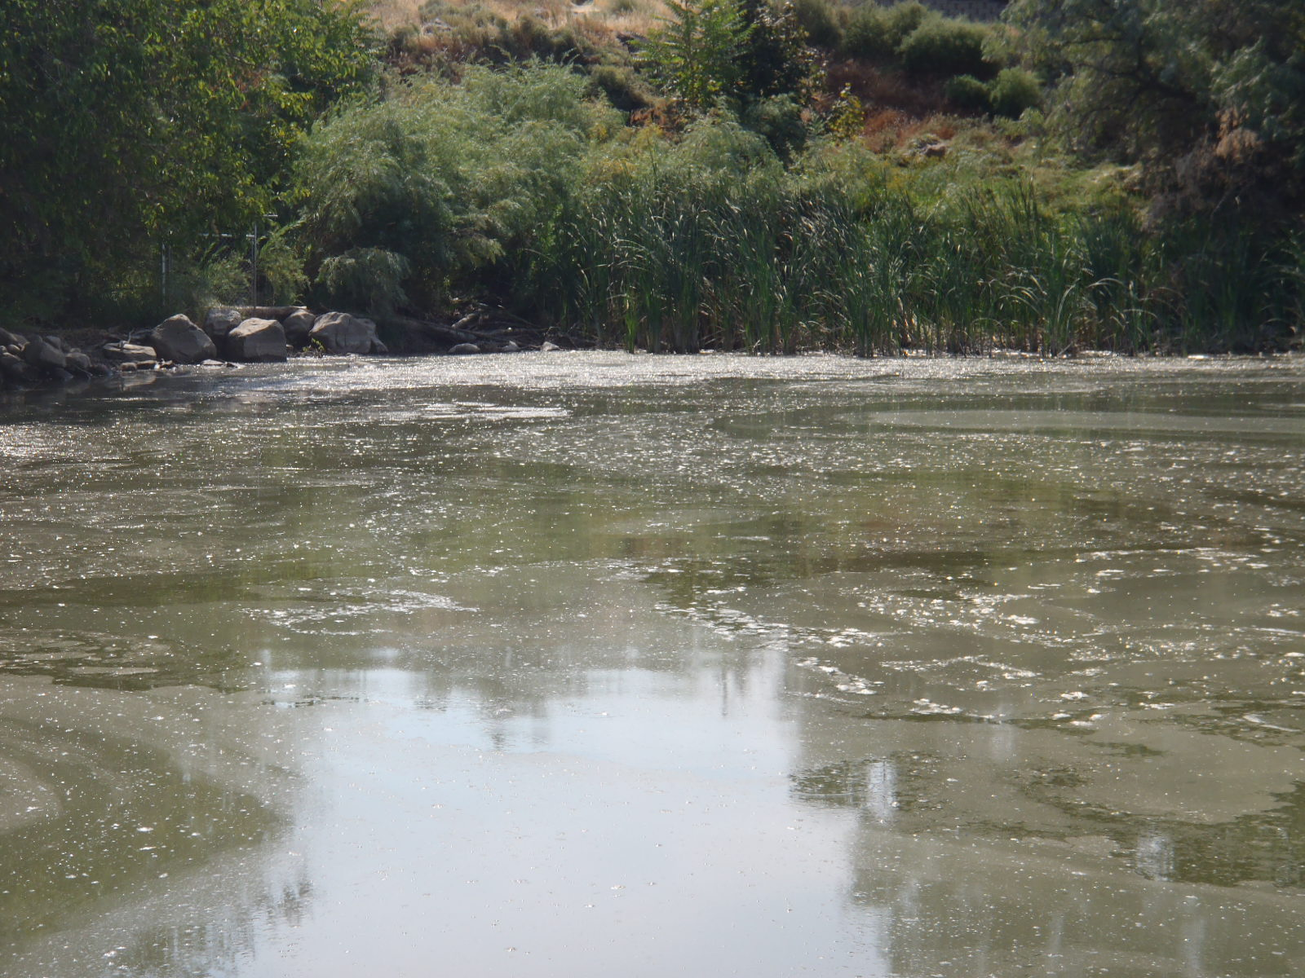
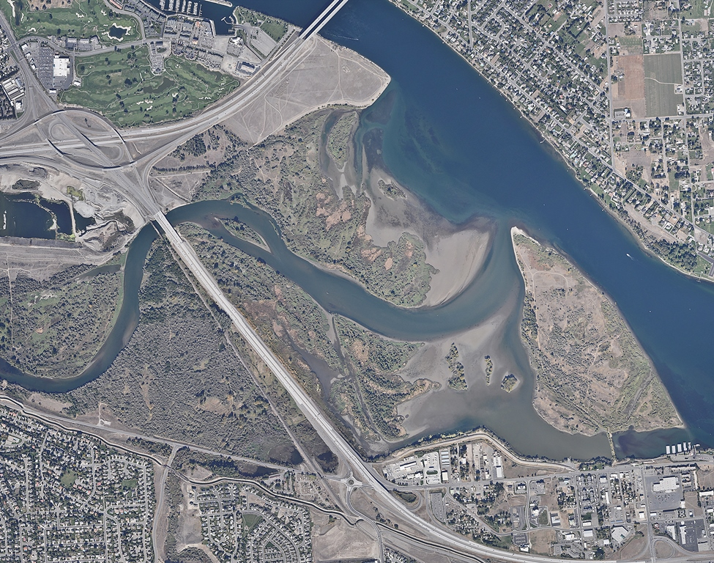
Columbia River
Yakima River

Slide 3
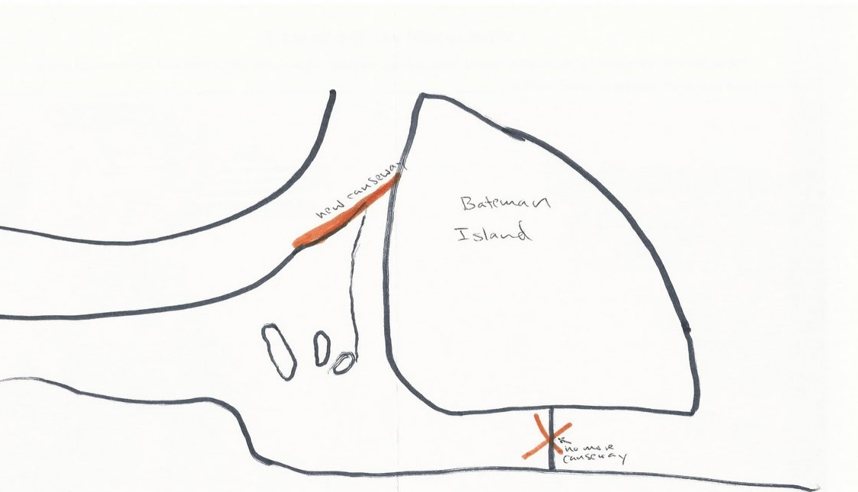
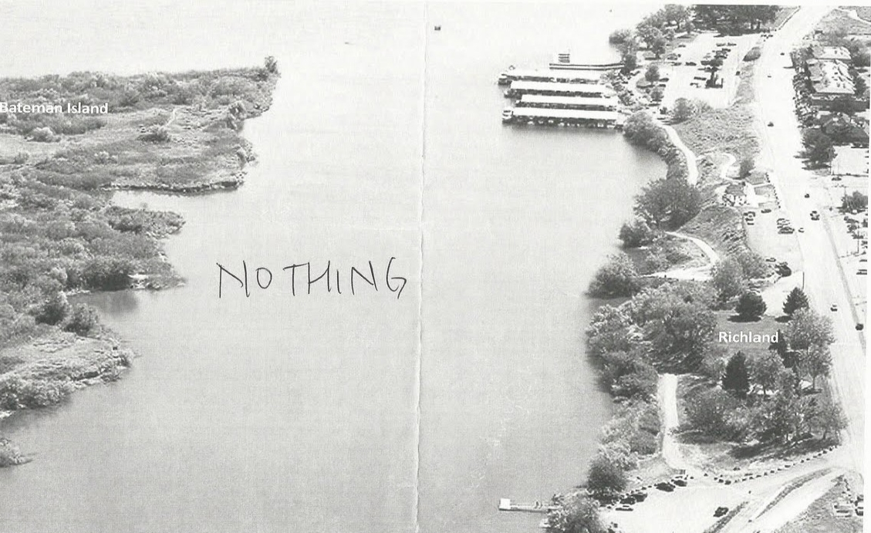
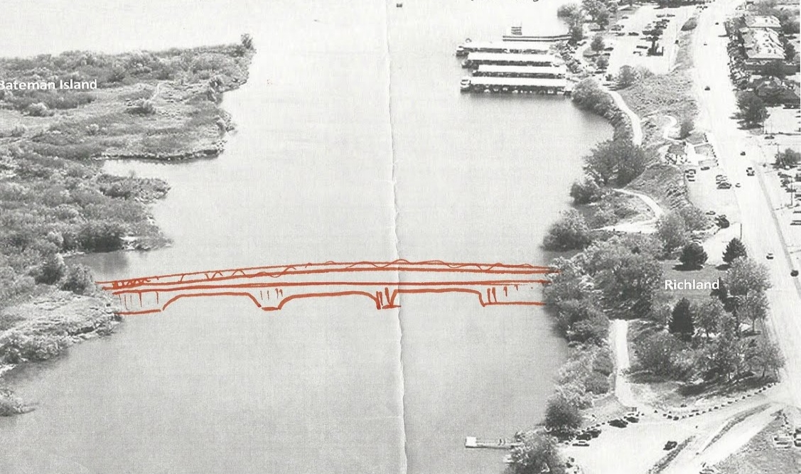
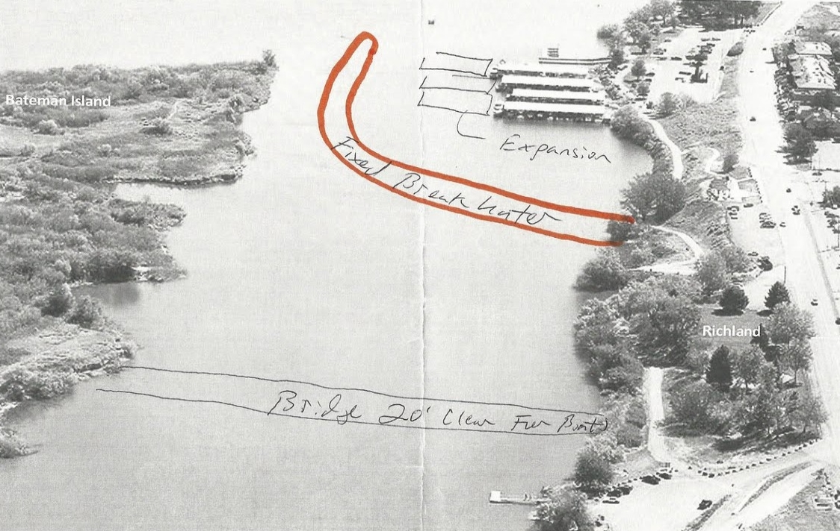
Alt. 2: Disconnect thalweg
Alt. 3: Full breach
Alts. 5, 6, & 7: Partial breaches
Alt. 8: Full breach & breakwater

Slide 4
Comparing between alternatives
Changes in flow, water temperature, and sediment transport
Impact on passage, predation, cultural resources, and recreational and commercial uses

Slide 5
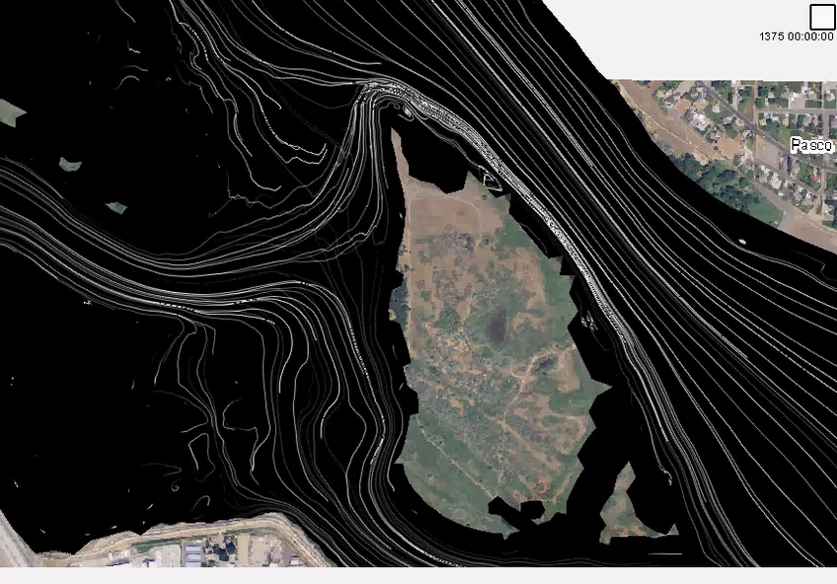

Slide 6
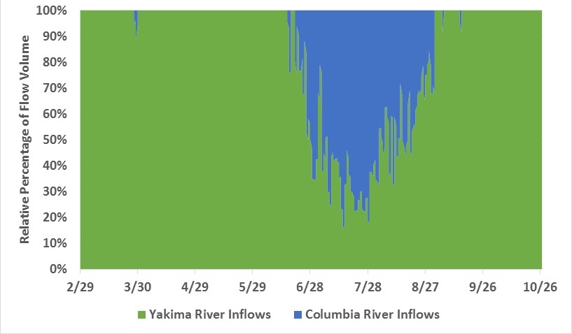
2012
Notes:
Flow Volumes by Source at Causeway Channel, Alt 3 (full breach), 2012
Cool Columbia River water has a strong influence during a key window of the year.

Slide 7
Alternative 8, June 1, 2012

Slide 8
Alternative 8, June 3, 2012
Notes:
In existing condition, the area west of Bateman Island warms to 23 – 24 C on this day. With the full breach and a breakwater or other flow-deflecting structure, the area west and south of Bateman Island is dominated by Yakima River water, and maintains temps between 17 and 18 C.

Slide 9
Alternative 8, July 8, 2012
Notes:
Be prepared to comment on boundary warming effect

Slide 10
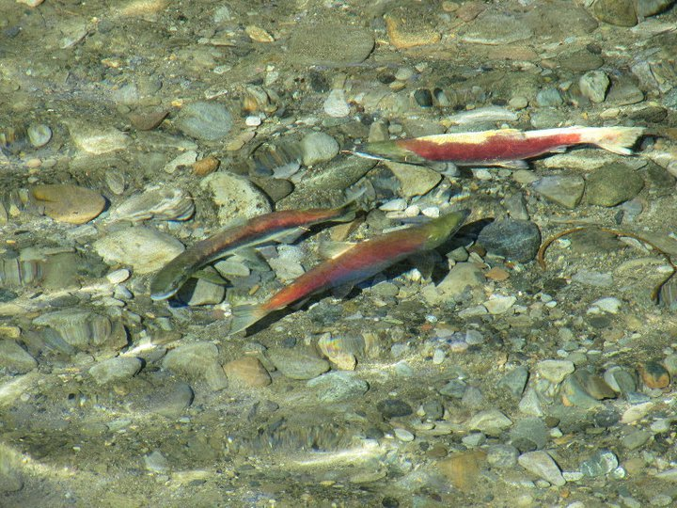
Source: plan.critfc.org

Slide 11
Number of summer days when downstream temperature > upstream
Alternative | Measured just above confluence |  |  | Measured in reopened causeway channel
 | 2012 | 2014 |  | 2012 | 2014
Alt. 1 - Existing Conditions | 38 | 38 |  | N/A | N/A
Alt. 6 - 130 foot Breach | 28 | 36 |  | 54 | 34
Alt. 7 - 200 foot Breach | 30 | 35 |  | 46 | 32
Alt. 5 - 260 foot Breach | 18 | 26 |  | 31 | 26
Alt. 3 - 560 foot Full Breach | 14 | 24 |  | 28 | 25
Alt. 8 – 560 foot Breach + Breakwater | 16 | 28 |  | 32 | 25
Notes:
Table 8: Number of Summer Days (June 1 - October 15) on which Water Temperature at Downstream Analysis Location is Greater than the Inflow Temperature at Hwy 240, “Delta through the Delta”

Slide 12
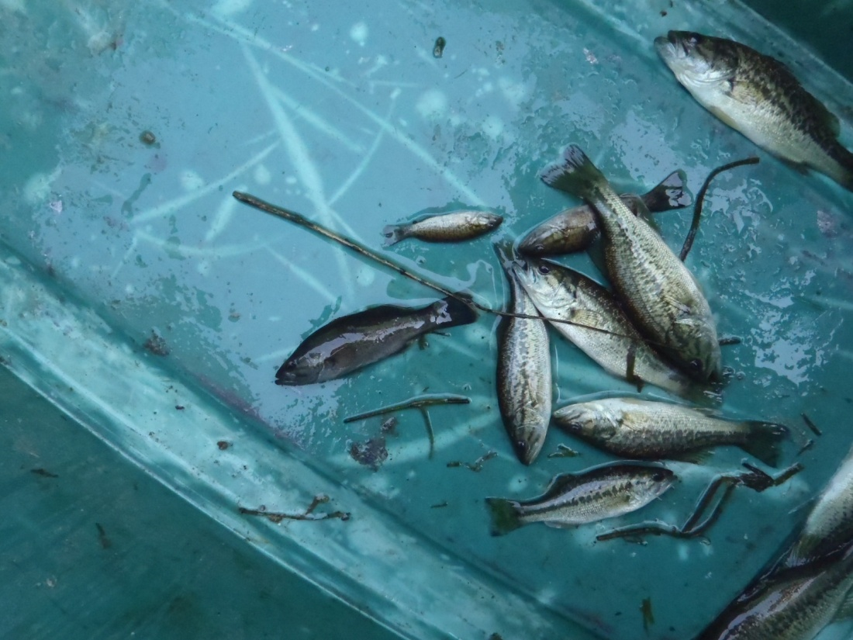
Source: Michael Porter, YN

Slide 13
Maximum Spring (March 15 – May 31) 7-DADMax Temperature
Alternative | Measured in channel west of island
 | 2012 | 2014
Alt. 1 - Existing Conditions | 19.6 ⁰C | 21.1 ⁰C
Alt. 6 - 130 foot Breach | 17.7 ⁰C | 18.7 ⁰C
Alt. 7 - 200 foot Breach | 17.6 ⁰C | 18.6 ⁰C
Alt. 5 - 260 foot Breach | 17.6 ⁰C | 18.5 ⁰C
Alt. 3 - 560 foot Full Breach | 17.6 ⁰C | 18.5 ⁰C
Alt. 8 – 560 foot Breach + Breakwater | 17.6 ⁰C | 18.5 ⁰C
Notes:
7-day average of the daily maximum temperatures

Slide 14
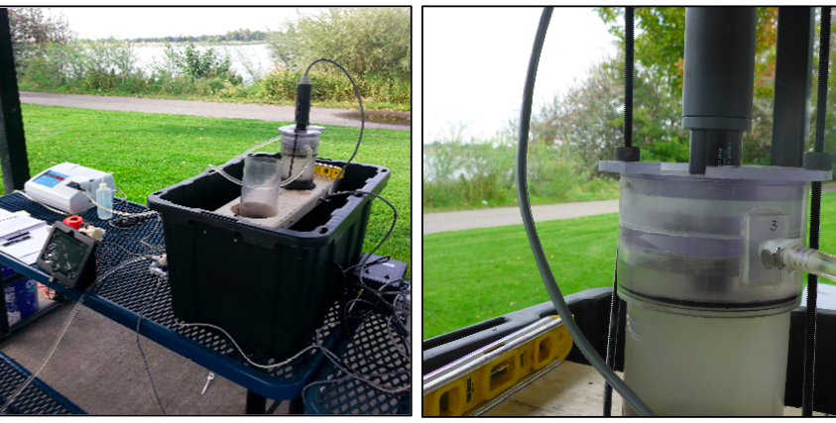
Sediment
Notes:
Substrate is cohesive mud

Slide 15
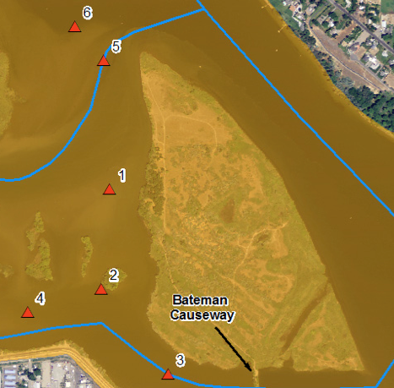
Time required for full erosion at each area after full breach
Area | Low Flow | Mid Flow | High Flow
 | weeks | weeks | weeks
Area 6: North of Yakima Inflow | 11.9 | 0.7 | 0.2
Area 5: Yakima River | no movement | 1.1 | 0.3
Area 1: West Side of Island | 112 | 6.2 | 1.8
Area 4: Small Channel South | no movement | 184.7 | 10.2
Area 3: West of Causeway | 57.9 | 3.5 | 1.0
Notes:
What are the flow ranges for low, mid and high?

Slide 16
Notes:
Breach, bridge, breakwater

Slide 17
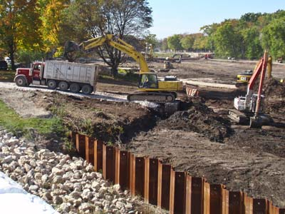
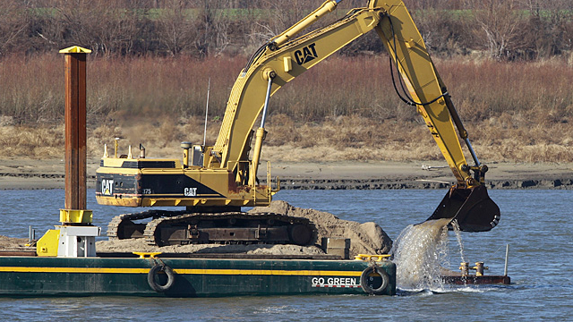
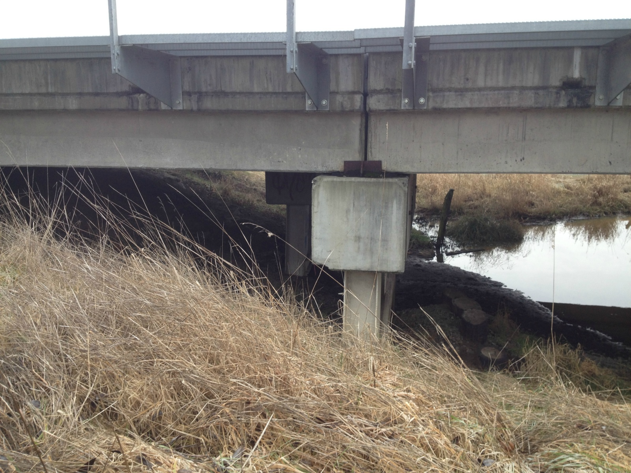
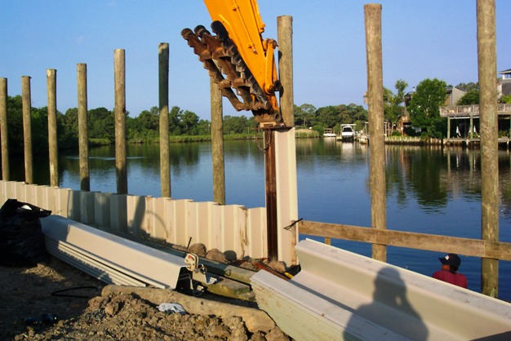
Notes:
Dewatering and excavation are greatest uncertainties in cost estimating. For a full breach, estimate ranges from $2.8 to 5.5 million. A 260 ft breach ranges from 1 to 2.4 million.
Cost estimate assumes a precast girder bridge that allows for full emergency vehicle access – approximately $2 million for full spanning bridge, $1.3 million for half span bridge (260 feet)
Breakwater is assumed to be sheetpile – also about $2 million
For those jotting down numbers as fast as I can talk, suffice to say that there are significant uncertainties in cost estimating at this point, but that a project including half to full causeway breach, a bridge, and a breakwater may cost between $4 million and $10 million.

Slide 18
BOR, Yakima Basin River Operations Meeting, Sept. 3, 2014
Notes:
Why? How do we weigh relative costs and benefits? We have evidence to support the hypothesis that cooler temperatures at the confluence, even for short durations, will allow for upstream passage, and that reduced springtime temperatures and greater flow will disrupt predator metabolisms and lie cycle.

Slide 19
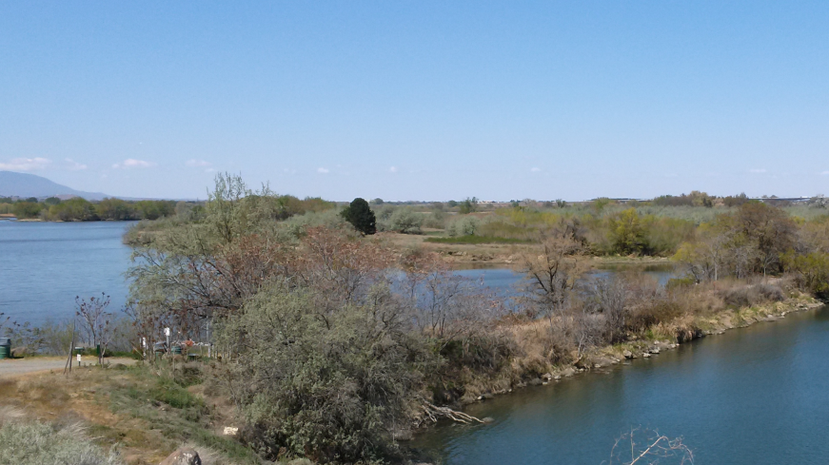
Next steps
Continued public involvement
Permitting
Funding

Slide 20
ftp://ftp.g-o.com/outgoing/MCFEG/Bateman%20Island%20Causeway%20Modifications/
Username: goftp Password: @go.ftp#

Slide 21
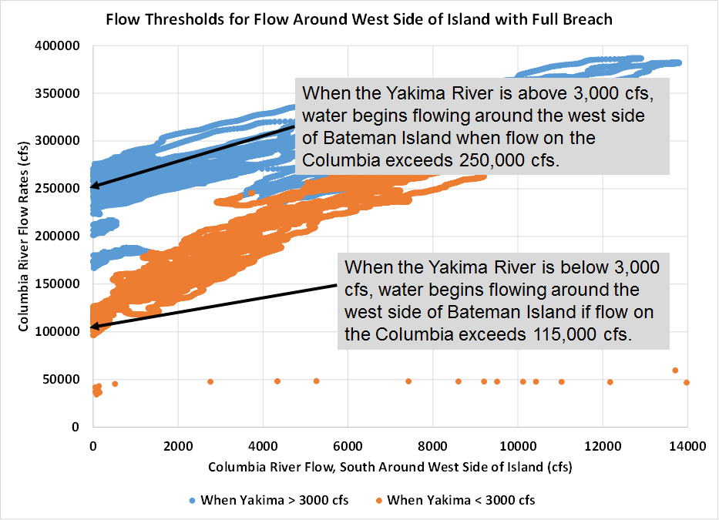

Slide 22
Percent of Total Flow Volume at Causeway Channel by Source (March through October)
Alternative | Yakima River Inflows |  | Columbia River Inflows
 | 2012 | 2014 | 2012 | 2014
6 - 130' Breach | 100% | 99% | 0% | 1%
7 - 200' Breach | 95% | 93% | 5% | 7%
5 - 260' Breach | 76% | 83% | 24% | 17%
3 - Full Breach | 72% | 81% | 28% | 19%
8 – Full breach + Breakwater | 75% | 80% | 25% | 20%
Notes:
Yakima River water dominates the discharge south of Bateman Island under each alternative. It’s relative influence decreases as the size of the breach in the causeway increases.

