Slide 1
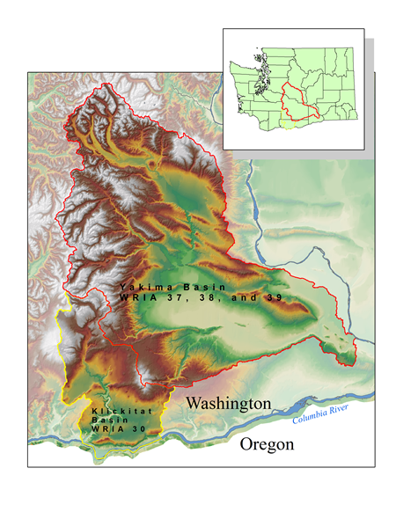

Yakima Klickitat Fisheries Project
Michael Porter
Fisheries Biologist
Avian and Fish Predation Studies
Yakima River Basin
Great Blue Heron PIT Recoveries
Chinook Survival in the Yakima River
Yakima River Fish Predators

Slide 2
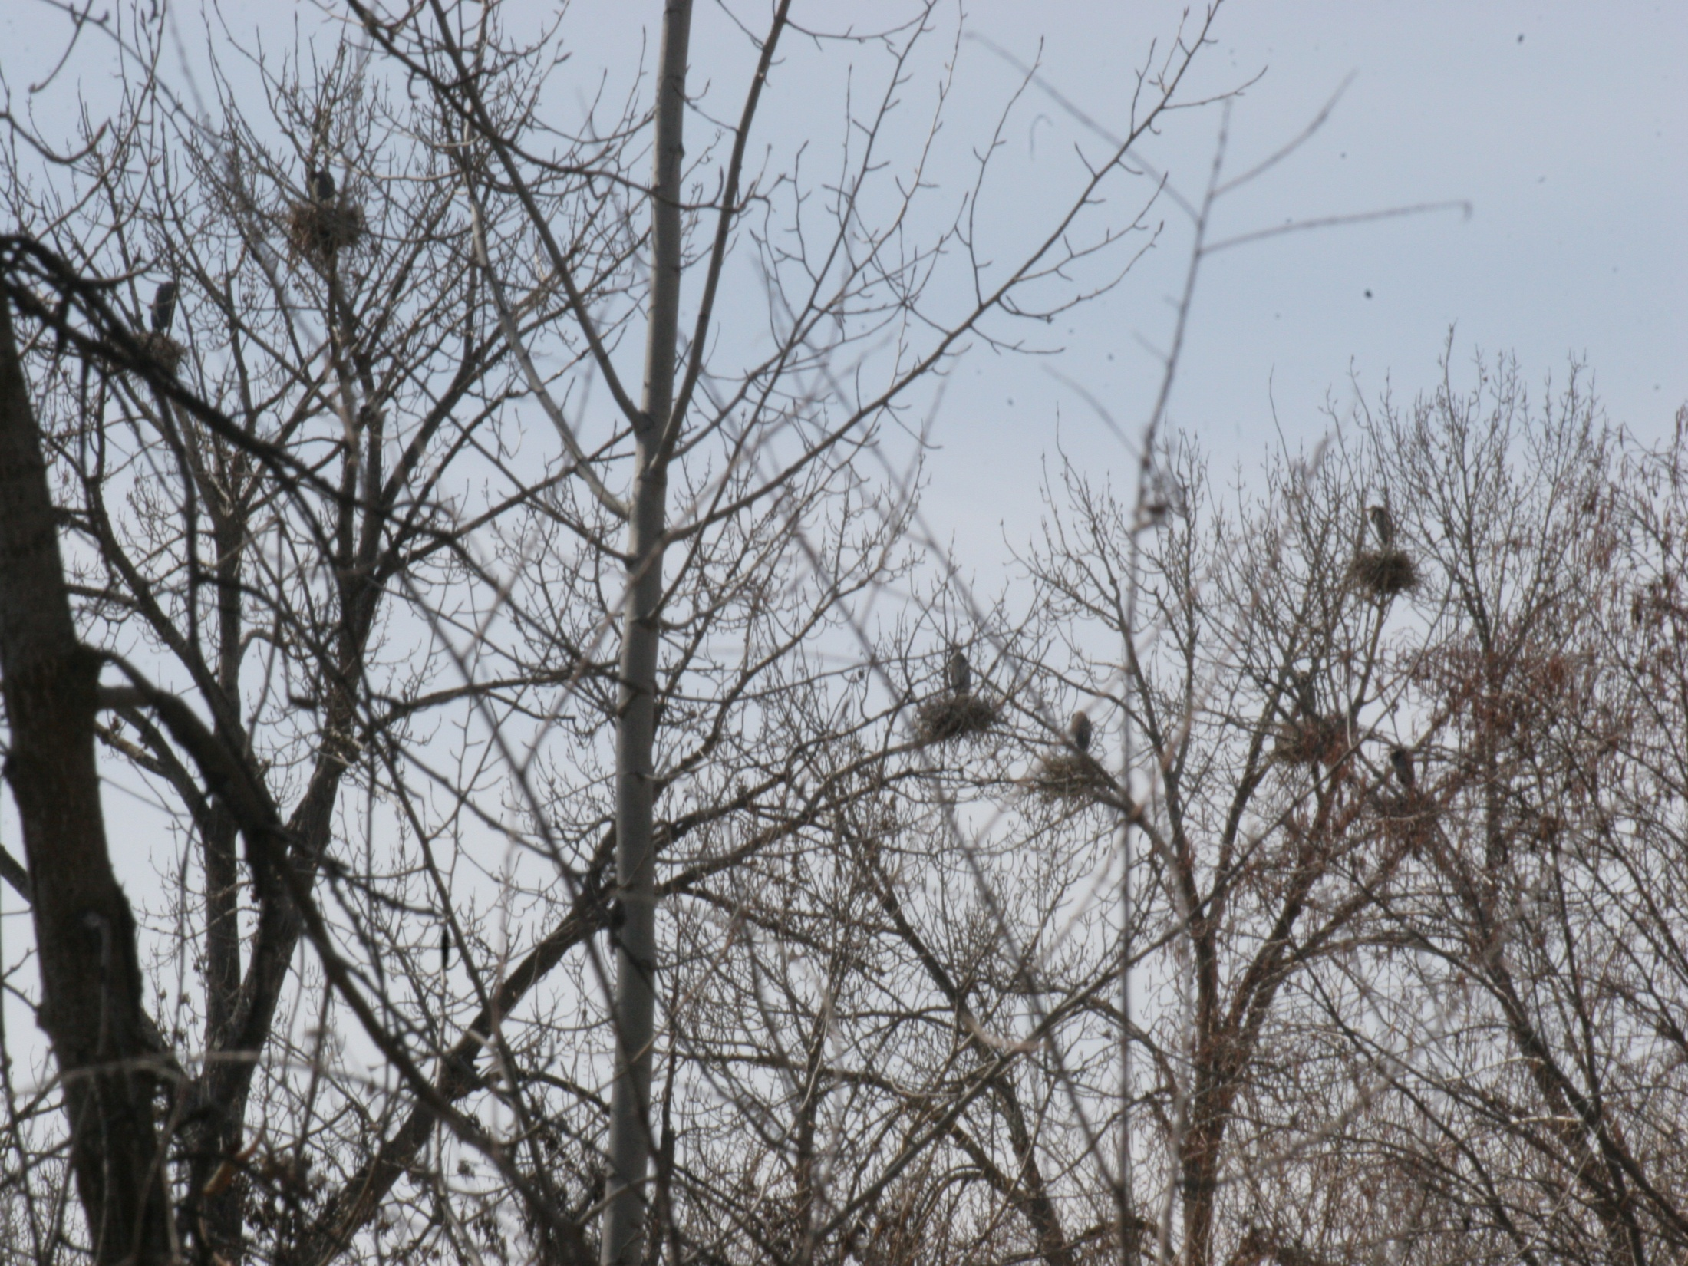
28 Great Blue Heron Rookeries Identified
8 New Rookeries in 2014 and 2015
2 Rookeries Contain Cormorants
PIT Tags – Passive Integrated Transponder Tags
Detailed info – Origin, Run, Rear….
In river interrogation sites tracking tagged fish
Portable Antennas used for scanning

Slide 4
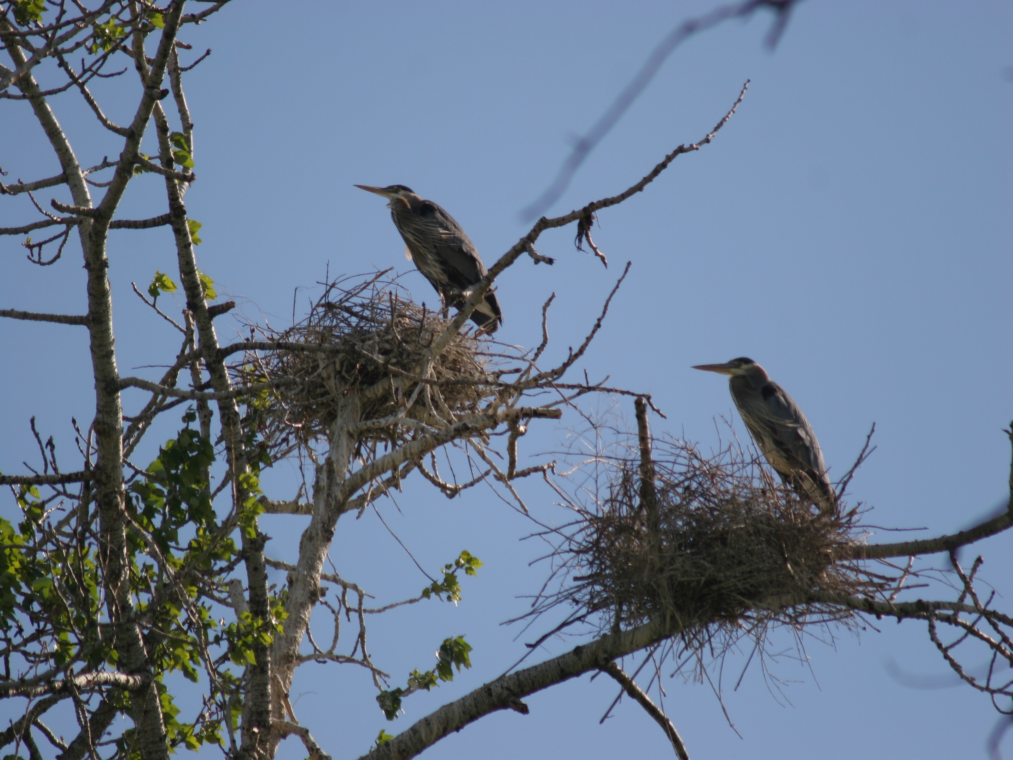
Selah Rookery
Surveys from 2008 to 2013
produced over 3100 PIT tags
Located along the Roza Reach of Yakima River
Frequently drops below the ideal flow regime for smolt out-migration
Creates predation opportunities for wading birds

Slide 5
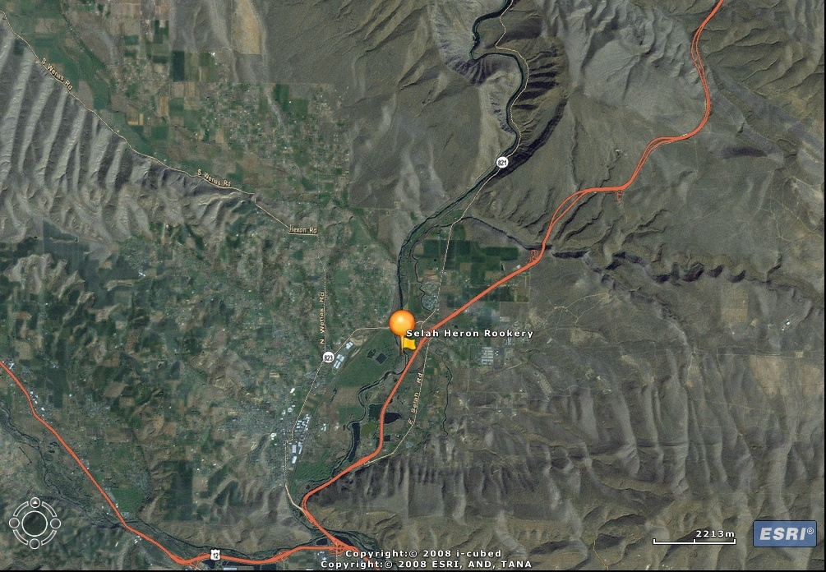
Roza Dam
Roza Reach
Roza Dam to confluence Naches River
Reach Distance - 18.3 Km
Roza Dam diverts water for Irrigation & Power
Naches River

Slide 7
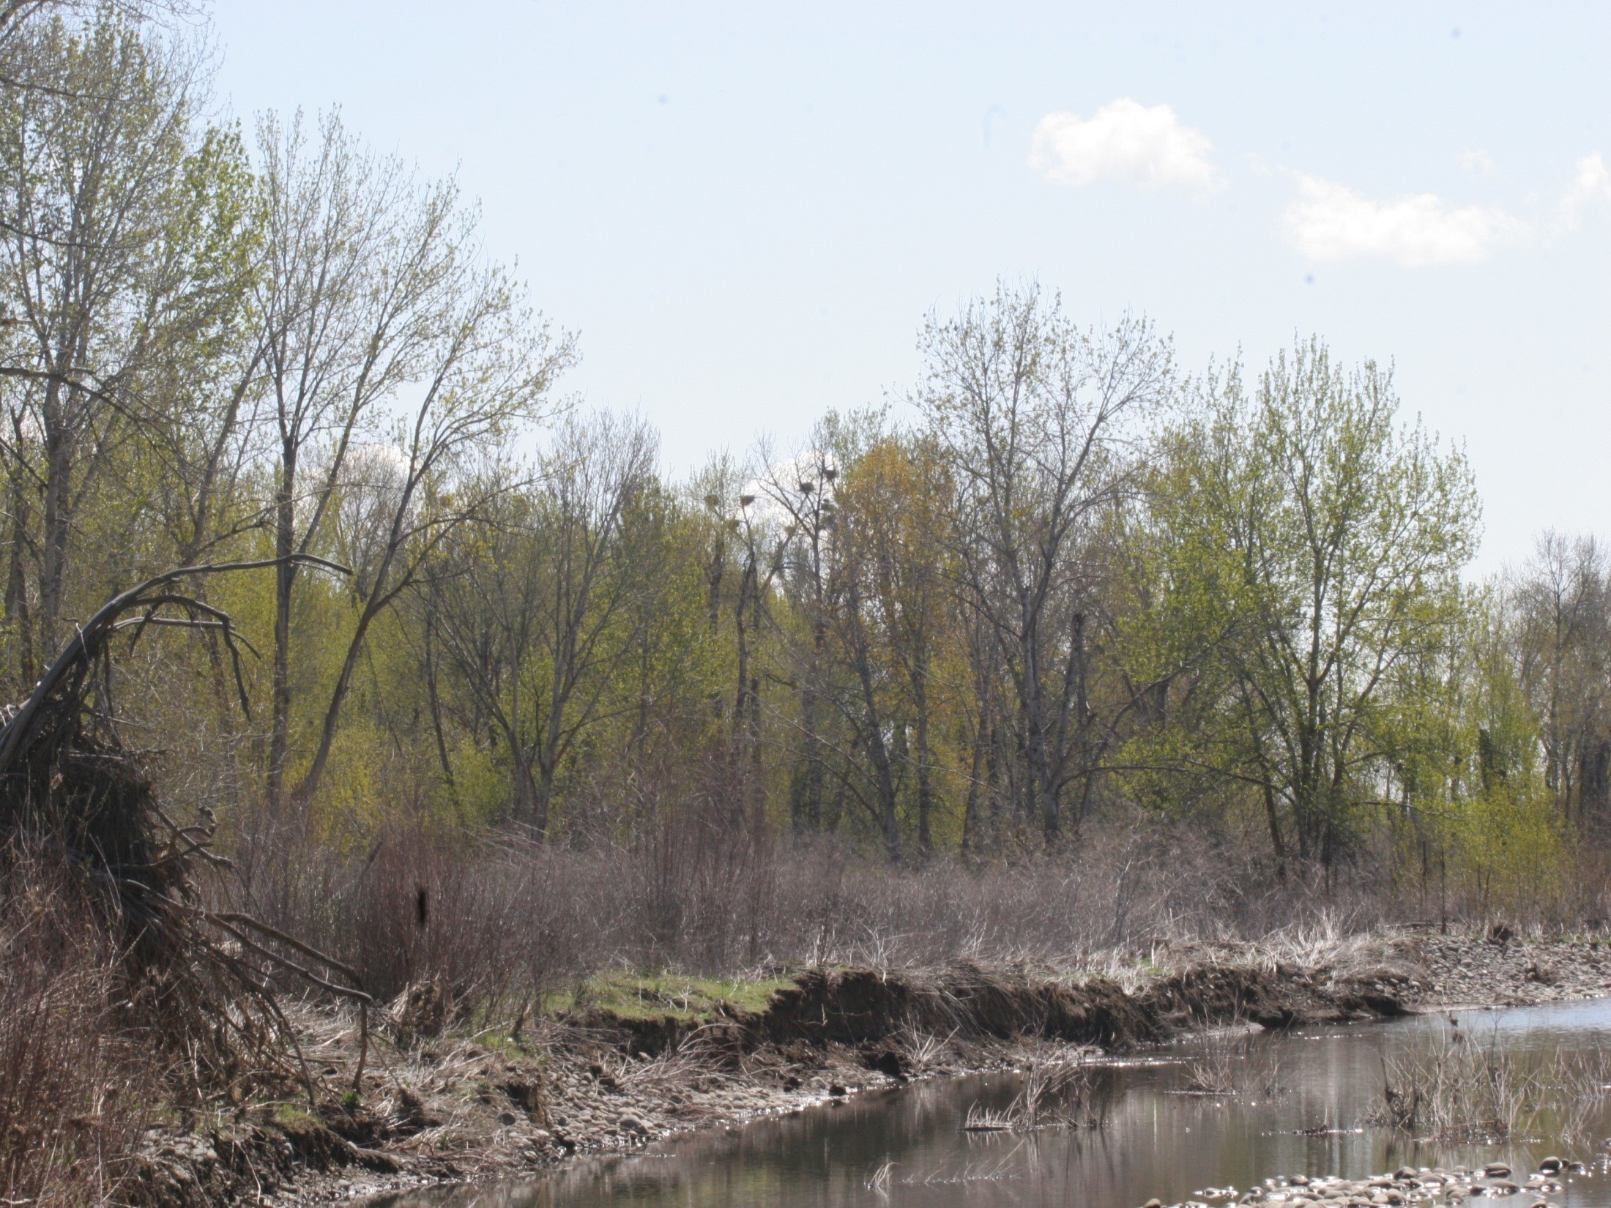
Seeding PIT tags for Detection Efficiencies
Detection Efficiency Results:
Selah Rookery 61%
Wapato Wildlife Rookery 71%
Wapato Wildlife Rookery
Produced – 4097 PIT tags
Located below both Parker and Sunnyside Dams

Slide 9
Great Blue Heron PIT tag Surveys
Useful in pointing out areas of smolt vulnerability to predation
Investigation of close proximity Irrigation Diversion Canals and Fish Screening Facilities
Gives a baseline Mortality

Slide 10
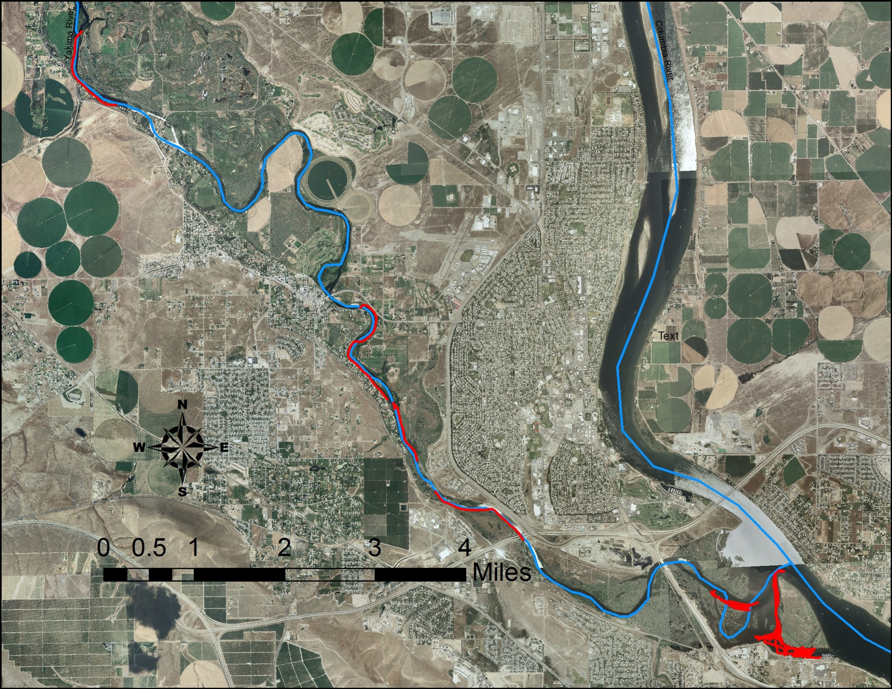
Fish Surveys and Predator Management
Lower Yakima River & the Yakima Delta

Slide 11
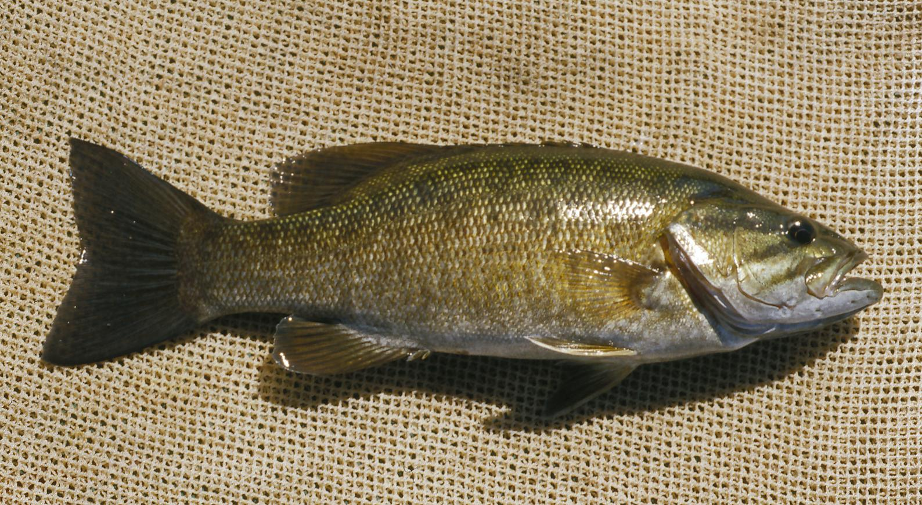
SMALLMOUTH BASS –
Micropterus dolomieu
By 1925, 5000, Smallmouth Bass had been introduced to the
Yakima River and had established resident populations.
The Yakima River serves as a spawning nursery for Smallmouth Bass
coming from the Columbia River

Slide 12
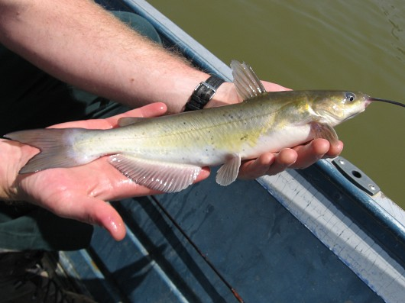
CHANNEL CATFISH –
Ictaluras Punctatus
Introduced into Washington State in 1892 (Lampman 1946)
Channel Catfish naturally produce in only the Columbia , Snake, Walla Walla, and
Yakima Rivers.

Slide 13
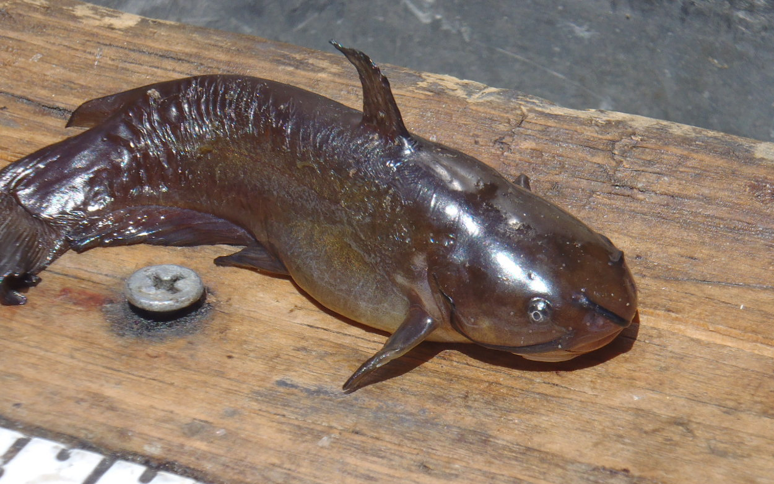
BROWN BULLHEAD –
Ameiurus Nebuloso
Introduced into Washington State in 1882 - 1883(Lampman 1946)
Brown Bullheads inhabit warm-water ponds, lakes, sloughs, and
Sluggish areas in streams. (Yakima Delta)

Slide 14
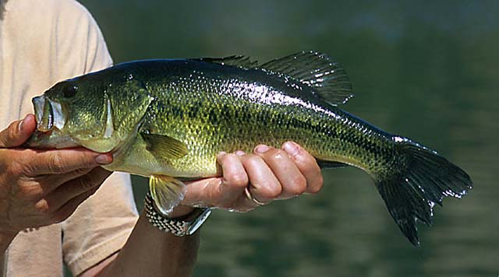
LARGEMOUTH BASS –
Micropterus Salmoides
Widely introduced into Washington by 1895 the Largemouth Bass
has established large populations in much of the Columbia River
is frequently present in the Delta of the Yakima River

Slide 15
Lower Yakima River and Delta
23 Fish Species

Slide 17
Yakima Delta Fish Survey Areas

Slide 18
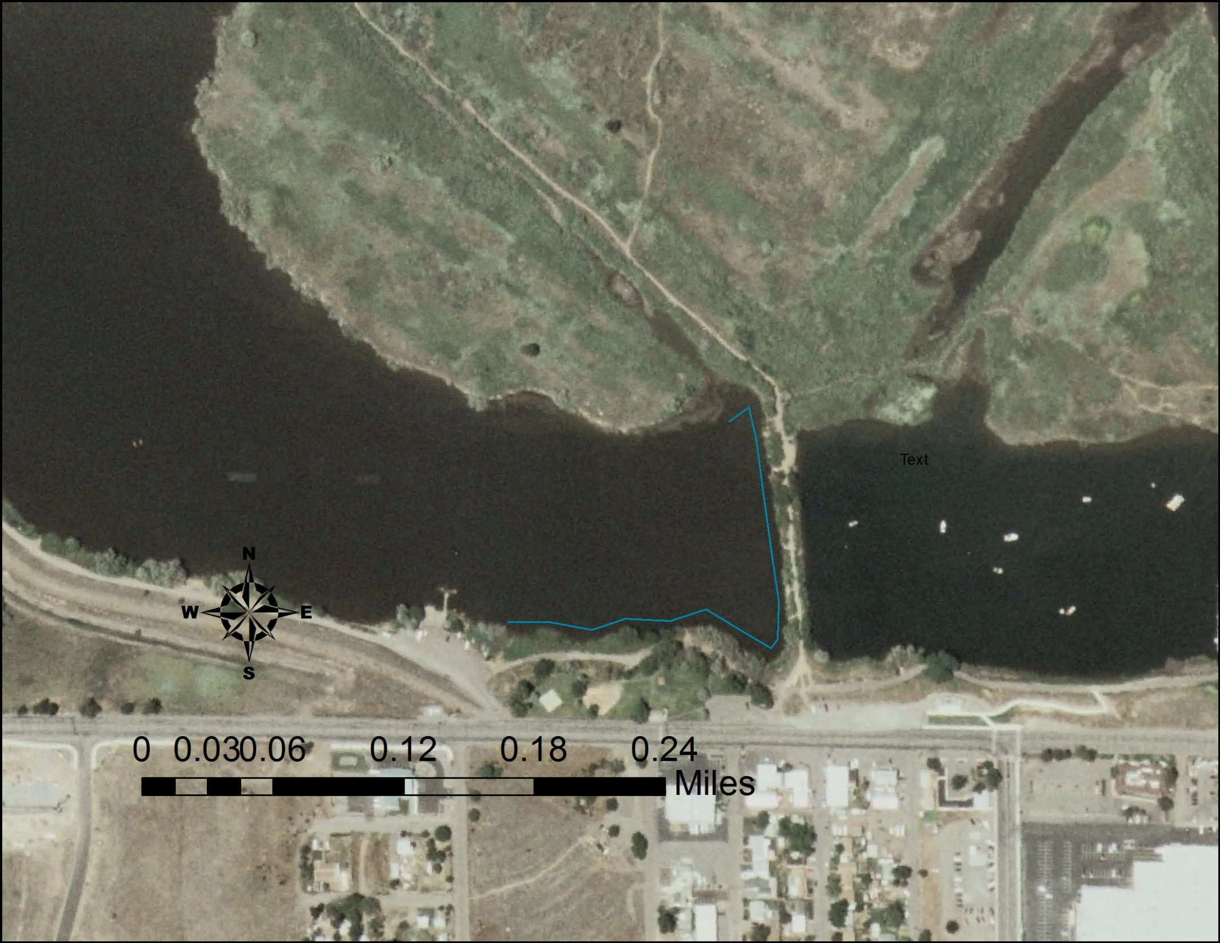
West of Causeway Below Bateman Island Displayed Greatest Utilization of Non-native fish species and piscivorous fish
Abundant Numbers of:
Smallmouth Bass
Largemouth Bass
Brown Bullhead

Slide 20
Sub yearling Chinook Survival
Prosser to McNary Dam survival limitations
Mortality in relation to Temperature
Parceling out areas of Sub yearling Chinook Losses
Survival as a function of Temperature
Fish Predation
Avian Predation
Acoustic Tags

Slide 22
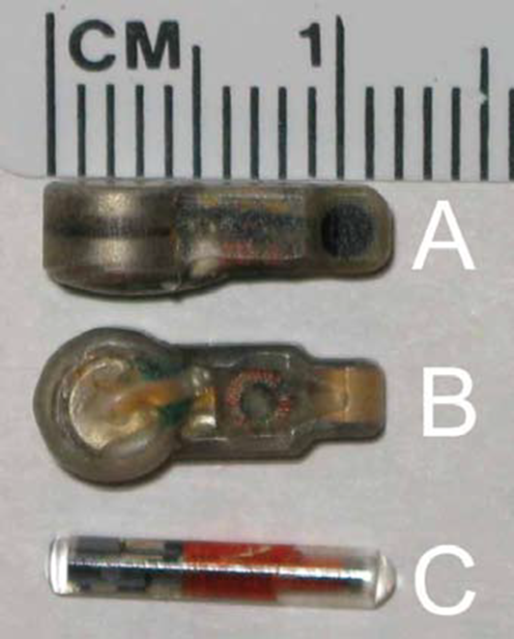
ATS Acoustic Tags
Used to investigate the location and level of sub yearling Chinook losses in the Lower Yakima River

Slide 23
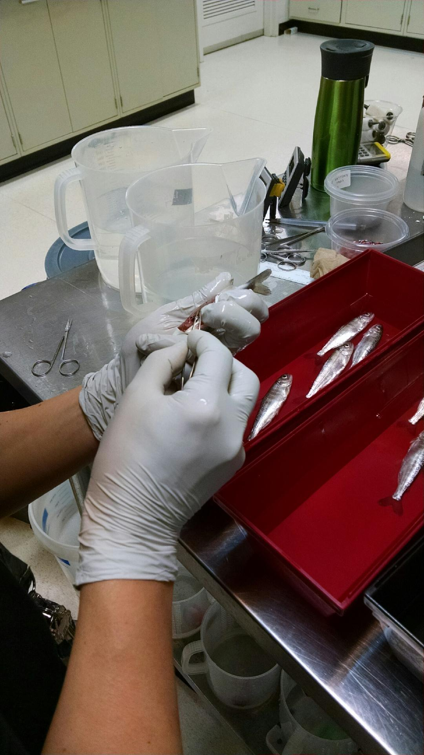
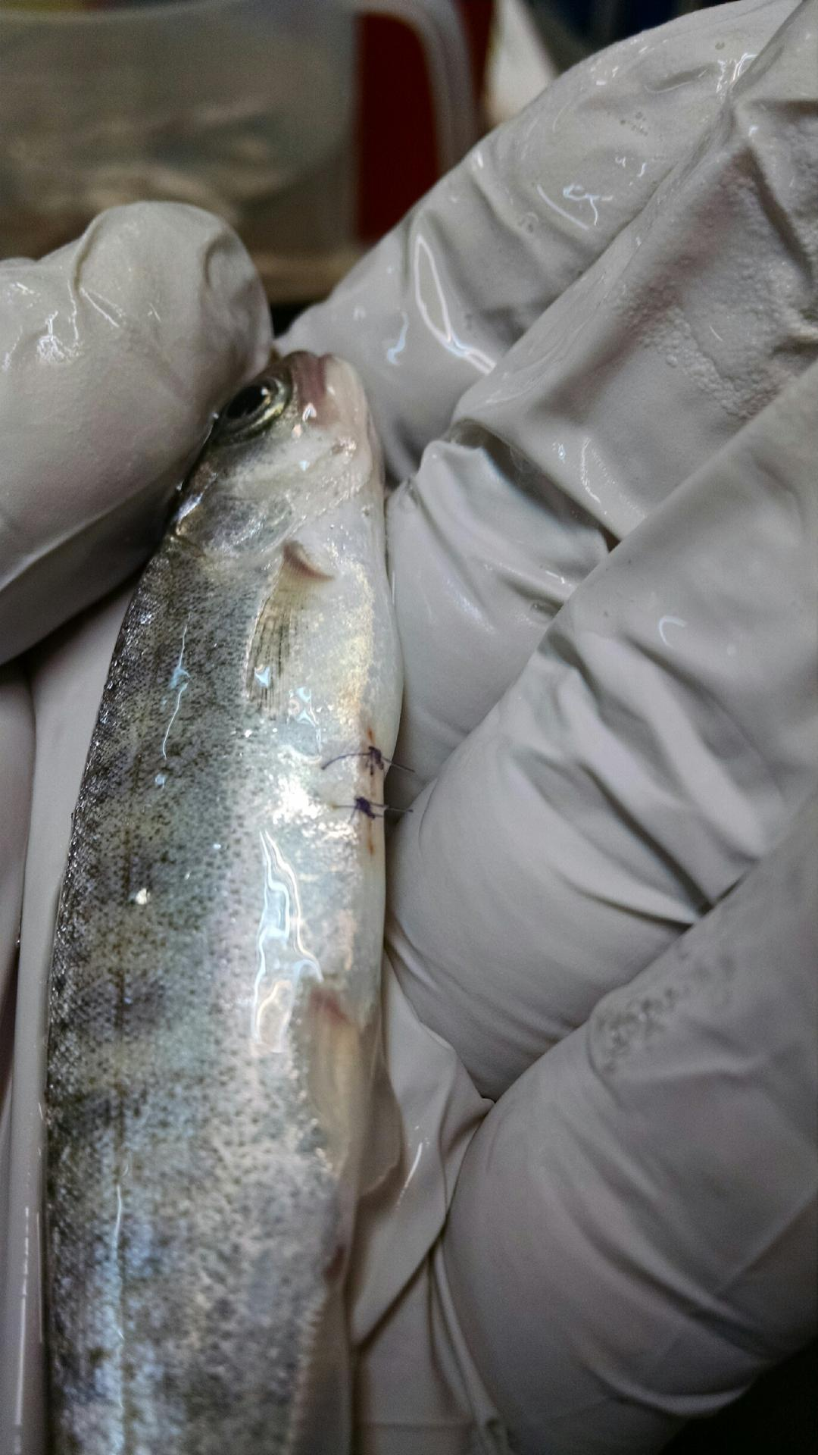

Slide 24
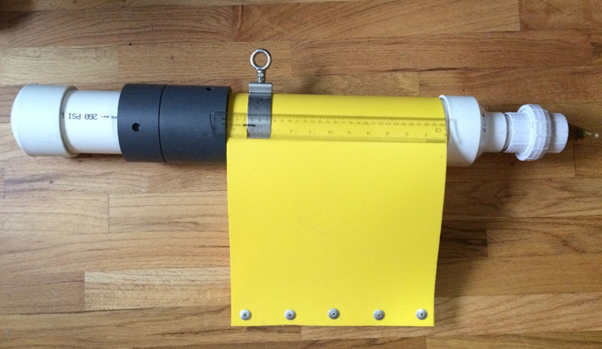
Acoustic Tag Receiver
12 ATS, Trident SR3000 Receivers will be strategically located in the Lower Yakima River and the Columbia River these will be paired with temperature gages

Slide 25
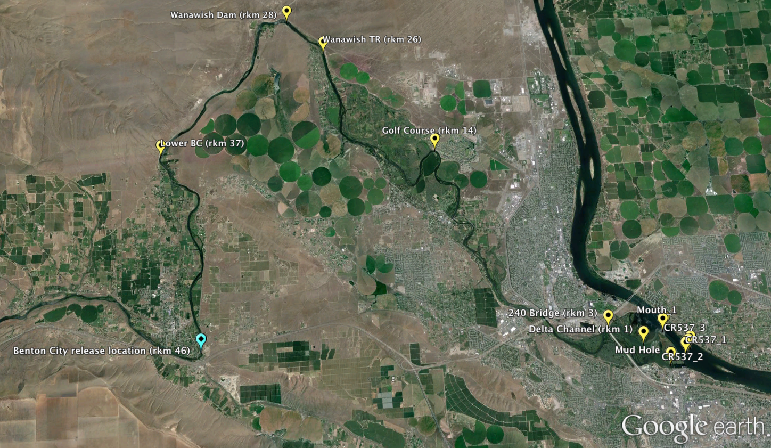

Slide 26
Acoustic Tag Pilot Study
Determine Location and Magnitude of Sub yearling Chinook Losses
Attempt to Identify Mortality Causes
Fish Predation
Avian Predation
Temperature
Structure
Water Flow

Slide 27
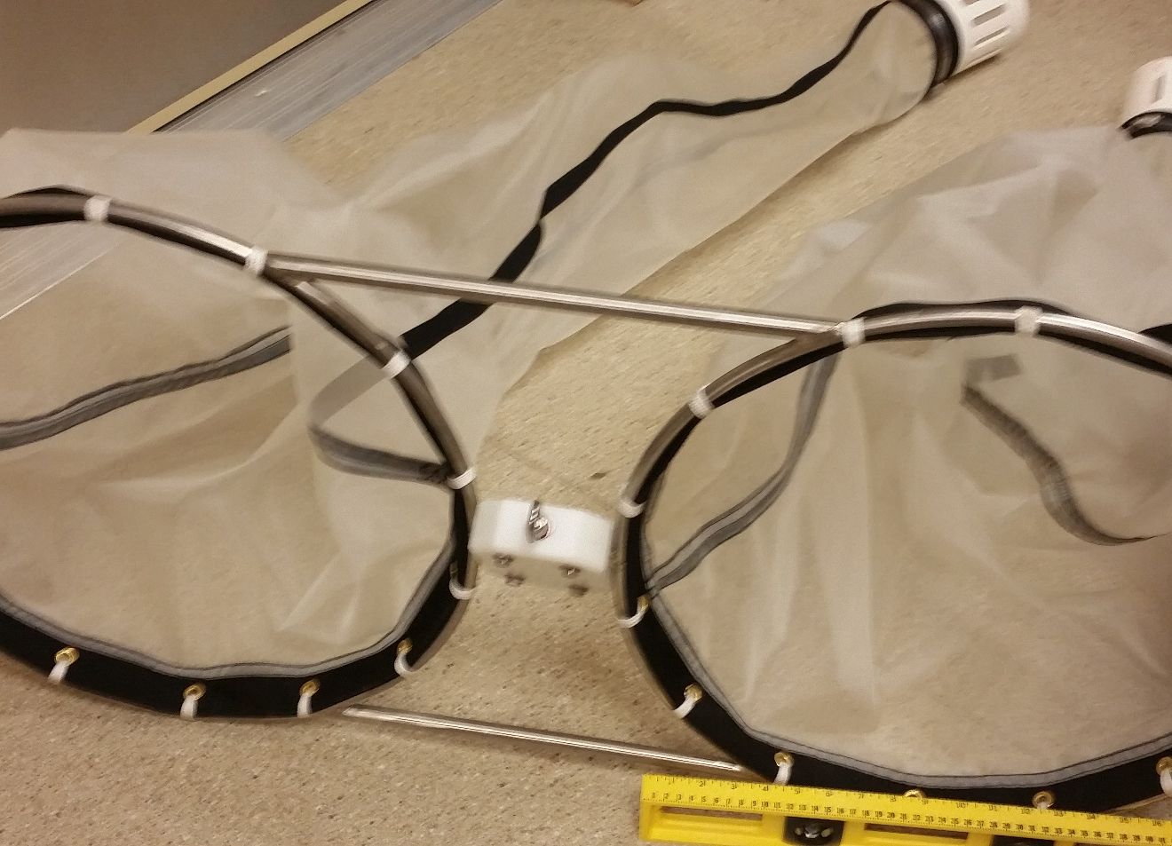
Yakima Delta as a non-native fish predator rearing area
Use Towed Bongo Nets to collect Larval Fish for identification

Slide 28
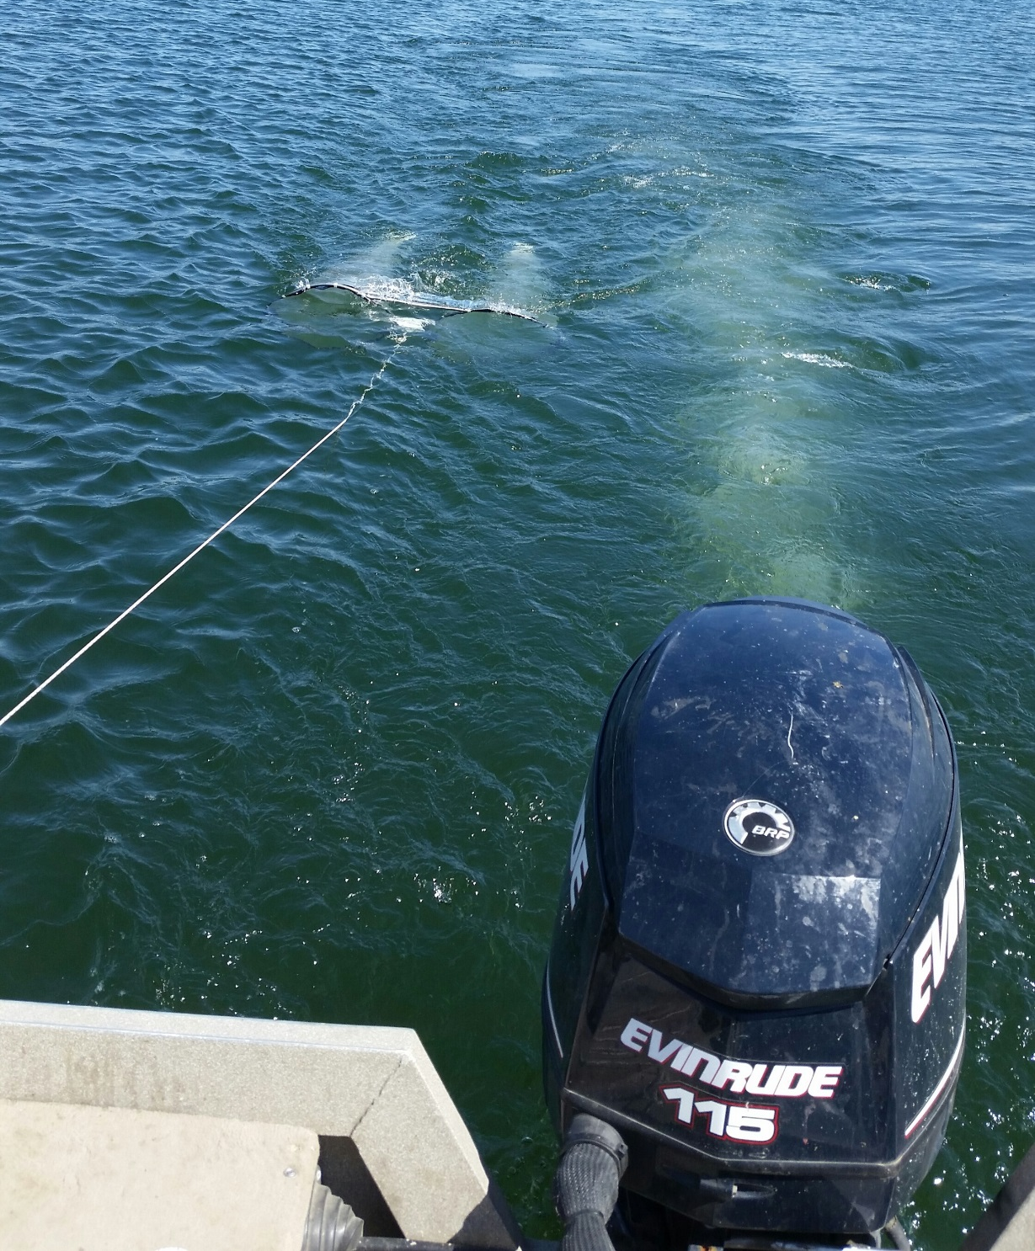

Slide 29
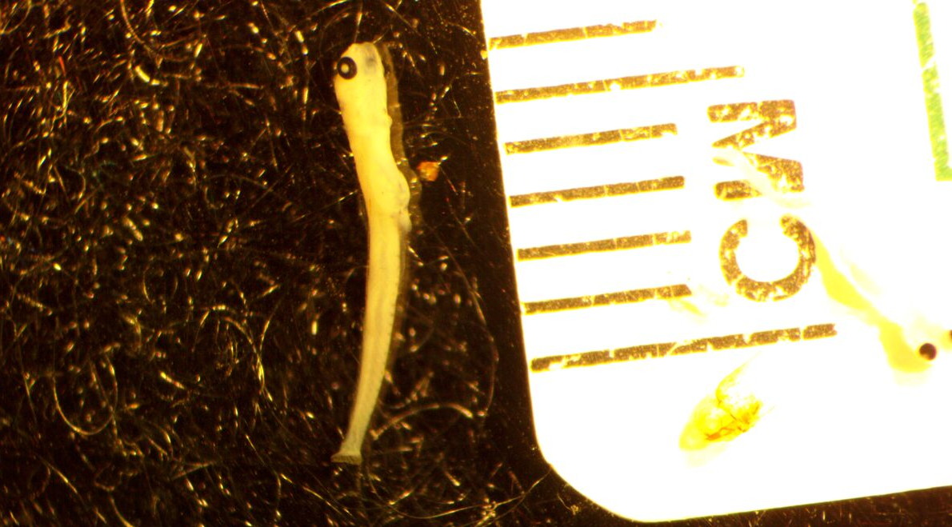
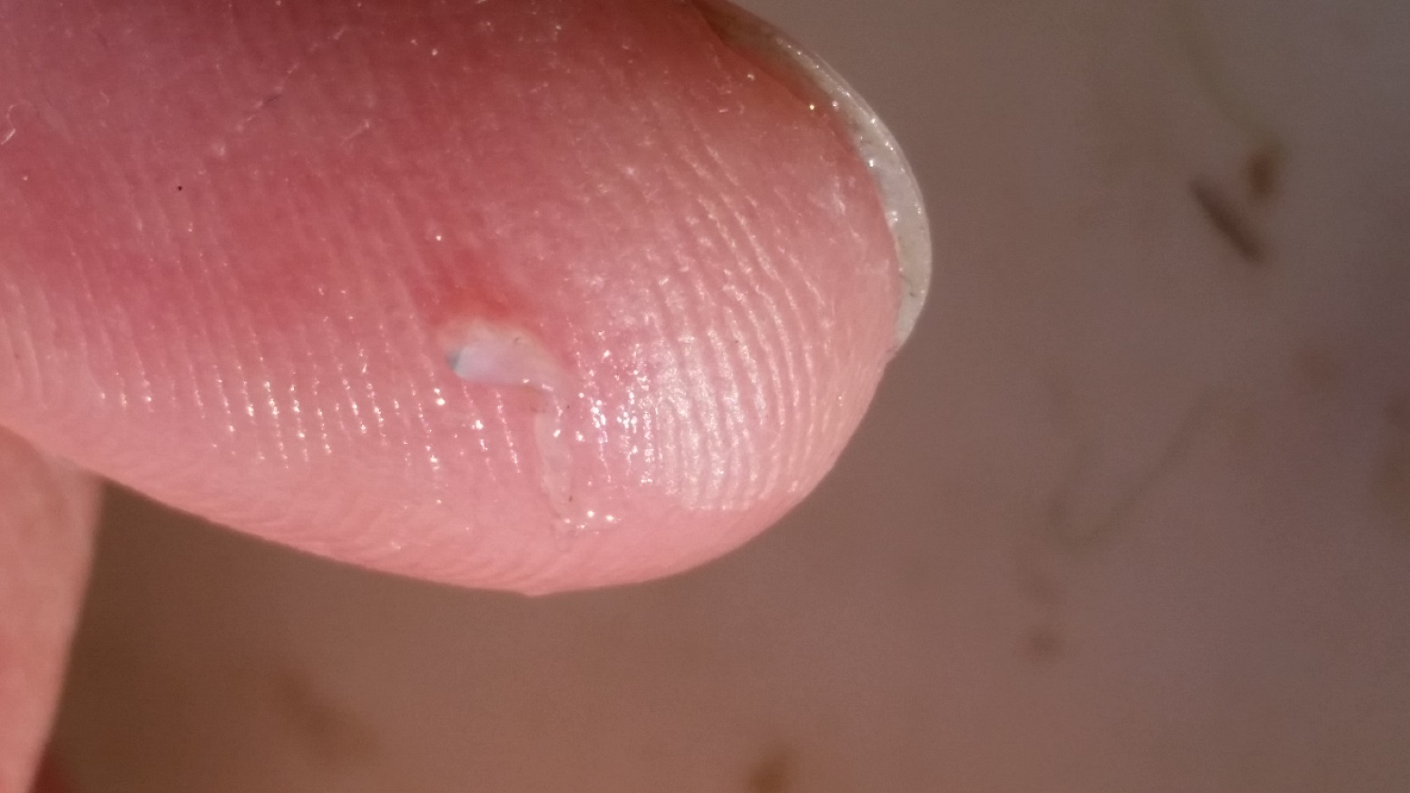

Slide 30
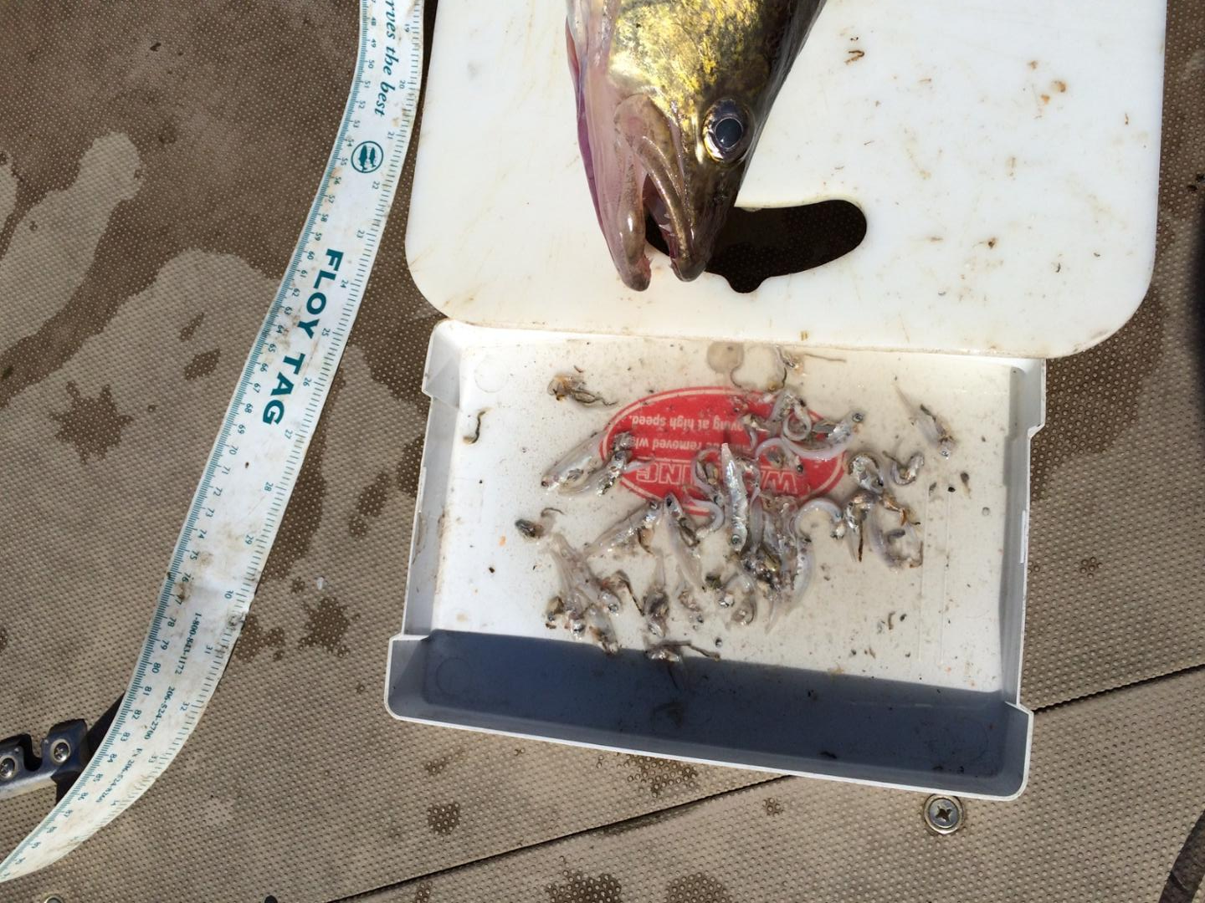
Implications of non-native fish predators rearing in Yakima River Delta
Larval Walleye in lacustrine Yakima
Adult piscivores actively spawning in Yakima River
Various non-native piscivores rearing in delta
Unknown component of Walleye predation

Slide 31
Yakima Delta – Bateman Island Causeway
Blocks Yakima River Flow
Creates an unnatural River Delta with stagnant water
Stagnant pool raises water temperatures and creates recruitment habitat for exotic predator fish species
Creates a thermal barrier for adult salmon migrating to the Yakima Basin by mixing with flowing river water
Changes to the Delta structurally
Water management may cause failure in year classes of exotic predators

Slide 32
Acknowlegments
Mainstem Fish Research
Pacific Northwest National laboratories

Slide 33
Questions?

