Slide 1
2015 Yakima Basin Science & Management Conference June 17, 2015
Why Whooshh?

Slide 2
Presentation Overview: Who We Are What We’ve Done Where We’re Going

Slide 3
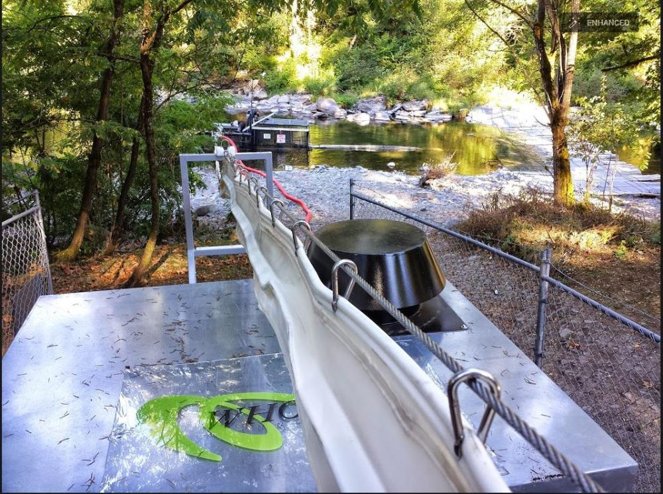
WDFW’s Washougal Weir Mobile System operates as part of fall Chinook Hatchery program.
The weir is used to collect hatchery and natural origin fish for broodstock.
The weir is also used for controlling hatchery fish on the spawning grounds.

Slide 4
Washougal Weir Mobile System
Takes half the time to load truck or surplus excess hatchery returns
Time saving allows for higher number of hatchery fish removed - control pHOS
System was funded by Pacific Coast Salmon Recovery Funds (PCSRF)

Slide 5
Supporting Studies to Date
2011
CRRL Testing
50’ system
2013 & 2014
Norway
250’ and 460’ systems
2013-14
YN Roza Facility
No difference finding
Results published in 2013 - Mesa
Excellent hygiene and handling
Up to 1,000 fish/hr in 460’ system
40’ system
Mortalities ½ of traditional system
Egg survival=98.7%

Slide 6
Supporting Studies to Date
SPRING 2014
250’ system
FALL 2014
120’ mobile system
Moved 10,000 in half the time
FALL 2014
40’ and 250’ systems
Egg survival = better than control group
WDF&W
No difference in survival v. control group
Live steelhead
Better for fish and people
WDF&W
No evidence of damage
PNNL/DOE

Slide 7
“The fish fly right through without so much as a scratch. Also, you won’t have to divert water, as you do in a ladder system. Out here, the economy is all about agriculture, and water is gold. That’s what makes Whooshh such a great concept.”
Roza Dam: Yakama Nations Controlled Study
--Mark Johnston, Research Scientist – Yakama Nation Fisheries

Slide 8
Roza Dam Study Results
S
Summary:
40’ Whooshh Fish Transport System
554 Spring Chinook
(Wild & Hatchery Control)
Collected: May - June
Held: May - October
Spawned: September - October
Results:
Mortality rate of “whooshed” fish
= half of traditional method
percentage: statistically
Egg survival percentage statistically
equivalent (783,495 eggs)

Slide 9
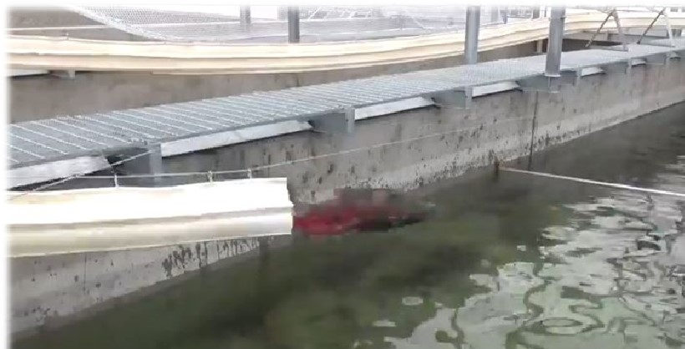
PNNL Study: Slime, Stress, and Survivability

Slide 10
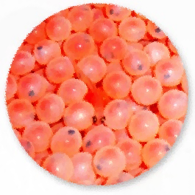
Pnnl Study Results
PNNL Study:
PNNL evaluated the efficacy of this technology with adult fall Chinook Salmon (Oncorhynchus tshawytscha) by comparing the physical, physiological, and reproductive effects of passage through two different lengths (40’ and 250’) of the Whooshh Fish Transport System (WFTS) to trap and haul, a standard method used to move fish around in-river barriers.
Key Findings:
No mortalities or obvious signs of injury to fish.
Immune responses and egg survival similar between Whooshh and trap and haul.
Effects of Whooshh comparable or better to that of a trap and haul.

Slide 11
PNNL Fluorescein Comparison Control v. Whooshh

Slide 12
Representative Applications
Volitional Live Fish Passage
Separation of Live Fish from Hatchery Fish
Hatchery & Broodstock Handling
Transport & Surplus
Whooshh & Haul
(Fish Rescue)

Slide 13
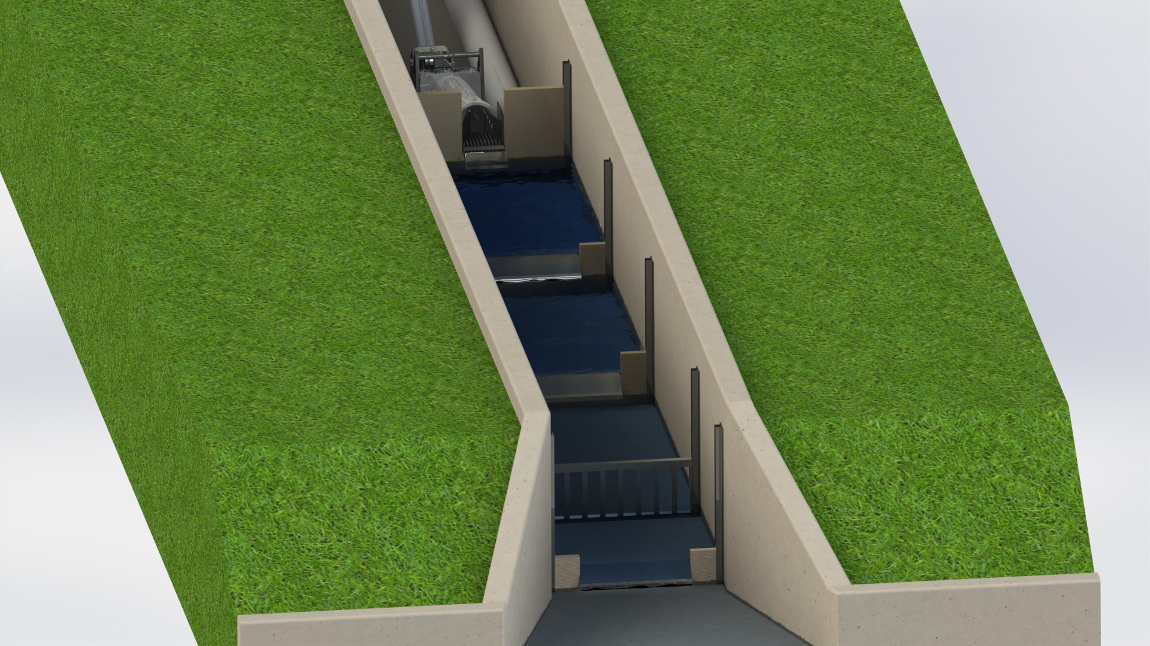
Volitional Entry - Side Channel

Slide 14
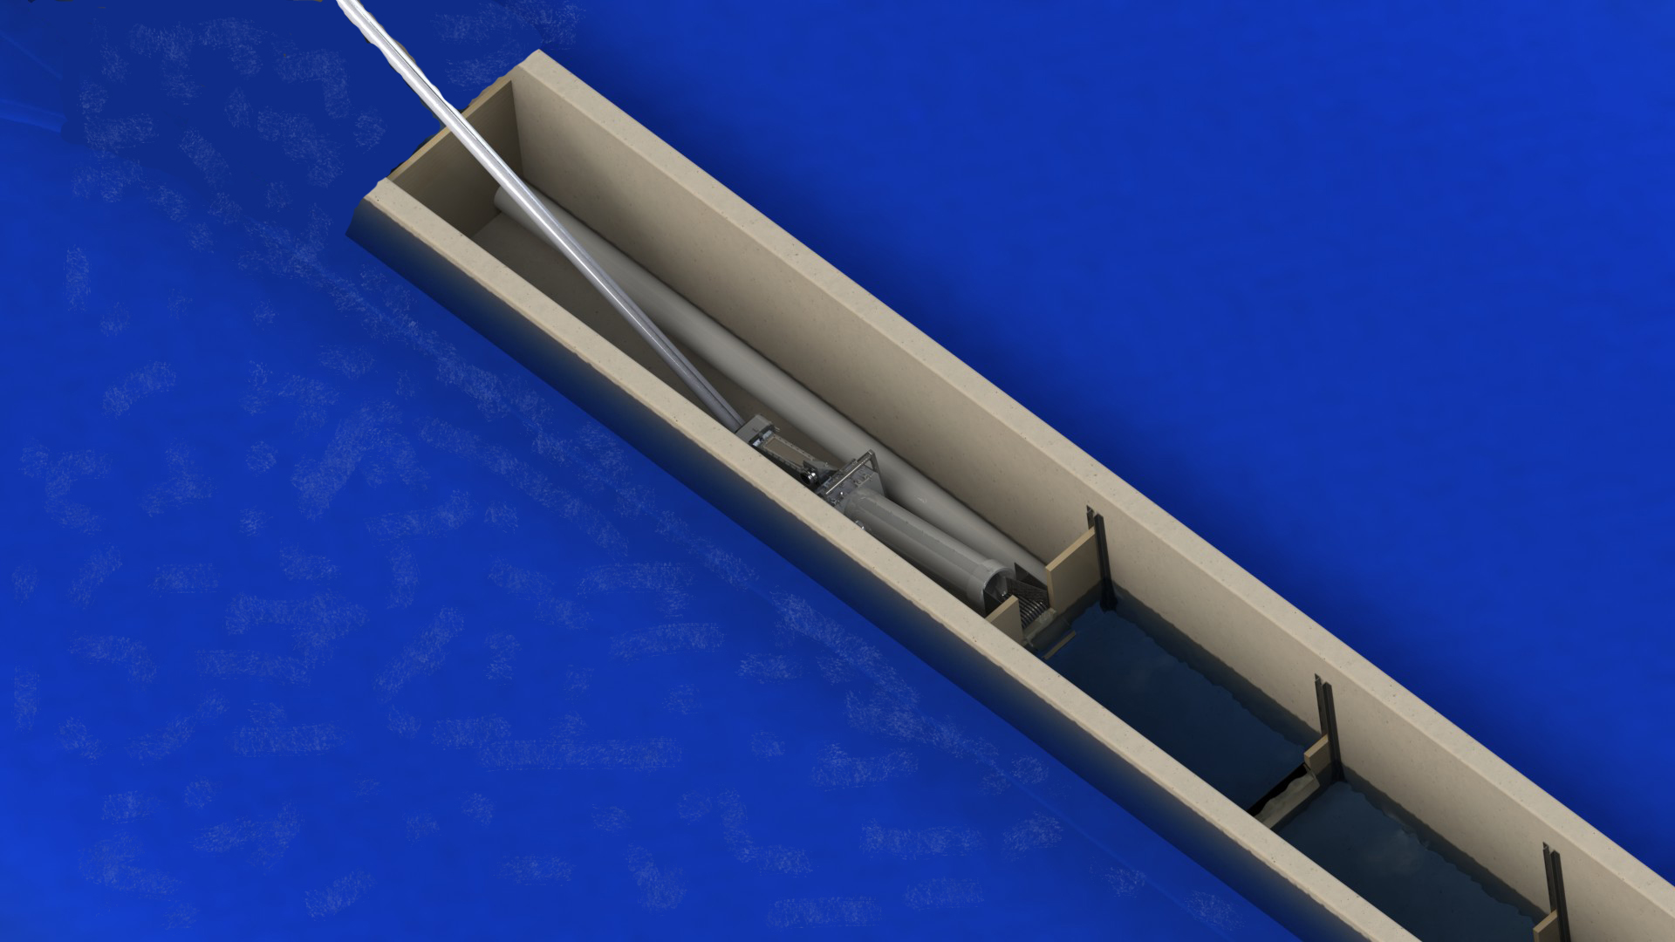
Volitional Entry - Mid-River

Slide 15
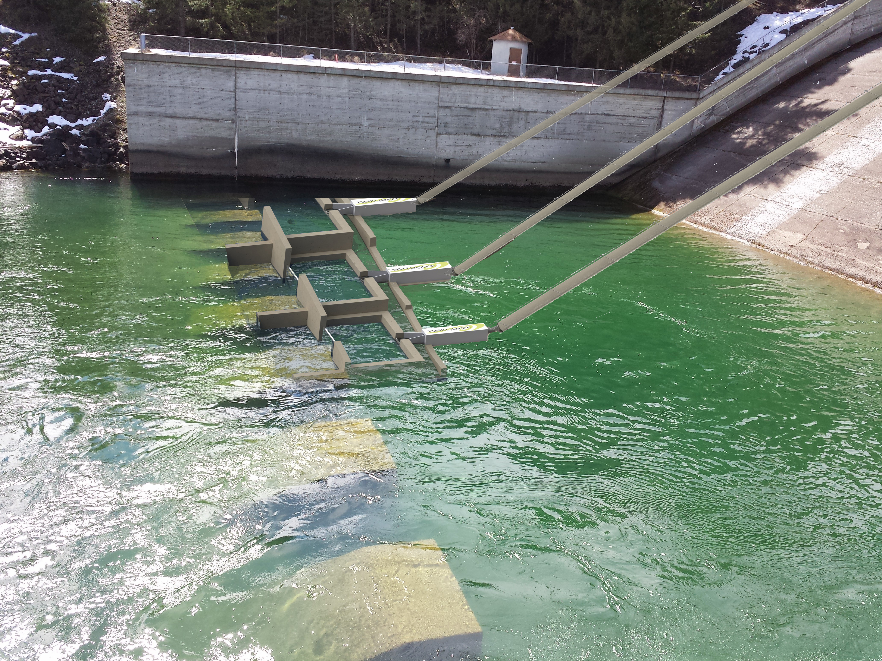
Volitional Entry - Permanent

Slide 16
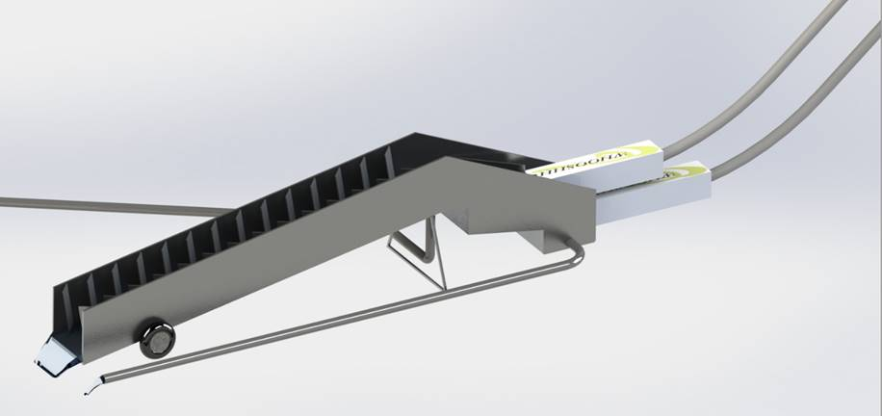
Volitional Entry – Seasonal

Slide 17
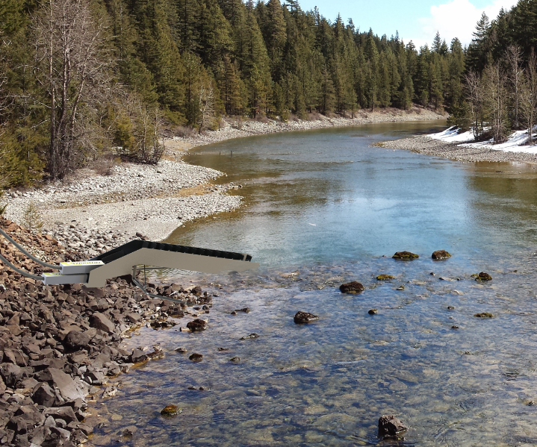
Volitional Entry - Seasonal

Slide 18
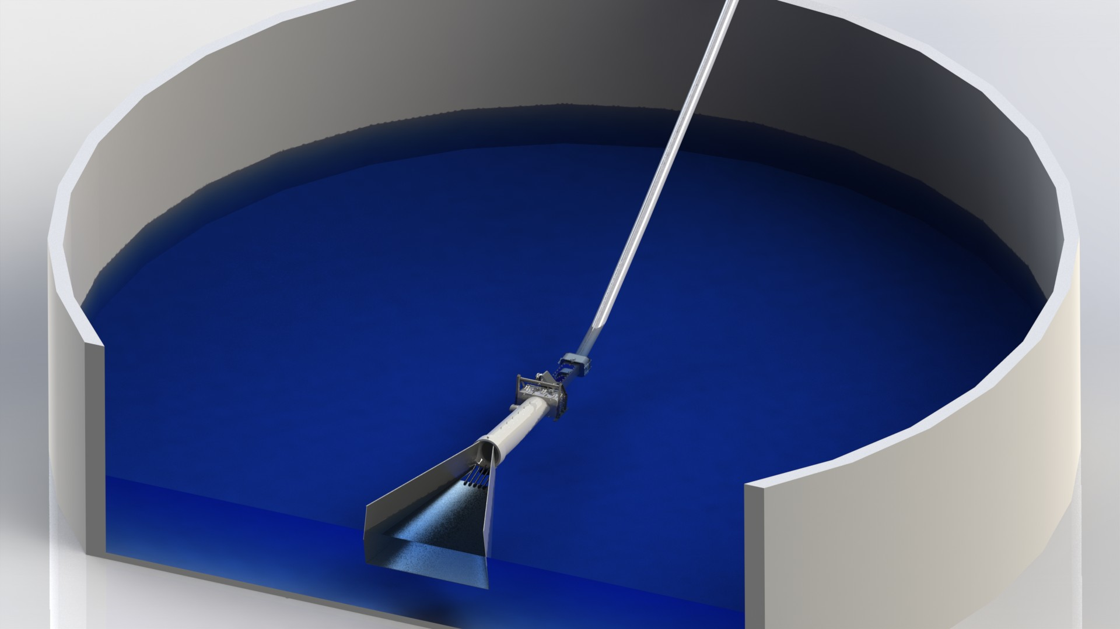
Assisted Entry – Mid-Tank/Trap
Notes:
One point we want to make here on this slide. We’ve had a lot of interest from aquaculture producers, who are interested in our system for their grow-out tanks as well as broodstock operations. Given the fact that in such operations, a single fish is worth at least $2,500, they’re looking for a “kinder, gentler” way to move fish from tank to tank within their operations.

Slide 19
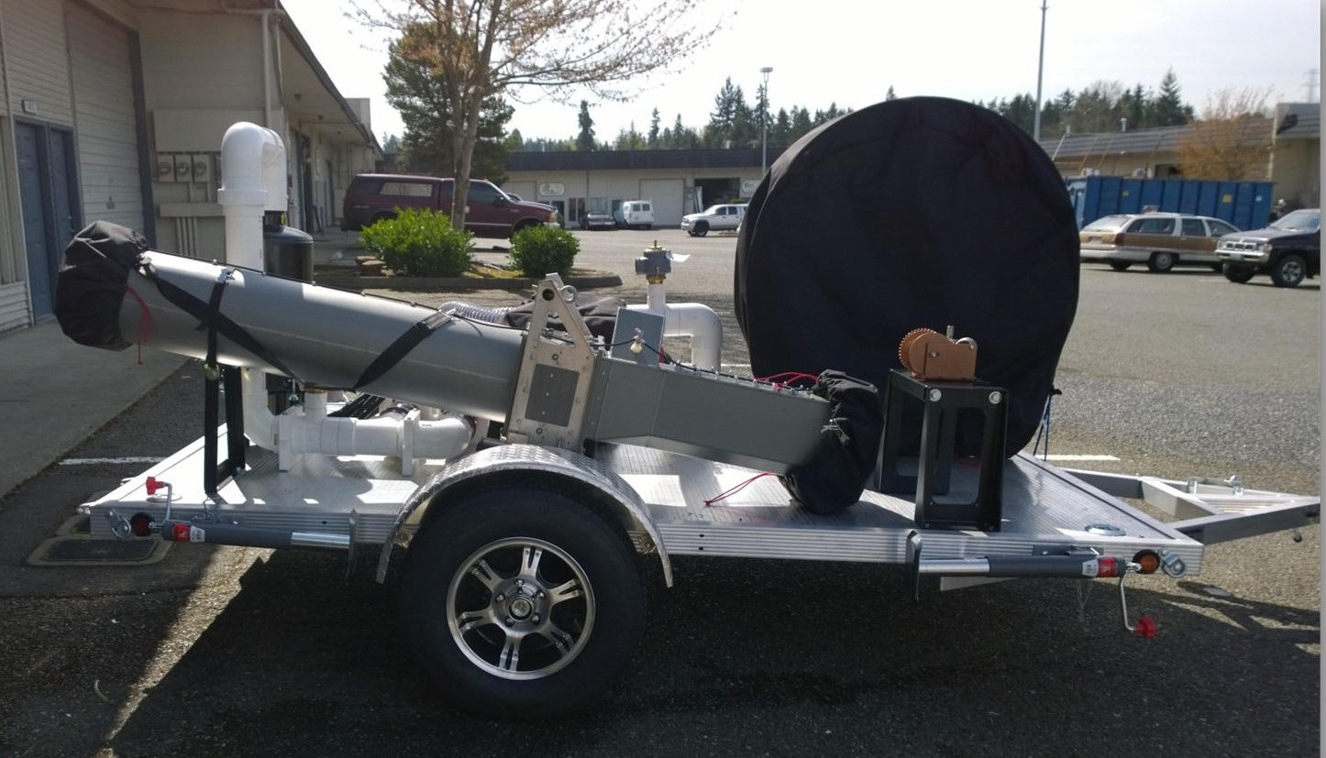
Mobile Fish Rescue Unit
Notes:
Reference the drought emergency—and the fact that we may be needing to use this system in Washington State.

Slide 20
Component Options
Scanning/sorting/data collection

Slide 21
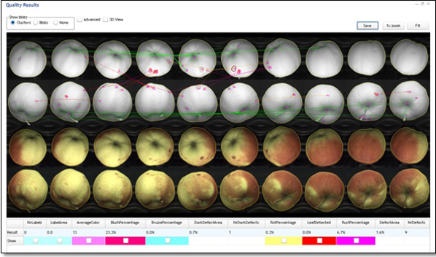
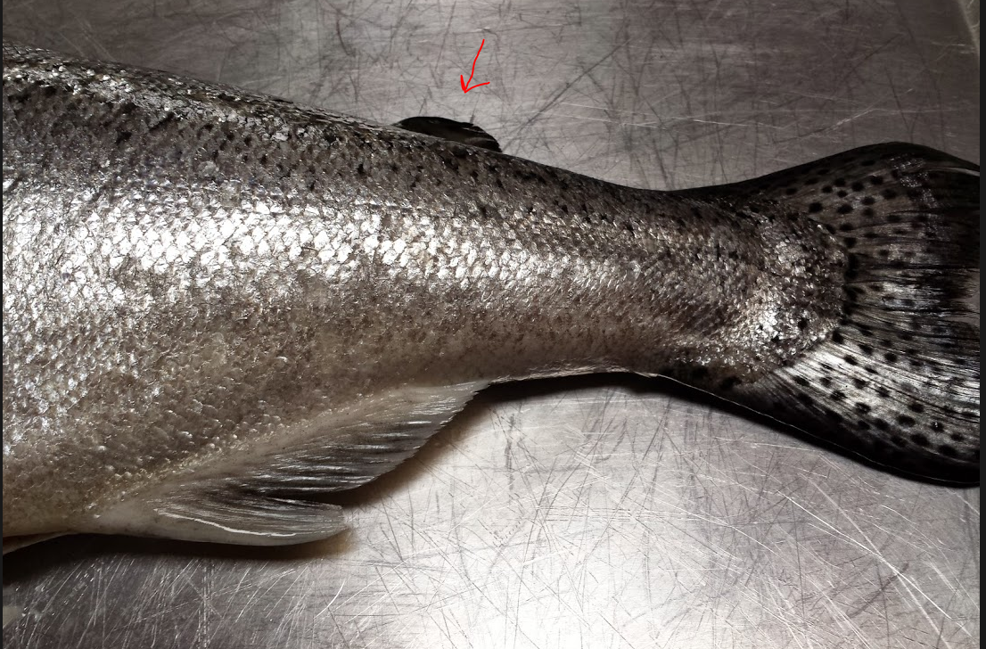
Component Options
Sorting – Hatchery v. Wild

Slide 22
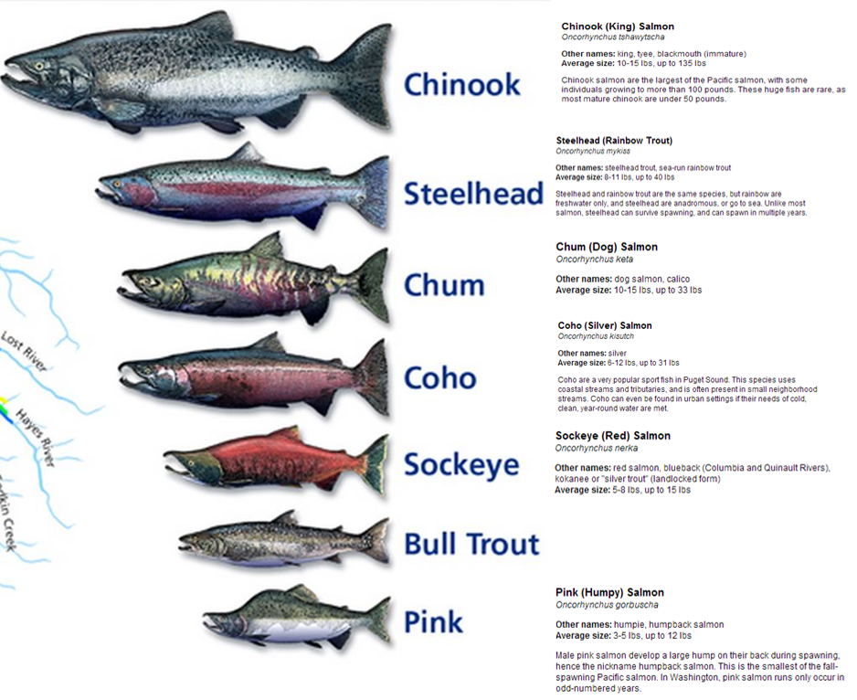
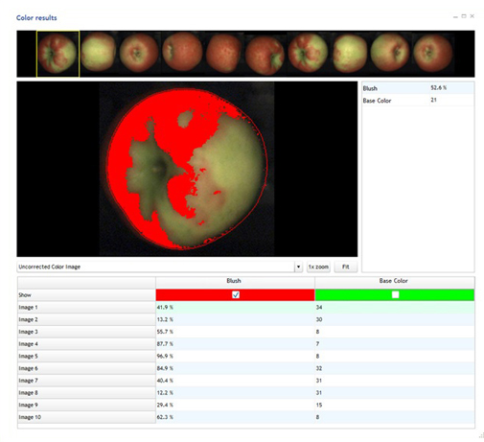
Component Options
Sorting - Species

Slide 23
Why NOT Whooshh? Thank You!
WHOOSHH.COM

