Slide 1
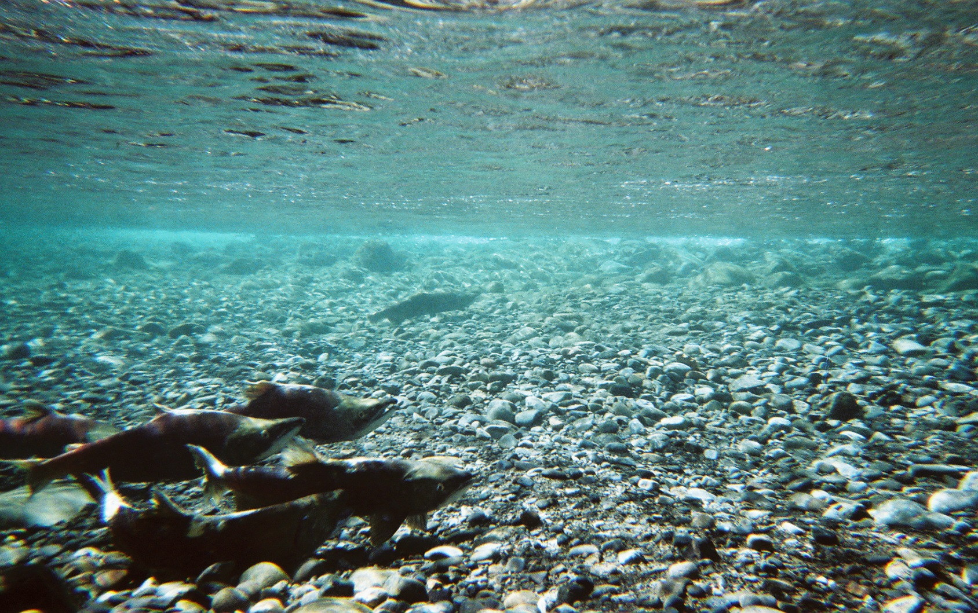
Yakama Nation: Sockeye Reintroduction Passage Update
Mark Johnston, Dave Fast, & Brian Paul Saluskin

Slide 2
SOCKEYE REINTRODUCTION
Two donor stocks Lake Wenatchee and Lake Osoyoos
Letter to Grant County Public Utilities District to use Adult trap at Priest Rapids Dam
Received a transport permit from Washington Department Fish & Wildlife
Notified all interested Agencies on our intensions
Contacted local land owner on accessing his property to release sockeye

Slide 3
SOCKEYE REINTRODUCTION
After escapement goals are reached at Bonneville Dam of 80,000 returning sockeye, a collection can begin at Priest Rapids Dam
The adult take starts at 1000 and can increase to 10,000 as the run increases the take increases per PAC approved sliding scale
Adult Take Numbers:
1000 in 2009
2500 in2010
4100 in 2011
10,000 in 2012
3996 in 2013
10,000 in 2014
Notes:
3
After escapement goals are reached our adult take and transfer can begin. The Production Advisory Committee approved a sliding scale so as the run increases the take can increase, ranging from 1000 to 10,000 adult transferred per year.

Slide 4
SOCKEYE REINTRODUCTION
Bio-sampling helps determine which stock is succeeding in the project Lake Wenatchee and Lake Osoyoos, this occurs at four different times in the reintroduction:
1.) Priest Rapids Dam adult collection
2.) On spawning grounds (carcass surveys)
3.) Smolt migration at Roza Dam and Chandler JV
4.) Returning adults back to the Yakima Basin
Smolt Production/Migration

Slide 5
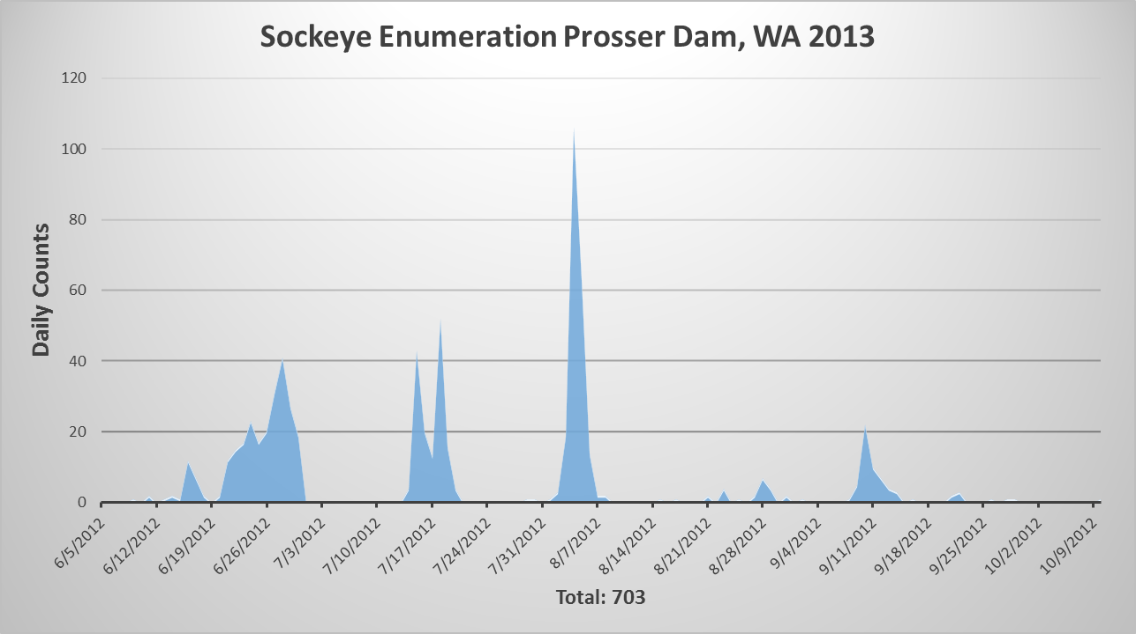
FIRST RETURNS
In 2009, 1000 Adult Sockeye Reintroduced. In 2013, 703 Sockeye Returned.
In 2010, 2500 Adult Sockeye Reintroduced. In 2014, 2679 Sockeye Returned.

Slide 6
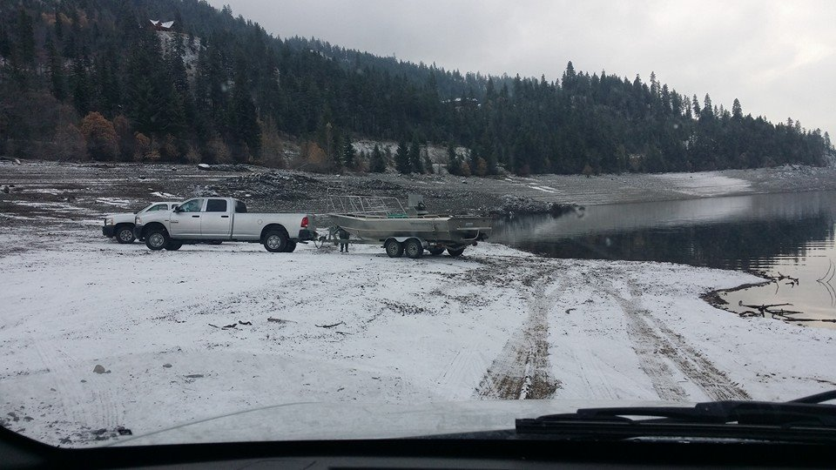
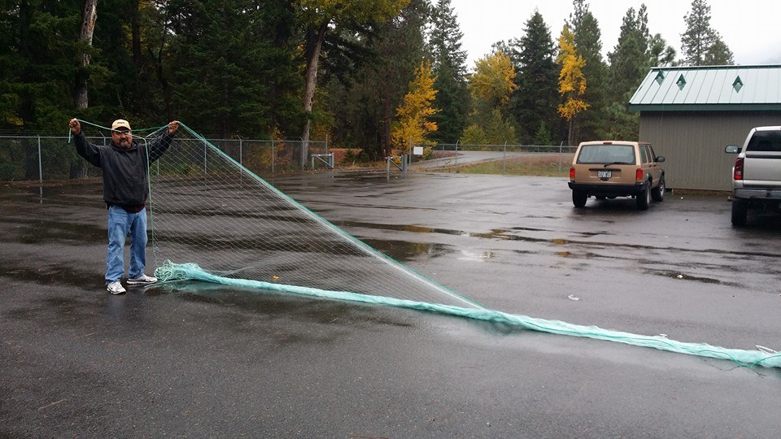
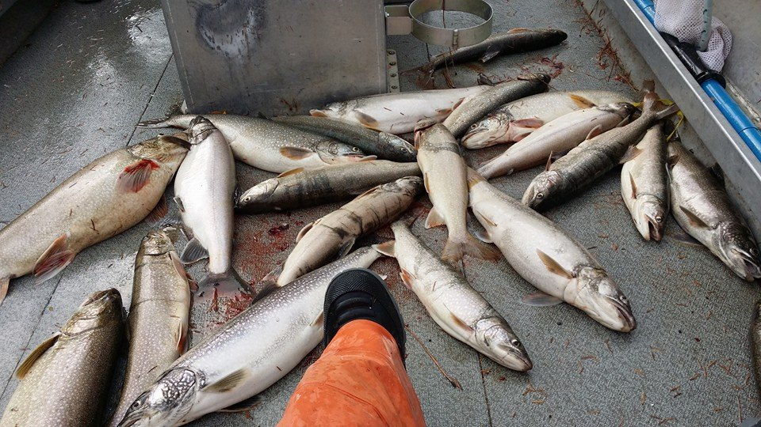
MACKINAW REMOVAL
ESTABLISHED 1920
Scientific Collectors Permit
Mackinaw Removal Proposal
WDFW
2013, 150 Removed
2014, 258 Removed
Weights, Lengths and Heads for aging
By-catch

Slide 7
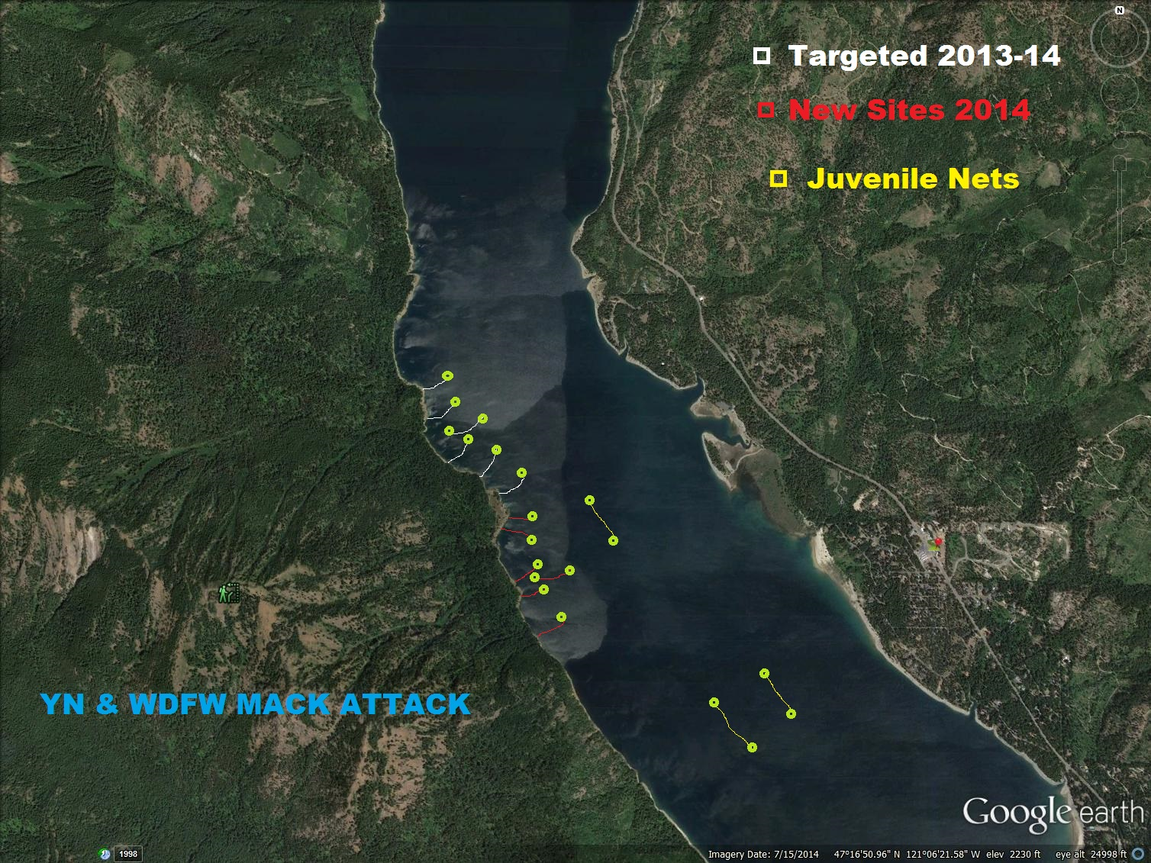

Slide 8
WHAT’S HAPPENING NOW
YN Hydro Acoustic Equipment -Sockeye smolt/fry pop counts in the lake and Mackinaw location
Genetic Sampling of the two stocks -Peter Galbreath and Andrew Matala CRITFC
Warning Signs Made to Discourage Fishing -Work with Forest Service to notify authorities of poachers and YN Fish & Game
Yakima River Integrated Plan -YN will continue to pursue fish passage past all dams in the Yakima Basin
Still Looking For Additional Funding/Partner -Project is expanding in area and needed resource's
Mackinaw Removal Gillnet/Fish Derby -Yakama Nation & WDFW
Lake Study -YN will begin accessing all Lakes in the Yakima Basin moving forward

Slide 9
CREDITS
Dr. Dave Fast (Senior Research Scientist)
Mark Johnston (Senior Research Scientist)
Emily Washines YN (Public Relation)
Chris Carlson GCPUD (Fish Biologist)
Andrew Matala CRITFC (Conservation Geneticist)
Peter Galbreath CRITFC (Fish Science Department)
Ida Sohappy Ike YKFP (Bookkeeper)
Monica Clark FRM (Bookkeeper)
Patrick A. Monk (US Fish & Wildlife Service)
Chuck Carl, Steve Blodgett, Arnold Barney, Jeremiah Waltermann,
Joy Jay Pinkham III, Andrew Lewis, Quincy Walahee, Gene Sutterlict Jr (Yakama Nation Technicians)

Slide 10
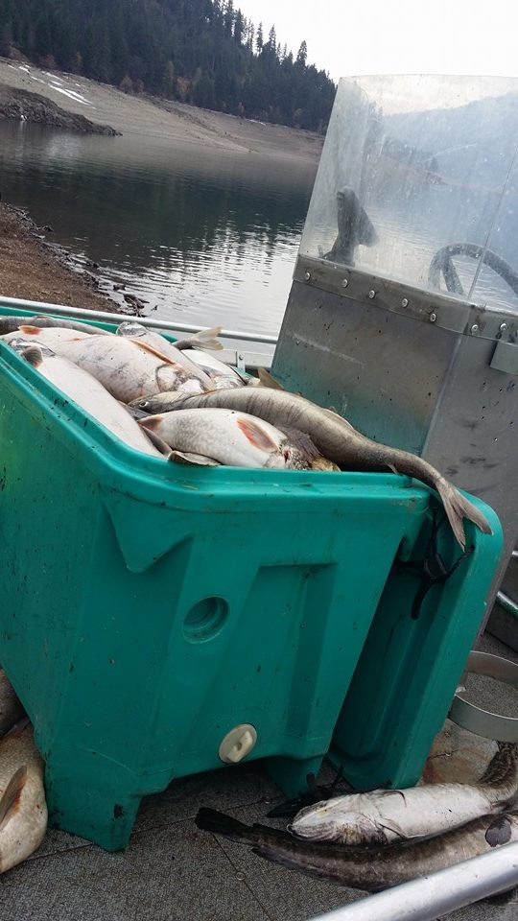
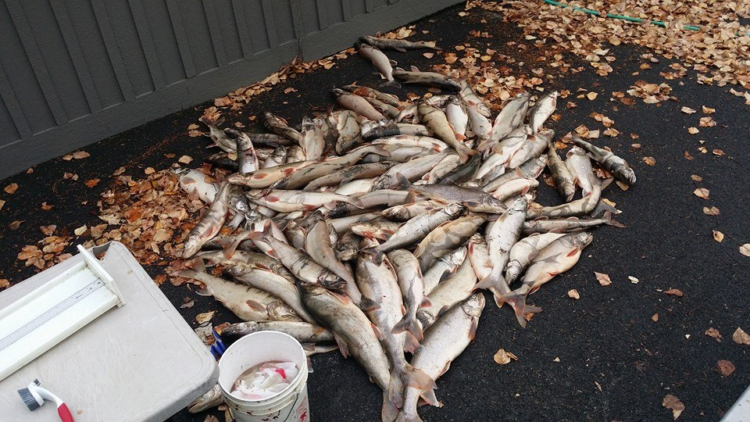
QUESTIONS?

