Slide 1
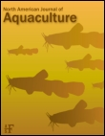
A Synthesis of Findings from an Integrated Hatchery Program after Three Generations of Spawning in the Natural Environment
David E. Fast, Curtis M. Knudsen, William J. Bosch, Anthony L. Fritts,
Gabriel M. Temple, Mark V. Johnston, Todd N. Pearsons, Donald A. Larsen, Andrew H. Dittman, Darran May, and Charles R. Strom
Acknowledgments: Melvin Sampson, Levi George, Yakama Nation, CESRF staff, Bruce Watson, Joel Hubble, Gerry Lewis, Joe Hoptowit, Doug Neeley, Craig Busack, Bill Hopley, Lynn Hatcher, Steve Schroder, Ray Brunson, Joy Evered, Sharon Lutz, Joan Thomas, Kerry Naish, Charlie Waters, Brian Beckman, Pat Oshie, Pat Spurgin, Peter Galbreath, Lars Mobrand, WDFW, NOAA, USFWS, BOR, CRITFC, U. of Idaho, U. of Washington, CWU, PSMFC, BPA, and NPCC
Proceedings of the Hatcheries and Management of Aquatic Resources Symposium, Little Rock, AK, Sept. 8-12, 2013

Slide 2
Cle Elum Spring Chinook
Supplementation and Research Facility
Goals
Increase:
  Harvest opportunity
  natural production
Maintain :
  ecosystem function
use research to:
  improve hatchery practices
  address critical uncertainties
Notes:
Conceived in 1980s as mitigation (harvest) program. In 1990s, goal was changed to supplementation to increase harvest and natural production and research to address critical hatchery uncertainties. To secure funding and implementation YN agreed.

Slide 3
Regional Assessment of Supplementation Project (1992)
“Supplementation is the use of artificial propagation in an attempt to maintain or increase natural production^^{and harvest} while maintaining the long term fitness of the target population, and keeping the ecological and genetic impacts on nontarget populations within specified limits”.
Notes:
Or stated more scientifically, the CESRF was constructed to test this concept – with the goal of maintaining or increasing harvest added by the project. Given this mouthful and the high priority placed on research to evaluate hatchery effects/uncertainties, a LOT of work went into design and implementation of a comprehensive monitoring program.

Slide 4
Evaluation Topics
  1. Life history traits and morphology
  2. Precocious male maturation
  3. Homing and spatial distribution
  4. Reproductive traits and success
  5. Redd and natural-origin abundance
  6. Gene flow
  7. Ecological interactions
  8. Pathogen screening
  9. Harvest
Notes:
M&E has been an integral part of project from inception. This paper summarizes findings for these research topics.

Slide 5
CESRF Management Practices
Cuenco et al 1993, Mobrand et al 2005
  random, representative broodstock selection
  local broodstock
  use natural broodstock if possible
  factorial mating to maintain diversity
  low rearing densities
  underwater feeders and cover to encourage natural behavior
  intensive disease monitoring
  acclimation sites in natural spawning areas
  state-of-the-art marking strategies for M&E
  test different rearing/release strategies to increase survival
Notes:
Note that these practices have been advocated by the Tribes for years (e.g., Cuenco et al. 1993) and were in fact built in to the Cle Elum program design from its inception, well before hatchery reform was even a popular regional concept.
Cuenco, M. L., T. W. H. Backman, and P. R. Mundy. 1993. The use of supplementation to aid in natural stock restoration. Pages 269-293 in J. G. Cloud and G. H. Thorgaard, editors. Genetic conservation of salmonid fishes. Plenum Press, New York.
Mobrand, L., J. Barr, H. L. Blankenship, D. E. Campton, T. T. P. Evelyn, T. Flagg, C. Mahnken, L. W. Seeb, P. R. Seidel, and W. W. Smoker. 2005. Hatchery reform in Washington State: principles and emerging issues. Fisheries 30(6):11–23.

Slide 6
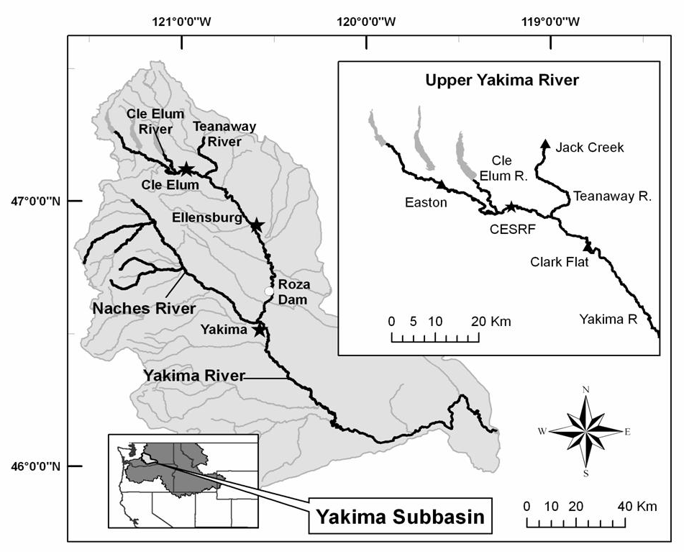
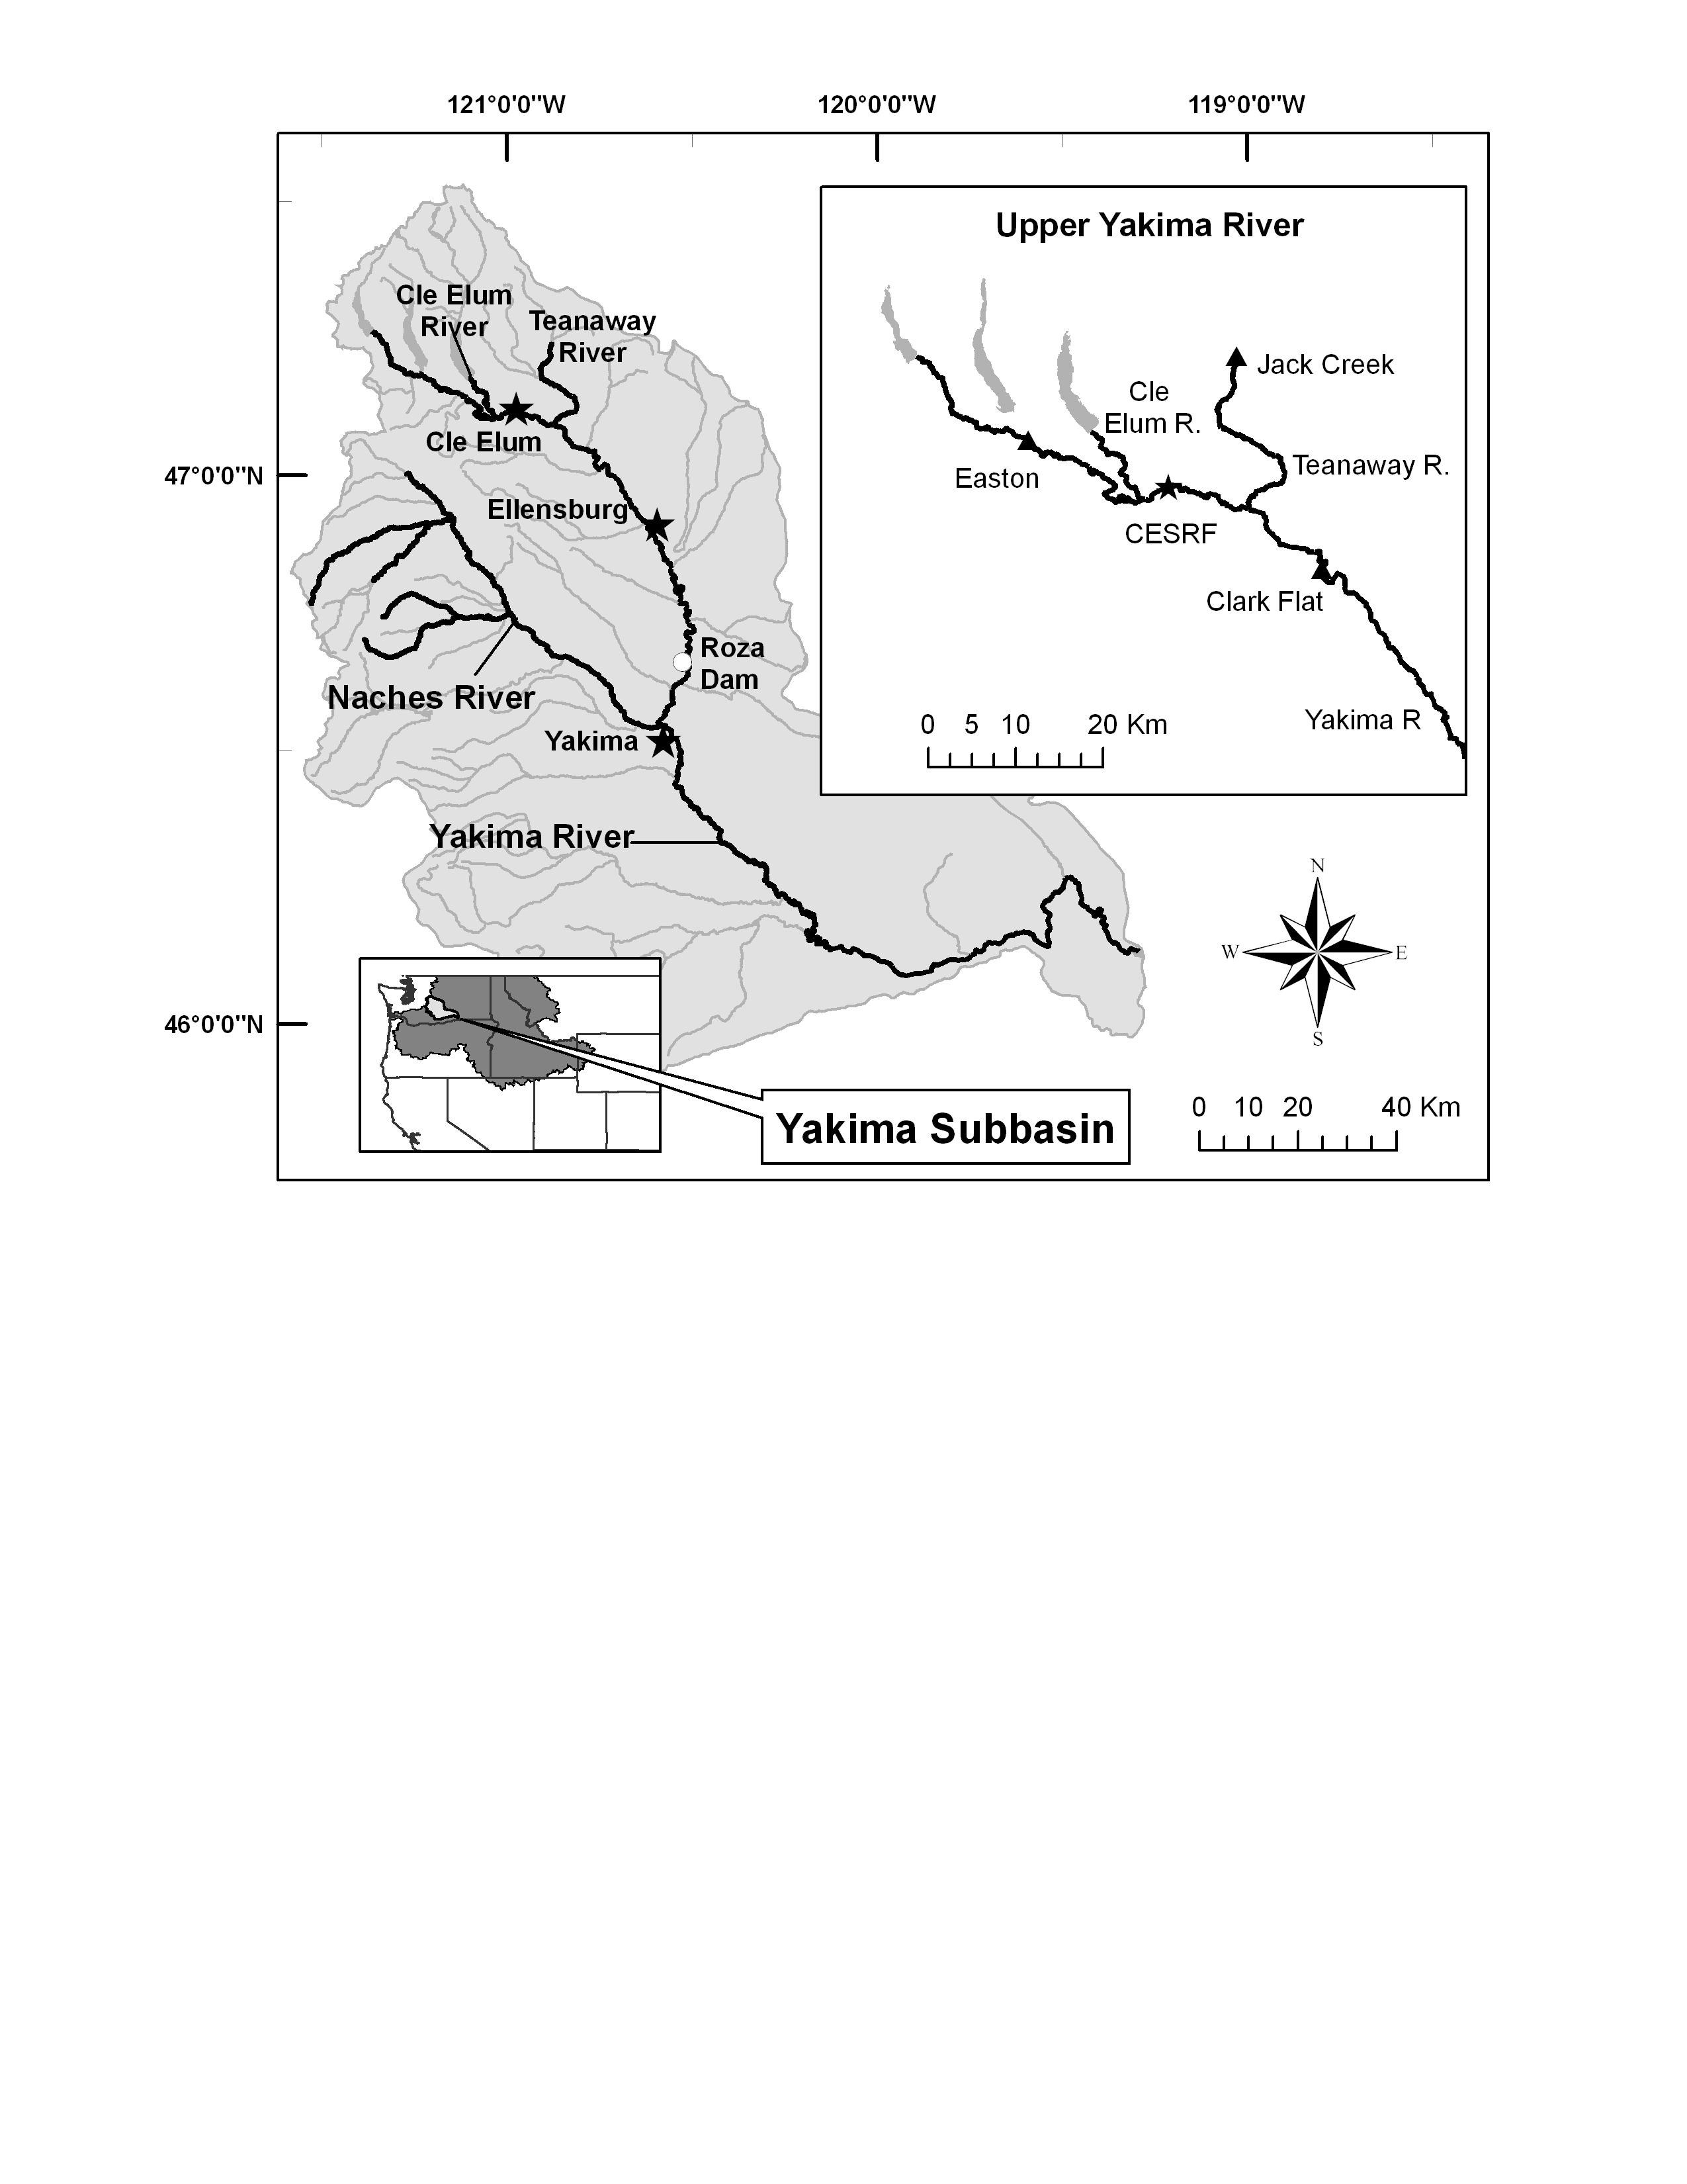
Integrated HxW spawning in the wild
Integrated F1 progeny return
Integrated F2 progeny return
Integrated F3 progeny return
1st Brood
1997
2001
2005
2009
2013
Notes:
Some more background on the Cle Elum spring chinook program in the upper Yakima. Note gravel-to-gravel concept where central facility used to rear fish, but fish released from 3 acclimation sites. 1st brood collected in 1997. 1st age-4 returns spawning in wild returned in 2001. 1st generation returns from integrated (HoR and NoR) spawners in 2005, 2nd generation returns began in 2009. Only NoR fish used for brood.
The Naches River is being used as a control stream. Both the upper Yakima and Naches systems experience very similar environmental conditions, e.g., droughts and floods rarely if ever occur in one stream without impacting the other as well. Also, historical data suggest there are virtually no upper Yakima fish which stray into the Naches system. Thus, differences in these two populations over time can be attributed to supplementation.

Slide 7
Upper Yakima vs Naches Redds, 1981-2014
 | Upp. Yak. | Naches
Pre-Supp. | 820 | 282
Post-Supp. | 1,802 | 427
% Change | +120 | +47

Slide 8
Restoring Fish and Habitat in the Teanaway
Teanaway R. redd counts
pre-supplementation mean: 3
post-supplementation mean: 70
This selected excerpt for one four-year brood cycle shows the potential of supplementation into relatively unoccupied habitats when habitat conditions are favorable.
Proportion NO Carcasses
Teanaway R. redd counts
Notes:
Redd counts in this tributary increased from a pre-supplementation average of 2.7±1.4 redds per year to a post supplementation average of 71.1±19.5 redds per year (P<0.001). The percentage of natural-origin carcasses in the Teanaway River changed from a mean of 13.8±8.2% prior to 2006, to 28.7±6.0% after 2006, the first year 4 year-old adult progeny of naturally spawning supplementation fish returned but these changes were not significant. The single redd observed in the Teanaway River in 1997 and 1998 combined (Figure 5), likely resulted in few wild fish returning to the Teanaway River in 2002. This was supported by the proportion of wild/natural-origin carcasses observed in 2002 (less than one percent; Figure 5). Thus it is highly probable that many of the natural-origin fish returning to the Teanaway River in 2006 (42% natural-origin carcasses from a total sample of 50 carcasses; Figure 5) were the product of hatchery-origin crosses from the 110 redds observed in 2002.

Slide 9
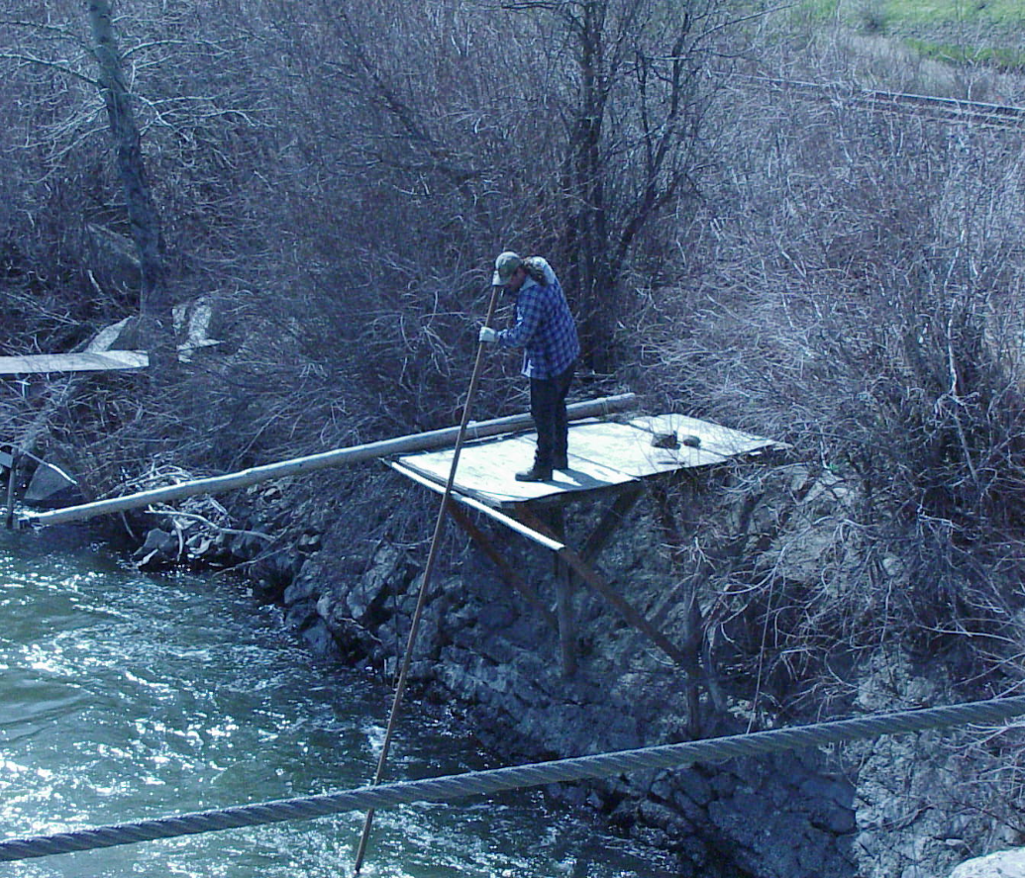
Total Estimated Harvest, 1982-2014
Mean Annual Harvest
Pre-CESRF: 550
Post-CESRF: 2,100
58% of all fish harvested since 2001 have been CESRF fish
Notes:
More fish are returning to these U&A fishing areas. Tribal harvest in all years. State recreational fisheries in 8 of the past 12 years after 40 years without. Very helpful in building local support for tribal programs – now frequently hear statements like, “We wouldn’t have these fishing opportunities without the tribes’ efforts”.

Slide 10
Life History Trait Differences, etc.
SH: more age-3s, smaller, later run timing, earlier spawn timing, and different body shapes than WN.
If same size, no difference in fecundity or egg mass for females.
Knudsen et al. 2006, 2008
Busack et al. 2007
Notes:
Mean POH age-4 females: WN=60.8cm, SH=59.8cm. Median passage (Adults, 2001-2014): WN=01Jun, SH=06Jun.

Slide 11
Whole River Pedigree Study
Challenges:
  Number of Samples
  Cost
Advantage: Stat. Power
Hatchery-reared fish, H (parents were N)
Natural-origin, N
07
08
09
10
11
12
13
14
15
16
17
18
Three types of matings in the wild:
Natural x Natural (N x N)
Hatchery x natural (H x N)
Hatchery x hatchery (H x H)
Natural-origin (wild-spawned) F₂s
Notes:
Fig. 2 Sampling design for the study. Illustrated is the sampling design for the first year of individual DNA sampling in 2007. Circles represent the brood year (BY), corresponding to the year that adults return to Roza Dam prior to spawning. This example shows first generation hatchery-origin fish (F₁) from BY 2007, which return to spawn alongside their natural-origin counterparts in 2010 (age 3, “jacks”), 2011 (age 4), and 2012 (age 5). Mating among hatchery-reared and natural-origin fish occurred in every subsequent year to create wild-born F₂s, which return 3 to 5 years later. The example follows fish (returning to Roza in 2007) that spawned in the wild and whose progeny returned as adults in year 2010-12, and produced naturally-spawned fish (F₂s) that returned in years 2015 through 2017.

Slide 12
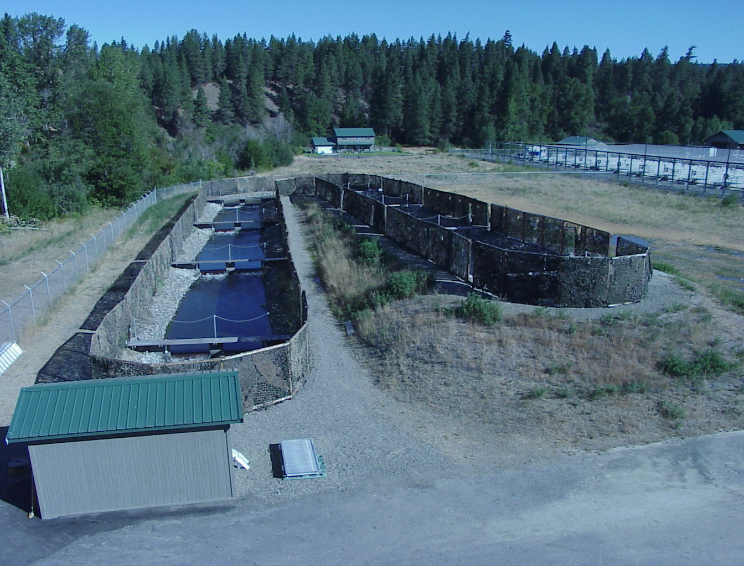
SPAWNING CHANNEL - Constructed summer 2000
RRS: Survival to Fry Schroder et al. 2008, 2010
 | W/N | H
Males | 1.00 | 1.00
Females | 1.00 | 0.94
Notes:
Constructed for the specific purpose of studying relative reproductive success. From 2001 to 2005, DNA-sampled and placed returning wild and hatchery-origin adults into the channel, let them spawn on their own, then collected DNA from a sub-sample of juvenile offspring and conducted a parent/progeny pedigree analysis to determine the number of progeny sired by hatchery- and wild-origin parents. Results were published in 2008 and 2010.

Slide 13
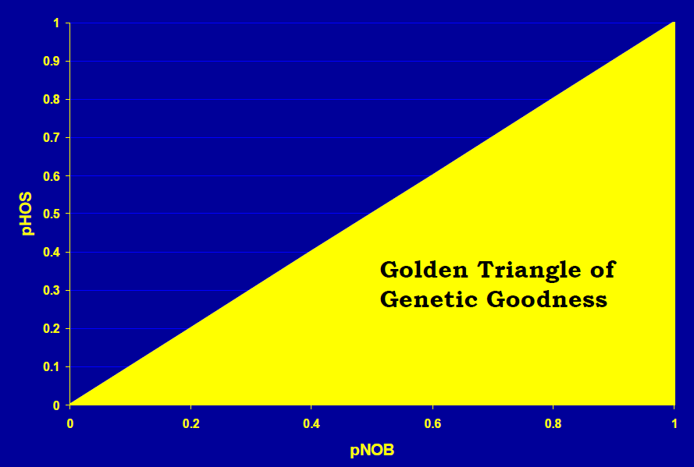
Annual PNI and pHOS
Means: PNI = 65%, pHOS = 56%
Notes:
We are not managing pHOS because of use of 100% NOR brood stock and a major objective is to evaluate performance of such an integrated program. Even still we are achieving levels of PNI recommended in the literature (HSRG) for maintaining “genetic goodness”.

Slide 14
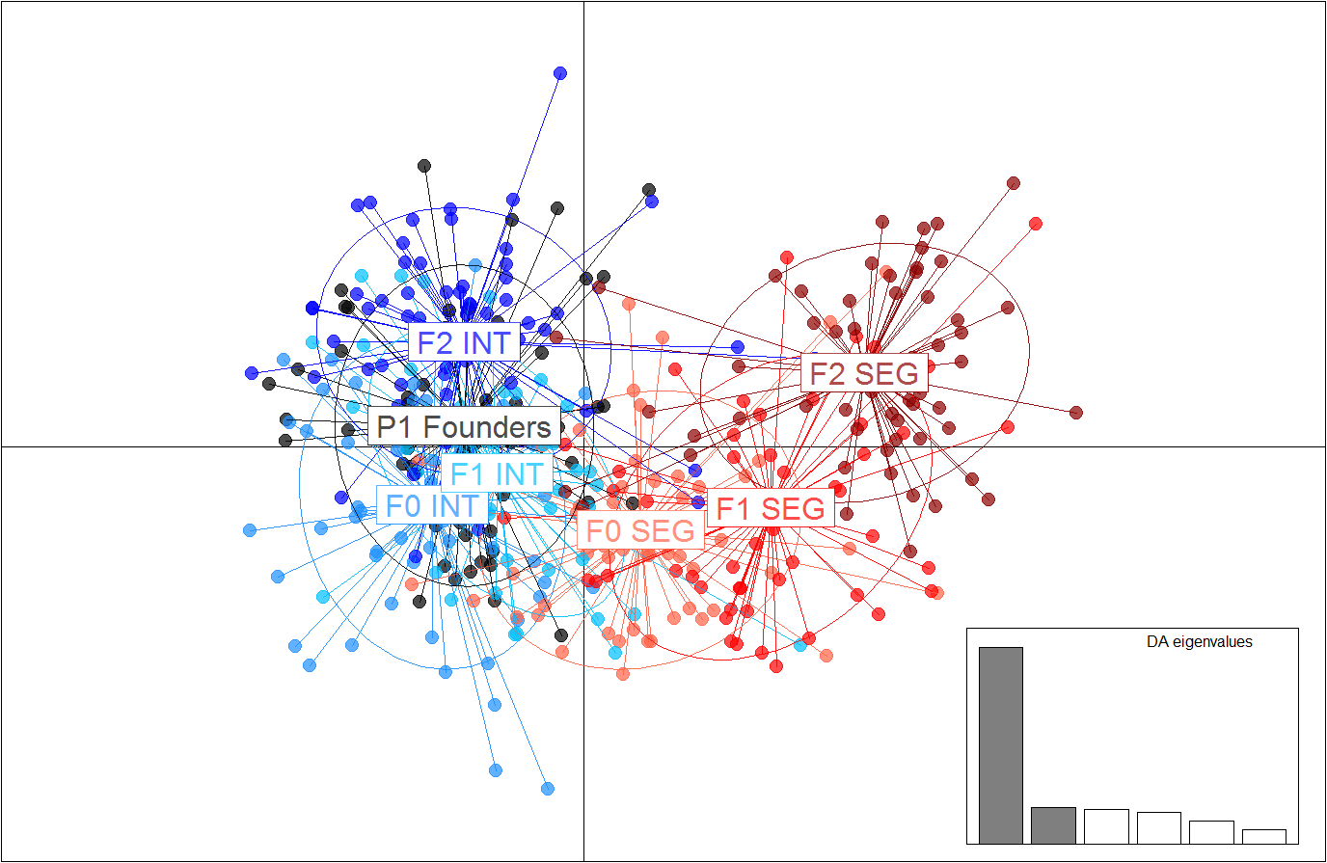
Evaluating Managed Gene Flow, Waters et al.
P1 Founders: BY 1998
F0 Int: BY 2002
F1 Int: BY 2006
F2 Int: BY 2010
F0 Seg: BY 2002
F1 Seg: BY 2006
F2 Seg: BY 2010
Notes:
Discriminant Analysis of Principal Components (DAPC): 10.9% on y-axis, 58.4% on x-axis.

Slide 15
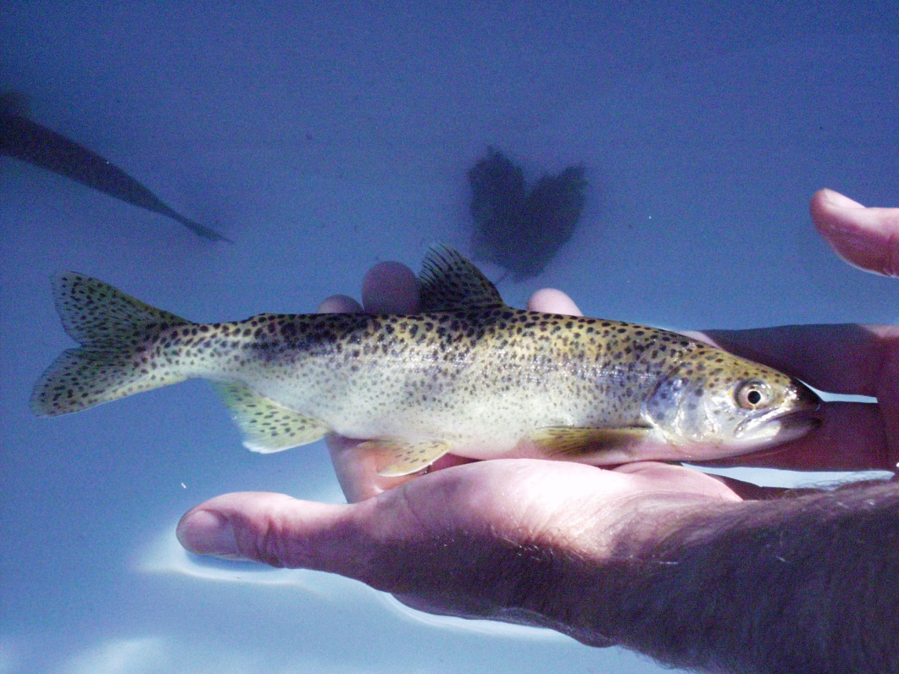
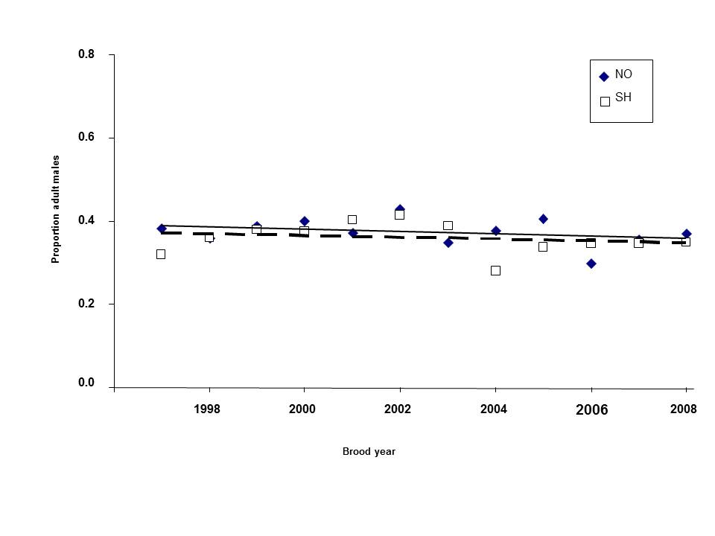
Residual/Precocious Wild and Hatchery Spring Chinook
Work by Larsen et al., Pearsons et al., and Knudsen indicate large proportion of hatchery-origin mini-jack and jack production
But Knudsen work for this study indicates no difference in returning HO and NO age-4 and age-5 male proportions
Notes:
Juveniles start out with roughly a 50:50 sex ratio (Larsen et al. 2013). High production of HO mini-jacks and jacks should skew adult returns highly in favor of females relative to NO fish. But our analysis of adult returns shows both HO and NO populations equally skewed toward females and we haven’t observed high numbers of HO mini-jacks on the spawning grounds.

Slide 16
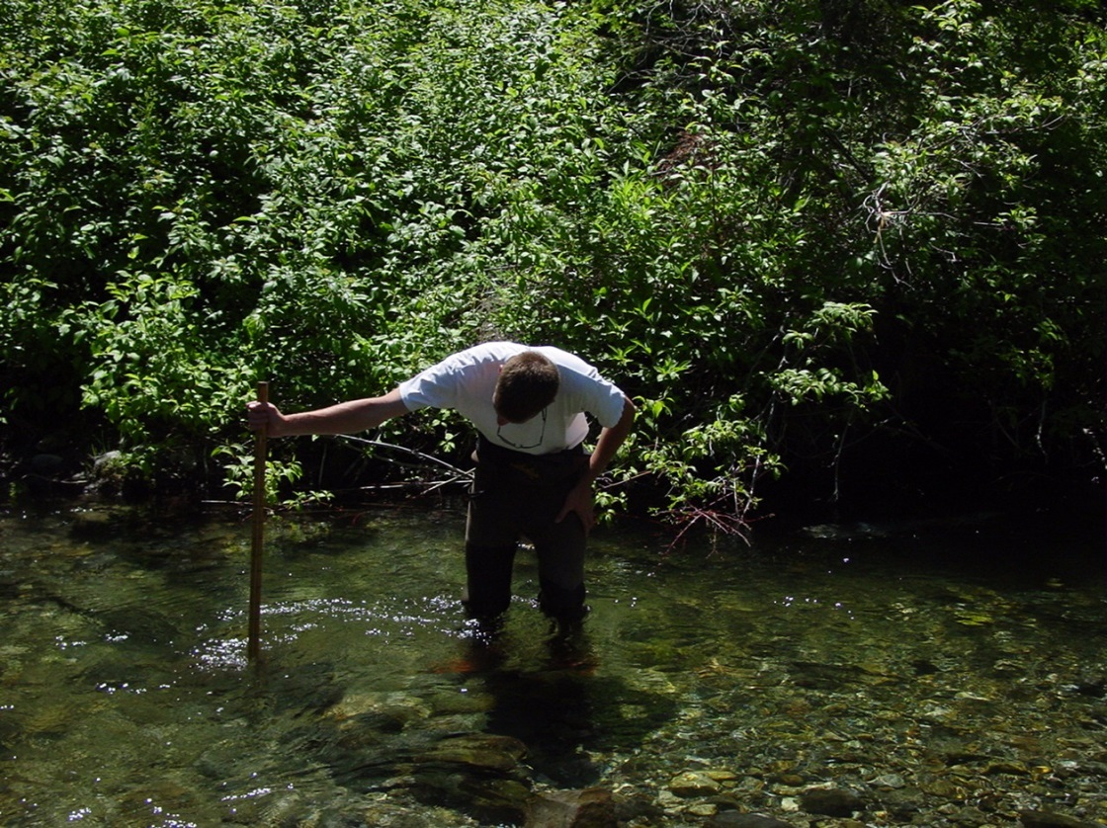
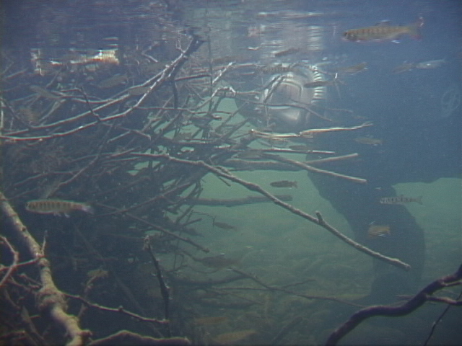
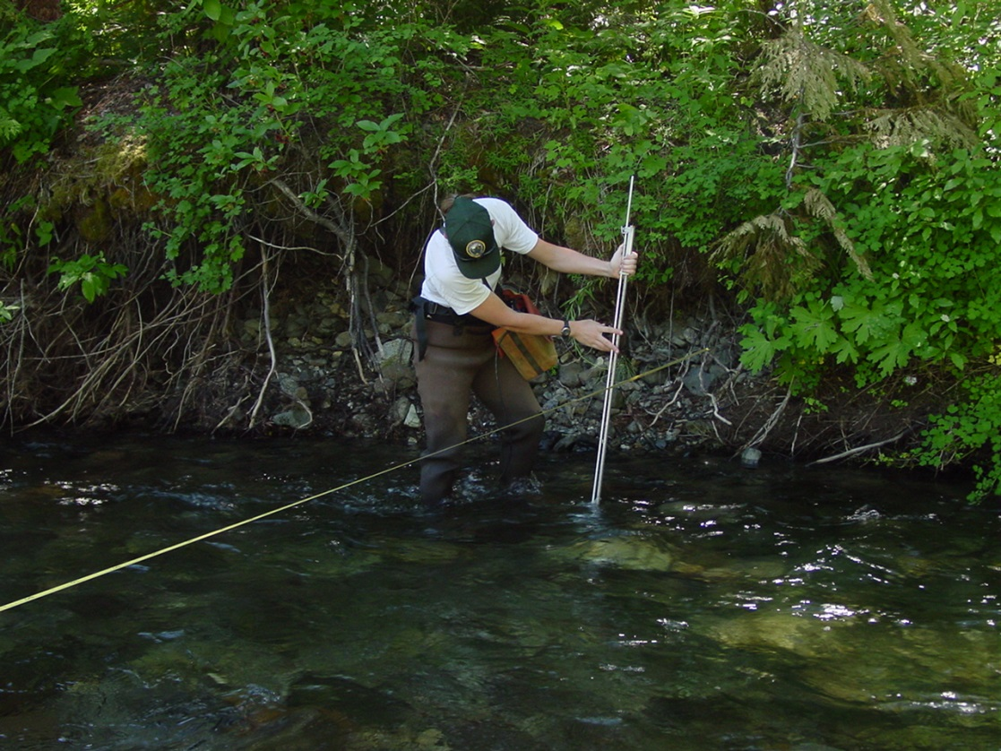
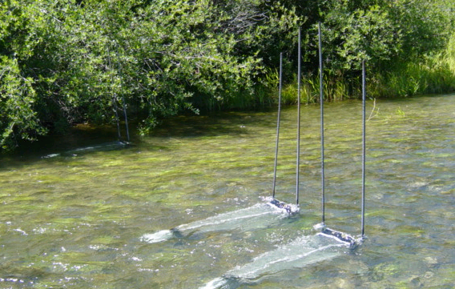
Other Ecological Risks
  Ecological interactions within adopted guidelines
  Stray rates < 5%
  Pathogen and BKD risk profiles very low

Slide 17
Upper Yakima vs Naches Natural-Origin Returns, 1982-2014
 | Upp. Yak. | Naches
Pre-Supp. | 3,103 | 1,394
Post-Supp. | 3,532 | 1,220
% Change | +13.8 | -12.5
Notes:
Neither change is statistically significant. Some folks look at this graph (Upper Yakima column) and say, “Aha, you can’t show an increase in the natural population – supplementation is not working”. Another view (Naches column) is that the alternative that relies solely on habitat actions is pretty risky. Remember production is NOT the same as productivity. Many factors affect natural productivity…

Slide 18
Density Dependence?
Notes:
Yes there is density dependence, but we see it for the Naches wild population as well in spite of a lot of habitat work in that subbasin as well. Are we really prepared to say that we only want to allow 1,200 wild fish to spawn in the Naches system each year because of density dependence? What about ESA-listed wild steelhead populations – should we be removing more of them when “too many” come back and we expect to be above carrying capacity? That’s why to me, this is a natural productivity issue. We need to keep doing as much as we can as noted in prior slides to address factors limiting natural productivity.

Slide 19
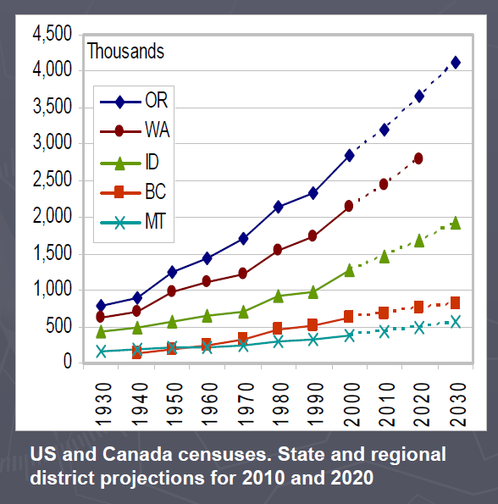
Human Population Growth (ISAB 2008)
Since 2000:
Yakima County +11%
WA State
+18%
Notes:
I think we’re all generally familiar with these human population trends (note OR and WA are reversed).

Slide 20
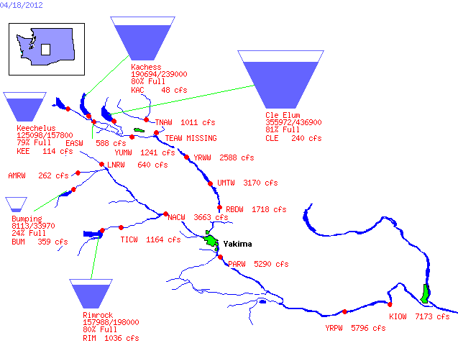
Bureau of Reclamation, Pacific Northwest Region
Major Storage Reservoirs in the Yakima River Basin
Notes:
Like many inland watersheds, the Yakima Basin is managed heavily for irrigation with five major water storage reservoir dams: Keechelus, Kachess, and Cle Elum in the Upper Yakima watershed, and Bumping and Rimrock in the Naches watershed. And many irrigation diversion dams: Horn Rapids (lower photo), Prosser (middle photo), Sunnyside, Wapato, and Roza (upper photo).

Slide 21
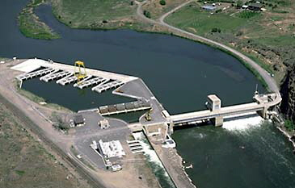
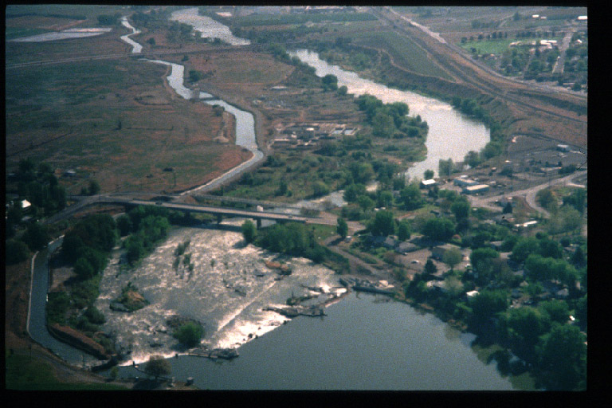
Bureau of Reclamation Diversion Dams
Notes:
And many irrigation diversion dams: Horn Rapids (lower photo), Prosser (middle photo), Sunnyside, Wapato, and Roza (upper photo). Two more are not shown.

Slide 22
Flow Regime Highly Altered
Notes:
But at the cost of a highly altered flow regime which of course affects productivity and capacity.
The USGS sums it up:
As a result of water use in the basin, the difference between mean annual unregulated and regulated streamflow in
the basin is about 2,000 ft^3/s, suggesting that some 1.4 million acre-ft of water, or about 17 percent of the precipitation in the basin, is consumptively used—principally by irrigated crops through evapotranspiration.
(Vaccaro and Olsen 2007, Estimates of Ground-Water Recharge to the Yakima River Basin Aquifer System, Washington, for Predevelopment and Current Land-Use and Land-Cover Conditions)

Slide 23
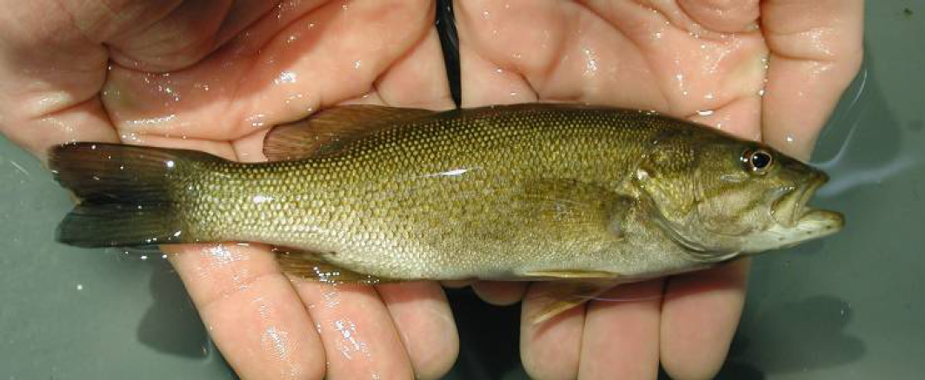
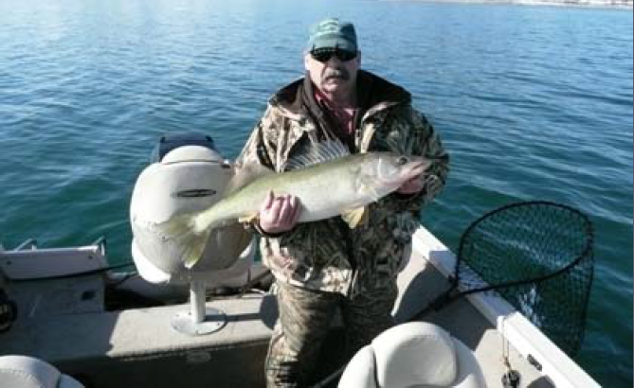
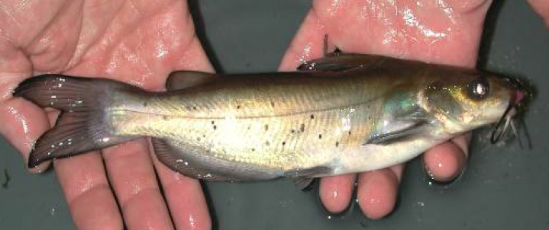
Predation
Smallmouth bass
Walleye
Channel Catfish
Notes:
Here’s a few other non-native species that have fared pretty well in the modified river environment.

Slide 24
American Shad – Bonneville Counts
Hinrichsen et al. (2013) reported that dam construction … likely contributed to the increase in abundance and spatial distribution of American Shad and Haskell et al. (2013) reported that this is altering food webs.
Notes:
And while the dams have provided many benefits, we know they are affecting productivity and capacity in many ways – here’s one example.
Hinrichsen et al. (2013) reported that dam construction and alterations to the temperature and discharge regimes of the Columbia River have likely contributed to the increase in abundance and spatial distribution of American Shad Alosa sapidissima and Haskell et al. (2013) reported that this is altering food webs potentially affecting Pacific salmon.
Hinrichsen, R.A., D.J. Hasselman, C.C. Ebbesmeyer, and B.A. Shields. 2013. The Role of Impoundments, Temperature, and Discharge on Colonization of the Columbia River Basin, USA, by Nonindigenous American Shad. Transactions of the American Fisheries Society, 142: 887-900.
Haskell, C.A., K.F. Tiffan, and D.W. Rondorf. 2013. The Effects of Juvenile American Shad Planktivory on Zooplankton Production in Columbia River Food Webs. Transactions of the American Fisheries Society, 142: 606-620.

Slide 25
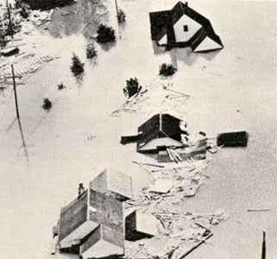
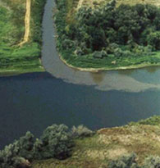
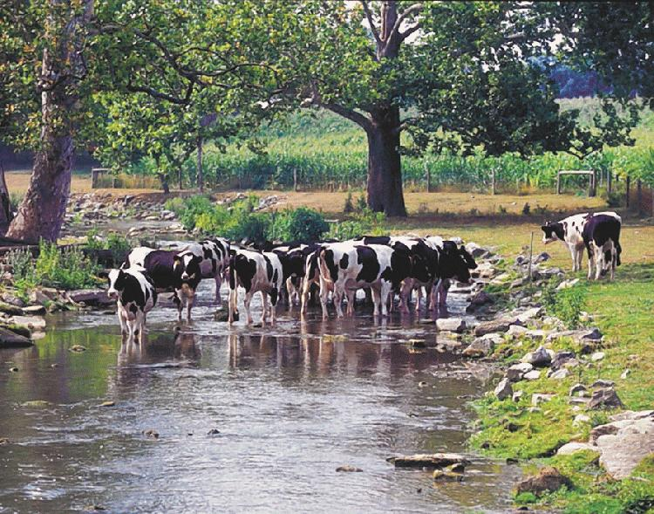
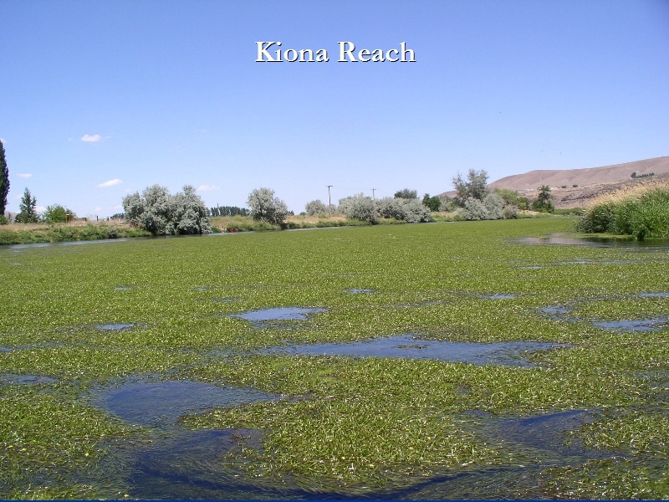
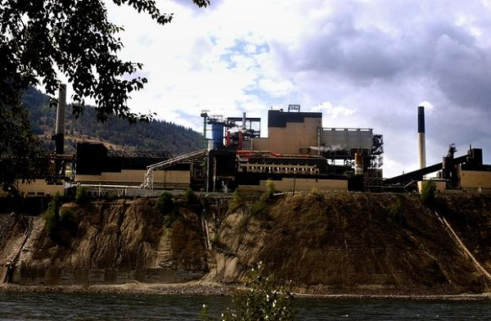
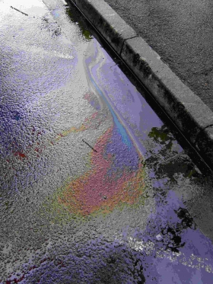
Some Other Factors Affecting Stream Productivity or Carrying Capacity

Slide 26
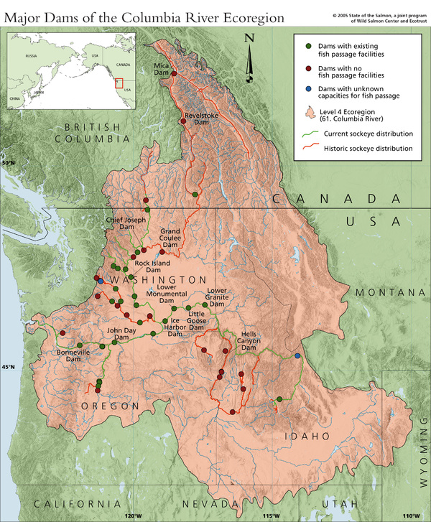
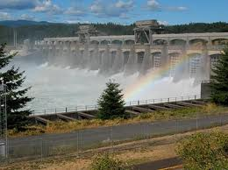
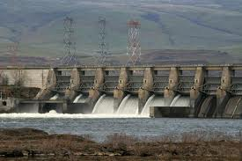
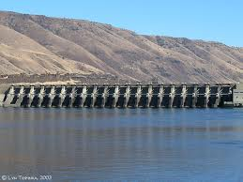
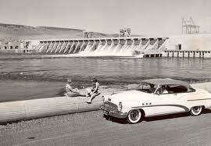
Notes:
And as we’re all aware, we humans have dramatically altered the natural environment, the dams being one major example.
Major Columbia and Snake River hydropower system constructed beginning in 1938. Photos depict the four dams that anadromous fish destined for the Yakima River Basin must pass to and from the confluence of the Yakima and Columbia Rivers. They are from top to bottom (completion year in parentheses) : Bonneville (1938), The Dalles (1958), John Day (1969), and McNary (1956).

Slide 27

Notes:
But does that mean we have or have to live with the river system in this state? Did we throw up our hands and say, like Eeyore, “woe is me – there’s no productivity or capacity left – why bother”?

Slide 28

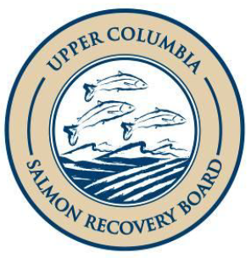




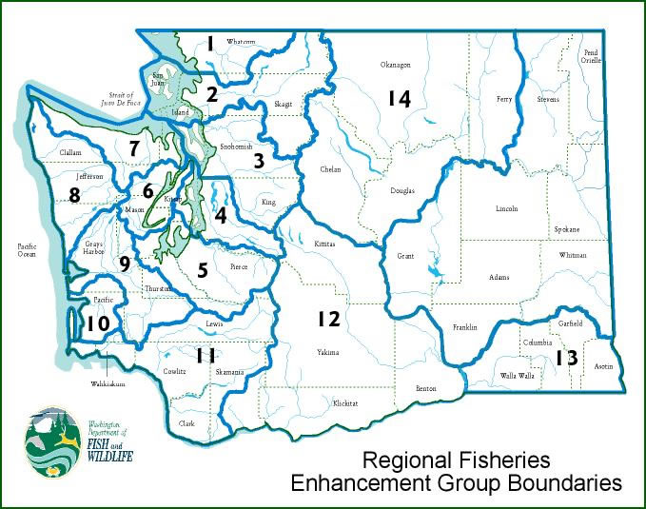


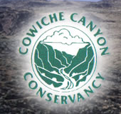




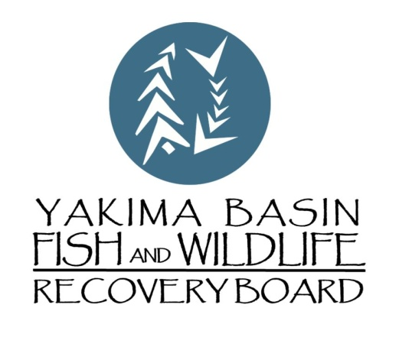
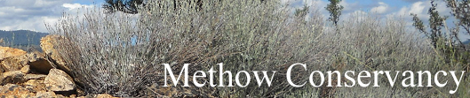
Notes:
No!! These are just a few of the organizations working hard to restore salmon habitats throughout the PNW. Could fill many more slides with tribal and other organization’s logos.

Slide 29
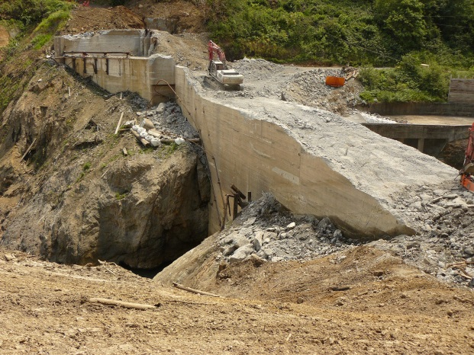
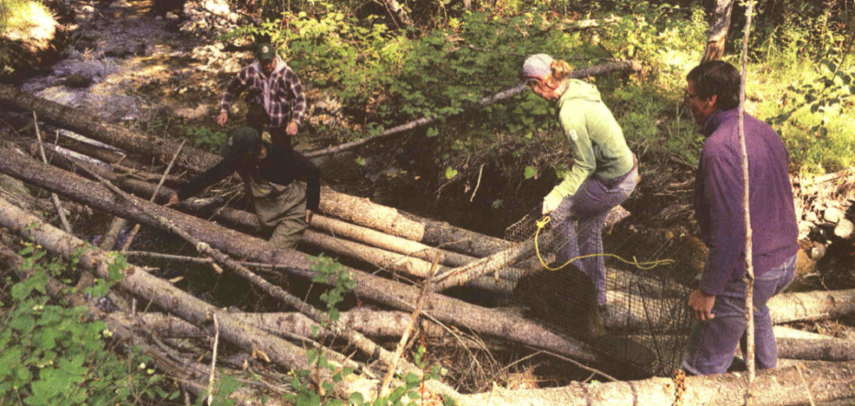
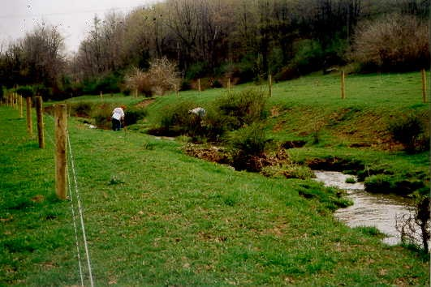
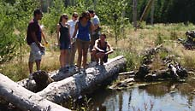
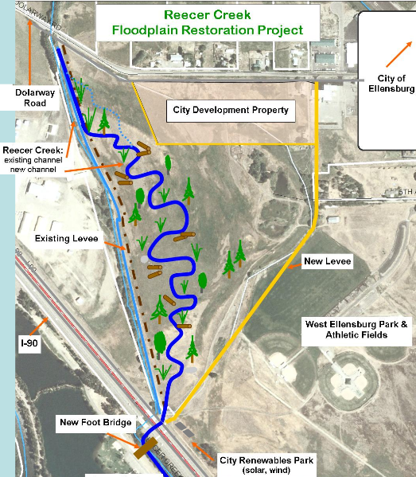
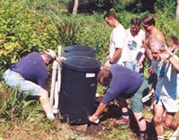
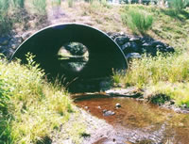
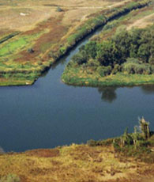
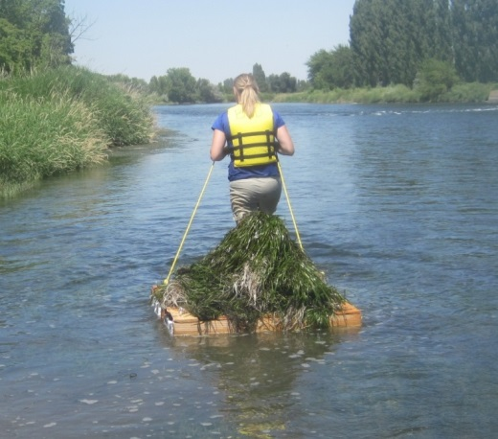
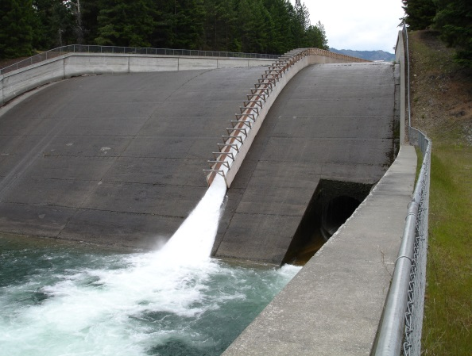
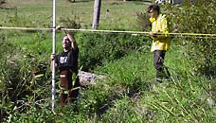
Notes:
And here’s some examples of the good work that’s being done.

Slide 30
50,000+ Salmon and Steelhead to Yakima Basin in 2014!!
Notes:
And this work is certainly helping. This is probably more salmon returning to the Yakima Basin than anyone in this room has observed in their lifetimes.

Slide 31
Summary
Expectations need to be consistent with reality
Hatcheries aren’t the cause of poor productivity
Hatchery reform can work
Each Subbasin is unique
Let’s keep working to address factors limiting natural productivity
  More info:
  Yakima Basin Science Conf. http://ykfp.org/par.html
  bbosch@yakama.com
Notes:
Is it realistic to expect “self-sustaining natural populations” in the highly altered river systems that we live and work in? Hatchery programs should be regularly evaluated at the local level using expertise across disciplines to collaboratively and iteratively develop appropriate solutions that address the unique problems and limiting factors encountered in each subbasin or tributary that hosts a hatchery program. Finally, evaluation of hatchery programs should include evaluation of environmental and other factors so that hatchery effects are properly reported.

