Slide 1
2015 Yakima Science & Management Conference
Habitat overview
Prepared by
Alex Conley
Yakima Basin Fish & Wildlife Recovery Board

Slide 3
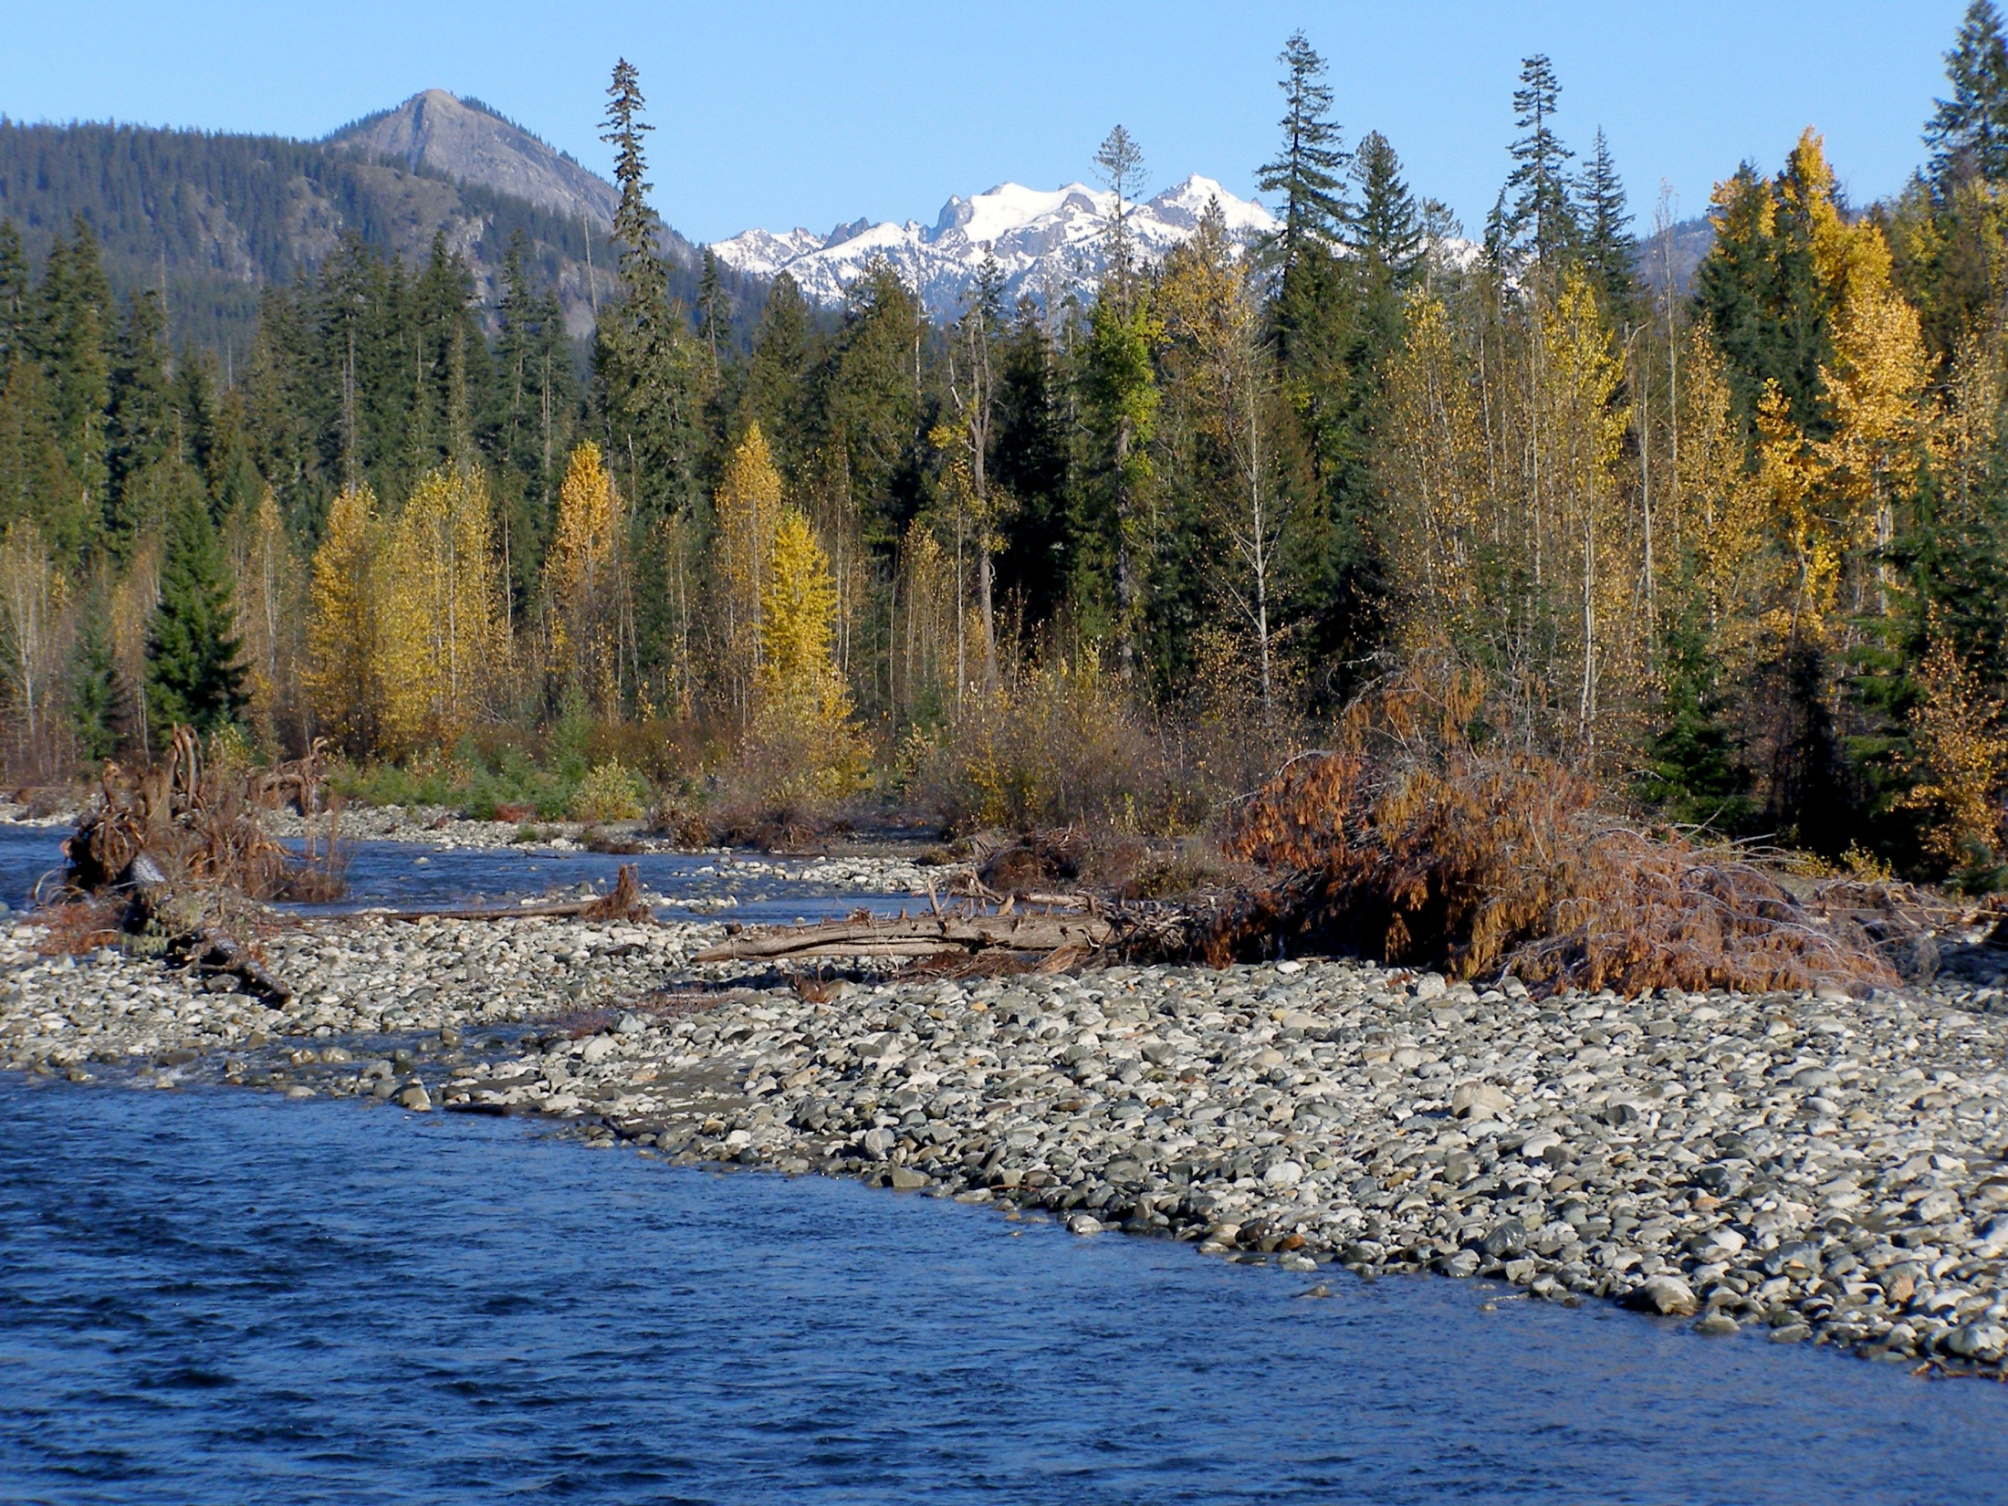

Slide 4
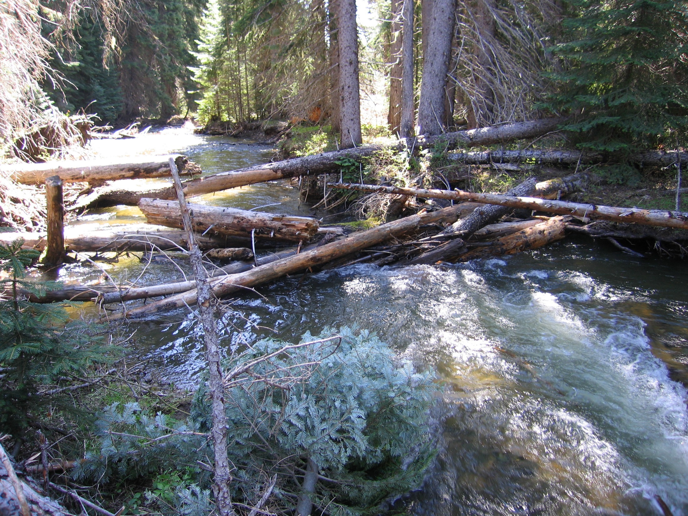
Trib Photo

Slide 5
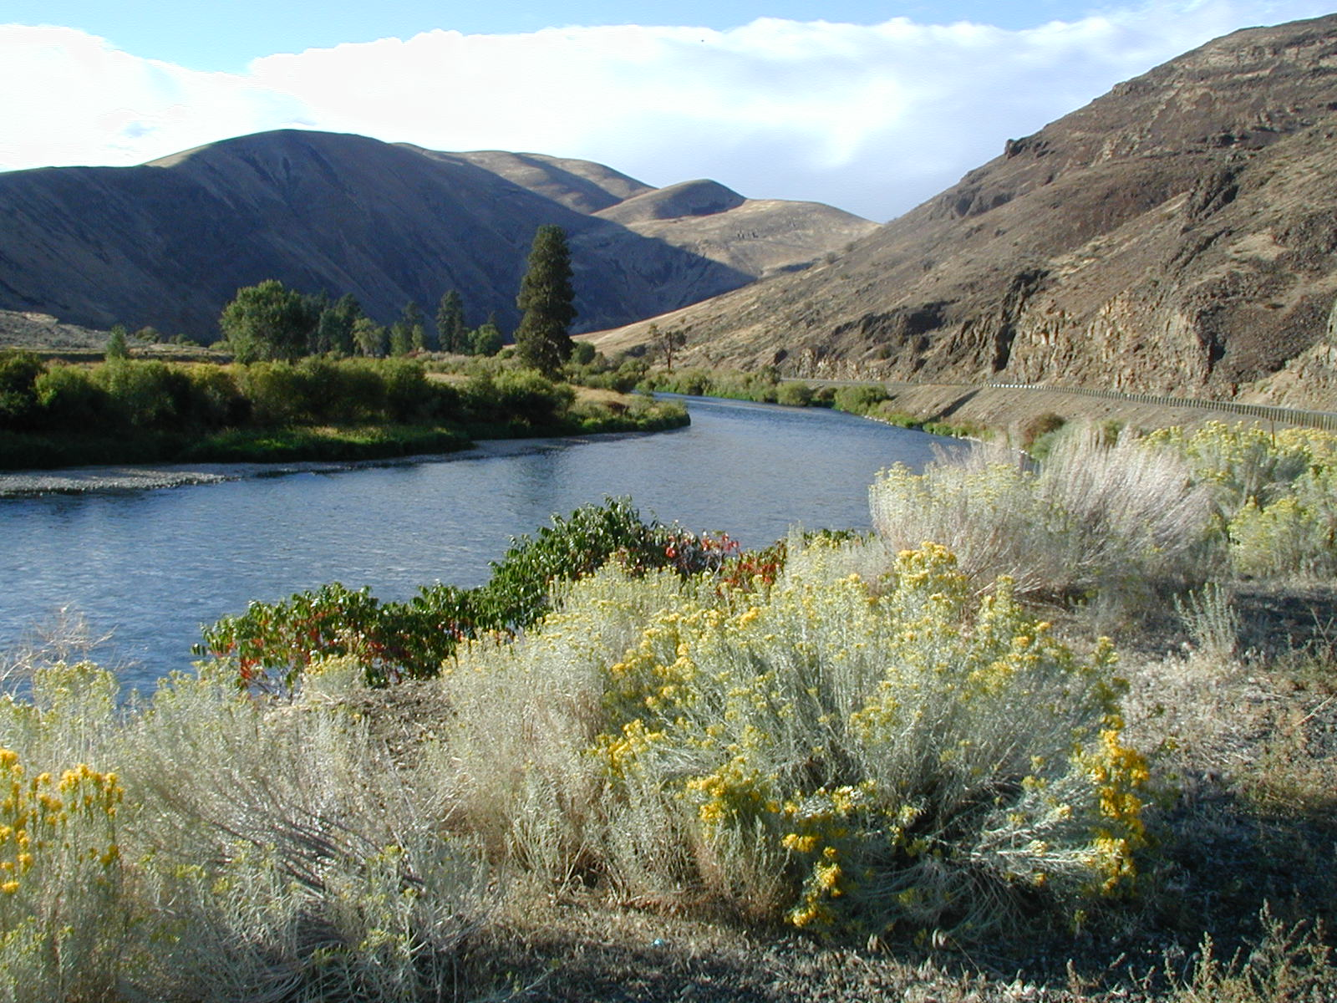

Slide 6
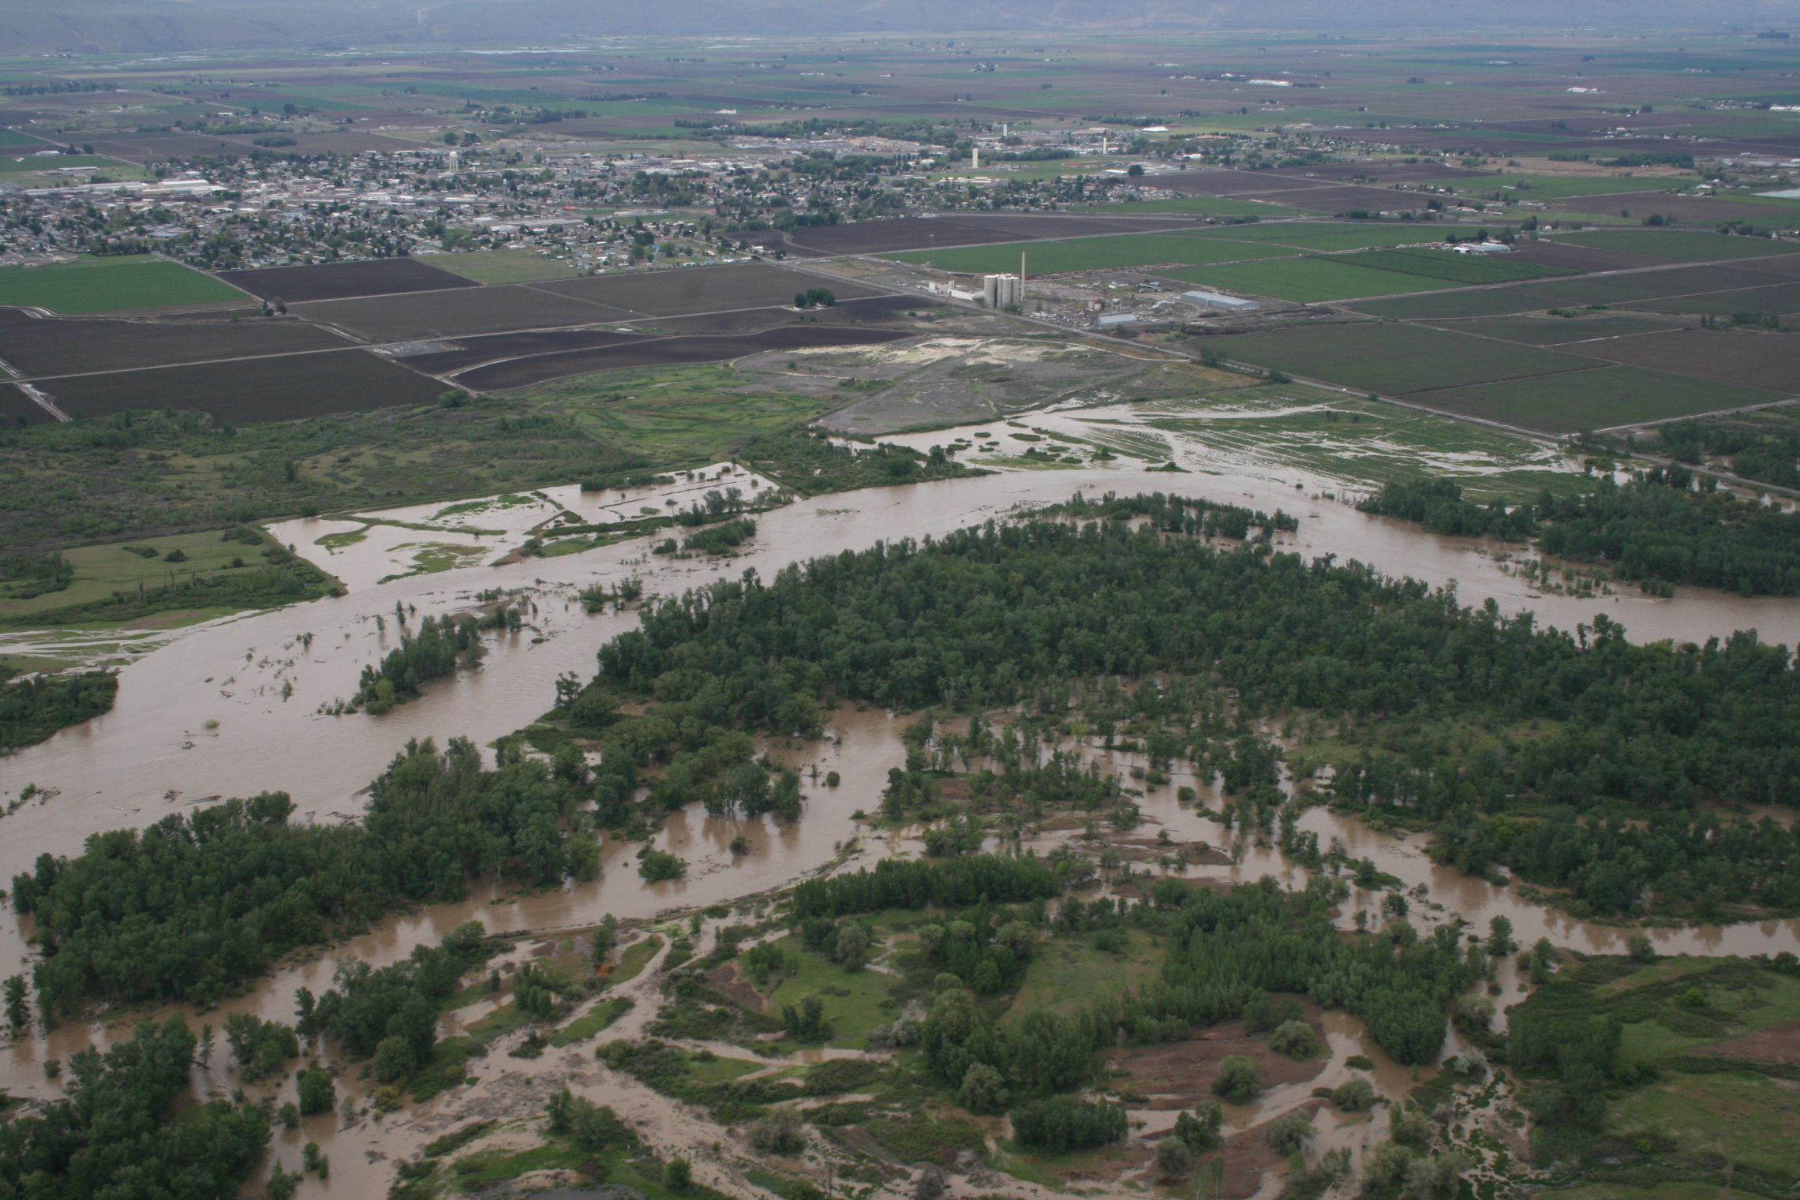

Slide 7
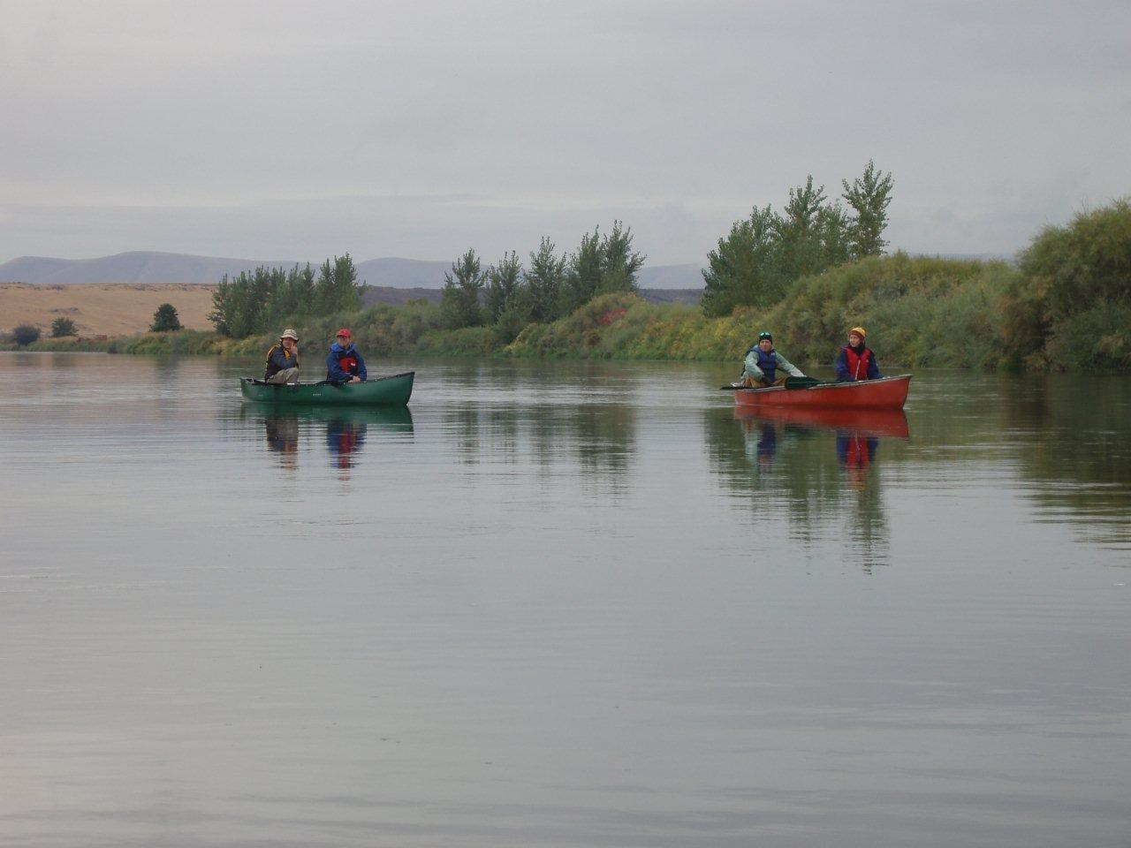

Slide 8
Historic Salmon Runs
Run | Low Estimate | High Estimate | Current Status | Low | Year | High | Year
Spring Chinook | 200,000 | 500,000 | Supplemented Population | 666 | 1995 | 21,472 | 2001
Fall Chinook | 38,000 | 100,000 | Supplemented Population | 523 | 1988 | 13,000 | 2002
Summer Chinook | ?? | ?? | Extirpated and reintroduced | - |  | 1,536 | 2014
Coho | 40,000 | 150,000 | Extirpated and reintroduced | - | till 93 | 20,997 | 2014
Sockeye | 100,000 | 200,000 | Extirpated and reintroduced | - |  | 2,676 | 2014
Steelhead | 30,000 | 100,000 | Wild Population | 721 | 1990 | 6,796 | 2009
Total | 408,000 | 1,050,000 |  | 1,910 |  | 66,477
Bull Trout | ?? | ?? | Wild Population |  |  | 2500-3000
Lamprey | ?? | ?? | Wild Population |  |  | 0 to 87 adults

Slide 9
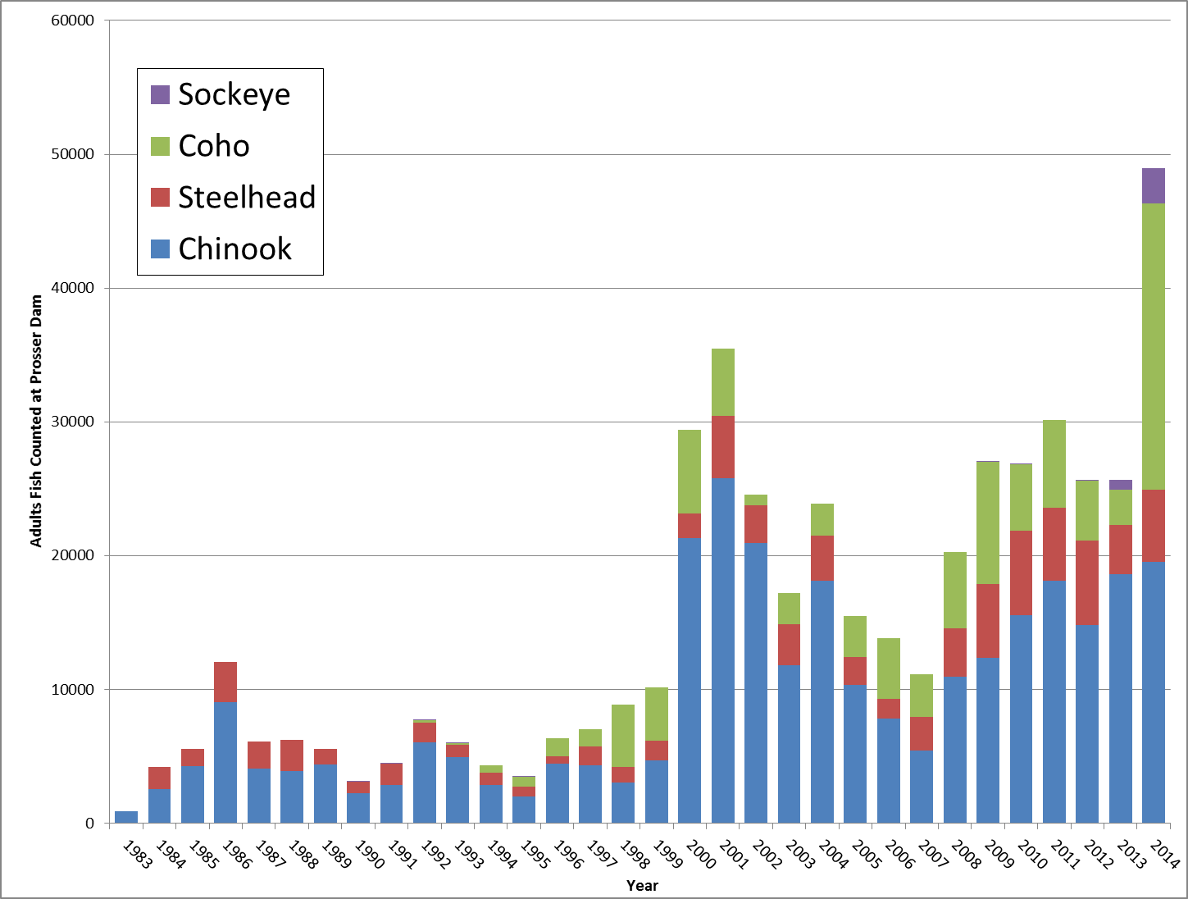
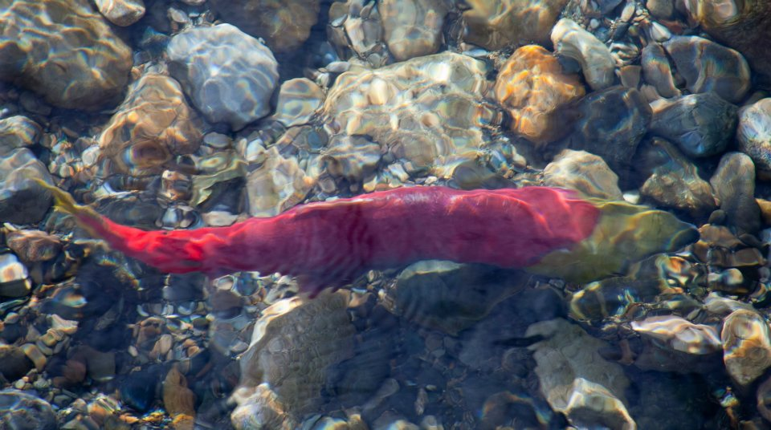

Slide 10
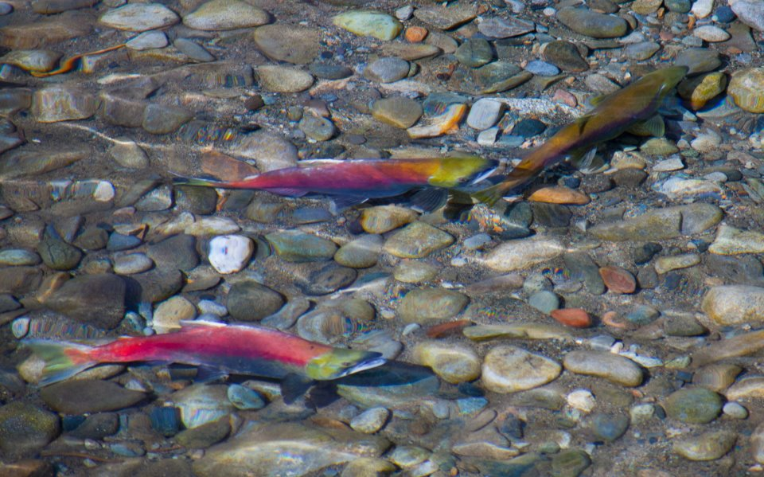

Slide 11
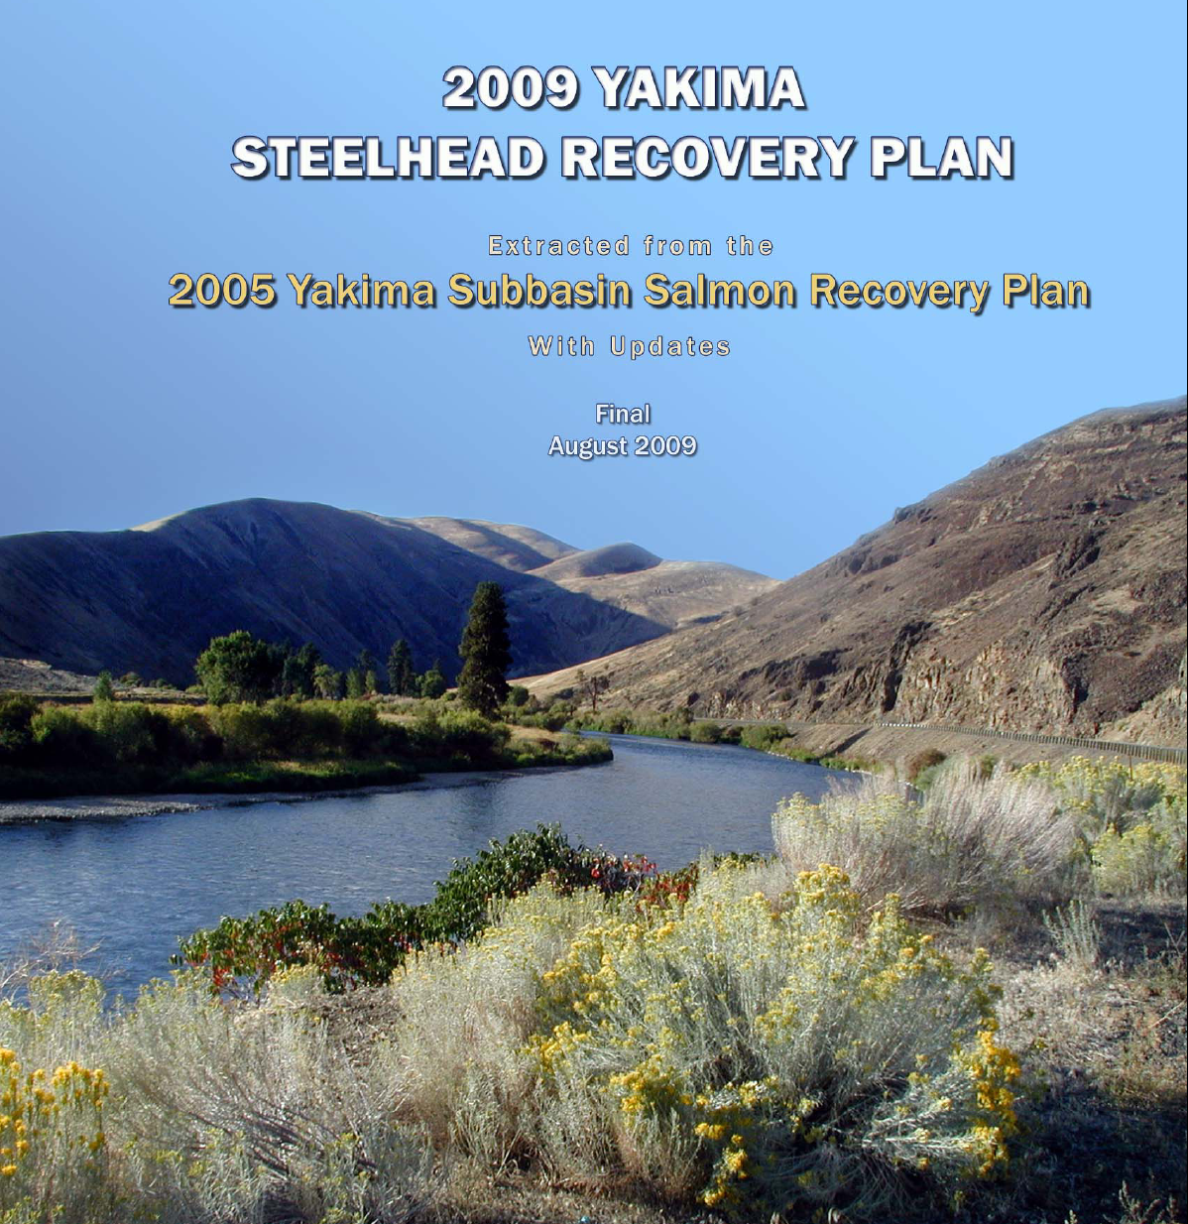

Slide 12
Steelhead Recovery Priorities
94 In-basin Actions Identified, focusing on:
Improved passage in key tributaries
Instream flows and habitat improvements in key tributaries
Improved mainstem flow conditions
Mainstem floodplain improvement in priority reaches

Slide 14
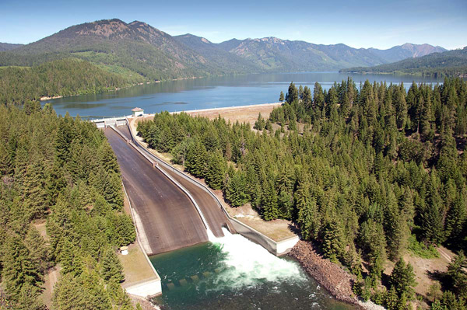
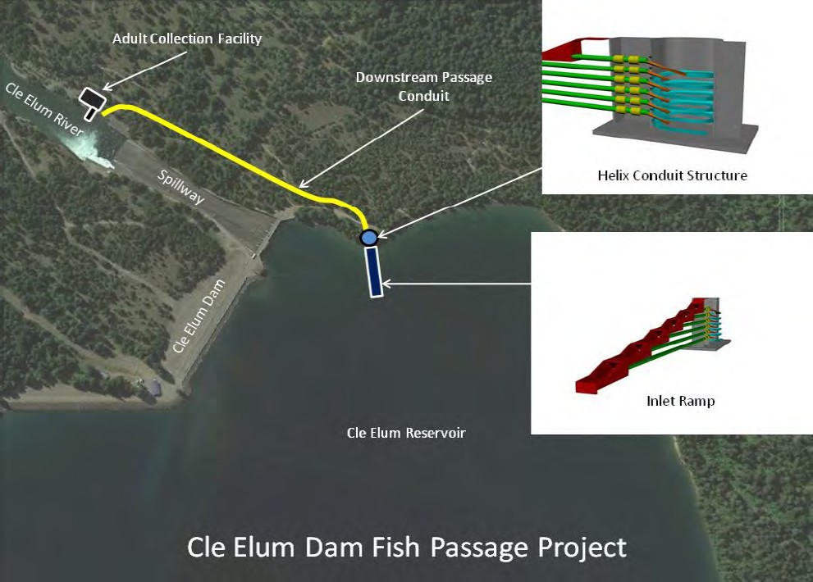
CLE Elum DAM Fish Passage
Bureau of Reclamation is lead,
Key part of Yakima Basin Integrated Plan
Essential for sockeye reintroduction
EIS complete; design in progress
Will require Congressional authorization
Cle Elum Sockeye Reintroduction/Passage
David Fast & Brian Saluskin at 9:20 on Weds
Status of Juvenile Fish Passage Design for Cle Elum
Joel Hubble at 10:20 on Weds
WHOOSHH- Potential Adult Passage Design
Todd Deligan at 10:40 on Weds

Slide 15
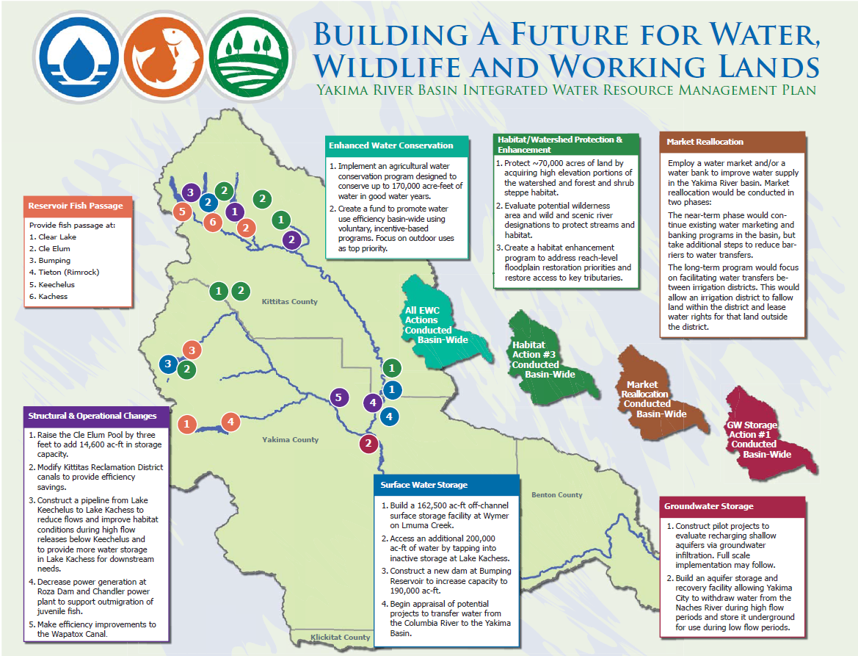
Yakima Basin Integrated Plan: Early Implementation
Derek Sandison at 11:40 on Weds

Slide 16
Manastash Passage
Decades work led by Manastash Committee & Kittitas County Conservation District
Significant funding from:
SRFB
BPA
Ecology
Bureau of Reclamation
Expect full passage by 2016!
Notes:
Saw it 3 times- as a 2010 project that was the withdrawn when the agreements with irrigators fell through, a 2011 project

Slide 17
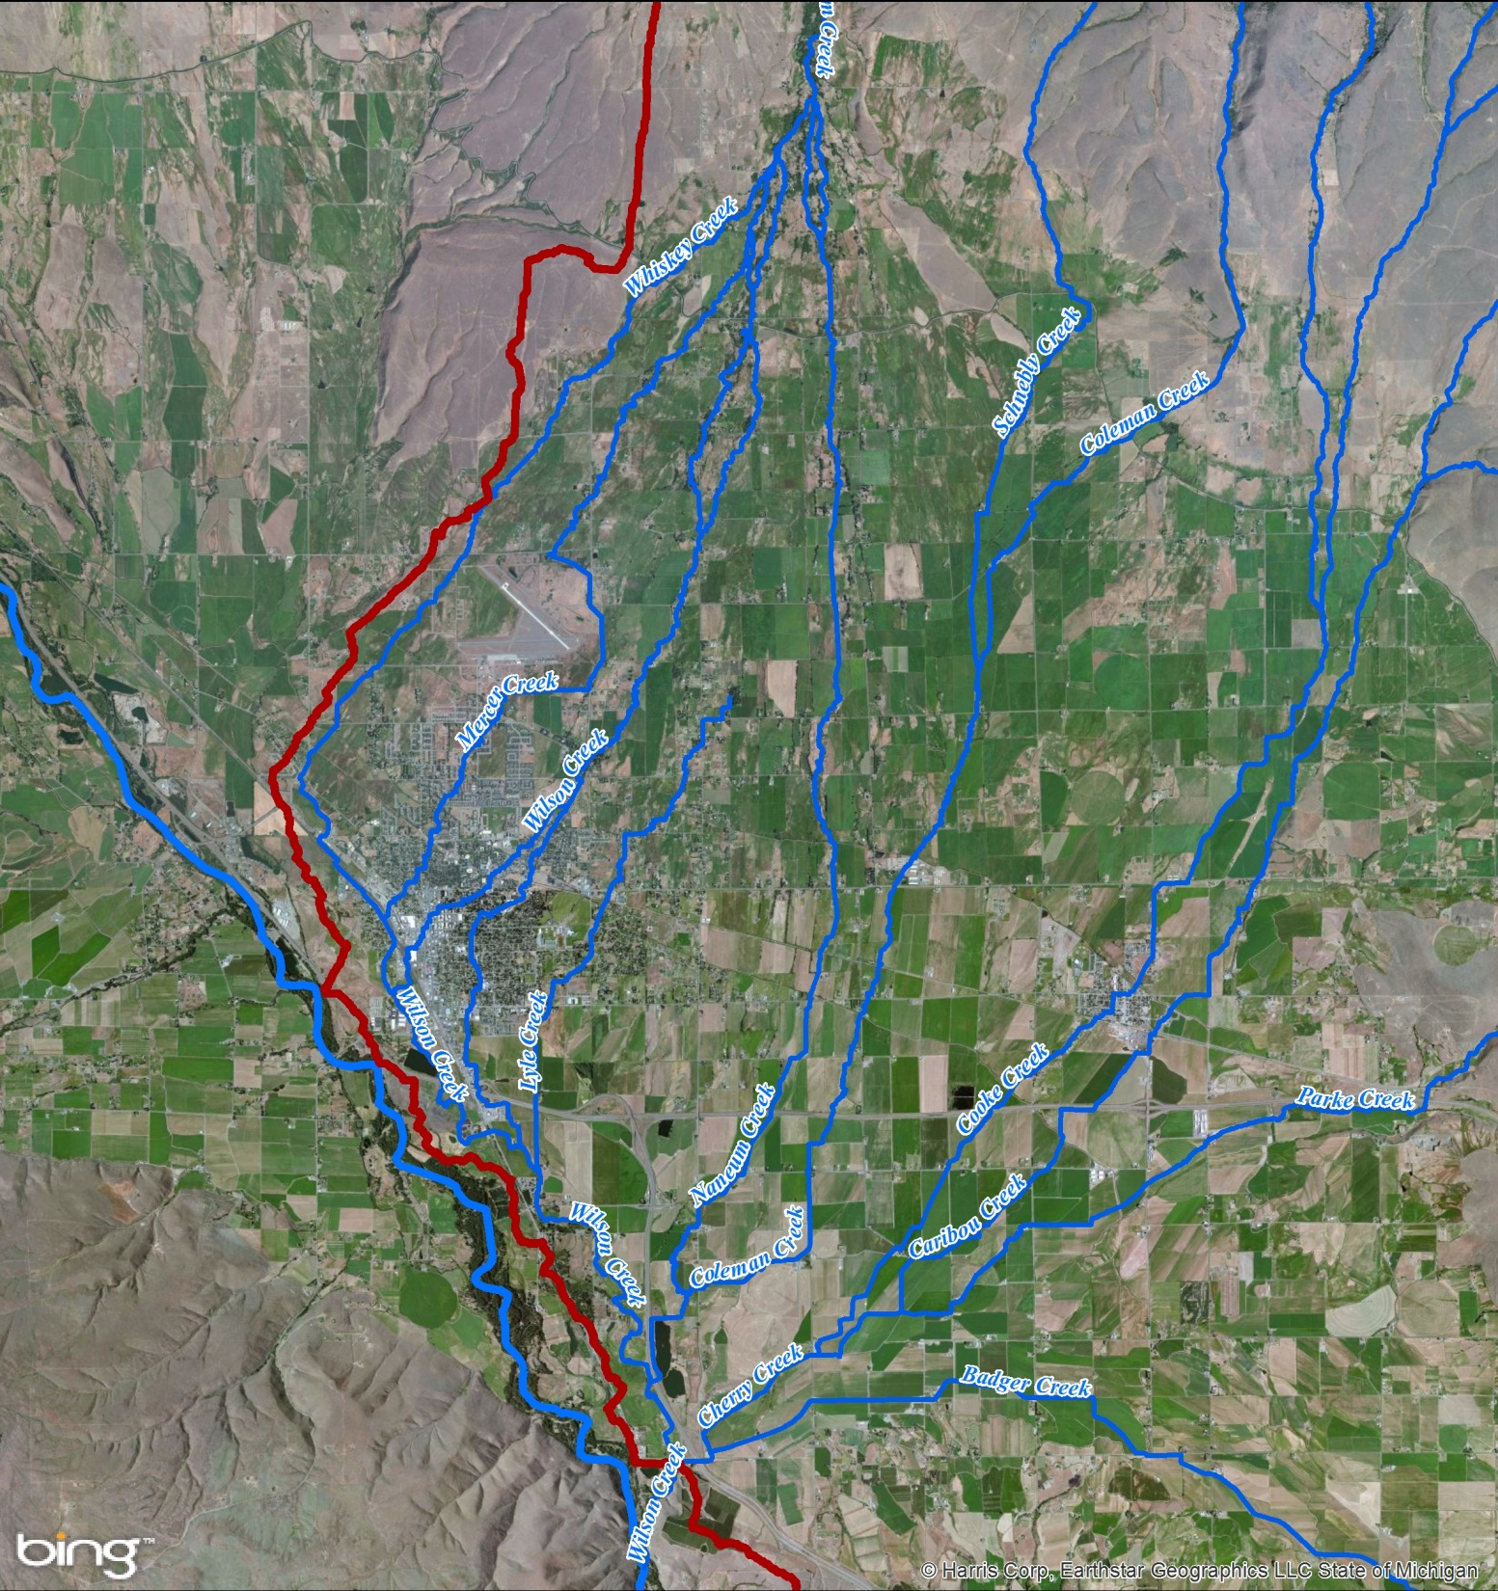
Naneum, Wilson, Cherry Creek Watershed

Slide 18
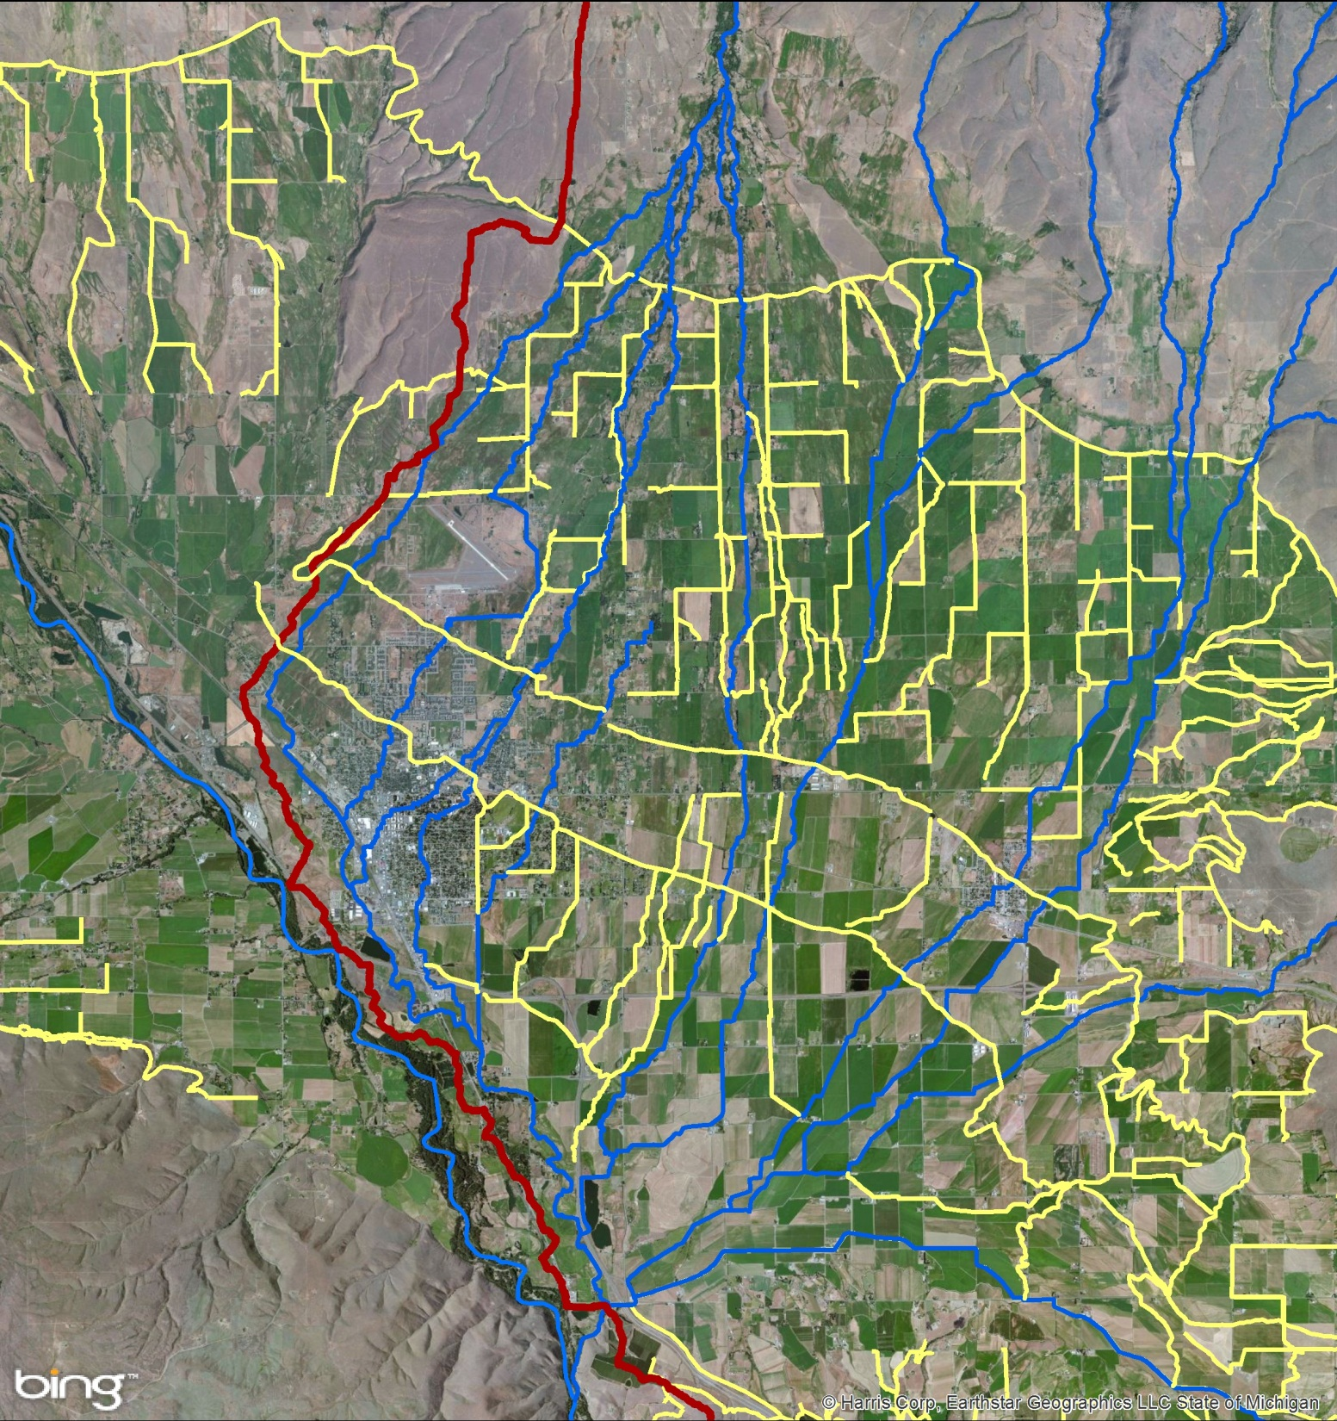
Irrigation Canals
& Ditches

Slide 19
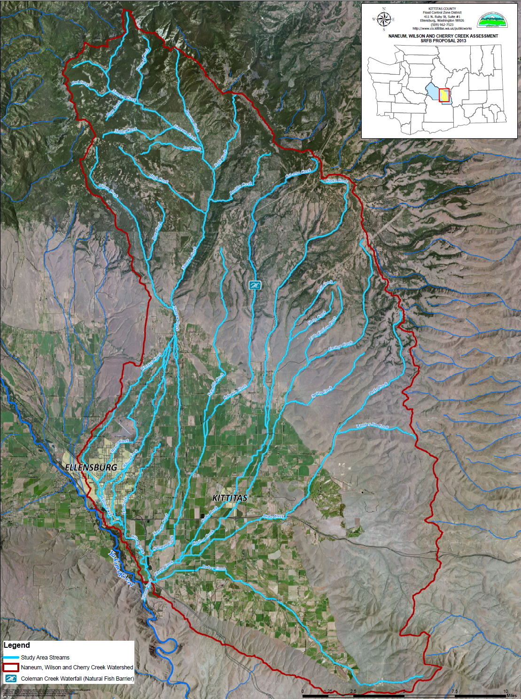
Wilson-Naneum
Assessment
Kittitas County as lead
Integrated approach looks at fish passage, screening, flood management, infrastructure
$s from SRFB, BOR, County, City of Ellensburg

Slide 20
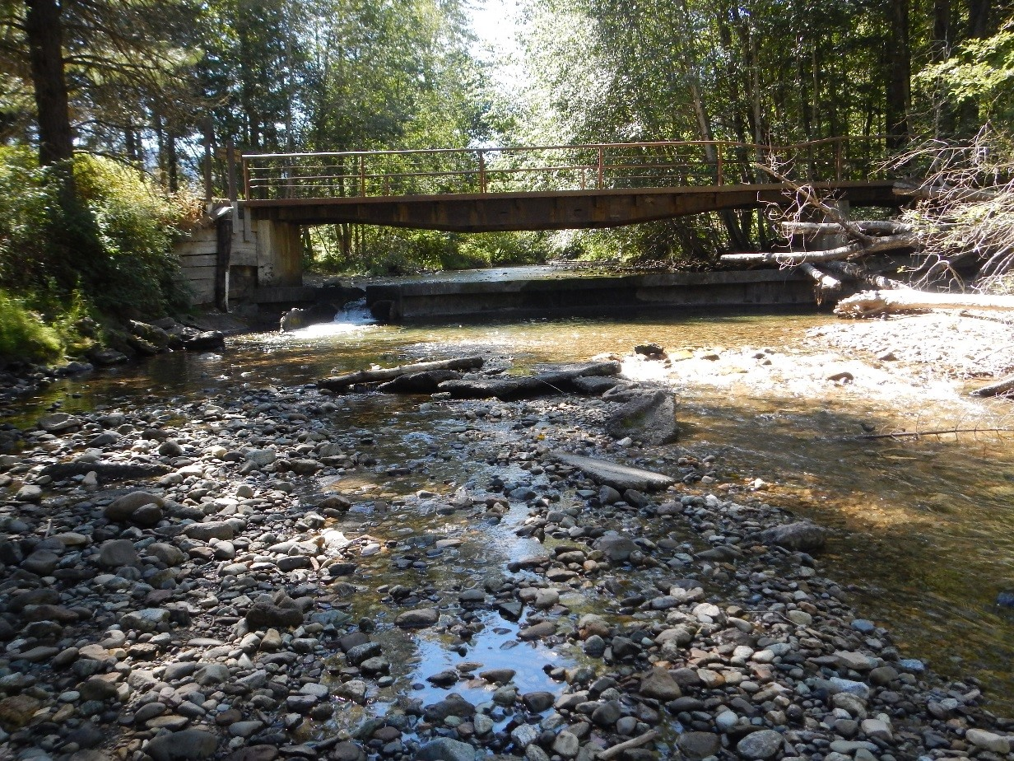
Big Creek Fish Passage
Kelly Clayton at 4:20 on Thurs

Slide 21
Bull Trout Passage at Clear Lake Dam
Jeff Thomas at 1:20 on Thurs

Slide 22
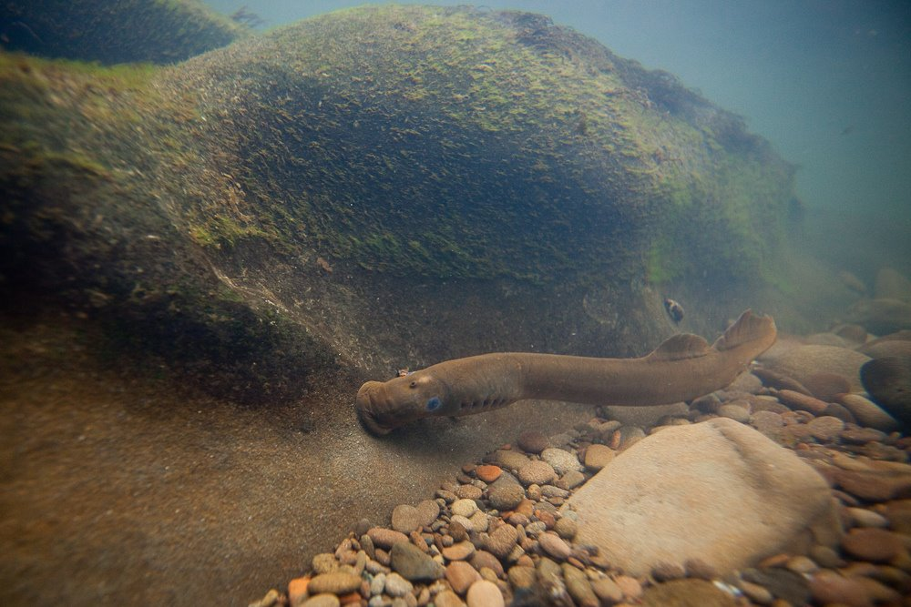
Larval/Juvenile Lamprey Entrainment in Irrigation Diversions
Tyler Beals at 11:00 on Thurs
Passage of Radio-tagged Adult Pacific Lamprey
Ann Grote at 11:20 on Thurs

Slide 23
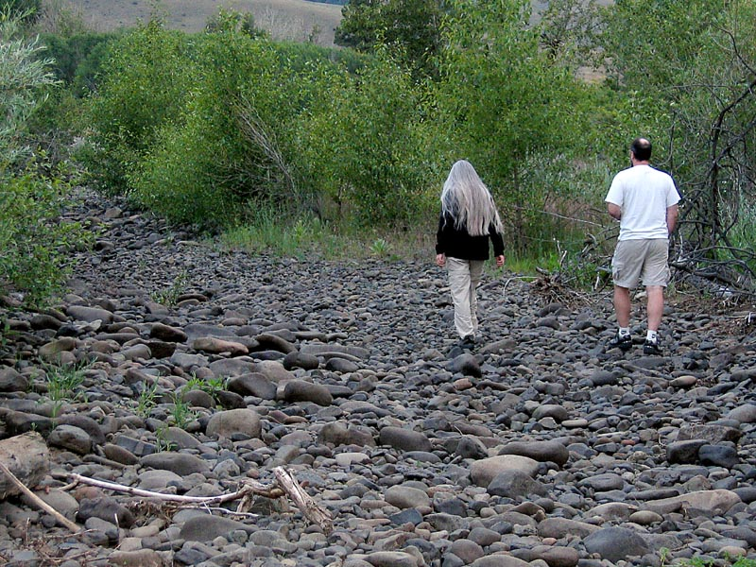
Tributary Instream Flows

Slide 24
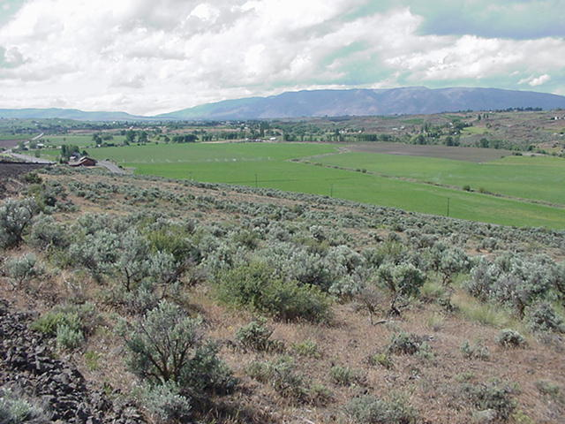
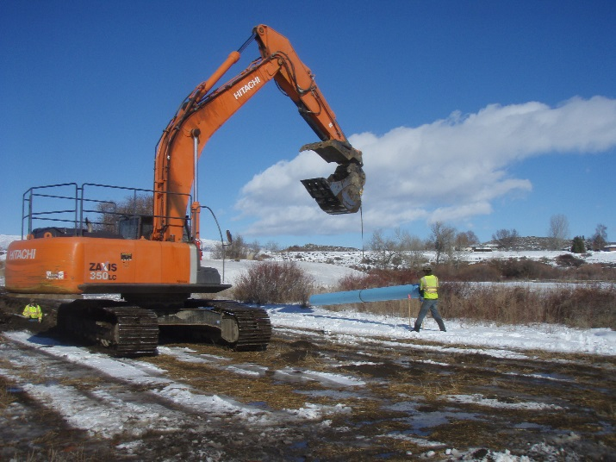
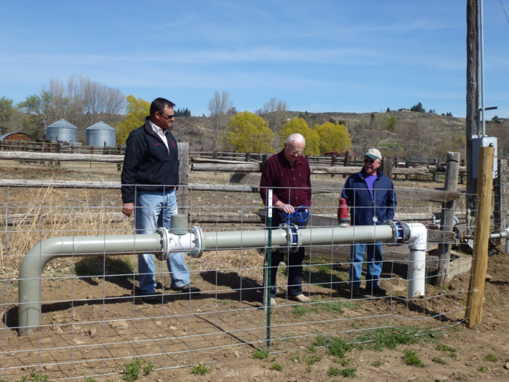
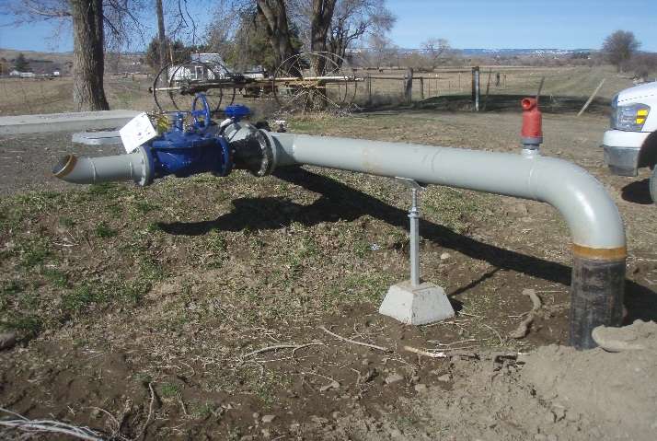
YTID-Cowiche Creek Water Users Association
Up to 8 cfs flow restored
Irrigators provided alternate pressurized water source

Slide 25
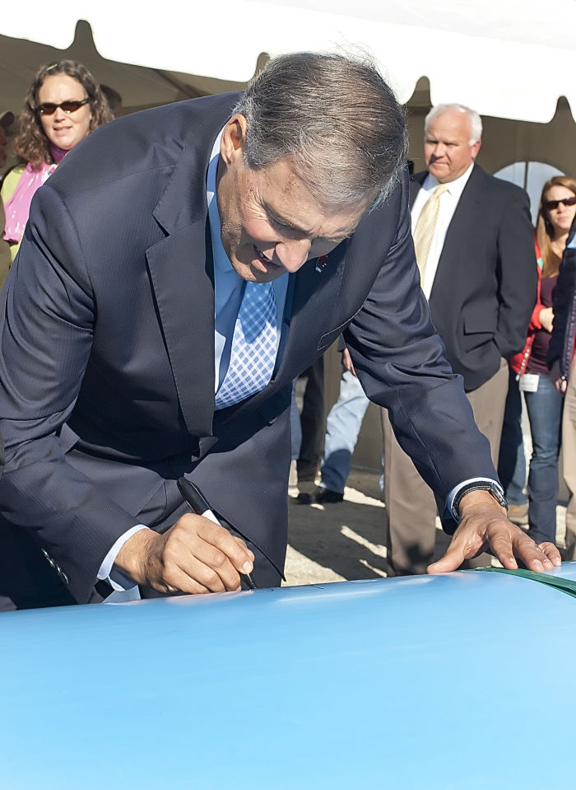
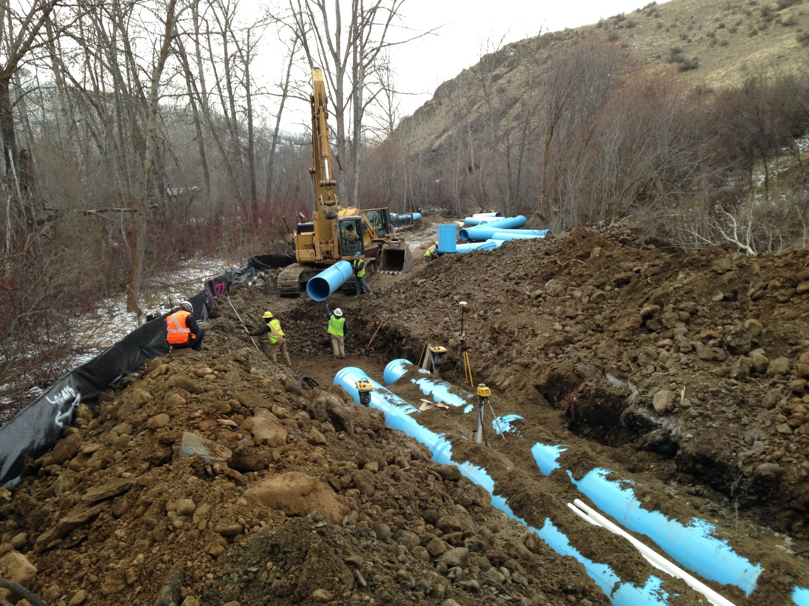
Manastash FLOW IMPROVEMENTS
Over 15 cfs trusted and more to come… major investments by bor and dept of ecology

Slide 26
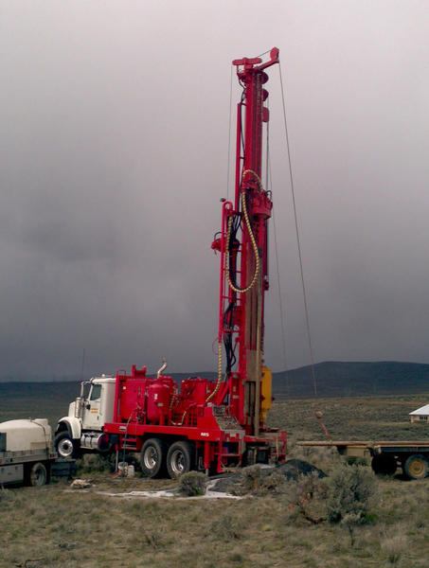
Yakima County Water Resource System: A Countywide Utility for Mitigating Domestic Groundwater Withdrawals
Joel Freudenthal at 2:20 on Weds

Slide 27
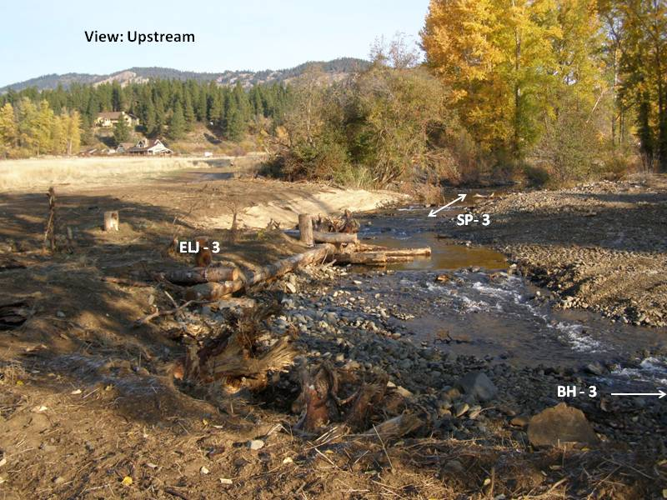
  Tributary Habitat Projects

Slide 28
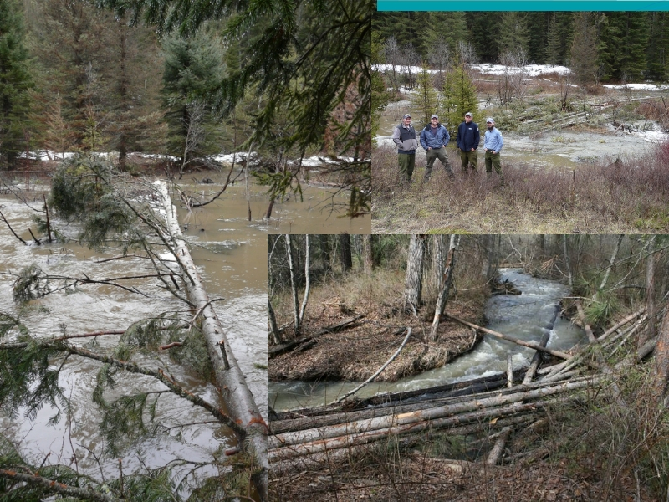
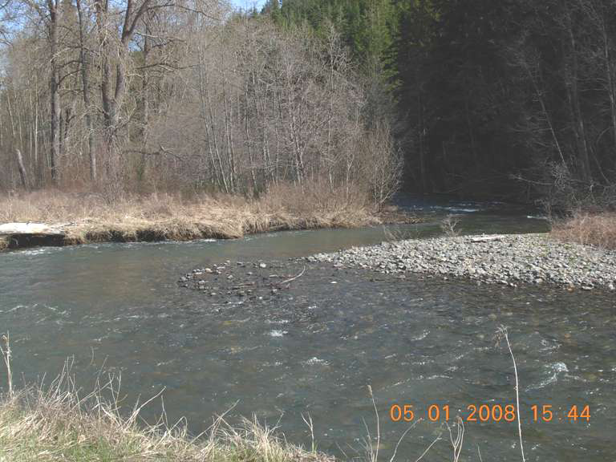
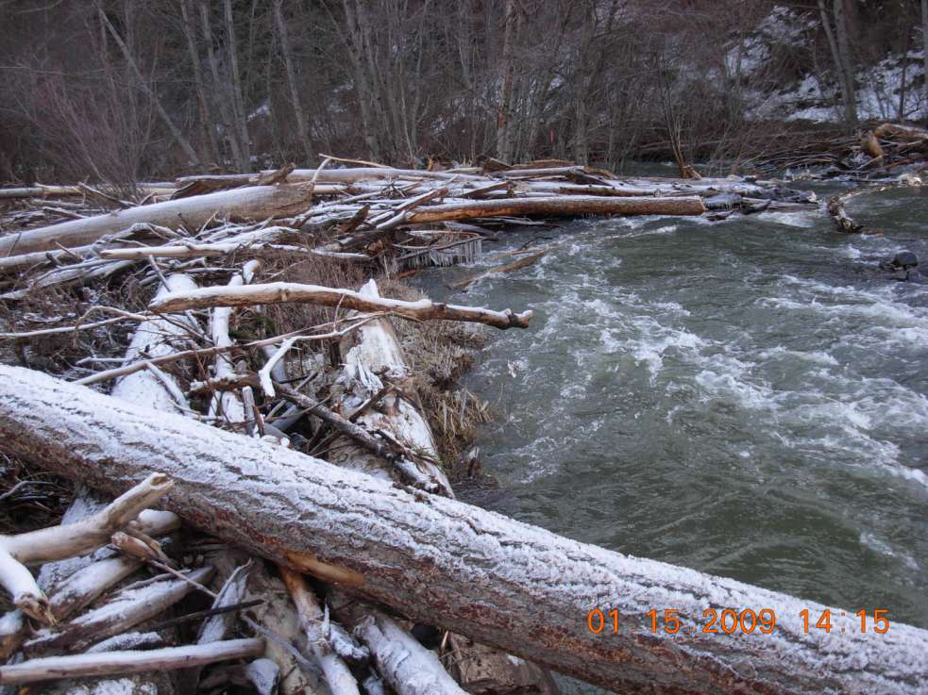
  Wood Placement in 2 new creeks…
Oak Creek Restoration: Using Wood for Floodplain Connectivity
John Marvin at 9:40 on Thurs
Yakima River Edge Habitat Project & Teanaway Pilot Restoration
Scott Nicolai at 1:40 on Weds

Slide 29
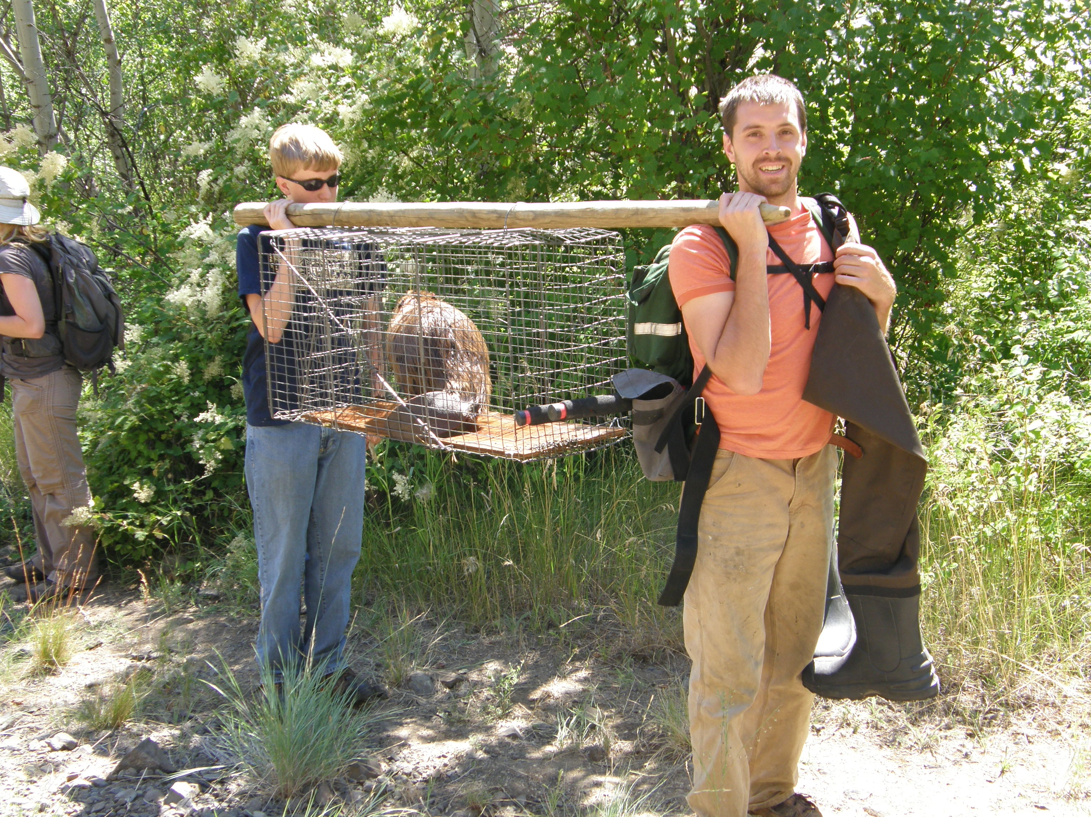
Beaver Reintroduction
Melissa Babik at 2:40 on Weds

Slide 30
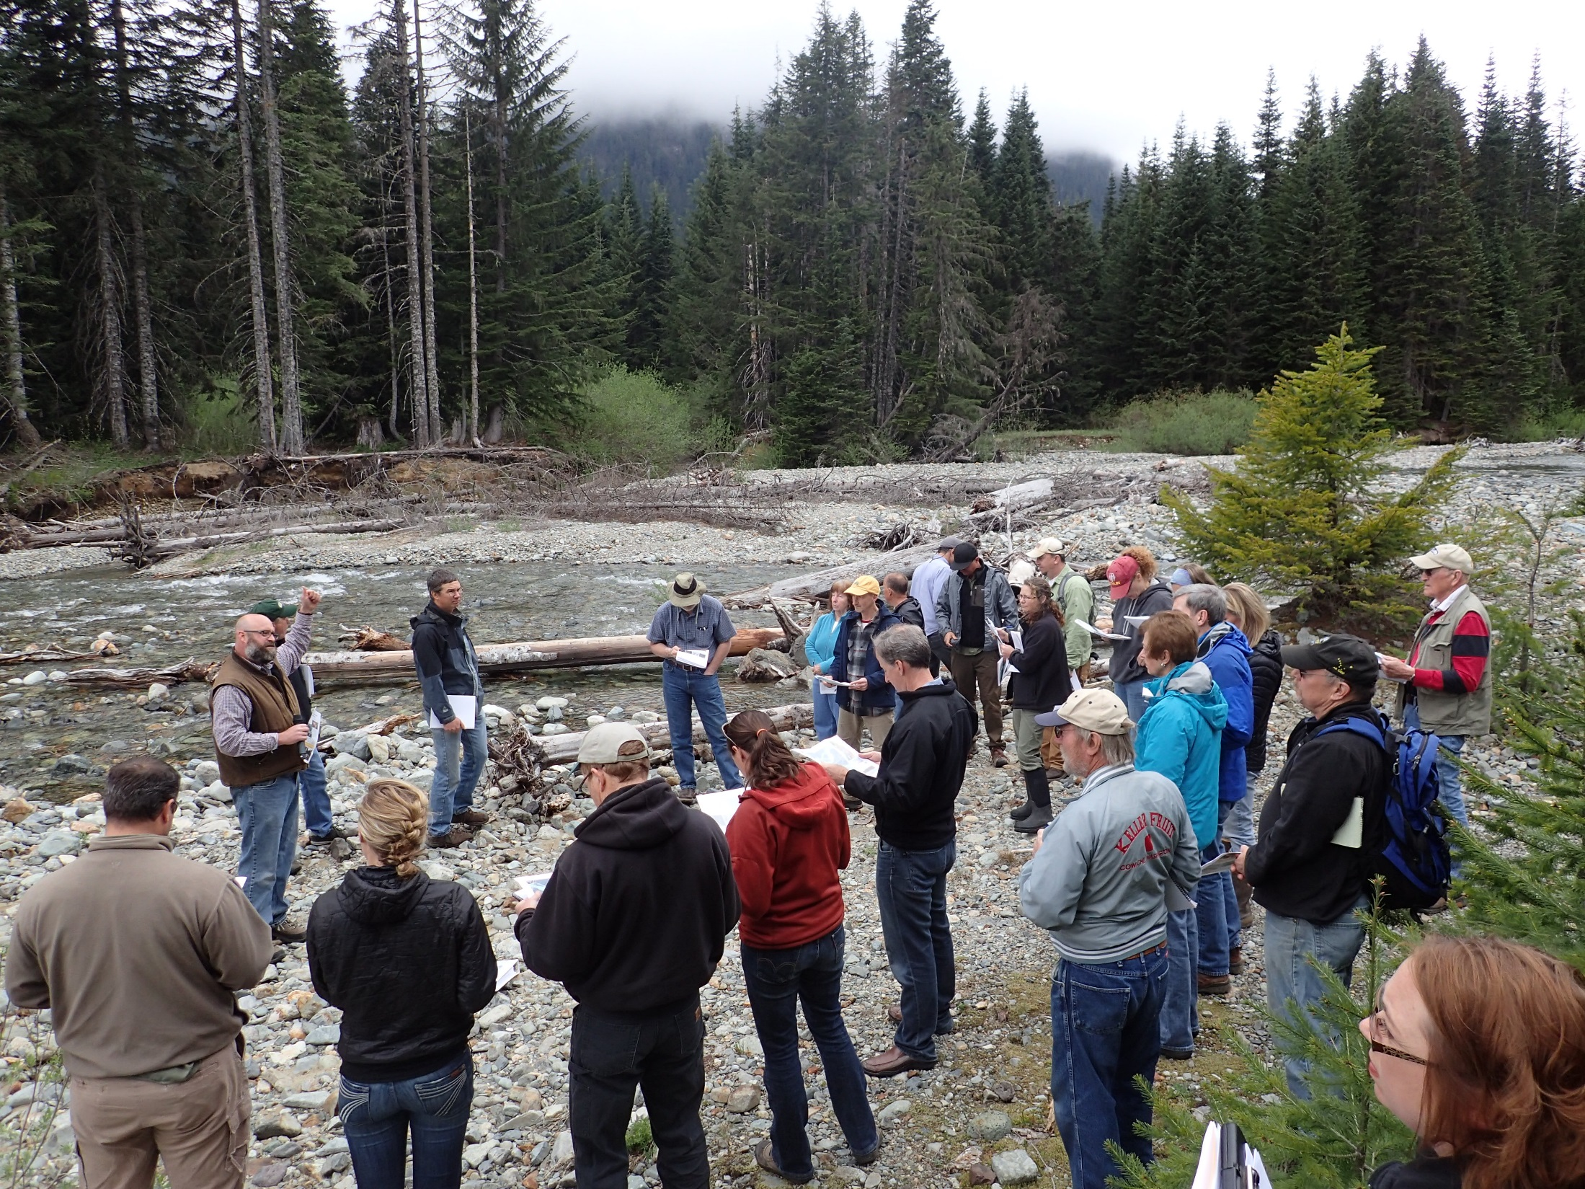
Gold Creek Assessment: Two Year Results & Conceptual Design
Mitch Long at 1:40 on Thurs

Slide 31
  Tributary Habitat Projects

Slide 32
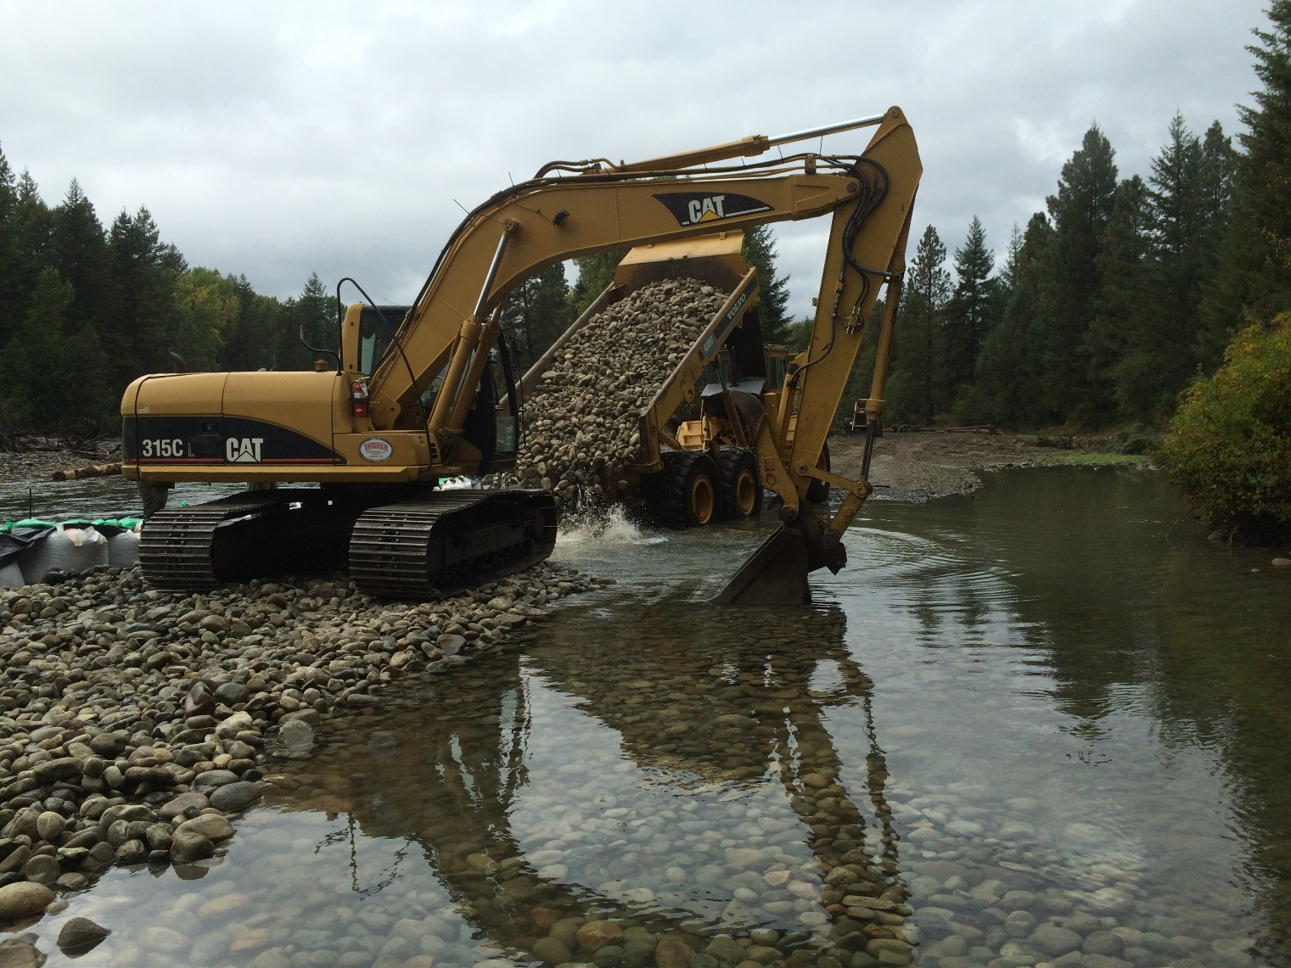
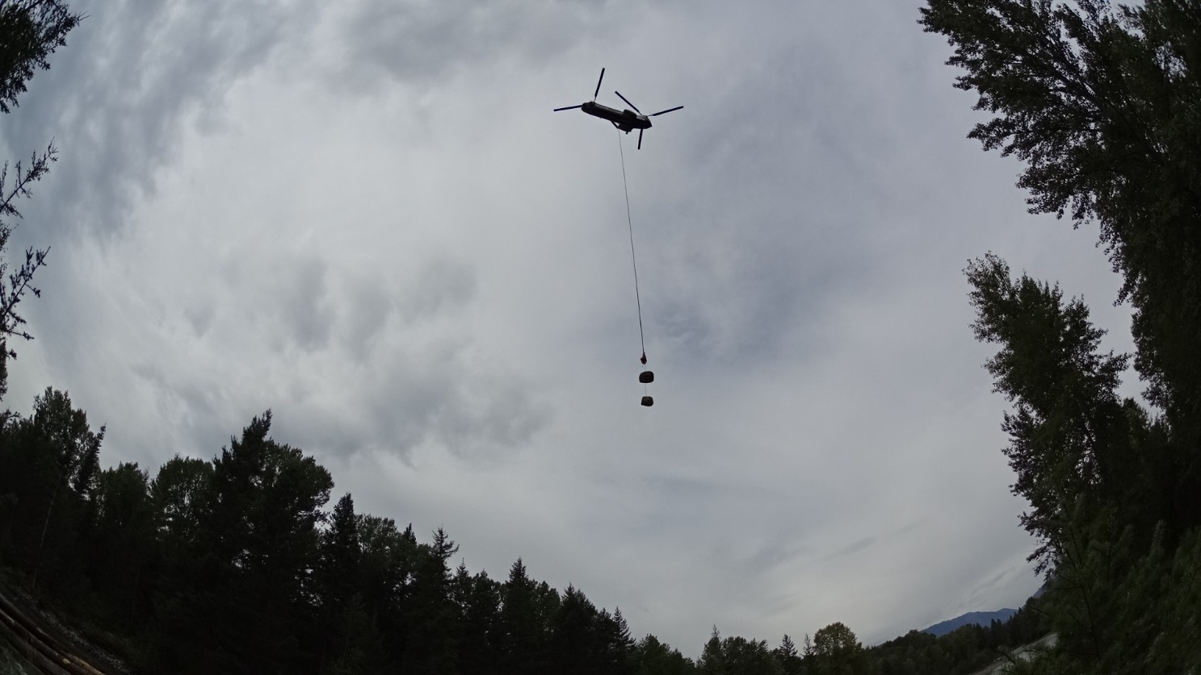

Slide 33
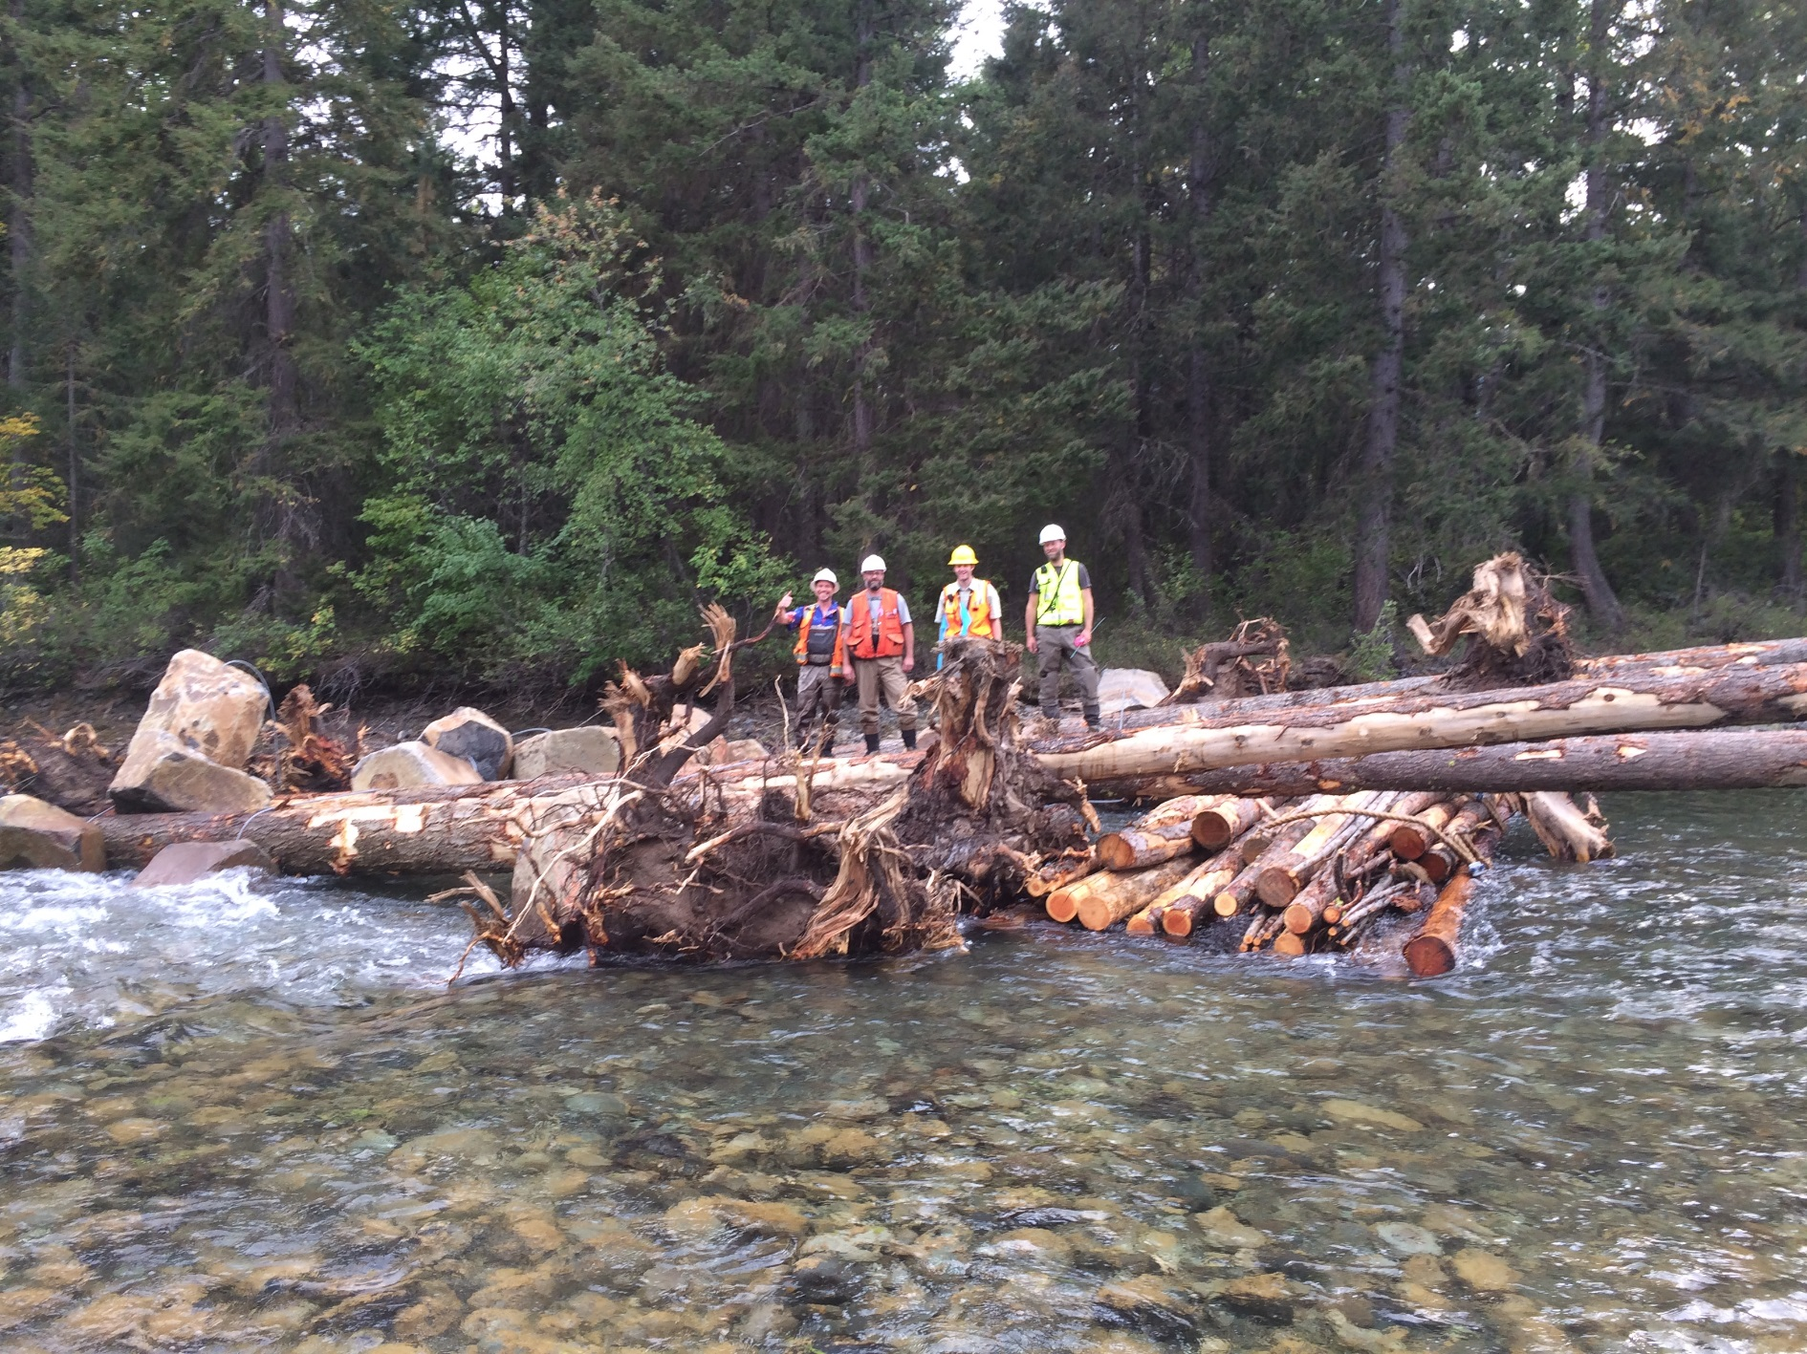

Slide 35
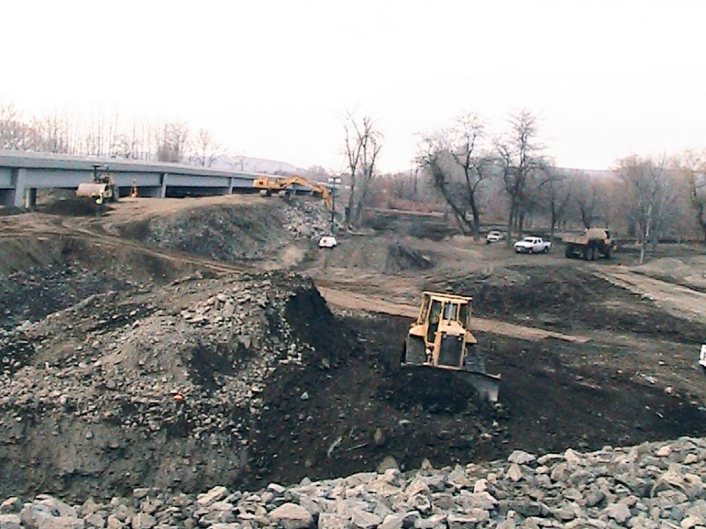
Counties actively setting back levee systems

Slide 36
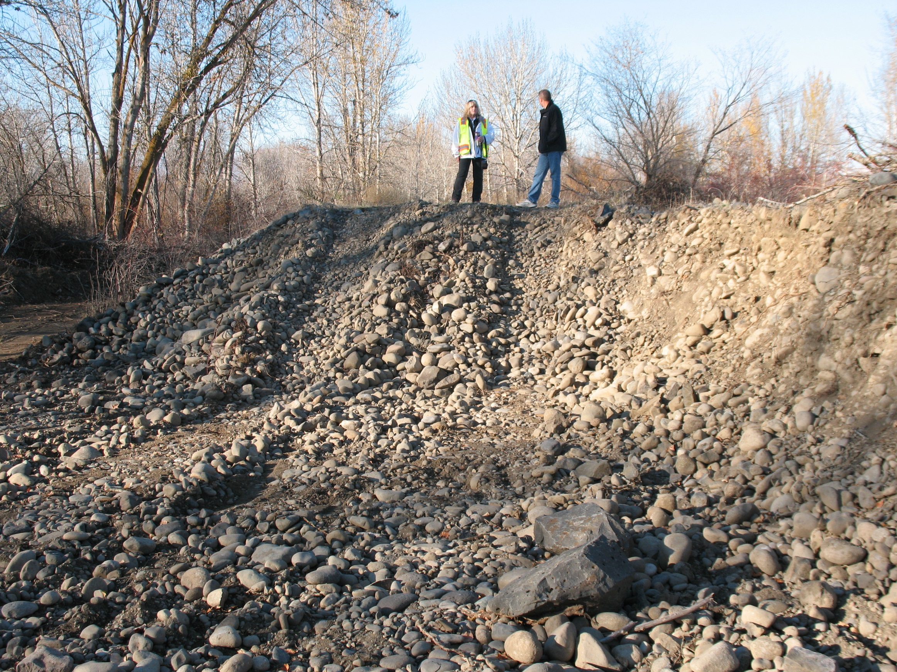

Slide 37
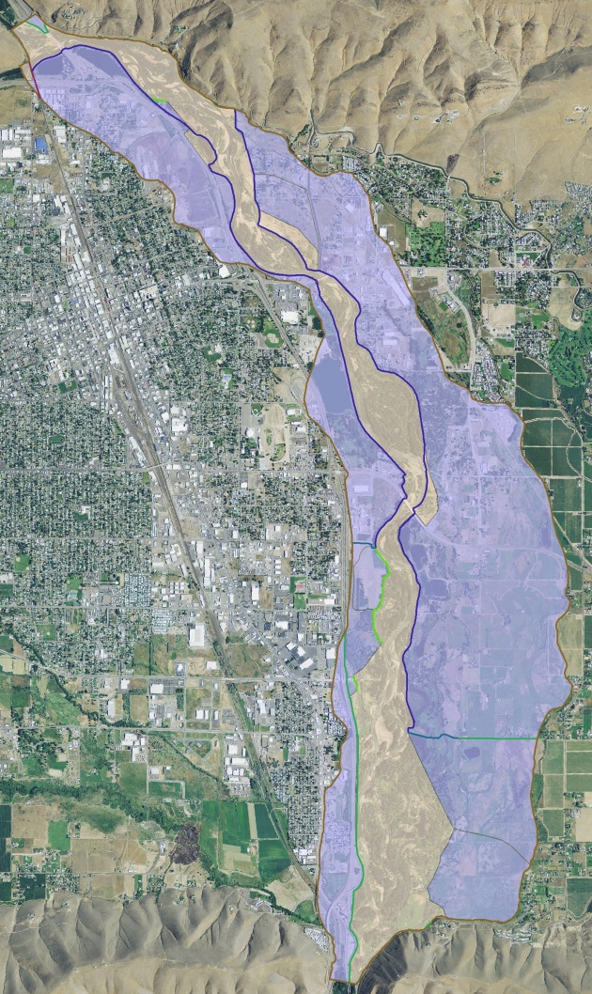
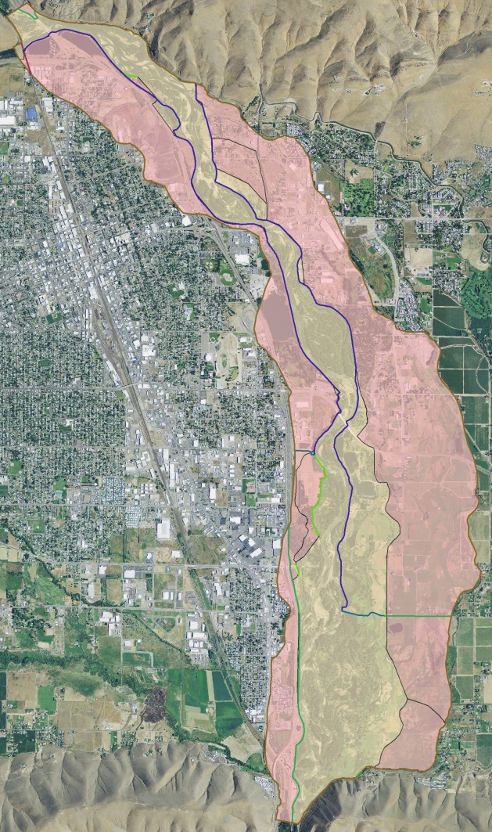
Current and Future Actions in the Gap to Gap Reach and Lower Naches
Joel Freudenthal at 2:00 on Weds
Floodplain Dates | Active (acres) | % of Historic (USGS)
2002 | 1,528 | 56
2014 | 1,640 | 60
2018 | 2,214 | 81

Slide 38
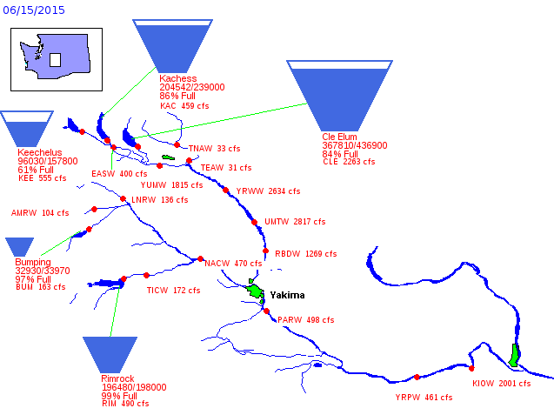
Mainstem Survival

Slide 39
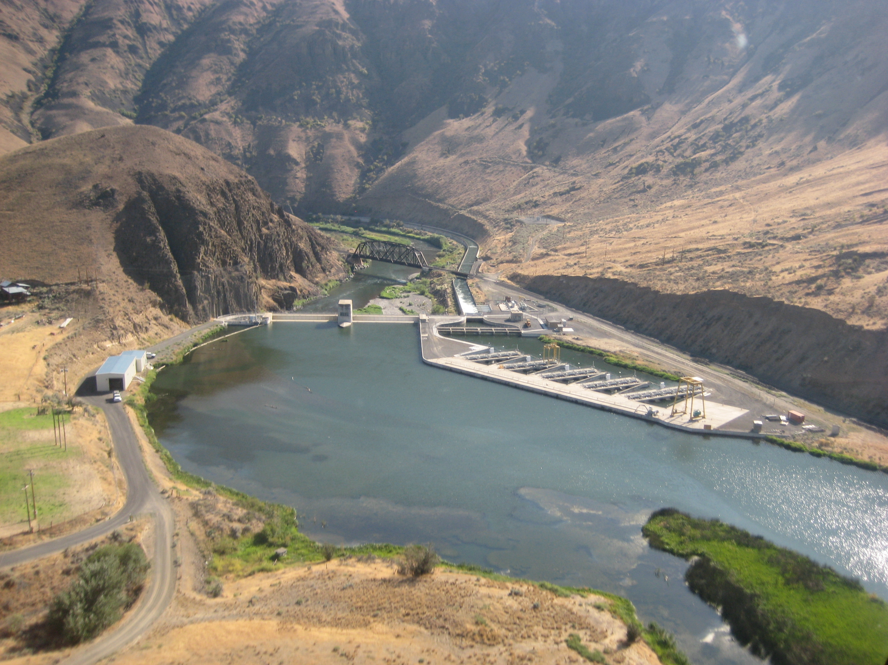
Assessment of Streamflow Effects on Smolt Survival Below Roza Dam
Ian Courter at 11:00 on Weds
Assessment of Passage Route Effects on Smolt Survival at Roza and Prosser Dams
Russell Perry at 11:20 on Weds

Slide 40
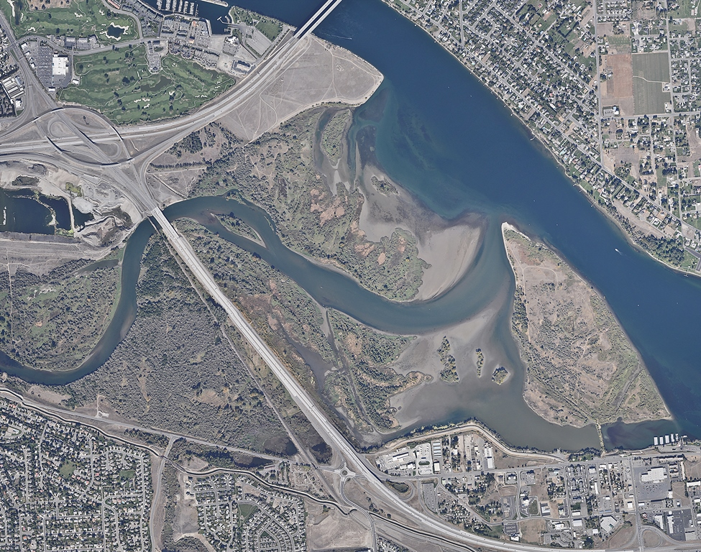
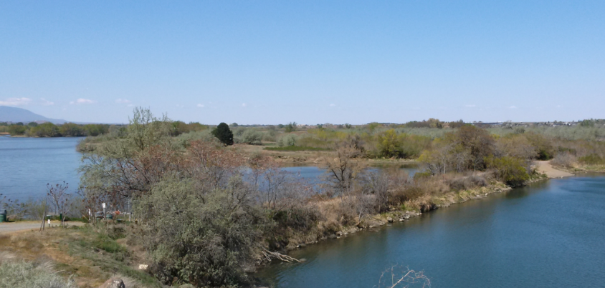
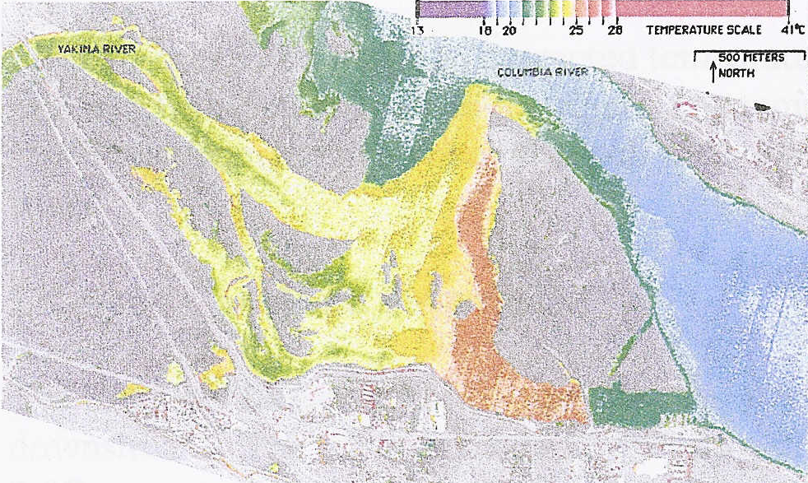
Yakima Delta PROJECT
Yakima River Delta Study
Rebecca Wassel at 10:20 on Thurs

Slide 41
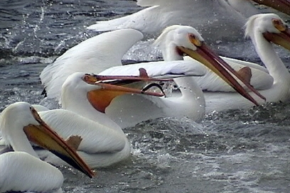
Bird and Fish Predation
Michael Porter at 11:40 on Thurs

Slide 42
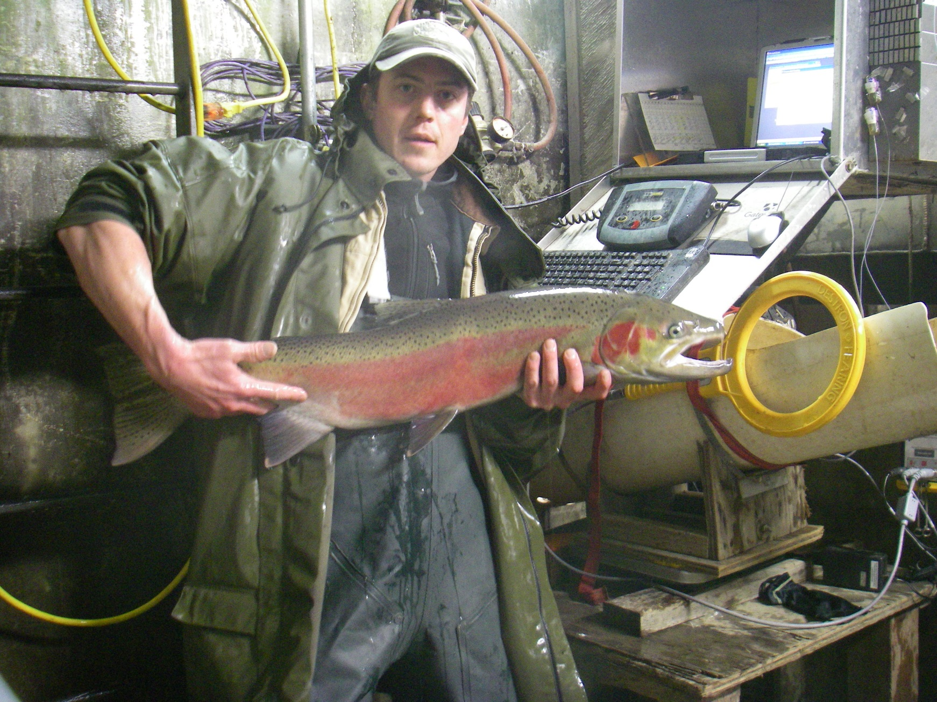
STEELHEAD VSP Monitoring

Slide 43
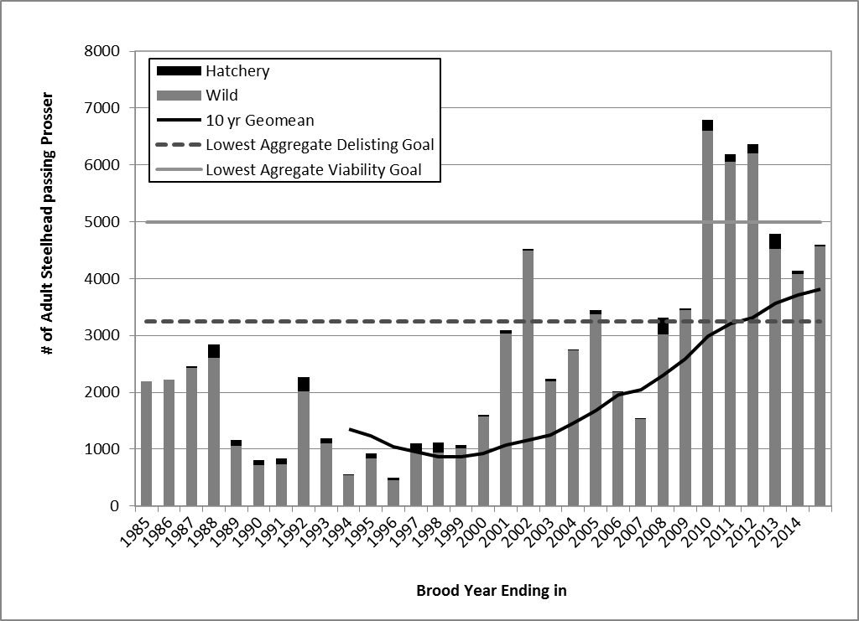
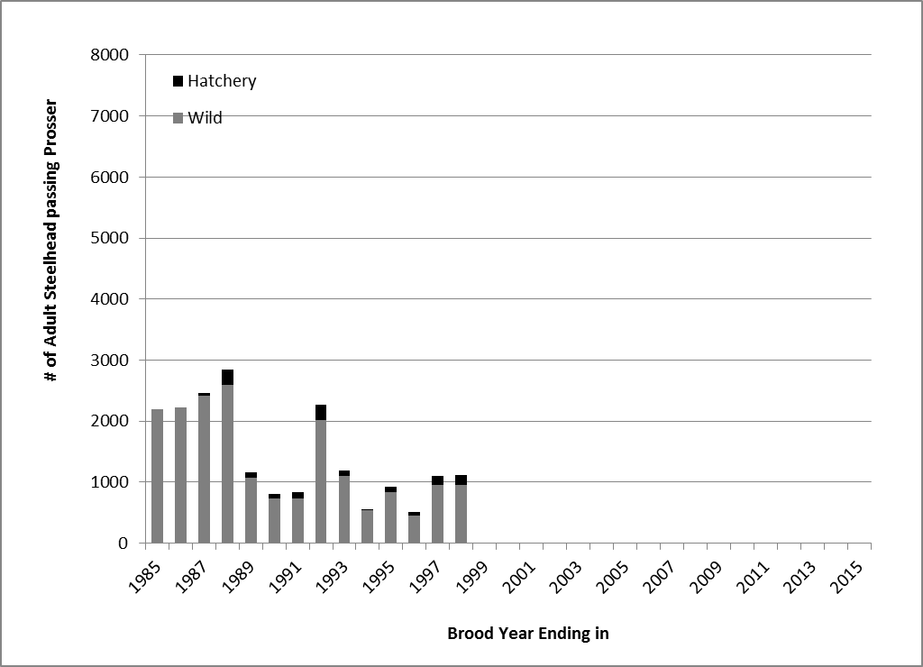
MPG-level Steelhead ABUNDANCE WHEN LISTED
Notes:
Here’s how combined abundance for our four steelhead populations looked at the time of listing…
You can see why they were listed

Slide 44
MPG-level Steelhead ABUNDANCE NOW
Notes:
Here’s that same graph updated through this year…
While our delisting criteria involve meeting population-specific criteria for abndance, productivity, spatial structure and diversity, this simple graph of aggregate adult abundance shows that trends in the Yakima are promising…

Slide 45
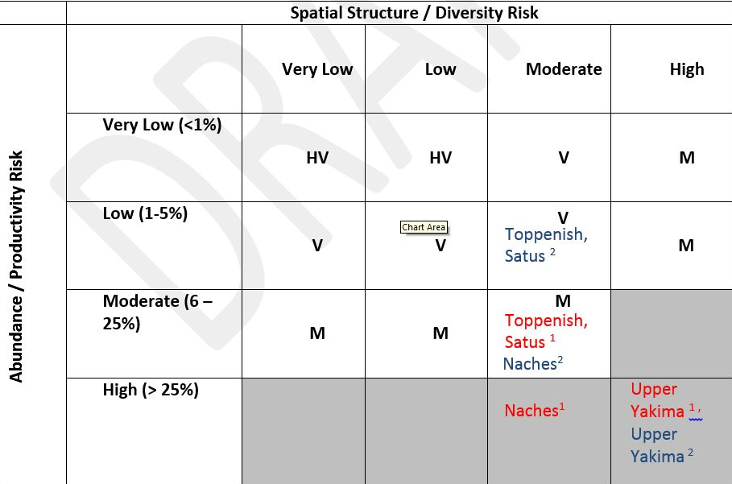
Keys to success:
Recovery Plan sets clear goals
Existing YKFP infrastructure supports monitoring
2011 VSP Monitoring Plan identifies gaps and priorities
Significant Funding available from BPA under FCRPS Biop
Strong support from Yakama Nation, WDFW & NOAA
Annual coordination among partners
Clear expectation of repeated analysis
Notes:
Who recognizes our chess board?

Slide 46
BTAP

Slide 47
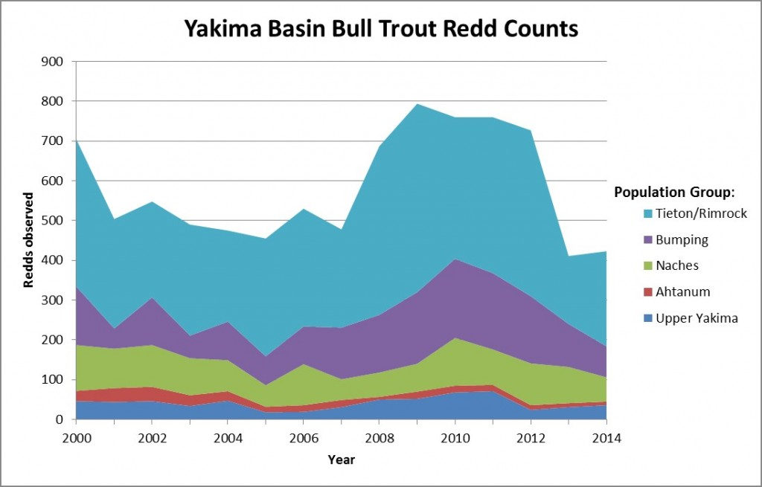

Slide 48
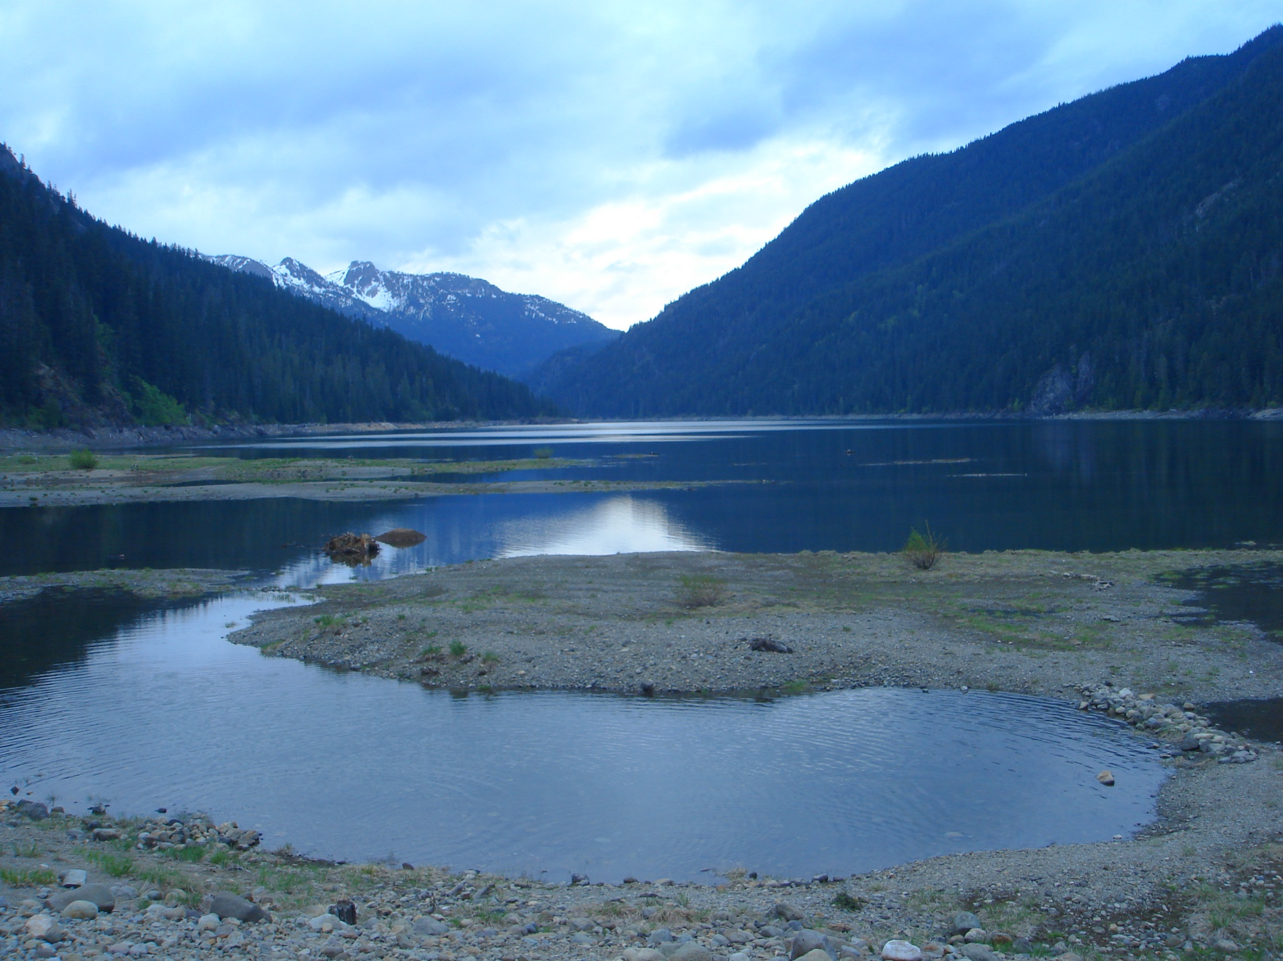
Evaluation of Factors Affecting Bull Trout and Kokanee Production in Kachess and Keechelus Reservoirs
Hansen, Beauchamp and Polacek at 2:00 on Thurs

Slide 49
Climate Change in The Yakima Basin:
Implications for Aquatic Habitat & Water Mgmt
Ingrid Tohver at 1:00 on Weds

