Slide 1
An evaluation of selection across four generations within a Chinook salmon supportive breeding program
Charles D. Waters¹, Jeffrey J. Hard², Marine S.O. Brieuc¹, David E. Fast³, Kenneth I. Warheit⁴, Robin Waples², Curtis M. Knudsen⁵, William J. Bosch³, and Kerry Naish¹
¹School of Aquatic and Fishery Sciences, University of Washington
²NOAA Northwest Fisheries Science Center
³Yakama Nation Fisheries
⁴Washington Department of Fish and Wildlife
⁵Oncorh Consulting

Slide 2
Outline
Quick review of the study system
Updated results of genetic divergence with the 4th hatchery generation
Preliminary results for identifying loci that are associated with phenotypic traits of adult spawners
Ongoing research

Slide 3
Segregated vs. Integrated
Wild Population
Segregated Line
Integrated Line
Hatchery Fish
Hatchery Fish
Wild Fish
2nd Generation
2nd Generation
Hatchery Fish
Hatchery Fish
3rd Generation
3rd Generation
Wild Fish
Has managed gene flow reduced divergence from founder population?

Slide 4
 |  | 1998
 |  | P₁-wild founders
2002 |  |  |  | 2002
F₁ adults-1st gen hatchery |  |  |  | F₁ adults-wild founders (no hatchery influence)
2006 |  |  |  | 2006
F₂ adults-2nd gen hatchery |  |  |  | F₂ adults-natural origin (possible hatchery influence)
2010 |  |  |  | 2010
F₃ adults-3rd gen hatchery |  |  |  | F₃ adults-natural origin (possible hatchery influence)
2014 |  |  |  | 2014
F₄ adults-4th gen hatchery |  |  |  | F₄ adults-natural origin (possible hatchery influence)
Segregated Line
Integrated Line

Slide 5
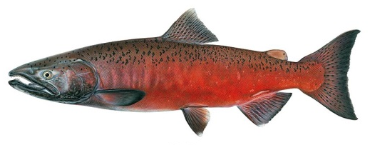
Experimental Approach
Chinook Map (Brieuc et al. 2014), 7146 markers
Metacentric
Acrocentric
Joseph R. Tomelleri
Number of loci = 8,872 RAD loci (4,178 are mapped)

Slide 6
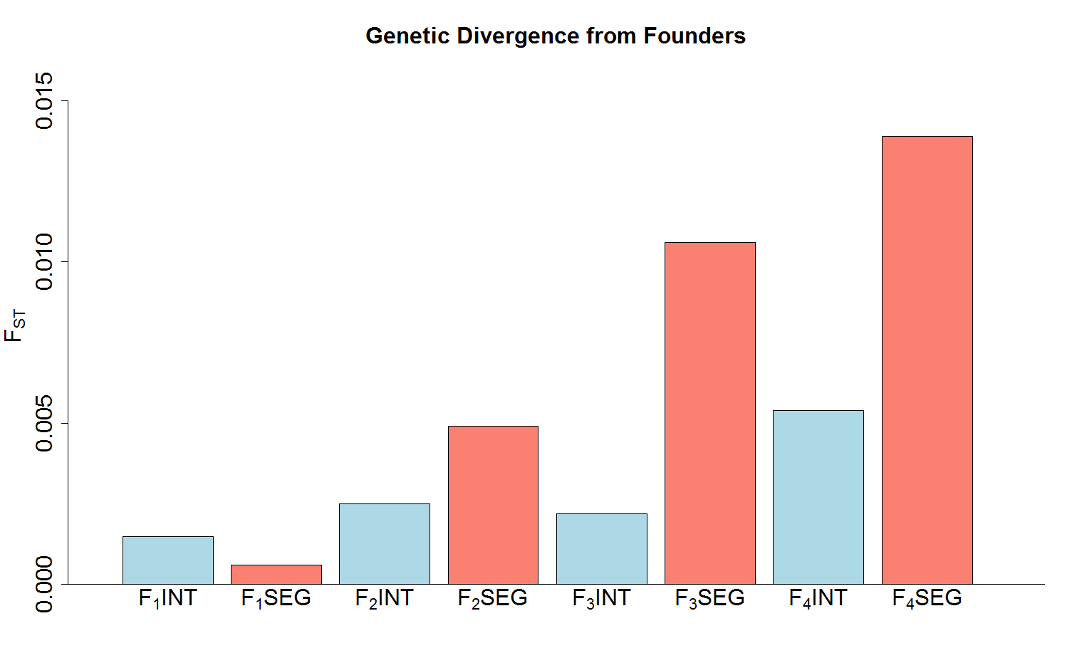
F_{ST}

Slide 7
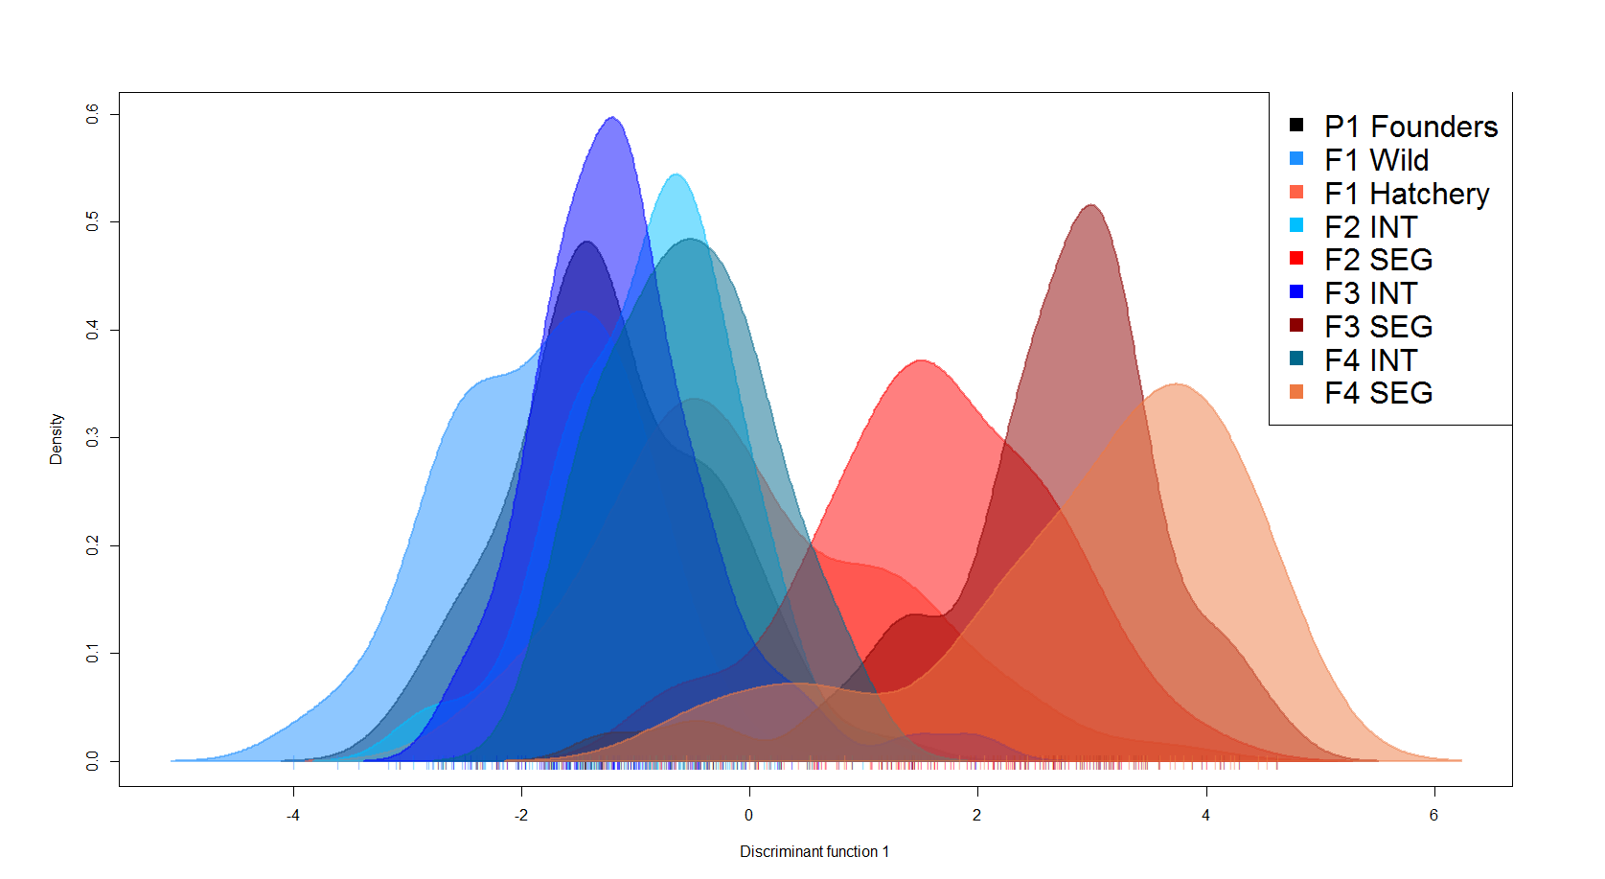
Discriminant Analysis of Principal Components
Density
0.0 0.1 0.2 0.3 0.4 0.5 0.6
-4 -2 0 2 4 6
DF 1 (59.3 %)
Notes:
Figure 2. Density of individuals for the wild founders (P₁ Founders, black) and three generations of the integrated (INT, blue colors) and segregated (SEG, red colors) hatchery lines plotted along the first discriminant function from the discriminant analysis of principal components (DAPC).
**Choose either this plot or the 2D plot

Slide 8
Effective Number of Breeders
Used to examine divergence due to genetic drift
Genetic drift is the dominant evolutionary process in small populations (loss of genetic variation; inbreeding)
Avg. # broodstock: INT=363; SEG=85
Estimated effective number of breeders using the linkage disequilibrium and temporal methods

Slide 9
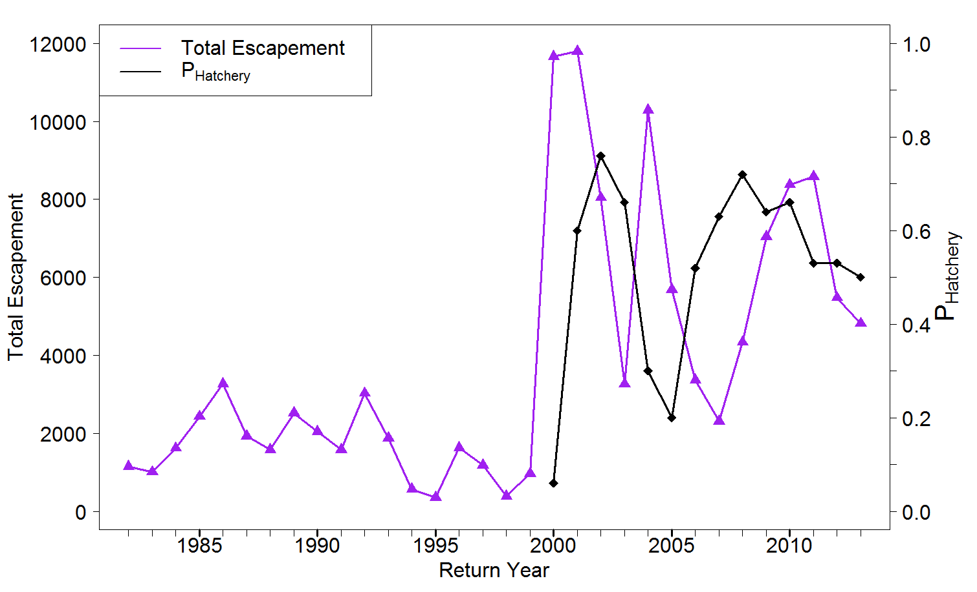
Notes:
Figure S2. Total annual escapement of adult Chinook in the upper Yakima river (purple line) and the proportion of spawners that are of hatchery origin (black line).

Slide 10
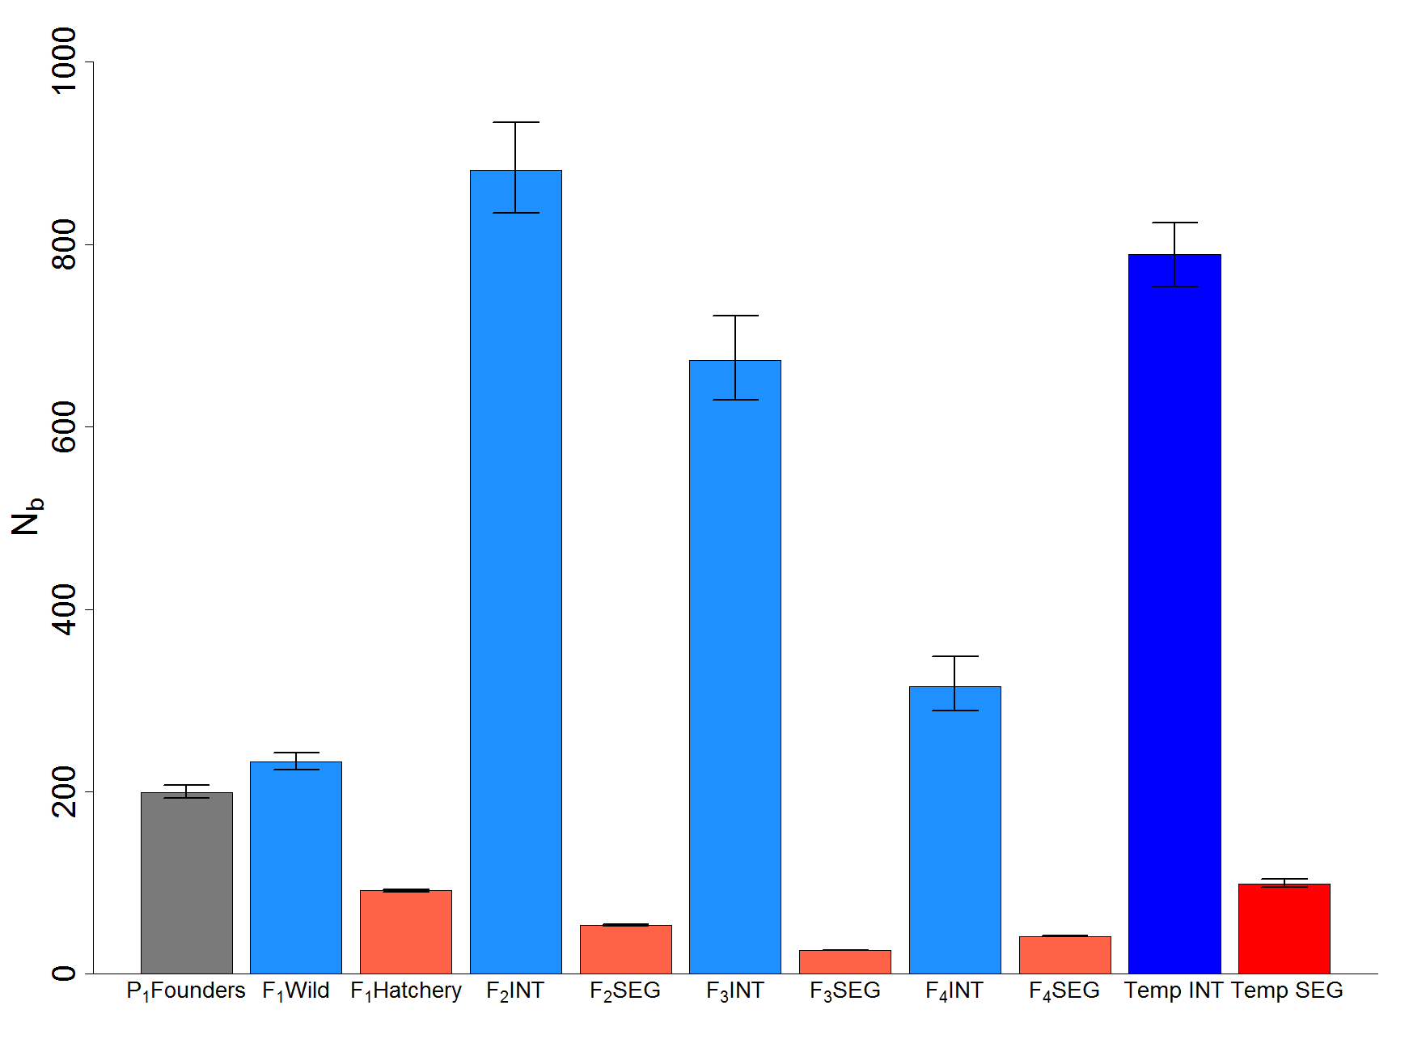
Linkage Disequilibrium
Temporal
N_{spawners} 563 387 338 8044 98 3364 69 9267 72
Notes:
Figure 3. Effective number of breeders, N_{b}, estimated by the linkage disequilibrium (LD) and temporal methods for the P₁ Founders (gray) and integrated (blue) and segregated (red) hatchery lines. The LD method allows estimation of N_{b} for every generation, while the temporal method yields a single estimate for the entire sampling period. LD estimates are adjusted for physical linkage and potential bias caused by overlapping generations and fluctuating population size. N_{spawners} is the total number of spawning adults, and P_{hatchery} is the proportion of spawners that are of hatchery origin.

Slide 11
 |  | 1998
 |  | P₁-wild founders
2002 |  |  |  | 2002
F₁ adults-1st gen hatchery |  |  |  | F₁ adults-wild founders (no hatchery influence)
2006 |  |  |  | 2006
F₂ adults-2nd gen hatchery |  |  |  | F₂ adults-natural origin (possible hatchery influence)
2010 |  |  |  | 2010
F₃ adults-3rd gen hatchery |  |  |  | F₃ adults-natural origin (possible hatchery influence)
2014 |  |  |  | 2014
F₄ adults-4th gen hatchery |  |  |  | F₄ adults-natural origin (possible hatchery influence)
Segregated Line
Integrated Line

Slide 12
Linkage Disequilibrium
Temporal
N_{spawners} 563 387 338 8044 98 3364 69 9267 72
Notes:
Figure 3. Effective number of breeders, N_{b}, estimated by the linkage disequilibrium (LD) and temporal methods for the P₁ Founders (gray) and integrated (blue) and segregated (red) hatchery lines. The LD method allows estimation of N_{b} for every generation, while the temporal method yields a single estimate for the entire sampling period. LD estimates are adjusted for physical linkage and potential bias caused by overlapping generations and fluctuating population size. N_{spawners} is the total number of spawning adults, and P_{hatchery} is the proportion of spawners that are of hatchery origin.

Slide 13
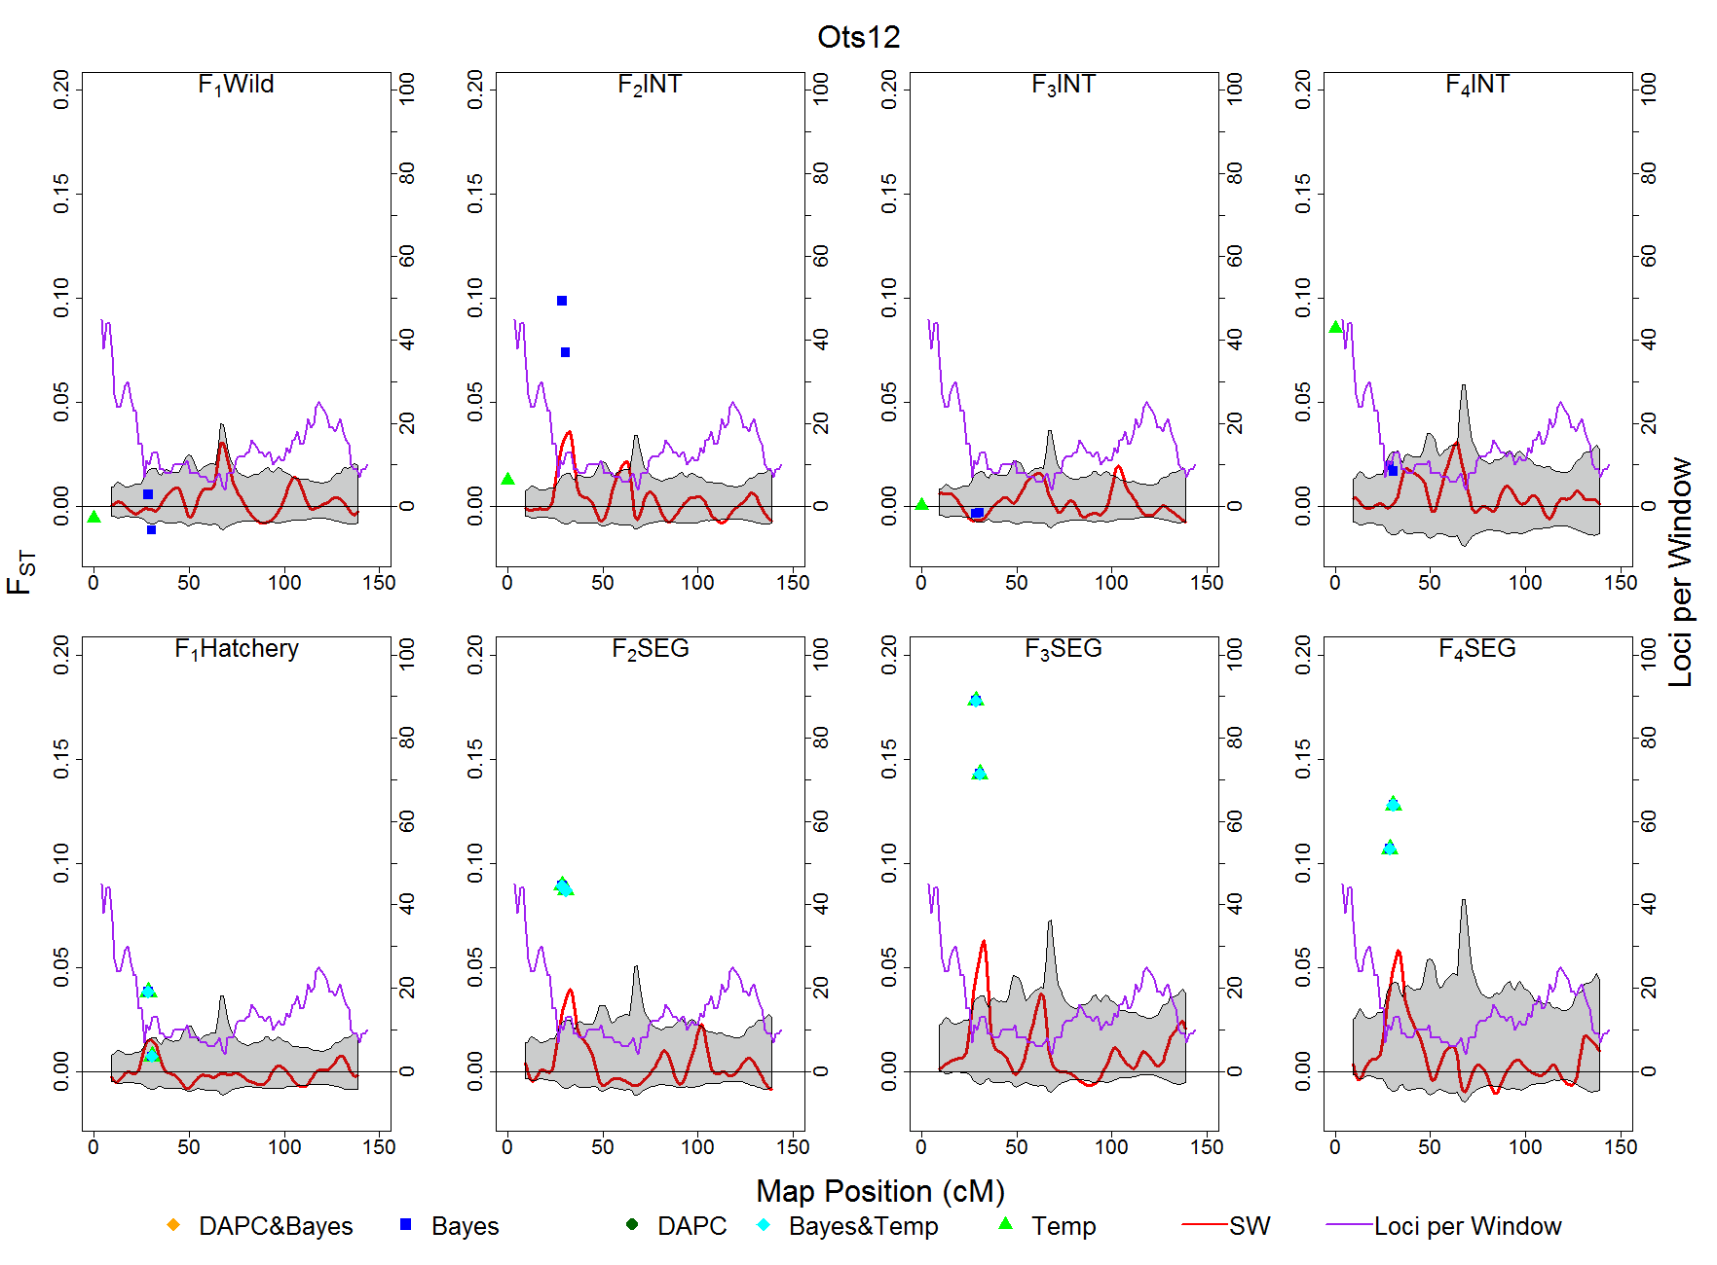

Slide 14
Is Selection Acting on Fitness-Related Traits?
Look for associations between genetic markers and traits of interest using GWAS and Random Forest analyses.
Preliminary results for GWAS on 361 individuals at 3428 loci
Return date to Roza
Age at return
Weights at Roza and CESRF
Fork length at CESRF

Slide 15
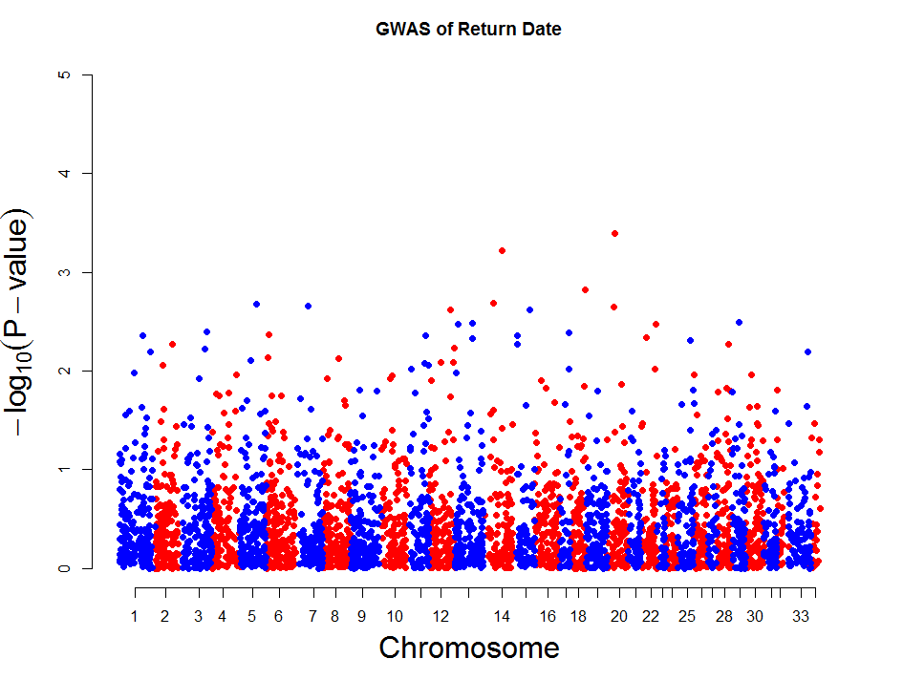

Slide 16
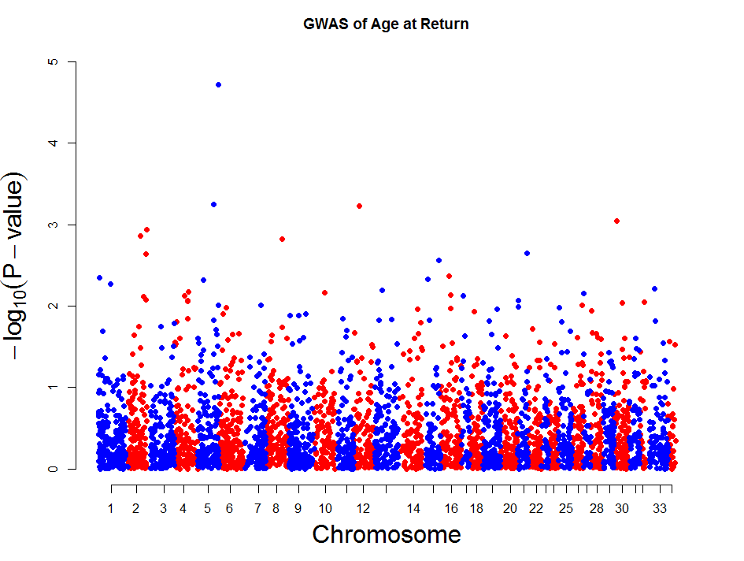

Slide 17
Summary of Results
Segregated line is still slowly diverging over time
F_{ST} also increased in F₄ INT generation
Genetic drift is driving divergence of SEG line (broodstock size)
Signatures of selection were identified using 3 methods with good agreement; more abundant and consistent in segregated line
Biological significance? No links to fitness-related traits in preliminary GWAS analyses

Slide 18
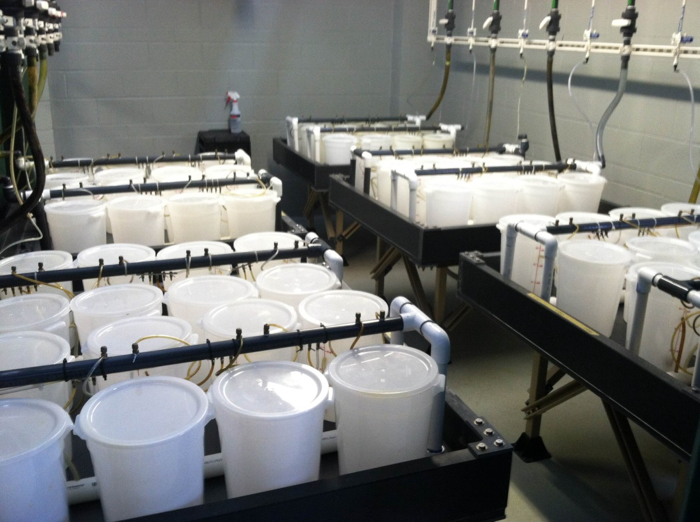
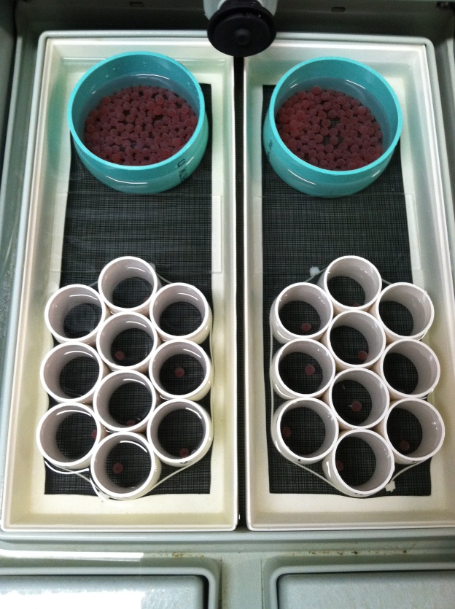
Ongoing Research
Finalize analyses to identify loci linked fitness related traits in adults, and determine if these traits are responding to hatchery selection
Identify genomic regions associated with hatch timing, early growth rate, and disease resistance

Slide 19
Acknowledgments
UW MERlab: Dan Drinan, Miyako Kodama, Isadora Jimenez-Hidalgo, Katrina van Raay, Lorenz Hauser
Charlie Strom and all CESRF staff
Steve Schroder (ret.) and Todd Kassler – WDFW
Mike Ford, NOAA
Daniel Goodman, MSU & Brian Riddell, PSF
Funded by Federal Biop funds “Hatchery reform” and Hall Conservation Genetics Award at UW

Slide 20
Questions? cwaters8@uw.edu

Slide 21
Overlap across Tests for Adaptive Divergence in Segregated Line
F_{TEMP}
Simulates neutral genetic divergence in a single population over time
Incorporates estimates of N_{b}, sample size, and # generations
Bayescan
Identifies candidate loci under selection based on differences in allele frequencies between populations
Sliding Window Analysis
Identifies regions of elevated divergence based on empirical genome-wide distribution of F_{ST}

Slide 22
Overlap across Tests for Adaptive Divergence in Segregated Line
Chromosome | Map Position (cM) | # gens SW INT | # gens SW SEG | F_{TEMP}INT | F_{TEMP}SEG | Bayescan
Ots04 | 37.52-43.15 |  | 2 |  | 2 | 2
Ots05 | 87.43-95.05 | 1 | 3 |  | 1 | 1
Ots06 | 94.64-100.65 | 1 | 1 |  | 1 | 1
Ots11 | 57.77-71.46 | 2 | 3 | 1 | 2 | 1
Ots12 | 26.14-35.29 | 1 | 2 |  | 2 | 2
Ots15 | 132.33-139.26 | 1 | 1 |  | 1 | 1
Ots20 | 93.65-99.49 | 1 | 2 |  | 2 | 1
Possibly the first signatures of domestication selection identified in Pacific salmon

Slide 23
INT: Return year
Initiation year
1997
1998
1999
2000
2001 | 2002 | 2003 | 2004 | 2005 | 2006 | 2007 | 2008 | 2009 | 2010 | 2011 | 2012 | 2013 | 2014
P₁
F₁ Wild
F₂ INT
F₃ INT
F₄ INT
SEG: Return year
Initiation year
1997
1998
1999
2000
2001 | 2002 | 2003 | 2004 | 2005 | 2006 | 2007 | 2008 | 2009 | 2010 | 2011 | 2012 | 2013 | 2014
P₁
F₁ Hatchery
F₂ SEG
F₃ SEG
F₄ SEG
Notes:
Figure 1. Timeline representing the founding (P₁) and subsequent generations (F₁-F₃) of integrated (INT) and segregated (SEG) hatchery lines of anadromous Chinook salmon surveyed at CESRF. Dark grey bars represent freshwater stages, light grey ocean life, ending with reproduction (square). The diagram represents the life history stages of a typical 4 year old fish, the most common age at which individuals mature; some may return as 2-5 year olds. Generation of returning adults denoted by arrows. Solid black squares represent wild adults; checkered squares are adults born in the natural environment that may of wild, hatchery, or wild-hatchery hybrid origin; cross hatched bars are adults born in the hatchery. Years in bold italics are years in which four year old adults were sampled for the current study.

Slide 24
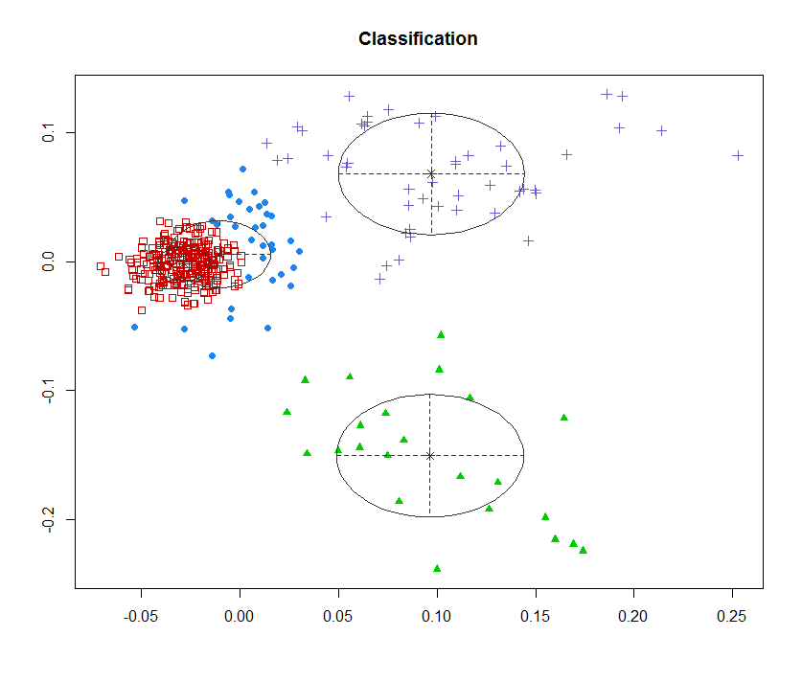

Slide 25
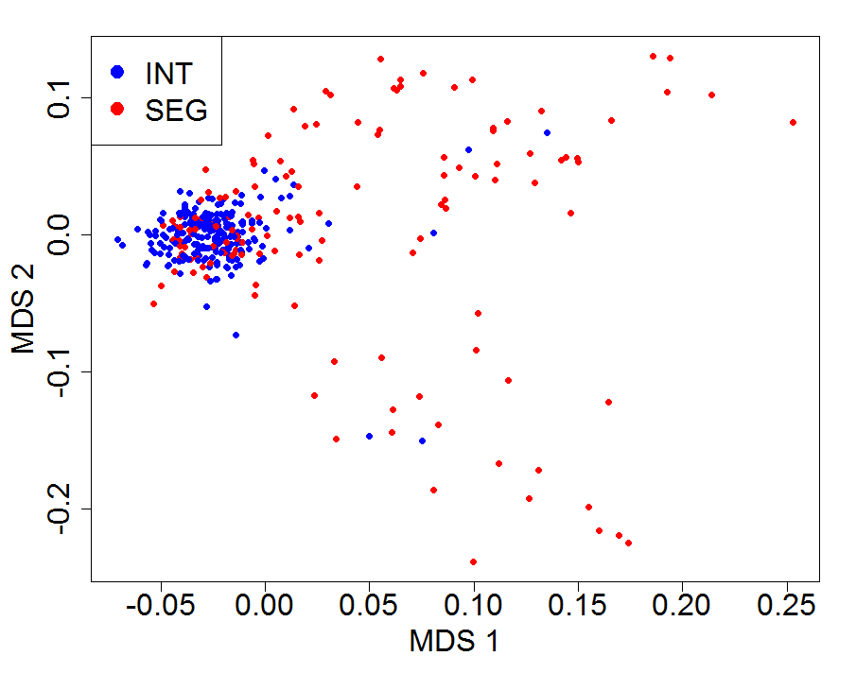

Slide 26
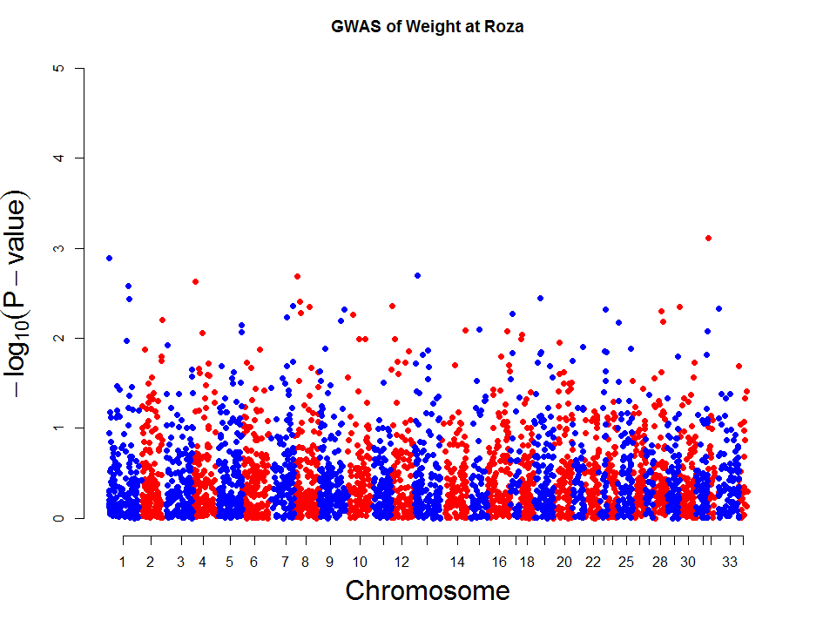

Slide 27
