Slide 1
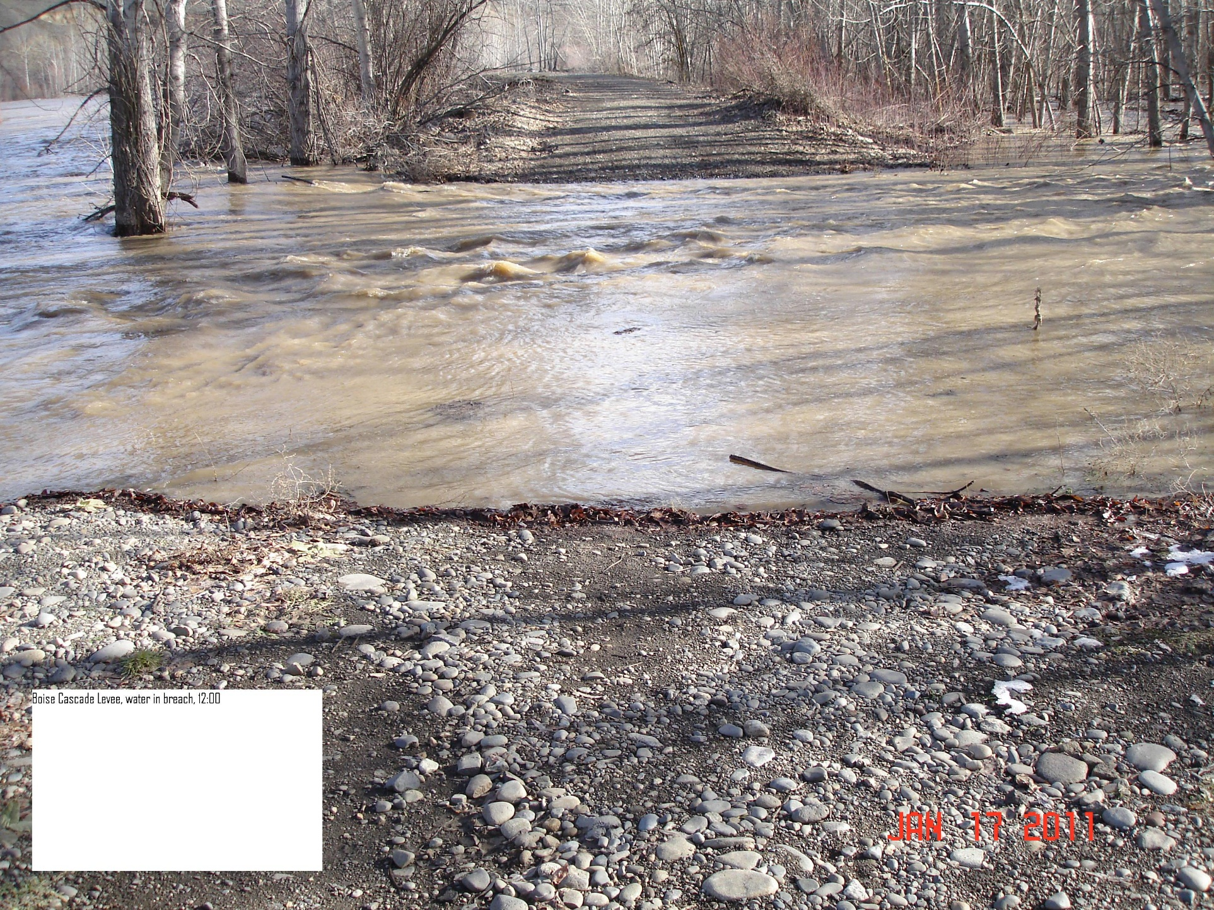
Projects on the Gap to Gap Reach and the Naches River
Joel Freudenthal
Yakima County Water Resources
Science and Management
Conference 2015

Slide 2
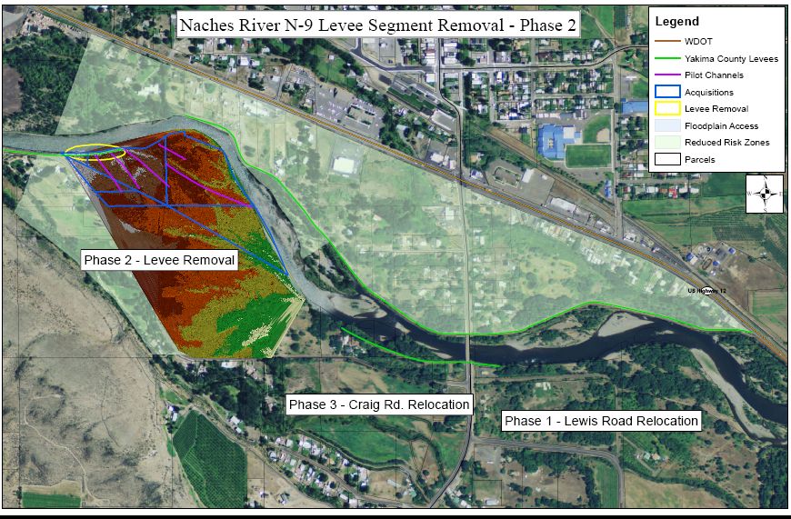
Town of Naches Levee
?

Slide 3
Ramblers Levee Setback

Slide 4
Ramblers’ Phase 2

Slide 5
?
Notes:
Ramblers Park
Multiple constrictions depending on the flow level
Constrictions can also happen interior to the levee system, often associated with Bridges or other infrastructure.

Slide 6
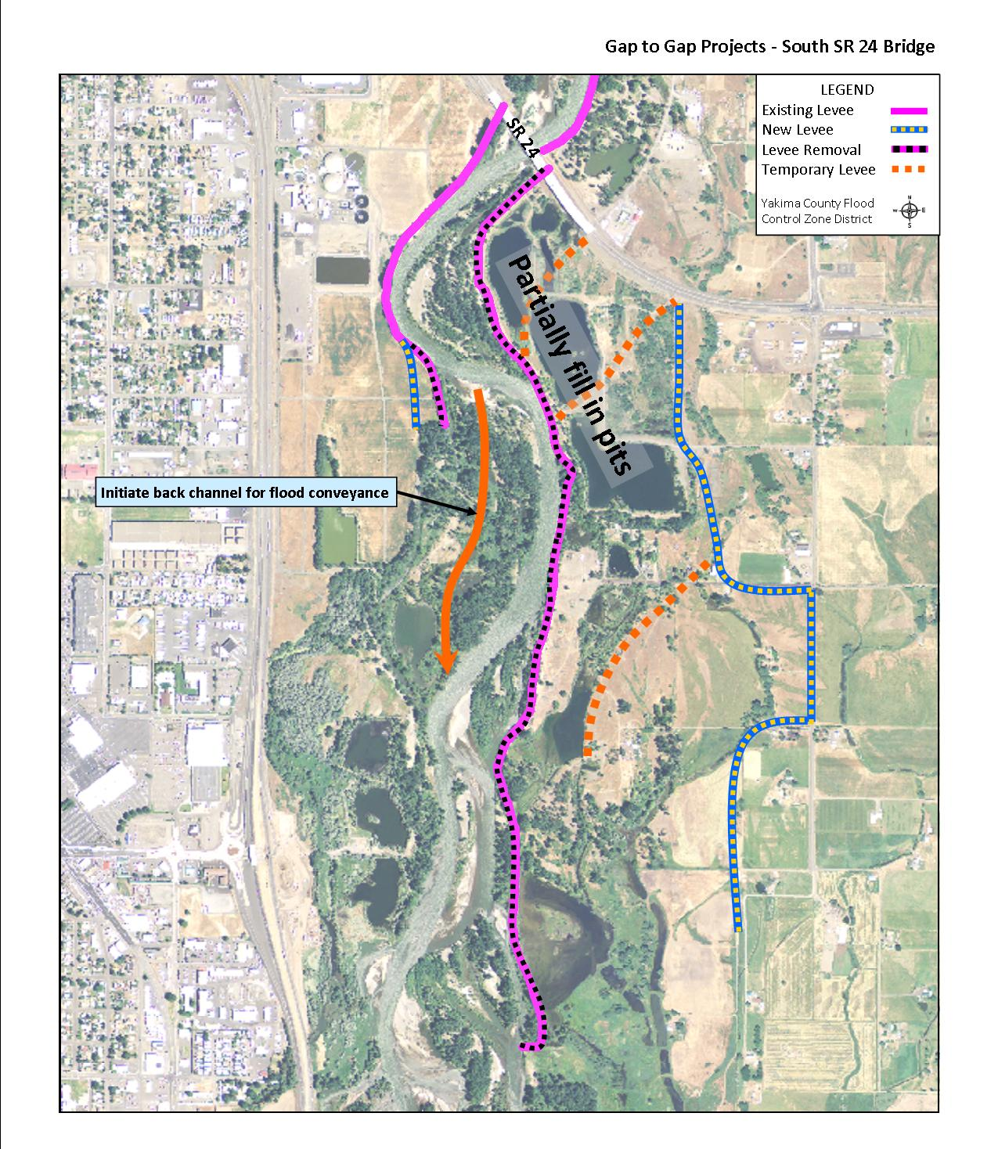
City of Yakima WWTP, Outfall and Floodplain

Slide 7
?

Slide 10
The Wrath of God Scenario
Figure 10: Buchanan Lake-Sportsman’s Park reach 1996 to 2013

Slide 11
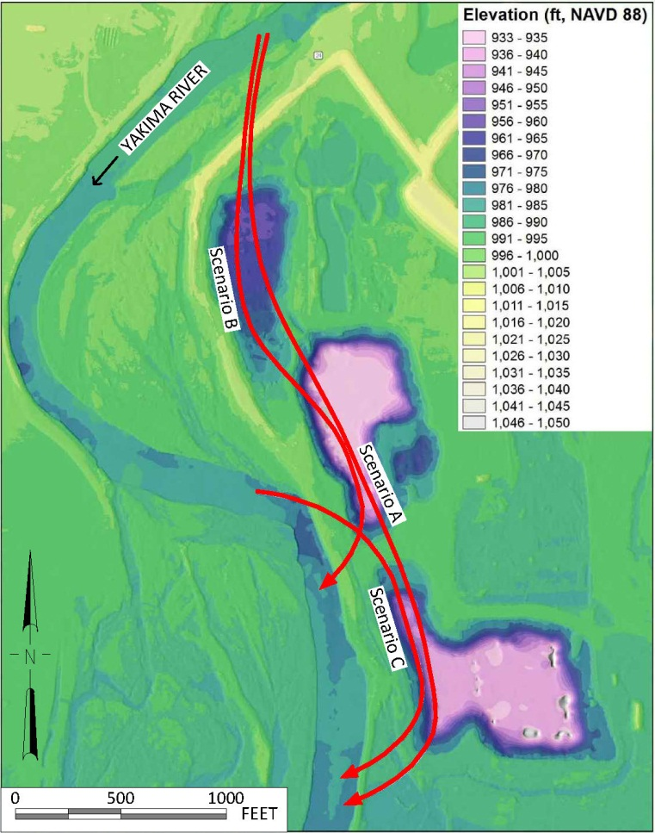

Slide 12
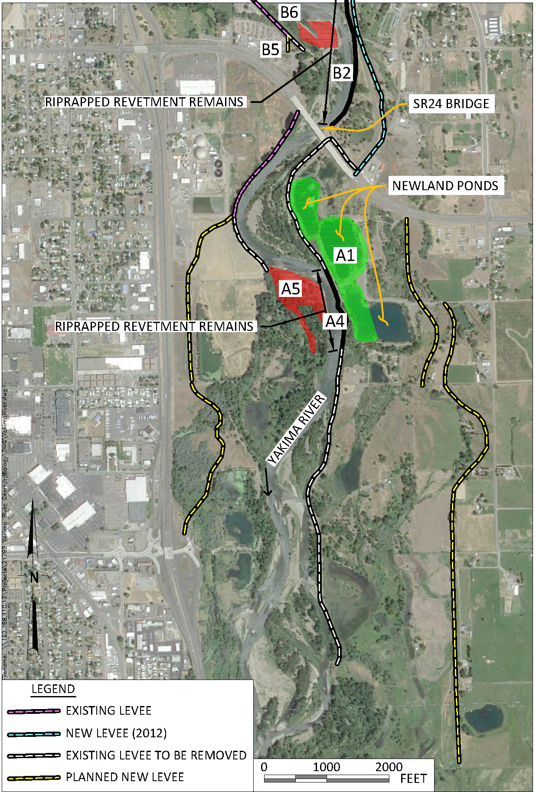
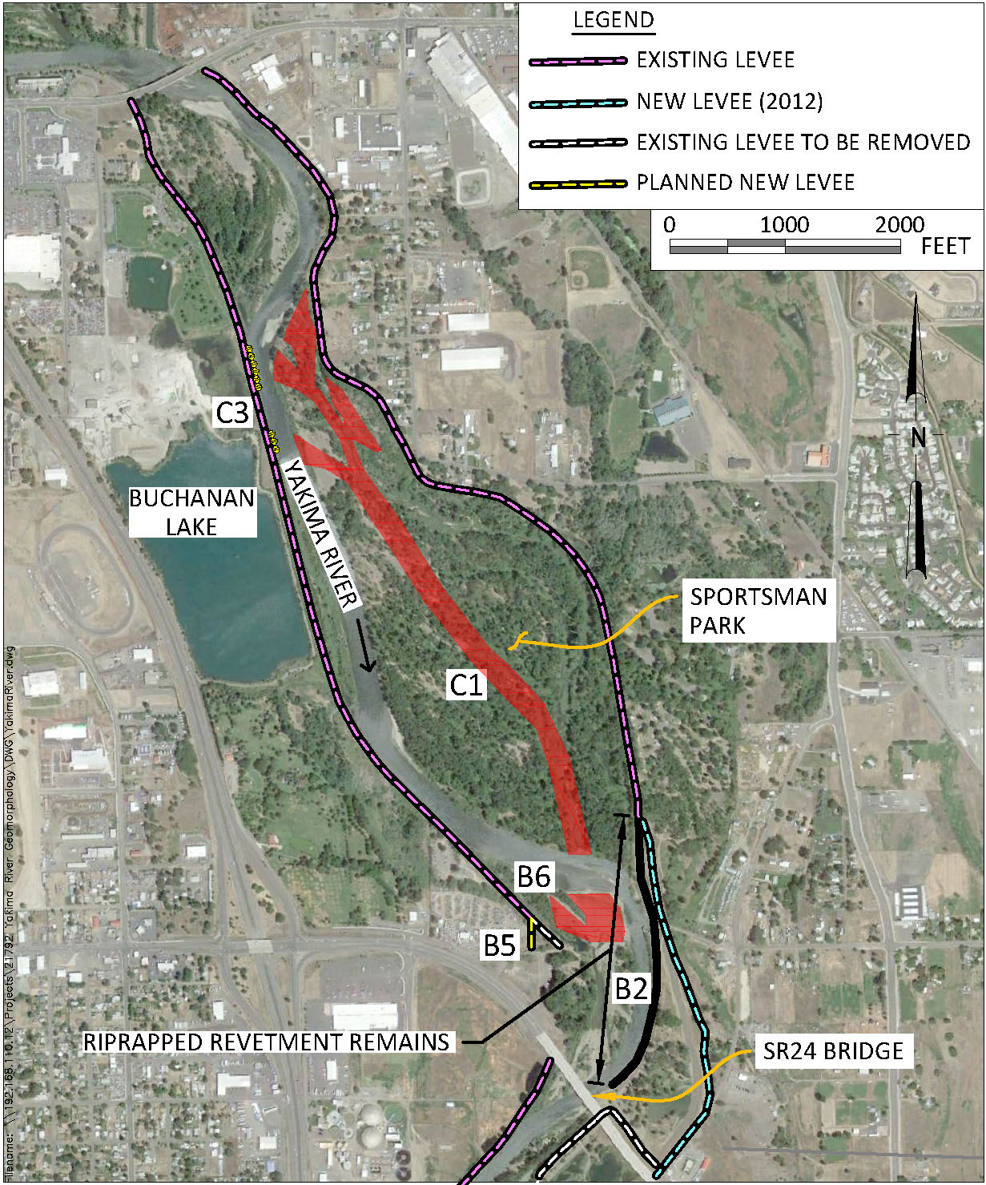
?
Figure 48: Mitigation measures in northern reach
Figure 49: Mitigation measures in southern reach

Slide 13
FCZD Budget Projection
 |  |  |  |  | 2014 |  | 2015 |  | 2016 |  | 2017 |  | 2018 |  | 2019
Beginning Balance
Cash & Cash Equivalents |  | $ |  | $ | 1,558,637 |  | 1,558,637 |  | 1,558,637 |  | 1,558,638 |  | 1,449,958 |  | 1,523,968
Projected Revenue
Beginning Fund Balance
Taxes |  |  |  |  | 1,327,352 |  | 1,340,626 |  | 1,354,032 |  | 1,367,572 |  | 1,381,248 |  | 1,395,060
Grants (Includes Corps &BOR contrib) |  |  |  |  | 3,413,275 |  | 3,263,061 |  | 6,382,163 |  | 954,800 |  | 80,000 |  | 80,000
Interest |  |  |  |  | 13,638 |  | 13,638 |  | 13,638 |  | 13,638 |  | 12,687 |  | 13,335
From Reserves |  |  |  |  | 430,871 |  | 231,329 |  | 308,479 |  | 29,321
Misc
 |  |  |  |  | 5,185,136 |  | 4,848,654 |  | 8,058,312 |  | 2,365,331 |  | 1,473,935 |  | 1,488,395
Projected Expenditures
Administration |  |  | job code fc10 |  | 476,268 |  | 481,031 |  | 488,247 |  | 495,570 |  | 503,004 |  | 510,549
Planning (General) |  |  | job code fc20 |  | 363,000 |  | 366,630 |  | 370,296 |  | 373,999 |  | 377,739 |  | 381,517
FCZD Projects (mapping) |  |  | job code fc 30 |  | 64,321 |  | 20,000 |  | 20,000 |  | 20,000 |  | 20,600 |  | 21,218
FCZD Studies (up to NEPA) |  |  | job code fc40 |  | 100,000 |  | 40,000 |  | 30,000 |  | 30,000 |  | 30,000 |  | 30,000
Maintenance (FCZD Structures) |  |  | job code fc50 |  | 44,300 |  | 45,629 |  | 46,998 |  | 48,408 |  | 49,860 |  | 51,356
FCZD Capital Improvements |  |  | job code fc 90 |  | 1,719,733 |  | 1,436,933 |  | 6,696,333 |  | 1,093,500 |  | unfunded |  | unfunded
Capital (Land) |  |  |  |  | 2,023,000 |  | 2,058,000 |  | - |  | - |  | unfunded |  | unfunded
Ending Fund Balance
 |  |  |  |  | 5,185,136 |  | 4,848,654 |  | 8,058,311 |  | 2,474,011 |  | 1,399,925 |  | 1,419,642
Projected Excess (Short Fall) Revenue |  |  |  |  | 0 |  | 0 |  | 0 |  | (1,300,000) |  | 74,010 |  | 68,753
Adjustments
(Increase) Decrease in Accounts Receivable
Increase (Decrease) in Accounts Payable |  |  |  |  |  |  |  |  |  |  |  |  | Center
Total Adjustments
Ending Cash Balance |  |  |  |  | 1,558,637 |  | 1,558,637 |  | 1,558,638 |  | 1,449,958 |  | 1,523,968 |  | 1,592,721
Reserves
Commited Reserves (Flood Recovery) |  |  |  |  | (1,000,000) |  | (1,000,000) |  | (1,000,000) |  | (1,000,000) |  | (1,000,000) |  | (1,000,000)
Assigned Reserves (COE Levee) |  |  |  |  | (569,129) |  | (337,800) |  | (29,321) |  | - |  | - |  | -
6 Mos. Operating Cash Flow |  |  |  |  | (600,000) |  | (600,000) |  | (600,000) |  | (600,000) |  | (600,000) |  | (600,000)
Available Cash Balance |  | $ |  | $ | (610,492) |  | (379,163) |  | (70,683) |  | (150,042) |  | (76,032) |  | (7,279)
Fixed Costs
Indirect Costs |  |  |  | # | 38,908.80 |  | 40,854.24 |  | 42,896.95 |  | 45,041.80 |  | 47,293.89 |  | 49,658.58
Purchasing Services |  |  |  |  | 312.90 |  | 328.55 |  | 344.97 |  | 362.22 |  | 380.33 |  | 399.35
Information Services |  |  |  |  | 40,749.45 |  | 42,786.92 |  | 44,926.27 |  | 47,172.58 |  | 49,531.21 |  | 52,007.77
GIS |  |  |  |  | 66,510.15 |  | 69,835.66 |  | 73,327.44 |  | 76,993.81 |  | 80,843.50 |  | 84,885.68
Rent-Facilities |  |  |  |  | 35,299.95 |  | 37,064.95 |  | 38,918.19 |  | 40,864.10 |  | 42,907.31 |  | 45,052.68
Liability Insurance |  |  |  |  | 4,986.45 |  | 5,235.77 |  | 5,497.56 |  | 5,772.44 |  | 6,061.06 |  | 6,364.11
Dept. of Security |  |  |  |  | 3,558.45 |  | 3,736.37 |  | 3,923.19 |  | 4,119.35 |  | 4,325.32 |  | 4,541.58
Computer Rental |  |  |  |  | 2,600.00 |  | 2,730.00 |  | 2,866.50 |  | 3,009.83 |  | 3,160.32 |  | 3,318.33
Phones |  |  |  |  | 694.05 |  | 728.75 |  | 765.19 |  | 803.45 |  | 843.62 |  | 885.80
Total Fixed Costs |  |  |  |  | 193,620 |  | 203,301 |  | 213,466 |  | 224,140 |  | 235,347 |  | 247,114

Slide 14
Questions

