Slide 1
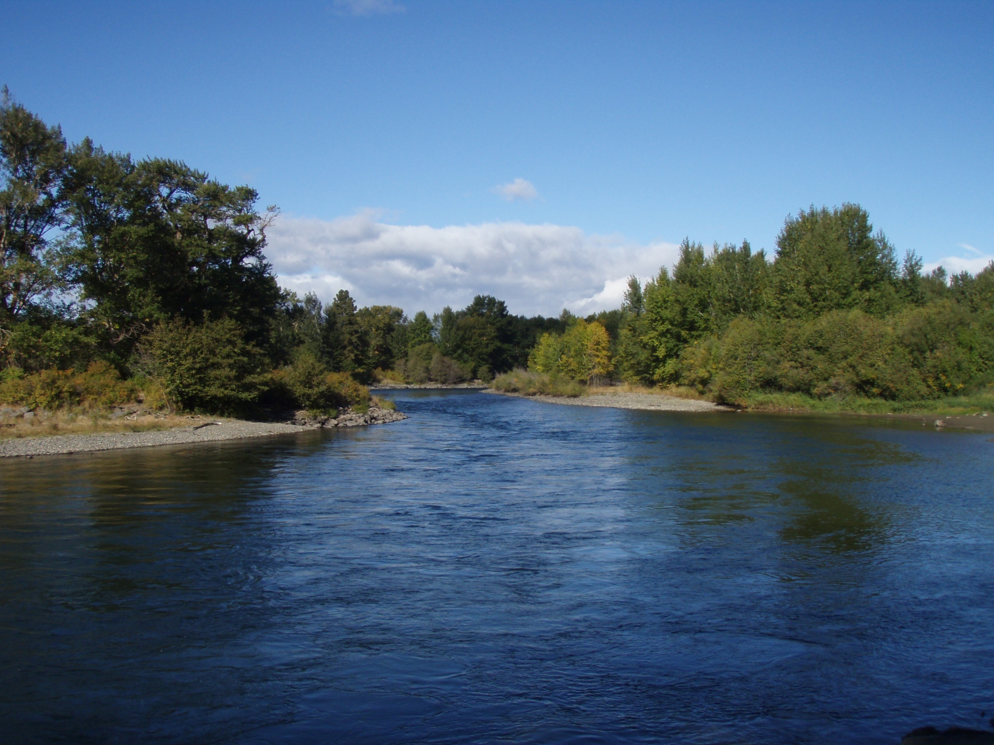
Yakima River Hooking Mortality
Anthony Fritts, Gabriel Temple, and Cade Lillquist
Ecological Interactions Team
Washington Department of Fish and Wildlife

Slide 2
Purpose
Estimate long-term mortality of spring Chinook salmon caught and released in the fishery below Roza Dam
Standard 10% rate currently used
Potential use for take estimates in other fisheries with ESA considerations

Slide 3
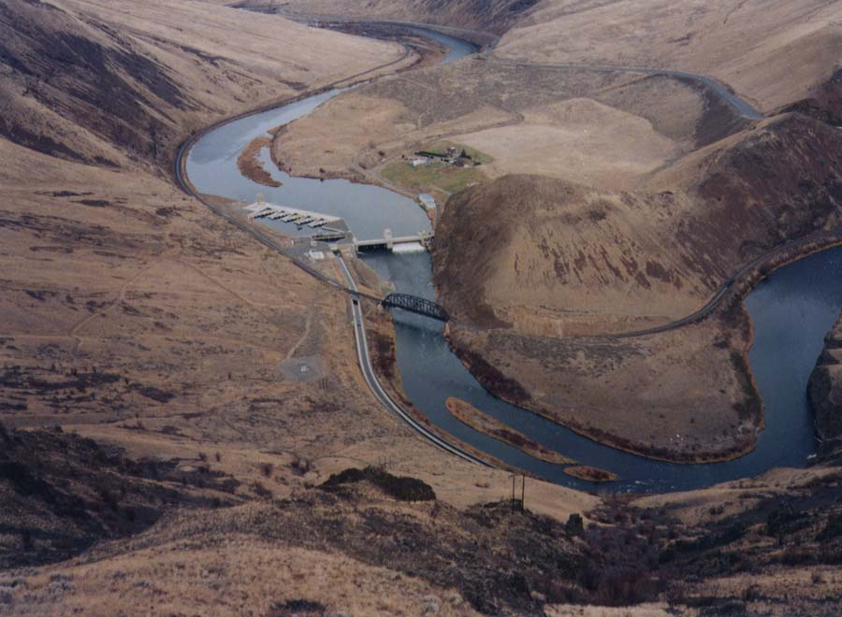
Fishery
Anchor-tag Chinook salmon in fishery below Roza Dam as they are caught
Record where fish is hooked, severity of bleeding, gear type, play time

Slide 4
Radio-tagging
Radio-tag treatment fish when they show up at Roza
Radio-tag an equal number of control fish (HO)
Both groups receive the same amount of handling at RAMF

Slide 5
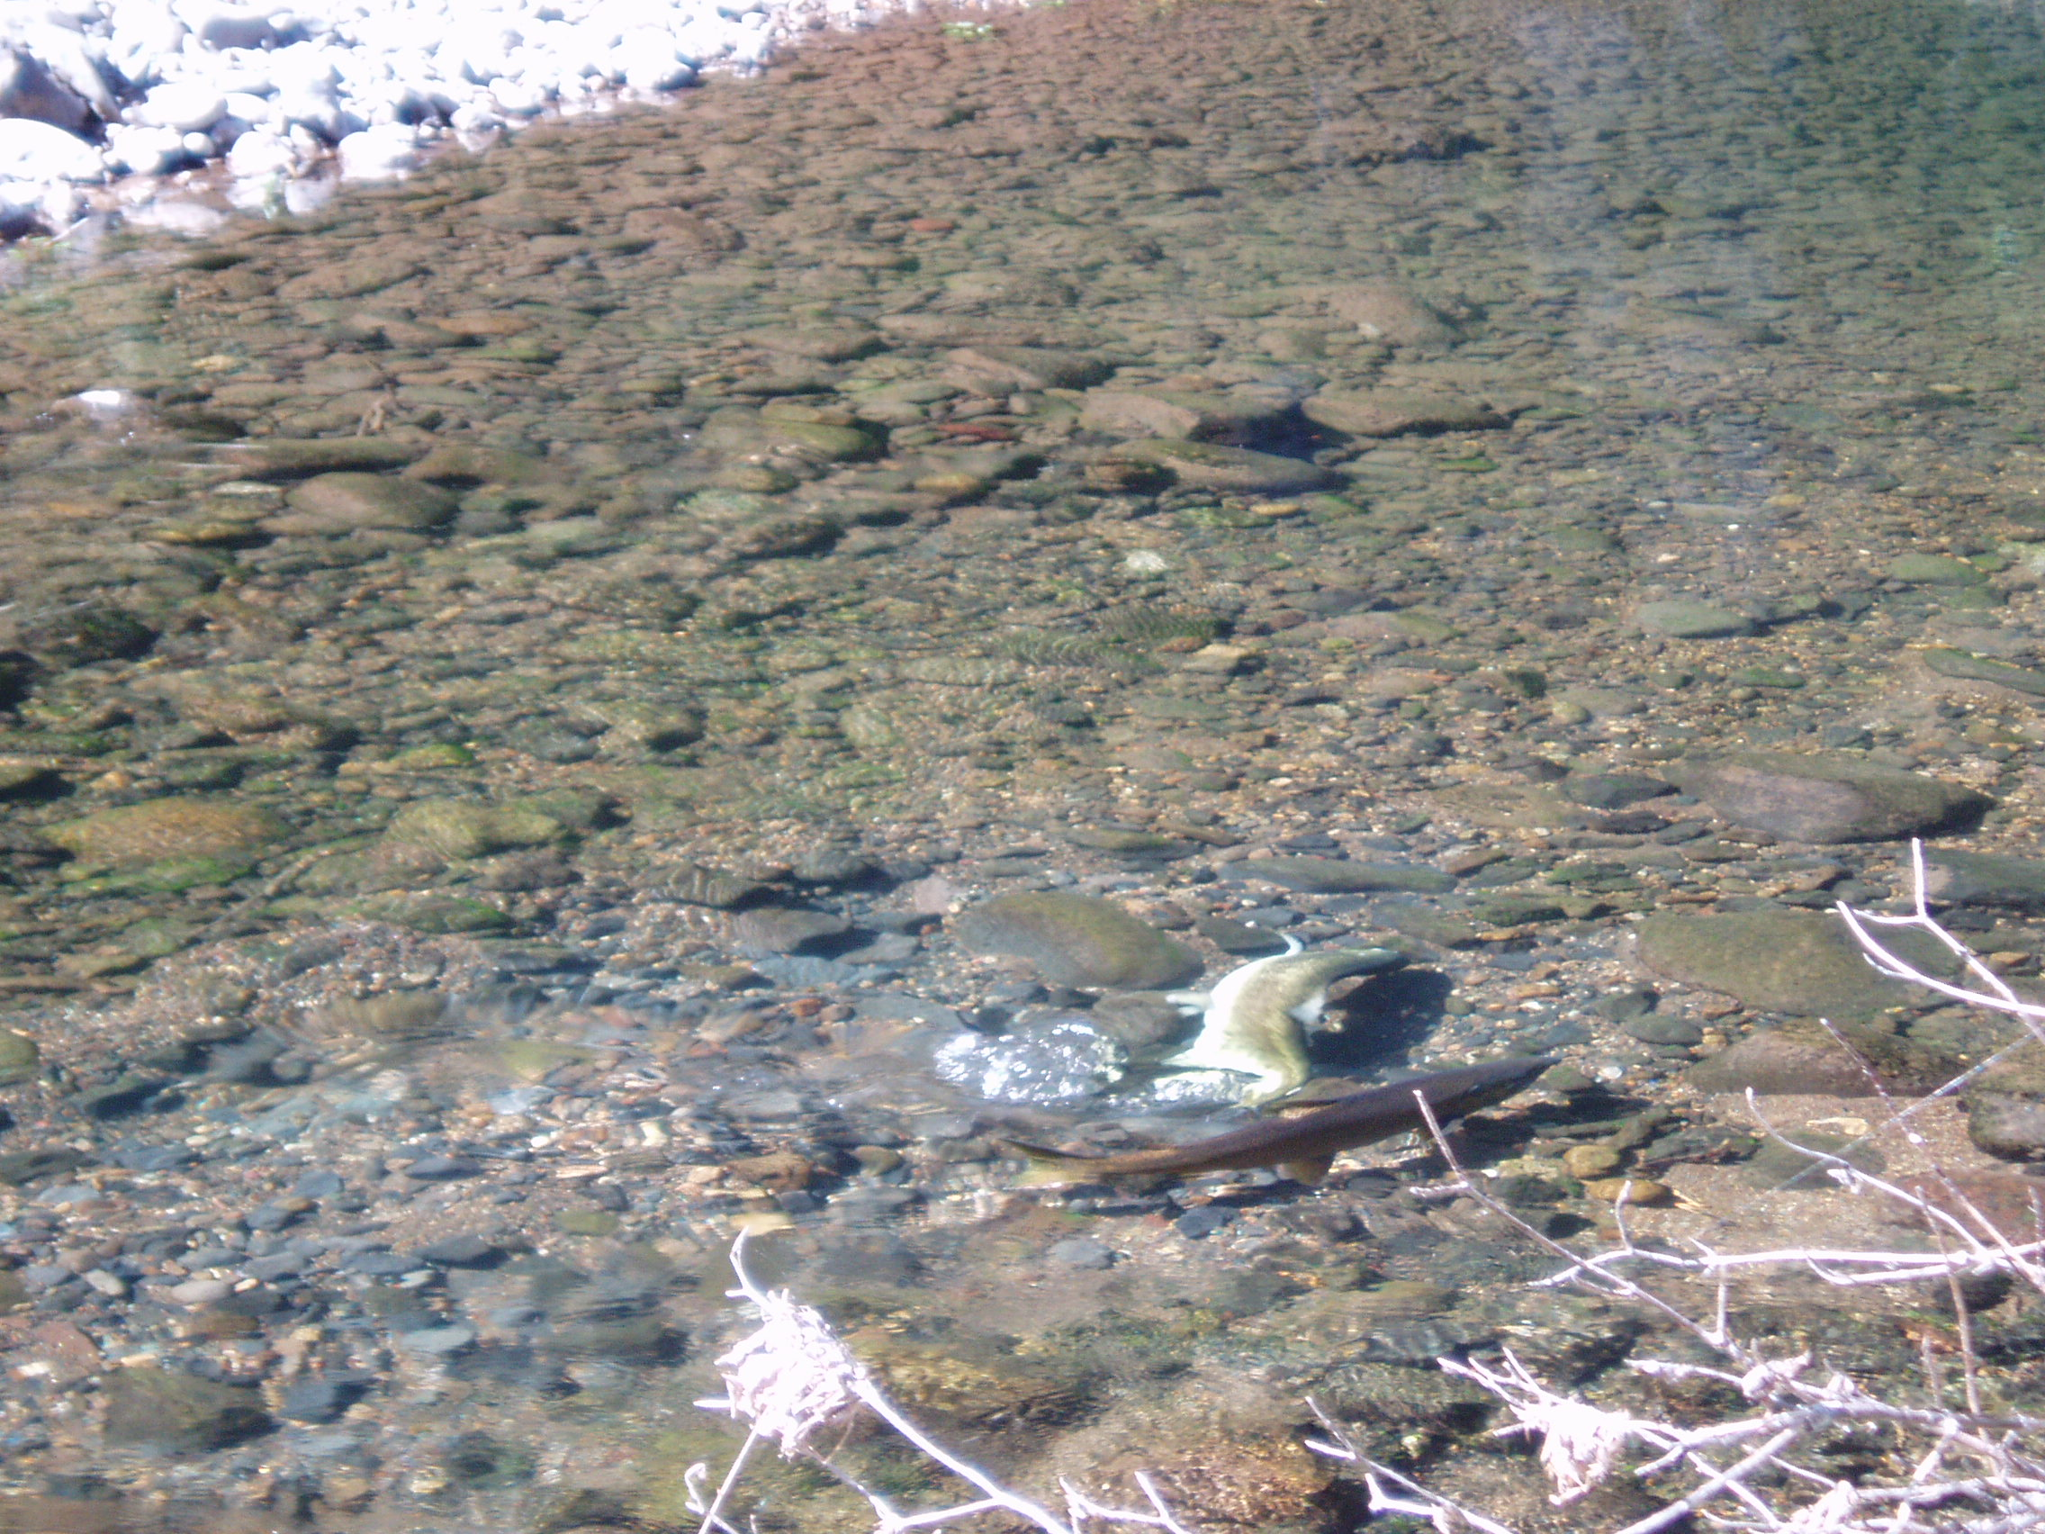
Tracking
Track tagged fish through spawning to determine ultimate fate
Snorkel to determine if holding fish are alive

Slide 6
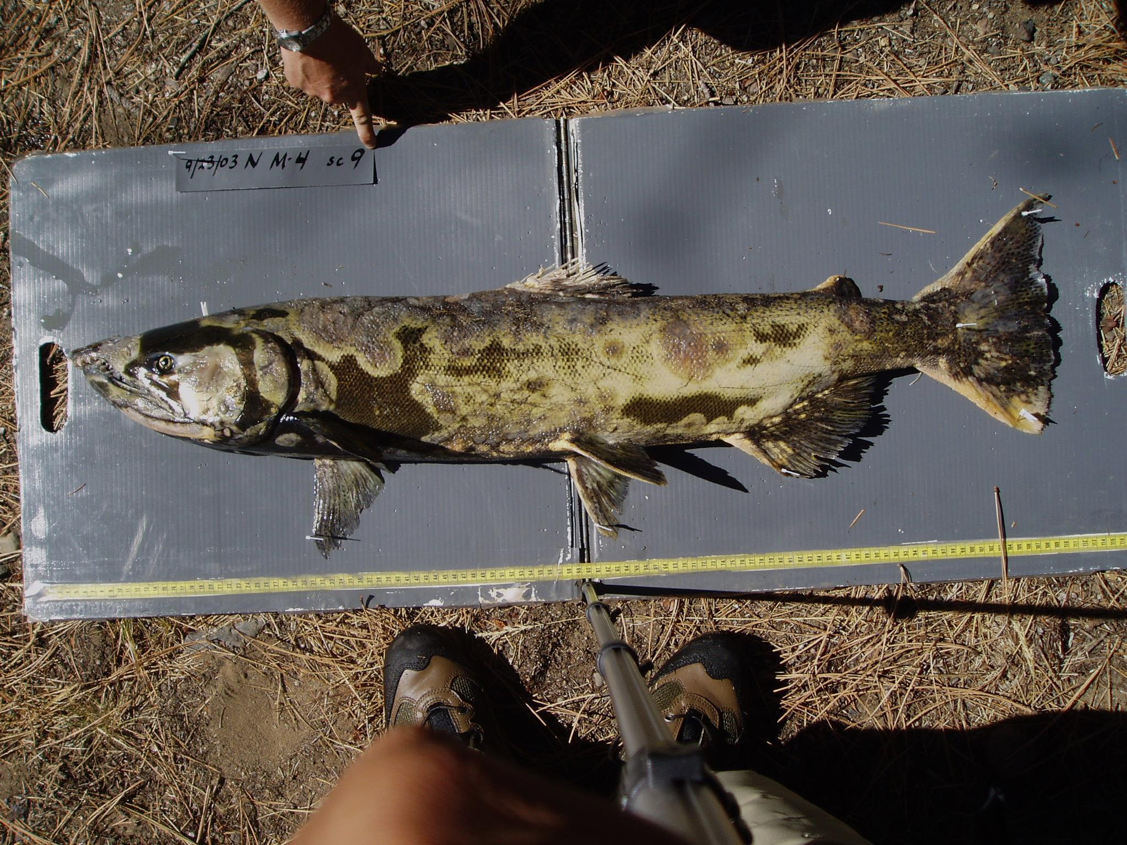
2012 Issues
Only ~76% were recaptured at RAMF*
Could not account for tag loss, fish spawning below Roza, strays

Slide 7
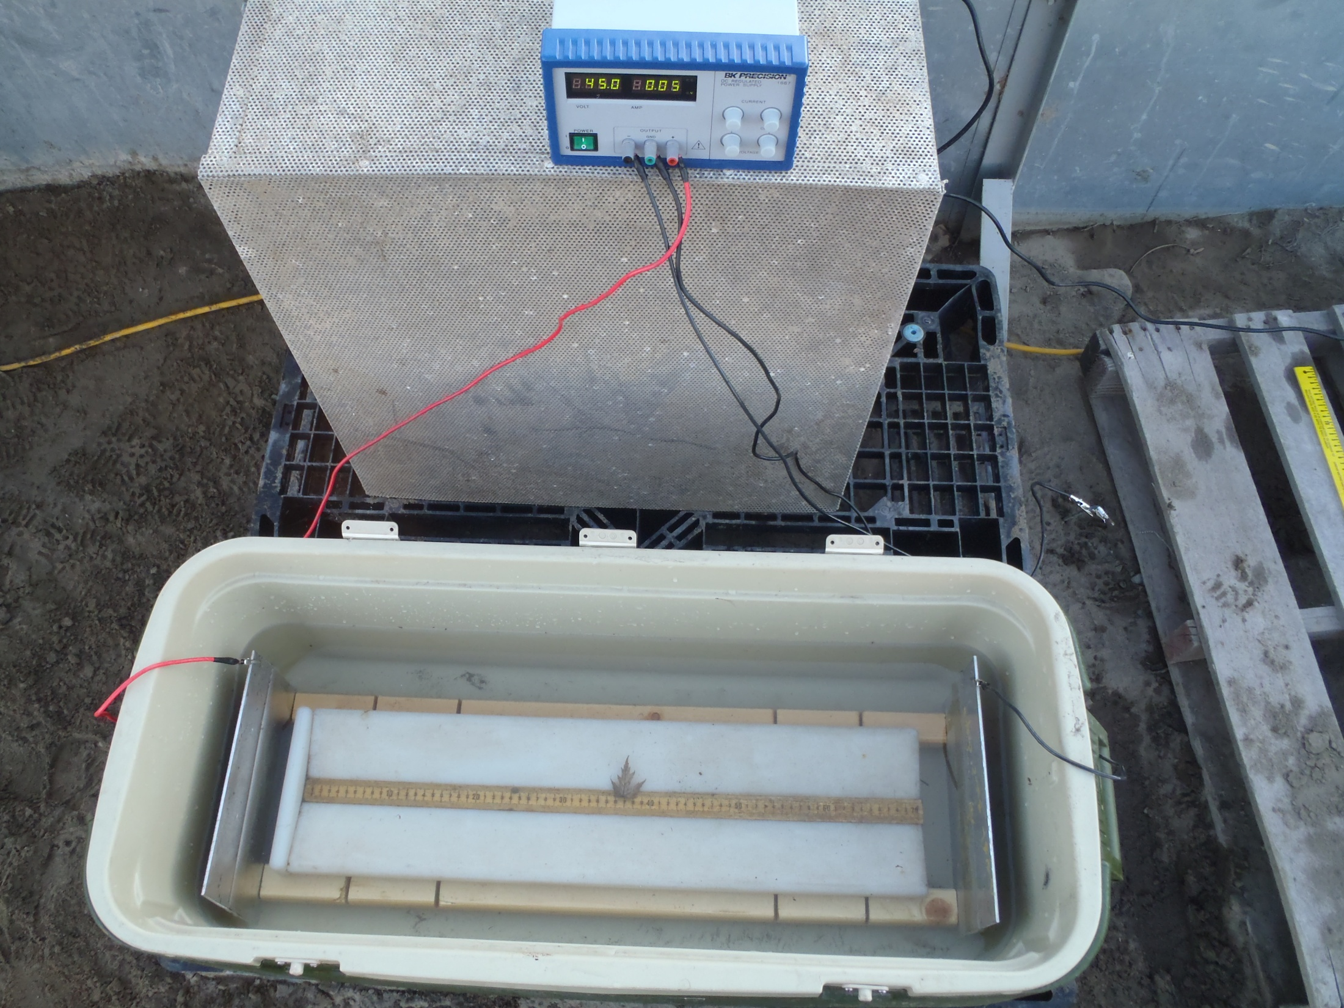
2013 - 2014 Methods
PIT-tagged and radio tagged fish as soon as they are caught below Roza Dam using portable electronarcosis unit
Tagged HO controls at Roza using electronarcosis

Slide 8
Analysis
Used Kaplan-Meier procedure (Pollack et al. 1989) to estimate survival each week
Censored fish that spit radio-tags, were taken out at Roza, disappeared in the upper Yakima, and all fish that were not radio-tagged in 2012
Mortalities were fish that were found dead or dropped well downstream of historic spawning areas prior to Sept. 1
Used logistic regression to examine the factors affecting survival (play time, handling time, hook location, bleeding severity, water temp, stream discharge, date caught)
Hooking mortality calculated as the mean difference between T & C survival from tagging to Sept. 1

Slide 9
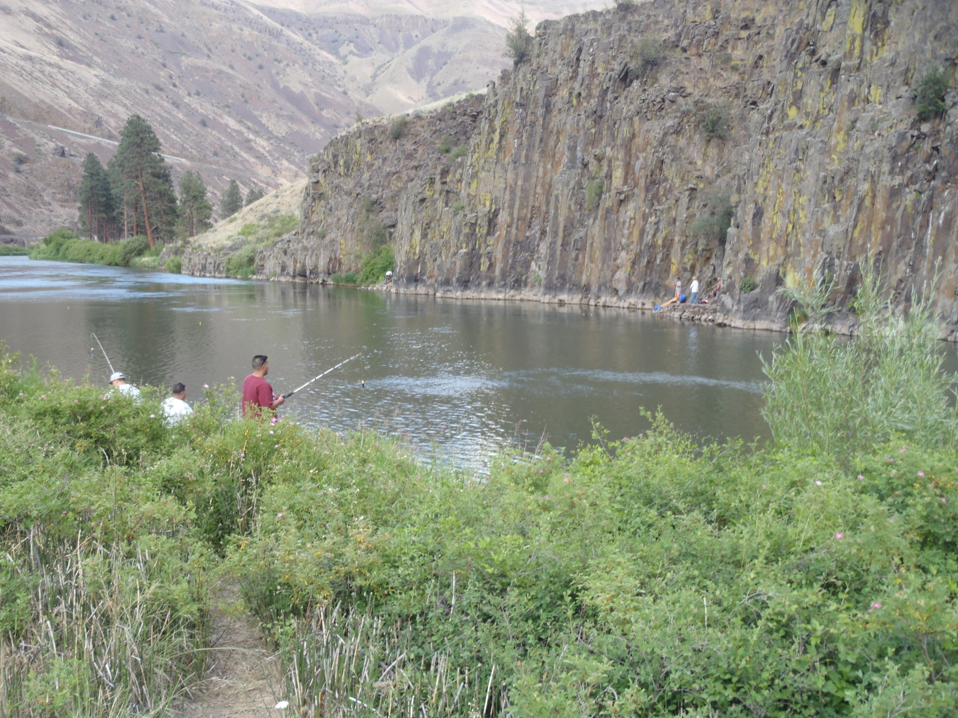
Results-Fishery
Anglers were instrumental in effort
107 adults anchor tagged in fishery in 2012
70 adults radio tagged in 2013
116 adults radio tagged in 2014
Equivalent number of control fish tagged each year

Slide 10
Factors Affecting Survival
Bleeding severity and hook location were significant factors
Highest mortality was for fish hooked in the gills followed by stomach/esophagus, tongue, jaw, and eye

Slide 11
Survival Estimates
9.7%
5.5%
14.1%

Slide 12
Closing Time
Average for 2013-2014 was slightly below 10%
If we had a way to estimate 2012 mortality below Roza the 3-year average would be higher but no reliable way to do this because of the lack of controls or the ability to track the treatments

Slide 13
Acknowledgements
Mark Johnston and his crew (Yakama Nation) at RAMF tagged fish at Roza and provided helpful suggestions to improve the study
Jeff Bates, Kyle Hatch, Alex Hedrick, Seth Shy, and Tommy Wachholder tagged fish below Roza and tracked to spawning; Scott Coil, Trenton De Boer, Zack Lessig, Nick Mankus, Zack Mays, Rochelle Polacek, and Tim Webster assisted with tracking
Funding was provided by the CRSSAB fund

