Slide 1
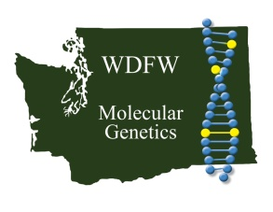
Fine-scale population genetic structure of bull trout in the Yakima basin
Maureen P. Small*, Denise Hawkins*, Yuki Reiss**,
Eric Anderson*, Jennifer Von Bargen*
*WDFW, **YBFWRB
Presentation to YKFP on June 18, 2009

Slide 2
Format
http://www.dfw.state.or.us/swwd/trout.html
1) Describe bull trout life history
2) Questions for study
3) Methods to address questions
4) Results

Slide 3
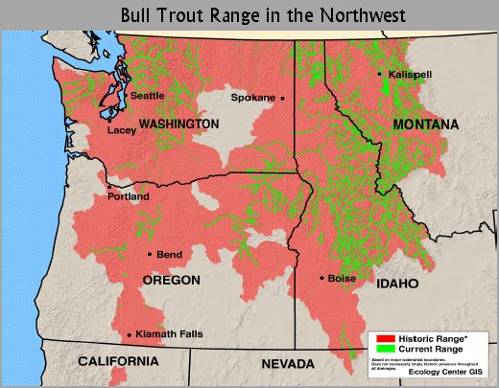
Bull trout life history
Considered “glacial remnants”
Spawn and rear in cold headwaters (< 8 ºC)
Repeat spawners
Juveniles stay in natal streams
Resident – remain in small streams
Fluvial – migrate out to mainstem rivers
Adfluvial – migrate out to lakes or reservoirs
Anadromous (amphidromous) – migrate out to saltwater but may move in and out of rivers
Connectivity important but disrupted in Yakima basin by irrigation impoundments and extractions
http://www.wildrockiesalliance.org/issues/bulltrout/index.html

Slide 4
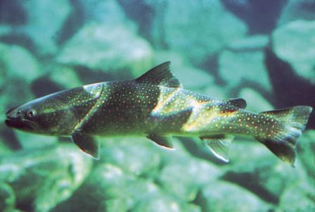
Bull trout questions in Yakima basin
What are the characteristics of Yakima bull trout – diversity, heterozygosity, effective population sizes?
What are the genetic relationships among populations?
How have dams affected connectivity?
Where do fish go if they get over a dam?
http://www.ecy.wa.gov/programs/wq/swqs/temperature.html

Slide 5
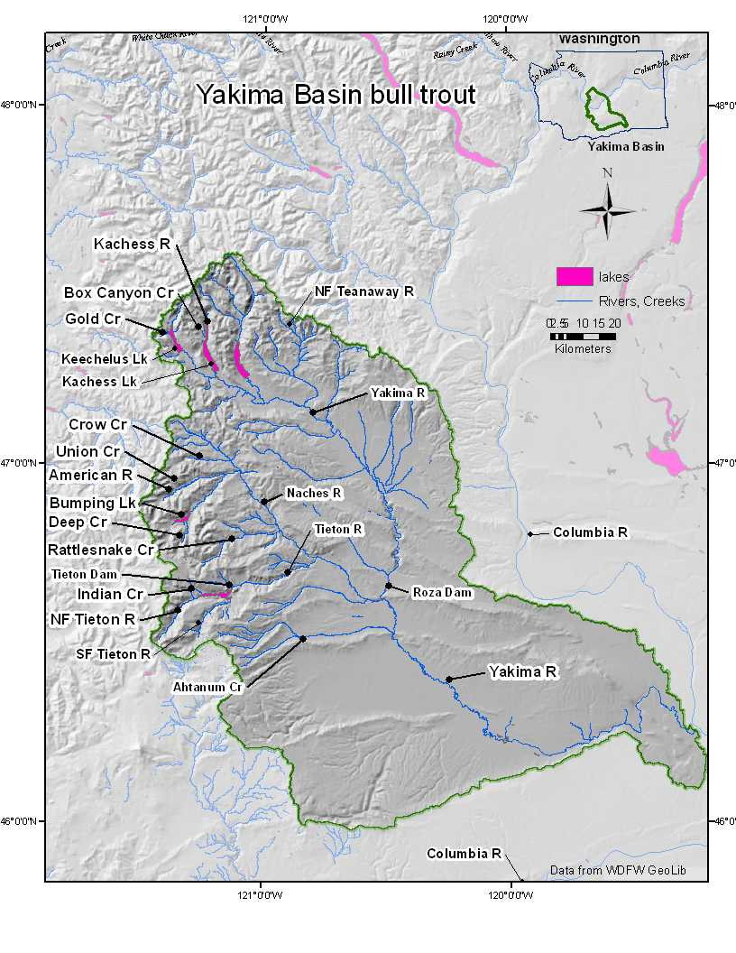
Map of the study area
Features affecting bull trout movement
Dams
Dewatered portions
Water temperature
Sediment load
Culverts
Roads
Vehicles in river
Cows in river and grazing
agriculture

Slide 6
Tieton Dam
Constructed in early 1900’s with no fish passage – 319 feet tall
Tieton pool formed at base

Slide 7
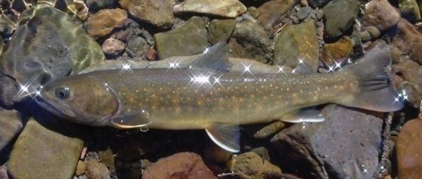
Identify Bull trout genetically
http://www.fws.gov/pacific/bulltrout
Use standardized bull trout microsatellite suite
Collaborative effort headed by USFWS, including WDFW, UBC, U of M, IDFG
Data compatible among participating labs
Standardized loci discriminate:
Local bull trout populations
Inland and Coastal bull trout
Bull trout and Dolly Varden
Bull trout and Brook trout
Identify hybrids

Slide 8
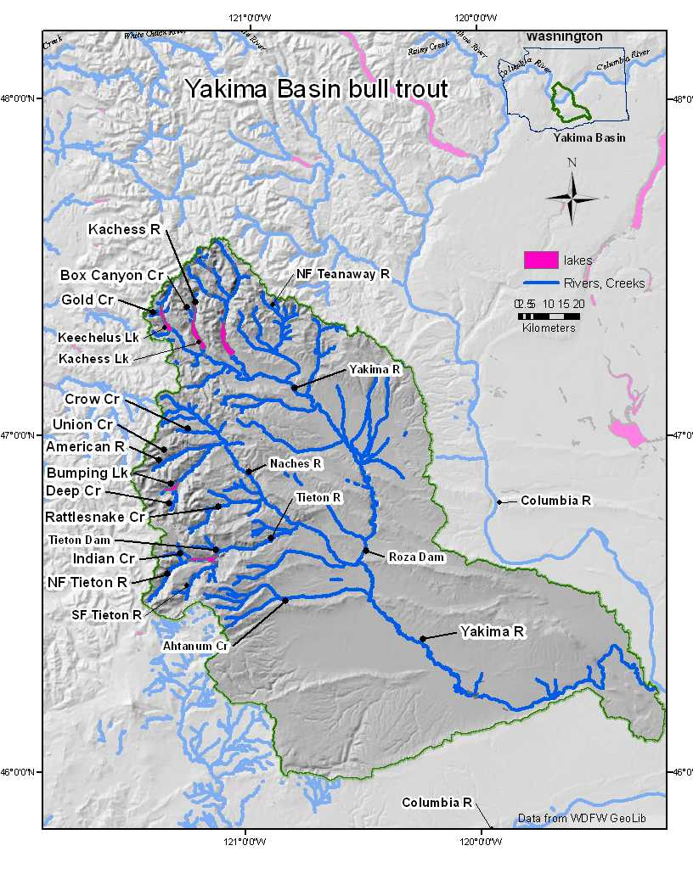
Bull trout effective population sizes
# fish

Slide 9
Genetic diversity vs Ne

Slide 10
Population structure
Naches tributaries
Middle Yakima
American
Union
Crow
100
Indian
Rattlesnake
Deep
NFTieton
SFTieton
Gold
100
100
AhtanumAd
100
BoxCanyon
AhtanumJ
Kachess
NFTeanaway
Upper Yakima
Cavalli-Sforza and Edwards distances in Neighbor-joining tree
1000 bootstraps
0.1

Slide 11
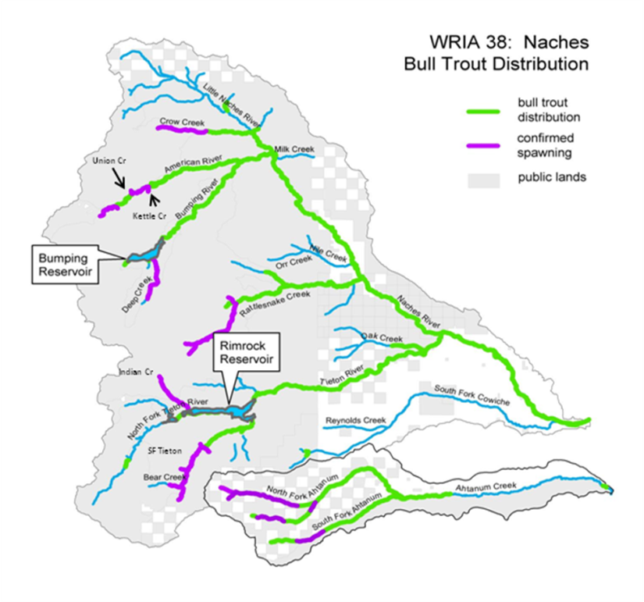
Isolation by distance in middle Yakima
Map by Mike Mizelle
Green – within Rimrock
Red – within Naches (except Deep Cr.)
Blue – between Rimrock and Naches

Slide 12
Tieton Dam
One-way barrier since 1925 – created adfluvial habitat for Tieton populations
Populations get bigger but lose some portion over the dam

Slide 13
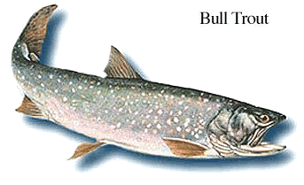
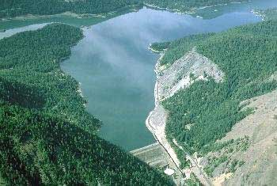
Tieton Pool composition - what happens to these fish?
http://srd.alberta.ca/fishwildlife/fishingalberta/gamefish/bulltrout.aspx

Slide 14
Self-assignment tests
http://www.cnr.usu.edu/wats/images/uploads/budy/bull%20trout4.jpg
 | BoxCanyon | Kachess | Gold | NFTeanaway | AmUnion | Rattlesnake | Crow | SFTieton | NFTieton | Indian | Ahtanum | Deep | N
BoxCanyon | 33 | 1 |  |  |  |  |  |  |  |  |  |  | 34
Kachess |  | 30 |  |  |  |  |  |  |  |  |  |  | 30
Gold |  |  | 19 (1) |  |  |  |  |  |  |  |  |  | 20
NFTeanaway |  |  |  | 10 |  |  |  |  |  |  |  |  | 10
AmUnion |  |  |  |  | 52 |  |  |  |  |  |  |  | 52
Rattlesnake |  |  |  |  | (1) | 43 (3) |  | 2 | 1 |  |  |  | 50
Crow |  |  |  |  |  |  | 30 |  |  |  |  |  | 30
SFTieton |  |  |  |  |  |  |  | 18 (2) |  |  |  |  | 21
NFTieton |  |  |  |  |  |  |  |  | 8 (1) |  |  |  | 9
Indian |  |  |  |  |  |  |  |  |  | 34 |  |  | 34
Ahtanum |  |  |  |  |  |  |  |  |  |  | 69 |  | 69
Deep |  |  |  |  |  |  |  |  |  |  |  | 31 | 31
3 adult fish sampled in the Rattlesnake spawning area came from SF Tieton and NF Tieton

Slide 15
What happens to fish after they get out of Rimrock Lake?
Go to nearest spawning area?
Gene flow estimates from MIGRATE show asymetric gene flow
1.62
Indian Rattlesnake
0.98
1.12
SFTieton Rattlesnake
0.89

Slide 16
What are impacts of dams?
Negative: fish unable to return to spawn in their natal tributary if they cross the dam
Lose genetic diversity?
Lower allelic richness than bull trout in Columbia and Snake
Alter genetic relationships?
Some of these fish go to nearby tributaries
SF Tieton fish in Rattlesnake
NF Tieton fish in Rattlesnake
One-way gene flow out of Tieton basin
Positive: opportunity for bull trout in Tieton tributaries to become adfluvial
Grow larger – have more offspring

Slide 17
Acknowledgements
Thanks
www.goodnaturepublishing.com
Thanks to all the samplers:
WDFW, Mike Mizelle, William Meyer, Yuki Reiss CWU, Yakama Nation, USFWS
Thanks to Adrian Spidle, Judy DeLaVerne, Scott Blankenship, Anne Marshall, Todd Kassler and Ken Warheit for comments and suggestions
Thanks to the people who post nice pictures of fish
Funding from USFWS and WA state general funds

Slide 18
Bull trout genetic statistics
 | N | rich | Gene Div | LD | Ne | FIS | Pval
BoxCanyon | 33 | 3.24 | 0.487 | 0 | 5.3 | -0.066 | 0.983
Kachess | 31 | 3.03 | 0.460 | 0 (18) | 6.2 | -0.062 | 0.958
Gold | 20 | 4.48 | 0.614 | 1 (4) | 19 | 0.016 | 0.314
NFTeanaway | 10 | 2.15 | 0.268 | 0 (4) | 2.6 | 0.050 | 0.284
American | 32 | 4.20 | 0.610 | 2 (9) | 19.2 | 0.027 | 0.167
Union | 20 | 4.49 | 0.621 | 0 (8) | 19.2 | 0.079 | 0.011
Rattlesnake | 49 | 4.67 | 0.635 | 1 (7) | 33 | 0.013 | 0.273
Crow | 32 | 4.55 | 0.637 | 2 (11) | 17.1 | -0.018 | 0.744
SFTieton | 22 | 4.07 | 0.582 | 0 (1) | 30.4 | -0.004 | 0.538
NFTieton | 9 | 3.44 | 0.507 | 0 (4) | 14.5 | 0.054 | 0.218
Indian | 35 | 4.44 | 0.587 | 1 (5) | 45.1 | 0.044 | 0.045
AhtanumJ | 51 | 3.64 | 0.563 | 10 (52) | 6.8 | 0.033 | 0.086
AhtanumAd | 18 | 3.78 | 0.571 | 1 (8) | 8.5 | -0.025 | 0.724
Deep | 31 | 5.06 | 0.662 | 0 (13) | 32.3 | 0.072 | 0.003
avg |  | 3.95 | 0.557 |  |  | 0.015
SD |  | 0.78 | 0.102 |  |  | 0.046
Allelic richness = avg. number of alleles per locus
Gene Diversity = avg. heterozygosity per locus
LD = number of locus pairs in linkage (number in parenthesis is before Bonferroni corrections)
Ne = effective population size
FIS = Hardy-Weinberg equilibrium value – based on departures from expected heterozygosity

Slide 19
Unknown fish assignment tests
 |  |  |  |  | Baseline populations
Collection site | BoxCanyon | Kachess | Gold | NFTeanaway | AmUnion | Rattlesnake | Crow | SFTieton | NFTieton | Indian | Ahtanum | Deep
Kettle |  |  |  |  | 3
UBumpPool |  |  |  |  |  |  |  |  |  |  |  | 1
LBumpPool |  |  |  |  | 2
KachessPool |  | 1
RozaDam |  |  |  |  | 1 |  |  |  |  | 1
WDFWsecondary |  | 1 | 1
07KachessAdult | 1 | 2
TietonPool |  |  |  |  | 6 | 7 |  | 11 | 2 | 17
NachesAdult |  |  |  |  | 19 | 1 | 2
http://www.robertnlowe.com/gallery/6914607_cCqHD#379909497_3WA35

